Slide 1
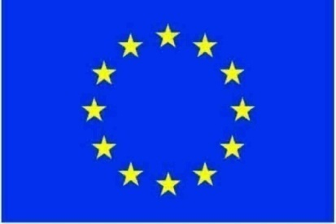

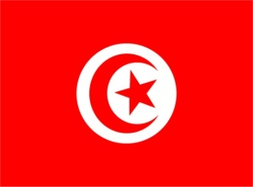
6th Meeting of the Expert Group on Marine Research Infrastructure
Ostend – Belgium
6 / 7 June 2011
Presented by : Slim GANA

Slide 2

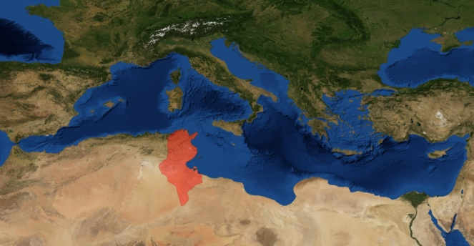
Tunisia
Sicily
Algeria
Libya
Libya
Surface : 163,610 sq. km. / Number of habitants : 10 629 186 + 1 000 000 abroad.
Closest neighbouring countries : Algeria, Libya and Italy.
Coastline length : 1300 Km.
It has 10 islands : La Galite, Kerkennah, Kneiss, Zembra, Kuriat, Cani, Djerba, Pilau, Chikly and ile plane.
Tunisia was the first Mediterranean country to sign an association agreement with the European Union
in July 1995. It came into force on March 1, 1998.
An important component of the Association Agreement is the clause providing for the establishment
of an EU-Tunisia free trade area by the year 2010.
Tunisia is making good progress towards obtaining an advanced partnership status with the EU.

Slide 3
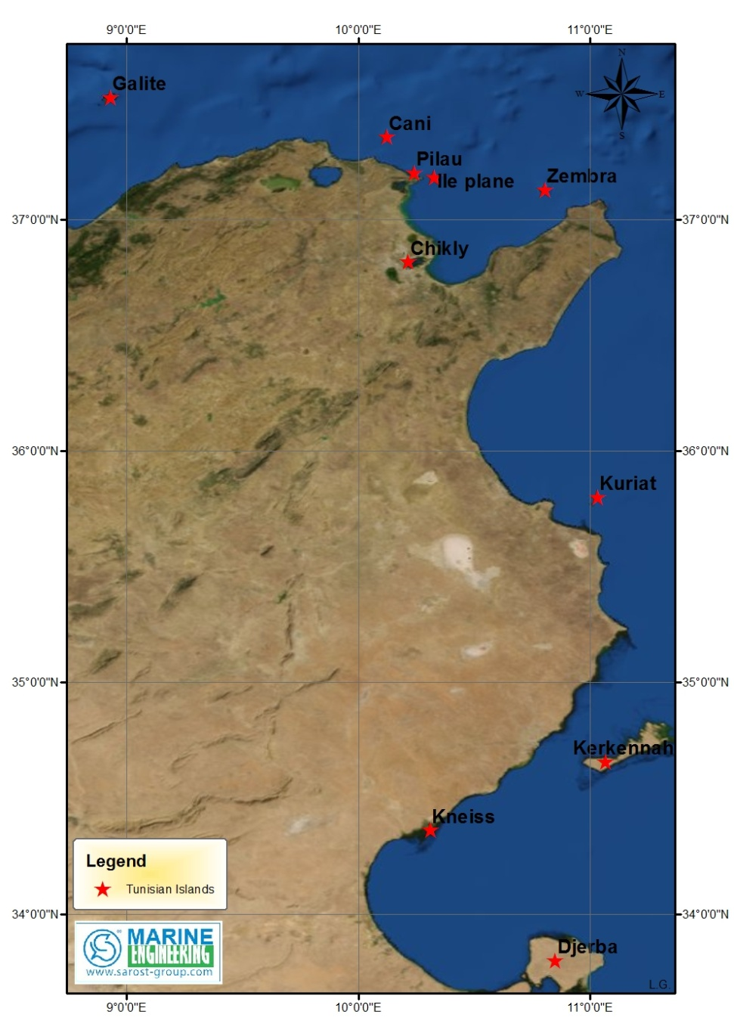
Tunisian Islands
Framework of the Tunisia-EU cooperation
Tunisia was the first Mediterranean country to sign an association agreement with the European Union in July 1995. It came into force on March 1, 1998.
An important component of the Association Agreement is the clause providing for the establishment of an EU-Tunisia free trade area by the year 2010.
Tunisia is now making good progress towards obtaining an advanced partnership status with the EU.

Slide 4
Institutions involved in marine issues

Slide 5
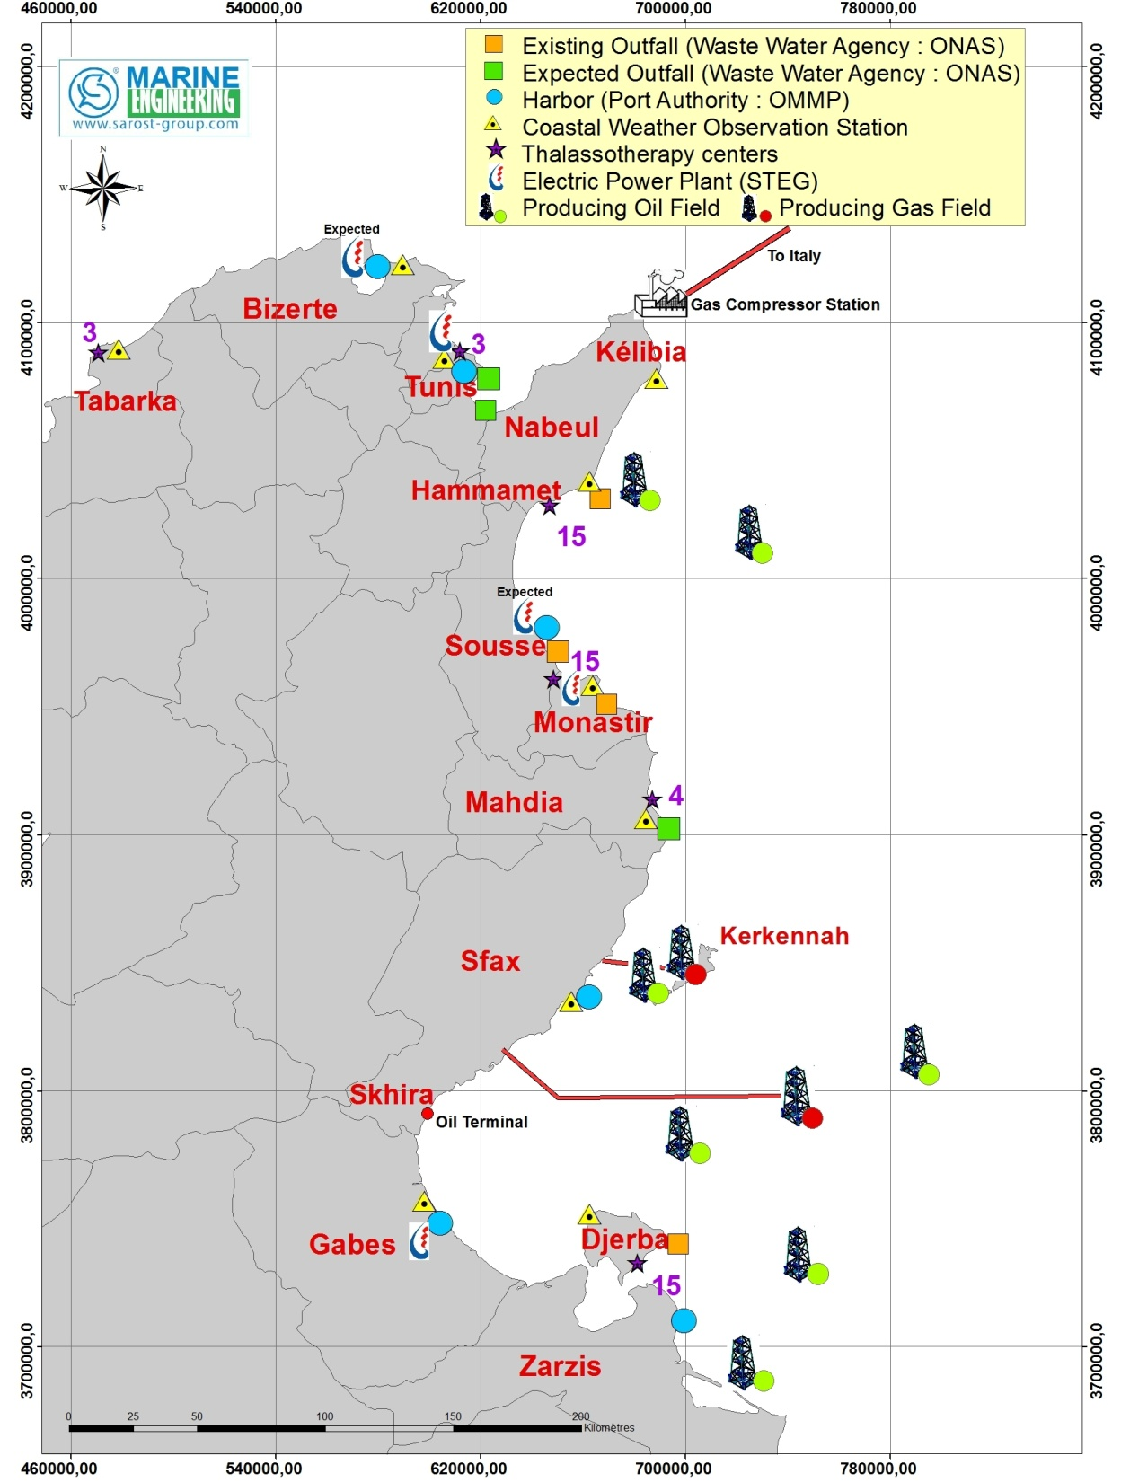

Slide 6
Commercial and offshore fisheries harbors

Slide 7
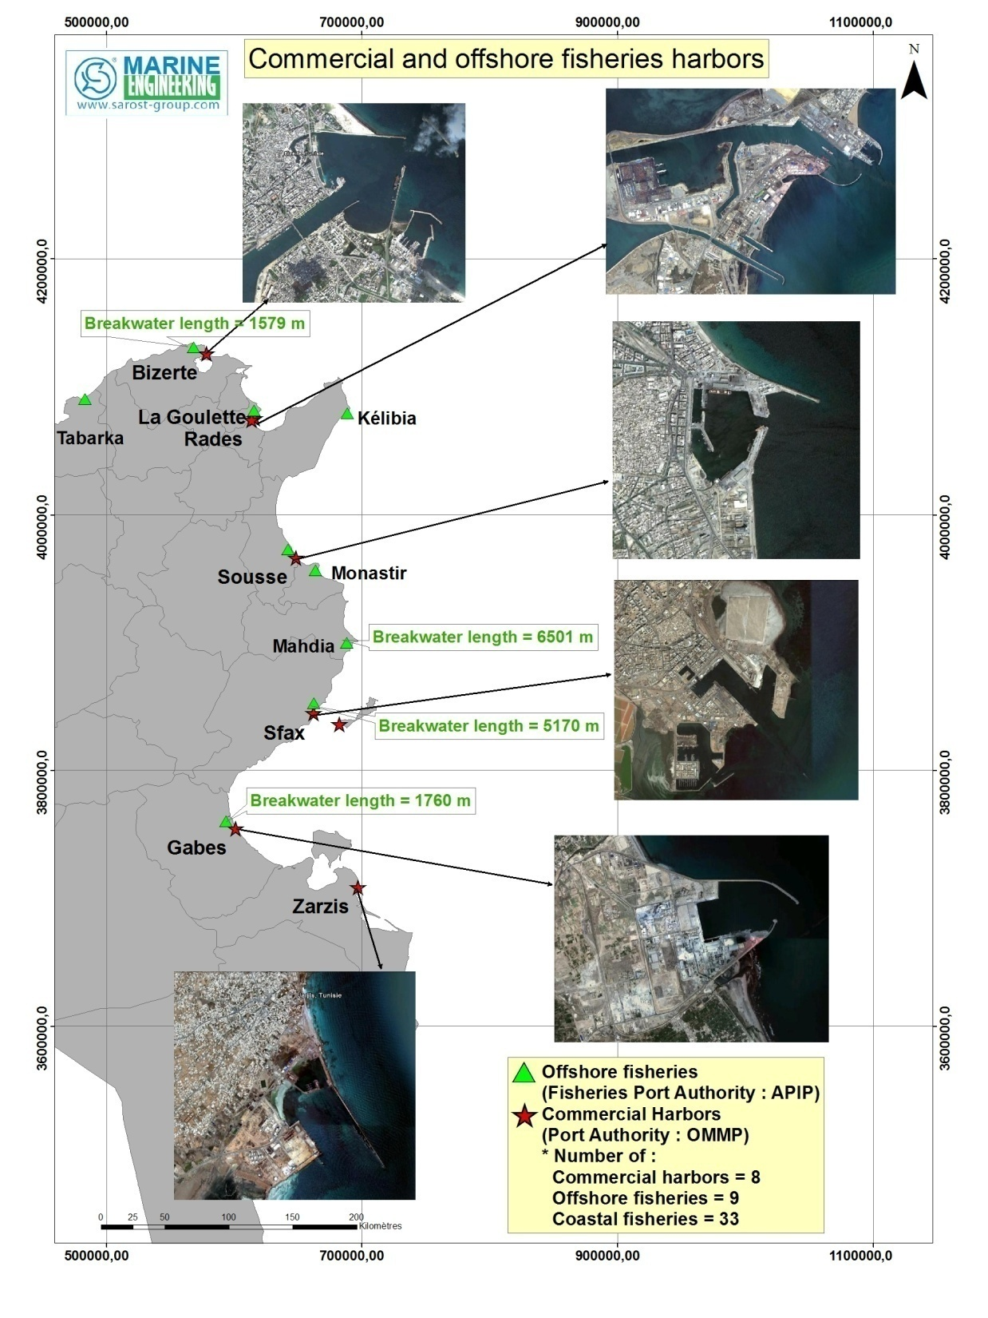

Slide 8
Scientific institutions

Slide 9
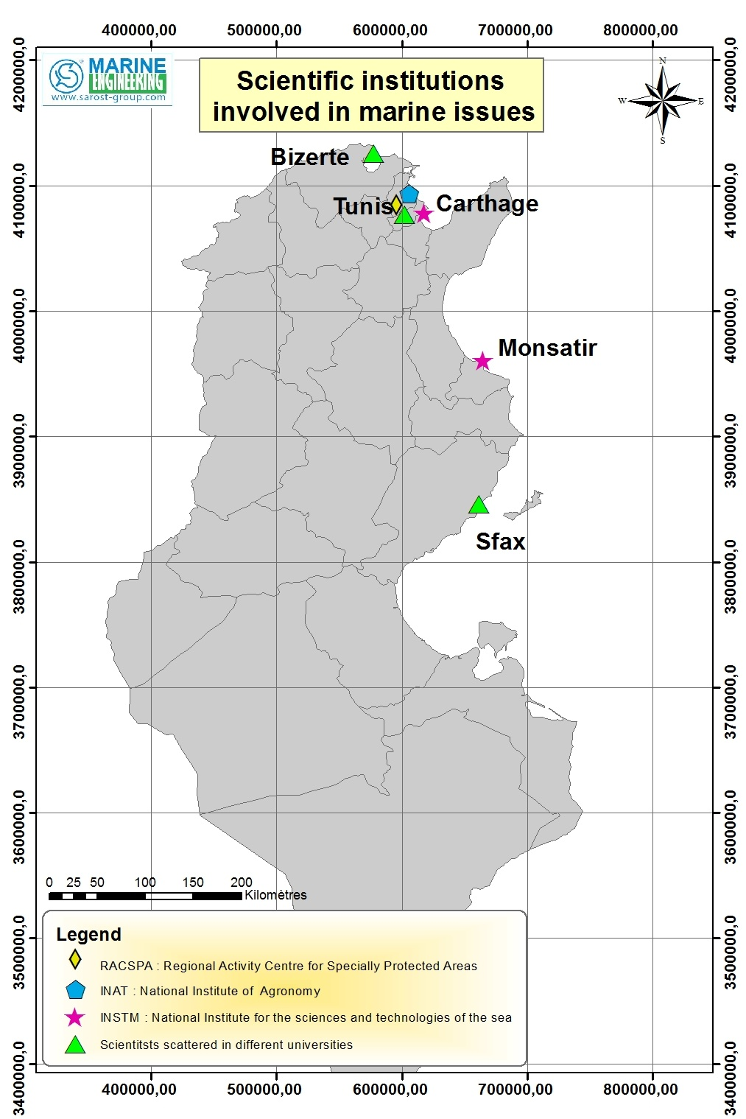
Monastir

Slide 10

SAROST S.A. ACTIVITIES

Slide 11
Four Divisions:
SAROST S.A.
Offshore Vessels
Marine Engineering
Energy Logistic
Subsea Works

Slide 12
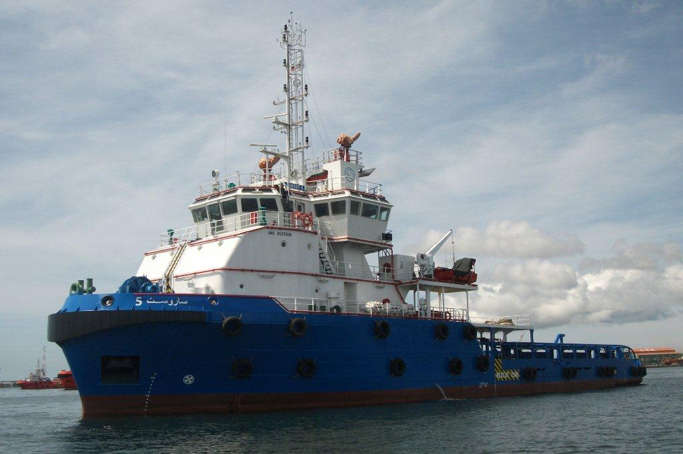
Offshore vessels
Currently own and operate a fleet of five vessels
ISM, ISPS and BV certified
SAROST 5
- Multipurpose offshore support vessel, equipped with a 150T pull Hydraulic double drum winch in waterfall arrangement, suitable for towing and anchor handling operations.
It is fitted with a KONGSBERG DP1 class system and is upgradable to DP2
- It offers large transport capacities for liquid cargo , bulk cement, mud, foam, dispersant, stores, materials and equipment transport

Slide 13
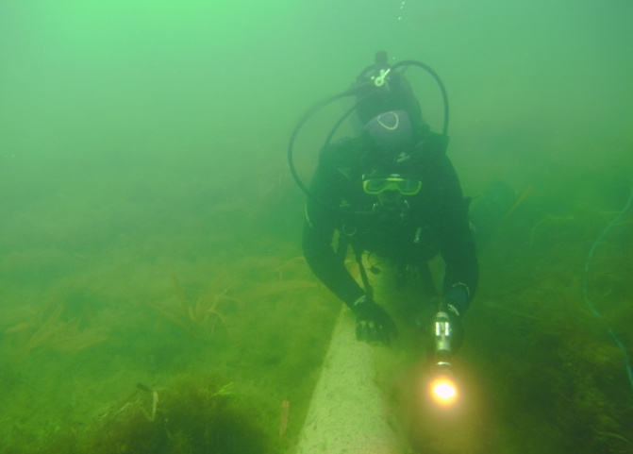
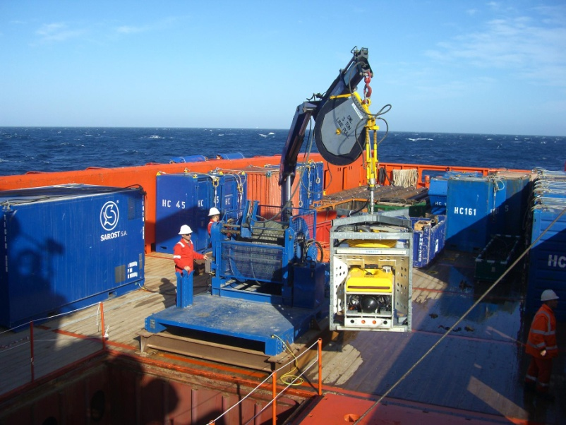
Subsea Works Division
Divers can work in depths of up to 70 meters
A fleet of ROV’s with experienced ROV surveyors, supervisors and pilots
ABS and BV certified for in-water surveys
Member of IMCA (International Marine Contractors Association)

Slide 14
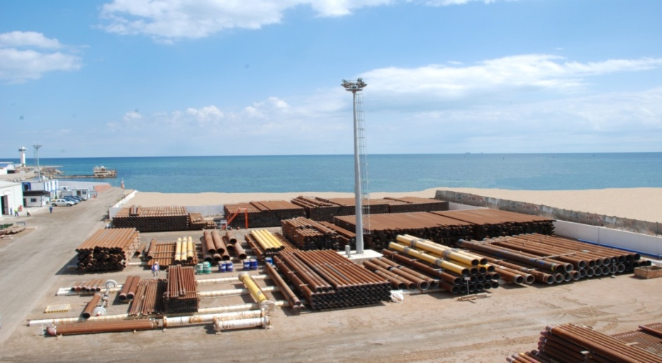
Energy Logistic
Main objective is to allow the Oil and Gas companies to focus on core business, by handling logistics issues such as :
  Providing competent experienced personnel,
  Providing yard space and office space close to the main ports,
  organizing the embarkment and disembarkment of equipment and people from the supply base to offshore platforms and vice-versa,
  customs clearance, etc.

Slide 15
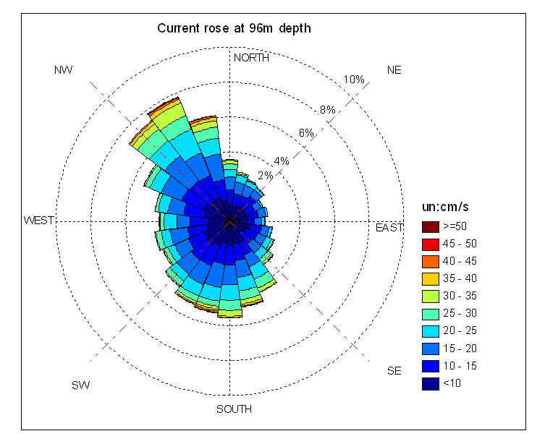
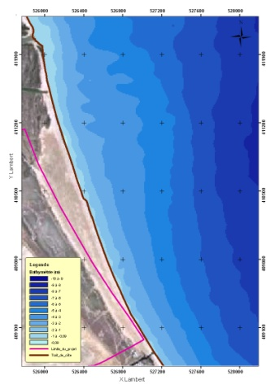
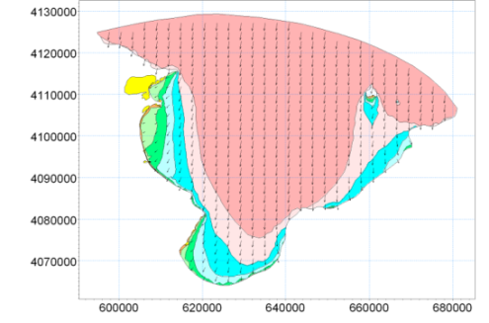
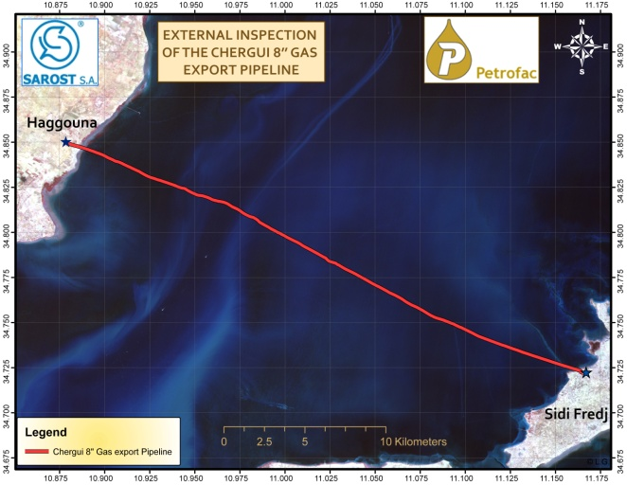
Marine Engineering
Types of studies that SAROST realizes:
1- Metocean Studies
2- Environmental Baseline Surveys
3- Hydrodynamical Surveys
4- Seabed Surveys
5- Coastal Engineering :
Wave, tide and current modelling
Structure design
6- Research and Development projects

Slide 16

SAROST MED main projects

Slide 17
1- Metocean Studies for offshore oil projects

Slide 18

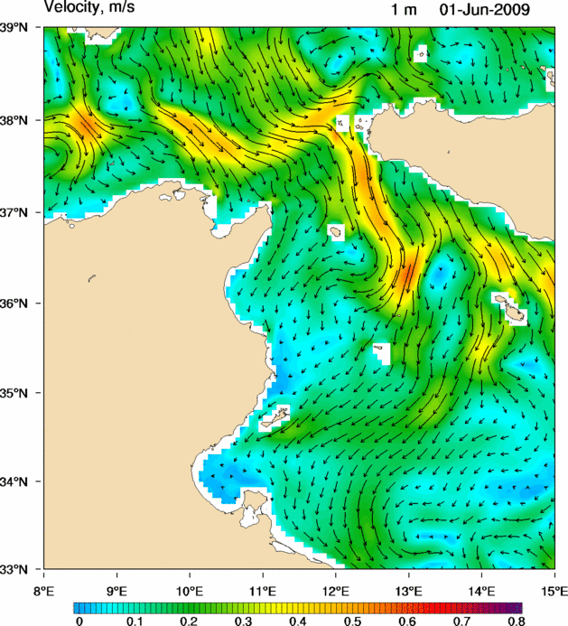
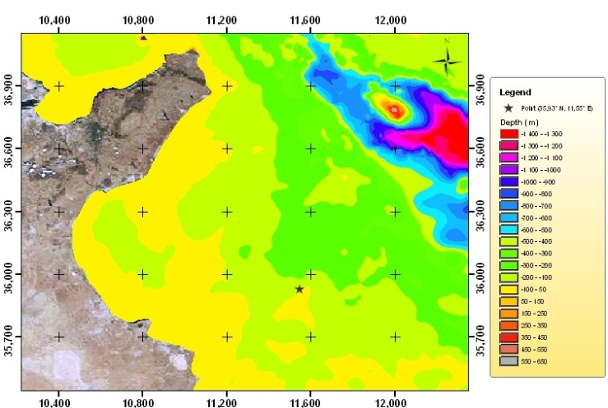
Halk el Menzel permit
This metocean study was carried out to determine the minimal environmental loads that must be taken in account for the design of the drilling platform structure that TOPIC plans to deploy in its Halk El Menzel offshore Oil field (Gulf of Hammamet, Tunisia).
The deliverables of this study were:
Significant wave height, direction and zero-crossing period statistics (sea-wave, sea-swell, sea and swell)
Wind velocity and direction statistics (at 10 m level)
Modeling of the extreme wind characteristics
Modeling of the extreme wave height characteristics
Estimation of the horizontal current vertical profile

Slide 19

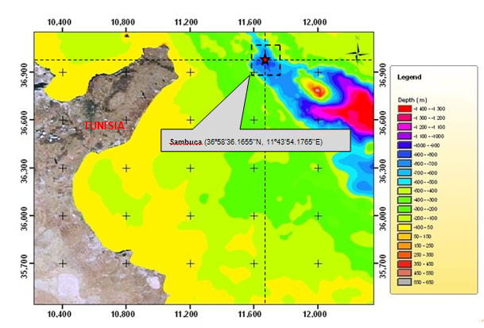
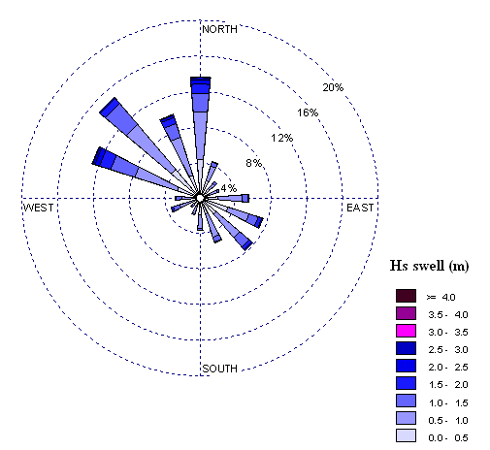
Lambuca permit
This metocean study was carried out to determine the minimal environmental loads that must be taken in account for the design of the drilling platform structure that Alpine Oil and Gas plans to deploy on its LAMBUCA well in the Kerkouane permit offshore, Tunisia.
The deliverables of this study were:
Significant wave height, direction and zero-crossing period statistics (sea-wave, sea-swell, sea and swell)
Wind velocity and direction statistics (at 10 m level)
Modeling of the extreme wind characteristics
Modeling of the extreme wave height characteristics
Estimation of the horizontal current vertical profile

Slide 20
2- Environmental Baseline Surveys

Slide 21

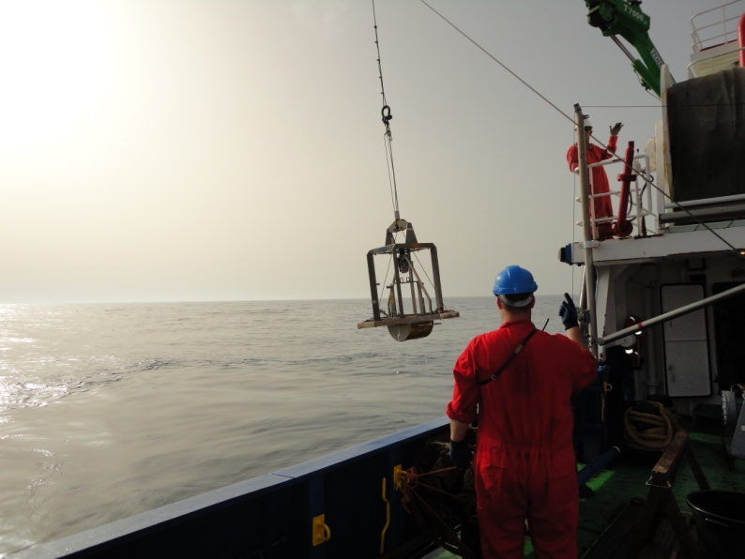
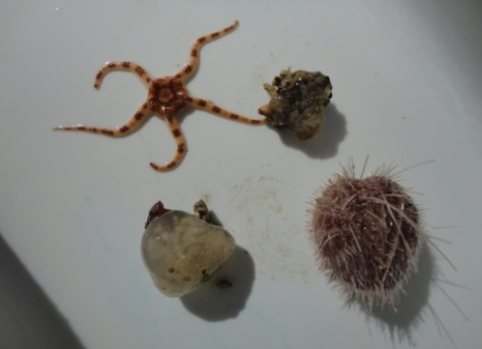
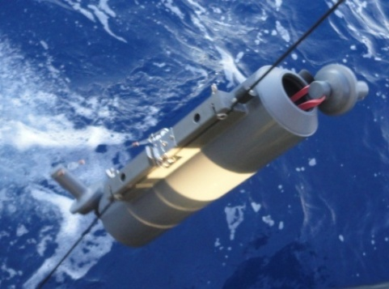
EBS – Sabratah Basin
Site survey : water, sediment and benthos sampling
Analyses : Chemical, physical and biological analyses
Reporting

Slide 22

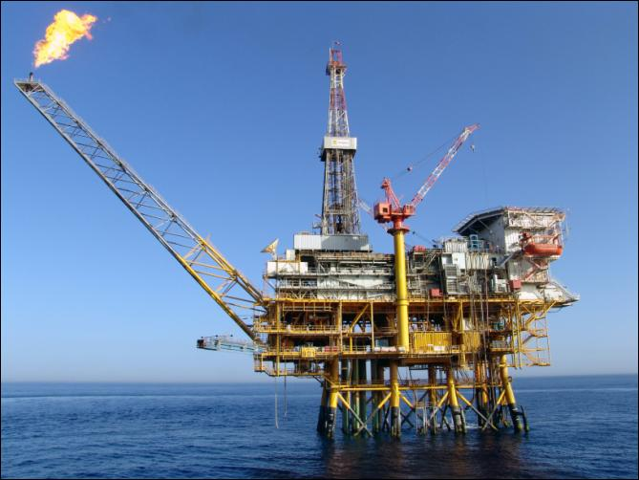
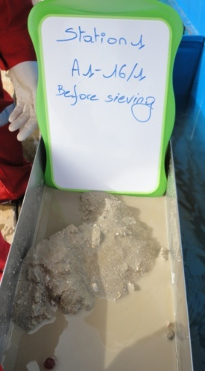
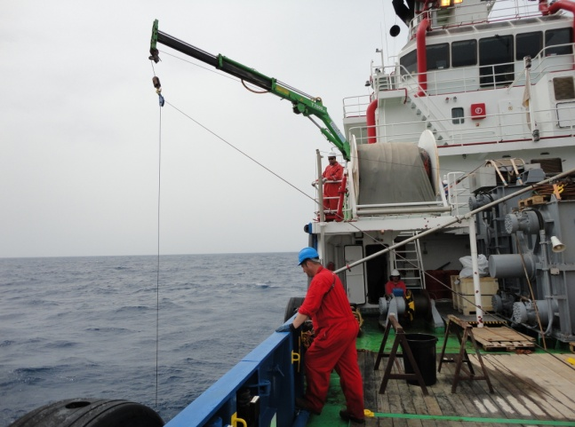
EBS – ALJURF Permit
Site survey : water, sediment and benthos sampling
Analyses : Chemical, physical and biological analyses
Reporting

Slide 23
3- Hydrodynamical surveys

Slide 24
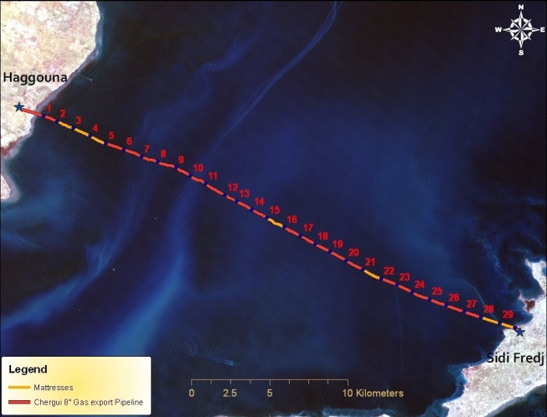


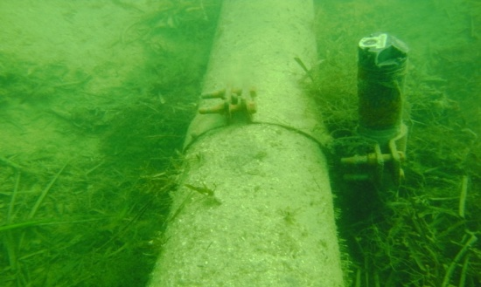
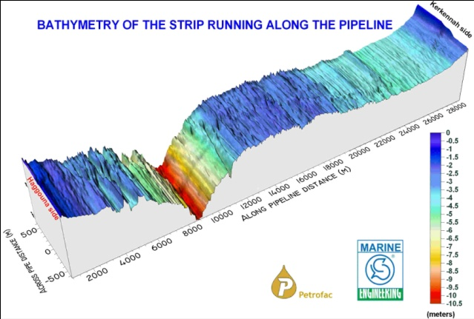
Hydrodynamical survey along the pipeline Haggouna – Sidi Frej (Kerkannah)
Cartography of the pipeline Haggouna - Sidi Frej
Mattresses & Free span
underwater survey
Hydrodynamical Survey

Slide 25
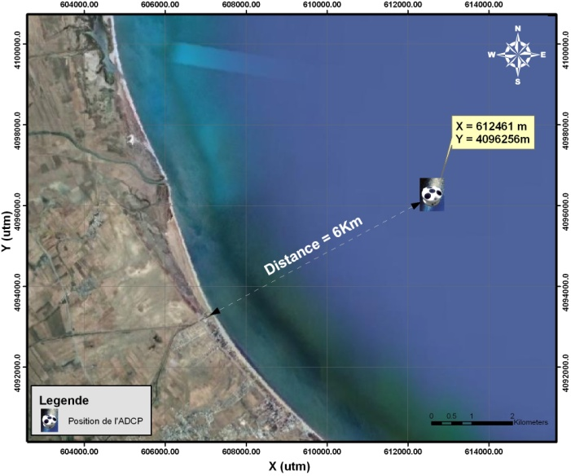

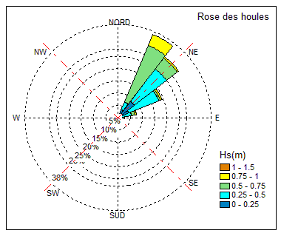
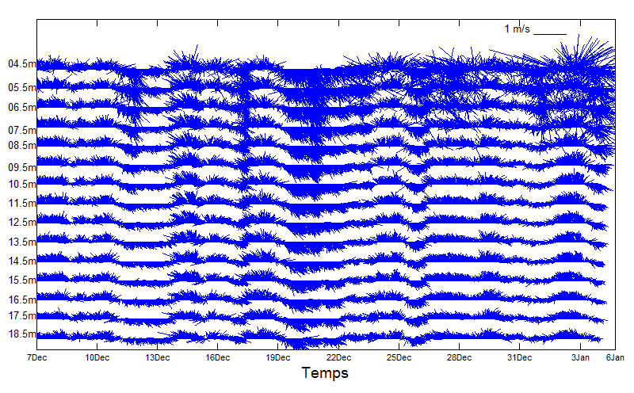
Hydrodynamical survey in Raoued Area
Current and physico-chemical measurements parameters at the projected zone for the sea outfall (Khélij) in Raoued Area

Slide 26
4 – Seabed surveys

Slide 27
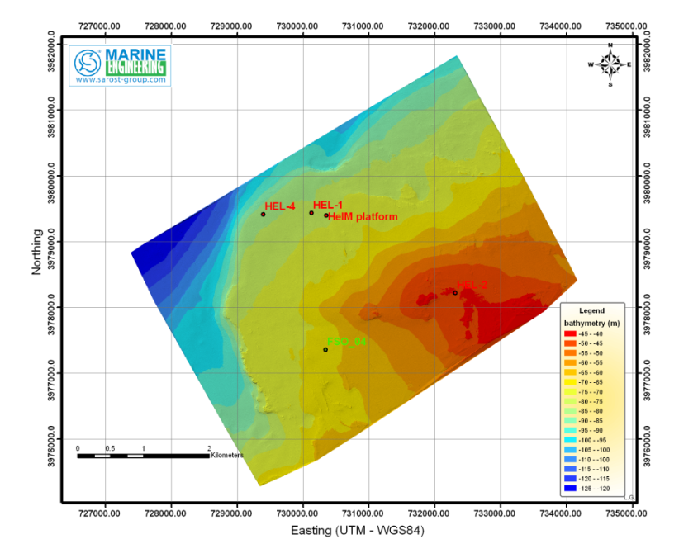
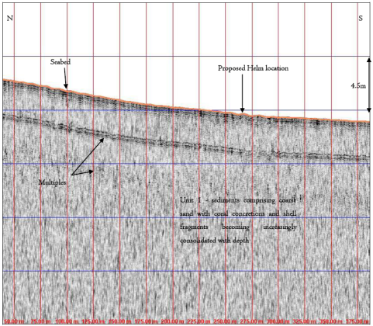
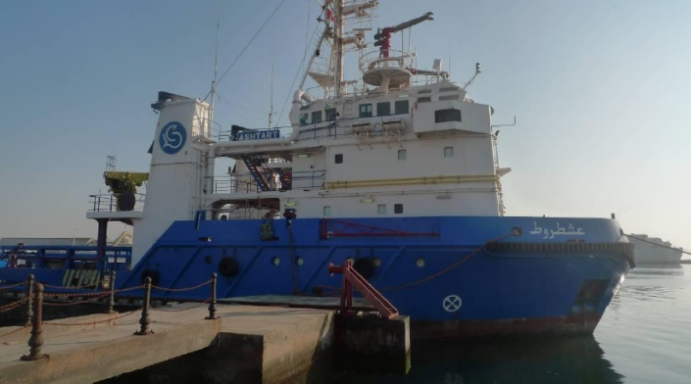
Seabed survey at el HelM Permit
The objective of the survey was to provide geophysical data to assist with the determination of anchoring conditions for a rig
During the site investigation the following data were collected:
- Sub-Bottom Profiler Data, with a vertical resolution of 10 – 20 cm.
- Multibeam Data with 100% coverage

Slide 28
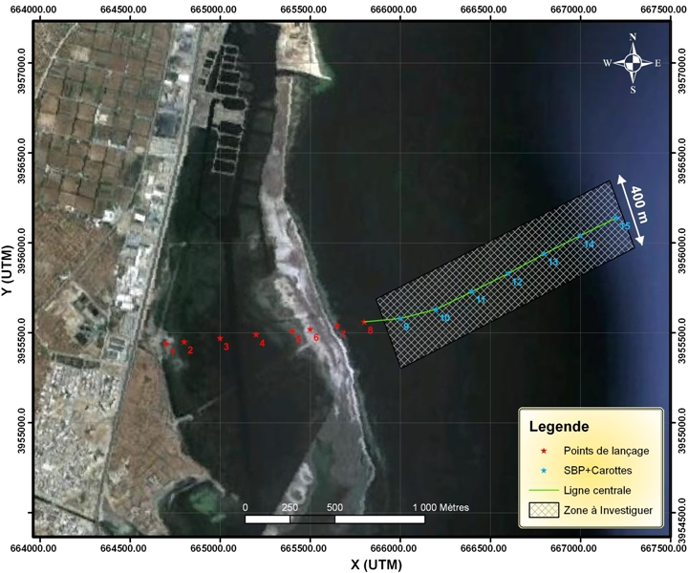
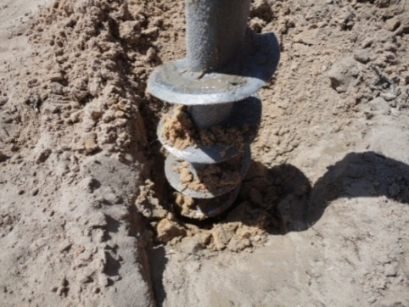
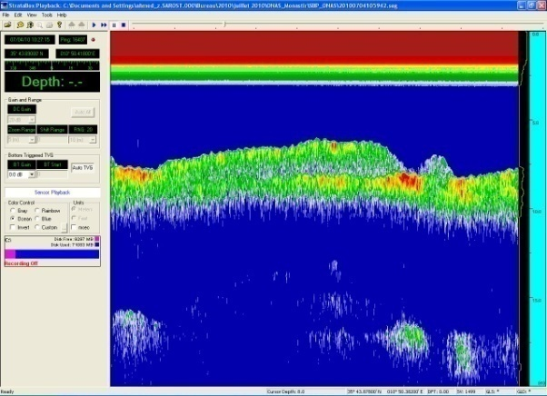
Seabed Survey at Frina (MONASTIR)
This geotechnical investigations included the following activities:
Recognition by auger drilling in order to identify the presence of sub-hard layers;
Recognition by coring;
Recognition by seismic refraction (Sub Bottom Profiler).

Slide 29
5- Coastal Engineering

Slide 30
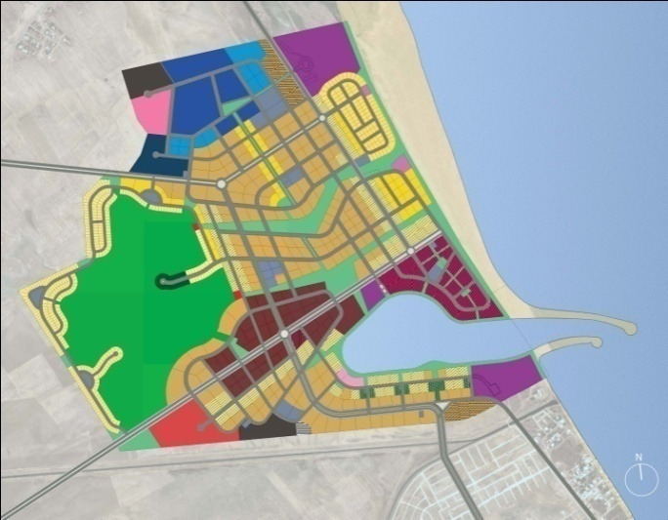

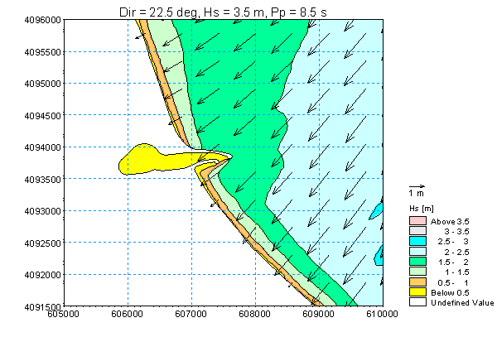
EIA – Tunis Bay Financial Harbor
EIA
Coastal Structure Design
Wave, tide and current modelling

Slide 31
6 – Research and Development projects

Slide 32
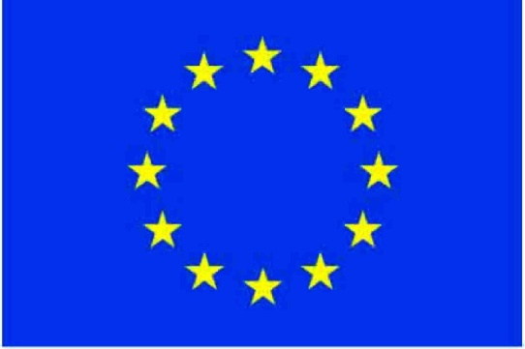
R & D projects in collaboration with the European Union
ECOOP
Implementation of an integration of observations and modelling into a pan-European marine information system of systems (EuroMISS) and design of a European decision support system (EuroDESS) for coastal and regional seas.
CMCC
Climate and local anthropogenic drivers and impacts for Tunisian Coastal Zone.
SESAME
Seasonal circulation and mass flux estimates in the western Sicily Strait derived from a variational inverse section model

Slide 33

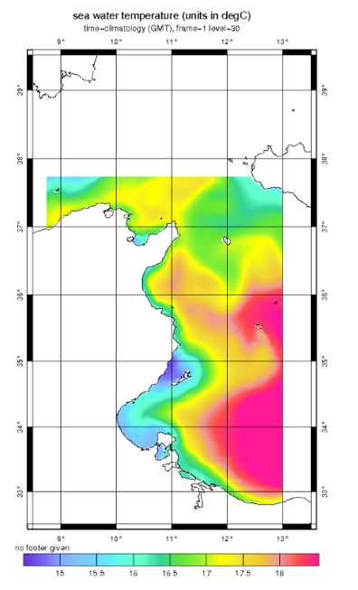
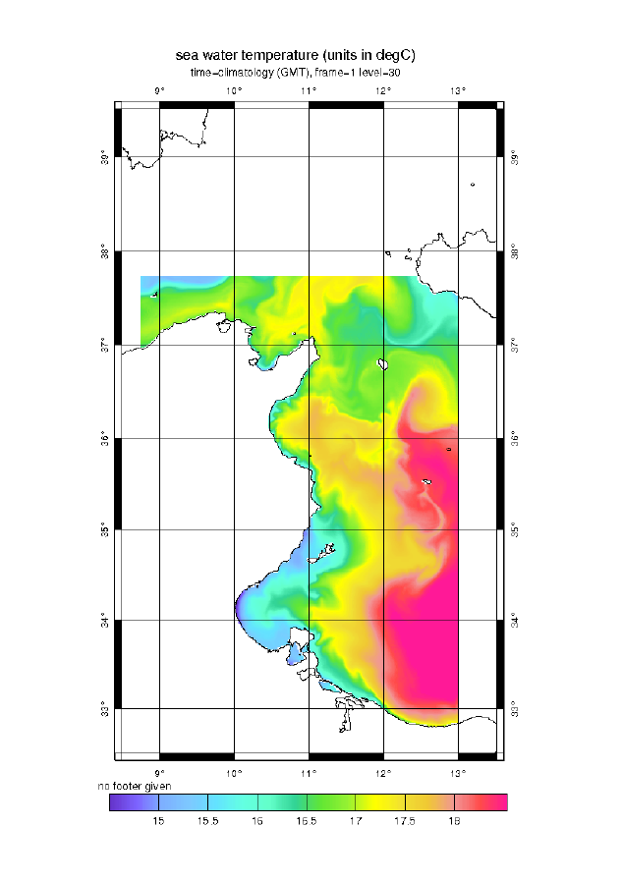
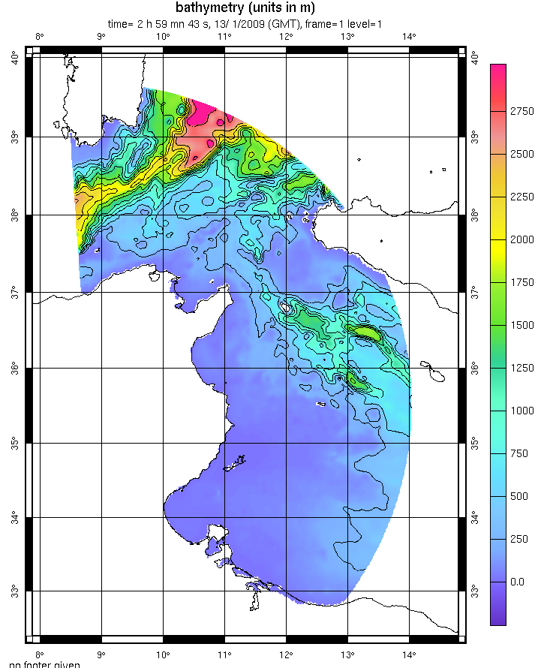
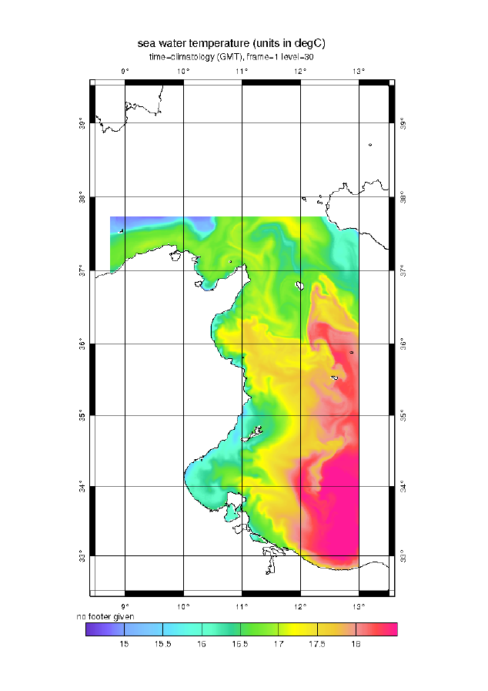
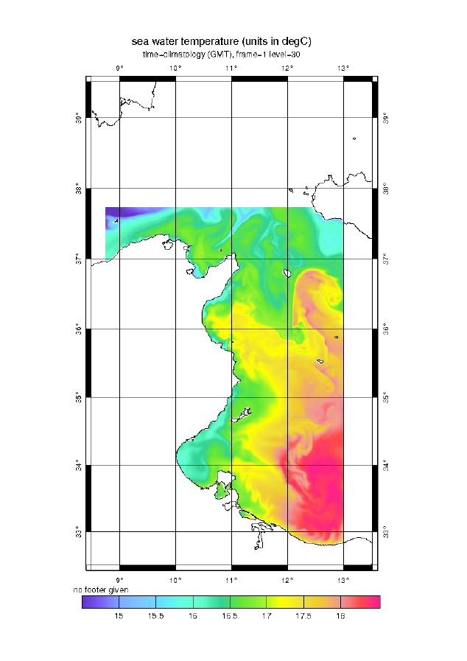
Implementation of the SYMPHONIE (three-dimensional primitive equation model) code on the Tunisian coastal shelf area (COSTUM)
1
2
Implementation of the last release of the numerical code (symphonie V2010.5) on a larger area in order to include the Sardinia Channel
(1) - Initialisation of the model
with the INGV OGCM output (January 1st, 2007).
The map shows the SST
(2)- SST given by COSTUM
8 days after the initialization (January 9th, 2007) – ALADIN forcing are applied hourly and INGV OGCM BC are applied daily.
(3)- SST given by COSTUM
17 days after the initialization (January 9th, 2007) – ALADIN forcing are applied hourly and INGV OGCM BC are applied daily.
(4)- SST given by COSTUM
26 days after the initialization (January 9th, 2007) –ALADIN forcing are applied hourly and
INGV OGCM BC are applied daily
3
4
Bathymetry interpolated
on a polar grid.

Slide 34

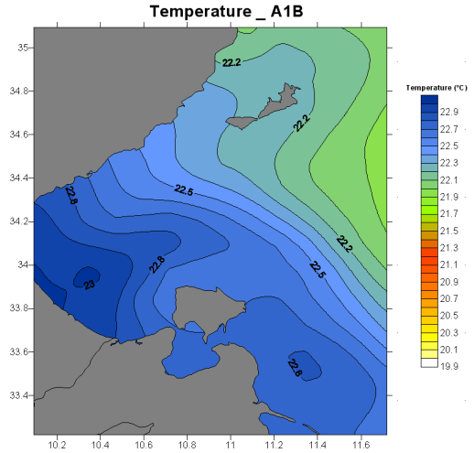
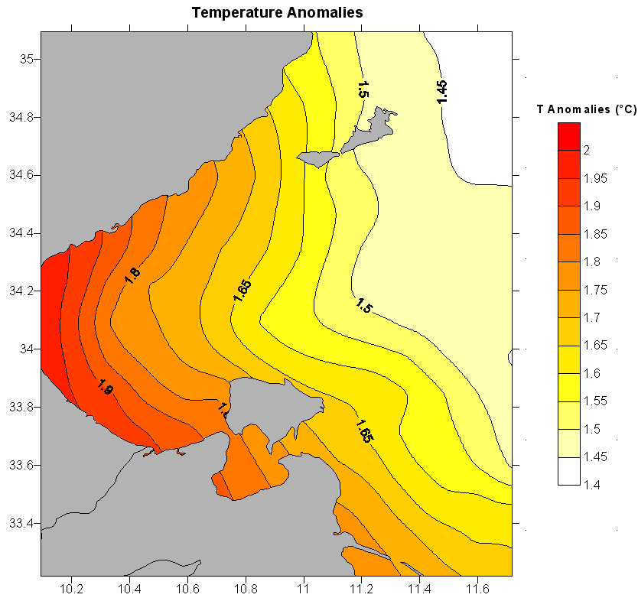
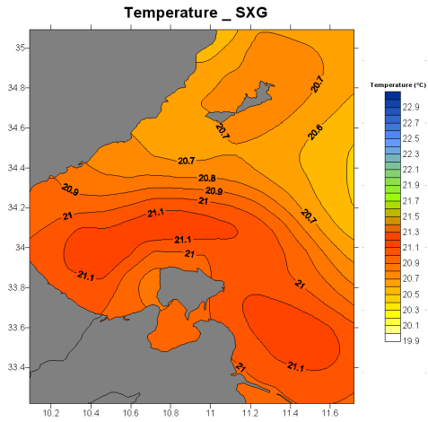
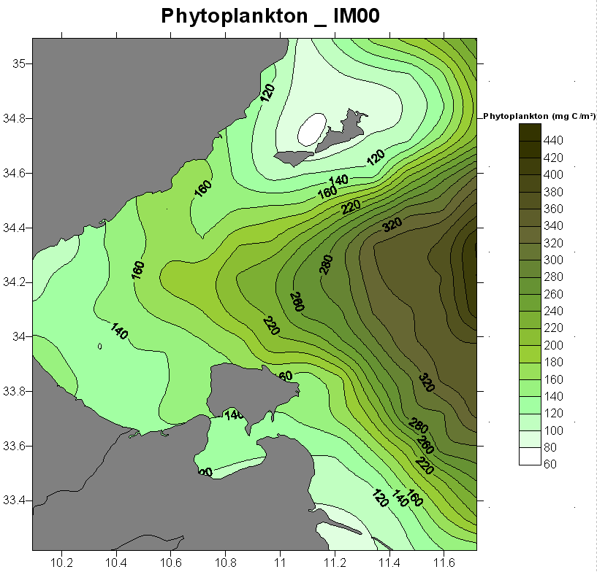
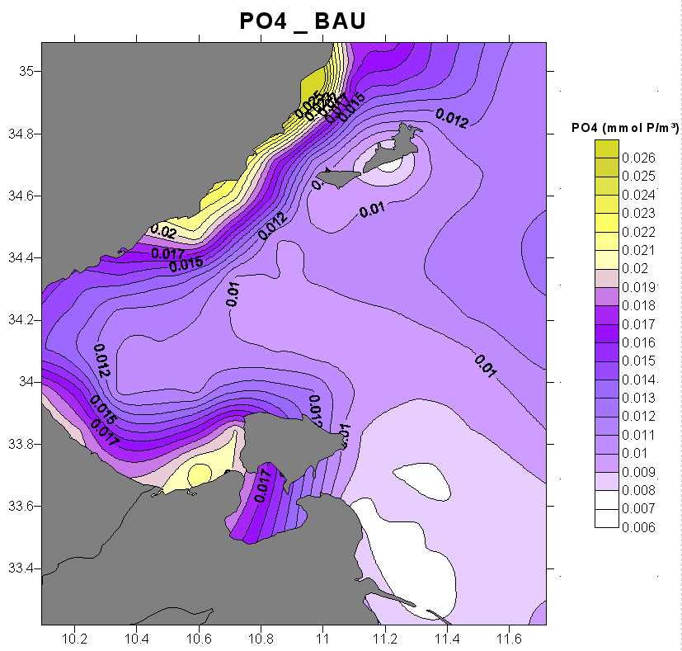


Vulnerability assessment of Gulf of Gabes to Climate Change
Provision of environmental data in order to perform vulnerability and risk assessment for the Coastal area of the Gulf of Gabes
Analysis of the results of the OPATM-BFM biogeochemical model of the Gulf of Gabes
Temperature anomalies for the Gulf of Gabes (difference between scenarios A1b and SXG)
Outputs of the 2D and 3D models for different scenarios

Slide 35



Seasonal circulation and mass flux estimates in the western Sicily Strait derived from a variational inverse section model
(Deep-Sea Research I 57 (2010) 1177–1191)
Inverse section model based on the finite element method combines a wide dataset from seasonal hydrographic and current meter measurements reproduces the seasonal climatological cycle of the circulation in the area.
It gives a description of the circulation, especially in its vertical phenomenology, as well as to give a firsthand indication of important dynamical features pertaining to the Tunisian near-shelf areas.
Monthly distributions of the horizontal velocities across the hydrographic section

Slide 36











Site Survey Equipment
W & S sampling
Seabed Survey
Hydrodynamics
Smith McInthyre Grab
DGPS : RTK SPS461
and SPS 852
Multibeam
echosounder system
Acoustic doppler
current profiler
Niskin bottles
Dynamic motion sensor
Sub-bottom profiler
Aquadopp
Multiparameter probe
Sound velocity profiler
Sidescan sonar system

Slide 37
Suggestions for cooperation and capacity building in marine science and oceanography
Gaps and Needs

Slide 38



Kerkennah Island
Chergui
Gharbi
LG
Traditionnal fisheries
Posidonia ocanica forms dense and large meadows
Oil and gas activities
Kerkennah may disappear due to sea level rise increase

Slide 39
Gaps and Needs
Needs
Understanding, assessing, predicting, mitigating and adapting to climate variability and change,
Improving metocean information,
Improving the management and protection of coastal and marine ecosystems,
Understanding, monitoring and conserving biodiversity.

Slide 40
Gaps
Long-term observation of critical parameters is lacking
Funding, master plan and overall coordination are missing

Slide 41



Capacity Building
Degrees in marine engineering and physical oceanography
Summer schools
On field trainings

Slide 42


Coastal Survey Vessel
Training,
Research
Commercial

