Slide 1
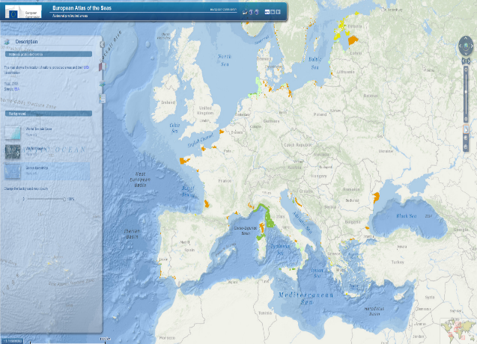
European atlas of the seas
Jean Dusart, Joint Research Centre
http://ec.europa.eu/maritimeaffairs/atlas/maritime_atlas/

Slide 2
The Atlas in a few words
Public web-based atlas available on the website of DG MARE
http://ec.europa.eu/maritimeaffairs/atlas/maritime_atlas/
    First release in 2011 targeting general public + policy maker
    Second release moved into production this spring 2013
    Current release will be enriched in the coming months with updated data (fishing quotas, Eurostat statistics, …)
    In parallel, design and development of next-generation atlas (release 3) accessing distributed data sources and providing additional functionalities (profiles, time series, basic stats)
  Being reliable, up-to-date and authoritative window on the European Seas while remaining intuitive to use

Slide 3
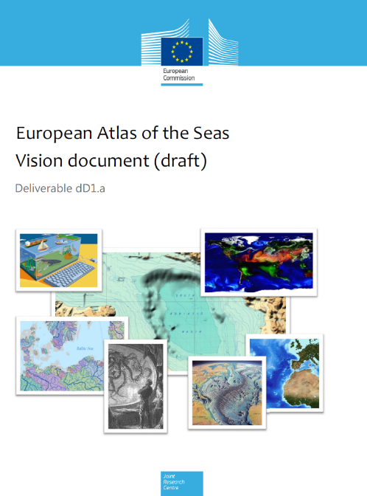
Project organisation
  Project conducted by JRC
  with support of EEA (hosting) for DG MARE
1. Development
General features
Existing data layers improvement
New data layers
Data analysis tools
2. Cooperation
Reinforcement
New cooperation
3. Promotion & Users’ feedback collection
4. Maintenance

Slide 4
Development: New data layers
Integrated Maritime Policy
Wind energy in Europe (European Wind Energy Association)
Maritime service areas (ESTAT)
Number and gross tonnage of vessels in the main ports (ESTAT)
Change of economically active population aged 15 years and more in coastal regions (ESTAT)
Urban-rural typology (ESTAT)
Structural funds 2007-2013: cross border cooperation (DG REGIO)
Structural funds 2007-2013: Transnational cooperation (DG REGIO)
TEN-T (DG MOVE)
Ourcoast project outputs (http://ec.europa.eu/ourcoast/)

Slide 5
Development: New data layers
Fisheries
Yearly Total allowable catches and quotas by MS, fishing zones and species: initial, adapted, consumed quotas
Simplified TACs and quotas 2013
Multi-annual plans
Technical measures and closed areas (including areas where bottom trawls are prohibited)
Fisheries and aquaculture producers' organisation & number of processing companies
Main commercial flows of fisheries products
Distribution, composition and economics of the EU fishing fleet
International Council for the Exploration of the Sea (ICES) State of the stocks
Financial instrument for fisheries guidance 2000-2006 -Projects by NUTS 3
Efforts zones
Fisheries Partnerships Agreements fishing zones

Slide 6
Development: New data layers
Addressing or updating a number of thematic areas supporting existing Maritime policies?
Seabed description
Maritime and coastal spatial planning
Fisheries
Tourism and cultural heritage
Transport and communication
Climate and Meteorology
Marine resources
Blue energy
Biodiversity
Pollution
Chemicals

Slide 7
Enhancing cooperation with communities
EMODNET/Copernicus MyOcean2/SeaDataNet
Preference for direct access to distributed view web services (OGC or better INSPIRE view services)
Issue of technicality/complexity of indicators measured
Provision of aggregated or generalized products of direct interest to the general public
Benefits: increased visibility of EMODNET datasets for general public
Benefits: increased visibility of EMODNET institutions, getting access to an additional audience (increased traffic)

Slide 8
Example of integration of Bathymetry
Integration of WMS service provided by EMODnet Bathymetry

Slide 9
Next steps
Have a look at the Atlas (demo) and provide your feedback on:
  Evaluation of the current atlas: what’s missing? What’s outdated? What could be improved? Which layers/functionalities are missing for addressing general public and policy maker?
  Would you be ready to collaborate and provide viewing access to some ‘simplified’ datasets (aggregated or generalized)? At what conditions? With which restrictions?
  How could we address issues of possible overlaps and confusing messages with respect to existing portals?
  How can we develop synergies with the EMODnet portal to be provided by VLIZ?

Slide 10
Thank you for your attention
  Contact:
  Jean DUSART
  European Commission, Joint Research Centre
  Digital Earth and Reference Data Unit
  Via Fermi, 2749 – TP262
  21027 Ispra (VA) ITALY
E-mail: jean.dusart@jrc.ec.europa.eu

