Slide 1
Baltic Sea Basin marine data stress test
Jun She
js@dmi.dk
Danish Meteorological Institute
3 March 2017
http://www.emodnet-baltic.eu

Slide 2
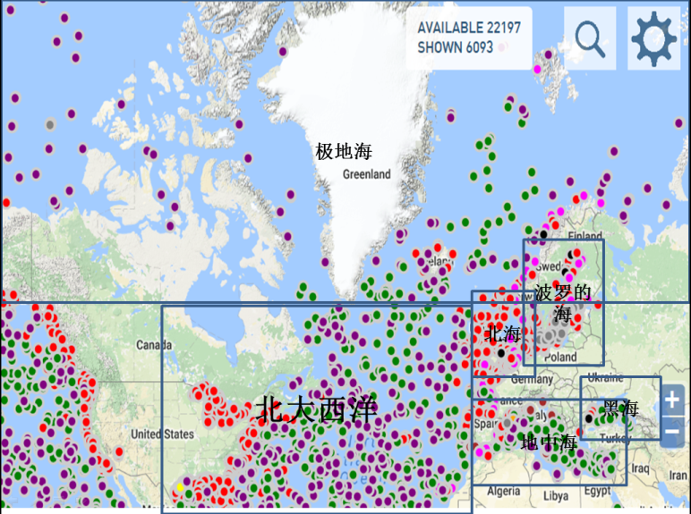
EMODnet and Checkpoint projects
EMODnet (2009-2020)
Seven Data Lots:
Multi-purpose datasets
bathymetry, biology, chemistry, geology, human activities, physics, sea bed habitat
Six Sea Basin stress test projects
Med.Sea, North Sea (2013-2016)
Arctic, Atlantic, Baltic, Black Sea (2015-2018)
EMODnet 包括7个资料库,6个适用性测试项目组成.
7个资料库: 地形, 生物, 化学, 地质,人类活动, 物理,海底生境
6个区域性数据测试项目

Slide 3
Rational (缘起)
The value of data will be realised only when thay are used
The motivation of data investors is to maximize the value of data
Data value depends on the efficiency of the data usage and quality of data, in many cases, an integrated use of multiple datasets
The purpose of the project is to answer ”do the existing marine data in the Baltic Sea fit for the purpose of major applications?”
问题：波罗的海现有的海洋数据是否满足海洋应用的各种需要？
基本出发点：海洋数据获取不易，数据是拿来用的，只有使用，数据才有价值。
测试问题：数据好不好用呢？(评估)
测试目的：如果不好用，是哪些原因造成，如何改进？(优化)

Slide 4
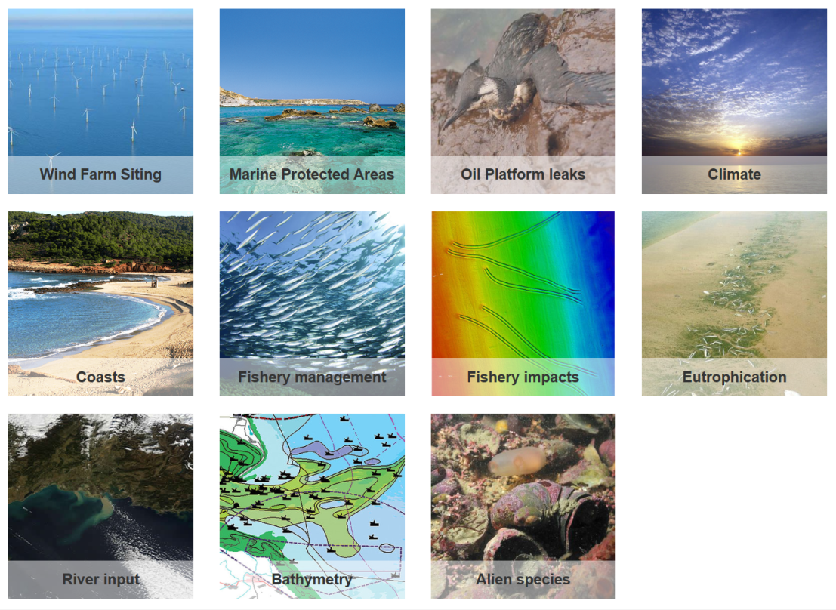
Scope of research
The data concerned cover air, water, biota, sea bed and human activity
The data sources are from in-situ, satellite, model, statistics of integrated modelling/ harmonisation methods, social-economic statistics
Challenge areas
海洋数据定义: 海洋大气层, 海洋
水域, 海底层, 海洋生物和人类活动
对于适用性研究，观测数据只是使用数据的一部分,
要判定观测数据是否够用，必须将所有可能的数据和
手段都使用上。因此，应用研究使用了模式、卫星和
现场三种手段的集成方法。
测试领域
风电选址
海洋保护区
海上溢油
海洋气候变化
海岸带保护
渔业管理
渔业影响
富营养化
河流输入
海底地形
外来物种

Slide 5
Project workflow (工作流程)
DG-MARE
Define tasks, applications
WP1
Identify input data
Review of existing data usage
WP2-WP12
Demonstrate data usage
Generating products
WP13
Display products in the portal
WP15
Data Adequacy Assessment
方法三要素：
已有海洋数据使用综述 （Literature Review Report）
行业示范产品和网站显示 (http://www.emodnet-baltic.eu )
数据适用性评估 (Data Adequacy Report)
项目质量保证
外部专家组独立评估（欧盟行业专家、国际组织专家+本区域学术专家9人）
用户会议-用户评估

Slide 6
Baltic Sea Observational Networks (波罗的海观测网络)
Operational monitoring BOOS
Environmental monitoring HELCOM
Fishery monitoring (open water, coastal fisheries)
National Geological Servey
Baltic Sea Hydrological Committee
Research data (BONUS, Interreg, H2020)
Commercial data
业务海洋观测网 (波罗的海业务海洋系统BOOS)
环境海洋观测网 (波罗的海环境保护委员会HELCOM)
渔业海洋观测网（近海渔业、远海渔业）
国家地质调查局（沉积物、底质类型）
国家水利和地形调查（波罗的海水利委员会BSHC）
研究项目（欧盟和区域研究计划BONUS，Interreg，H2020）
商业观测项目

Slide 7
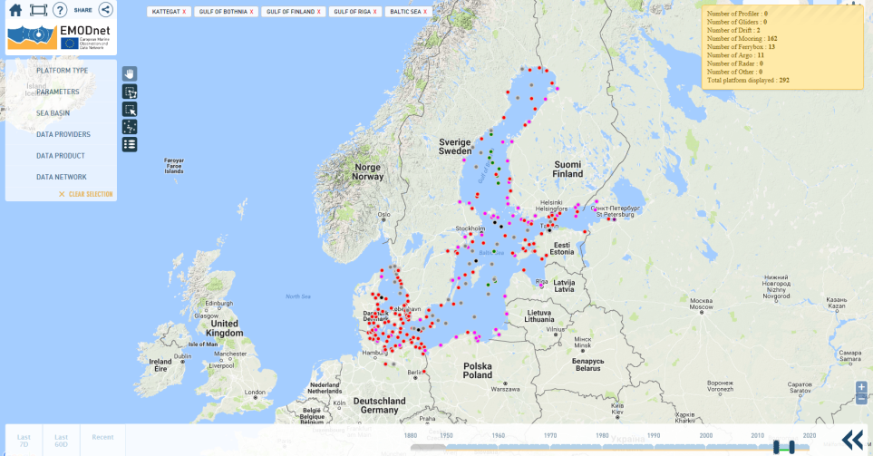
Baltic Sea observational networks
Operational data:
Drifters: 2
Argo floats: 11
Fixed statiosn: 163
Ferrybox: 13
Non-operational data (2010)
5703 stations for T/S
1457 CTD stations
Adaptive monitoring: Gliders
业务;高频;近岸
延迟;
低频;
全覆盖

Slide 8
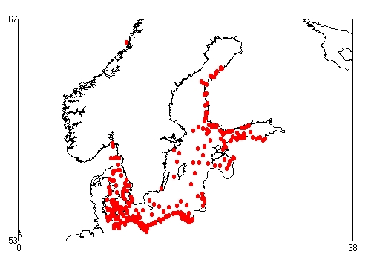
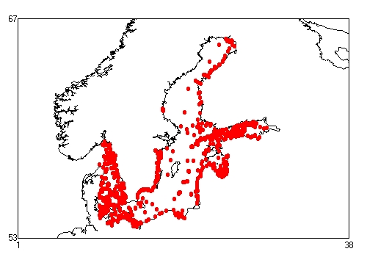
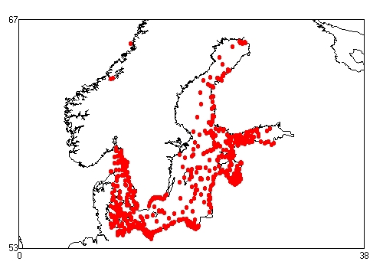
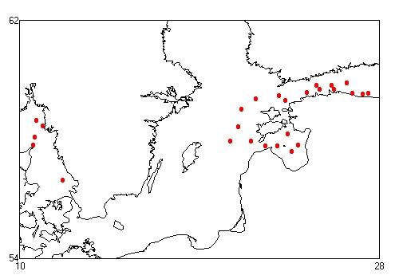
Chl-a data
2014: 2900 stations
2015: 3060 stations
2016: 26 stations
2014
2015
2005-2009
2010-2014
时间滞后: 1年
2016

Slide 9
Major outcomes

Slide 10
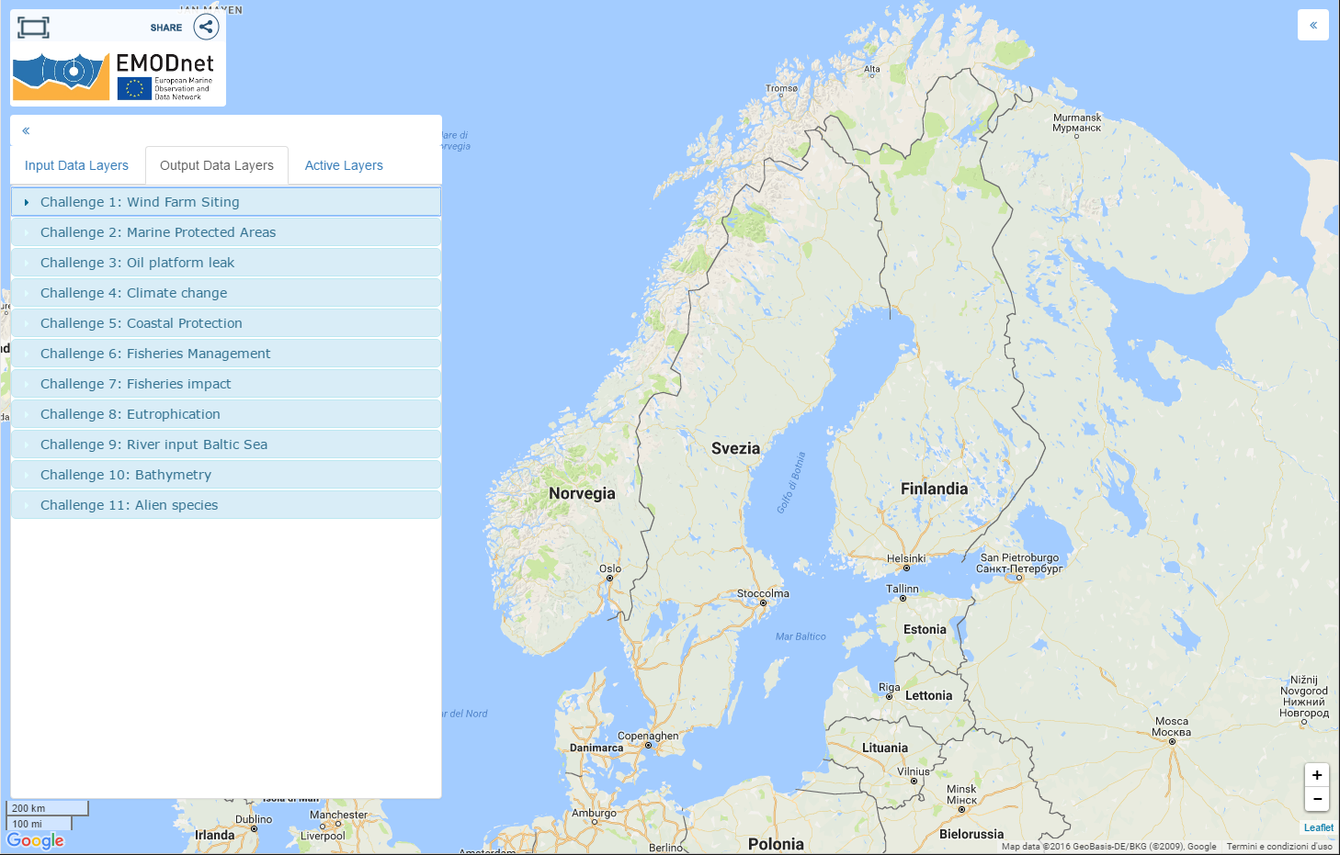
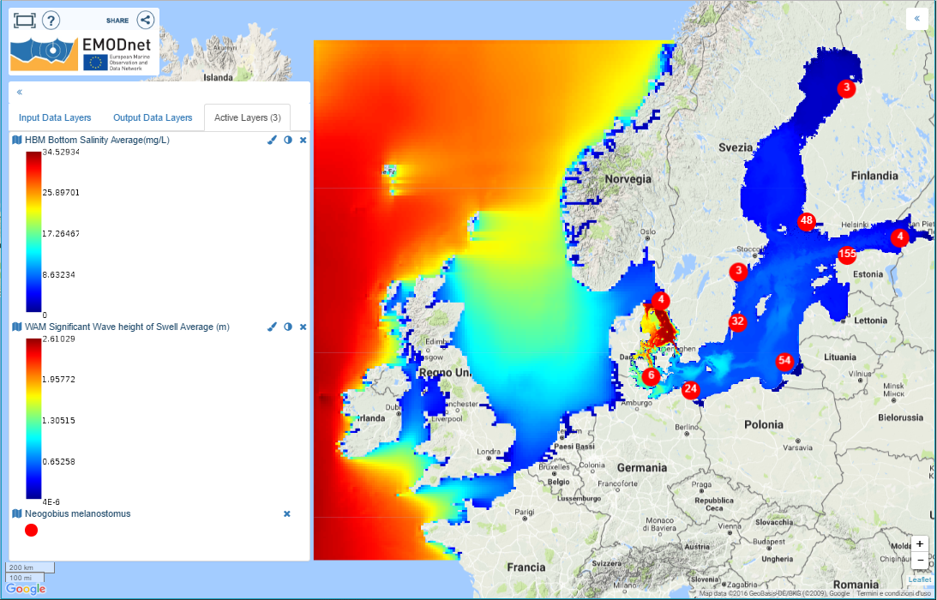
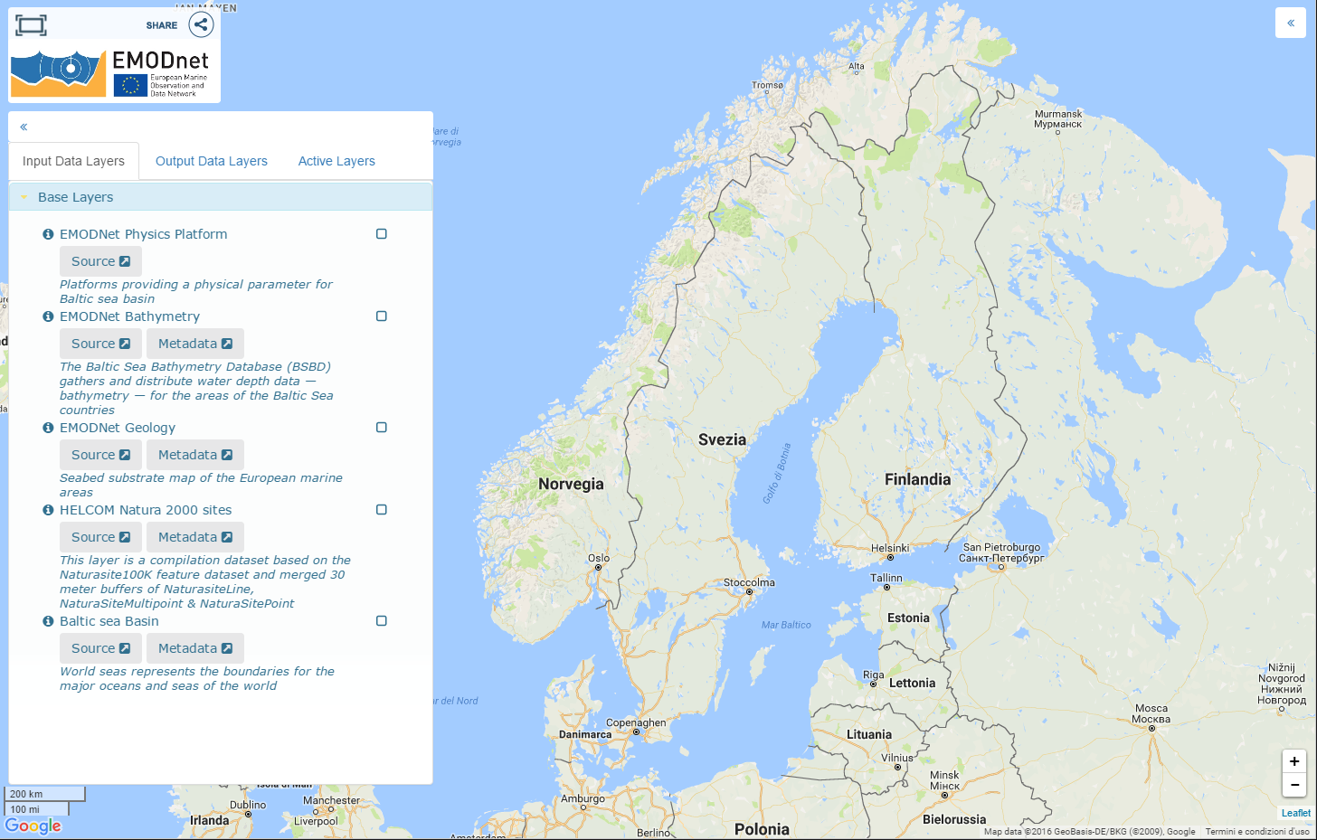
Interactive Map and data layers:(动态数据层制图)
http://www.emodnet-baltic.eu/map
Input Data Layers - Data Sources
Output Data Layers - Data Products
Active Layers - management

Slide 11
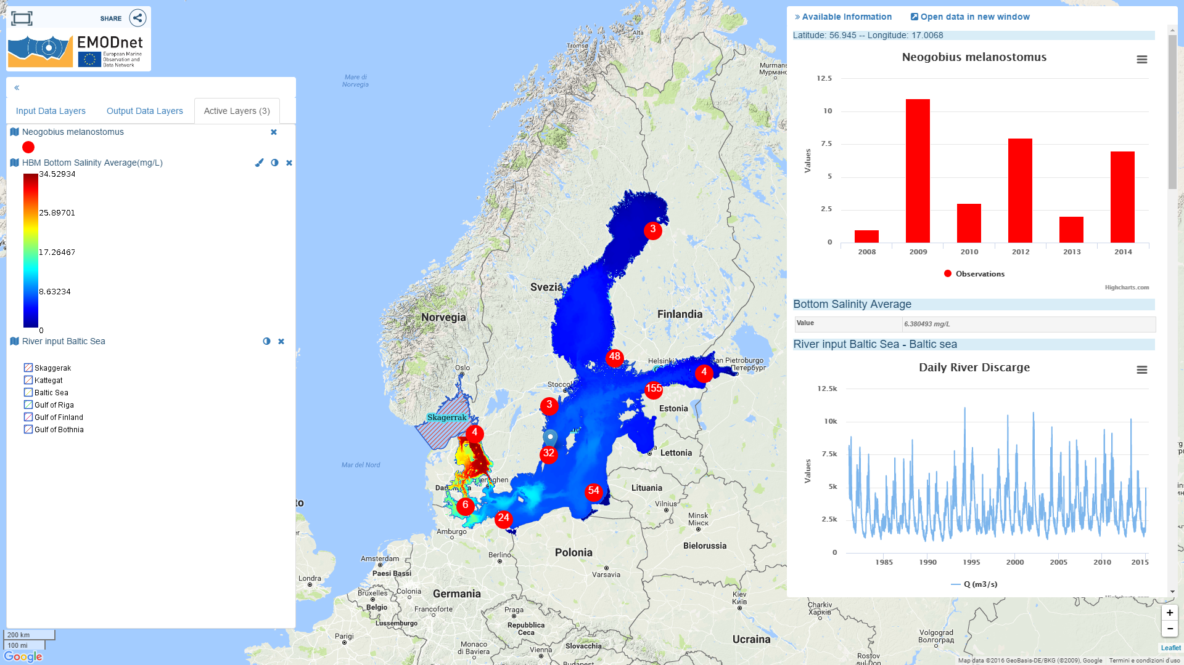
Data extraction and visualization(数据抽取和视图)

Slide 12
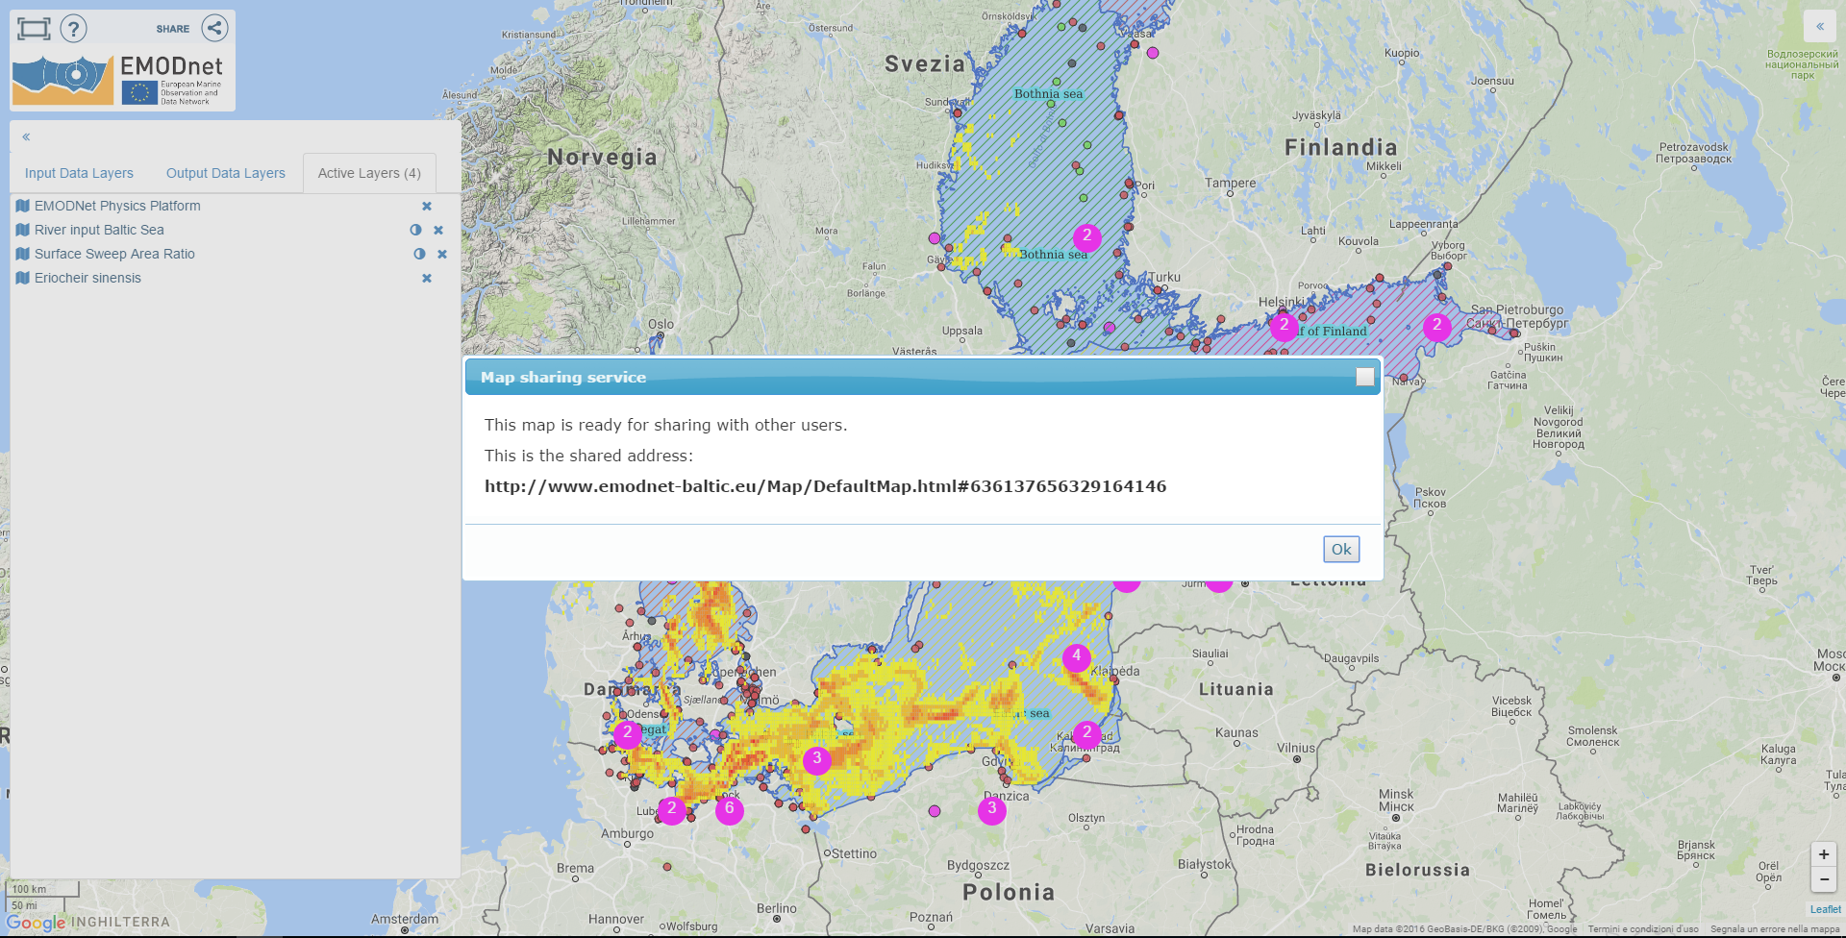
Share selection(共享链接功能)
http://www.emodnet-baltic.eu/Map/DefaultMap.html#636137656329164146

Slide 13
Major findings（主要发现)
EMODnet has already provide huge amount of data for the tested areas
Some data categories are totally missing in EMODnet
There are still many data missing in the EMODnet：part of them exist in the member states
Research and commercial data are rarely included in EMODnet
Part of the environment monitoring data are missing in EMODnet
The BSCP study provide a basis from open data to open knowledge
Satellite and modelling are efficient tool to complement the in-situ data
EMODnet已经在为大多数测试领域提供数据
有些数据完全不在EMODnet里：如，径流相 关的数据, 风剖面数据, 近海渔业,悬浮颗粒物分布等.
在已有的数据类中, 仍有不少数据散落于成员国数据集，部分已确认，有待收集．
多数研究数据和商业项目数据不在EMODnet中．
部分环境监测数据不在EMODnet中．
已有研究提供了一个从开源数据产品到开源知识创新的平台
卫星和数值模式可以有效补充现场数据的不足. 比如, 通过整合现场和模式再分析, 有效重建了波罗的海过去100年的相对和绝对水位时间序列．

Slide 14
Major findings（主要发现）
New challenge areas to be tested
Marine Spatial Planning,
Ocean acidification,
Hypoxia,
Operational forecasting
Marine pollutant,
Underwater noise,
Atmospheric deposition
Sectorial data policy is the major issue to handel for future data sharing
Promote open data policy
Make a common EU research data policy to EMODnet
Adapt EU data infrastructure to different data policies so that wider data providers can be engaged
WRT commecial data, a sustainable business model is needed
有很多重要的应用领域尚未评估:
海域空间规划，
海洋酸化,
海水缺氧，
业务海洋学,
海洋污染,
水下噪音，
大气沉降等.
行业性数据政策是将来数据共享所要处理的主要问题之一：
提倡开源数据政策
在欧盟层次制定一个针对EMODnet的研究数据政策
提高EMODnet等数据网对不同行业数据政策的适应性，从而使更多的数据提供者可参与其中
对于商业数据, 一个互利共赢的可持续商业模式是必须的.

Slide 15
Thank you for your attention!
For further information, please visit
http://www.emodnet.eu/baltic or send email to
Jun She, js@dmi.dk
BSCP coordinator

Slide 16
Bathymetry 地形 | Data are available from BSHC Baltic Sea Bathymetry Database (BSBD) and EMODnet, in 500m resolution; Due to national regulations, data availability varies greatly with countries. In Lithuanian and Russian waters, BSBD uses data from GEBCO 30” bathymetry data. Sweden and Finland have restrictions on the resolution of released bathymetry, i.e., 500m, while other countries e.g., Denmark and Germany release data up to 4m resolution; The existence of good quality bathymetric data sets is gradually improving but bathymetric surveys are expensive and time consuming operations. In a substantial area of the Baltic Sea the quality of available bathymetry is still low. This seems to be especially the case for shallower waters that are not of interest for commercial shipping.
sea bed slope/海床坡度 | Finer seabed slope products are needed, especially for Wind farm siting.
Sediments/沉积物 | There is a lack of sediment concentration observations in river discharge; Existing seabed sediment and substrate type data are useful in general wind farm siting assessment but not in refined wind farm siting design.
Sea ice/海冰 | High-resolution (1-3km) weather and ocean-ice assimilation and reanalysis (>30years) should be developed; The total mass of ice is difficult to measure and there is a lack of long-term time series;
Winds/风 | Offshore wind profile and current measurements are not sufficiently monitored and shared; Quality of modelled winds and currents in the shallow coastal regions need more validation and to be improved.
Temperature and salinity 温盐 | Spatiotemporal distribution of long time series for temperature and salinity (>50 years) are uneven, and are available only from a limited number of locations.
Currents/海流 | Coastal currents measurements have large gaps for wind farm siting, oil spill forecasting
Sea-level/水位 | By combining existing sea level data with models, it is possible to reconstruct high quality monthly sea level data in entire Baltic Sea in the past 100 years; most of the sea level data from Poland, Lithuania and Latvia are not included in EMODnet database. Some historical data may be recorded in paper, therefore will need digitization.
River/径流 | The river temperature dataset has few observations, discharge observations are available from different databases but with major data gaps. The BHDC is no longer updated. The E-HYPE model is used to fill in the gaps and has shown good results.
Nutrients/营养盐 | River nutrient load is calculated using discharge and nutrient concentration. The observed concentration is often too sparse to calculate loads, while the E-HYPE model can be used to fill in the gaps with good results. High data confidence for eutrophication is only found in less than half of all sub-sea ­basins. Both EMODnet and ICES have data that others do not have, but it is more time ­consuming to download EMODnet data. Generally, the sub-basins in transition waters and icing waters were lacking sufficient amount of data for the high confidence assessments. For DIN and DIP, more observations are needed in Danish Straits, Gulf of Finland, Åland Sea and The Quark; for Chlorophyll-a, more observations are needed in Great Belt, Åland Sea, Bothnian Sea, The Quark and Bothnian Bay; for secchi depth, more observations are needed in Danish Straits, Western Gotland Basin, Åland Sea, The Quark and Bothnian Bay.
Plankton species/浮游物种 | Two spring bloom species and two summer bloom species are assessed for their adequacy in basin-wide climate trend analysis. It was found ICES data: Lots of missing data & pending data; EMODnet data: trend analysis is impossible to accomplish. This is because the target species is not always observed in all samples taken; SMHI Sharkweb data: only partly in ICES; Estonian EEZ data: only available locally but not in open database; LHEI data: only a few stations are in ICES; Finish data: all monitoring data are freely available, but there is no web-page to download these; Polish data: even though the monitoring data should be freely available, the response to the data request was not always positive: research project data -CHARM dataset: 1973-2001 and THRESHOLDS dataset: Baltic Sea-wide 1966-2008. Unfortunately, it is not easy to get access to these databases, no on-line accessThere is no ready-to-use information on fish migration from and to the Arctic rivers. Only combining results from monitoring programs in and outside rivers gives an impression of the fish migration.

Slide 17
Migration from rivers 洄游鱼类 | The data on salmon smolt production, number of spawners and other data from national monitoring is brought by the national representatives to the annual meeting of the ICES Working Group for Baltic Sea Salmon and Sea Trout (WGBAST). The data is documented in the reports of the group, currently no common database. The stock data from Kattegat originates from the HELCOM SALAR project report River surveys include: parr density estimates, smolt trapping, monitoring of spawning runs and river catches. Sea surveys include: catch data, fishing effort data and catch composition estimates. Joint river and sea surveys include: tagging data (tagging in rivers, recaptures from sea and river fishery).
Alien species 外来物种 | Alien species data are available from AquaNIS database, ICES, EMODnet and research communities; monitoring data is completed by the geo-referenced information from literature sources; it is recommended that point information should be completed by empirical modelling to show the areas where Non-Indigenous Species (NIS) are already present and may spread in the future. In summary, data for taxonomy is available through the online information system on aquatic non-indigenous and cryptogenic species AquaNIS and EMODnet, where verification of taxonomic information is being performed regularly through the World Register of Marine Species, while the introduction history of alien species is based on reports by national representatives from all Baltic Sea countries. There is no centralized database on alien species impacts, therefore relevant task is being fulfilled by the analysis of literature sources (published peer-reviewed papers). Geo-referenced data is being collected from the ICES data center and published sources.
Fish/鱼类 | Fish landing data are adequate for stocks where relevant/available and used for stock assessment and subject to continuous improvements of sampling programs. Fish discard data are acceptable for stocks where used in stock assessment and subject to uncertainty check. No regular monitoring on the fish bycatch, the data generally adequate for the purpose when available and availability limited.
Fisheries impact/渔业影响. | Fisheries data (VMS-data) are spatially and temporally restricted, they are only available at a scale of grid-cell size of approx. 10 km x 5km for the years 2009-2013 at a yearly scale. For fishery impact assessment, species data are considered available and adequate, but variable in quality, e.g., variable prediction confidence in modelled data and substantial extrapolations due to lack of ecological data in some areas.
Ship traffic/海运 | AIS data are required for oil platform leak and wind farm siting, but is lacking in EMODnet. Information required for identification of IUCN categories for approximately 15% of MPA’s is not readily available, scattered among different sources and mostly in national languages. However, when access to the needed information is set, data are usually adequate for assigning IUCN categories.

