Slide 1
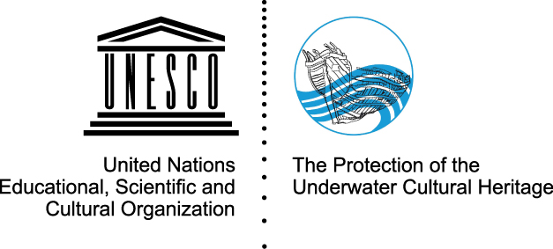
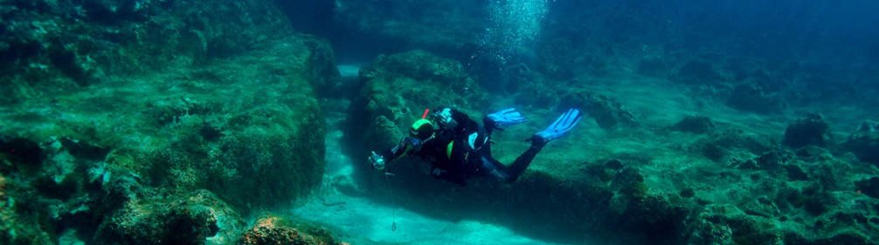
Underwater Cultural Heritage
Scope, threats and challenges, and the potentials for the European States

Slide 2
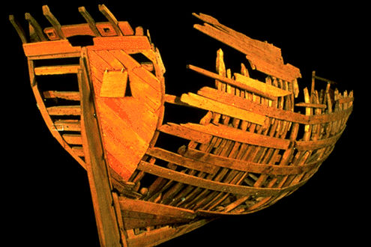
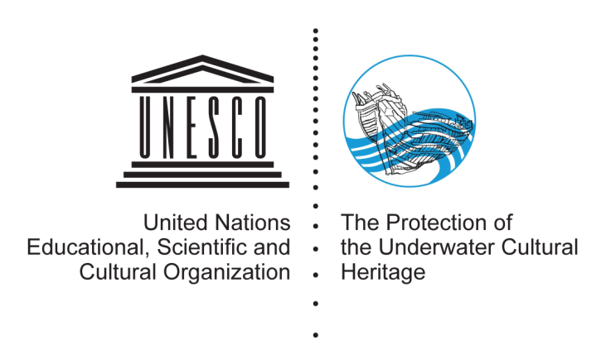
An example case: The San Juan Shipwreck
Excavated 30 years ago
Proves whaling industry history and connection Canada – Basque Country
High cultural importance for both countries, surprising historical information
Inscribed in World Heritage, Logo of 2001 Convention
Now replica in construction
Major factor in election of San Sebastian as cultural capital of Europe
Major factor for identity, education and employment

Slide 3
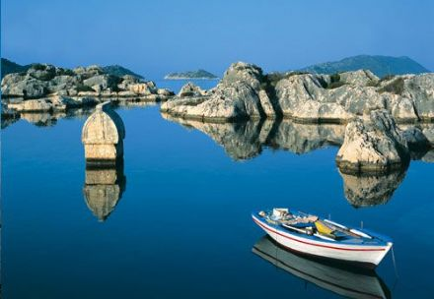
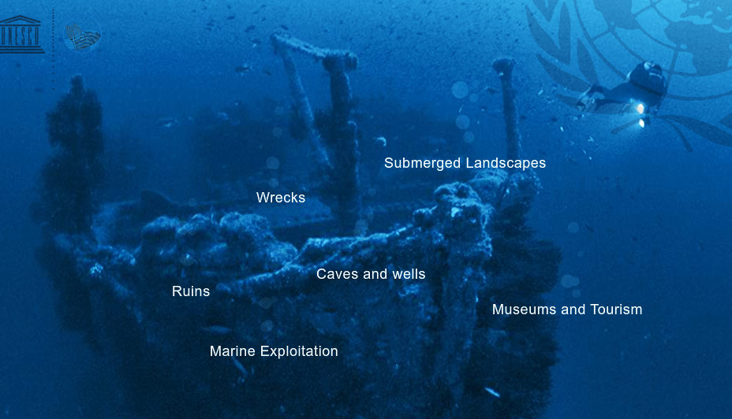
underwater cultural heritage
3 Million ancient shipwrecks (Titanic, Mary Rose, Vasa)
Hundreds of sunken cities (150 in Mediterranean alone)
Submerged landscapes with prehistoric finds (Doggerland, Black Sea)
Flooded caves with prehistoric paintings, sacrificial sites, graves (Cenotes)
Remains of fishing installations and ports

Slide 4
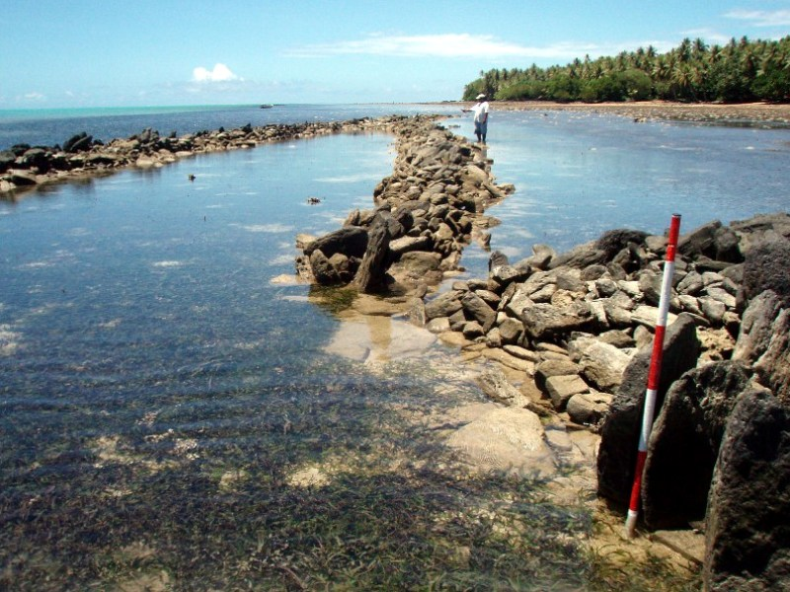
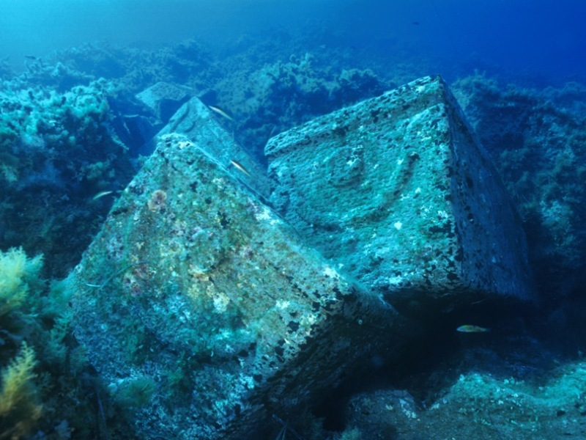
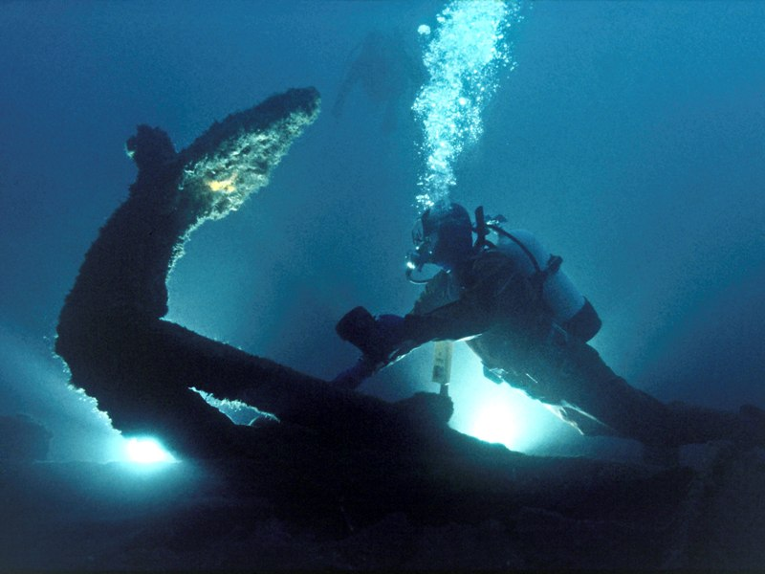
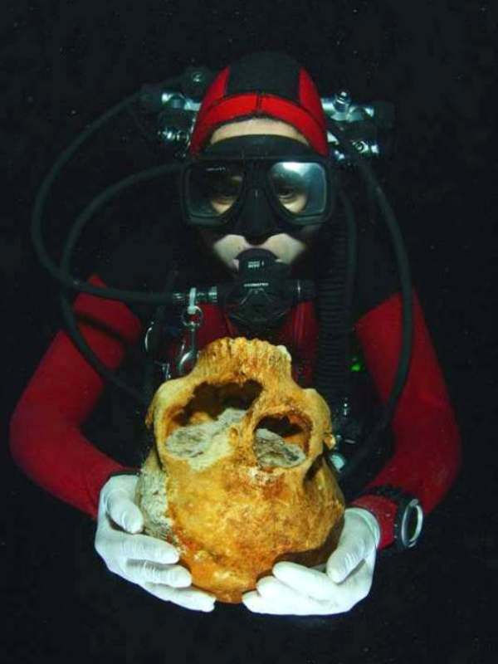
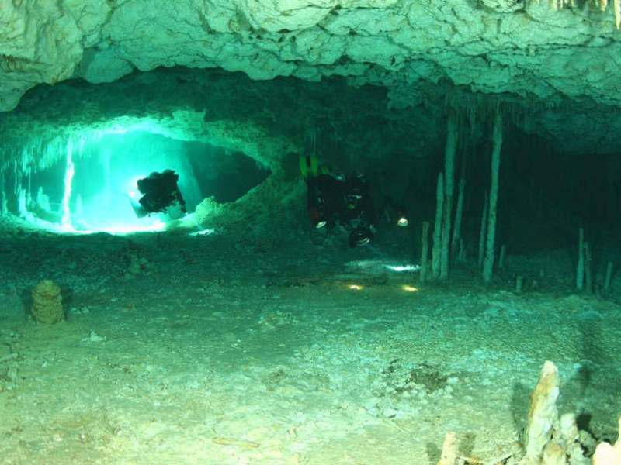
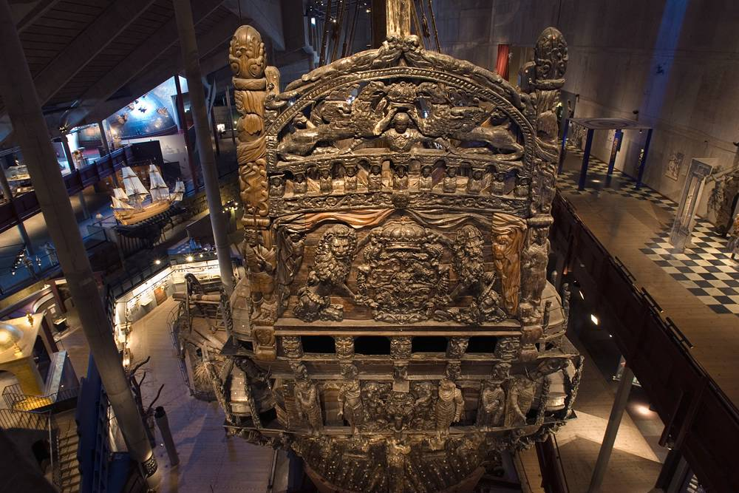
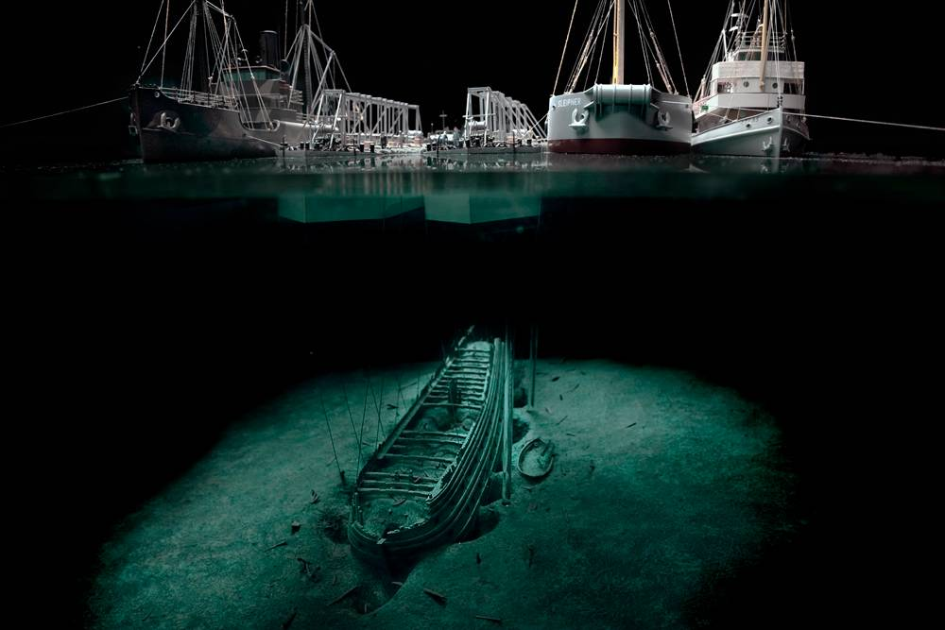
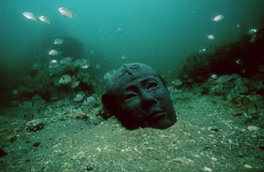
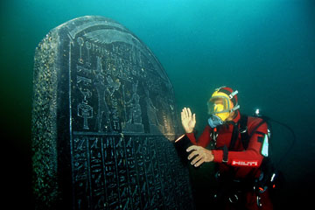

Slide 5
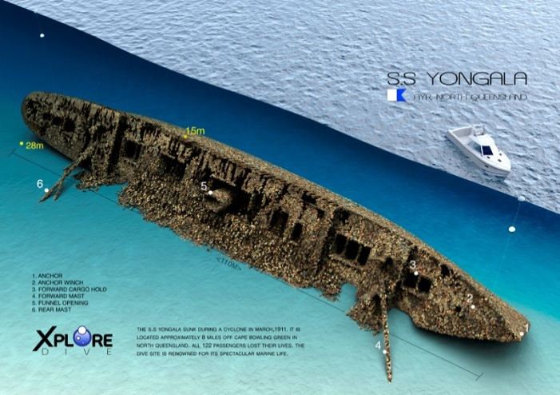
The Potential of Underwater Heritage

Slide 6
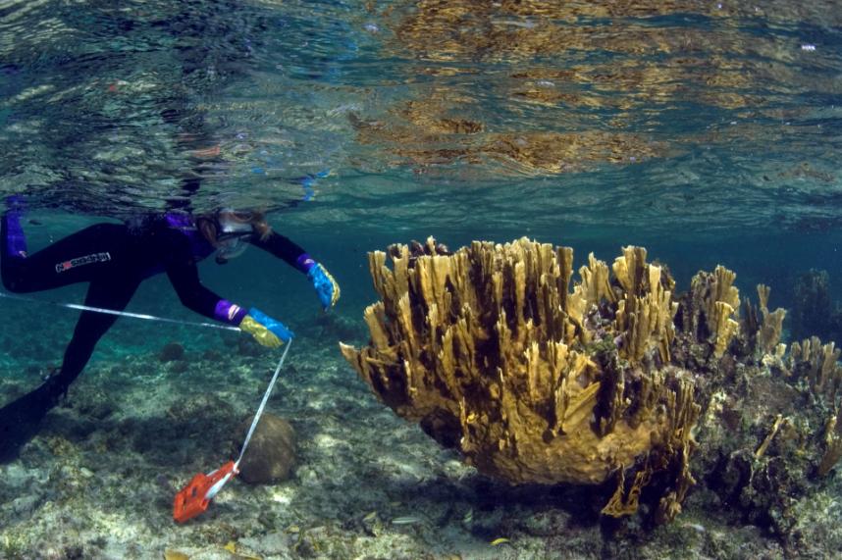
the importance for Europe
Why do you call this planet ‘earth’,
when it is actually ‘water’?
Thousands of ancient shipwrecks
Ancient trade routes crossed to, from and in Europe
Numerous sunken cities and ports
Sunken heritage in caves
Lake and well offerings
Many prehistoric sites and landscapes

Slide 7
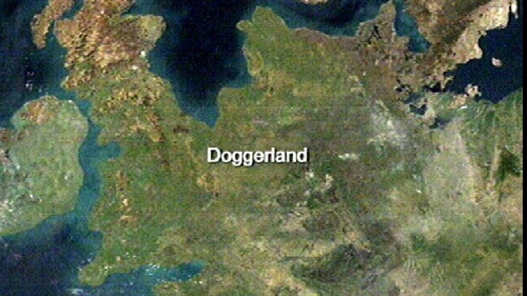
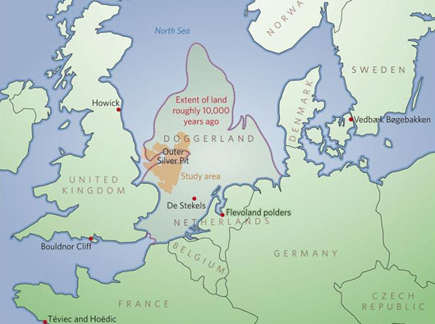
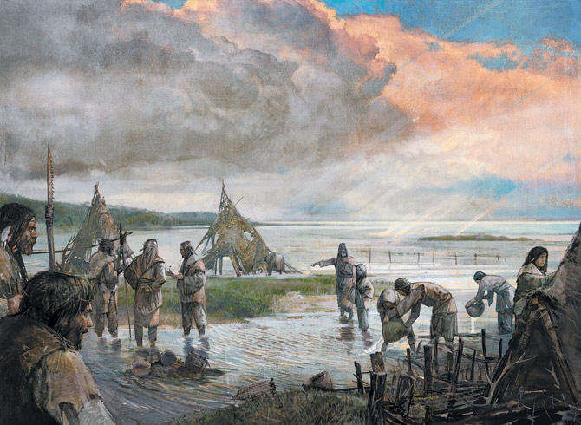
Submerged Europe

Slide 8
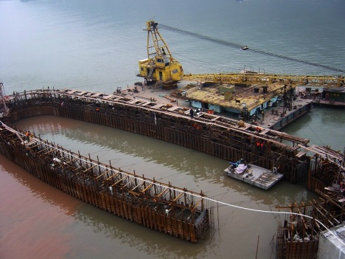
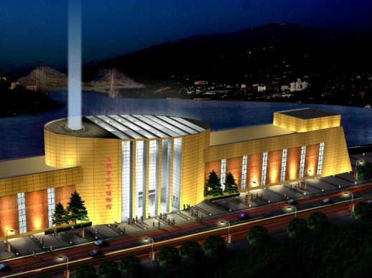
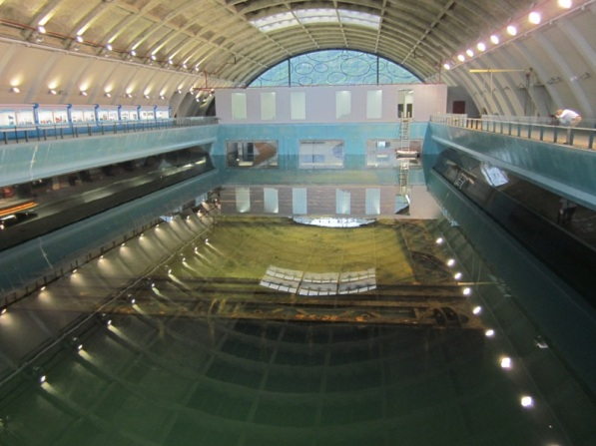
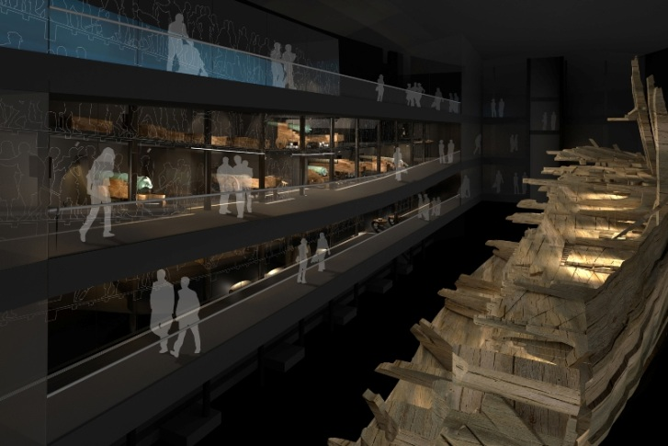
Factor for
Scientific research
Education
Local pride & community identification
Urban development
Tourism

Slide 9
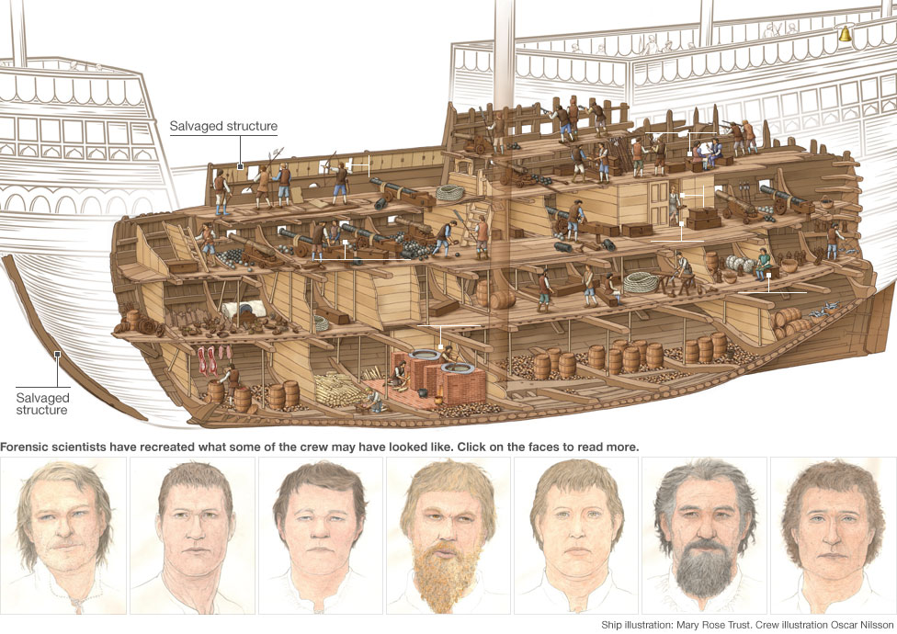
Scientific research
Shipwreck as time-capsule
Very rich and varied sites
Especially good conservation
of biological material

Slide 10
Comparison: Land versus waterlogged
Sigtuna 11th century
Land finds
Birka 8-10th century
Waterlogged finds

Slide 11
Education
Information on maritime past
Shipwreck or submersion of city as local catastrophic event
Strong community importance
Connector with other regions of the world

Slide 12
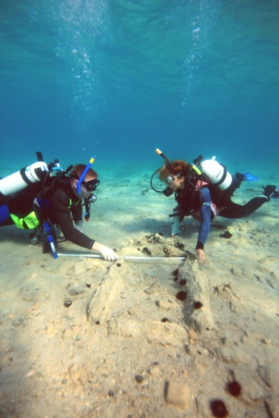
Tourism and Urban Development
Heritage belongs to humanity
Responsible public access is encouraged
  Dive trails
  Glass-bottom boat visits
  Underwater Museums
  Land-based Museums on UCH
  Aquarium museums
Side benefit:
every Euro invested in heritage increases the economic activity around a site by up to 12, depending on the significance of the site and the extent of development.
particularly in the sector of tourism (hotels, food sales, transport, guides).
37 % of all tourism is culture related. Divers spent more money and stay longer.

Slide 13

Dive trail Yongala, Australia
Shipwreck site with dive trail, water-proof maps and land-based museum with authentic artefacts

Slide 14
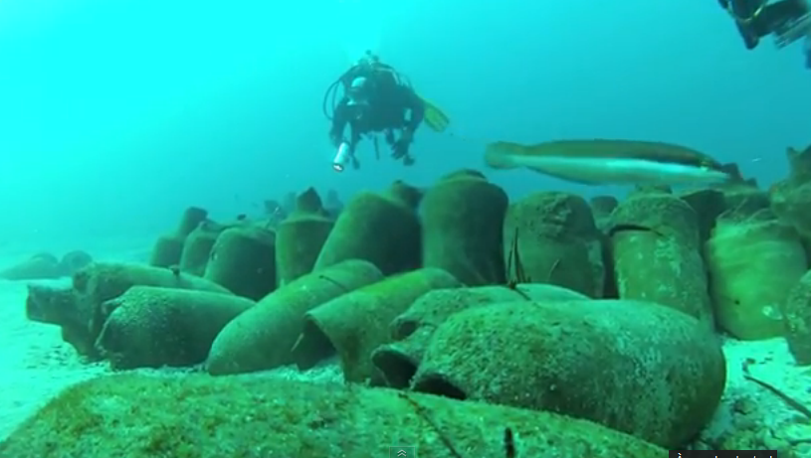
France Demi-Replica site
dive over the amphorae discovered by Jacques Cousteau in 1950 and returned to a semi-authentic site in 2011.

Slide 15
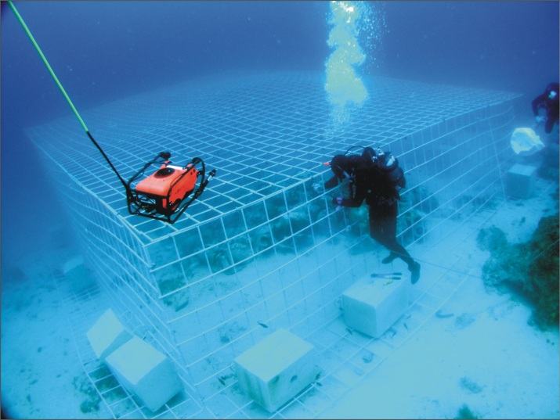
Croatia Metal Cage Protection
Metal Cage protect fragile sites
Remain accessible with keys
Contract with trusted dive center
Payment of licence fee
finances site protection and research

Slide 16
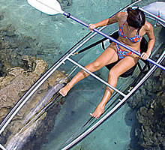

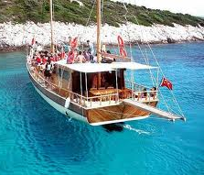
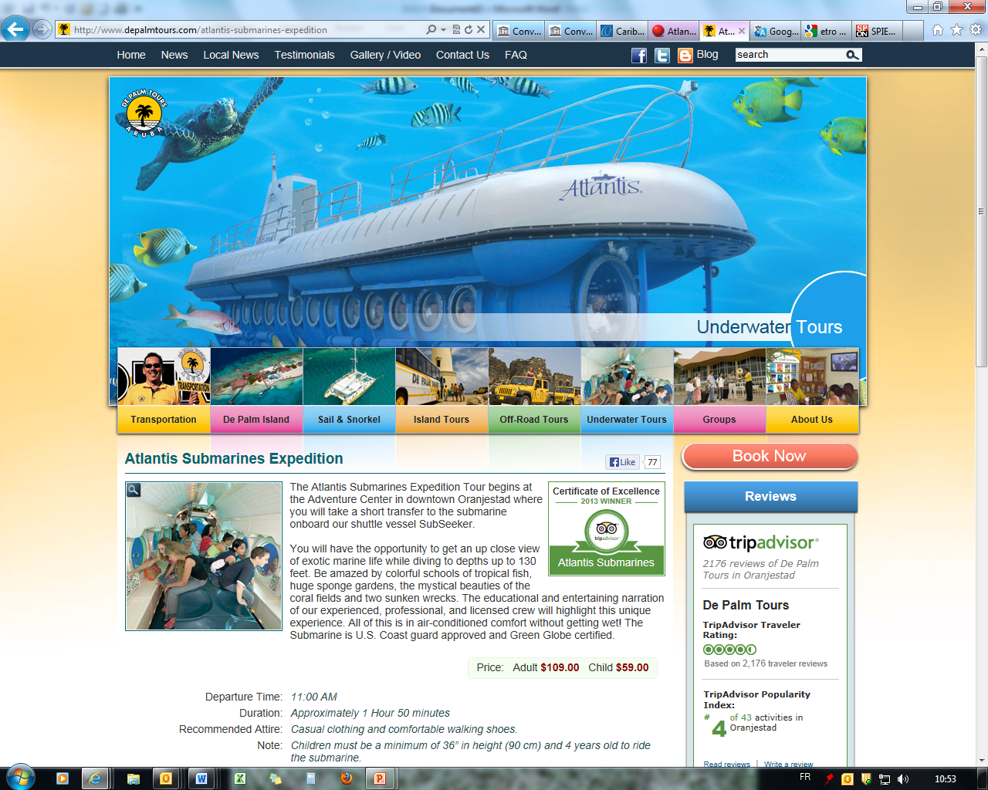
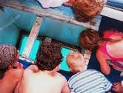
Dry-footed access
Access by glass-bottom boat, submarine or glass canoe
Impressive underwater museums, aquarium museums and land-based
museums

Slide 17
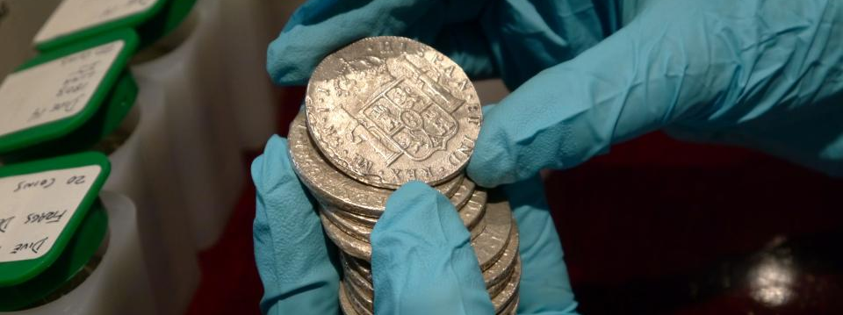
Threats to Underwater Cultural Heritage

Slide 18
Pillage & Commercial exploitation
Looting by divers
Industrial work
  Tourist promenades
  Oil drilling
  Metro and auto-route crossing in channels or with bridges
  Recovery of gravel and sand
  Building of artificial islands
Climate change, pollution
Trawling

Slide 19
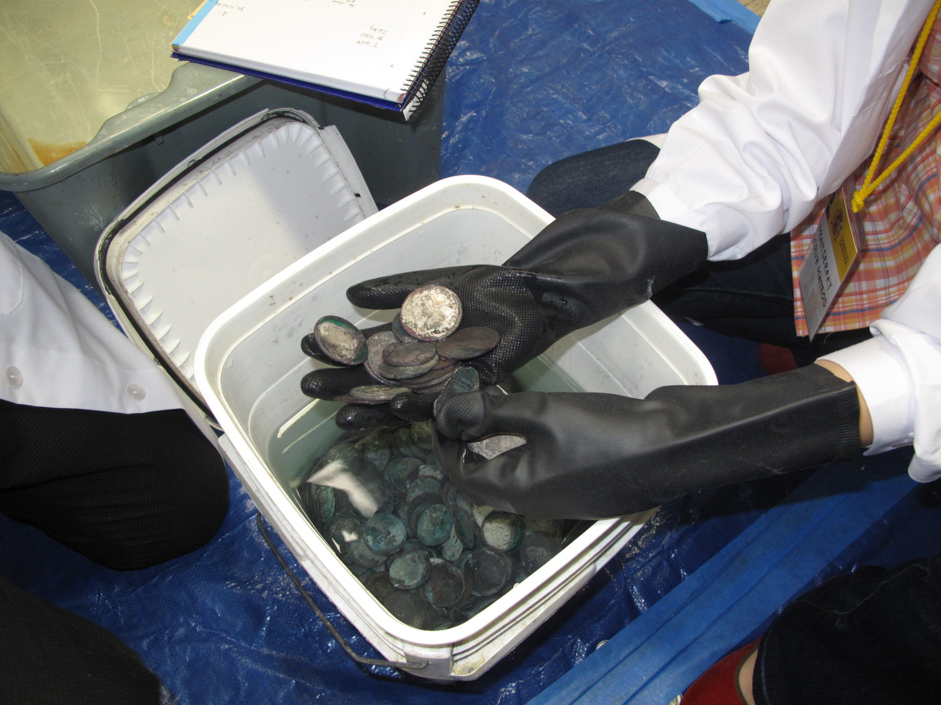
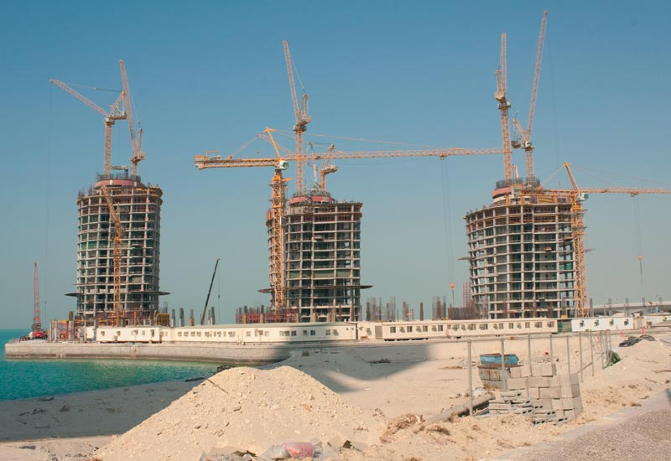
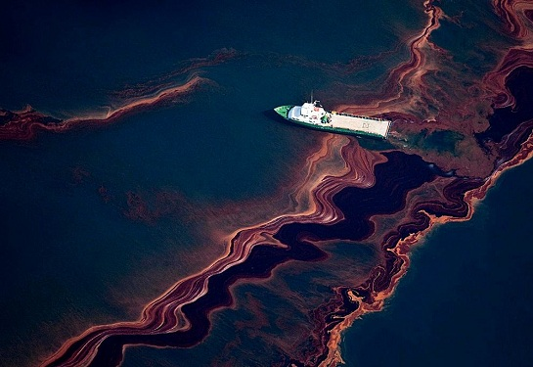
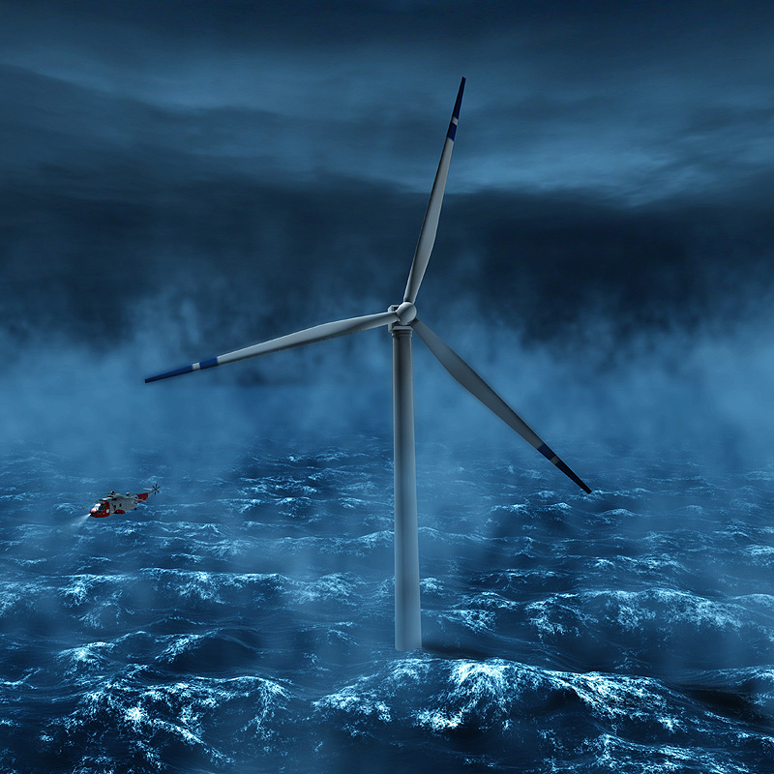
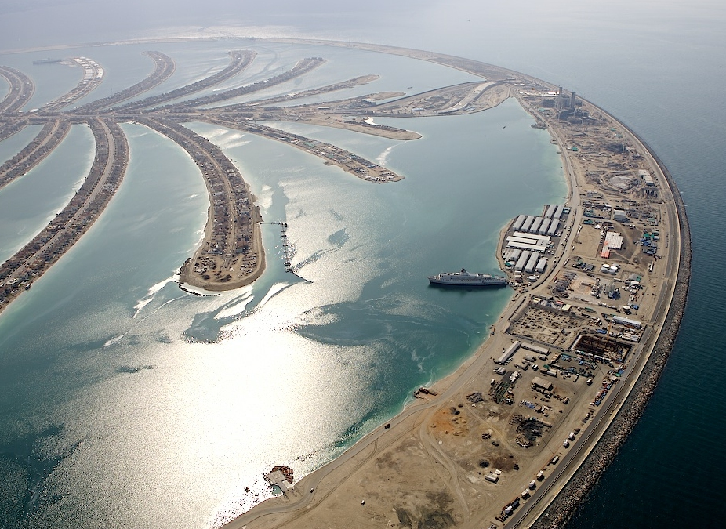
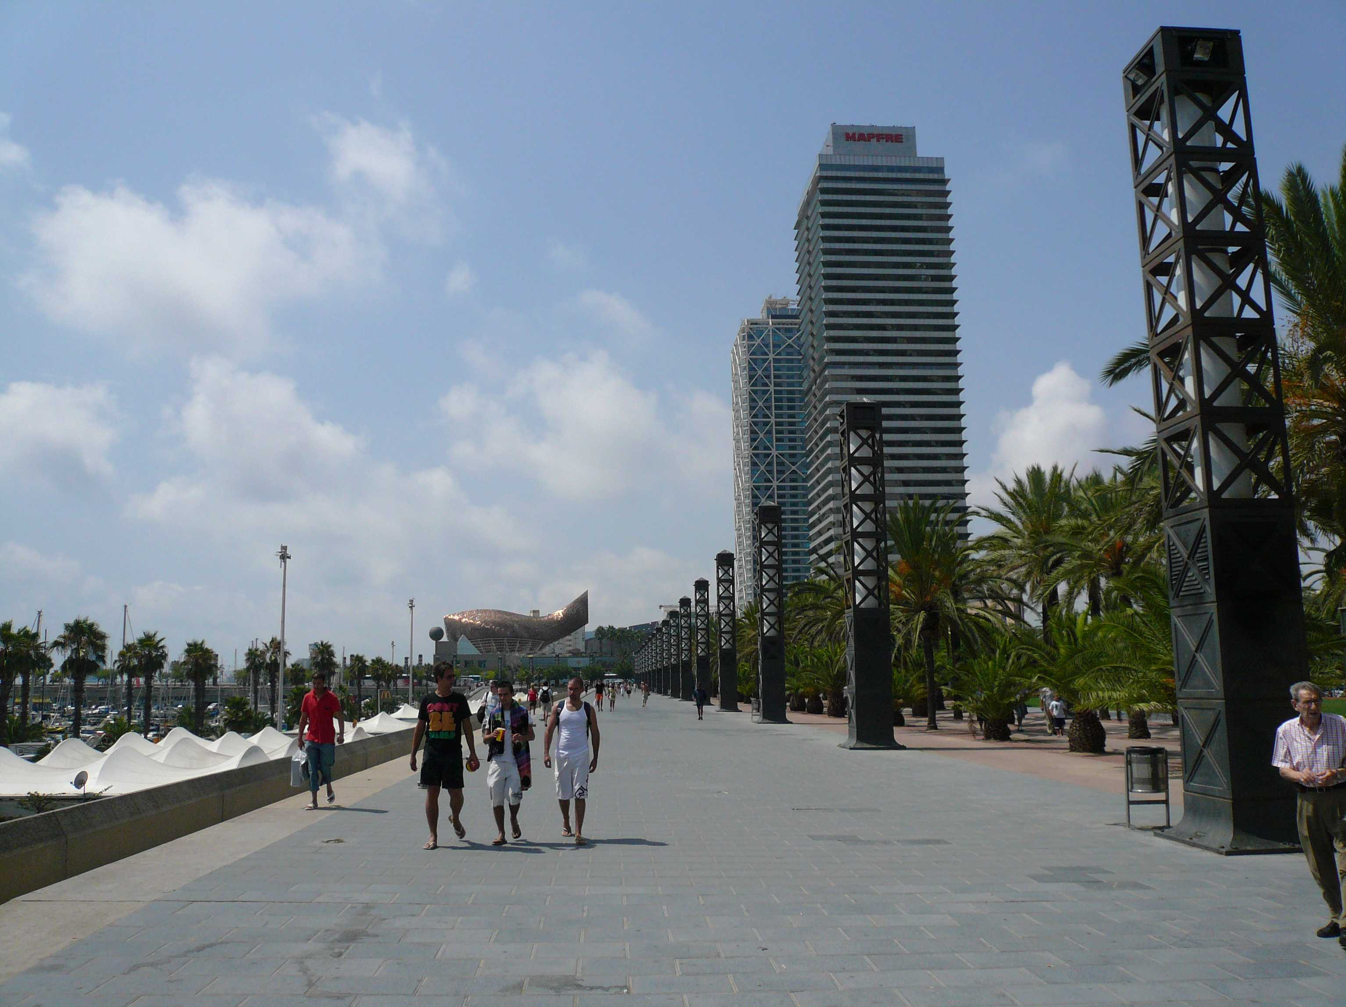
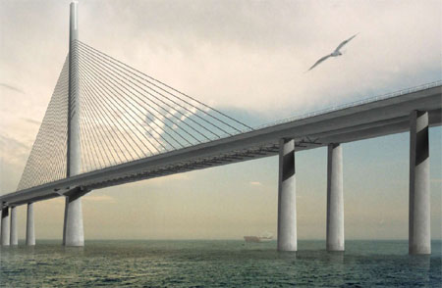

Slide 20
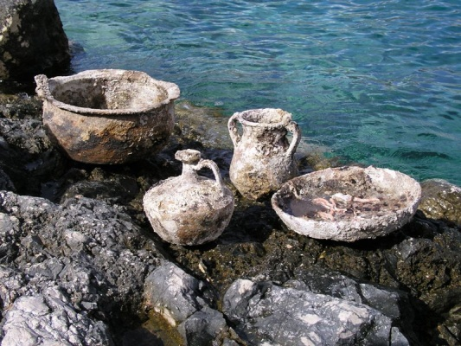
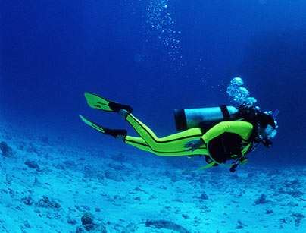
Challenges
Overall issues (and depending on the country):
Legal protection of the underwater heritage
  2001 Convention
  National implementation laws
Building research and protection capacity
Locate & inventory the heritage
Protect sites against pillage and commercial exploitation
Valorise sites and make them accessible
Create public awareness & access offers
Common approach of all States

Slide 21
The 2001 Convention

Slide 22
Convention on the Protection of the Underwater Cultural Heritage
adopted by the UNESCO General Conference in 2001.
international community’s response to destruction of submerged archaeological sites
ensures same protection to underwater heritage as that accorded to land-based heritage.

Slide 23
The Convention:
  provides legal protection in all waters,
  enables States Parties to adopt common approaches to preservation, and
  provides effective professional guidelines on how to deal with and research underwater heritage (Annex).
The Convention:
  forbids pillage and commercial exploitation,
  allows recovery for scientific or public benefit purposes.
  does not regulate ownership or maritime zones.

Slide 24
The Status
Every 2 years Meeting of States Parties at UNESCO.
Scientific and Technical Advisory Body can give guidance and help.
11 accredited NGOs.
Associated with the 5 leading universities in underwater archaeology.
45 States have ratified the Convention until now, many in Europe.
(Belgium, Bulgaria; Croatia; France, Italy; Lithuania; Portugal; Romania; Slovakia; Slovenia; Spain; and Ukraine. Candidates: Montenegro, Albania and Bosnia and Herzegovina)

Slide 25
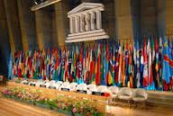
UNESCO’s Work

Slide 26
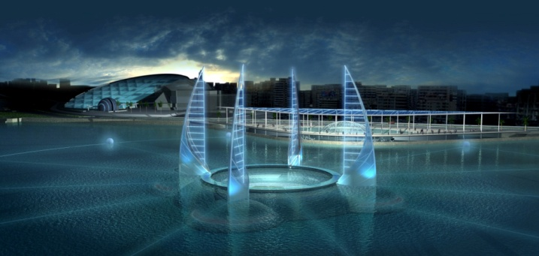
Improvement of law:
2001 Convention
Cultural heritage law database
Law drafting assistance – Model Law available
Scientific Support:
Conferences on UCH and underwater archaeology
Assistance in museum development
Unitwin twins 5 leading universities on underwater archaeology
2011 - Trainings in underwater archaeology and conservation:
trained more than 400 Persons from more than 80 countries since 2007
Training material:
Manual on activities directed at underwater cultural heritage – En, Fr, S
Training course book

Slide 27
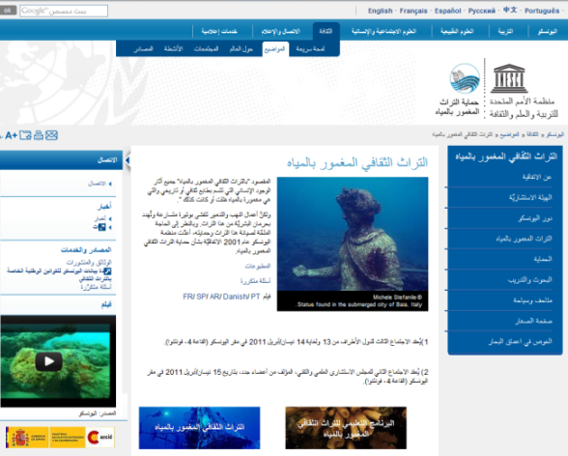
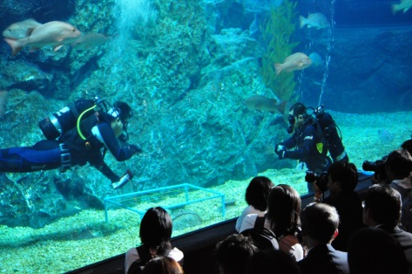
Awareness-raising
Website on underwater cultural heritage
Kids webpage & Children cartoon, Ipad application in preparation
Film on UCH and 2001 Convention
Exhibitions on underwater heritage

Slide 28
Thank you

Slide 29
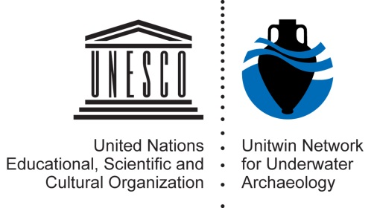
Fostering the research of submerged heritage
Thijs Maarleveld Brussels 23 September 2013

Slide 30
Fostering the research of submerged heritage
- Submerged Prehistory
- Ship remains
- Underwater Cultural Heritage as Resource
Thijs Maarleveld Brussels 23 September 2013

Slide 31
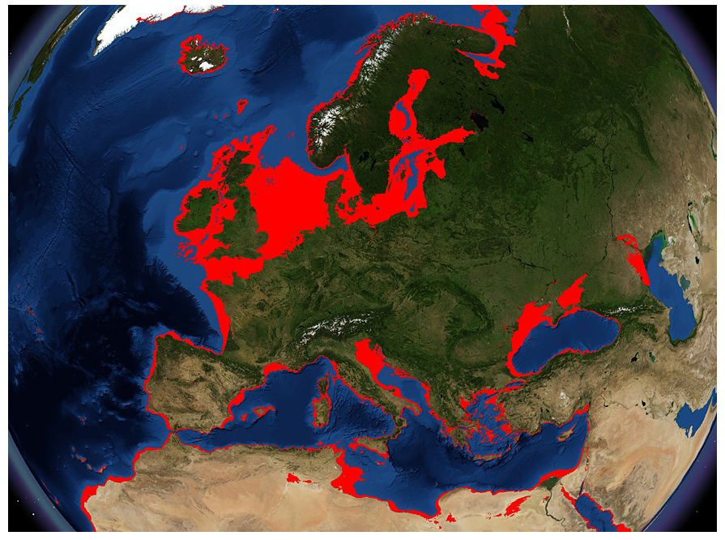
© Simon Fitch
Thijs Maarleveld Brussels 23 September 2013

Slide 32
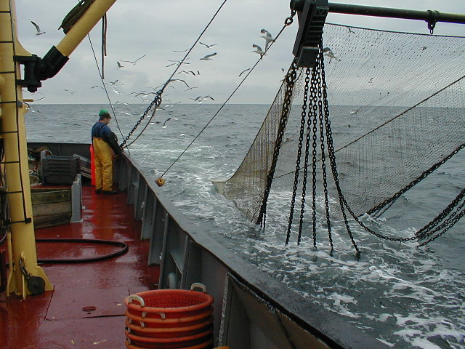
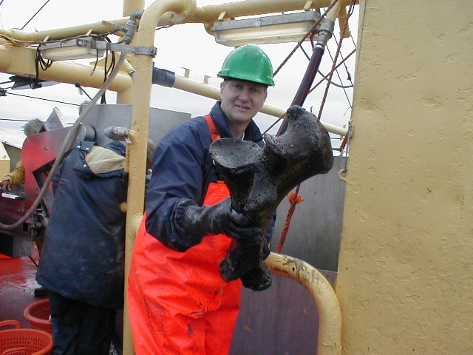



Thijs Maarleveld Brussels 23 September 2013

Slide 33

Thijs Maarleveld Brussels 23 September 2013

Slide 34

Thijs Maarleveld Brussels 23 September 2013

Slide 35

Thijs Maarleveld Brussels 23 September 2013

Slide 36




Thijs Maarleveld Brussels 23 September 2013

Slide 37







Slide 38





Thijs Maarleveld Brussels 23 September 2013

Slide 39

Thijs Maarleveld Brussels 23 September 2013

Slide 40






Slide 42


© MMT
Thijs Maarleveld Brussels 23 September 2013

Slide 43

Thijs Maarleveld Brussels 23 September 2013

Slide 44





Thijs Maarleveld Brussels 23 September 2013

Slide 45


Thijs Maarleveld Brussels 23 September 2013

Slide 46


Thijs Maarleveld Brussels 23 September 2013
© Christian Lemée

Slide 47





Slide 48

Submerged Prehistory
  Climate Change
  Social Change and adaptation under
    catastrophic circumstances or long-term environmental change
  Sustainability
Ship remains
  Technological and comparative economic history
  Understanding Transfer of Technology and Innovation
UCH as Resource
Understanding extent and quality, threats and losses
  Developing management tools and benefits for all
Thijs Maarleveld Brussels 23 September 2013

