Slide 1

Current state of the marine environment in the Pacific Ocean
1. Radioactivity in seawater and marine soil by
Japanese monitoring in 2012
2. Simulation of marine dispersion in the Pacific Ocean
15.Oct. 2012
Masanao NAKANO
Japan Atomic Energy Agency

Slide 2
1. Radioactivity in seawater and marine soil by Japanese monitoring in 2012

Slide 3
Sea Area Monitoring Plan in FY2012
Basic concept of the revision of the monitoring plan is to ascertain
(1) concentration levels mainly for ceasium-134,137 in seawater by enhancing the analysis accuracy,
(2) the spatial distribution and chronological movement of radioactive materials in marine soil and characteristics of marine soil,
(3) the chronological changes in radioactivity concentrations in fishery products with regard to marine organisms.
Furthermore, the monitoring content will be enhanced and strengthened by taking into account not only the routes of radioactive materials discharged into the sea from TEPCO’s Fukushima Dai-ichi NPP but also those of radioactive materials flowing into the sea from the land area via rivers.
When conducting the sea area monitoring, attention will also be paid to the viewpoints of helping the understanding of the movement of radioactive materials from the environment to marine organisms and the bioconcentration process.
http://radioactivity.mext.go.jp/en/contents/5000/4854/view.html

Slide 4
Five sea areas
(i) Sea area close to TEPCO’s Fukushima Dai-ichi NPP: The area near the 1F-NPP requiring close watch
(ii) Coastal area: The area within about 30 km from the coastline of Aomori (only partially), Iwate to Miyagi, Fukushima and Ibaraki prefectures (including river outlets)
(iii) Off-shore area: The area within about 30 to 90 km from the coastline
(iv) Outer sea area: The area within about 90 to 280 km and 280 km or farther from the coastline
(v) Tokyo Bay: The closed sea area where radioactive materials are highly likely to flow in from rivers and be deposited in particular
(ii)
(iii)
(i)
(iv)
(v)
http://radioactivity.mext.go.jp/en/contents/5000/4854/view.html

Slide 5
Seawater
In area(i), high frequency (dairy) monitoring with the aim of checking any new leakage of radioactive materials from the NPP with detection limit(DL) at 1 Bq/L. TEPCO will be in charge of this monitoring.
In areas (ii)-(v), monitoring by lowering detection limits according to sea areas for the purpose of scientifically ascertaining long-term effects with DL at 1 mBq/L. Mainly MEXT will be in charge of this monitoring.
Main objective nuclides are Cs-134,137, but sometimes H-3, Sr-89,90, I-131, Pu-238,239,240 etc. will be analyzed.
* http://radioactivity.mext.go.jp/en/contents/5000/4854/view.html

Slide 6
Marine soil
Measuring points will be determined by taking into consideration river outlets and fishing grounds in order to understand the flow and movement of radioactive materials into the sea via rivers.
In area(i) and part of (ii), monthly measurement for I-131 and Cs-134,137 are conducted with DL at 10 Bq/kg.
The other areas except (iv), lower frequency measurement are conducted with DL at 1 Bq/kg .
* http://radioactivity.mext.go.jp/en/contents/5000/4854/view.html

Slide 7

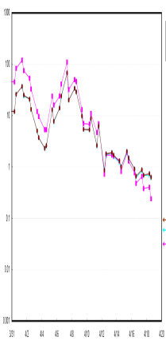
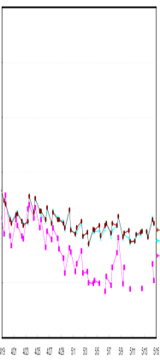
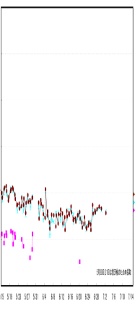
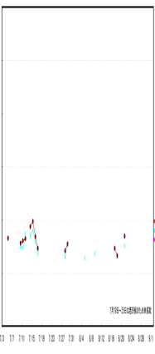
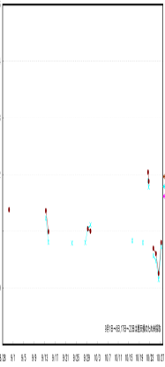
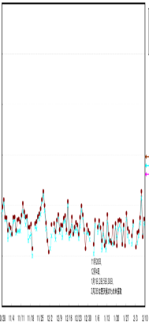
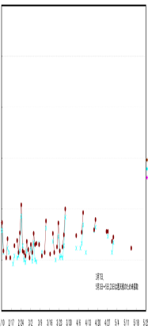
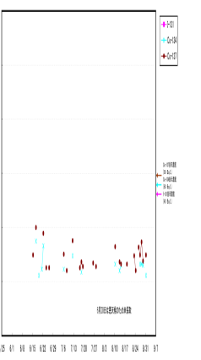
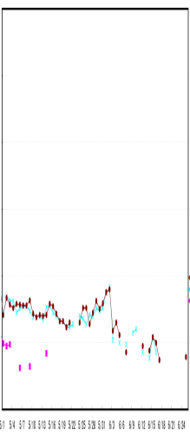
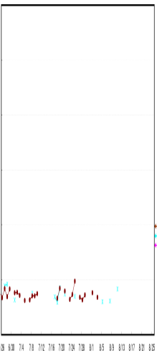
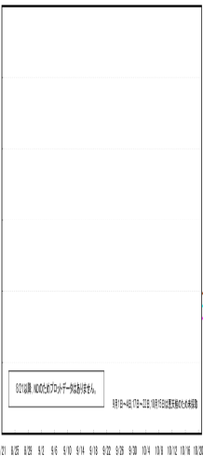
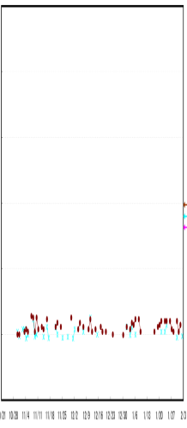
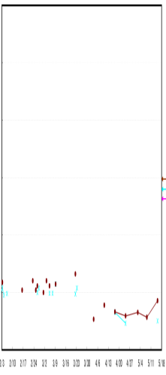
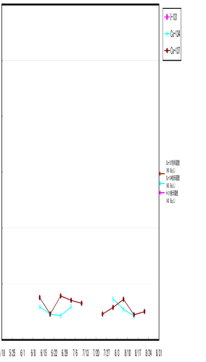
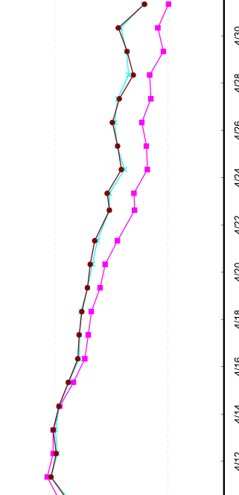

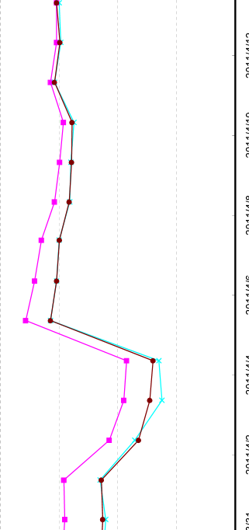
Seawater in area (i)*
(Bq/L)
Northern Side of the Water Discharge Canal of 5 and 6
1,000,000
100,000
10,000
1,000
100
10
1
0.1
2011
2012
：I-131
：Cs-134
：Cs-137
Max:68,000Bq/L(2011.4.7)
1~10Bq/L
3 4 5 6 7 8 9 10 11 12 1 2 3 4 5 6 7 8
(Bq/L)
Iwasawa coast (15km south of 1F-NPP)
10,000
1,000
100
10
1
0.1
2011
Max:1,400Bq/L(2011.4.5)
2012
：I-131
：Cs-134
：Cs-137
0.1~1Bq/L
3 4 5 6 7 8 9 10 11 12 1 2 3 4 5 6 7 8
BG level for ¹³⁷Cs before the accident=0.001~0.002 Bq/L
* http://www.tepco.co.jp/en/nu/fukushima-np/f1/index9-e.html

Slide 8
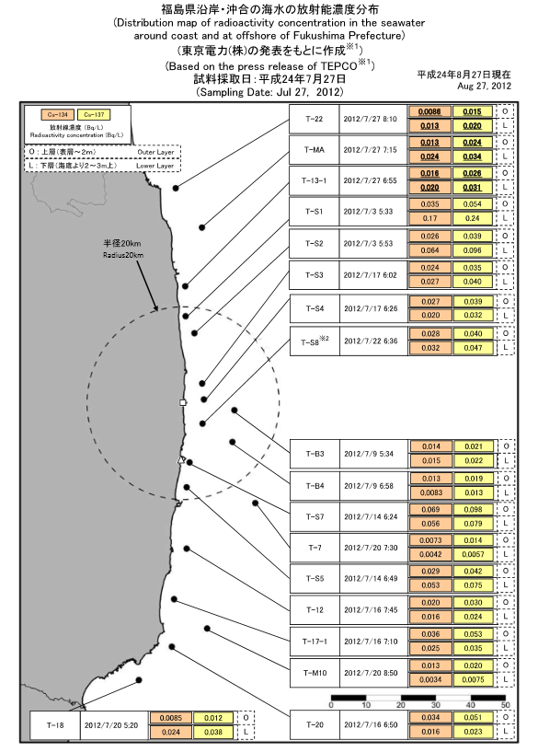
Seawater in area (ii)
(Bq/L)
2012 | Cs-134 | Cs-137
Miyagi (27,June) | ND~0.022 | 0.0017~0.032
Fukushima (27, July) | 0.0034~0.069 | 0.0057~0.098
Ibaraki (6-9, August) | ND(<1.1) | ND(<1.1)
0.05＞
0.01～0.05
＜0.01
(Bq/L)
river
20km
In Fukushima prefecture,
North ＜ South
But less than 0.1 Bq/L
river
http://radioactivity.mext.go.jp/ja/contents/7000/6107/24/229_m_0831.pdf
http://radioactivity.mext.go.jp/ja/contents/7000/6069/24/229_F_0727_0827.pdf
http://radioactivity.mext.go.jp/ja/contents/6000/5979/24/229_3_120815.pdf

Slide 9
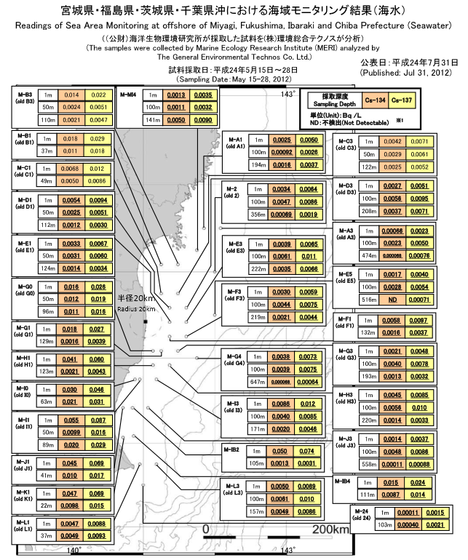
Seawater in area (iii)
(Bq/L)
15-28, May, 2012 | Cs-134 | Cs-137
Miyagi | ~0.018 | ~0.029
Fukushima | ~0.041 | ~0.060
Ibaraki | ~0.055 | ~0.087
0.05＞
0.01～0.05
＜0.01
(Bq/L)
In 3 prefectures,
North ＜ South
Less than 0.1 Bq/L
Miyagi
Deep sea
(Bq/L)
Fukushima
15-28, May, 2012 | Cs-134 | Cs-137
Miyagi(474m) | 0.000068 | 0.00076
Fukushima (516m, 647m) | ND ~0.000068 | 0.00064 ~0.00071
Ibaraki(558m) | 0.00011 | 0.00088
Ibaraki
Cs-137=BG level
Cs-134=1/10 of Cs-137
http://radioactivity.mext.go.jp/ja/contents/6000/5876/24/229_mhic_0731.pdf

Slide 10
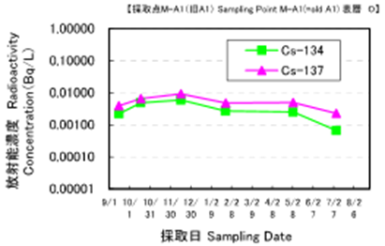
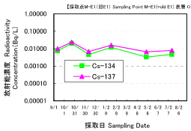
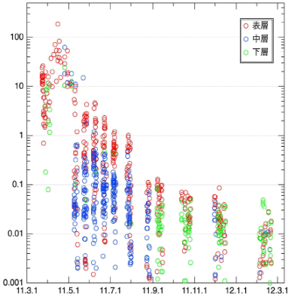
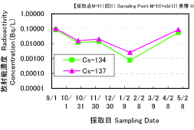
Trend of seawater in area (iii)
Concentration of Cs-137 had been decreasing till last September. But since then,
unchanged in Miyagi and Fukushima,
Fluctuated in Ibaraki, depending on desorption from marine soil? Inflow from river? Release from NPP?
Miyagi (M-A1 O)
Surface
Middle
Lower
Fukushima (M-E1 O)
Cs-137 concentration (Bq/L)
Ibaraki (M-I1 O)
May,2012
http://www.mext.go.jp/b_menu/shingi/chousa/gijyutu/019/shiryo/__icsFiles/afieldfile/2012/08/07/1324368_6_1.pdf (in Japanese)
http://radioactivity.mext.go.jp/ja/contents/6000/5876/24/229_mhic_0731.pdf

Slide 11
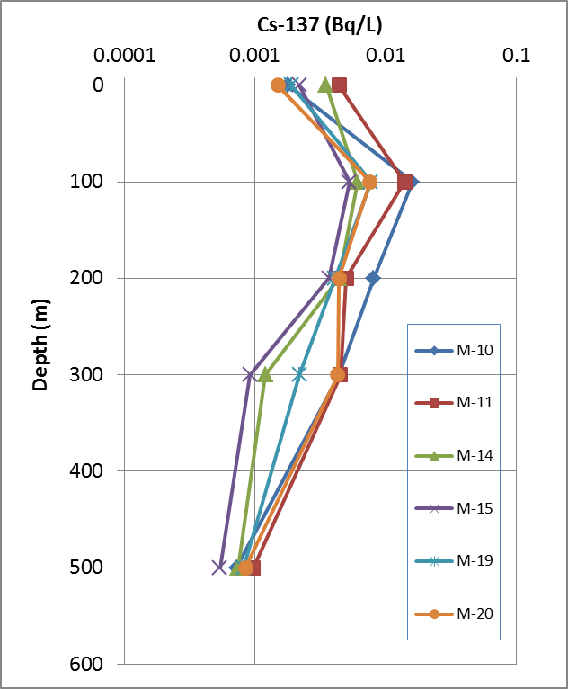
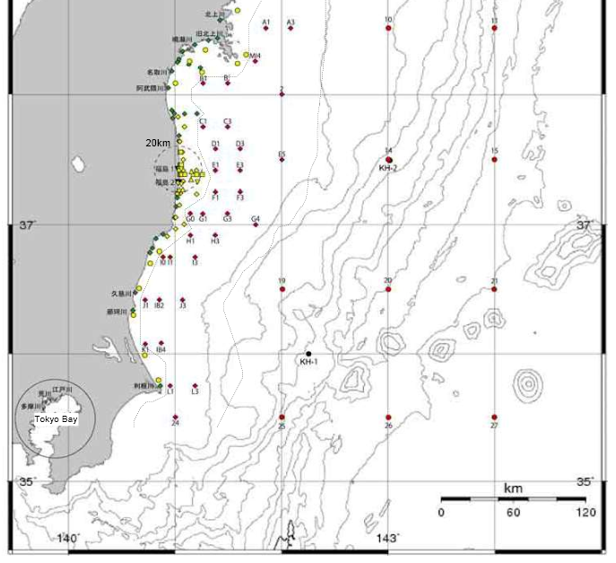
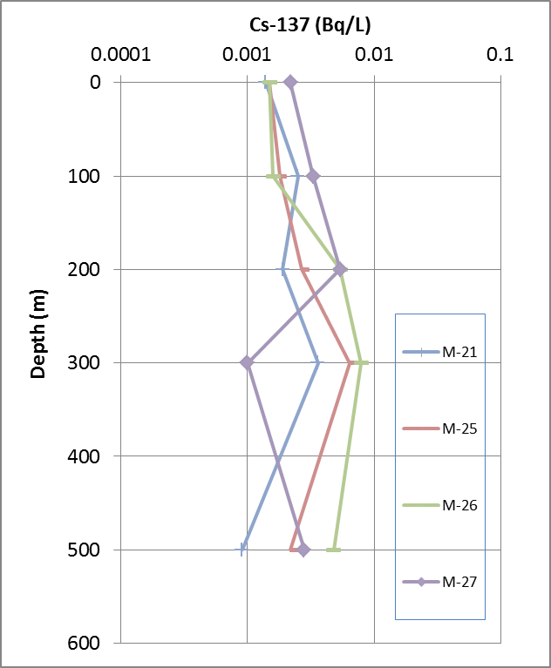
Seawater in area (iv)
Oyashio region
Maximum: 100m depth
90-280km
Nov.2011
May.2012
0.05＞
0.01～0.05
＜0.01
(Bq/L)
Oyashio
May.2012
Kuroshio region
Maximum: unclear
Oyashio
(Cold )
^{134, 137}Cs
Kuroshio
(Warm )
Kuroshio
http://radioactivity.mext.go.jp/ja/contents/4000/3806/24/1330_012414.pdf
http://radioactivity.mext.go.jp/ja/contents/7000/6124/24/229_mfic_0903.pdf
May.2012

Slide 12
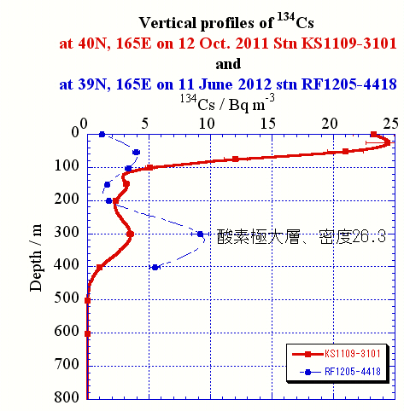
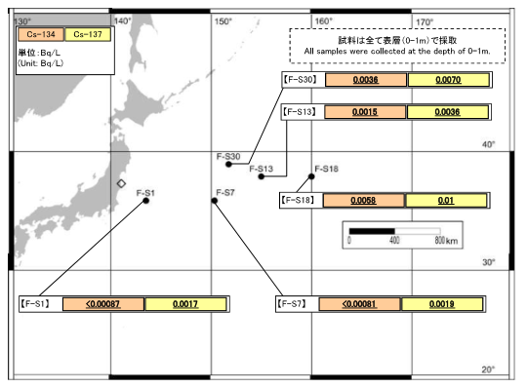
Seawater in area (iv)
280km~
0.05＞
0.01～0.05
＜0.01
(Bq/L)
Oxygen maximum
By Aoyama, MRI
In May 2012:Less than 0.01 Bq/L
Surface seawater
Oct 2011: 0.025 Bq/L
June 2012: 0.001Bq/L
http://radioactivity.mext.go.jp/ja/contents/6000/5889/24/229_g_0802.pdf
http://www.mri-jma.go.jp/Topics/hotyouhi/houtyouhi_sea.html (in Japanese)

Slide 13
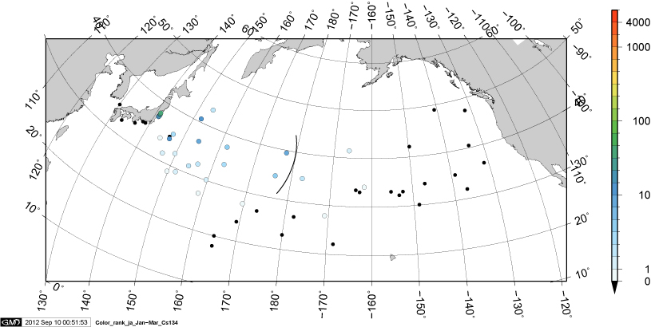
¹³⁴Cs in surface water in Jan. – Mar. 2012
Data sources: MEXT monitoring, Aoyama this study
Solid circle with color: observed data unit: Bq m⁻³
0.01Bq/L
=10 Bq m⁻³
Aoyama, unpublished

Slide 14
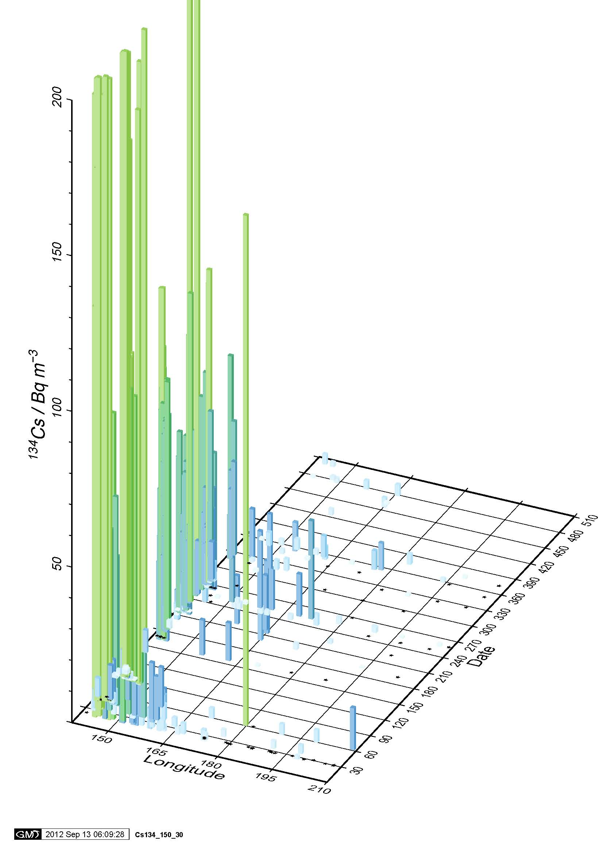
Eastward movement of observed Fukushima
origin ¹³⁴Cs in surface water
during the period from March 2011 to July 2012
Estimated speed ：8 cm s⁻¹
1800km (140E->160E) 270 days
This is consistent with 4-16 cm s⁻¹
Days since 1 March 2011
150 E
150W
Aoyama, unpublished

Slide 15
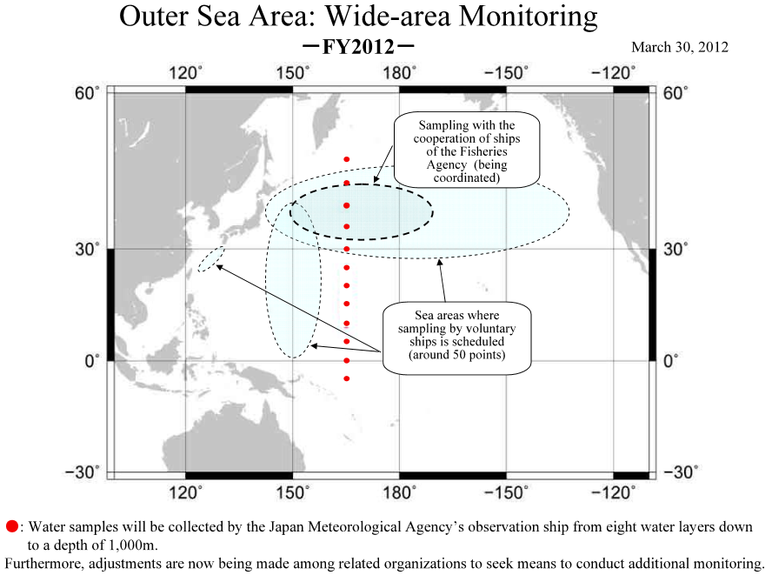
More data in area (iv) in near future
Seawater samples collected during June 2012 by MRI are analyzing now.
Only data from two stations at 39 deg.N and 35 deg. N along 165 deg. E are available.
http://radioactivity.mext.go.jp/en/contents/5000/4854/view.html

Slide 16
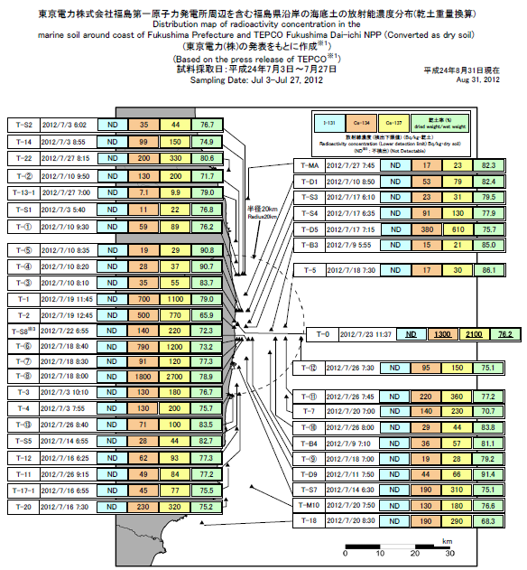
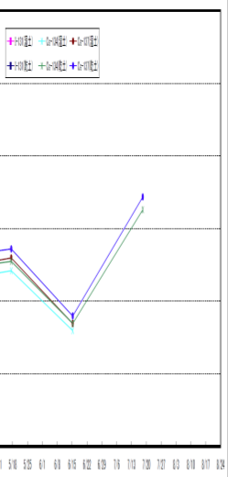
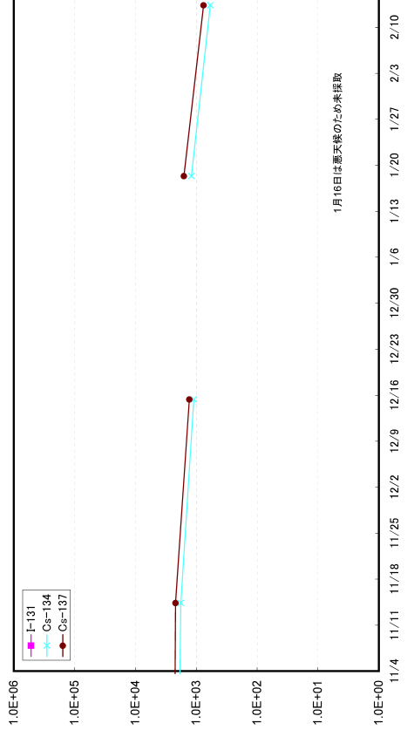
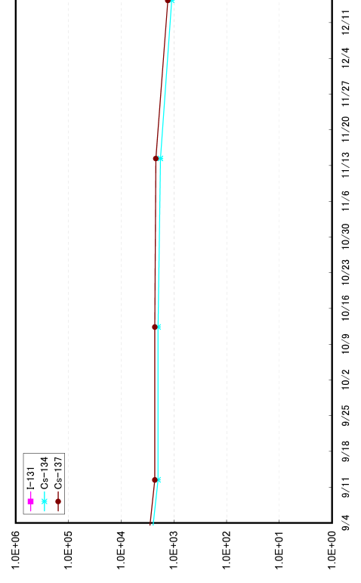
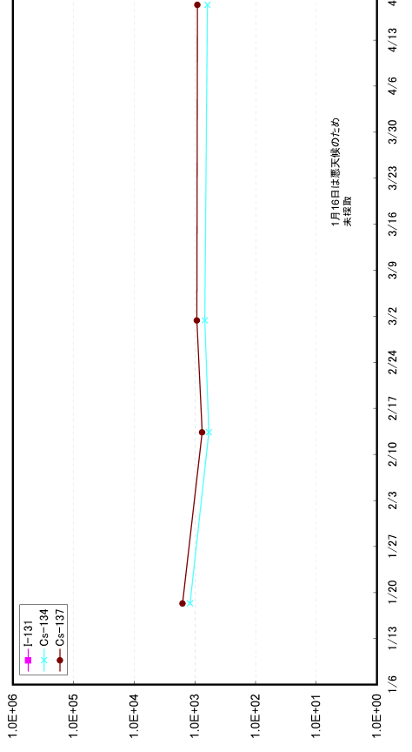
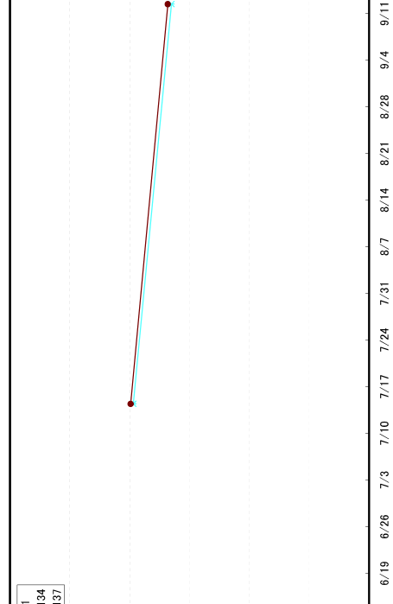
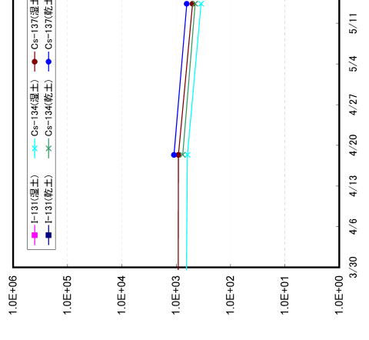

Marine soil in area (i)(ii)
Northern Side of the Water Discharge Canal of 5 and 6
(Bq/kg)
1E6
1E5
1E4
1000
100
10
1
＞1000
100～1000
10～100
＜10
2011
2012
(Bq/kg)
BG:0.8~1.4
7 8 9 10 11 12 1 2 3 4 5 6 7 8
20km
30km
(Bq/kg)
July, 2012 | Cs-134 | Cs-137
~20km | 11~1800 | 21~2700
20~30km | 7.1~140 | 9.9~230
30km~ | 17~230 | 23~330
http://www.tepco.co.jp/nu/fukushima-np/f1/index9-j.html
http://radioactivity.mext.go.jp/ja/contents/7000/6108/24/229_kando_0831.pdf

Slide 17
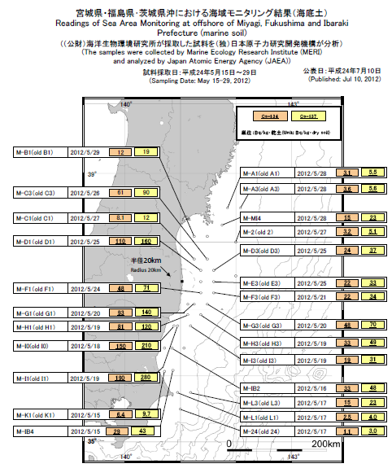
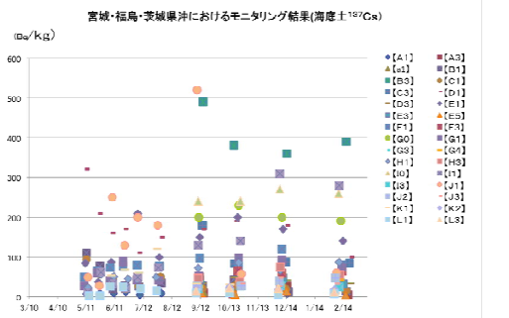
Marine soil in area (iii)
(Bq/kg)
15-29, May, 2012 | Cs-134 | Cs-137
Miyagi | ~15 | ~23
Fukushima | ~110 | ~160
Ibaraki | ~190 | ~280
＞1000
100～1000
10～100
＜10
(Bq/kg)
The concentration in marine soil varied widely, if taken at the same places.
http://www.mext.go.jp/b_menu/shingi/chousa/gijyutu/019/shiryo/__icsFiles/afieldfile/2012/08/07/1324368_6_1.pdf (in Japanese)
http://radioactivity.mext.go.jp/ja/contents/6000/5703/24/229_so_0710.pdf

Slide 18
Current state of Cs-137 in seawater and marine soil in 2012
Area | Seawater (Bq/L) | Marine soil (Bq/kg)
(i) Close to NPP | 1 -10 (discharge ports) 0.1-1 (Iwasawa coast) | 20-3000
(ii) Coastal area | 0.002-0.1 | 10-400
(iii) Off-shore area | BG-0.1 | 10-300
(iv) Outer sea area | BG-0.01 | No data
BG before accident* | 0.0011-0.0018 Offshore 1F NPP in 2010 | 0.8-1.4
(ii)
(iii)
(i)
(iv)
(v)
* http://www.kaiseiken.or.jp/publish/itaku/rep2011.pdf (in Japanese)

Slide 19
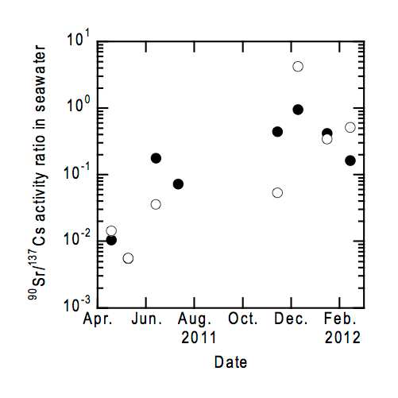
Sr-90 in seawater and marine soil
Near 1F NPP
Seawater: ND~0.15(Bq/L), 100 times of BG(0.001), 0.1 time of ¹³⁷Cs
Marine soil: ND～3.4(Bq/kg), 100 times of BG(0.03), 0.001 time of ¹³⁷Cs
The ratio of ⁹⁰Sr/¹³⁷Cs was increasing, because of leakage of processed(Cs-removed) reactor water?
(Povinec at al., 2012)
Pavel P. Povinec et al., Radiostrontium in the Western North Pacific : Characteristics, Behavior and the Fukushima Impact, Environ. Sci. Technol., Just Accepted Manuscript, DOI: 10.1021/es301997c, (2012)

Slide 20
2. Simulation of marine dispersion in the Pacific Ocean

Slide 21
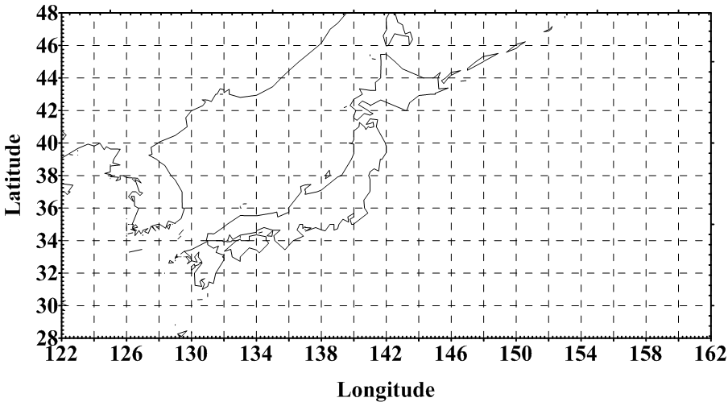
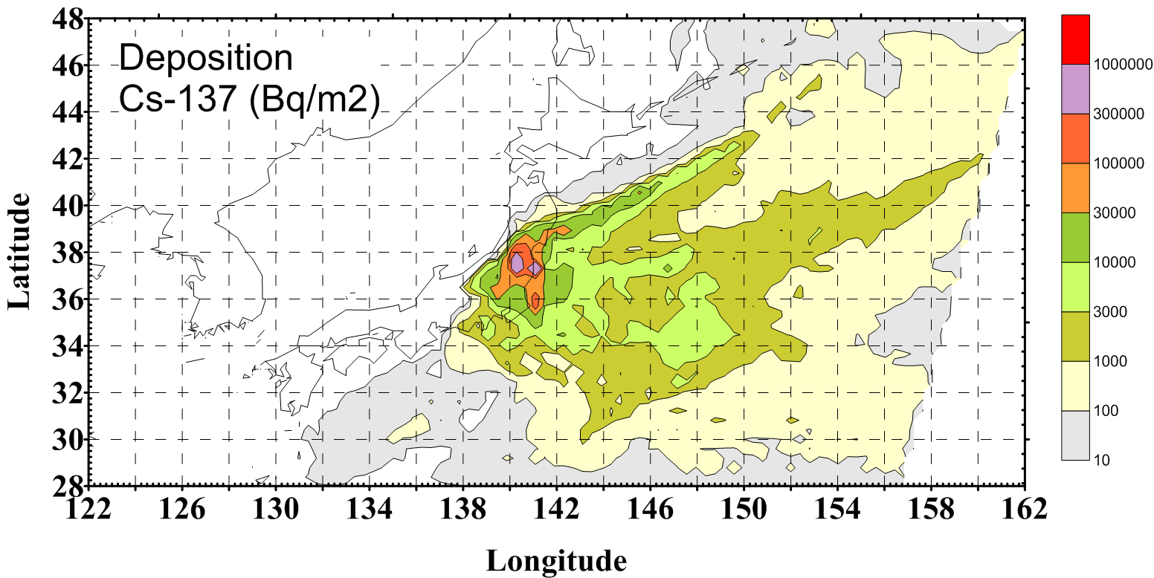
Re-simulation by LAMER
EU meeting in 2011
(Nakano and Povinec, 2012)
15*0.5+(0.94+0.0096)=8.45PBq
8.45PBq(direct)
2PBq(outside of map)
6PBq(deposition to ground)
4PBq(direct)
5PBq(deposition to sea)
EU meeting now
Kawamura et al. (2011)
Nakano and Povinec, Long-term simulations of the 137Cs dispersion from the Fukushima accident in the world ocean, Journal of Environmental Radioactivity 111, 109-115,(2012)
Kawamura et al., Preliminary Numerical Experiments on Oceanic Dispersion of 131I and 137Cs Discharged into the Ocean because of the Fukushima Daiichi Nuclear Power Plant Disaster, Journal of NUCLEAR SCIENCE and TECHNOLOGY, Vol. 48, No. 11, p. 1349–1356 (2011)

Slide 22
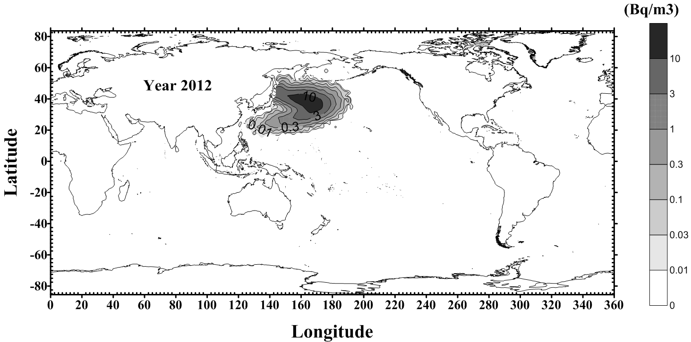
Re-simulation by LAMER
(Nakano and Povinec, 2012)
Almost same movement with the previous calculation with the preliminary source term
Maximum concentration of Cs-137 in April 2012 was calculated as 21 Bq/m³ (=0.021 Bq/L) at 38N, 164E. (23 Bq/m³ by the previous calculation)

Slide 23
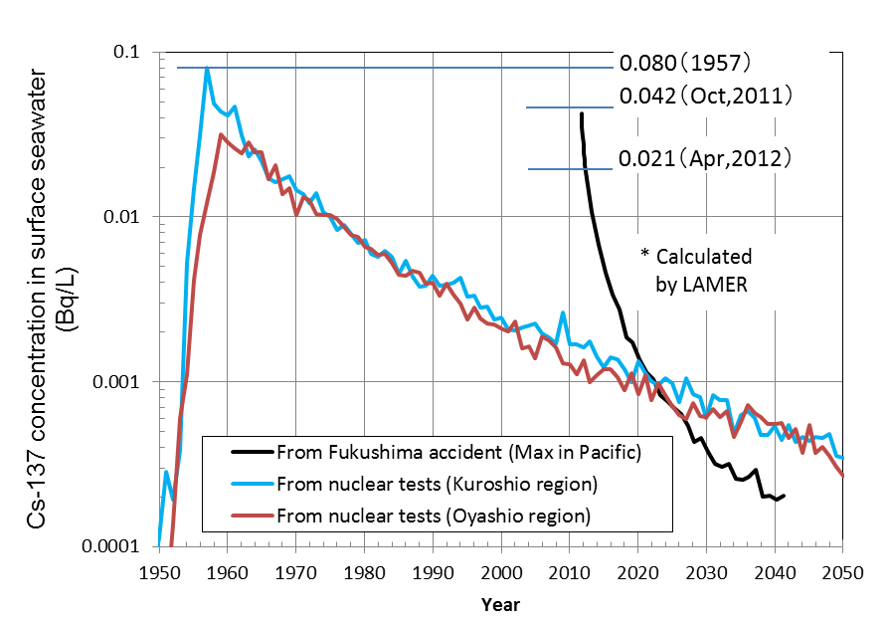
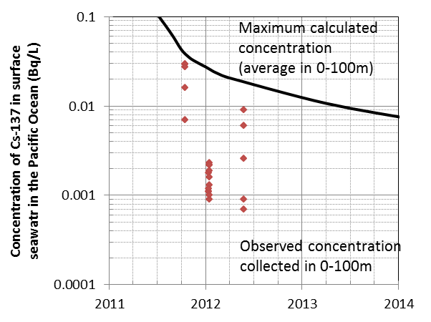
Comparison with the observed concentration in seawater
expand
1mBq/L was reduced as BG contribution
Comparison of Cs-137 concentration in seawater outside 200 nautical mile line
(= 370km) due to Fukushima accident (BG(0.001) was reduced.)
Nakano, unpublished

Slide 24
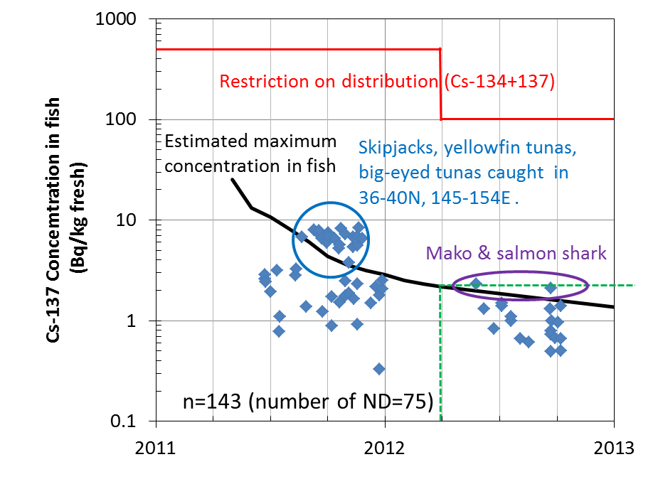
Simulated Cs-137 concentration in fish outside 200 nautical mile line
Simulated max concentration in fish
at equilibrium at time(t)
= Cw(t)* CF(fish)
Cw(t): simulated maximum
concentration in seawater
CF(fish):concentration factor of fish
(=100)
If you take 64-g fish of this concentration (2 Bq/kg) everyday, you will receive 0.62μSv/a from ¹³⁷Cs and 0.80 μSv/a from ¹³⁴Cs .
The observed data was extracted from the website of “http://www.jfa.maff.go.jp/e/inspection/index.html”
Nakano, unpublished

Slide 25
Dose assessment in 2012-2014
Species | Internal dose in 2012 (μSv/a)
 | ⁹⁰Sr | ¹³⁴Cs | ¹³⁷Cs | Total
Fish | 0.0040 | 0.80 | 0.62 | 1.42
Crustaceans | 0.00057 | 0.034 | 0.026 | 0.060
Cephalopods | 0.00023 | 0.0062 | 0.0048 | 0.011
Shellfish | 0.00074 | 0.026 | 0.021 | 0.047
Seaweed | 0.0021 | 0.063 | 0.049 | 0.112
Total | 0.0077 | 0.93 | 0.73 | 1.67
Internal exposure by the intake of the marine products in 2012 would be 1.67 micro Sv per year mainly from ¹³⁴⁺¹³⁷Cs in fish, when adopting the maximum concentration and the averaged Japanese diet.
Internal exposure in 2013 and 2014 would be 0.74 and 0.41 micro Sv per year, respectively.
Because the dose is proportional to the consumption amount of sea food, most public in the world will get lower doses than the Japanese population.
25

Slide 26
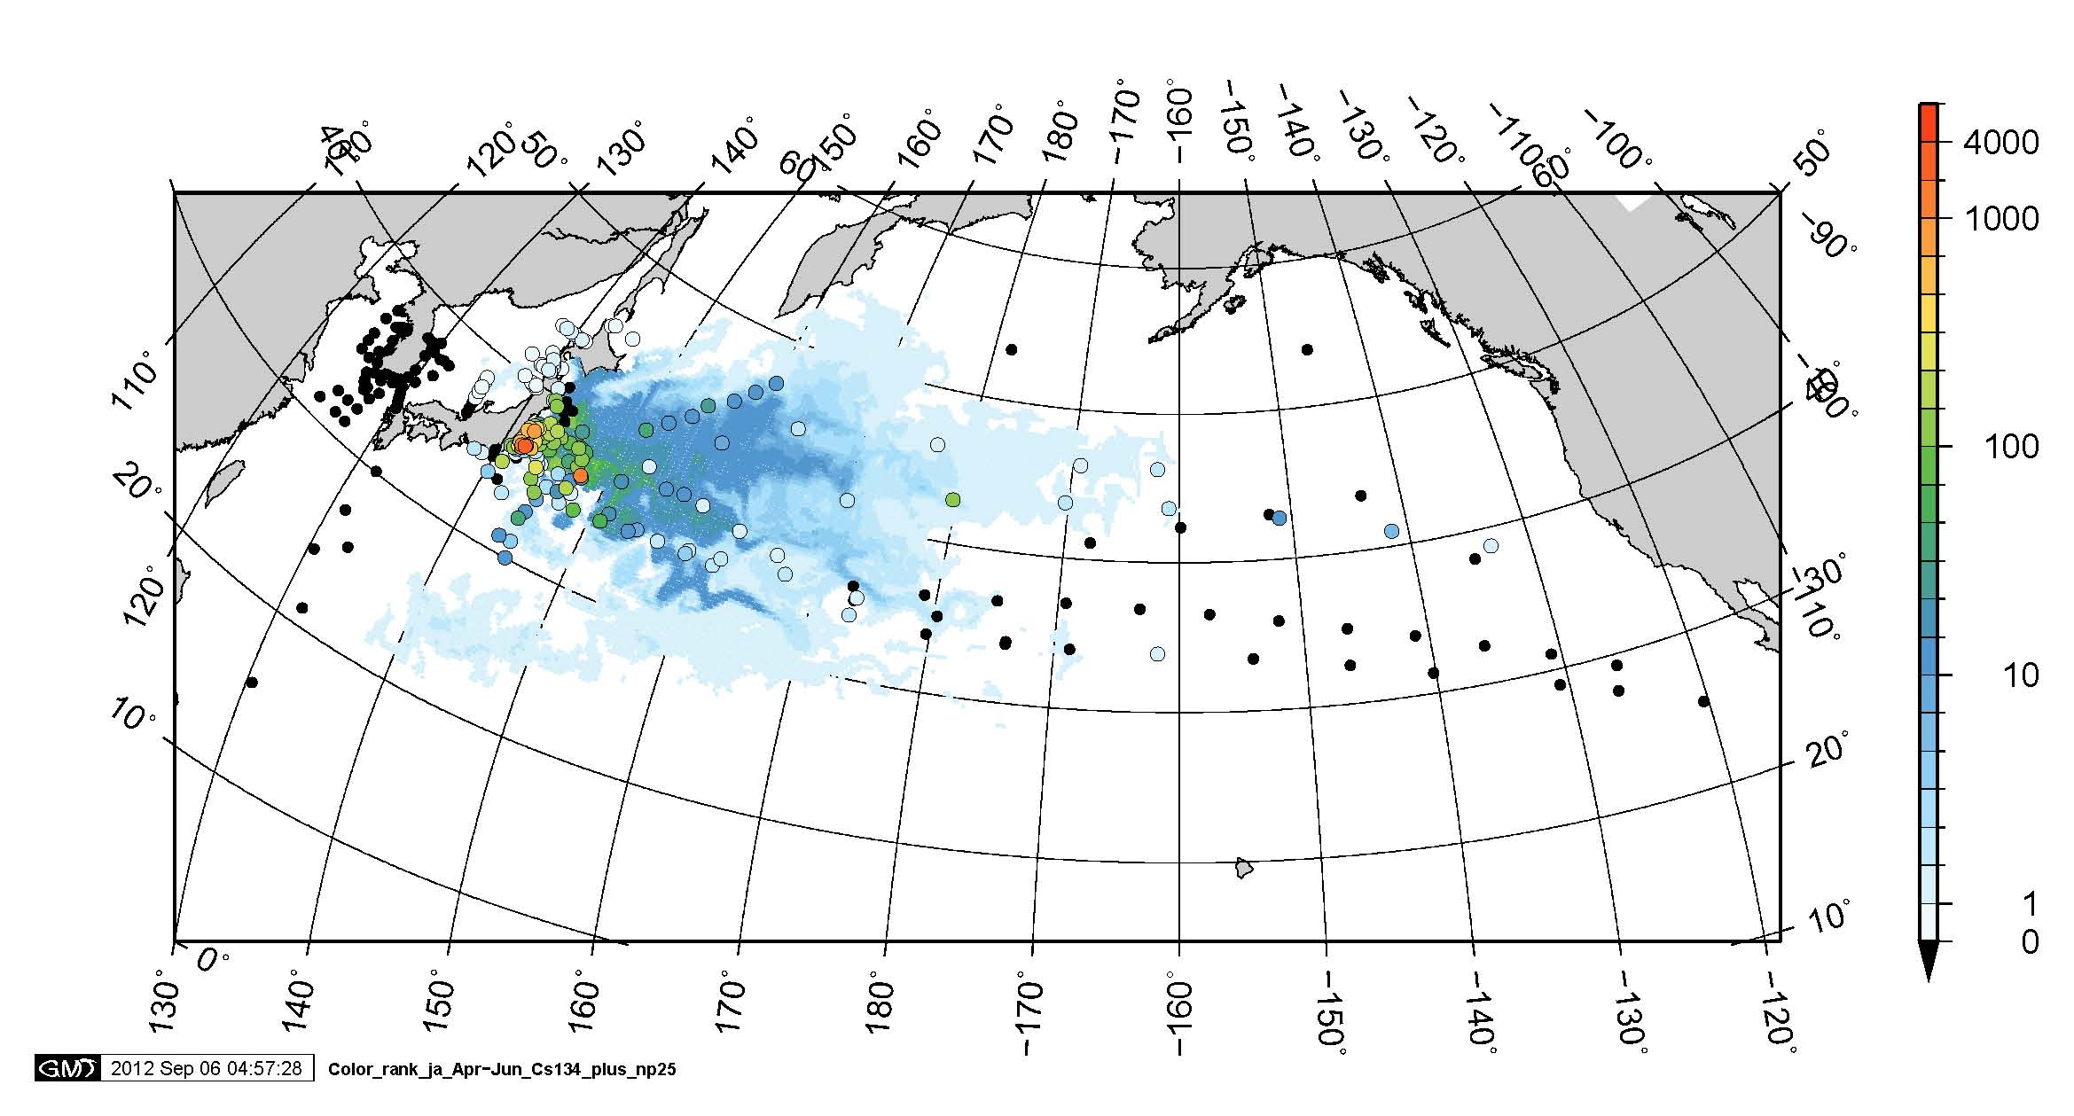
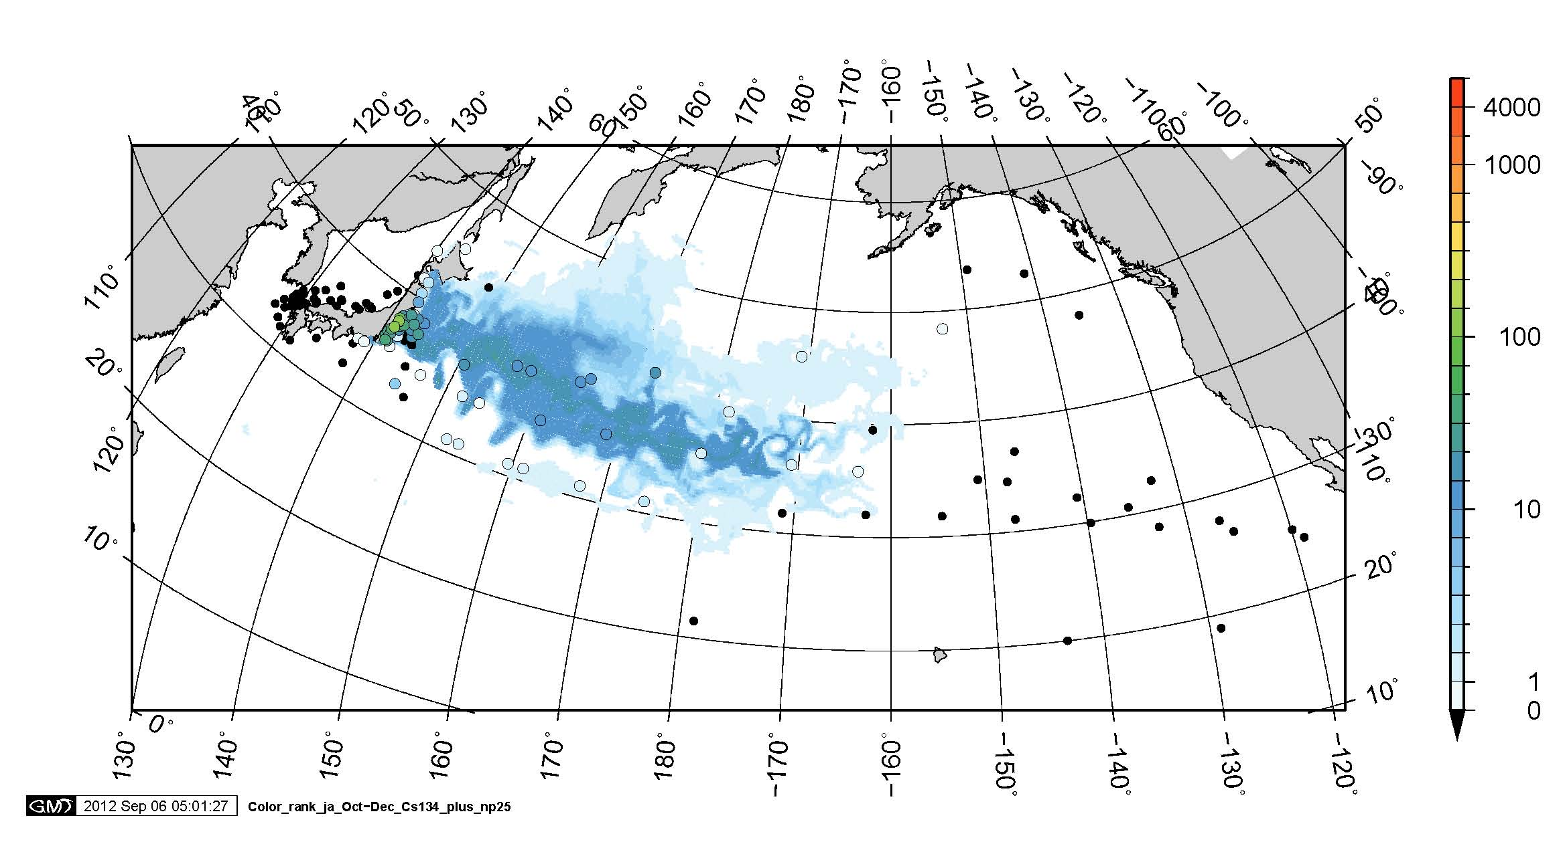
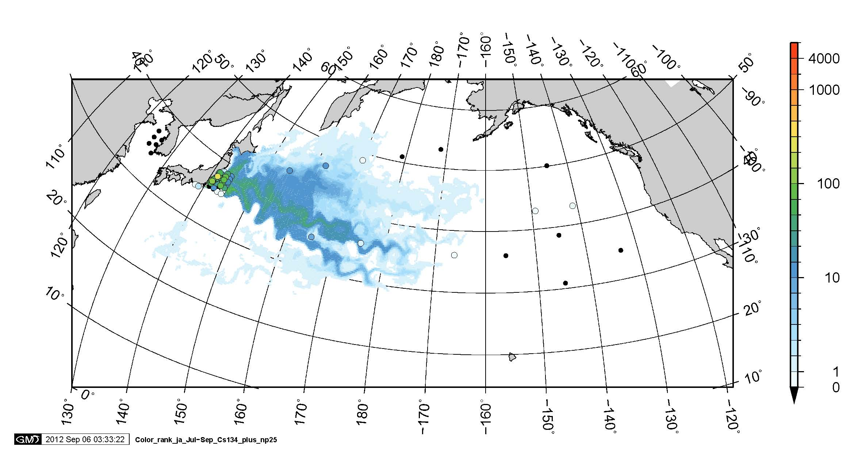
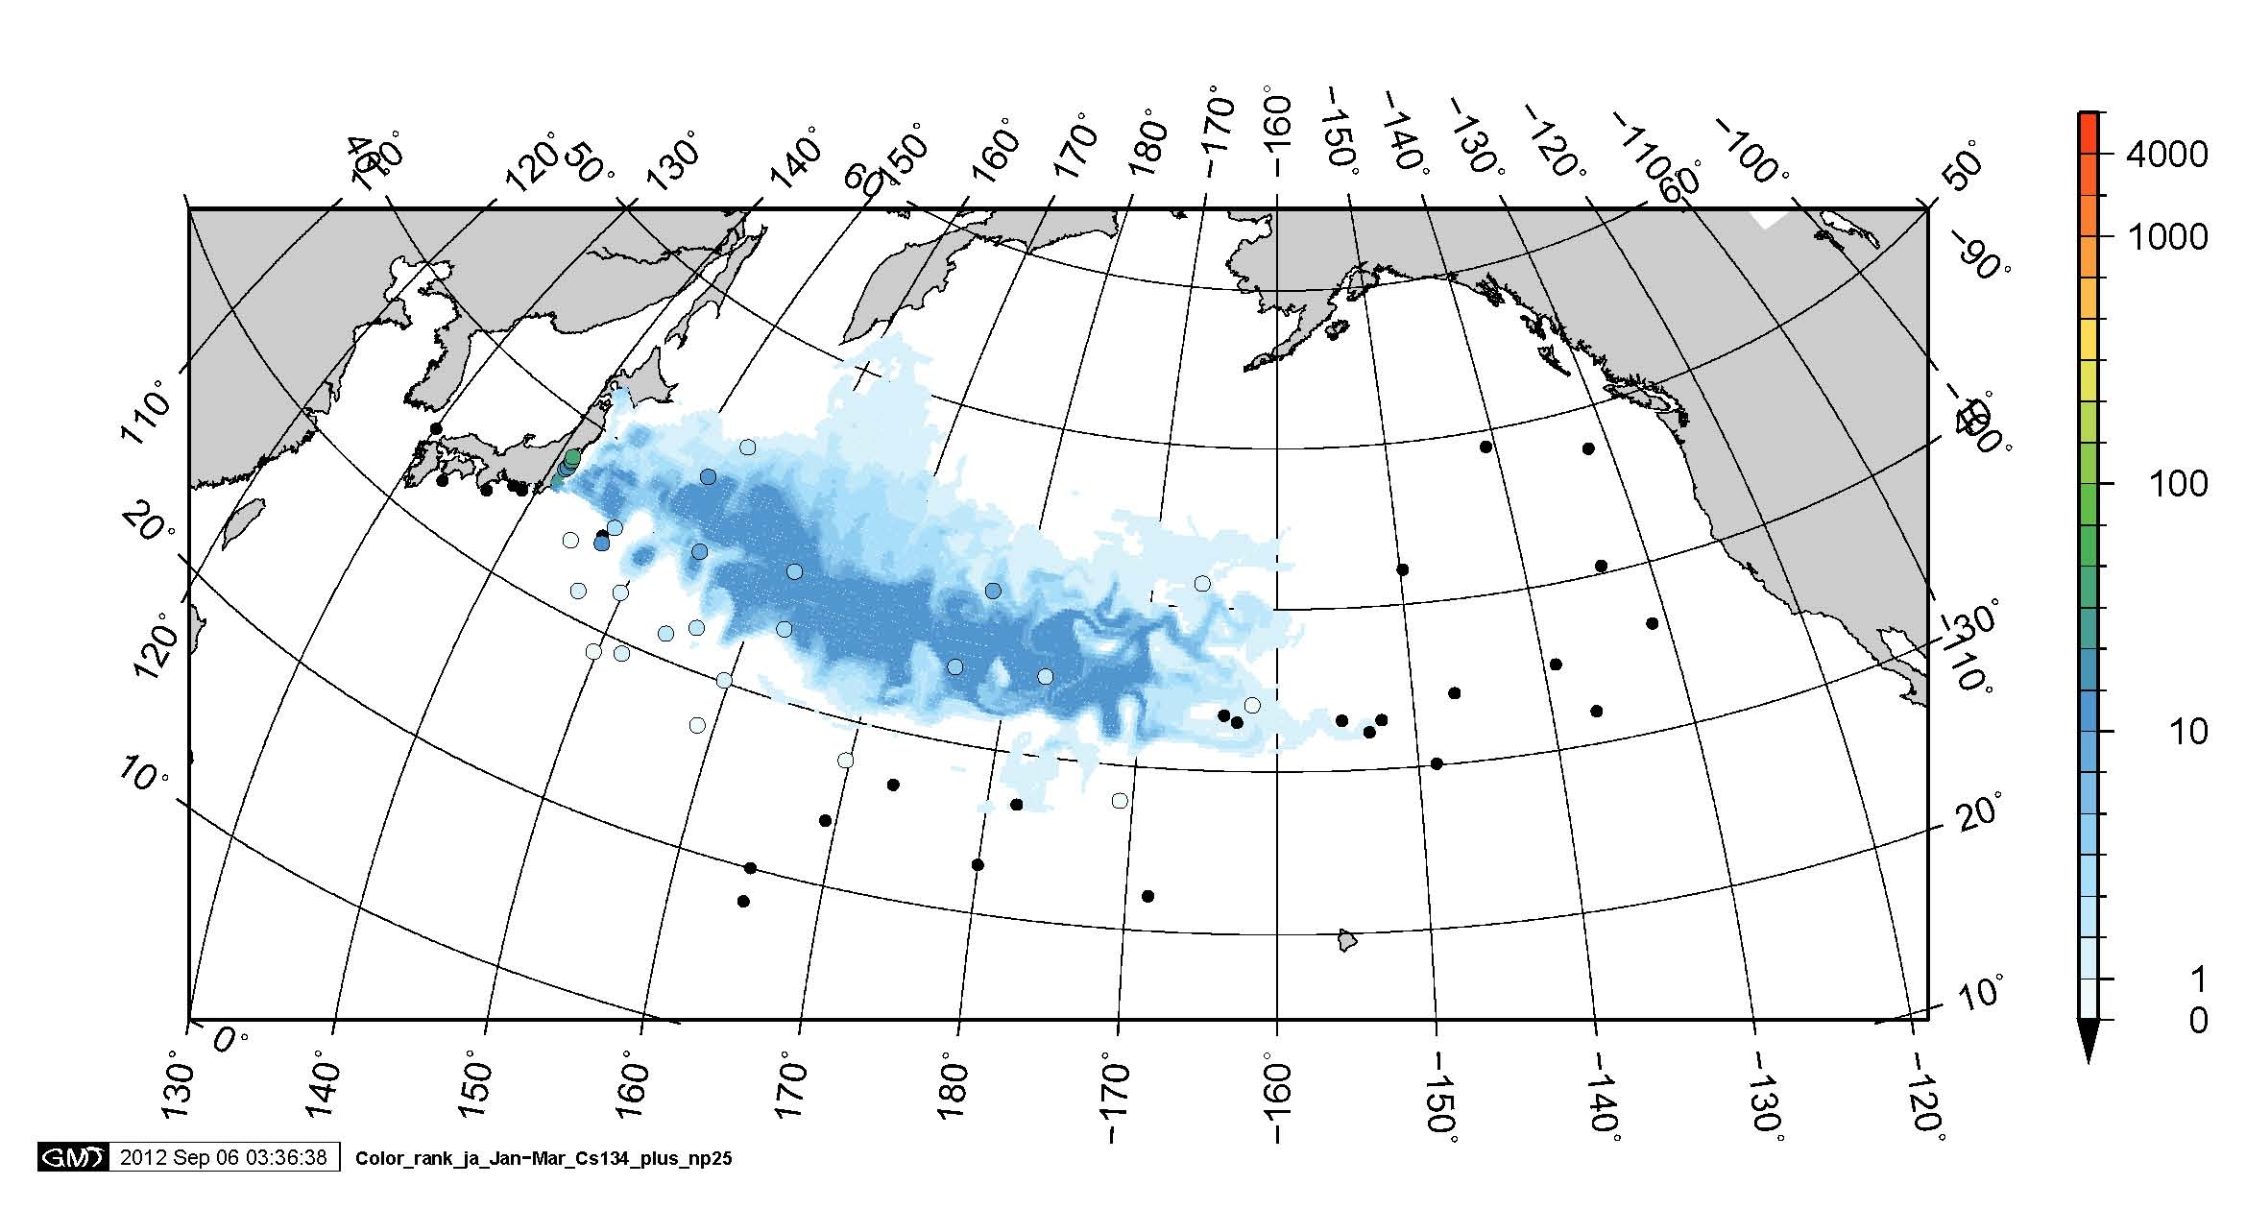
26
¹³⁴Cs in surface water By Aoyama (unpublished)
Data sources: NYK ships, Inoue et al., MEXT, Hakuho
Solid circle with color: observed data
Pattern: Atmospheric model with ocean model simulation
Source term Chino et al. 8.8 PBq for atmospheric release and Tsumune et al., 3.5 PBq for direct discharge
unit: Bq m-3
in Apr – June 2011
in Oct. – Dec. 2011
in July – Sept. 2011
in Jan. – Mar. 2012

Slide 27
Conclusion
The concentration of ^{134,137}Cs in seawater near 1F-NPP was considerably decreased to 1~10Bq/L in 2012, which is 1,000-10,000 times of BG level.
The concentration of ^{134,137}Cs in the deep Pacific is BG~0.01 Bq/L, which is 10 times of BG level.
The simulation by LAMER estimated the concentrations of ¹³⁷Cs in seawater and marine products. The result agrees the observation of them.
The internal dose from Japanese consumption of all marine product was estimated to be 1.7, 0.74 and 0.41 micro Sv/a in 2012, 2013 and 2014, respectively.

