Slide 1
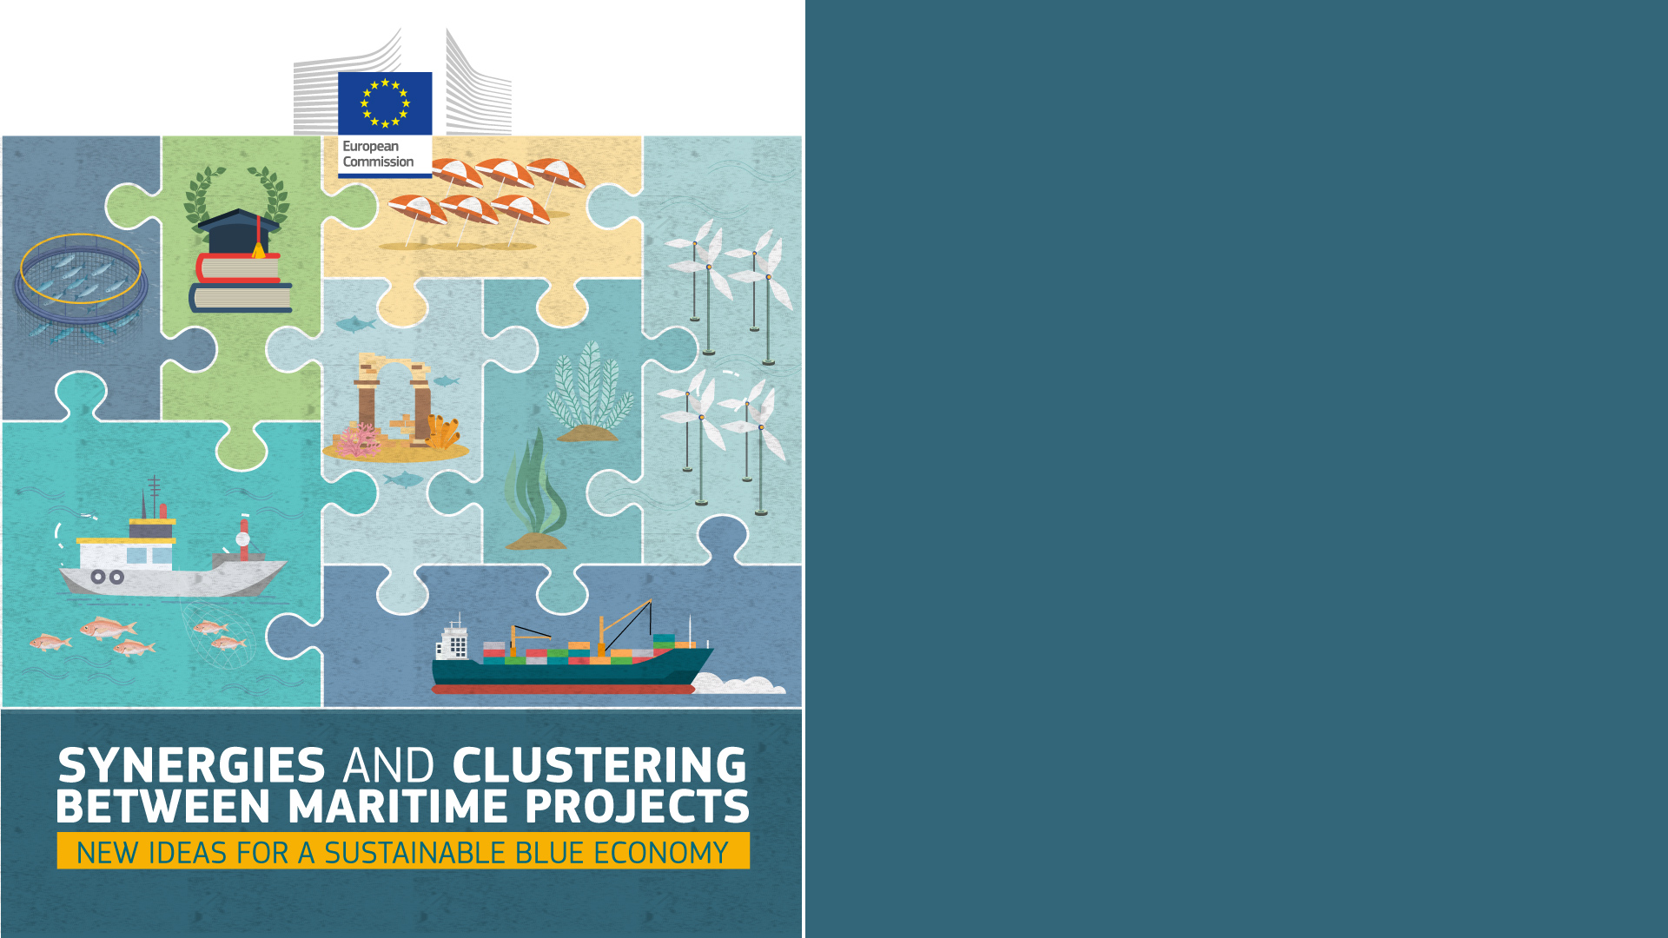
Assistance Mechanism for the Atlantic Action Plan
Mariana Taylor de Jesus
7 July 2022

Slide 2
Sea-basin strategy
The Atlantic Action Plan 2.0 includes four pillars which represent a practical way to make the common vision a reality. All pillars are integrally interconnected and transregional by nature and address key challenges and aim to foster sustainable blue growth and contribute to greater territorial cooperation and cohesion in the EU Atlantic area.
ATLANTIC STRATEGY COMMITTEE
WORKING GROUPS
Atlantic ports as gateways and hubs for the blue economy
Blue skills and ocean literacy
Atlantic Action Plan 2.0 was set to unlock the potential of blue economy in the Atlantic area while preserving marine ecosystems and contributing to climate change adoption and mitigation.
European Commission adopted an Atlantic Maritime Strategy.
Atlantic Action Plan was set with practical steps to be taken in the member states with Atlantic coasts.
NATIONAL HUBS (SP, PT, IR, FR)
CENTRAL TEAM
Marine renewable energy
A healthy ocean and resilient coasts
2011
2013
2017
2020
Mid-term Review of the AAP
The plan had spurred over 1200 new maritime projects and nearly
6 billion euro of investments.
Pillars
AM
DG MARE & CINEA

Slide 3
Work of the Assistance Mechanism
Main areas of action
WORKSHOPS
Support the Pillar Coordinators and National Hubs on bringing together Atlantic stakeholders, including SMEs, improve knowledge and exchange of experiences on AAP 2.0 goals, and further promote cooperation in the Atlantic area:
# Workshops in 2021 - 6
# Workshops in 2022 - 5
COMMUNICATION
Development of communication materials for the dissemination of the Atlantic Strategy 2.0, including the preparation of the Atlantic Stakeholder Platform Conference
Banners and socials media posts about workshops & other events
Flash Reports
Infographics
Brochure
PROJECT MONITORING, IMPLEMENTATION OF THE AAP 2.0 & ASC SUPPORT
The assistance mechanism must ensure a robust monitoring mechanism that tracks the progress made as regards the implementation of the action plan (including project monitoring and funding opportunities)
Support the ASC Committee meetings (e.g. Inviting attendants, content preparation, logistics and minutes; occasional, active participation in the ASC meeting, having presented a first draft of the Flagship concept on the last one (June 2022)
NATIONAL HUBS
Support the work of the national representatives with view of the implementation of the Atlantic Strategy and it action plan.
The tasks of the national hub ought to be defined jointly with the national representative in a rolling 6-months roadmaps
Engagement with Atlantic Stakeholders
Notes:
Incluir deliverables da Central Team

Slide 4
Funding opportunities available in the sea basin
 | EUROPEAN MARITIME FISHERIES AND AQUACULTURE FUND | The EMFAF is the fund for the EU's maritime and fisheries policies for 2021-2027 (replacement of the European Maritime and Fisheries Fund – EMFF)
 | HORIZON EUROPE | Research and innovation funding programme until 2027. It tackles climate change, helps to achieve the UN’s Sustainable Development Goals and boosts the EU’s competitiveness and growth
 | CONNECTING EUROPE FACILITY 2 | The 2nd generation of the Connecting Europe Facility (CEF-2 programme) “Digital” strand (2021-2027) aims to support and catalyse investments in digital connectivity infrastructures of common interest.
 | LIFE PROGRAMME | The LIFE Programme is the EU’s funding instrument for the environment and climate action. On 21 May 2022 it turned thirty
 | INNOVATION FUND | The Innovation Fund is one of the world’s largest funding programmes for the demonstration of innovative low-carbon technologies.
 | INTERREG ATLANTIC AREA | The INTERREG Atlantic Area programme cofinances cooperation projects in the fields of Innovation & Competitiveness, Resource Efficiency, Territorial Risks Management, Biodiversity and Natural & Cultural Assets
 | RENEWABLE ENERGY FINANCING MECHANISM | To better support renewable energy projects, and thereby encourage a greater uptake of renewable energy sources across the EU, the European Commission has established a new EU financing mechanism.
EU FUNDING
OPPORTUNITIES
The Atlantic Ocean does not have funding on its own. However, several EU programs take into consideration the Atlantic Action Plan 2.0 goals and priorities
NON-EXHAUSTIVE

Slide 5
Projects identification and progress in the sea basin
CENTRAL TEAM
The monitoring team is continuously working on identifying new funding instruments and mechanisms along with the assistance of the National Hubs.
New financing opportunities are constantly being identified and added to the website.
PILLAR COORDINATORS & NATIONAL HUBS
Cooperation in finding nationally funded projects.
Continuous support in the identification of projects as well as good practices examples to be incorporated in the Atlantic 2.0 database.
Projects’ updated in the Maritime Datahub: as a result of exchange and networking in the context of events and workshops.
EU FUNDING
OPPORTUNITIES
&
PROJECTS
The Atlantic actors work in collaboration to find regional and national projects opportunities with synergies and impacts among other sea basins. Several EU programs take into consideration the Atlantic, Westmed and Black Sea priorities whih represents an opportunity to achieve individual goals in a common basis.
NON-EXHAUSTIVE
Notes:
What each profile do…Approach
Link with Westmed and Black Sea… how they help in supporting projects

Slide 6
Best practices | indicative
ATLANTIC PILLARS
I. Atlantic ports as gateways and hubs for the blue economy
II. Blue skills and ocean literacy
III. Marine renewable energy
IV. A healthy ocean and resilient coasts
Atlantic Smart Ports Blue Acceleration Network (AspBAN) aims to support Atlantic Ports to act as ecosystems in order to foster innovation in the blue economy, thus diversifying their business models and revenue sources. AspBAN has the support of a large and representative pool of 137 strategic partners and a total universe of 391 ports, from EU Atlantic, Norway, USA, Canada.
Mari4_YARD aims to implement a portfolio of worker-centric solutions, by relying on novel collaborative robotics and ubiquitous portable solutions, enabling modular, flexible, reconfigurable and usable solutions targeting the execution of key labour-intensive tasks by preserving industry-specific workers’ knowledge, skills and biomechanics health status.
The aim of the SafeWAVE project consists of overcoming non technological barriers that could hinder the future development of one of the main pillars of the EU Blue Growth strategy.
Clean Atlantic aims to protect biodiversity and ecosystem services in the Atlantic Area by improving capabilities to monitor, prevent and remove (macro) marine litter.
EMFF
Horizon 2020
EMFF
Interreg Atlantic Area
EU Funding Program
Notes:
Here we have selected some good practices of projects developed covering different Atlantic priorities. Today we have here at least two members of the two different Atlantic projects such as Clean Atlantic and Mattes, and they we will have the opportunity to share some of their experience in finding some synergies with other projects as well as within and between sea basins.
Considering the time and in order to have the opportunity to focus on an intra-basin discussion, I will highlight the Aspban project as one of the project example where the innovation and the technology are a driver for competitiveness and for economic growth.
Pillar I:
Site: https://aspban.eu/en/home/
Focused on developing a dynamic acceleration platform, AspBAN helps EU Atlantic ports work as blue economy hubs. By becoming the main playground for the development of new blue businesses, EU Atlantic Ports have the opportunity to diversify their revenue sources and work towards a sustainable ocean economy. Ports are one of the primary interfaces with the ocean, which means they will play a strategic role as launchpads for a new generation of blue companies.
They have established a strong network of partners not only in the Atlantic area.
Pillar II:
Site: https://www.mari4yard.eu/
Pillar III:
The aim of the SafeWAVE project consists of overcoming some of the non-technological barriers that could hinder the future development of Ocean Energy, one of the main pillars of the EU Blue Growth strategy: (i) environmental risk and uncertainty about the potential environmental impacts of wave energy (WE) developments; (ii) the need for a Maritime Spatial Planning (MSP) approach to overcome the potential competition and conflicts between WE and other marine users; (iii) complex and long consenting processes and (iv) opposition among host communities of future WE deployments.
Site: https://www.safewave-project.eu/
Pillar IV:
WP: http://www.cleanatlantic.eu/packages/

