Slide 1
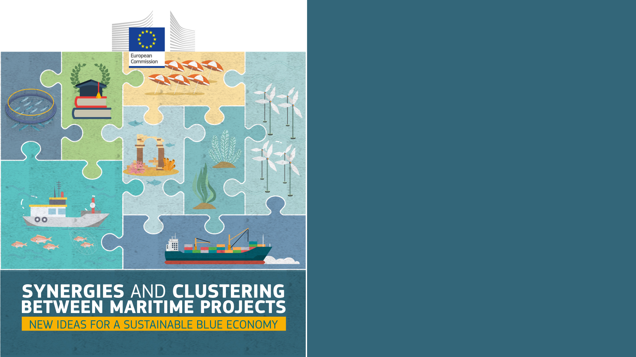
Black Sea Assistance Mechanism
Thanos Smanis
7 July 2022

Slide 2
The Common Maritime Agenda
Three goals for a sustainable and resilient blue economy:
1
Healthy marine and coastal ecosystems
2
Competitive, innovative and sustainable blue economy for the Black Sea
Investments in the Black Sea blue economy.
3
The CMA: a strategic reference framework in the Black Sea to support green, smart and resilient transformation of blue economy sectors

Slide 3
BSAM set up
Central Team
National coordinator
National coordinator
National Hub
National Hub
National coordinator
National Hub
National coordinator
National Hub
Steering Group
National Hub
National Hub
National coordinator
National coordinator

Slide 4
Specific objectives for the BSAM
Provision of expertise
CMA Steering Group and its Coordinator (rotating coordination 2020 (BG), 2021 (TR), 2022 (GE))
Key public officials and private sector stakeholders in the beneficiary countries to adhere to the principles of the blue economy and the CMA priorities.
1
2
Support the monitoring of CMA implementation
3
Project development
Improve knowledge and assure project development support for a sustainable blue economy
Improve the capacity of Black Sea Blue Economy stakeholders to make the best use of funding opportunities for cooperation in project in the Black Sea
4
Communication
Organisation of national and regional events related to the CMA – both in terms of logistics and expertise.
Set up an efficient communication, to create a Black Sea Blue economy community

Slide 5
Funding opportunities available in the sea basin
Initiatives | Coverage (geographic and sectoral/theme) | Common Maritime Agenda (Goals)
 |  | 1 | 2 | 3
EU Grants
EMFAF | EU (& Partners) | x | x | x
EMAF sea basin calls | Sea basins specific
INTERREG NEXT BSB | Sea basins specific | x | x | x
Horizon Europe | EU (& Neighbors) | x | x | x
EU Missions/Lighthouse | Sea basins specific | x
COSME | Theme specific | x | x | x
ERASMUS+ | Theme specific | x | x | x
… | …
EU Finance
EU Invest | EU focused |  | x | x
EIF/EIB | EU (& Neighbours) | x | x | x
EBRD | EU Neighbours | x | x | x
EFSD+ | EU Neighbours | x | x | x
Modernisation Fund | EU focused |  | x | x

Slide 6
Projects identification & development
To identify relevant project ideas, taking in consideration key past events and projects
Match make with funding opportunities
Gradual stakeholder involvement to further develop some ideas
Identification of possible synergies
Monitoring of funding opportunities
Stakeholders involvement

Slide 7
Process
Idea:
Accelerating the uptake of innovation for blue entrepreneurship
Funding Mechanism:
EMFAF-2021-PIA-FLAGSHIP
Topic: to boost innovation and digitalisation in blue economy sectors
Project:
4BIZ

Slide 8
Supported by BSAM: 4 BIZ
Kick off: 14th June 2022
Duration 24 months
Total budget: 638,105.19
Title: Boosting the Blue Economy in the Black Sea Region by Initiating a Business Collaborative Framework in the fields of Fisheries and Aquaculture, Coastal and Maritime Tourism and Maritime Transport
Objective: The 4BIZ Project aims to develop a collaboration framework that will bring together Blue Economy stakeholders in EU and eligible non-EU Black Sea countries to identify and tackle local capacity building needs to boost innovation, digitalization and investment in the Black Sea Blue Economy with the main focus on Fisheries and Aquaculture, Coastal and Maritime Tourism and Maritime Transport.
Coordinator
BLACK SEA UNIVERSITIES NETWORK (BSUN)
Partners
INTERNATIONAL CENTER FOR BLACK SEA STUDIES - ICBSS
CAMERA DE COMERT, INDUSTRIE SI AGRICULTURA GALATI - Romania
NATIONAL TECHNICAL UNIVERSITY OF UKRAINE IGOR SIKORSKY KYIV POLYTECHNIC INSTITUTE - Ukraine
PUBLIC UNION UKRAINIAN MARITIME CLUSTER - Ukraine
LEPL TEACHING UNIVERSITY-BATUMI STATE MARITIME ACADEMY – Georgia
DOGU KARADENIZ KALKINMA AJANSI BASKANLIGI - DOKA - EASTERN BLACK SEA DEVELOPMENT AGENCY - Turkey
MARINE CLUSTER BULGARIA SDRUZHENIE – Bulgaria
ACADEMIA DE STUDII ECONOMICE DIN BUCURESTI - Romania
Black Sea Assistance Mechanism:
BSAM supported the formulation of the project idea, adapting it to the characteristics of the call for proposals and supported the consortium set up, identifying partners with relevant project ideas to create this synergy

Slide 9
Other Case: MINE-EMI
Title: Maritime Innovative Network of Education for Emerging Maritime Issues
MINE-EMI was based on the Vasco Da Gama experience and its initial aim was to become a Vasco Da Gama spin-off for the Black Sea.
Therefore partners of Vasco Da Gama based on the experience of the project led by the CPMR (funded by DG MOVE) and the experience of NVNA and other Maritime Education & Training Institutions and maritime-related institutions and organisations from the wider Black Sea region, developed this Erasmus+ project.
Coordinator: Piri Reis University – Turkey
Partners:
CPMR
Constanta University - Romania
Nikola Vaptsarov Naval Academy – Bulgaria
The University of the Aegean – Greece
Marine Cluster Bulgaria – Bulgaria
Municipality of Piraeus - Greece

Slide 10
Synergies between sea basins:
Working Group on Underwater Cultural Heritage
How it started: The workshop was a great opportunity to share views on the topic and discuss relevant project ideas in line with the goals and priorities set by the Common Maritime Agenda (CMA).
More specifically, the discussion touched upon the Goal II of the CMA, by fostering knowledge on underwater heritage as a means to improve its protection and potential synergies with sustainable tourism across the Black Sea.
Idea: Concrete inputs were provided for further collaboration across blue economy partners in the Black Sea and beyond, bridging research needs, areas of innovation for business operators, and need for further actions by local authorities across the region.
Result: Set-up of an informal working group in this area, as a way to develop further cooperation and associated projects on this matter.
Next Step: Exchanges with experienced partners from other sea basins to promote collaboration and transfer knowledge between sea basins

