Slide 1
Status and Trends of Marine Big Data in China
XIANG Wenxi
Brussels, Belgium
1 June 2017
Notes:
Good afternoon, everyone,
I am Xiang Wenxi from National Marine Data and Information Service of China. I am very happy to give you a brief intrudution on the status and trends of marine big data in China.

Slide 2
OUTLINE
1.
Big Data of China
2.
Development of Marine Big Data in China
3.
Application and service of Marine Big Data
4.
The future of Marine Big Data
Notes:
My report includes the following 4 parts. First, some general information of big data in China. Second, the development of Marine Big Data . Third, how Marine Big Data is applied. And last, where will Marine Big Data go and what we can do together.

Slide 3
1. Big Data of China
Big Data of China
1. The Big Data
2.Government Policy Supports
3. Provinces Development
4. Industries Development
Notes:
Big Data of China cover the following 4 parts:
first. The Big Data
second. Government Policy Supports
third. Provinces Development
fourth. Industries Development

Slide 4
1. Big Data of China
Big Data of China
1. The Big Data
2.Government Policy Supports
3. Provinces Development
4. Industries Development
Notes:
1、First, everyone know that big data have the characteristics of ‘4Vs’：Volume、Velocity、Variety、Veracity；Along with the technique development, the big data also develops to‘5Vs’ and ‘6V s’ currently. The 5Vs means add visualization on the foundation of the 4Vs；The 6Vs means add Validity on the foundation of the 5Vs. As a new technology，big data is able to find valuable rules and hidden relationship from massive data, thus identify some important factors and information unknown before. In other words, big data can make the knowledge visible.

Slide 5
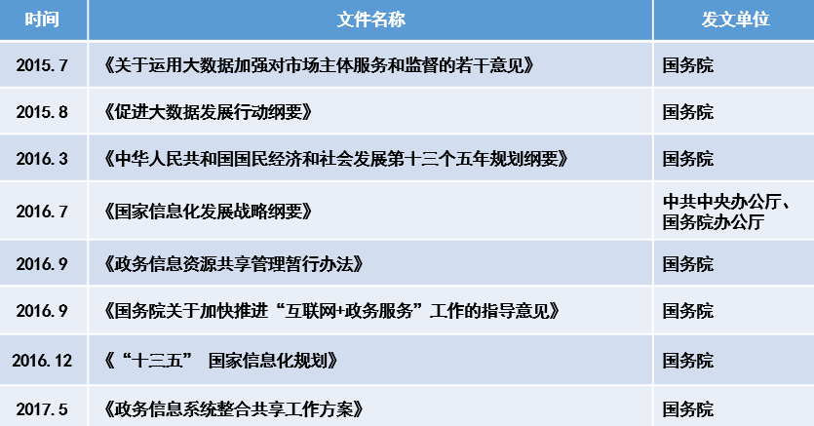
1. Big Data of China
Big Data of China
1. The Big Data
2.Government Policy Supports
3. Provinces Development
4. Industries Development
Notes:
2、The concept of National Big Data Center was proposed in October 2016. Through data integration and sharing, the National Big Data Center will promote the integration of technology, business and all kinds of data, to achieve multi-level , multi-regional, multi-system, multi-sectoral and multi-business collaborative management and service.
The Chinese government pay high attention to big data, from 2014 to 2017, big data was written in the government report;

Slide 6
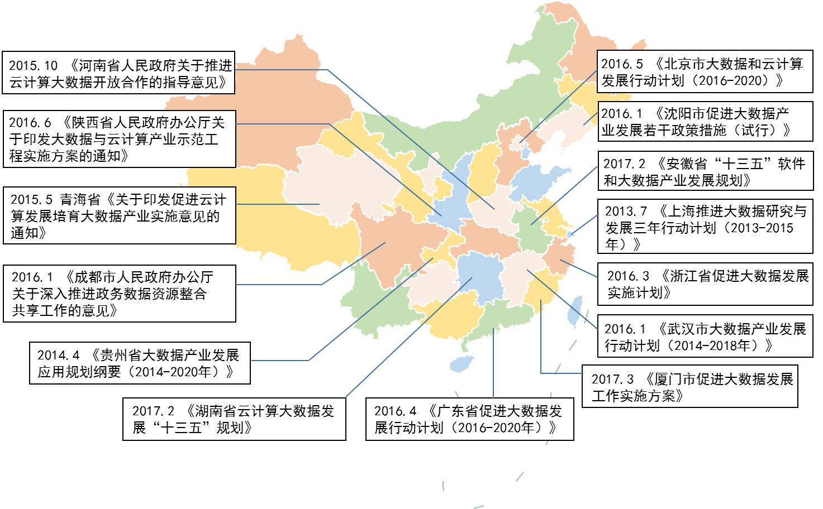
1. Big Data of China
Big Data of China
1. The Big Data
2.Government Policy Supports
3. Provinces Development
4. Industries Development
Notes:
3、Form 2013 Shanghai propose the first Big Data plan. Then 23 provinces have already published their policy documents;

Slide 7
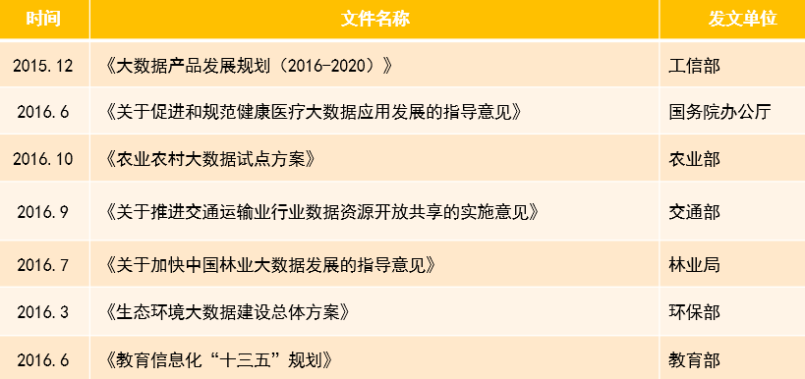
1. Big Data of China
Big Data of China
1. The Big Data
2.Government Policy Supports
3. Provinces Development
4. Industries Development
Notes:
4、in fields of public administration, manufacturing, electricity, e-commerce, intelligent transportation, finance, scientific research, education, health, telecommunications and culture, big data develop guidance and planning have also been developed.
Through years of efforts,the application of big data in China is developing by leaps and bounds.

Slide 8
OUTLINE
1.
Big Data of China
2.
Development of Marine Big Data in China
3.
Application and service of Marine Big Data
4.
The future of Marine Big Data
Notes:
Second, the development of Marine Big Data.

Slide 9
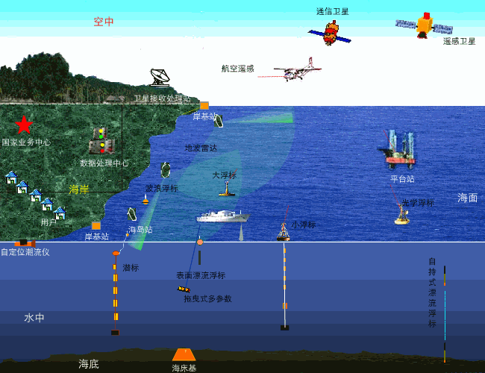
2. Development of Marine Big Data in China
The three-dimensional marine observation network
。
Notes:
We make the best of national ocean observation, monitoring and survey resources, carry out global ocean observation cooperation, establish and improve the three-dimensional marine observation network and data transmission network.
For this end, we will strengthen and improve the space-based, outer space-based, shore-based, sea-based and other means of observation, expand functions of each observation site. Establish China's coastal marine environment on-line monitoring system, implement monitoring on typical ecosystems and Gulfs, and establish a comprehensive and systematic marine investigation system.
At the same time, promote the construction of deep sea, polar and ocean observing systems to provide a useful complement to the Global Ocean Observing System.

Slide 10
2. Development of Marine Big Data in China
Design of marine information system
Construction of marine cloud platform
Construction of marine integrated database
Research on Marine Big Data standardization
Research on marine data processing and analysis

Slide 11
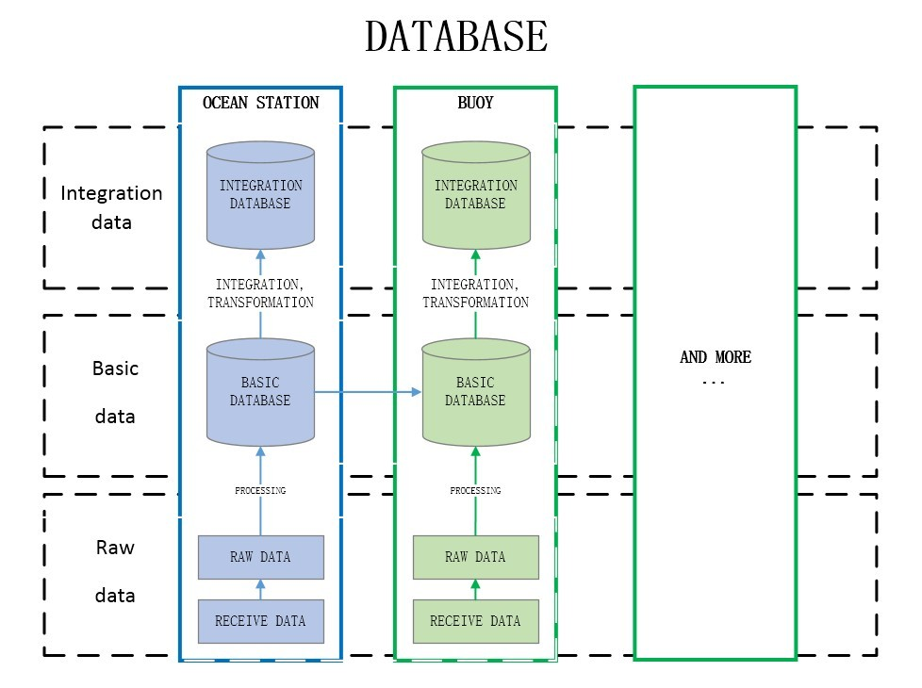
2. Development of Marine Big Data in China
Marine data classification
Raw data
Basic data
Integration data
Design of marine information system
Notes:
NMDIS carry out marine data management system research and design. is created . According to the marine data processing procedure, data types and other attributes, a hierarchical data management structure is created, including three parts: raw data, basic data and integrated data.
Raw data includes receiving data and raw data.
Basic data is various of marine environmental standard data sets, marine geography and marine thematic information and all kinds of marine information products.
Integration data is data used for analysis and application that extracted, standardized and quality assessed from the heterogeneous basic data, by using the database cluster technology, the objective of integrated data and basic data traceability and linkage update are realized.

Slide 12
2. Development of Marine Big Data in China
Design of marine information system
Construction of marine cloud platform
Construction of marine integrated database
Research on Marine Big Data standardization
Research on marine data processing and analysis

Slide 13
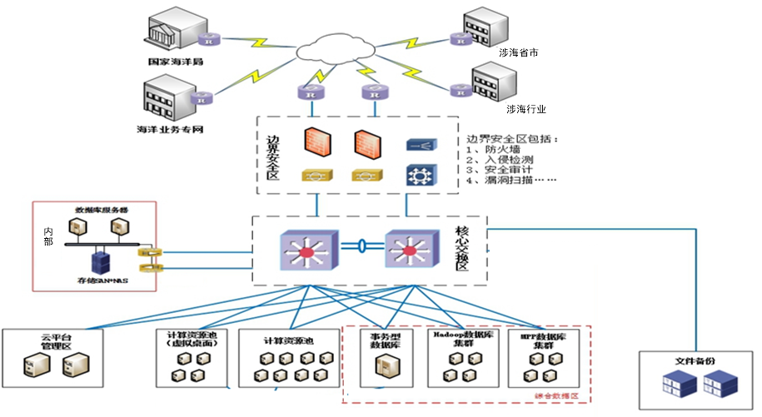
2. Development of Marine Big Data in China
沿海省市
Border security Area
Inner operation
Core Exchange Area
cloud platform management
computing resource pool
storage resource pool
Construction of marine cloud platform
Notes:
On the basis of data resource management system design, NMDIS has carried out the construction of marine cloud computing platform. Cloud platform construction is divided into six parts, including border security zone, core exchange area, cloud platform management area, computing resource pool, storage resource.
All six parts are independently planed and deployed with server, storage, management software and virtualization software, corresponding to their functions. Smooth expansion is designed in respective area .

Slide 14
2. Development of Marine Big Data in China
Design of marine information system
Construction of marine cloud platform
Construction of marine integrated database
Research on Marine Big Data standardization
Research on marine data processing and analysis

Slide 15
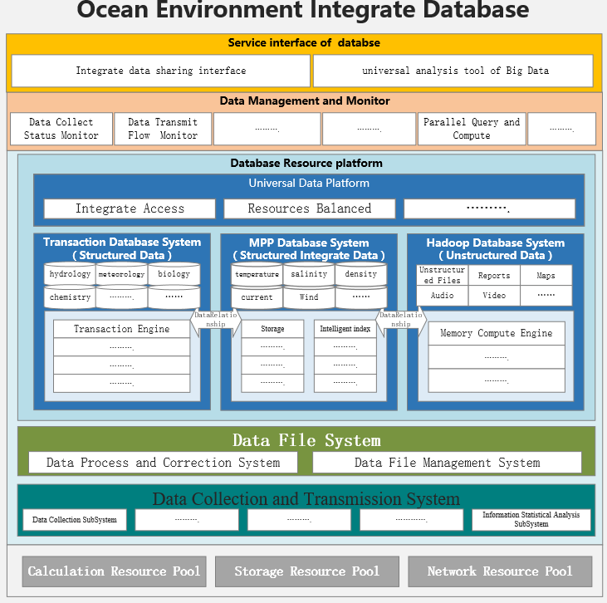
2. Development of Marine Big Data in China
Interface of
databse
Database management
Database
Resource Platform
The basic
support
platform
Construction of marine integrated database
Notes:
The ocean environmental integrated database and marine cloud computing platform is under construction using the mode based on variety of architectures to support multiple applications. This will solve the current data management bottlenecks, to promote the marine data management and mining. In general, integrated ocean environment database mainly includes the basic support platform, the database resource platform, the database management platform and the database service interface. Among them:
The basic support platform mainly includes computing resource pool, storage resource pool and network resource pool.
The database resource platform is the core part of the database, and uses the platform as a service model to integrate all kinds of data platforms involved in the acquisition, processing, transmission, storage, analysis and application of various ocean data.
Database management platform aims at unified management and coordination of resources.
The database service interface mainly provides the data management-related interface and the Marine Big Data analysis tool, to realize the unified management of database sharing service.

Slide 16
2. Development of Marine Big Data in China
Design of marine information system
Construction of marine cloud platform
Construction of marine integrated database
Research on Marine Big Data standardization
Research on marine data processing and analysis

Slide 17
2. Development of Marine Big Data in China
6. Information
Safety standard
1.Basic standard
Standard
ization
2. Technical standard of Data
5.Application standard
3. Platform and
Tool standard
4.Management standard
Research on Marine Big Data standardization
Notes:
Research and development of a unified data standards and technical specifications are carried out at NMDIS to improve the application of big data standards. Including the hierarchical structure of the Marine Big Data system, the standard composition, and the intrinsic relationship between standards.
At present, the ocean data system is composed of six basic systems, which are :
basic common standard, data technology standard, platform and tools standard, management standard, safety management standard and application standard. These six sub-systems are interacted, interdependence and complement to each other.

Slide 18
2. Development of Marine Big Data in China
Design of marine information system
Construction of marine cloud platform
Construction of marine integrated database
Research on Marine Big Data standardization
Research on marine data processing and analysis

Slide 19
2. Development of Marine Big Data in China
Marine Big Data mining, analysis method library
Application of Maine Big Data methods
methods research of Big Data analysis
Single factor time series analysis and prediction
Analysis of Multi - factor Data Intensity Correlation
Uncertain data gray system analysis and prediction
Marine Big Data visual analysis
Multiple Regression
……
Feature extraction
Association mining
Depth study
Method Library Based on Marine Big Data Analysis
Research on marine data processing and analysis
Notes:
We are planning to develop a data resource pool for heterogeneous marine data , research and develop technique as big data extraction and transformation, standardization quality assessment, quality integration and other processing technology.
Meanwhile, we have started to research on and develop Marine Big Data mining technology, providing technical support to Marine Big Data application of all kinds.

Slide 20
OUTLINE
1.
Big Data of China
2.
Development of Marine Big Data in China
3.
Application and service of Marine Big Data
4.
The future of Marine Big Data
Notes:
My report includes the following 4 parts. First, some general information of big data in China. Second, the development of Marine Big Data . Third, how Marine Big Data is applied. And last, where will Marine Big Data go and what we can do together.

Slide 21
3. Application and service of Marine Big Data
Marine big data processing and service
The development and application of blue economy big data
Big Data of marine ecological spatial planning and management
Big Data of sea area and island management

Slide 22
3. Application and service of Marine Big Data
Mining and application
application
Quality of
Data integration
integration
Quality evaluation
quality evaluation
Format transformation
and data classification
transformation
Environment
data collection
data collection
Marine big data processing and service
Notes:
Carry out multi-modal data acquisition, Format transformation and data classification, Quality evaluation , Quality of Data integration, Mining and application service.

Slide 23
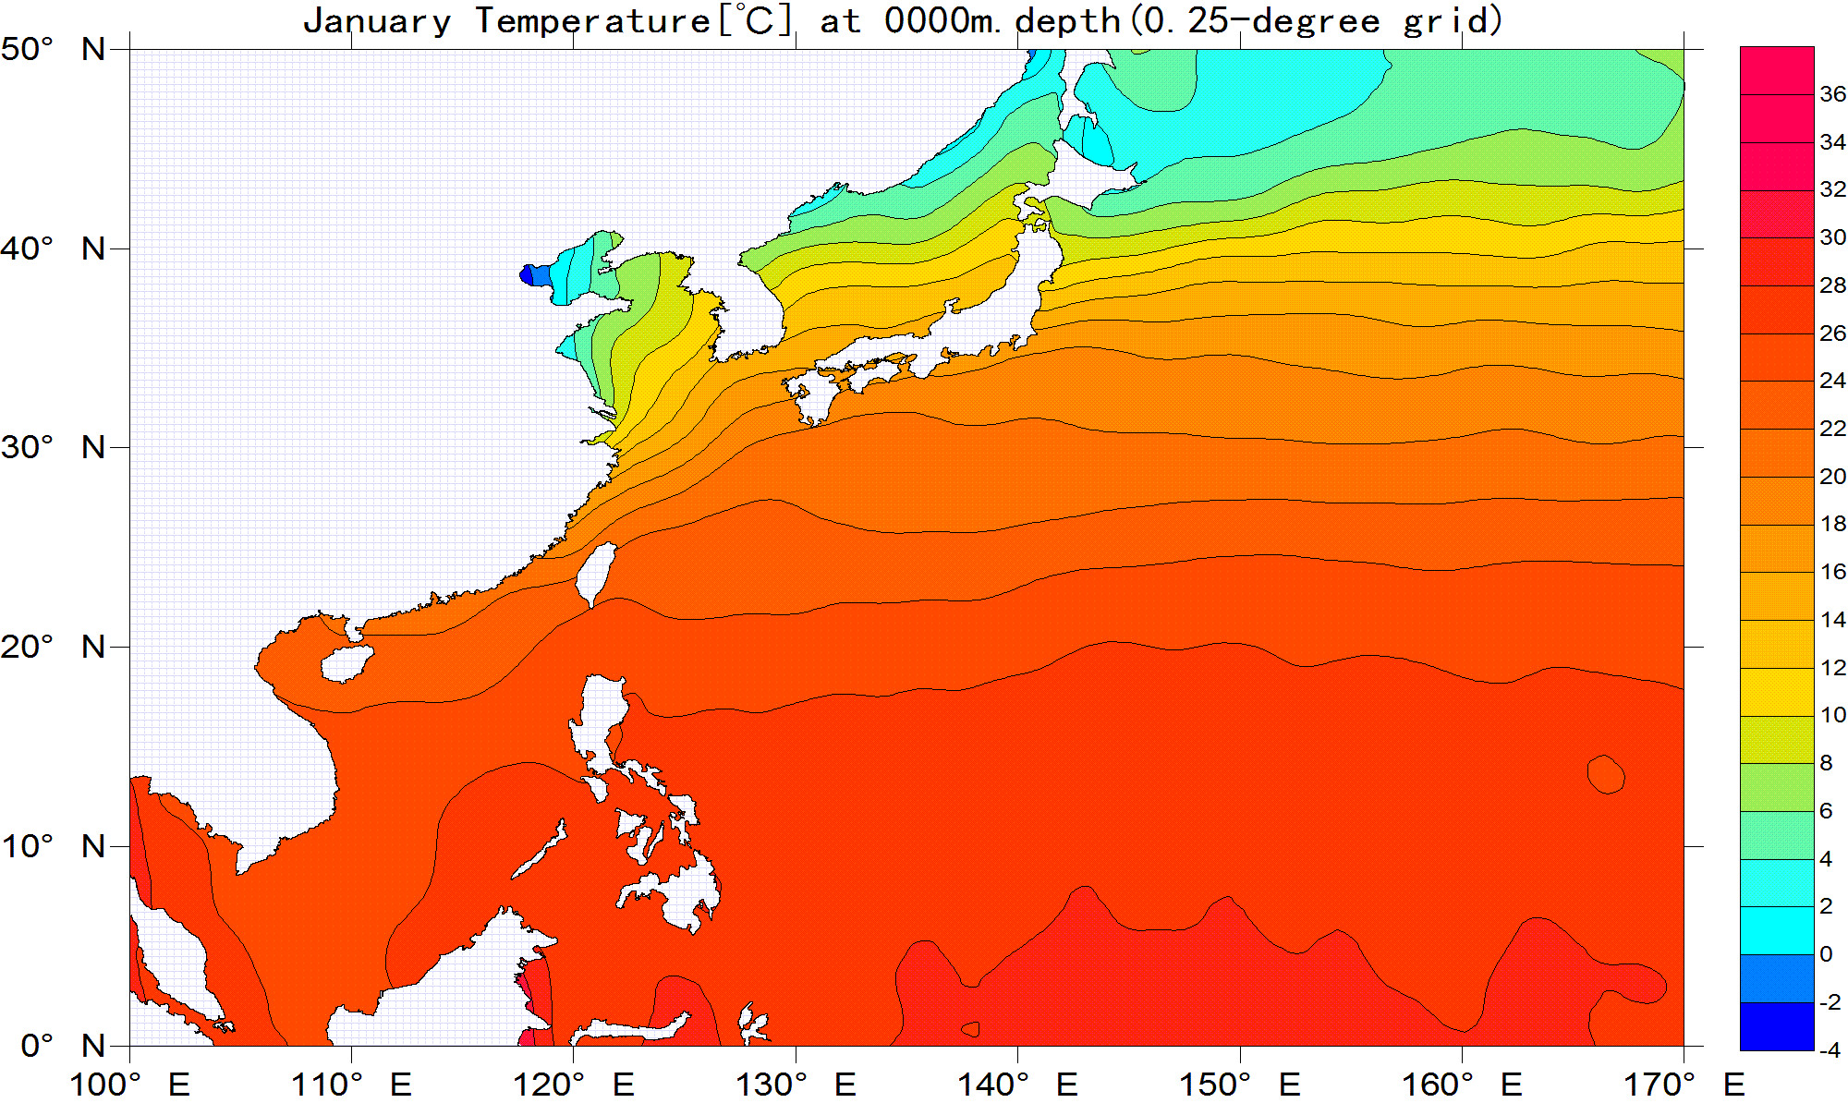
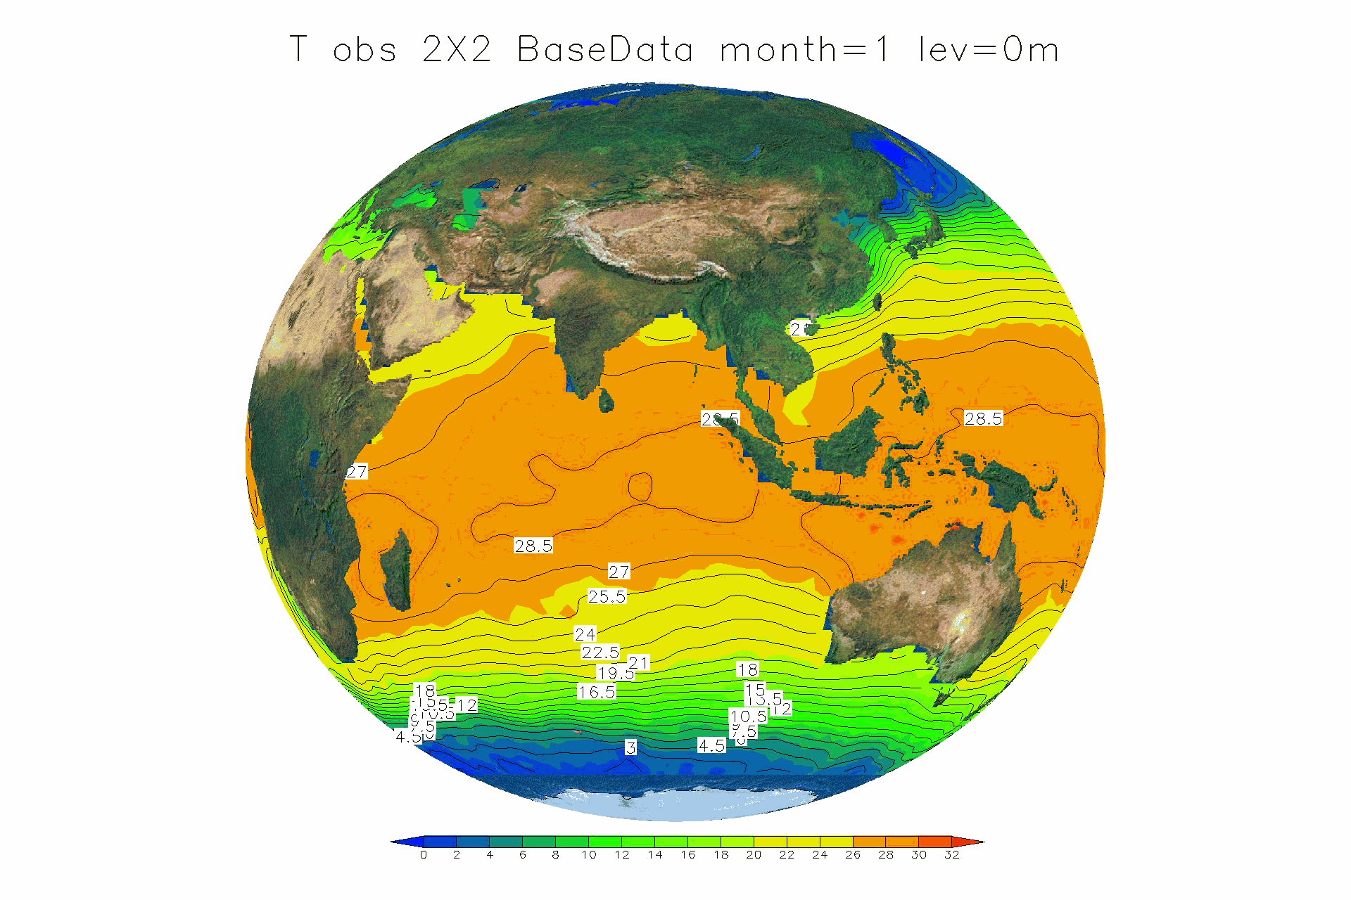
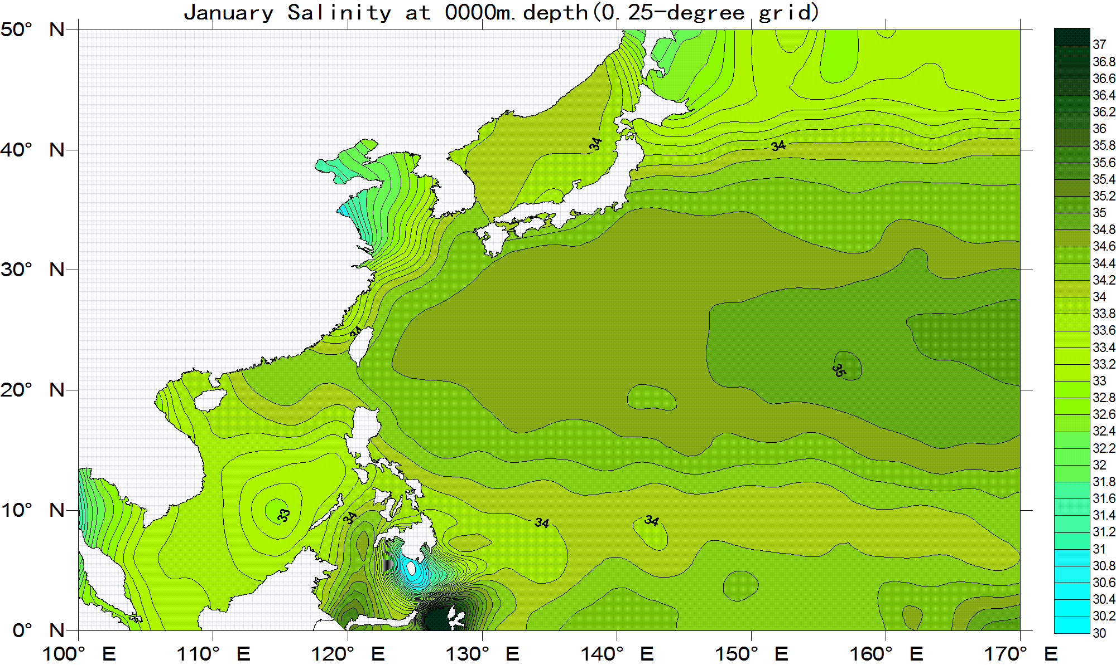
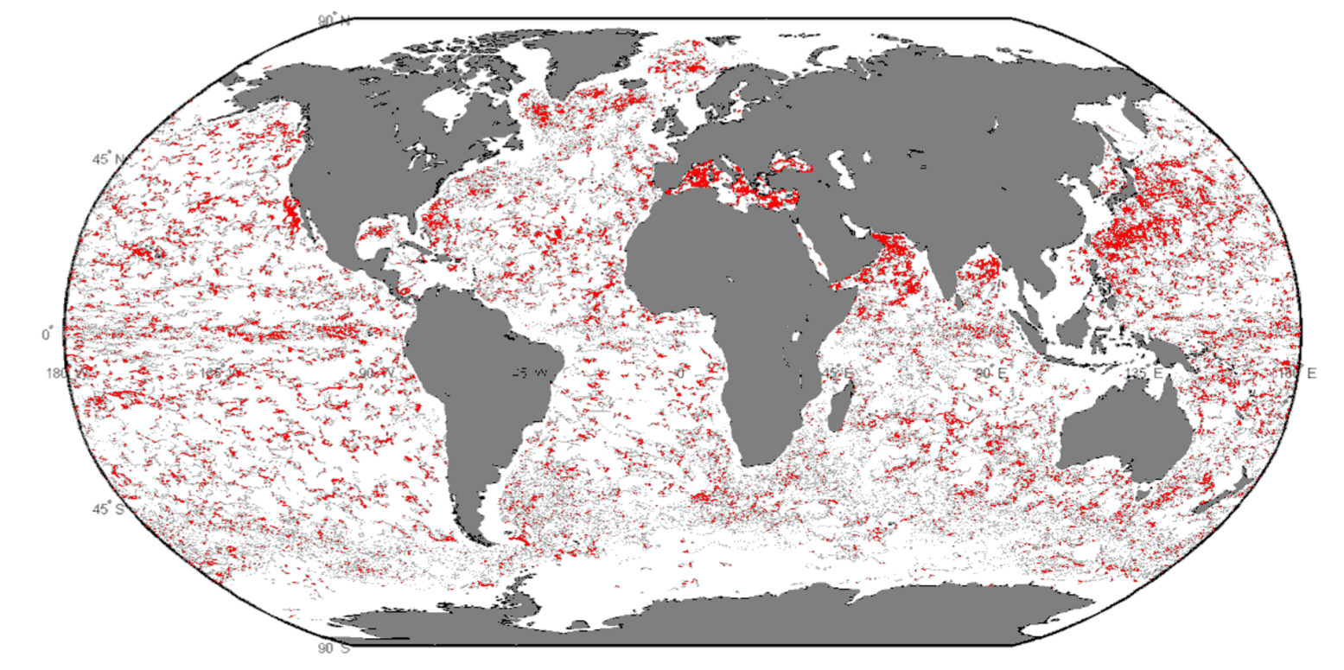
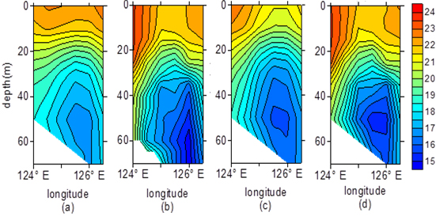
3. Application and service of Marine Big Data
Global temperature statistics
Temperature&salinity
Annual observation data
station map
marine section products
Marine big data processing and service
Notes:
These are some examples of Marine Big Data application and service in China.
Basic product ：Marine measured data products, global and regional marine environment statistical analysis products, marine section statistical analysis products

Slide 24
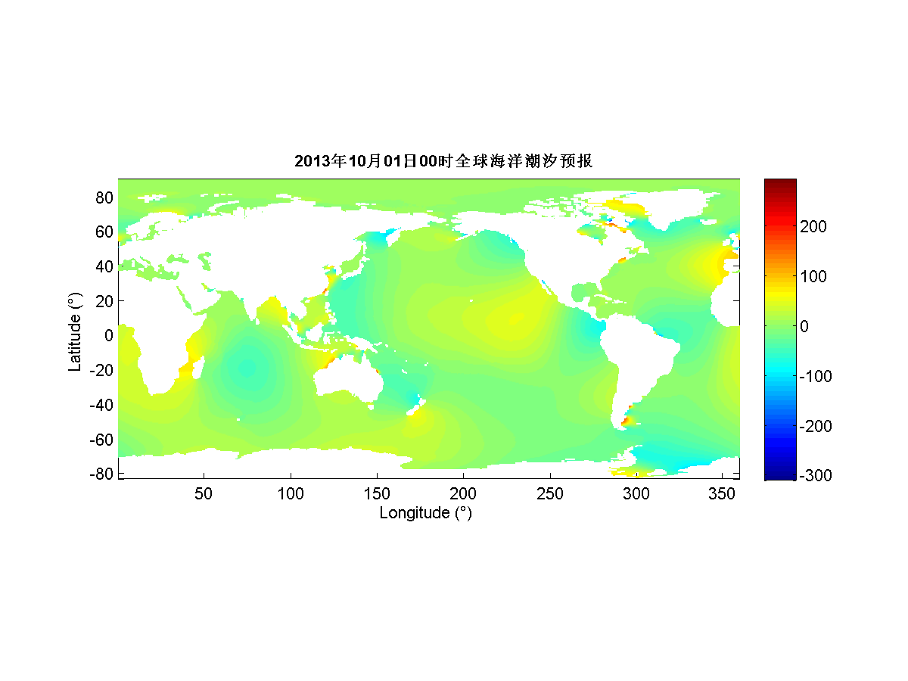
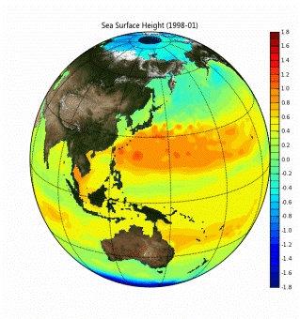
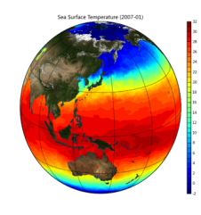
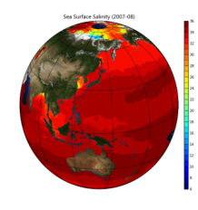
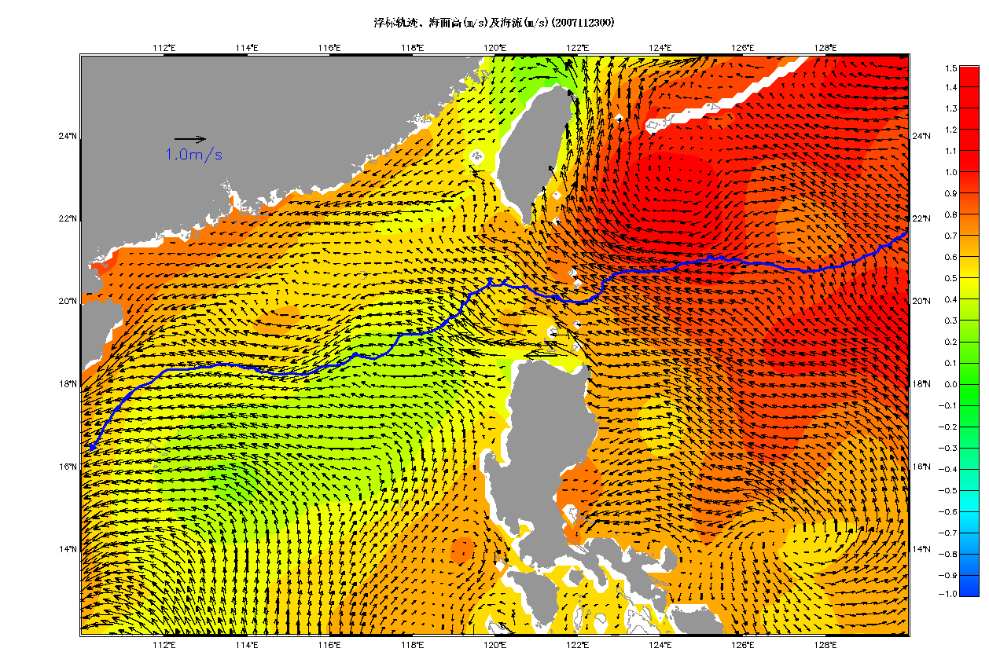
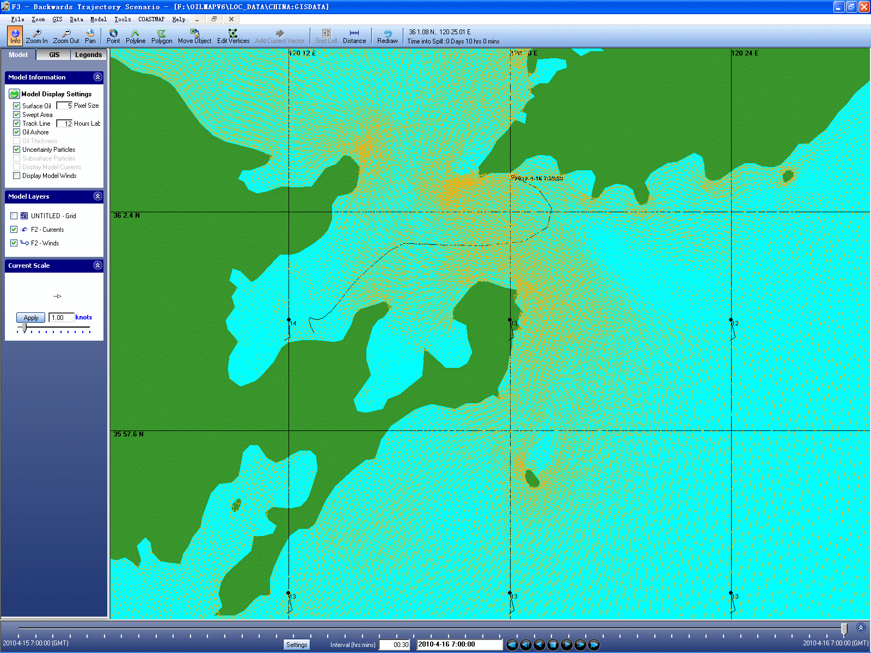
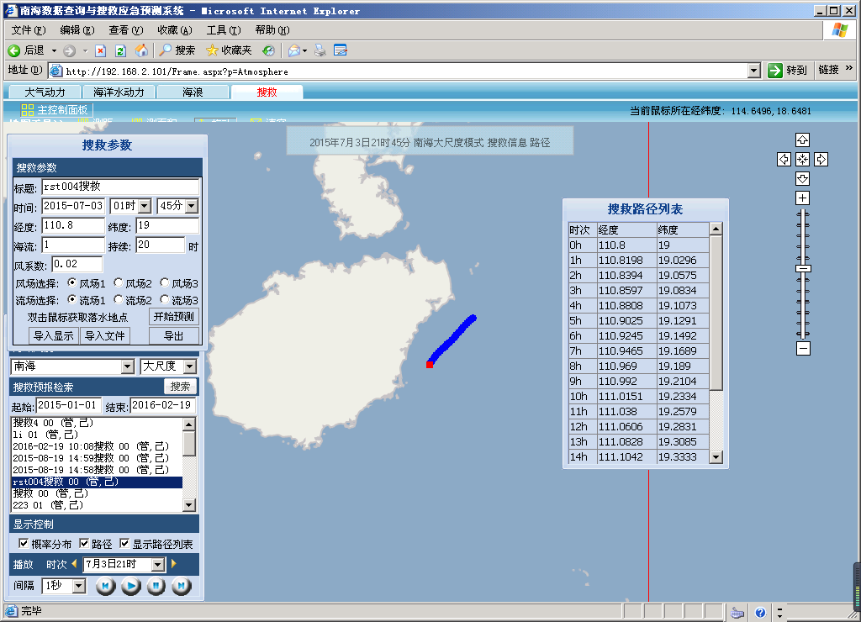
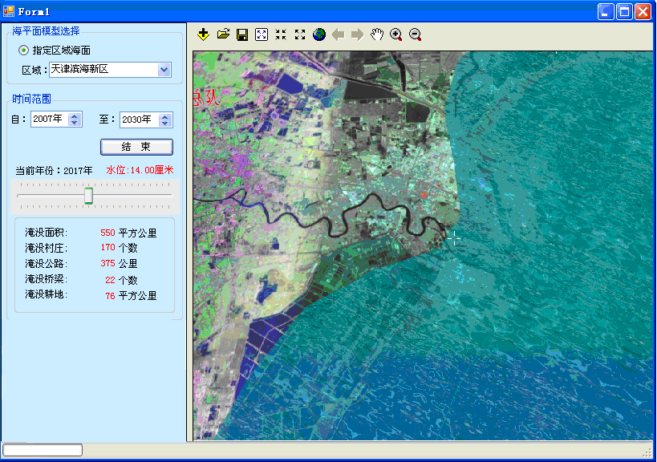
3. Application and service of Marine Big Data
CORA of China
Current and Buoy trajectory
Tide forecasting
Tide forecasting
rescue decision system
HaiNan，July3,2015
Huang Island 2010
oil spill monitoring system
Tianjin ，China
sea level impact assessment
Marine big data processing and service
Notes:
1、NMDIS has developed a set of marine environmental numerical model, （China Ocean ReAnalysis（CORA））making use of operational observation data, national survey data and international exchange data to run the numerical model and realize data dissemination and service.
2、Big data technology is used in the development of sea level assessment system, by analyzing data of sea level change, tides feature, elevation, coast condition, population, economic development and so on, the proper indicators can be selected to evaluate the vulnerability of sea level rise.
3、The Big data technology are applied in the research and development of oil spill monitoring system, as well as rescue decision system. These systems make full use of marine environmental parameter data including sea surface wind, air pressure, wave, current, temperature and salinity, tides and tidal current, and so on, taking into account of marine environmental reanalysis data, buoy tracking data, satellite data, ship observation data, drifting material features, to make comprehensive evaluation on oil spill trajectory and impact areas, search and rescue spot and routes, therefore help to make decision based on priorities.

Slide 25
3. Application and service of Marine Big Data
Marine big data processing and service
The development and application of blue economy big data
Big Data of marine ecological spatial planning and management
Big Data of sea area and island management

Slide 26

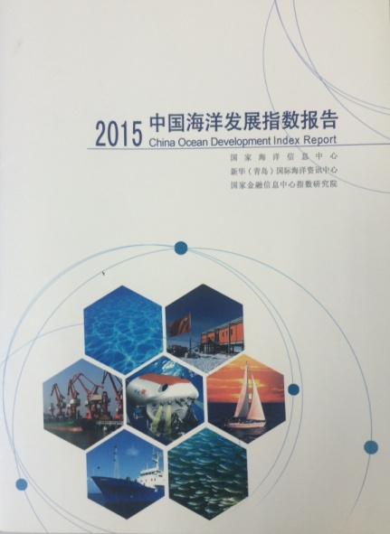
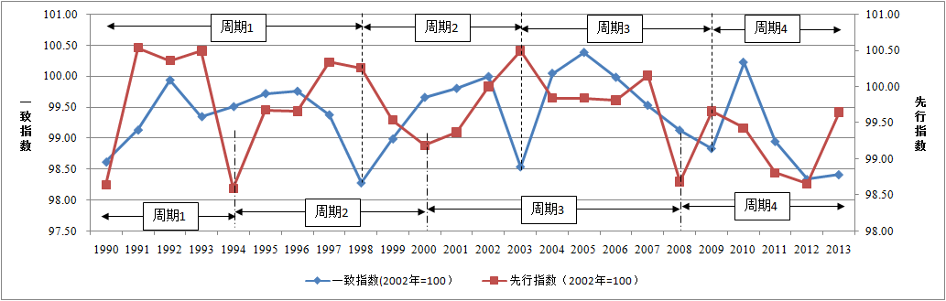
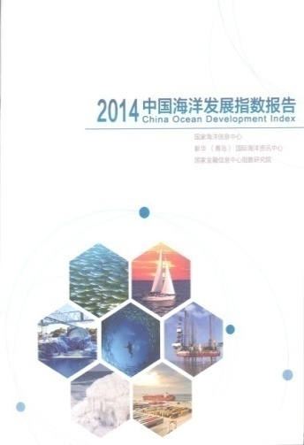
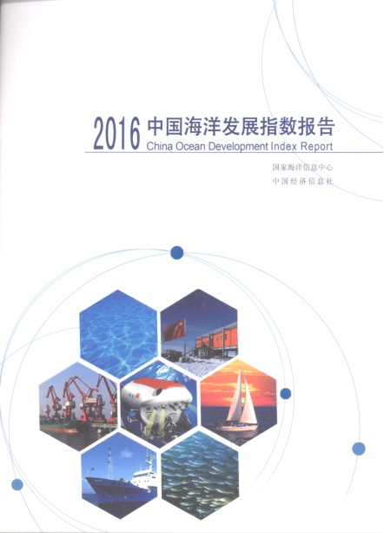
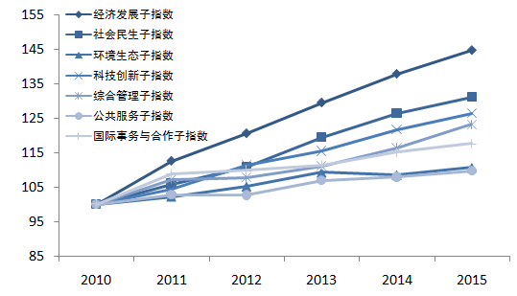
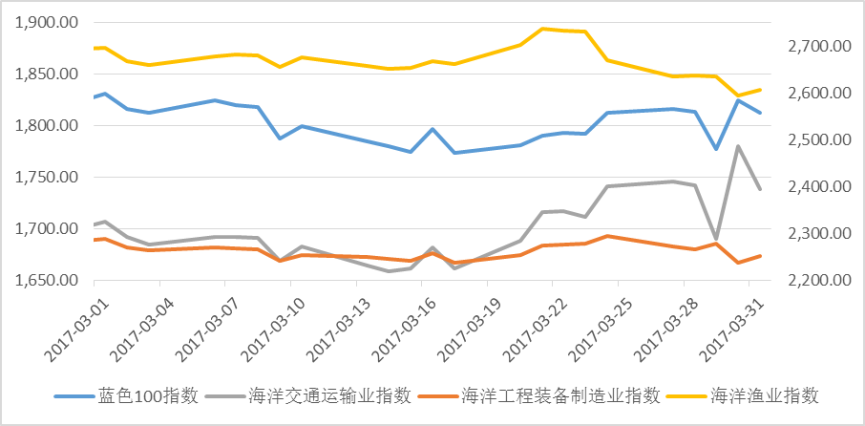
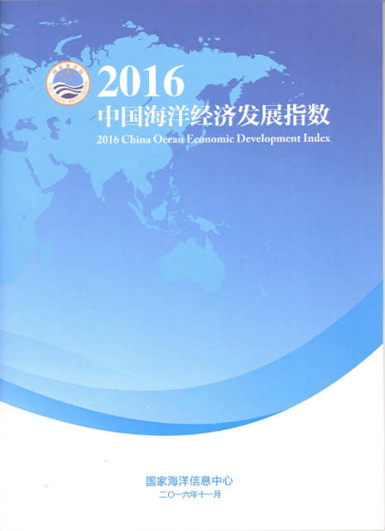
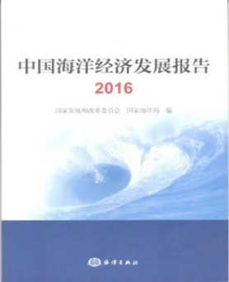
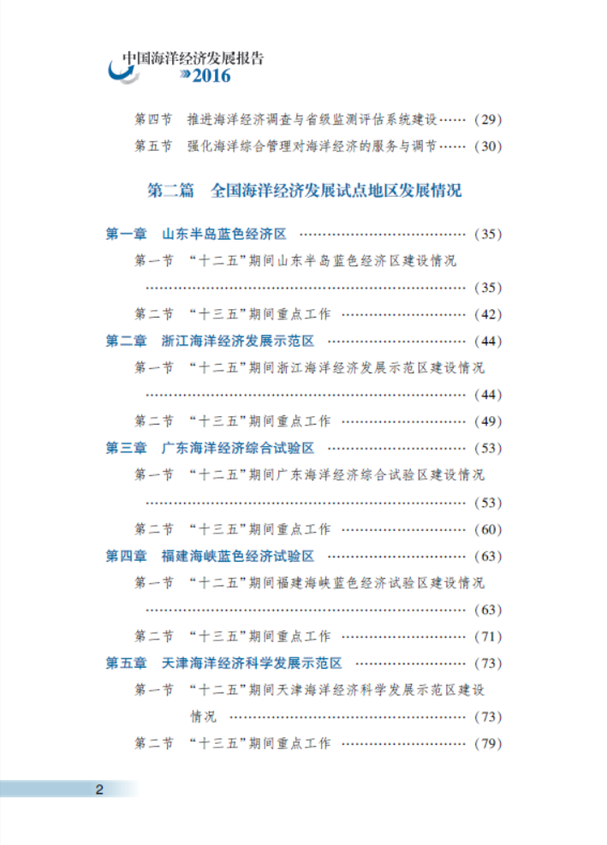
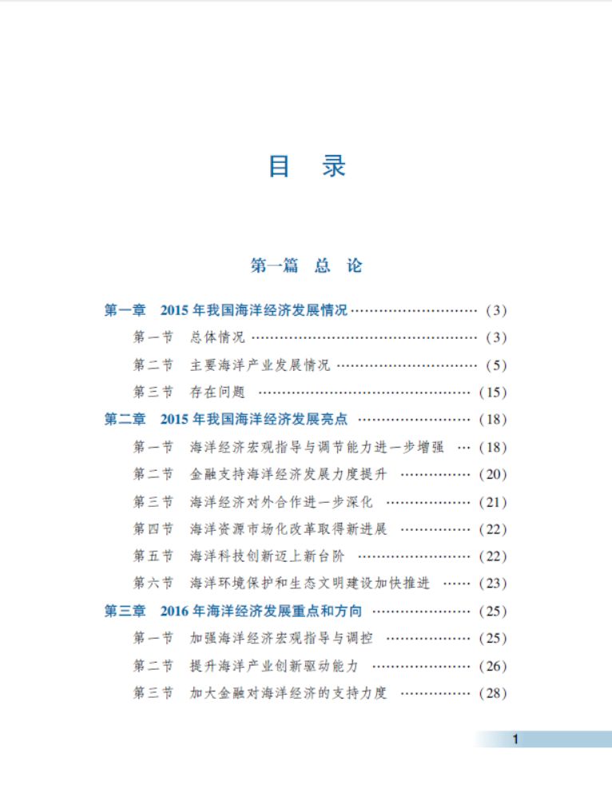
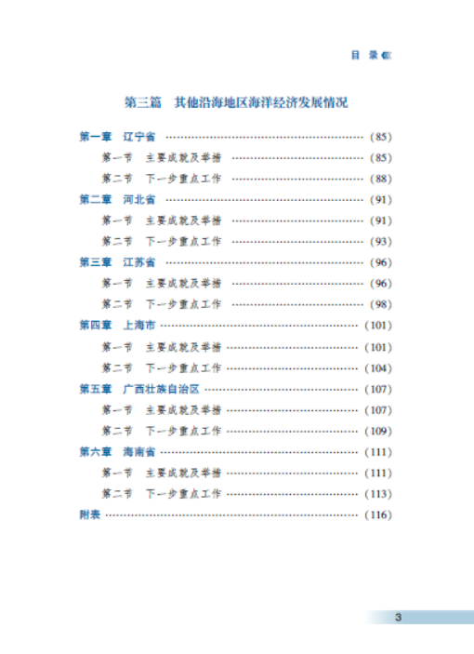
3. Application and service of Marine Big Data
Marine Economic Climate Index Report
China Ocean Development Index
Coincident indicator
Period 1
Period 2
Period 3
Period 4
Leading indicator
Period 1
Period 2
Period 3
Period 4
Coincident indicator,
2002=100
Leading indicator,
2002=100
The "blue 100" Marine Economic Stocks Price Index
China Ocean Economic Development Index
China Ocean Economic Development Index
Developmental level sub-Index
Report on China’s Economy Development
Developmental achievements sub-Index
Developmental potential sub-Index
The development and application of blue economy big data
Notes:
Using the data in the domain of economic development, social livelihood, environmental ecology, scientific innovation, comprehensive governance, public service, international issues and cooperation, we design the “China Ocean Development Index”, in order to reflect the overall development of ocean economy and ocean issues in a quantitative way.
We also design the “China Ocean Economic Development Index”, “Marine Economic Climate Index Report” and “The ‘blue 100’ Marine Economic Stocks Price Index” as well.

Slide 27
3. Application and service of Marine Big Data
Marine big data processing and service
The development and application of blue economy big data
Big Data of marine ecological spatial planning and management
Big Data of sea area and island management

Slide 28
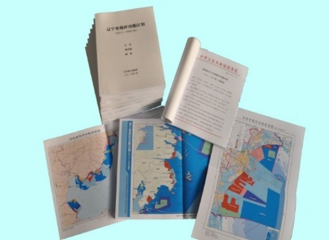
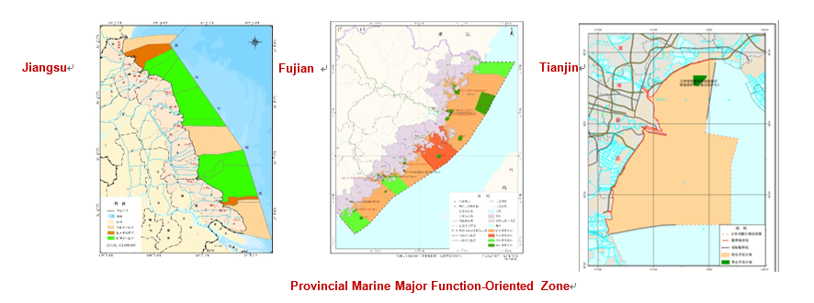
3. Application and service of marine big data
Marine Spatial Planning
Marine Major Function-Oriented
Zone Planning
  Marine Functional Zoning
Provincial Marine Functional Zoning
Notes:
Based on big data of marine ecosystem, marine environment, ocean resources, ocean economy, sea use, SOA has carried out marine spatial planning at national, provincial, city and county level. Basically, Chinese MSP contains two types, one is marine major function-oriented zone planning, the other is marine functional zoning. Tomorrow My colleague Dr lu will give you more detail information about Chinese MSP.
The first picture you can see in this slide is about research outputs of Chinese provincial marine functional zoning. NMDIS has actually been in charge of establishing the standard for marine functional zoning, and every coastal province in China has its own Marine functional zoning plan.
The lower part of this slide are provincial marine major function-oriented zone plans of three coastal provinces, which are Jiangsu, Fujian and Tianjin. In a word, marine big data plays an important role in Chinese marine spatial planning.

Slide 29
3. Application and service of Marine Big Data
Marine big data processing and service
The development and application of blue economy big data
Big Data of marine ecological spatial planning and management
Big Data of sea area and island management

Slide 30
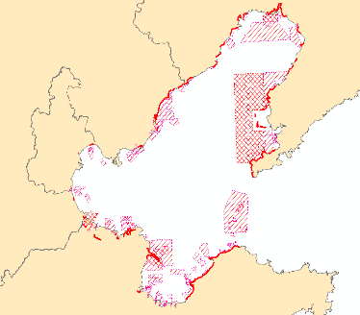
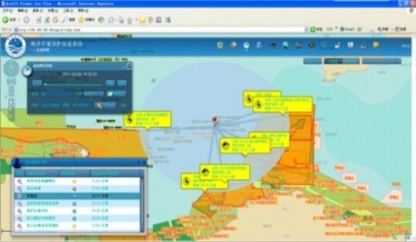
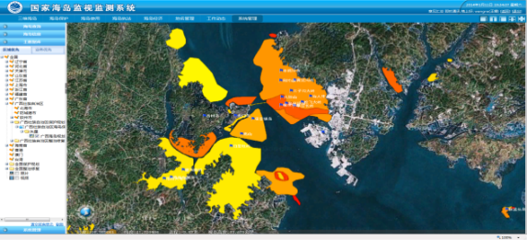
3. Application and service of marine big data
Hebei
Liaoning
Big data of sea area and islands management
Sea use, islands utilization and marine environmental monitoring systems
  Setting up redline for the protection of ecological regions.
  Marine integrated management based on ecosystem
Tianjin
Shandong
Redline for Protection of ecological regions in Bohai sea
National ocean environmental monitoring System
Big data of sea area and island management
National Sea Use and Island Utilization Monitoring System
Notes:
China actually attaches great importance to marine integrated management by applying marine big data. In 2015, SOA released Maine Ecological Civilization Construction Plan, which introduces measures for strengthening ecological conservation and pursuing green development.
SOA has established sea use monitoring system, islands utilization monitoring system, and marine environment monitoring system in China. The left bottom image in this slide is National ocean environmental monitoring System of China. The right bottom image is National Sea Use and Island Utilization Monitoring System of China.
By these systems, we can get huge amount of data with different types from our ocean. These data along with other types of ocean data, like ocean economy data, social data et al, could help us to set up redline for the protection of ecological regions in order to better protect our ocean. The first picture in this slide shows the redline for protection of ecological regions in Bohai sea.
Redline for the protection of ecological regions, along with marine functional zoning, marine major function-oriented zoning, help us to achieve our goal of marine integrated management based on ecosystem.

Slide 31
Global service of Marine Big Data of China
3. Application and service of Marine Big Data
CMOC/China：Data mirroring, technology communication and application of big data
ODINWESTPAC：integration of information in the WESTPAC , user-oriented information service
IOI-China Regional Center for Western Pacific Region: marine data management training
Others：China-ASEAN Big Data Center, China Argo Data Center, ODP WESTPAC node
Notes:
Through a number of international and regional project/program, Marine Big Data and data products are providing service regionally and globally.
CMOC/China: carry out dataset mirroring with other international or national node, provide integrated marine environmental data set for users domestic and abroad; develop big data technology communication and data sharing; cooperate on Marine Big Data application.
ODINWESTPAC：integrate marine data and information in the Western Pacific Region, provide user-oriented service for WESTPAC members.
IOI-China Regional Center for the Western Pacific Region：Provide data management training program for the WESTPAC region.
We also have other data center that proving big data service worldwide ,like the CHINA-ASEAN Big Data Center, China Argo Data Center, Ocean Data Portal WESTPAC node, and so on.

Slide 32
OUTLINE
1.
Big Data of China
2.
Development of Marine Big Data in China
3.
Application and service of Marine Big Data
4.
The future of Marine Big Data
Notes:
My report includes the following 4 parts.

Slide 33
4. The future of Marine Big Data
computing and storage resources integration
The construction of marine cloud platform
resource sharing using mirroring technology
Marine Cloud
Marine big data
center
of China
CHINA-ASEAN
Big Data Center
….
CMOC/CHINA
….
Vietnam
CMOCa
CMOCb
Thailand
Cambodia
Malaysia
CMOCc
Notes:
China Marine big data center is built on the "centralized and distribution" concept
It will integrate existing storage and computing facilities ,to put the demand customization and expansion capabilities into reality.
Make use of virtualization technology, the big data center will establish an open marine cloud computing platform which is safe and with unified standard.
Through the construction of CMOC / China, China Marine Big Data is planning to establish mirror protocols and mechanisms, by means of the technology such as Data Mirror, Database Mirror, Database Synchronous ,to ensure the data center and international related NODC data sharing and information interoperability.

Slide 34
4. The future of Marine Big Data
China - EU Marine Big Data Center Initiative
Marine data sharing and exchange：
Explore opportunities of cooperation between China and EU on Marine Big Data center, carry out dataset mirroring, data sharing and exchange
Technical research cooperation：
Blue economy,marine environmental protection, sea level change impact assessment, coastal management, etc.
Notes:
We would love to actively explore cooperation opportunities between China and EU on Marine Big Data center, to carry out dataset mirroring, data sharing and exchange. Under the framework of the big data center, technical research and cooperation on blue economy, marine environmental protection, sea level change impact, ocean and coastal management would be developed, to enhance the marine Informatization level of both China and the European Union members.

Slide 35
Thank You !
Notes:
This is My report about “Status and Trends of Marine Big Data in China”，Thank you for your attention！

