Slide 1
MERCATOR OCEAN operator of operational oceanography

Slide 2
MERCATOR OCEAN : Ocean Monitoring and forescasting
MyOcean : an EU/FP7 project of the GMES program
Oceanic circulation in the Japan area

Slide 3
MERCATOR OCEAN : Ocean Monitoring and forescasting
MyOcean : an EU/FP7 project of the GMES program
Oceanic circulation in the Japan area

Slide 4



MERCATOR OCEAN international context
French level : civil society (50 people)
European Level:
Contributes through the project MyOcean the Marine Core Service of the GMES (Global Monitoring for Environment and Security)
→ Mercator Ocean is the coordinator
61 partners, 29 countries, ~350 people http://www.myocean.eu.org
International level:
Contributes to the international program of analysis and forecasting of the ocean GODAE-OceanView
http://www.godae.org

Slide 5
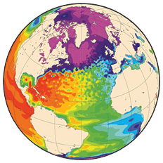
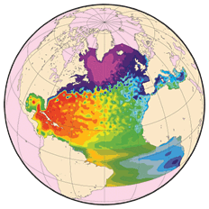
MERCATOR OCEAN – Systems
Mercator target system:
Global Ocean
and High Resolution
Strategy: from BASIN SCALE to GLOBAL
from R&D to OPERATIONAL
regional 1/36°
Atl 1/12°
2011
2011
1/15°
Global 1/12°
2006
Global 1/4°
2002
1/15°
Coupled with
♦ an ice model
♦ an ecosystem model
Global 1/4°
Global 2°
Assimilation :
Altimetry
Altimetry + SST + T(z) + S(z)
Notes:
The Mercator systems are based on an ocean model coupled with an assimilation scheme that integrate 3 types of data :
Satellite Altimetrics data
In-situ data
SST products from satellite products ( differents of the satellite data for which we assimilate along tracks)
The assimilation scheme combined to the ocean model provides states of the ocean as close as possible to the reality which is then used to provide initials and boundaries conditions for users.
You can see on this slide, the evolution of Mercator systems since 2002. The objective is to cover the global ocean high resolution by assimilating all the data available to force the physic. That is what we do today.

Slide 6
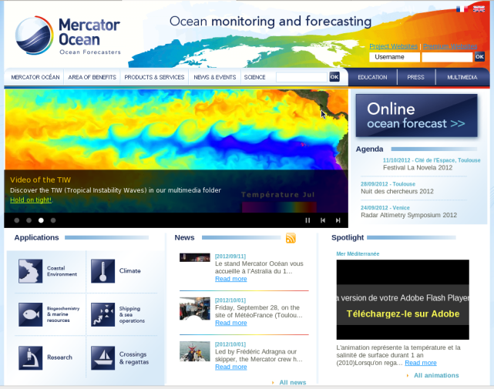
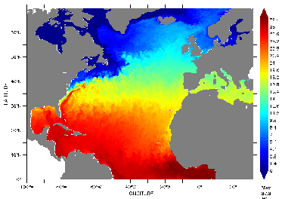
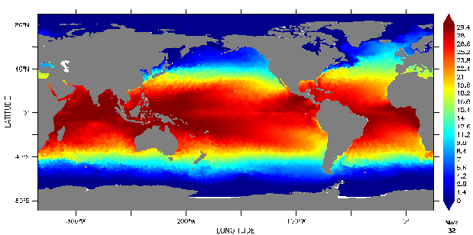
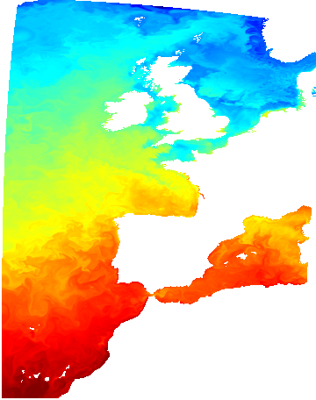
Operational ocean prediction and reanalysis systems
Global Ocean, real time
  Global 1/4°, physics (incl. Sea ice), daily
  Global 1°, bio, weekly (coupled to the global ¼° physics). New system available in MyOcean.
  Global 1/12°, physics (incl. Sea ice), weekly
Basin and regional seas, real time
  North Atl & Med 1/12°, physics, daily
  Atl IBI area, 1/36°, physics, daily,
Global Ocean, Reanalysis
  Global 1/4°, physics (incl. Sea ice, 1992 to 2009,
  (17 years)
All systems are based on NEMO OGCM and assimilate Altimetry, SST and in situ T&S (incl. ARGO)
  (except #5 IBI: no assimilation)
www.mercator-ocean.eu
Notes:
Here is the list of operationnal Mercator systems available today

Slide 7
Real Time operation
T_{i}-14
Model Hindcast
T_{i}-7
Model Nowcast
T_{i}
T_{i}+7
Model Forecast
Wednesday
(T_{i})
Every week:
  2 weekly analyses back in time (hindcast and nowcast),
  1 week of forecast,
  a set of daily maps & numerical fields, from top to bottom : T, S, U, V, W, SSH, ice
  driven at the surface by atmospheric conditions from the ECMWF.
  Every day:
  A one week forecast is produced thanks to an update of the atmospheric condition. That will be available for the global high resolution in 2013.
Model Hindcast
Model Nowcast
Model Forecast
Wednesday
(T_{i+1}=T_{i}+7)
T_{i+1}-14
T_{i+1}-7
T_{i+1}
T_{i+1}+7

Slide 8
MERCATOR OCEAN : Ocean Monitoring and forescasting
MyOcean : an EU/FP7 project of the GMES program
Oceanic circulation in the Japan area

Slide 9

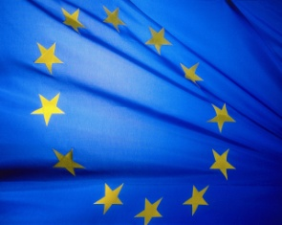
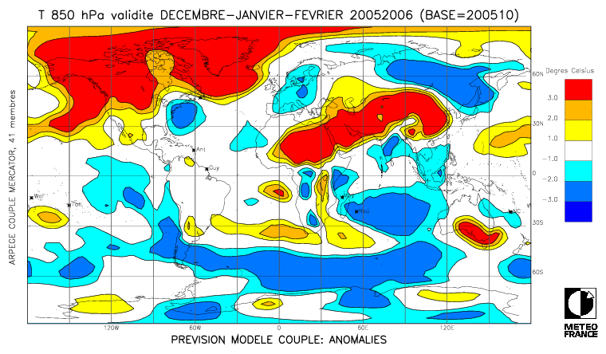
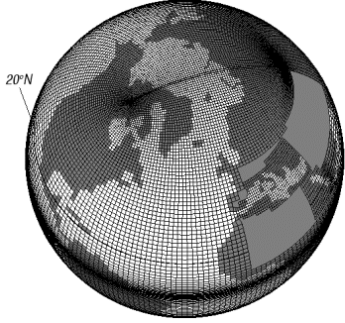
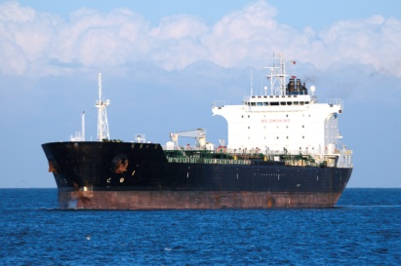
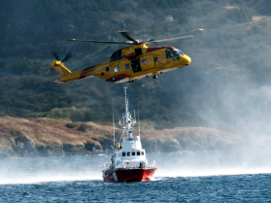
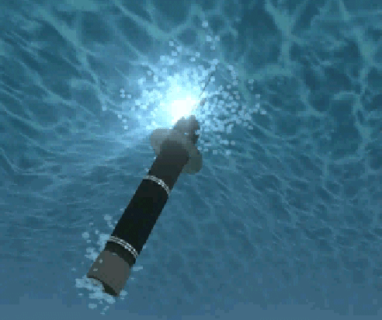
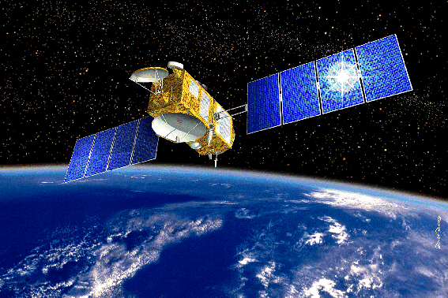
MyOcean2 is the GMES EU/FP7 project committed to implement the European Marine Core Service.
Same goal and same organization as MyOcean
Project from 2012 to 2014.
Sustainable service is planned after 2014
Core
information
(ocean state)
User customized
information
(user products)
GMES input
information
GMES
Satellite
and
in situ
networks
Marine
Core
Service
Downstream
Services
National Users
GMES
Service
outputs
(others)
Notes:
Myocean is the european service set up as part of GMES for the ocean.
In this organisation, MyOcean is the implementation of the Marine Core service.
Upstream, the data providers ( Space agencies, ARGO program,…) and downstream the implementation of services for users.
The core service, its the coordination between data providers, the development of the forecasting and analysis systems, and the diffusion of products to users.

Slide 10
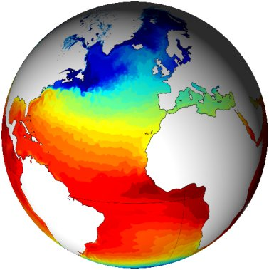
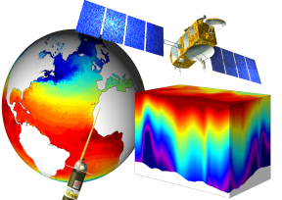
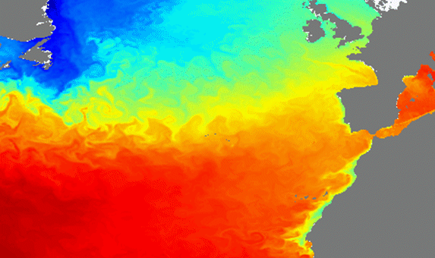
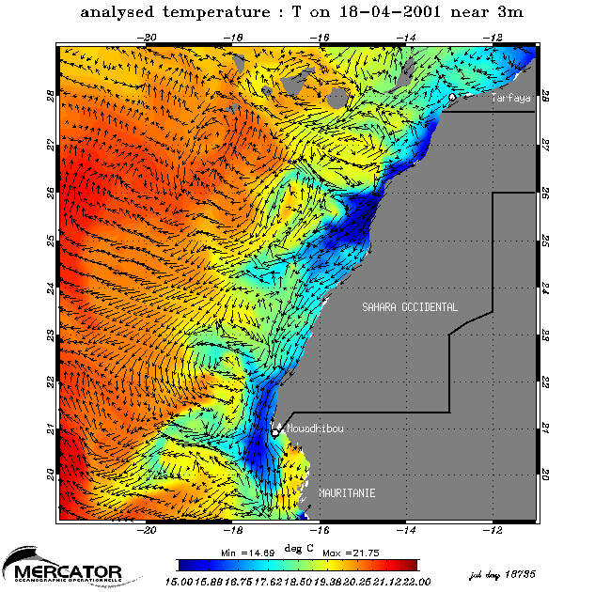
MyOcean : european GMES core service for the Ocean
  “MyOcean delivers a regular systematic information, (data and elaborated products) on the state of the ocean and seas :
          At the required resolution for intermediate users and services providers,
          Quality and accuracy,
                For global ocean and european seas. ”
Journée DORIS_NET – Mer et Littoral – 29 mai 2012

Slide 11
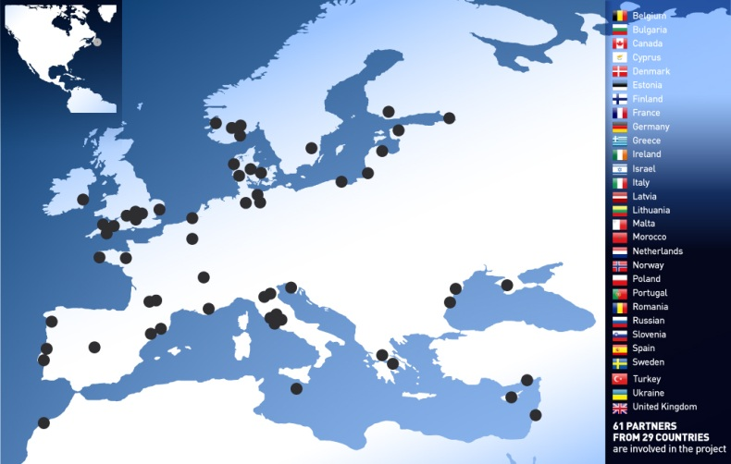


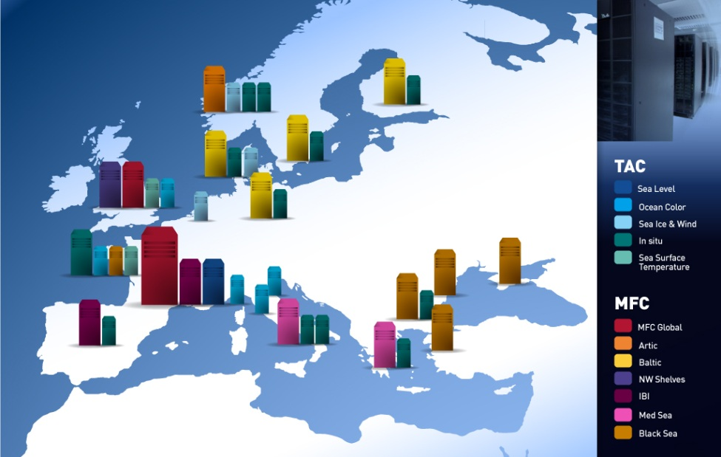
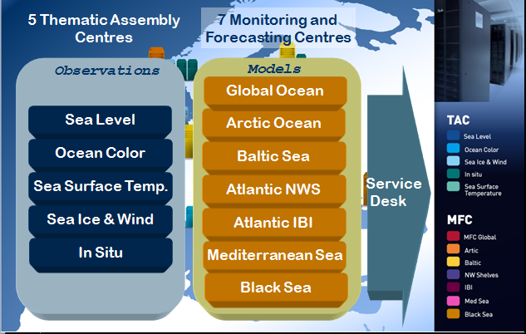
61 PARTNERS and 29 COUNTRIES
Notes:
This is the specific organisation of MyOcean based on 2 types of production centers :
The thematic Assembly Centers that collect data to provide users and analysis and forcasting systems. There are 5 centers : -----; These data are mainly based on data from satellite. And, in situ data come essentially from the ARGO program, but also from measurement campaign, and marine animals.
There are 7 monitoring and forecasting centres and downstream, the service desk for the users .
Mercator-Ocean provides the global system, and on the the back up for the IBI area with the spanish, and is in charge of the service desk.

Slide 12
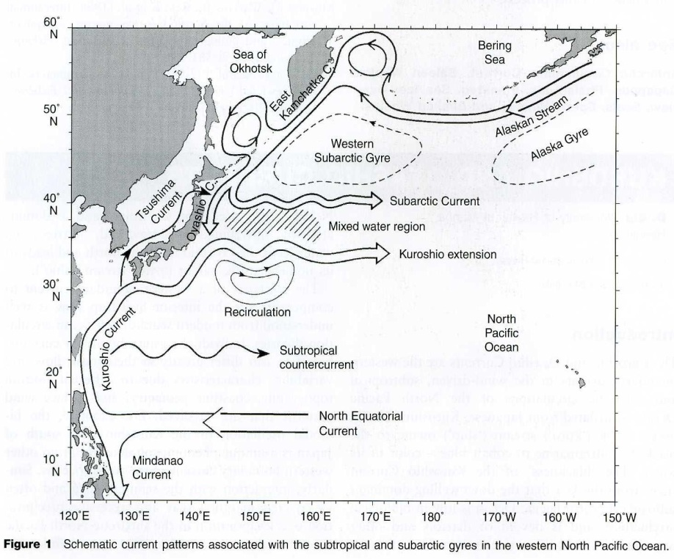
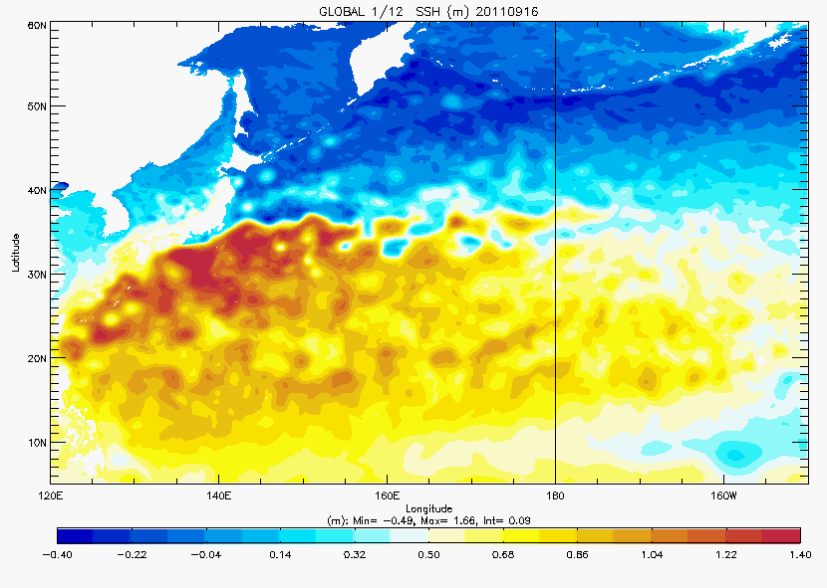
The North Pacific Circulation
Global 1/12 SSH(m)
Alaskan Stream
Oyashio current
The Kuroshio Extensiont
The Kuroshio current
North Equatorial current
Notes:
Le courant équatorial Nord Pacifique bifurque généralement entre 12°N et 13°N à l’Est des côtes Philippines. Sa branche allant vers le Nord forme le courant Kuroshio (la branche allant vers le Sud, le courant de Mindanao) : il s’agit d’un courant chaud (à l’instar du Gulf Stream dans l’Atlantique Nord) qui transporte les eaux tropicales vers la région polaire. Sa trajectoire passe par le détroit de Luzon, longe Taiwan, continue vers le Nord Est. Autour de 128°E-129°E et 30°N, le Kuroshio se détache de la pente continentale et vire vers l’Est à travers le détroit de Tokara. Une partie des eaux transportées par le Kuroshio alimente le courant de Tsushima circulant vers le Nord le long des côtes Ouest du Japon. C’est le mélange des eaux continentales froides et des eaux chaudes du Kuroshio à l’Est de la mer de Chine qui est à l’origine du courant de Tshushima.
Le Kuroshio poursuit ensuite sa trajectoire vers le Nord Est, passant le long des îles Ryukyu avant de longer les côtes japonaises dont il se sépare près de 35°N et 140°E et poursuit sa route vers l’Est du bassin. A l’Est du Japon, on observe la présence de deux méandres quasi-stationnaires ayant des crêtes situées à 144°E et 150°E. Ces méandres résultent de la topographie de la dorsale Izu. Près de 159°E, au niveau de la dorsale Shatsky, le Kuroshio bifurque : le corps principal du Kuroshio continue vers l’Est et une seconde branche s’étend vers le Nord-Est jusqu’à 40°N où il rejoint le courant subarctique circulant vers l’Est. Cœur ?
Il manque beaucoup de noms qui sont dans ton texte sur la figure.
On this slide you can see a schematic representation of the circulation in the North Pacific Ocean, with the main currents : the North Equatorial Current, the subarctic gyre, the kuroshio.
This is a plot of SSH from the Mercator Global 1/12° system. We can see that the system gives a good representation of the main currents, the position of the different fronts : the kuroshio, its ectension flowing eastward, the Alaskan Stream, … The North equatorial current whose position has a seasonally variability.
The system at 1/12° reproduces successfully the meso-scale structures, like eddies.

Slide 13
Validation
Spatial distribution of the salinity (left, PSU) and temperature (right, °C) RMS error departures from the observations in the global system in January-February-March 2011, averaged in the 0-50 m layer (upper) and in the 0-500m layer (lower). The size of the pixel is proportional to the number of observations used to compute the RMS in 2°x2° boxes.
Notes:
First exemple of validation is the comparaison between the model and th in situ obs.
An exemple with the statistics computed for 3 months. This validation is done regularly in the operationnal systems.
In the Kuroshio you can see that the error is quite small is the southern part of the current, less than 0.1PSU and 0.5°C.
Along the front of the Kuroshio, the error increases, but stays smaller than 0.4PSU and 2degrees.
We have the same pattern for the surface layer and the deeper levels.

Slide 14
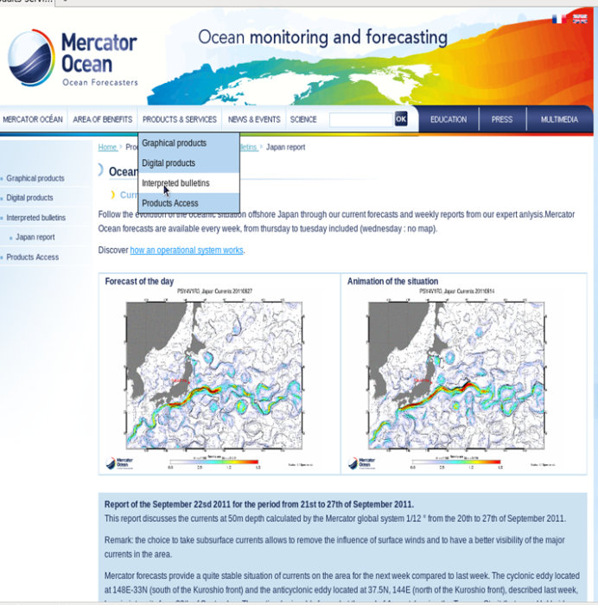
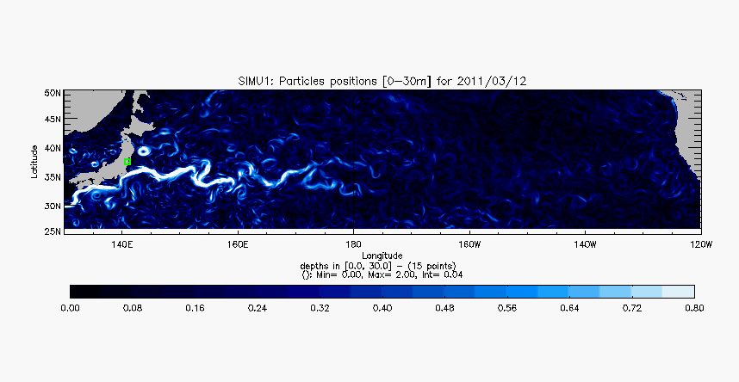
Lagrangian drift of water particles since
March, 12, 2011
Specific Mercator Bulletin
In Japan area
PSY4 : Module of current (m.s-1)
ARIANE : Blanke B, Raynaud S : Kinematics of the Pacific Equatorial Undercurrent:
An Eulerian and Lagrangian approach from GCM results;
JOURNAL OF PHYSICAL OCEANOGRAPHY Volume: 27 Issue: 6 Pages: 1038-1053; JUN 1997
Monthly update
Notes:
-During 1 year we have elaborated dedicated to the oceanic situation over the area of Japan with the global 1/12°, on which we described the currents, their position , intensities. We provided also details about Temperature, salinity, penetration depth of the currents
This was completed in March 2012.

Slide 15
Conclusions
MyOcean/Mercator-Océan provides in real time analysis and forecast for the global ocean at high resolution which allows a good representation of the main currents and meso scale structures as eddies.
MyOcean products are freely available after registration on the website , there is no production on request.
Mercator Océan performs validation and expertise of the real time production on the global ocean. Other specific products which are not available in MyOcean catalogue can be deliver by Mercator Océan. For example, better resolution, longer period …
MERCATOR OCEAN
e-mail: products@mercator-ocean.fr
URL: www.mercator-ocean.fr
MYOCEAN
e-mail: servicedesk@myocean.eu.org
URL: www.myocean.eu
Notes:
15

Slide 16
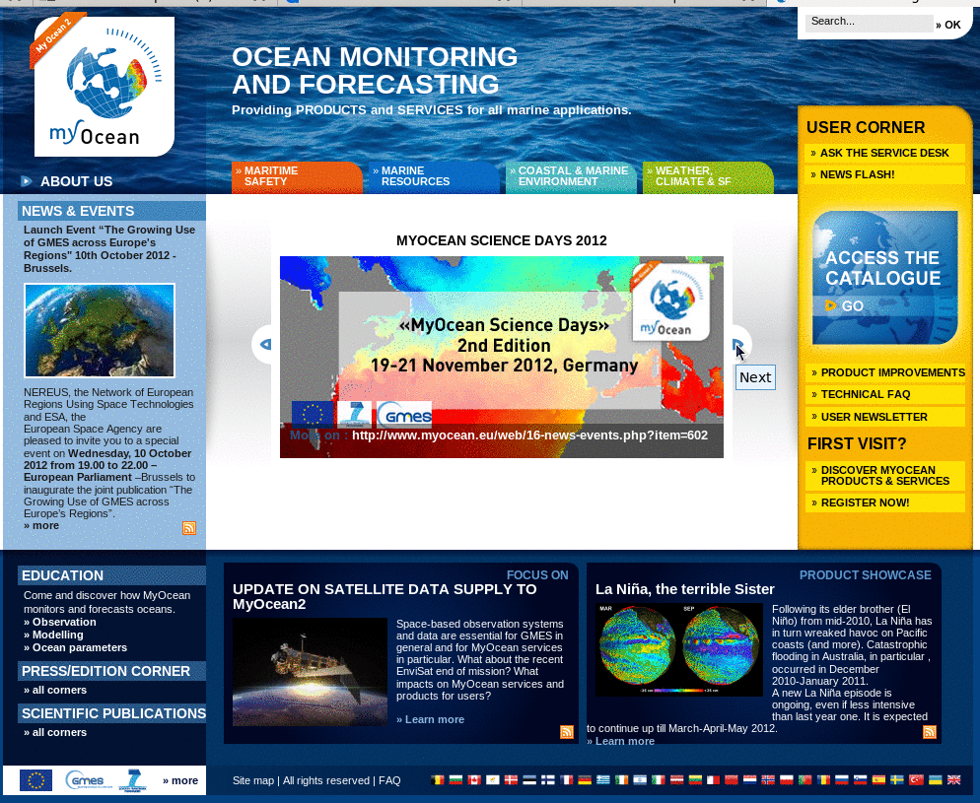
http://www.myocean.eu.org/
Notes:
Le site web de MyOcean avec l’accès au catalogue des produits fournis par les différents centres de production.

