Slide 1
measuring the blue economy
Member States' Expert Group,
on Integrated Maritime Policy,
9 December 2015

Slide 2
shipbuilding
non-living resources
transport
living resources
presented to ad-hoc expert group 29 September, 2015
coastal tourism

Slide 3
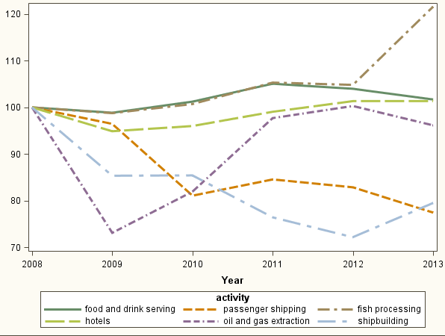
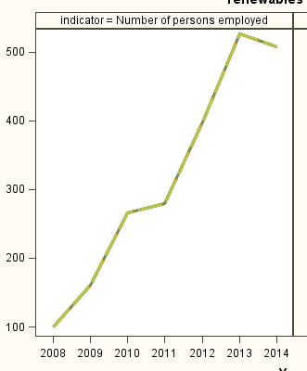
growth in employment
traditional industries
offshore wind

Slide 4
average wages

Slide 5
5 million employed?

Slide 6
The EU's blue economy covers market activity taking place on European territory that is intrinsically linked to the sea.

Slide 7
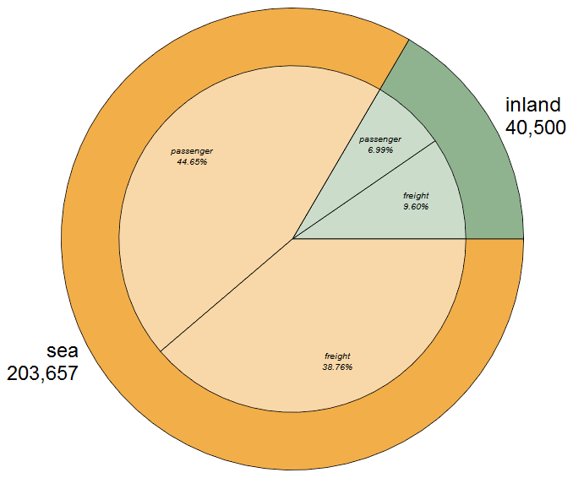
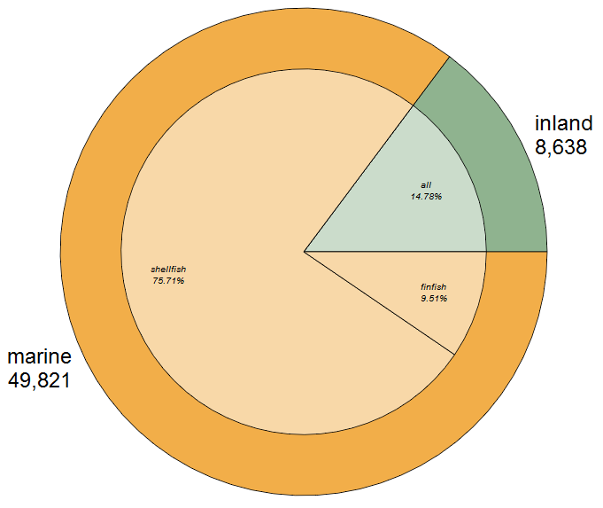
include inland activities
shipping
aquaculture
employment

Slide 8
include income from activities outside EU

Slide 9
count non-market activities separately
research
defence
coastguard
etc

Slide 10
next steps
consulting
Industry associations
Member States
filling gaps
study to kick off January 2017
checking anomalies
Structural Business Statistics versus Labour Force Survey
presenting results
event?
annual 'State of the Blue Economy' report?

Slide 11
stress tests on marine data
Member States' Expert Group,
on Integrated Maritime Policy,
9 December 2015

Slide 12
are data fit for use?
Mediterranean and North Sea
at half-way point
Arctic, Atlantic, Baltic, Black Sea
beginning
do we have coherent set of marine protected areas?
how quickly can we assess damage from oil spills?
how fast are our coasts eroding?

Slide 13
interim results
oil spill impact forecasts
highly sensitive to wind forecasts
fishing activity in the North Sea and sensitive areas in the Mediterranean;
marine protected areas
information on the management measures incomplete
cannot tell if they are coherent set
eutrophication in the Mediterranean reduced over past 10 years;
no comparable data on coastal erosion
more than 9 months to get fisheries data
and still incomplete
Confirmed usefulness of
OSPAR sea-basin convention (for the North Sea)
completed EU research projects (for the Mediterranean)

Slide 14
more information on EMODnet portal

