Slide 1
Coastal Mapping
WP1 – Digital mapping
Worldline
Joseph.colin@worldline.com

Slide 2
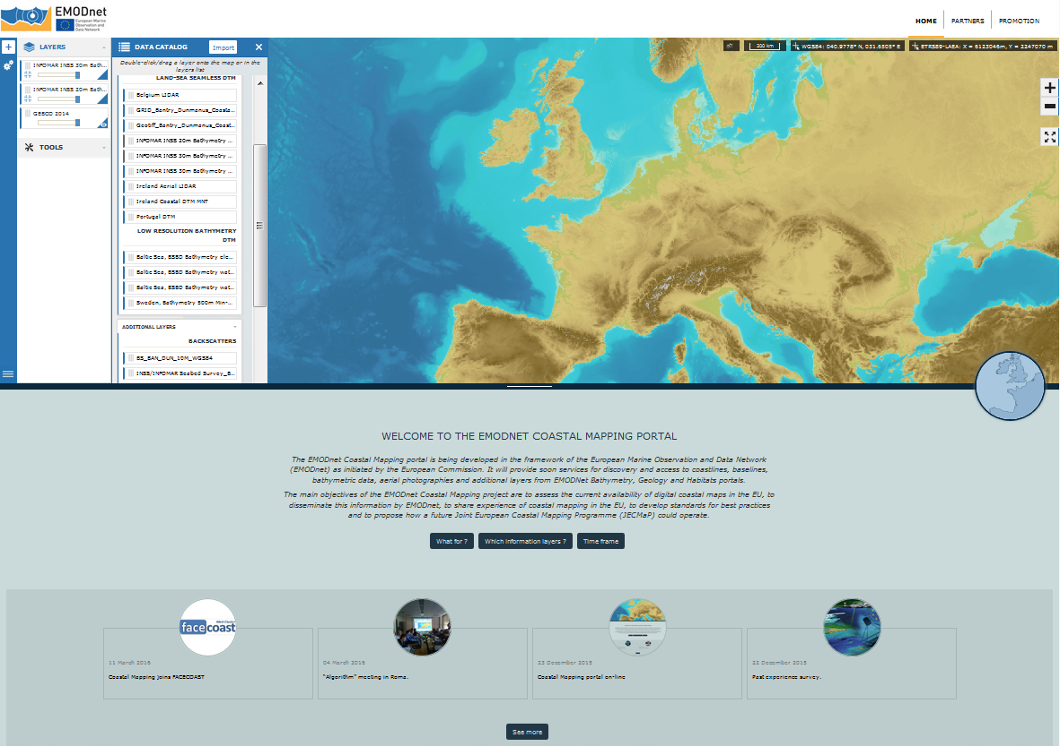
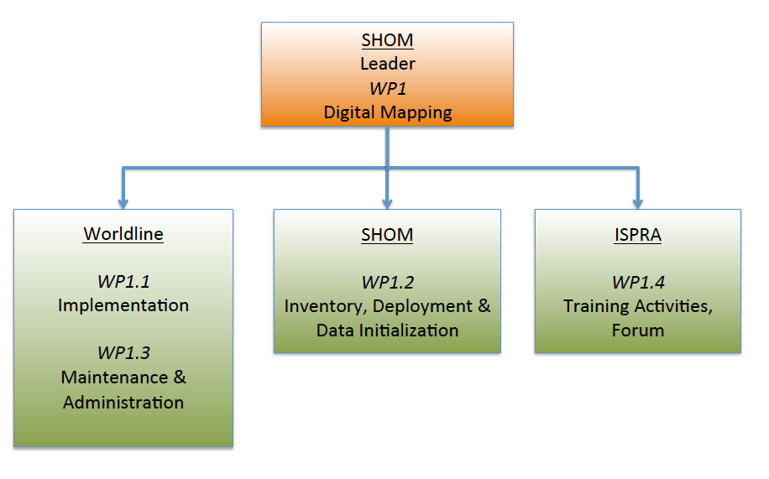
WP1: Digital Mapping

Slide 3
Internet Portal
Portal
EMODnet look and feel
Simple and modern design
Catalog of digital maps
Tools
Bathymetric profile
Data and metadata download
Coastal Mapping Planner Algorithm
Data ingestion of GPS points
Data Warehouse
Data ingestion of Digital Terrain Models and surveys
Upload of images and data files, and publishing as WMS

Slide 4
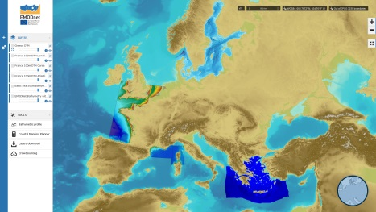
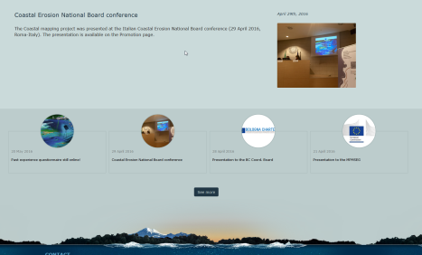
Portal architecture and data origins
Coastal Mapping portal
Partner 1
WMS Service
GIS portal
+
catalog
Partner 2
WMS Service
Data files
Data Warehouse
Data ingestion, transformation and publishing
WMS Service
Partner 3
Editorial portal
Data files

Slide 5
Portal demo
Navigation
Available datasets
Tools

