Slide 1
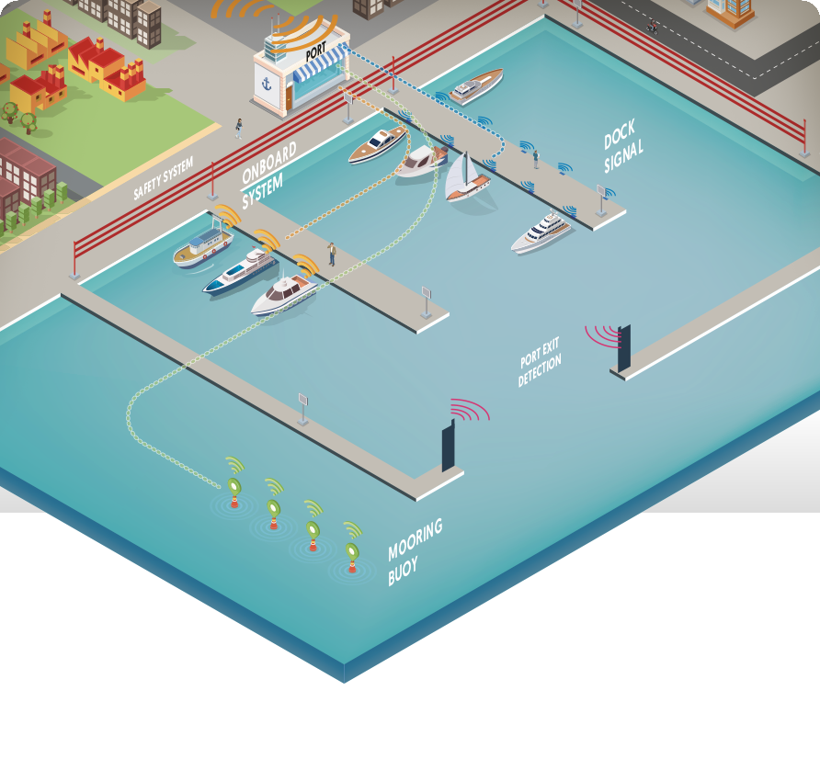
--- Harbor management solutions for real-time berth supervision ---

Slide 2
Current Problems
Leisure Harbor
Manual inventory
Berth capacity unknown
Financial loss due to non-optimization
Boaters
Declaration of Absence : 10 %
Stopover
Available berth shortage
Time consuming process
Low service offer

Slide 3
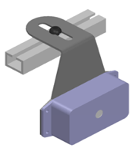
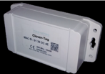
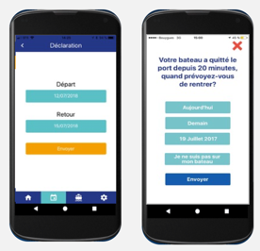
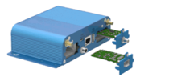
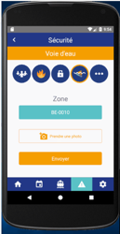
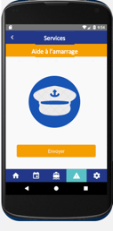
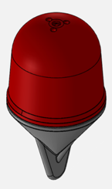
Two complementary solutions
Real-time Berth Supervision : sensors
Services : Mobile App
Pontoon
On board
1
Weather / Live Cam
2
Declaration of Absence
3
Incident Alerts
4
Mooring Assistance
Mooring buoy

Slide 4
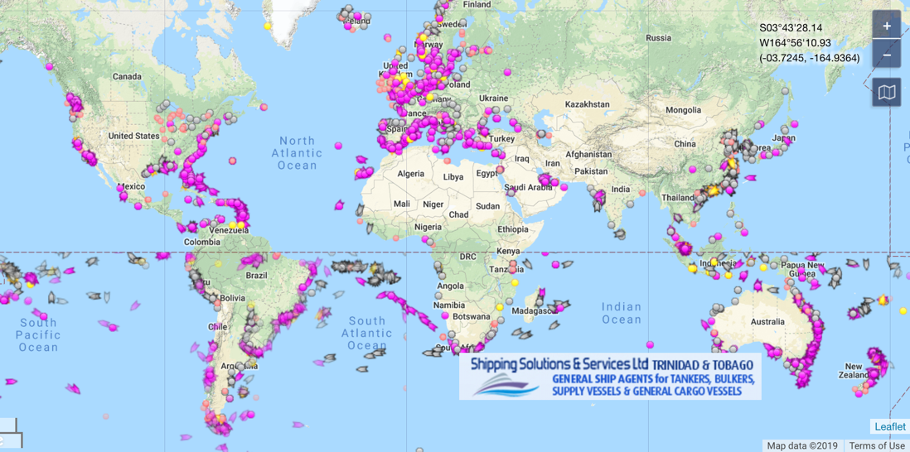
Market and competition
Europe
4 000 harbors
1 500 000 berths
Marina Softwares
Booking platforms & boaters App
B2B / B2C approach
Own sensors developped with Electronics University
Real Time complementary solution

Slide 5
Benefits for around 0,5 - 1% of turnover
Financial Gain
Stopover : Up to + 20% turnover (up to 80K€)
Services : Up to + 5% turnover
Boaters
Customer satisfaction
Loyalty
Operational benefits
Real-time supervision
Security
Staff motivation (Services Vs Problems)
Strategic benefits
Connected Smart Harbor
Dynamism of port activity and Tourism
« Cupping Boats » Identification > Reduced waiting list
Increased berth capacity
Highlighting the Human in the service of boaters

Slide 6
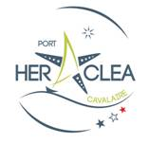
Company Vision / Goals
Be a reference
in marina management
Get 15 harbors including 2 international
Create a 100
Harbors
community
Implement pilots in major countries in the Mediterranean Sea
2021
2020
2019
Reach
30.000 users
2017-2018
4 harbors
250 sensors
60 K € turnover

Slide 7
Raise funds between 500K up to 1 M € to go fast globally
HR
Product
cost
Partnership
R&D
Sales Expansion
Internalize Hardware & Software
Increase production
Reduce production cost
Increase margins
Install faster & bigger
Distribution
Harbor builders
Pontoon Manufacturer
Berth booking actors
Improve software
Develop new product
Stay ahead of the competition

Slide 8
Thank you for your attention

Slide 9
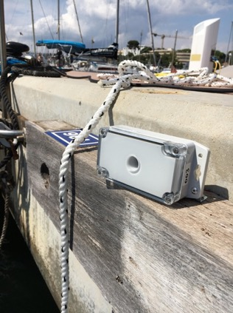
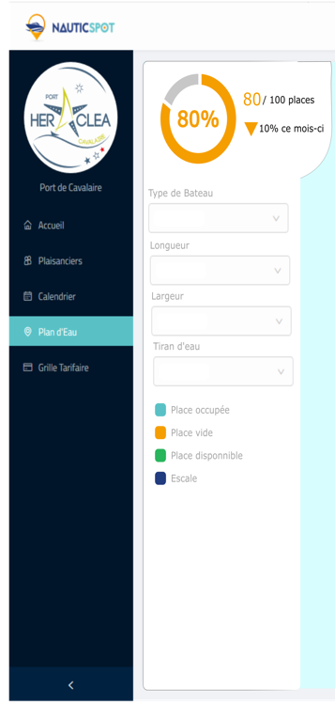
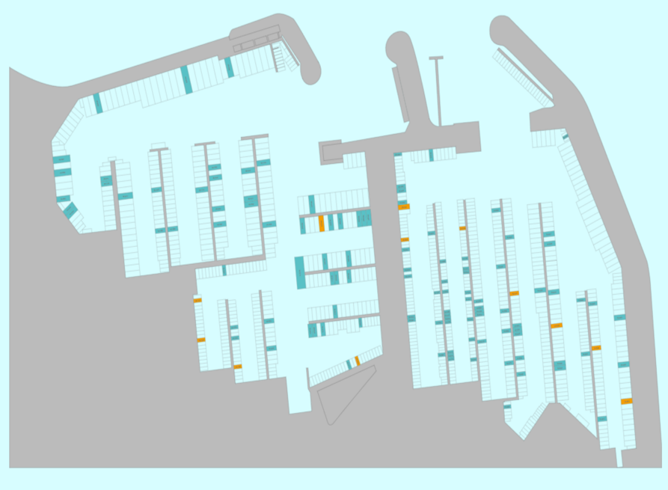
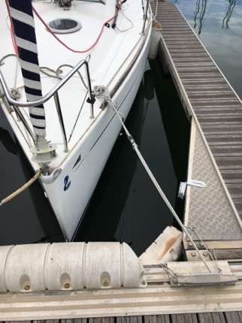
Real-time berth supervision

Slide 10
Services – all involved in the marina safety

