Slide 1
Large-scale sustainable water reuse and resource recovery based on microalgae and bacteria symbiosis
Zouhayr Arbib
and Frank Rogalla

Slide 2
Index
Introduction
Design & construction
Demo plant description
Process operation
Conclusions

Slide 3
1. Introduction
Wastewater treatment in small communities
European Directive 91/271/EEC about Wastewater Treatment (WWT) excludes agglomerations smaller than 2,000 inhabitants, falling the responsibility directly on each state member …
new revision targets 1000 inhabitants
In Spain, 72% agglomerations have <2,000 inhabitants. Besides, approximately 50–60% of the population from small communities do not have an adequate sanitation coverage
Aragón et al., 2013
WWT in small communities faces administrative issues.
Energy consumption ratio increases as size of plants decrease
Hernández-Chover et al., 2018; Saúco et al., 2021
WWT based on microalgae systems would have several advantages compared to traditional systems: no sludge, no energy
Notes:
- European Directive 91/271/EEC about Wastewater Treatment (WWT) excludes agglomerations smaller than 2,000 inhabitants, falling the responsibility of the WWT in these communities, directly on each state member (European Commission Directive, 1991).
- In Spain, 72% of the agglomerations have less than 2,000 inhabitants. That way, according to Aragón et al., (2013), approximately 50–60% of the population from small communities in Spain do not have an adequate sanitation coverage.
- WWT in small communities faces not only bureaucratic issues, but it is also well known that energy consumption ratio increases as the size of the WWTP decreases.
- For that reason, WWT based on microalgae systems would have several advantages compared to traditional systems.

Slide 4
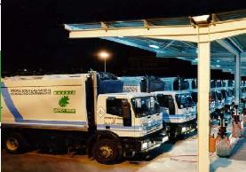


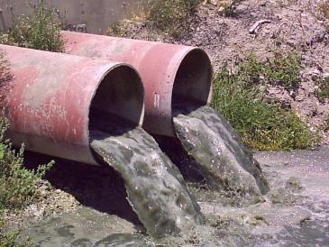


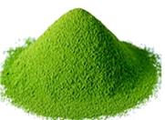
Introduction
Microalgae-bacteria symbiosis
Biomethane
WW rich in
C, N and P
P
N
C
Microalgae
O₂
CO₂
Symbiosis
Reuse
RD 1620/2007
COD
Bacteria
Biofertilizers and others
Notes:
Microalgae-bacteria wastewater treatment is described as a symbiotic relationship in which microalgae take CO₂ and solar radiation to generate O₂ through photosynthesis. Then, heterotrophic bacteria make use of this oxygen to assimilate and degrade organic matter. Finally, CO₂, inorganic nitrogen, and phosphorus are used by microalgae, closing the cycle.
In conventional WWTPs, O₂ supply represents the highest energy cost of the process (up to 70%). However, in this case, microalgae are able to supply O₂ “for free” by a natural way, through photosynthesis.
Therefore, microalgae systems appear to be ideal technologies to fill the gap of WWT in small communities, providing sustainable and low-cost solutions.

Slide 5
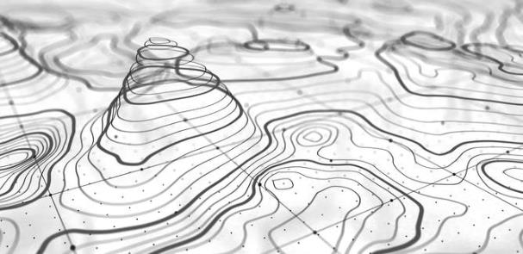
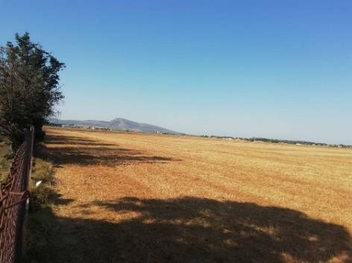
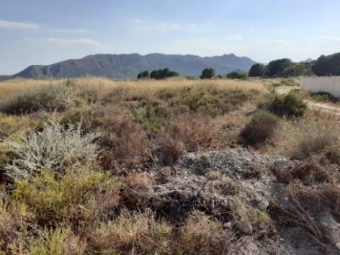
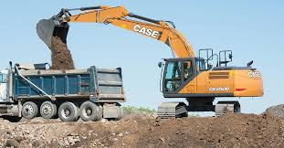
2. Design & construction
Engineering
IDENTIFYING AND STRUCTURING CHALLENGES AT LARGE-SCALE
1
2
Topography
Nature of the terrain
Land Use Competition
Investment cost
Economical sustainability
Agriculture, Tourism
Earthworks
Landfill management
Adapt to Terrain
> 35% total cost
Case I
Case II
Notes:
- Construction process can vary significantly, since the TOPOGRAPHY, as well as the NATURE OF THE TERRAIN, will play a very important role in the definition of the process, which finally will affect the investment cost of the installation, and therefore the economical sustainability.
- EARTHWORKS AND LANDFILL MANAGEMENT can play a very important role in the final cost of the construction process, the worst case can suppose more than 35% of total cost.

Slide 6
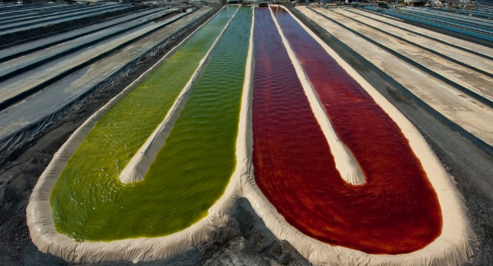
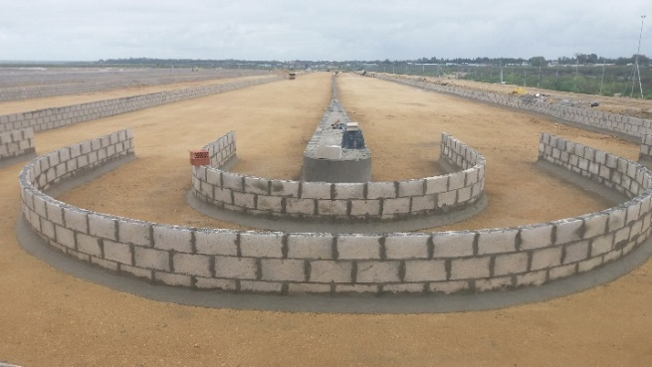
Design & construction
Engineering
IDENTIFYING AND STRUCTURING CHALLENGES AT LARGE-SCALE
5
6
Reinforced concrete → more expensive, durable, complex shapes
Polyester resin → smooth walls, mobile, easy to service, limited to small-scale
Earthworks
Channels digging
Compacting
Lining
Low-cost construction
Conventional construction
Notes:
- Low-cost method: Based on earthworks, digging the channels, compacting and finally lining. Earthen raceways with plastic liners cost little and are easy to build. Because of the slope needed to maintain the wall stable, this design needs more space compared to the traditional concrete raceways ponds
- Conventional method: Most raceways are made of reinforced concrete, Reinforced concrete is more expensive, but is durable and can be shaped in complex ways. Raceway tanks can also be built from polyester resin. These tanks have smooth walls and are mobile and easy to service. However, their cost limits them to small sizes, below 5 cubic metres.
However, there is a third alternative, which is a combinantion of both methods. And that is what we did for our demo plant in Mérida, Spain

Slide 7
Design & construction
Engineering
DEMO PLANT IN MÉRIDA (SPAIN)
10,000 m² microalgae raceway pond with paddle wheel system
5,000 m² microalgae raceway pond with paddle wheel system
5,000 m² microalgae raceway pond with LEAR® system.
Harvesting based on dissolved air flotation (DAFAST®)
Constructed wetlands for clarification
Decanter centrifuge for solids dewatering
Notes:
In the case of Mérida DEMO site, three different raceway reactors have been designed and built, with 10,000 m², 5,000 m² and 5,000 m², combining different mixing system for their further comparison.
2 Channels design.
No space limit
Straight sections of <300m

Slide 8
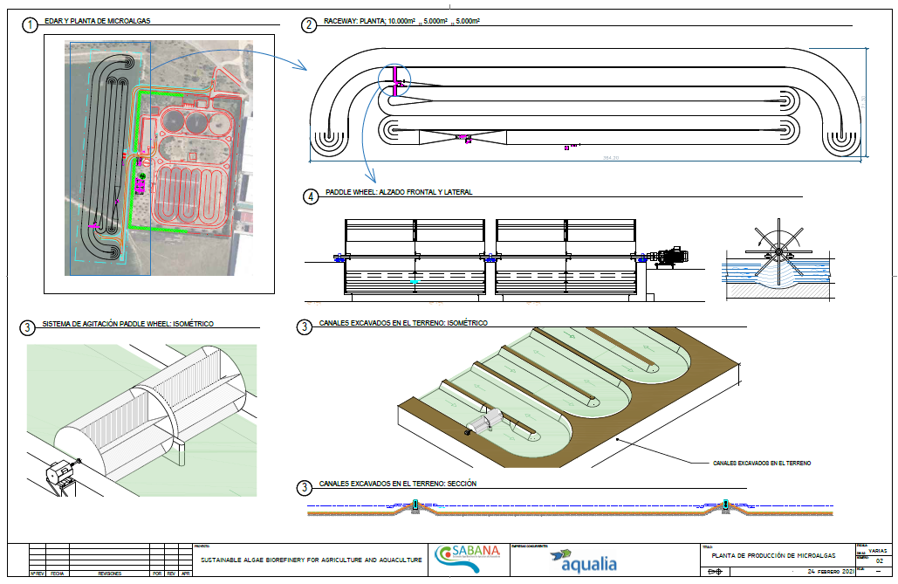
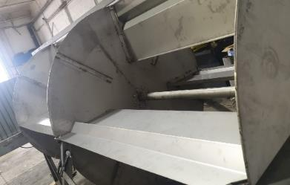
Design & construction
Engineering
Cultivation area:
26,026 m2
71,5 m
Raceway ponds:
20,000 m2
364 m
Paddle wheel system

Slide 9
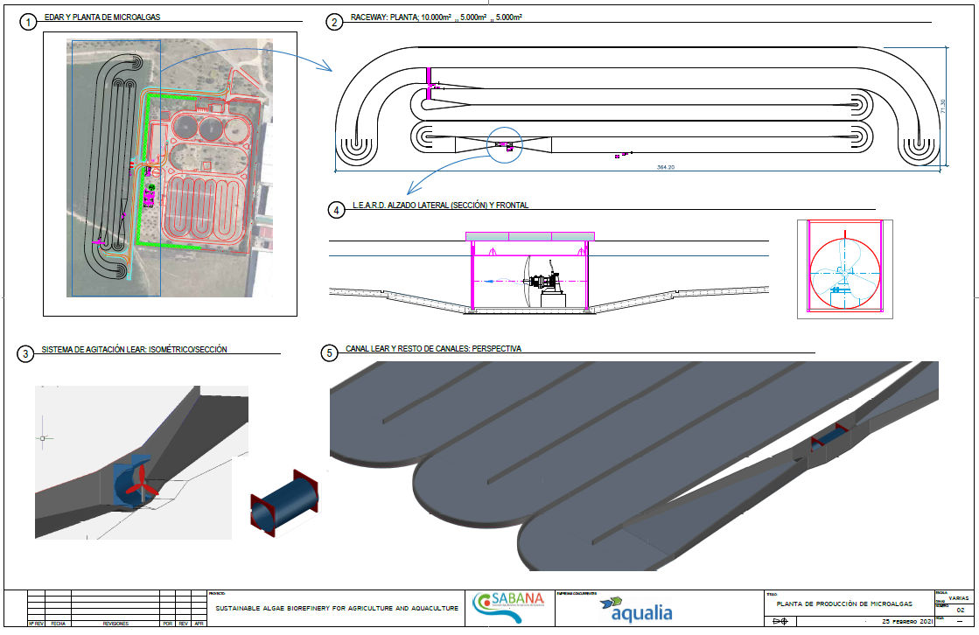
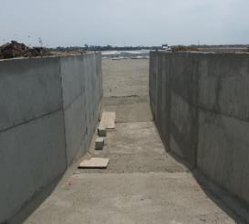
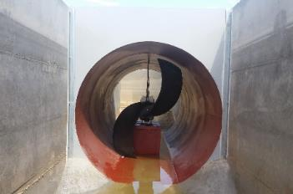
Design & construction
Engineering
Cultivation area:
26,026 m2
71,5 m
Raceway ponds:
20,000 m2
364 m
LEAR® system

Slide 10

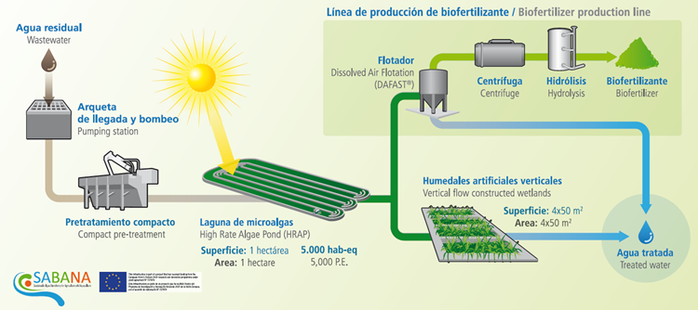




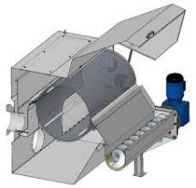






3. Demo plant description
2-hectare demo plant
Mérida, Spain

Slide 11
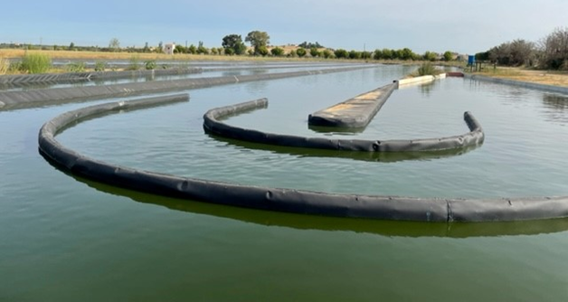
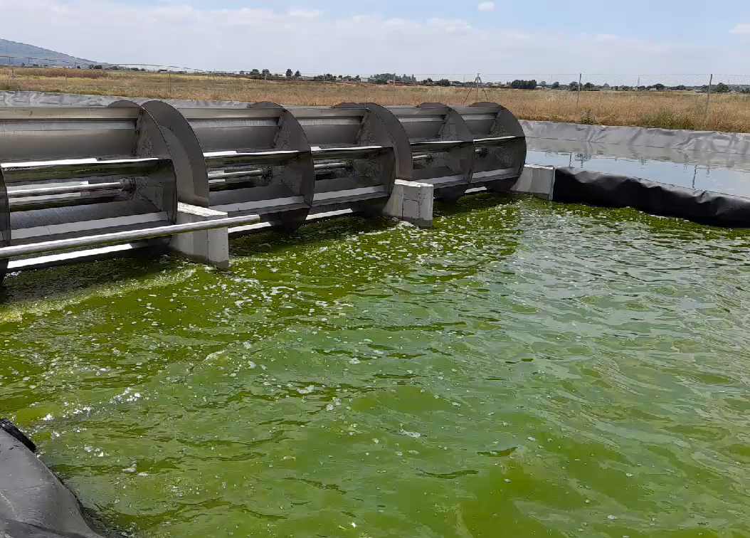

Demo plant description
High-Rate Algae Ponds (HRAPs)
2-hectares demo plant
Mérida, Spain
Notes:
A total of 2-hectares raceway ponds have been constructed. These 3 High-Rate Algae Ponds are:
1 reactor with 10,000 m2 and paddlewheel as agitation system
1 reactor with 5,000 m2 and also with paddlewheel as agitation system
1 reactor with 5,000 m2 but using a patent of Aqualia as agitation system (LEAR system: Low Energy Algae Reactor)

Slide 12

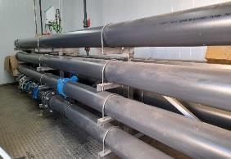
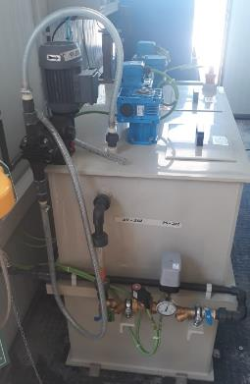
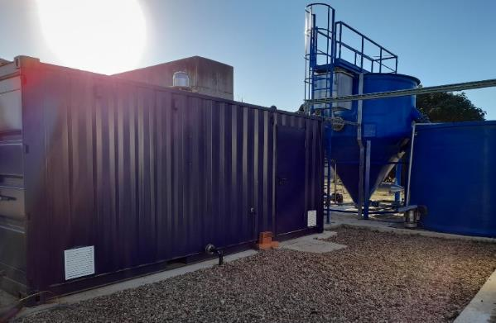
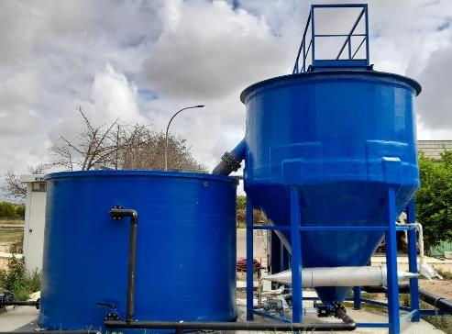
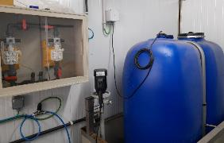
Demo plant description
2-hectares demo plant
Mérida, Spain
Dissolved Air Flotation unit
DAFAST
Coagulation-flocculation unit
20 m³- buffer tank
Notes:
After the cultivation process, two lines have been designed.
The first one is the biofertilizer production line, where the biomass harvesting is carried out by a Dissolved Air Flotation unit with a treatment capacity of up to 100 m³ h⁻¹. A coagulation-flocculation unit before the DAFAST was installed to favour the separation of biomass and treated water.

Slide 13

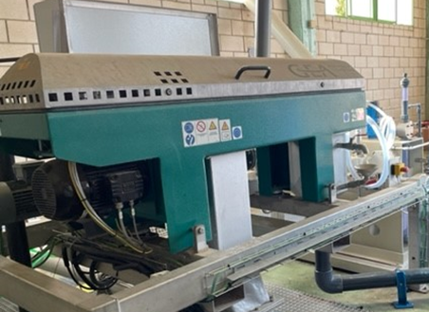
Demo plant description
2-hectares demo plant
Mérida, Spain
Decanter centrifuge
Notes:
Additionally, biomass harvested in the previous step goes to the dewatering process by a decanter centrifuge. The concentrated biomass can be sent for hydrolysis treatment to produced biofertilizer.

Slide 14
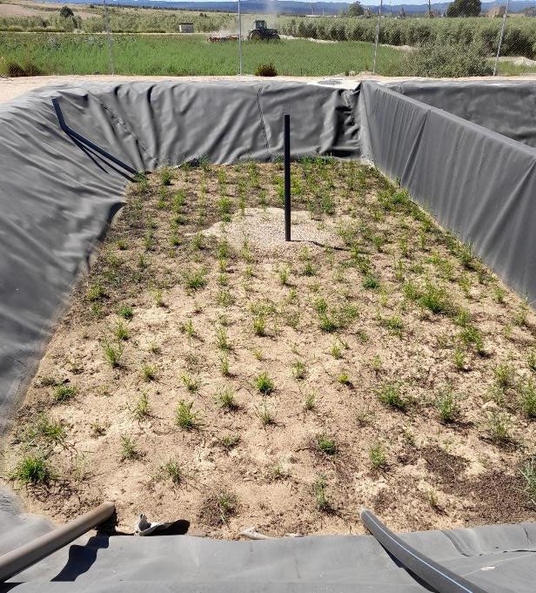
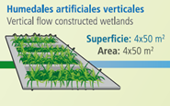
Demo plant description
2-hectares demo plant
Mérida, Spain
Constructed wetlands
Notes:
Besides the biofertilizer production line, an alternative line has been designed after the biological treatment. It consists of 4 vertical flow constructed wetlands with 50 m2 each, as clarifying step.

Slide 15
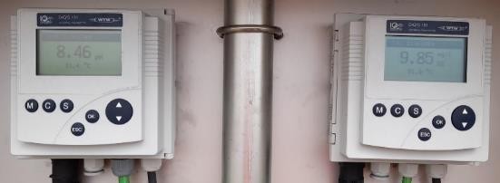
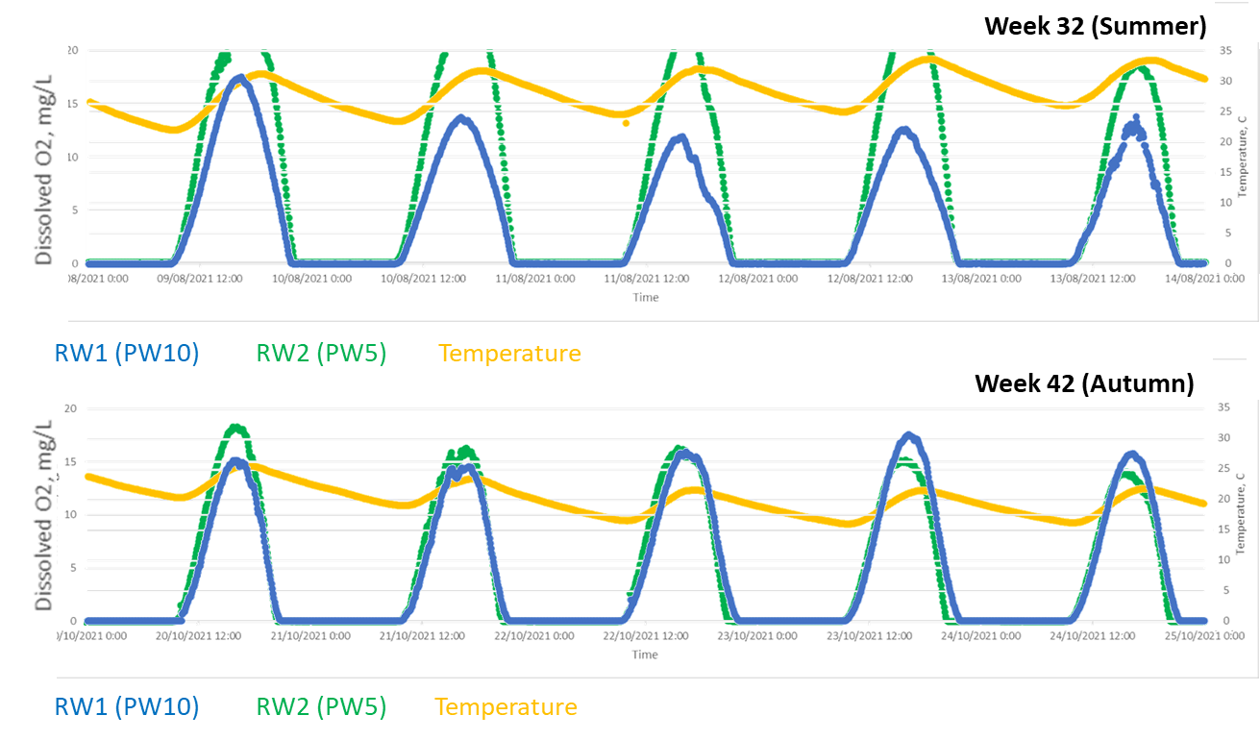
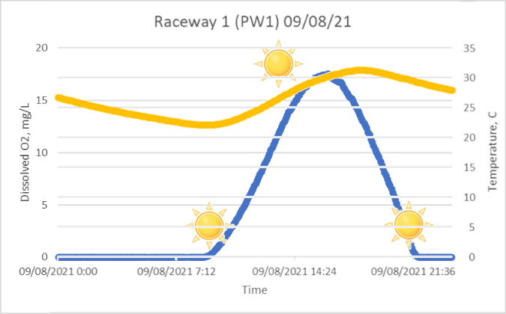

4. Process operation
Online monitoring
Parameter | Removal
COD, mg/L | 77-91%
TN, mg/L | 68-80%
TP, mg/L | 55-62%
Flow | < 2000 m3/d
Algae biomass | 420 mg/L
pH / Temp.
Dissolved O2
Notes:
Both pH, T and dissolved oxygen concentration was online monitored continuously in the culture .
Dissolved O2 achieved values from 0 during the night to values over 20 mg O₂ L⁻¹ during the hours of maximum solar irradiation. You can see an example of O2 profile in the graphic of one day in summer. The variations observed in the oxygen profile were directly correlated with the ambient temperature and light irradiance in Mérida, Spain.
Here you can see other examples of O2 profile and T along week 32 in Summer and week 42 in Autumn. Notice that sometimes in Summer, O2 concentration exceeded the limit of the probe, meaning that the system is capable /’keipǝbl/ to assimilate higher organic load.

Slide 16
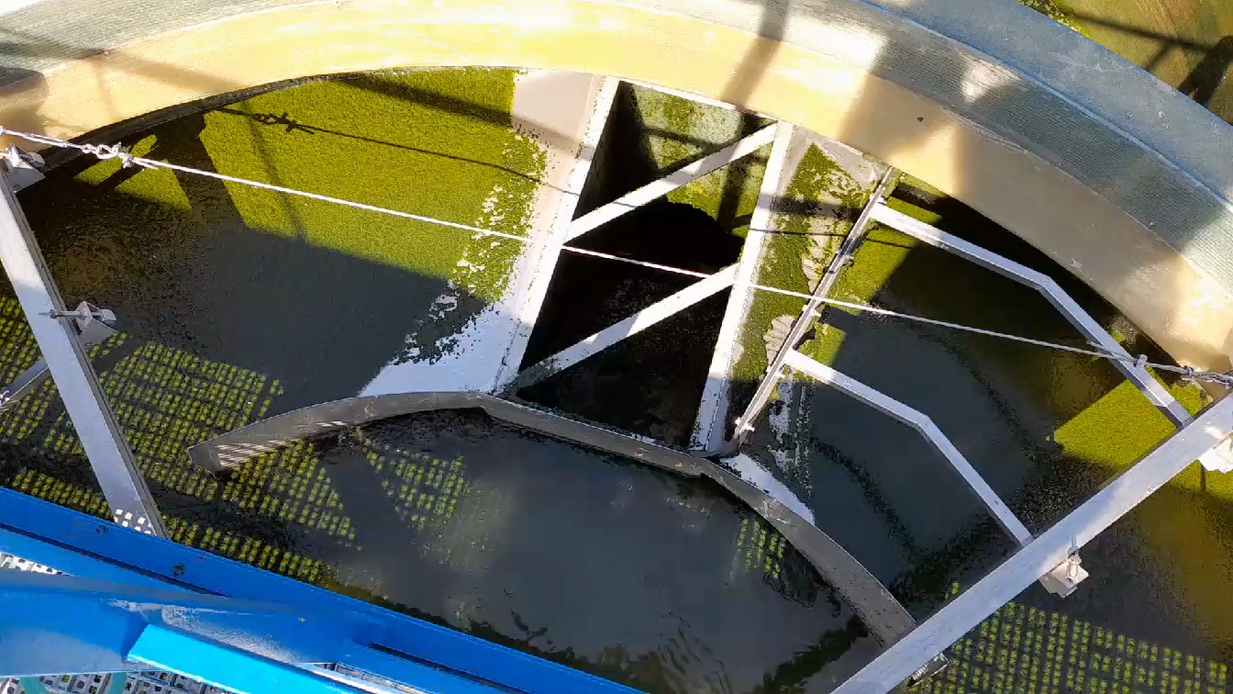
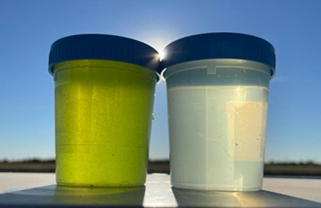
Process operation
Biomass harvesting
Algae culture
Clarified water
Parameter | Inlet
COD, mg/L | 455 ± 106
TN, mg/L | 43.4 ± 4.6
TP, mg/L | 9.04 ± 2.76
TSS, mg/L | 150 ± 42
Parameter | Average | PW10 | PW5 | LEAR5
COD, mg/L | 105 | 110 ± 38 | 93 ± 32 | 113 ± 29
TN, mg/L | 13.7 | 15.2 ± 4.1 | 11.7 ± 7.5 | 14.1 ± 3.5
TP, mg/L | 4.08 | 4.70 ± 1.25 | 3.80 ± 1.56 | 3.76 ± 1.30
Biomass, mg/L | 420 | 410 ± 122 | 509 ± 200 | 340 ± 94
Water quality
Notes:
DAFAST® system operated continuously supplying clarified water and generating concentrated biomass lately centrifuged. At the outlet of the DAFAST® unit, the concentration in the water reached average values of 100 mg L⁻¹ for COD, 14 mg L⁻¹ for TN, 4 mg L⁻¹ for TP and 20 mg L⁻¹ for TSS, fulfilling with the water discharge limits requirements.
The low TSS concentration values in the treated wastewater involved a high solids recovery efficiency in the DAFAST®, reaching values of biomass concentration over 1.5-2% of dry mass before centrifugation.

Slide 17
5. Conclusions
Large-scale microalgae-based wastewater treatment plants
1
2
The feasibility of microalgae cultivation for tertiary treatment and reuse has been demonstrated on large scale
Large-scale microalgae-based demo plant presented effective performance
3
4
Water quality fulfils with the discharge limits requirements + disinfection
Microalgae-bacteria symbiosis represents an excellent alternative for sustainable water reclamation in small communities
Notes:
The feasibility of a microalgae cultivation as secondary treatment has been demonstrated to be a suitable WWT solution. Large-scale microalgae-based demo plant presented effective performance and fulfil with the water discharge limits requirements. Microalgae-bacteria symbiosis represented an excellent alternative for sustainable WWT in small communities.

Slide 18


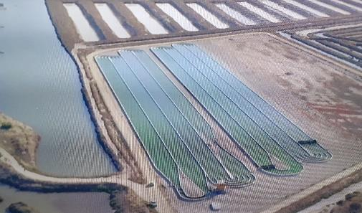
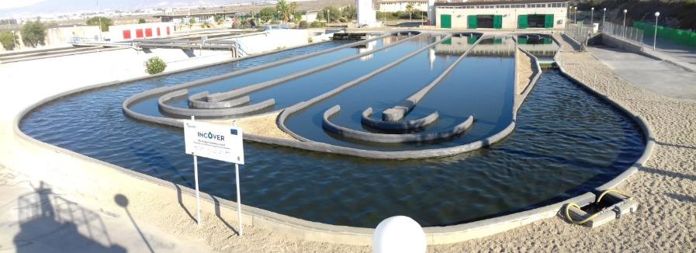
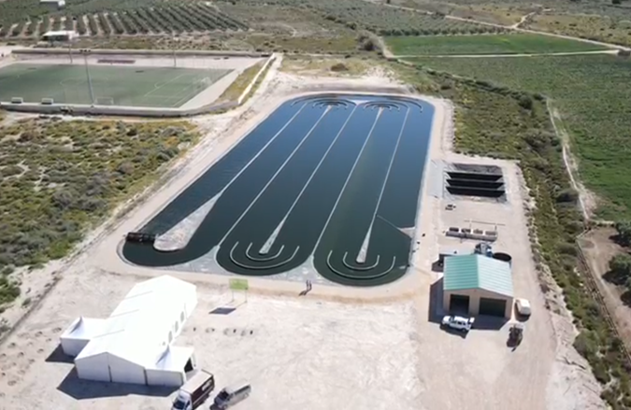

Conclusions
Large-scale microalgae-based wastewater treatment plants
4 X 5,200 m²
3,000 m²
El Torno WWTP
(Chiclana de la Frontera, Cádiz, Spain)
El Toyo WWTP
(Almería, Spain)
Agramón WWTP
(Hellín, Albacete, Spain)
10,000 m²
Notes:
To conclude, let me show you other experiences in WWT based on microalgae that Aqualia has in Spain. We started at lab scale more than 10 years ago and now we are operating demonstration plants with different configurations.

Slide 19


Thank you for your attention
1st International Conference
on Novel Photorefineries for
Resource Recovery 2024
September 9th-11th 2024.
This project has received funding from the European Union’s Horizon 2020 Research and Innovation program under the Grant Agreement No. 727874

