Slide 1



Pilot Blue Cloud Workshop
presentation
S.Tarot (Ifremer), S. Pouliquen (Ifremer)
28th March 2017

Slide 2
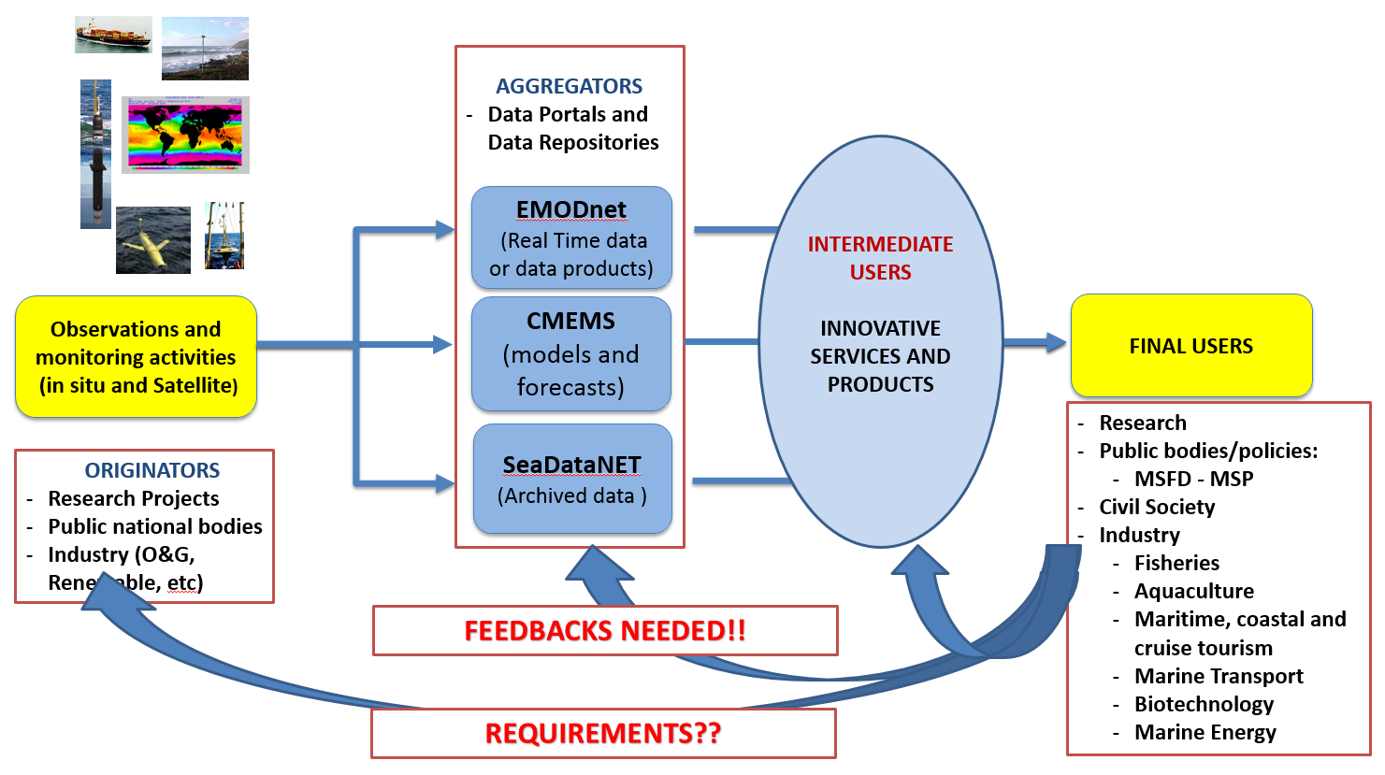
Open Marine data value Chain

Slide 3
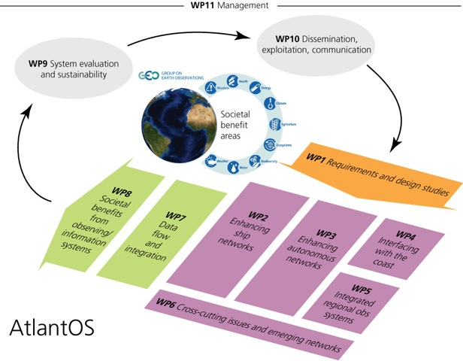

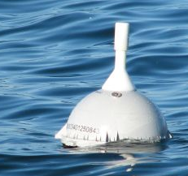
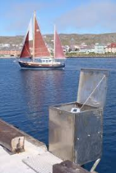
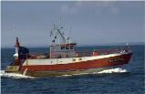
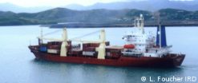
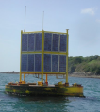

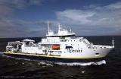
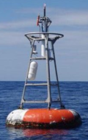
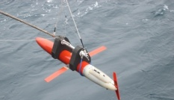
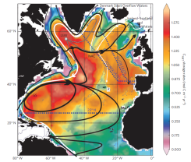
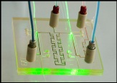
AtlantOS proposal
Optimizing and Enhancing the Integrated Atlantic Ocean Observing System

Slide 4
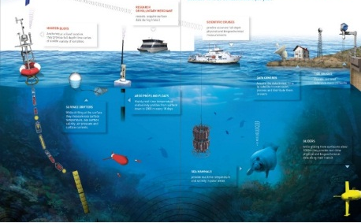
Data flow – starting point
Data management for network
Data management for network
Data management for network
INS TAC Copernicus
Data management for network
SeaDataNet
EMODnet
Euro-BIS
ICES
Data mgt for network
GEOSS
Standardization between networks
from acquisition to service to users

Slide 5
Data flow – long term goal
Data exchange backbone
Data management for network
Data management for network
INS TAC Copernicus
Data management for network
SeaDataNet
GEOSS
EMODnet
Euro-BIS
Data management for network
ICES
Data mgt for network
tools
tools
tools
Users
Standardization between networks
from acquisition to service to users
Agreement on Metadata
Agreement on Vocabularies
Agreement on RTQC procedures
Agreement on Dissemination Services

Slide 6
Potential Blue Cloud interface
Data exchange backbone
Data management for network
Data management for network
INS TAC Copernicus
Data management for network
SeaDataNet
GEOSS
EMODnet
Euro-BIS
Data management for network
ICES
Data mgt for network
tools
tools
Standardization between networks
from acquisition to service to users
Other thematics
Blue Cloud
(storage & computing)
New tools
New services
(VREs)
Users +
new users

