Slide 1
FORUM
EOOS events Advisory Committee, 8 February 2018
Dina Eparkhina, EuroGOOS
info@eoos-ocean.eu

Slide 2
Both bottom up: community push
Top down: policy pull and support
Not an infrastructure or a system with a central governance BUT a common conceptual framework and a brand, endorsed and promoted, representing a consolidated vision of the EU Observing as a whole
EOOS will help:
local/national/regional prioritization and funding
pan-EU cooperation (communal synergies and projects targeted at filling the gaps)
EU leadership at the global level
www.eoos-ocean.eu
Dina Eparkhina, 8/02/2018

Slide 3
FORUM
The intent for the Forum is to get implementers, funders and users on board and involved in helping to shape EOOS. Their ideas and input are key to making EOOS a success and to taking it to the next stage.
The outcomes of the Forum will inform the strategy and conference in November, but as well as this, it’s hoped that participants will advocate for, and take an active part in, taking EOOS forward in their own areas.
The key issues for the development of EOOS now are how to ensure that the ocean observing system in Europe is sustainable and fit for purpose.
www.eoos-ocean.eu
Dina Eparkhina, 8/02/2018
Dina Eparkhina, 8/02/2018

Slide 4
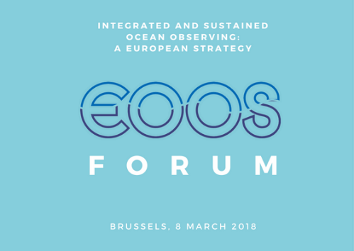
EOOS Forum, 8 March 2018, Area 42, Brussels
Integrated and sustained ocean observing: a European strategy
EOOS
Principle objective: The EOOS Forum 2018 will bring together the main ocean observing funders, implementers and users in Europe. It will examine the extent to which the current observing systems are sustainable today, and what opportunities and threats there are.
Initiated by the EOOS Steering Group as the main forum for an integrated European Ocean Observing System, the event will discuss the EOOS strategy, developed further to the stakeholder consultation Dec. 2016- Jan. 2017, and seek feedback from the funders, implementers and users on the way forward.
FORUM participants:
Contribute their ideas and concerns
Feel more confident in making the case for further and increased investment in EOOS
Appreciate and understand the scale of the challenges in sustaining this complex system, parts of which are fragile
Have strengthened relationships with other key players - implementers, users, and funders
The guidance and recommendations from the discussions will inform the EOOS strategy 2018-2023 and implementation plan. Implementation will be explored in greater depth at the EOOS Conference in November 2018.
www.eoos-ocean.eu
www.eoos-ocean.eu
Dina Eparkhina, 8/02/2018

Slide 5
Images from: http://www.msp-platform.eu/, DG MARE MSP Conference, Area 42, Brussels, Oct. 2017

Slide 6
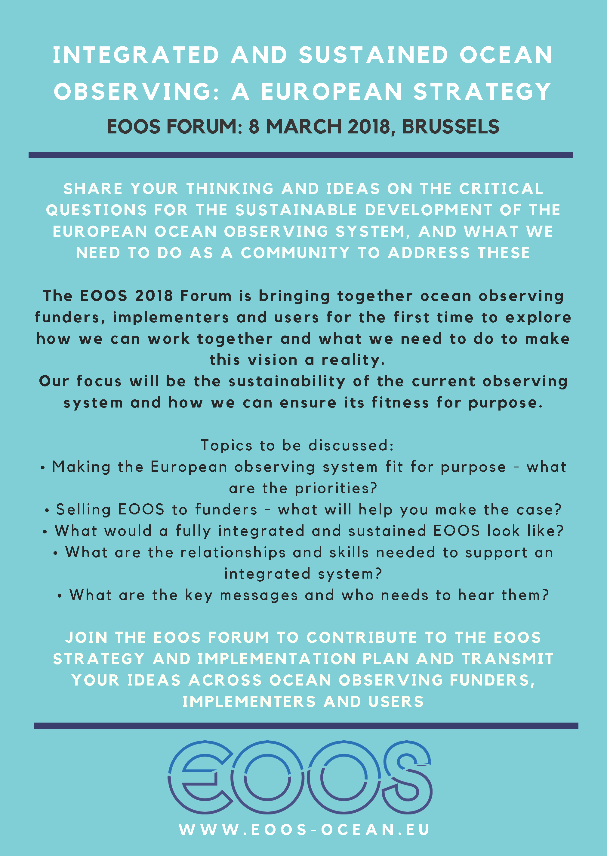
www.eoos-ocean.eu/forum
We are seeking feedback and comments from the Advisory Committee on:
General approach
Structure
Ideas for active input or interventions
Engagement in participation
Help with spreading the invitation
Please send your further comments at: Dina.Eparkhina@eurogoos.eu
Dina Eparkhina, 8/02/2018

