Slide 1

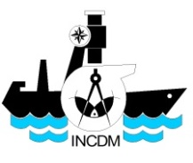
Conference on Blue Economy in the Black Sea
Connecting the region through marine and maritime cooperation
Maritime Spatial Planning
for Blue Growth:
EU support for Visions, Indicators, Examples, Navigation.
Romanian Experiences
Laura Alexandrov,
*National Institute for Marine Research and Development G.Antipa, Constanta,
**Black Sea Focal Point for Maritime Spatial Planing under EU-MSP Platform
(s.Pro – sustainable projects GmbH Berlin, Germany)
15 September 2017, Batumi, Georgia

Slide 2
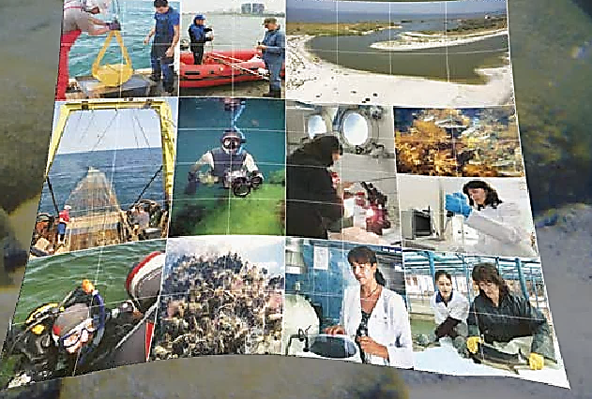
The Integrated Maritime Policy of the EU
Definition and scope
Economic growth based on different maritime sectors:
Blue growth
Marine data and knowledge
Maritime spatial planning
Integrated maritime surveillance
Sea basin strategies
BLACK SEA MSP PROJECTS
PlanCoast
PEGASO
ESaTDOR
COCONET
PERSEUS
MISIS
SymNet/CBC-Black Sea
ICZM/CBC-Black Sea
SRCSSMBSF
CLEANSEA
CREAM
MARSEA
MARSPLAN-BS
ECOAST (COFASP)
STUDY CASES
Sulina
Sf.Gheorghe
Sinoe lagoon
Tasaul Lake
Mamaia Bay
Siutghiol Lake
Eforie
Techirghiol
Mangalia – Limanu
Vama Veche
NIMRD G.ANTIPA

Slide 3
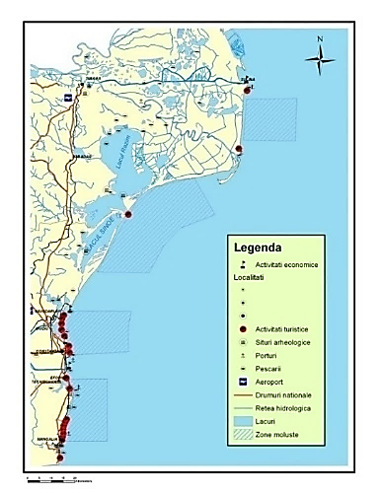
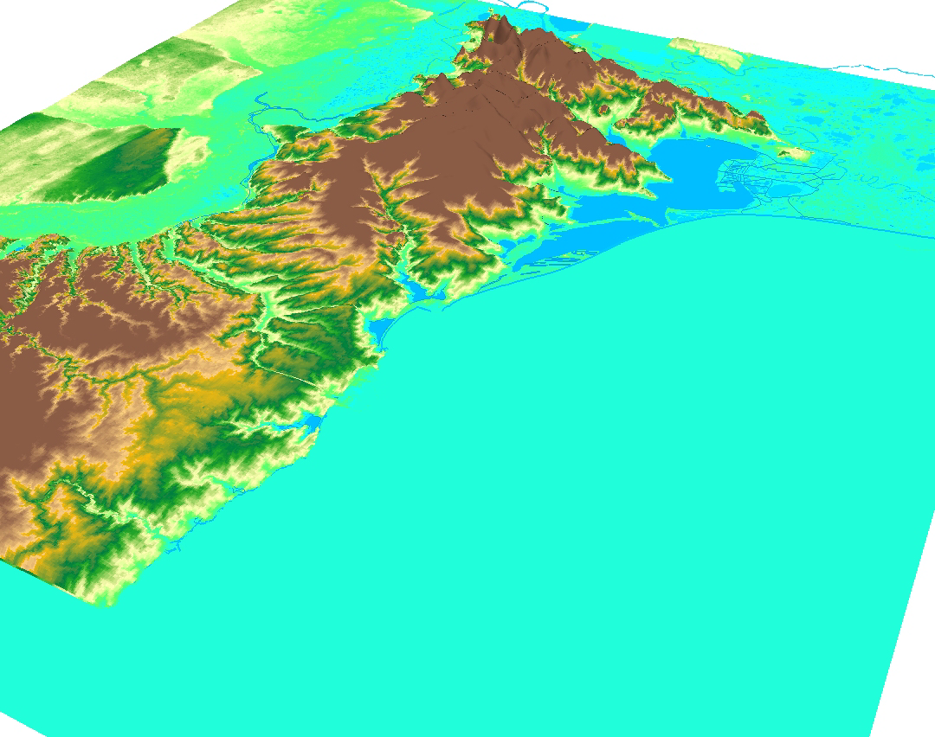
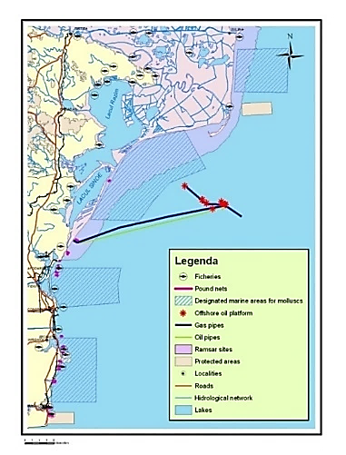
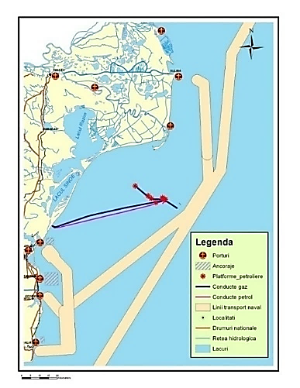
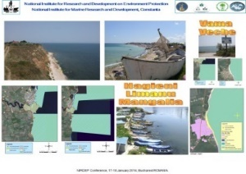
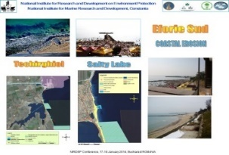
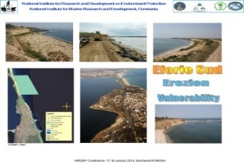
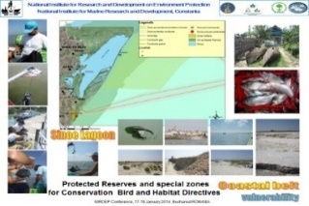
The Integrated maritime policy of the EU
Sulina-Musura
Razelm-Sinoe Complex /
- ecological rehabilitation
Coastal belt - vulnerability
*Tasaul Lake – fishery, catchments impact
Mamaia Bay – defenses
Siutghiol Lake - pollution
Eforie – coastal erosion
Tekirghiol Lake – salty water
Hagieni-Limanu-Mangalia - dam link
Vama Veche – marine protected area
NIMRD G.ANTIPA

Slide 4
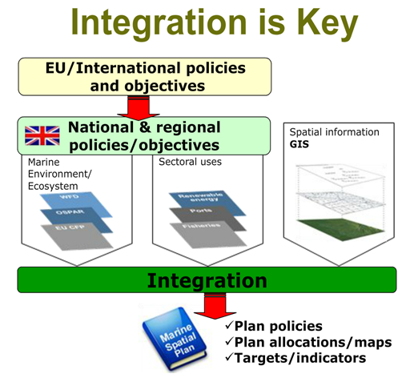
The Integrated Maritime Policy of the EU
Definition and scope
Blue growth
Marine data and knowledge
Maritime Spatial Planning
Sea basin strategies
Integrated maritime surveillance
Source: Gilliland & Laffoley 200842, DEFRA 2006

Slide 5
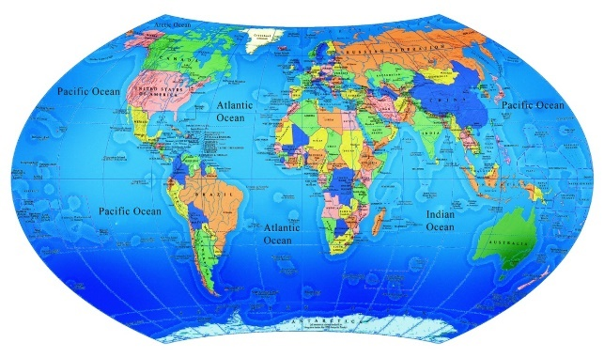
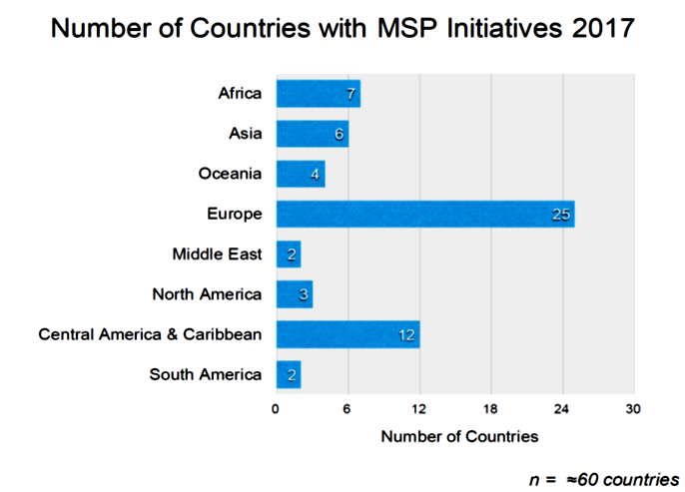
Why do we need it The Integrated maritime policy?
“To take account of the inter-connectedness of industries and human activities centred on the sea.”
1
About 150 of the World’s 195 countries have an EEZ
More than 50% People are living around continents, on the coast
Marine research,
shipping and ports,
wind energy,
fishing
tourism,
2
Marine research,
shipping and ports,
wind energy,
fishing
tourism,
MARINE RESEARCH,
shipping and ports,
wind energy,
fishing
tourism,
3
To save time and money by encouraging authorities to share data across policy fields
To Cooperate with decision-makers in the different sectors at all levels of government – national maritime authorities, regional and local authorities, and international authorities, both inside and outside Europe.
Charles Ehler, Paris, March 15, 2017

Slide 6
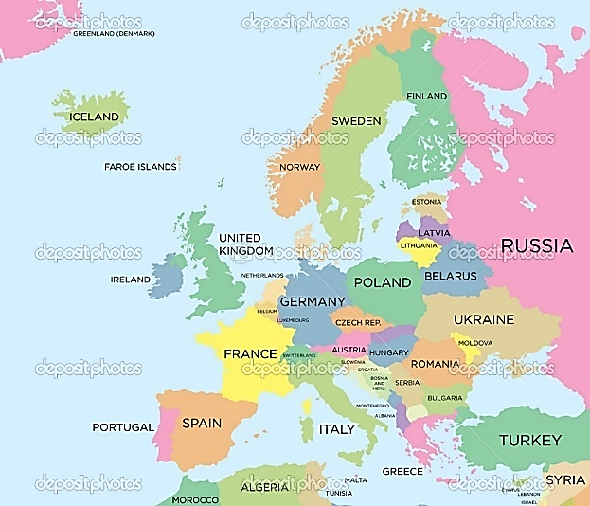
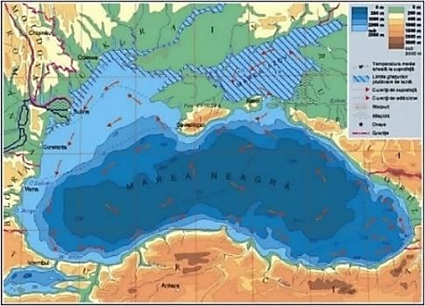
“Marine and maritime agenda - The Limassol Declaration
IMP seeks to coordinate, not to replace policies on specific maritime sectors.”
Blue growth
There are some more EU Drective concerning the se space and its activities. Some of them are dedicated separately to fisheries, navigation, tourism, energy,..
Marine data and knowledge
Research activities, experience from different projects, studies and study cases, present project MARSPLAN BS, ECOAST, MSP Assistence for MSP, EU MSP Platform; Data Base Center and site in working
Integrated maritime surveillance
CISE Commission (active since 2010) integrated in IMP Commission
Its activity; working groups; permanent activity
Maritime Spatial Planning
Sea basin strategies
National Authorities, Stage in implementation, Project support for implementation, Event organization (thematical workshops) and EU MSP assisstence for support
EU-MSP Platform
Trasboundary approach
Study Cases

Slide 7


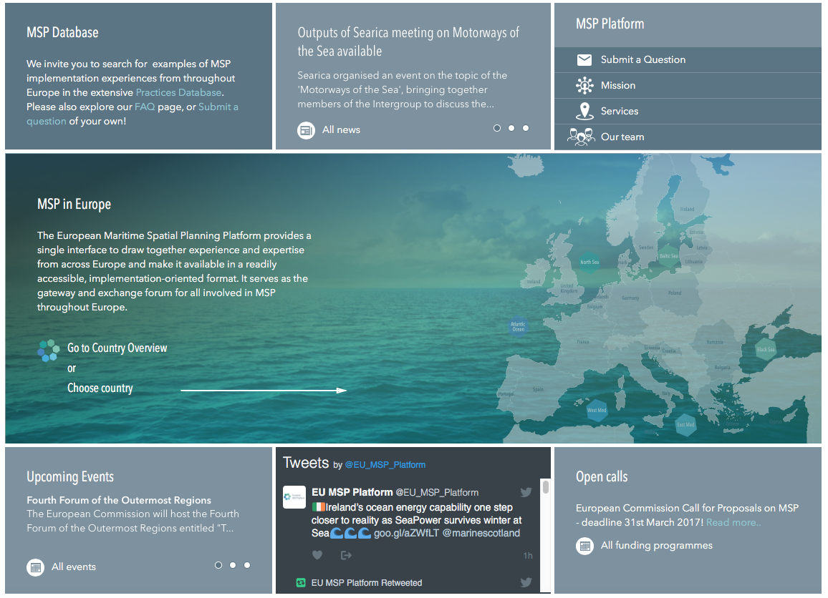
EU MSP Platform
www.msp-platform.eu
“Blue Growth is the long term strategy to support sustainable growth in the marine and maritime sectors as a whole.”
Services
Interactive information gateway
Team of experts (Sea Basin Focal Points)
Technical studies – filling identified knowledge gaps
Notes:
Service contract for the European Commission Directorate General for Maritime Affairs and Fisheries, to support Member States with the implementation of the MSP Directive

Slide 8

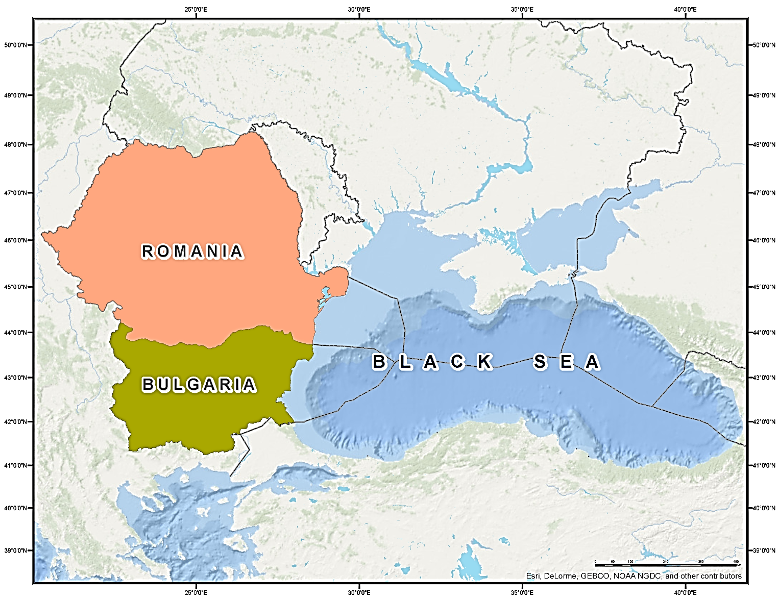
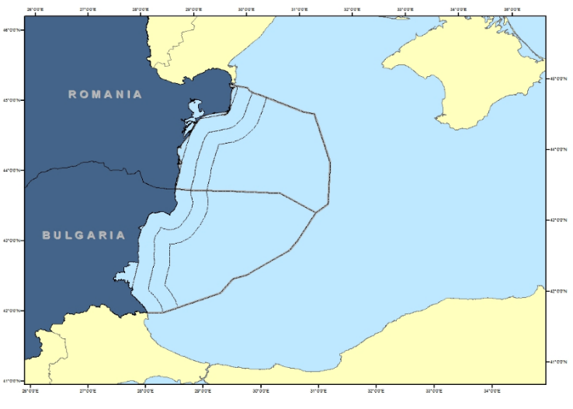
What is doing?
MSP Practices database (349)
MSP Projects database (117)
Country and sea basin profiles
FAQs
List of funding opportunities
Events list & News services
Member States expert group on MSP (EU COM)
Q&A service
Workshops and conferences
What can be offered
Promote your project, event,
or news
Ask a question via Q&A Service
Organise a workshop with our help
Contact us via
info@msp-platform.eu
Follow us on Twitter
@EU_MSP_Platform
Attend ‘MSP for Blue Growth’ conference 11-12 October in Brussels
MSP Focal Points

Slide 9
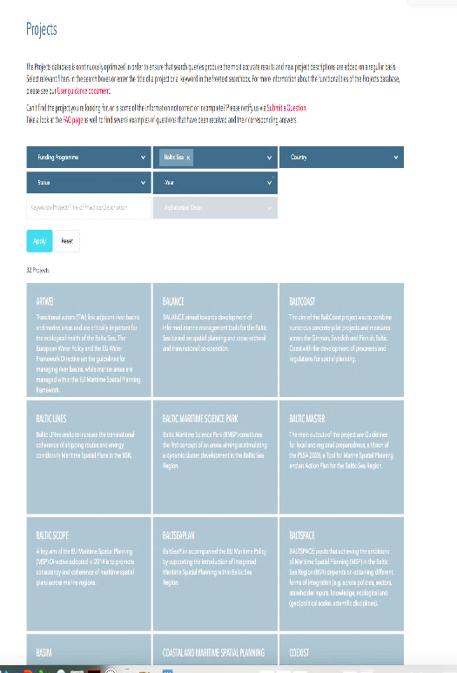
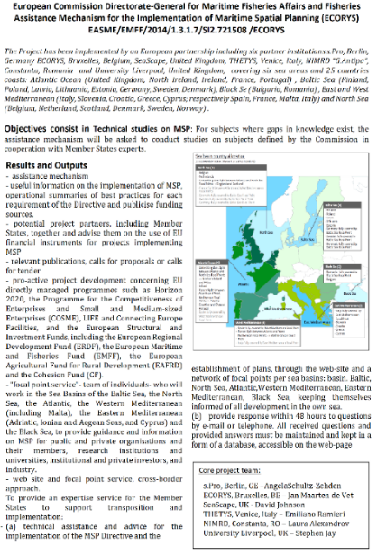
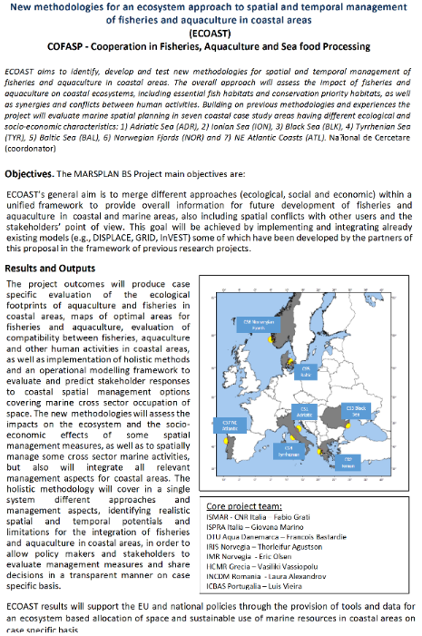
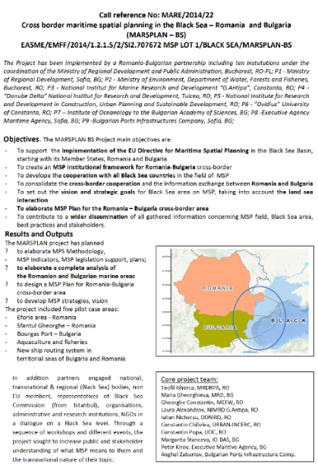
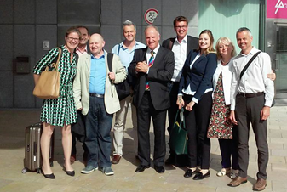
BLUE GROWTH
Wich is the aim? LONG TERMS STRATEGIES
How to proceed in the conflicts identification and to avoid them for a sustainable economic development? USING IMPORTANT – SPECIFICAL METHODS
Why to establish Short and Long terms for strategies elaboration?
FOR SMART, SUSTAINABLE AND INCLUSIVE GROWTH
DG MARE/2014/22
EU PROJECTS
EU MSP PLATFORM
ECOAST
MARSPLAN BS
2015 -2019
http://www.msp-platform.eu/msp-practice/msp-projects

Slide 10
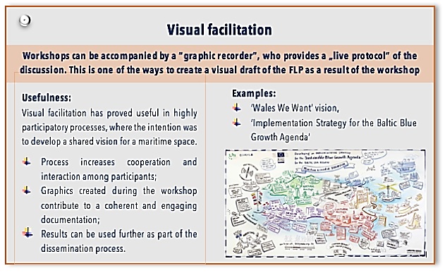
Technical Study: ‘’MSP for Blue Growth:
MSP as a tool to support a sustainable
Blue Economies’’
Ivana Lukic, s.Pro – sustainable projects GmbH Berlin, Germany
11-12 October 2017, Brussels, Belgium, #MSP4BG
Study Task 1. Methodology for developing MSP-relevant visions
Study Task 2. Methodology to investigate current and future potential of key maritime sectors
Study Task 3. Methodology for developing indicators
Full handbook publication, Dec 2017
Presentation
‘MSP for Blue Growth
Conference’ 11-12 October
Postcard style summary
Features on the EU MSP Platform - immediate links to the building blocks and the FAQs
What are available scenario development techniques?
What is the difference and the link between FLP and MSP processes?
What time horizon spans can be used in an FLP?
What skills are necessary for developing an FLP?
http://www.msp-platform.eu/msp-practice/msp-projects

Slide 11
Technical Study: ‘’MSP for Blue Growth:
MSP as a tool to support a sustainable
Blue Economies’’
Ivana Lukic, s.Pro – sustainable projects GmbH Berlin, Germany
11-12 October 2017, Brussels, Belgium, #MSP4BG
Vision
Strategy
Terms understood and used arbitrary
Combinations of formats used to organize an FLP vary widely
Scenarios
Roadmap
Action plan
Forecast
What is meant by Vision or a Forward-Looking-Process (FLP) ?
http://www.msp-platform.eu/msp-practice/msp-projects

Slide 12
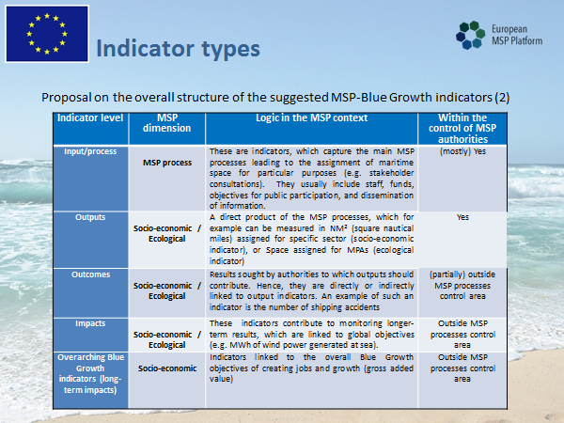
Indicators
Developing
Process
MSP Methodology
MSP Data Base
Daniel Nigohosyan, ECORYS,
PROMARE, 2017

Slide 13
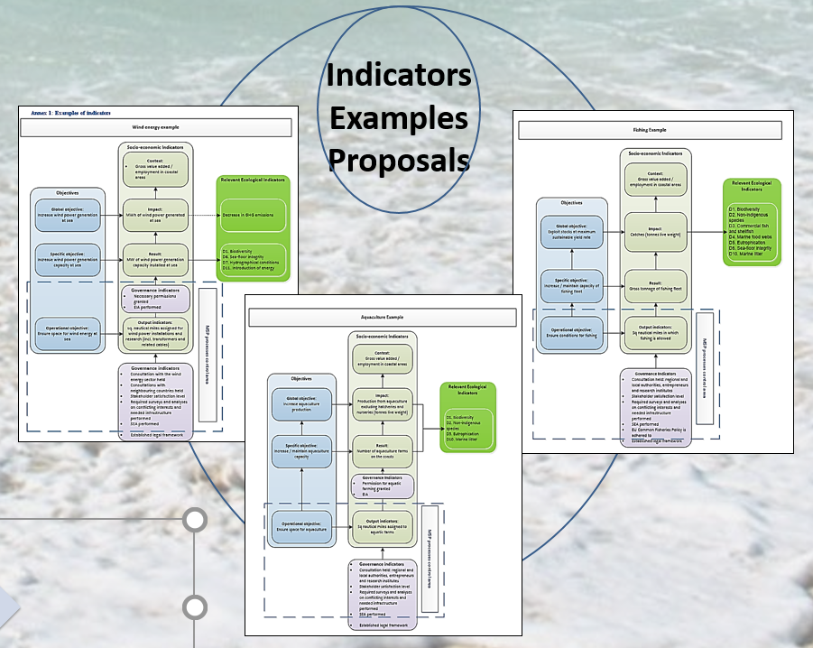
MSP
process indicators
-Wind Energy
-Aquaculture
-Fisheries
Daniel Nigohosyan, ECORYS, PROMARE, 2017

Slide 14


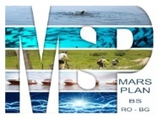
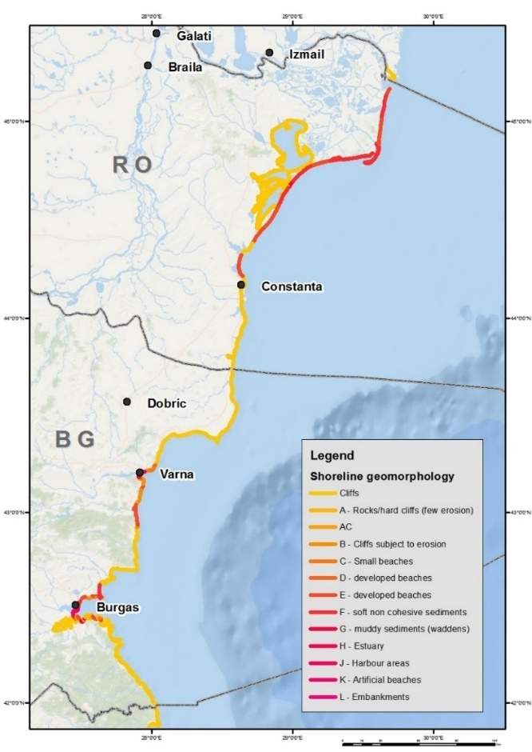
Marine data and knowledge
“Marine Knowledge 2020 brings together marine data from different sources with the aim of helping industry, public authorities and researchers find the data and make more effective use of them to develop new products and services as well as improving our understanding of how the seas behave.“
Inventory - gathering of data and information
MARSPLAN BS
Oceanographic information; MSP Data Center; Spatial Plans
natural environment ;
Geological information (sediments, deposits, mineral resources, etc).
Current use of sea space (shipping routes, anchorage sites, cables and pipelines, areas of exploration and extraction of mineral resources, the areas of cultural heritage, dumping sites, military areas, fishing grounds and areas important for the conservation of commercial fish species, areas used for sports /tourist/recreational, ports and harbors).
Knowledge on the coastal areas (land use, hydrography, roads, railways, tourism, population density, administrative division, coastal erosion);
Local and regional spatial plans, studies, strategies, programmes - in order to ensure consistency between planning land and sea.
International and national legislation and strategic documents.
The results of the relevant projects.
Planned and potential uses of marine areas (renewable energy, mining, mariculture, etc.)
Spatial analysis
Source: Jacek Zauka, ECORYS, PROMARE, 2017

Slide 15
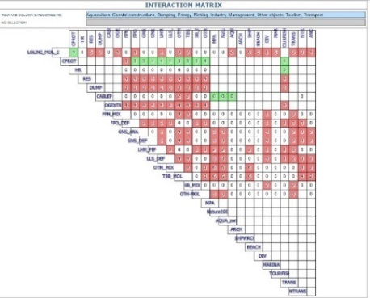
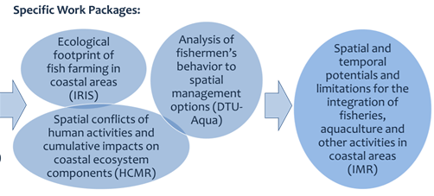


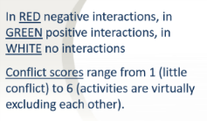
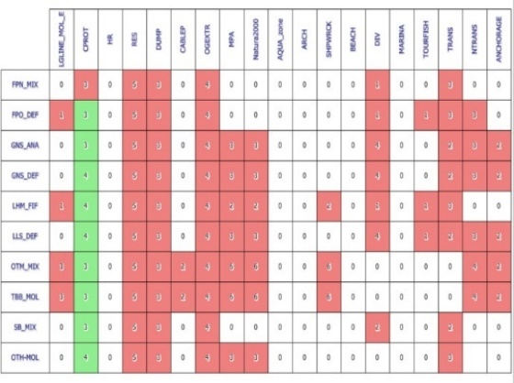
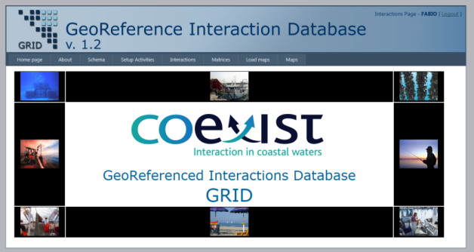
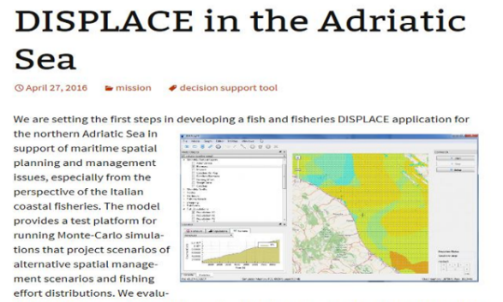
Maritime Spatial Planning (MSP)
“In July 2014, the European Parliament and the Council adopted legislation to create a common framework for maritime spatial planning in Europe:Directive EU/89/2014”
“MSP is about planning when and where human activities take place at sea – to ensure these are as efficient and sustainable as possible.”
Benefits of MSP
Reduce conflicts between sectors and create synergies between activities;
Encourage investment – by instilling predictability, transparency and clearer rules;
Increase coordination – between administrations in each country;
Increase cross-border cooperation – between EU countries;
Protect the environment – through early identification of impact. ABC

Slide 16
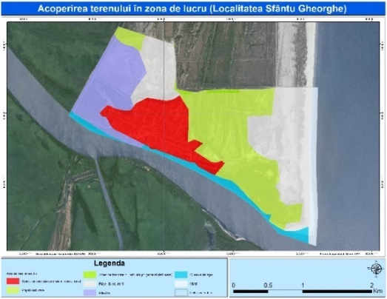
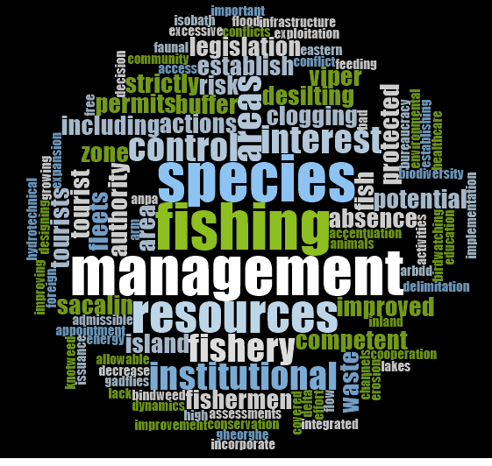
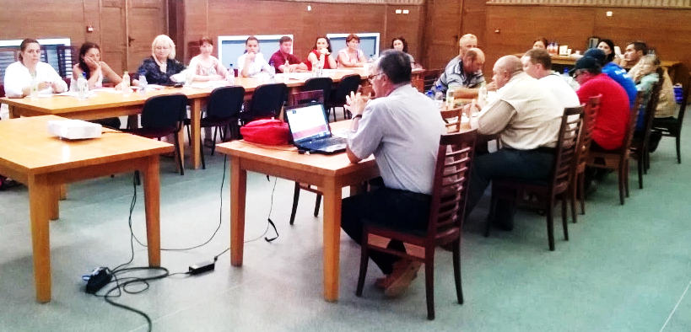
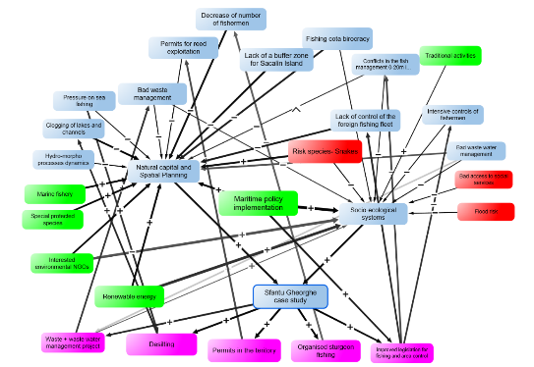
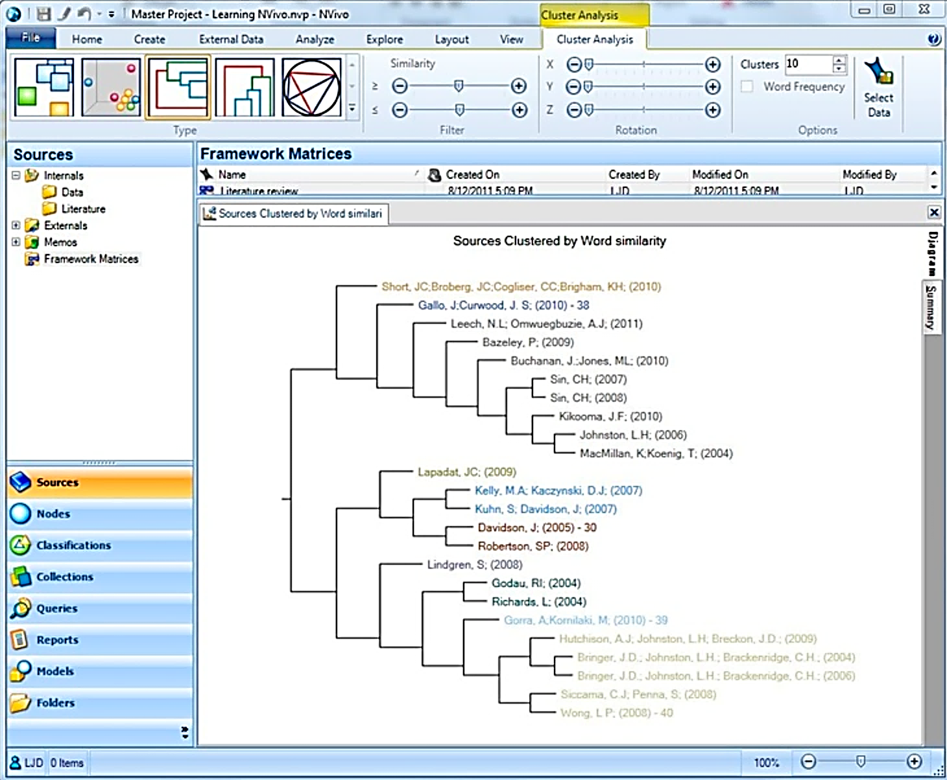

Maritime spatial planning (MSP)
“MSP involves stakeholders in a transparent way in the planning of maritime activities. Competition for maritime space – for renewable energy equipment, aquaculture and other growth areas – has highlighted the need for efficient management, to avoid potential conflict and create synergies between different activities.”
System analysis
STUDY CASES
IMPORTANCE
DANUBE DELTA National Institute for Research and Development, Tulcea; Iulian Nichersu, PROMARE, 2017
Integrated maritime surveillance
“A Common Information Sharing Environment (CISE) is currently being developed jointly by the European Commission and EU/EEA member states. It will interlink existing surveillance systems and networks and give all concerned authorities access to the information they need for their missions at sea.”

Slide 17

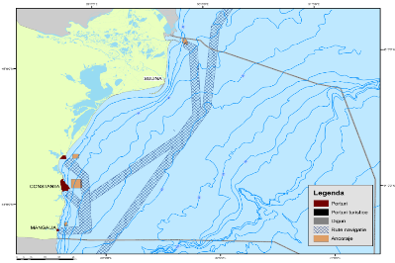
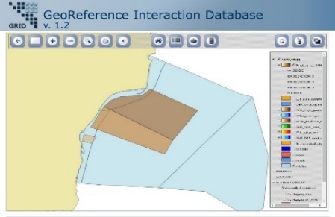
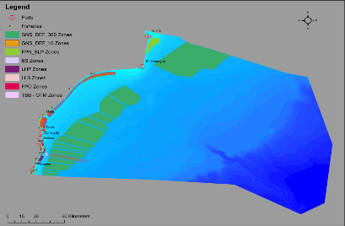
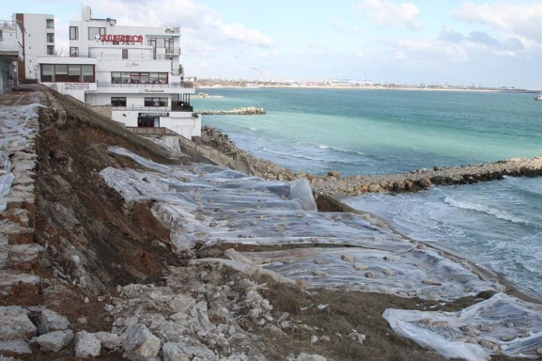


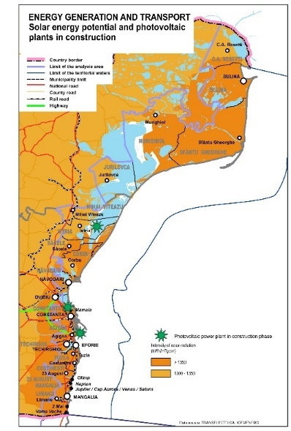
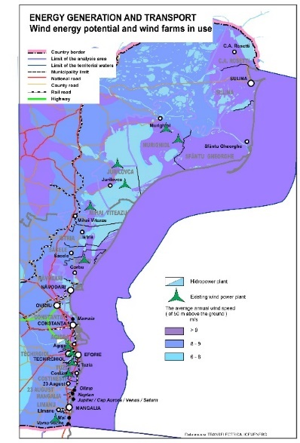
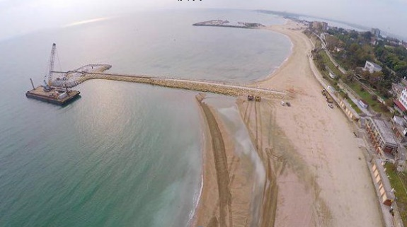
Sea basin strategies
“The Baltic Sea, Black Sea, Mediterranean Sea, North Sea, the Atlantic and the Arctic Ocean – each sea region is unique and merits a tailor-made strategy.“
Pelagic trawl

Slide 18

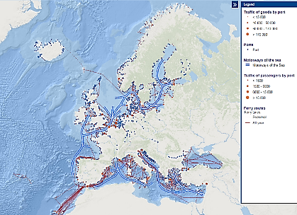
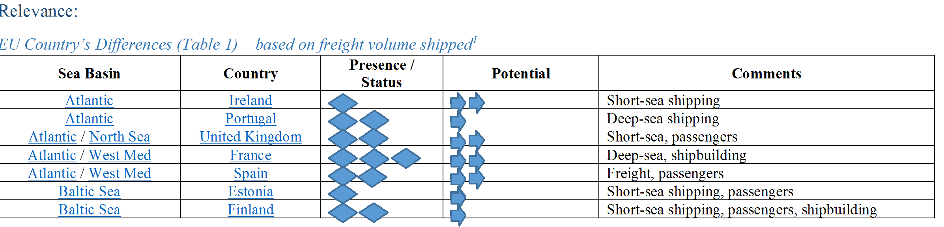
Shipping
One of the sector of blue economy crucial for values and jobs is marine transport and related activities (ports, shipbuilding and ship repair)
At European Union level it represents roughly 885.000 jobs and generates a gross added value of almost 85.000 million euro/year
“MSP as a tool to support Blue Growth” Technical Study Factsheet.
Introduction:
Overall size of the sector and industry structure:
Temporal ad Spatial characteristics/needs
EU shipping industry geographical snapshot in 2012 (Source: European Atlas of the Seas)
(https://ec.europa.eu/maritimeaffairs/policy/blue_growth_en)
Source: Javier Fernandez, ECORYS, Spain, 2017

Slide 19
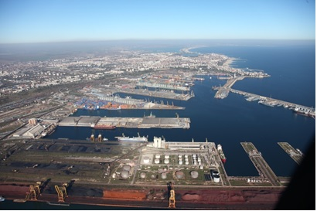
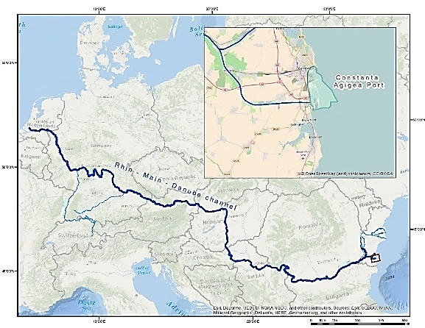




Port activities and marine transport history on Romania
Ports infrastructures
Connections, shipping routes, port traffic and shipping flows

Slide 20





Shipping routes
Nr. Crt | Regular lines name | Regular lines route | Local agent
1 | CMA CGM FRENCH LINE | Hamburg - Rotterdam - Antwerpen - Tanger Med - Malta - Gebze - Avcilar - Haydarpasa - Constantza - Gemlik - Avcilar - Gebze - Aliaga - Malta - Tanger - Casablanca - Zeebrugge | CMA CGM ROMANIA SA
2 | CMA CGM FRENCH LINE | Constantza - Varna - Ilyicevsk - Samsun - Constantza - Ilyicevsk - Novorossiysk - Samsun - Constanta | CMA CGM ROMANIA SA
3 | EBS | Damietta - Port Said - Istanbul - Constanta - Odessa - Chornomorsk -Novorossiysk- Constanta -Istanbul - Port Said - Ashdod - Damietta | ROMAR SHIPPING AGENCY SRL, ORION SHIPPING SRL
4 | EMES FEEDERING SAM | Cagliari - Izmir - Marport - Constanta - Odessa - Varna - Constanta - Marport - Cagliari | ROMAR SHIPPING AGENCY SRL
5 | EVERGREEN LINE | Pireu - Istanbul - Novorossiysk - Odessa -Constanta - Varna - Pireu | BOSPHORUS SHIPPING AGENCY ROMANIA S.R.L.
6 | ICS DANUBE LOGISTICS | Constantza - Giurgiulesti - Constanta | C. STEINWEG ROMANIA SRL
7 | MSC | Constanta - Tekidrdag - Istanbul - Gebze - Gemlik - Aliaga - Pireu - Gioia Tauro - Trieste - Koper - Ravenna - Venetia -Gioia Tauro -Trieste - Koper - Ravena - Venetia -Gioia Tauro - Pireu - Gemlik - Gebze - Tekidrdag - Istanbul - Novorossiysk | MSC ROMANIA SHIPPING SRL BUC.
8 | OCEAN THREE | Dalian - Xingang - Kwangyang - Pusan - Shanghai - Ningbo - Chiwan - Port Kelang - Beirut - Izmit - Avcilar - Constanta - Odessa - Kavkaz - Avcilar - Pireu - Port Kelang - Dalian | TEAM LOGISTIC SPECIALISTS SRL, CMA CGM ROMANIA SA, CHINA SHIPPING (ROMANIA) AGENCY CO LTD, FORMAG SRL
9 | TBX / IM 2 | Pireu - Istanbul - Novorossiysk - Constanta - Varna - Istanbul - Thessaloniki | TEAM LOGISTIC SPECIALISTS SRL, COSCO ROMANIAN SHIPPING AND TRADING S.R.L.
10 | TURKON | Kumport - Gemlik - Odessa -Constanta | DTS LOGISTIC SERVICES SRL
11 | UNITED FEEDER SERVICES | Pireu - Mardas - Novorossiysk - Odessa - Constanta - Varna - Marda - Pireu | ECONOMU INTERNATIONAL SHIPPING AGENCY S.R.L.
Port traffic and shipping flow
Black Sea shipping intensity

Slide 21

Pressures on marine environment
Activities related with marine transport that can impact the marine environment are :
Port Construction: coastal and sea, including dikes/dams, channels, pipelines, oil terminals
Marine transport, navigation activities , recreational boating
The effects of marine transport:
Physical effects:
  Disturbance in coastal hydrodynamics and sediments flow
  Removing and substrate modification, turbidity etc;
  Destruction and fragmentation of habitats;
  Dredging and disposal of dredged material;
  Noise pollution/ Visual pollution;
Chemical / biological effects:
  Contamination of sea water: eg. Nutrients, pesticides; heavy metals, chemical substances, hydrocarbons in case of incidents
  2007-2011 was recorded a total of 39 pollution incidents from both ashore and sea: discharges from ships, deficiency at operation systems, accidents during the loading - unloading, sunken vessels – it consisted mainly oil products,
  Oil and hydrocarbons products - although impact the entire marine ecosystem most affected are seabirds and marine mammals
Marine transport activities versus environmental protection
Marine transport activities versus environmental protection
Number of accidental pollution
Number of accidental pollution
Ships generate movements of water masses that changes the flow of nutrients into the water column amplifying eutrophication
structural changes and decreased of fish resources in coastal areas
Increase quantities of marine litter
Introduction of non-indigenous invasive species (fouling and ballast water and sedimenst) – ex. Rapana venosa
Noise pollution – can affect the dolphin behavior, especially Phocena phocena

Slide 22




Physical effects on shore
According to the initial project from 1856, these Sulina dams were designed to protect the waterway from clogging due to sediment transport on Chilia. Construction began in 1958, now reaching 8 km length. Dam has disrupted the littoral currents in the area, the sediment transport was diverted offshore with consequences in the distribution of sediments on the southern beaches.
Sulina sector is a complex beach barrier, supplied by circular current generated by the Sulina dikes/dams, the most important anthropogenic structures in the area, and the sand dredged form Sulina fairway.
Construction of Midia port in the north sector of Mamaia bay in 1953 and Constanta Port disrupted sedimentary transport by diverting current offshore. The sectors evolved into a “littoral cell” forming an “alluvionar trap” and stoping the sedimentary current to south.
Belona Marina is in infrastructural conflict with the new extension of the soft protections works, now significantly supplied with more than 1mil. cubic meter of sand, thus requiring each year dredging works of its entry channel each year for summer season preparation. Also, often the dredging it’s are not effective as a result of redistribution enforced by longshore sediment transport.
Belona marina

Slide 23




Thank you!
For further information, please visit
the MSP Platform at
http://www.msp-platform.eu/

