Slide 1
1. Progress in Understanding c. Calculations of Ocean Circulation Japanese Simulations of Radioactivity Concentrations in the Sea Area
3, Oct., 2011
Masanao NAKANO
Japan Atomic Energy Agency

Slide 2
Contents
1. Necessity of numerical simulation
2. Simulations by Japanese government
a) JCOPE2 (JAMSTEC)
b) LAMER (JAEA)
3. Ongoing simulation project in Japan

Slide 3
1. Necessity of numerical simulation
Why is numerical simulation useful?
to understand overview of radioactive dispersion
to make future monitoring plan
to estimate the effect (the internal dose for public) of dispersion
To research and develop the dispersion modeling

Slide 4
2. Simulations by Japanese government http://radioactivity.mext.go.jp/en/distribution_map_sea_area_simulation/
a) JCOPE2 (JAMSTEC)
Published 5 times from 12 April to 24 May
Covering the northwestern Pacific Ocean
High resolution grids (8km) with forecast current
Only horizontal advection and diffusion on surface without scavenging
b) LAMER (JAEA)
Published at 24 June
Covering whole global ocean without marginal seas
Coarse resolution grids with annual averaged current
Both horizontal and vertical advection and diffusion without scavenging
Estimation the internal exposure from marine products

Slide 5
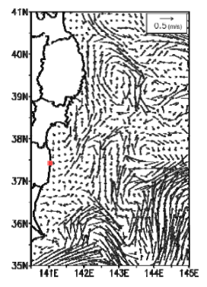
a) JCOPE2 (JAMSTEC)
Input
[Figure 1] Scenario of Radioactivity Concentrations in the Effluent Discharged from the Fukushima Dai-ichi NPP The scenario assumes that radioactive substances diffuse on the sea surface of 8 × 8 km at 1/100 of the concentrations observed at the coast based on “Results of Nuclide Analysis of Seawater” (March 21-May 20) released by TEPCO, and the same level of discharge as that as of May 20 continues until May 22. The vertical axis indicates the assumed radioactivity concentration as an index showing how many times it is higher than the effluent concentration limit for nuclear facilities.
The current velocity pattern simulated by JCOPE2 incorporates the on-site observation data and satellite observation data up to May 19. The
half-lives of radioactive substances (cesium-134: approx. 2 years, cesium-137: approx. 30 years) are taken into consideration in the
simulation.

Slide 6
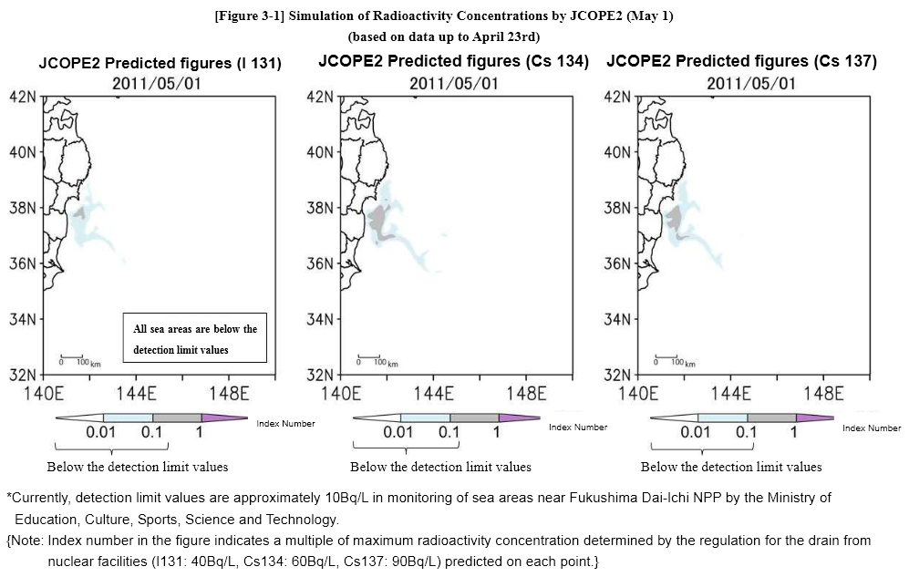
Output

Slide 7
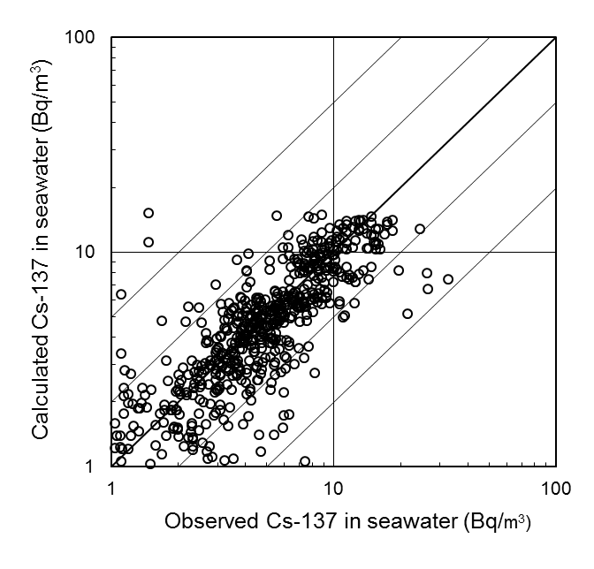
b) LAMER (JAEA)
LAMER: Long-term Assessment Model of Radionuclides in the Oceans, developed by JAEA to predict the radioactive dispersion in global scale with the annual mean three dimensional velocity fields.
The grid size of the velocity field is 2 degrees (200km*200km) horizontally and 15 layers vertically.)
The surface mixed layer was considered.
Concerning the validation of used model, evaluation of ¹³⁷Cs concentration in the seawater which was released from the past atmospheric nuclear tests was carried out by using LAMER code, and the obtained results were compared with the observations.

Slide 8
Assumption (Input amount)
Input amount to the model was adopted from the press release information.
Considering the deposition of the radioactive substances from the atmosphere in a simplified manner.
Because no deposition data was available, the radioactivity as a point source was released off shore the power plant at 1st April 2011, then no release occurred after that date.
 | Deposited from atmosphere | Direct release to sea |  | Total
In Bq | 11-16 March | 1-6 April | 10-11 May
¹³¹I ¹³⁴Cs ¹³⁷Cs | 1.6e17*0.5=8.0e16 1.8e16*0.5=9.0e15 1.5e16*0.5=7.5e15 | 2.8e15 9.4e14 9.4e14 | 8.5e11 9.3e12 9.8e12 | 8.28e16 9.95e15 8.45e15
*0.5: assuming as half of atmospheric release

Slide 9
Assumption (Others)
Because the purpose of the simulation was the conservative and simple estimation of seawater concentration in the open ocean, the following assumptions were adopted.
The sedimentation to the seafloor, the resuspension from the seafloor, the adsorption and the desorption with the particulate were not considered.
The inflow from rivers were not considered .
Because of the coarse grid system, this estimation of the concentration in seawater and the internal exposure from marine products is valid not in coastal sea but in open ocean.

Slide 10
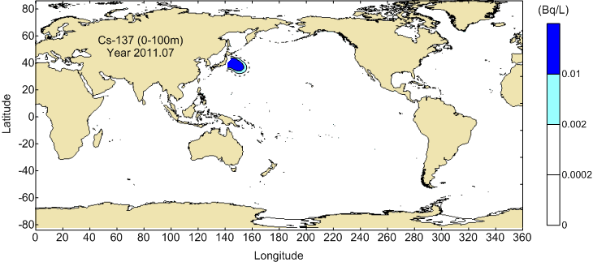
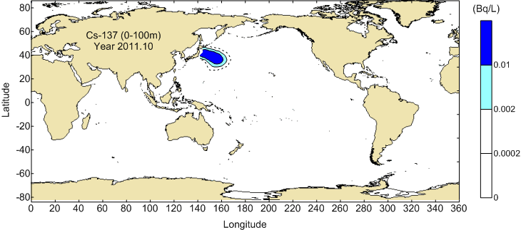
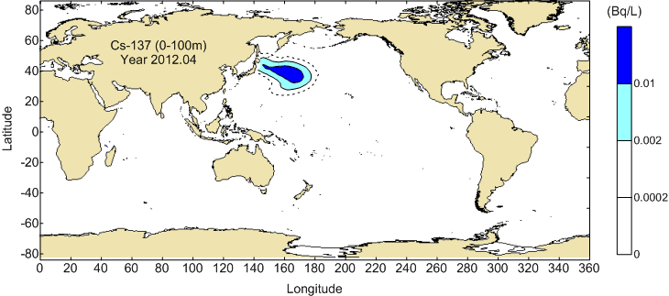
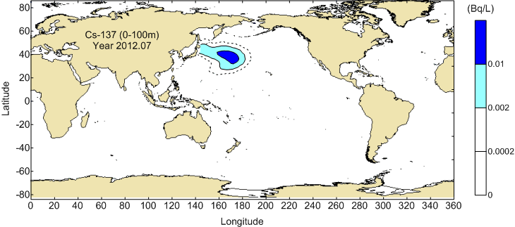
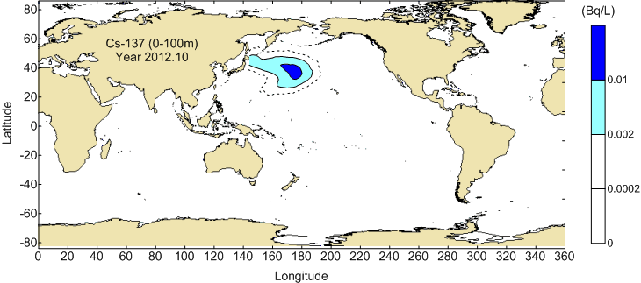
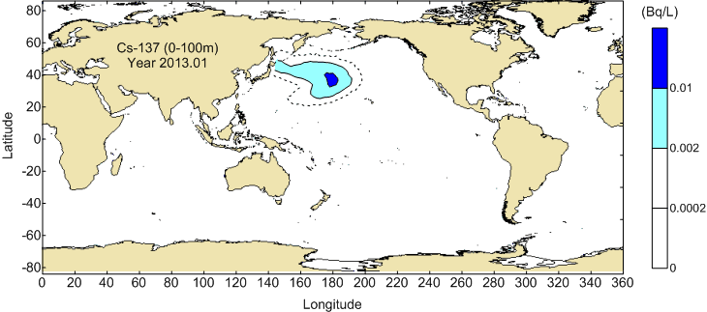
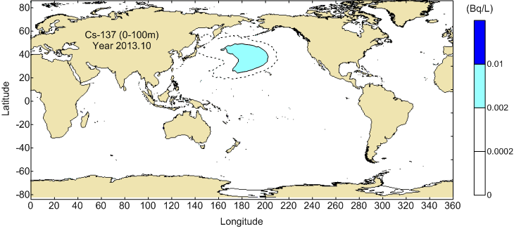
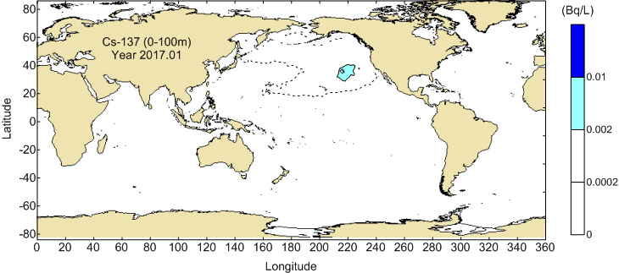
Change of ¹³⁷Cs concentration in seawater
(dotted line)
As the deposition from atmosphere was assumed as a point source, the spread and concentration of Cs are underestimated and overestimated, respectively.
It is expected that water mass containing Cs-137 moves to eastward in the Pacific Ocean by Kuroshio current, its extension and north pacific current, then the center of the water mass would reach at the east of the north Pacific in 3 years.
The water mass of about 0.0002 Bq/L (one tenth of the present background) would arrive at the west coast of US in 5 years.
The radioactive concentration in all part of the Pacific Ocean would be less than 0.002 Bq/L in 7 years, and diluted into low level that we cannot discriminate from the present background.
Notes:
大気からの沈着については、点線源としての投入なので、実際にはより早く到達する。
しかし実際の海洋の濃度は計算よりも低くなるので、最高濃度の見積もりとしては保守側である。

Slide 11
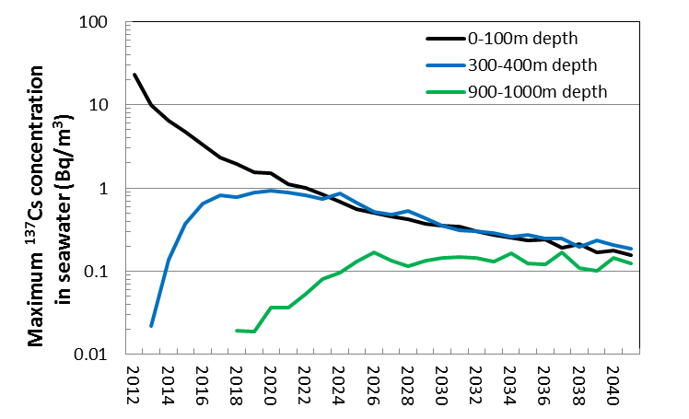
Change of ¹³⁷Cs concentration in seawater – concentration in several depth –
Although the surface concentration will gradually decrease, the concentrations at middle and deep layers will be increasing from zero up to the surface level in 10 and 30 years, respectively.

Slide 12
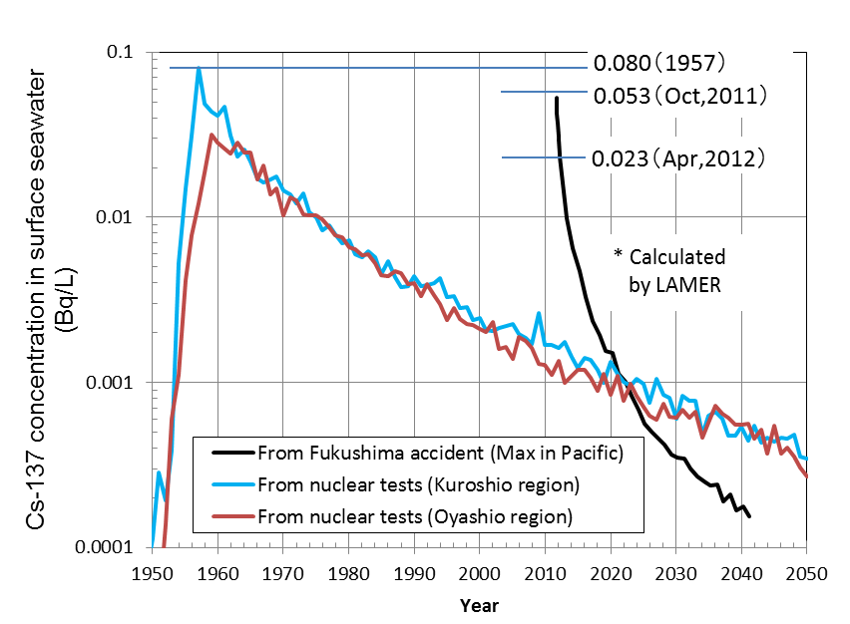
Change of ¹³⁷Cs concentration in seawater – comparison of past concentration –
2023
The radioactive material from the nuclear tests has already dispersed in the world, so will not dilute more.
The radioactive material from Fukushima Dai-ichi NPP is diluting rapidly.
It is predicted that the maximum concentration in October 2011 would be the same level with that in 1957, and that the maximum concentration in 2023 would be the same with the background level.

Slide 13
Trial calculation for Japanese internal exposure from marine products
S : effective dose from marine products (Sv/a)
(DC)_{j} : the dose coefficient of nuclide j (Sv/Bq)
(intake)_{k} :the annual intake amount of biota k (kg/a)
(CF)_{j,k}: concentration factor of nuclide j, biota k (Bq/kg per Bq/L)
(Cw)_{j} : the highest estimated concentrations of nuclide j in the Pacific ocean (Bq/L)
Species | Intake (g/d) | Concentration factors (Bq/kg per Bq/L)
 |  | ¹³¹I | ¹³⁴Cs | ¹³⁷Cs
Fish | 64 | 9 | 100 | 100
Crustaceans | 5.4 | 3 | 50 | 50
Cephalopods | 5.5 | -(3) | 9 | 9
Shellfish | 3.5 | 10 | 60 | 60
Seaweed | 10 | 10000 | 50 | 50
Dose Coefficient (Sv/Bq) |  | 2.2E-8 | 1.9E-8 | 1.3E-8
Concentrations (Bq/L) |  | 4.7e-15 | 0.020 | 0.023

Slide 14
Result of trial calculation
Species | Internal dose (μSv/a)
 | ¹³¹I | ¹³⁴Cs | ¹³⁷Cs | Total
Fish | 2.1e-14 | 0.89 | 0.70 | 1.6
Crustaceans | 6.1e-16 | 0.037 | 0.030 | 0.067
Cephalopods | 6.2e-16 | 0.0069 | 0.0054 | 0.012
Shellfish | 1.3e-15 | 0.029 | 0.023 | 0.052
Seaweed | 3.7e-12 | 0.069 | 0.055 | 0.12
Total | 3.8e-12 | 1.0 | 0.82 | 1.8
The trial calculation shows that the internal exposure by the intake of the marine products would be 1.8 micro Sv per year , when adopting the maximum concentration and the averaged Japanese diet.
Additionally, the internal exposure in 1960’s was estimated about 1.7 micro Sv/a by the same procedure.
Because the dose is proportional to the consumption amount of sea food, most public in the world will get lower doses than the Japanese population.

Slide 15
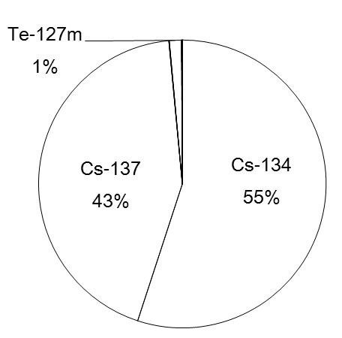
Contribution from other nuclides
Using the atmospheric release rates for 30 nuclides published by NISA, the internal dose from these radionuclides was also roughly estimated.
As the contribution from ^{134,137}Cs to the total dose delivered by 30 radionuclides represents 98%, it has been confirmed that the Cs isotopes are of main interest for the dose assessment.
Cs-134, Cs-137, Sr-89, Sr-90, Ba-140, Te-127m, Te-129m, Te-131m, Te-132, Ru-103, Ru-106,
Zr-95, Ce-141, Ce-144, Np-239, Pu-238, Pu-239,
Pu-240, Pu-241, Y-91, Pr-143, Nd-147, Cm-242, I-131, I-132, I-133, I-135, Sb-127, Sb-129, Mo-99

Slide 16
Conclusions
The main results obtained in the present study could be summarized as follows:
After 1 year, the maximum ¹³⁷Cs concentrations in surface waters of the open Pacific Ocean (~23 Bq/m³ in 2012 at 38N, 164E) will be comparable to that observed during the 1960´s after atmospheric nuclear weapons tests.
The ¹³⁷Cs concentrations at middle (300-400 m) and deep (900-1000 m) water layers will be increasing from zero up to the surface levels in 10 and 30 years, respectively.
The total internal dose from the intake of marine biota found in the open Pacific Ocean was calculated to be 1.8 μSv/a, which was mostly delivered by ^{134,137}Cs. The estimated dose is by about a factor of 500 lower than the present dose limit for the public.

Slide 17
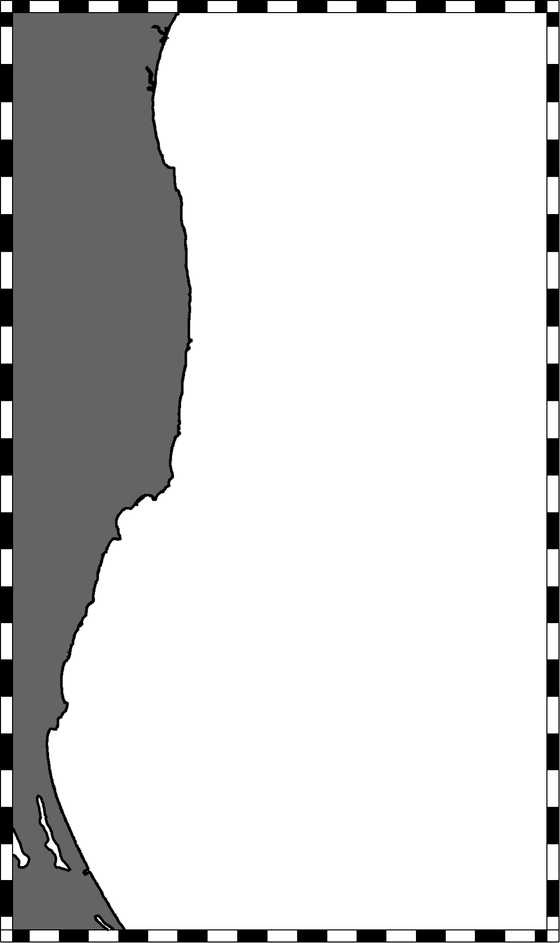
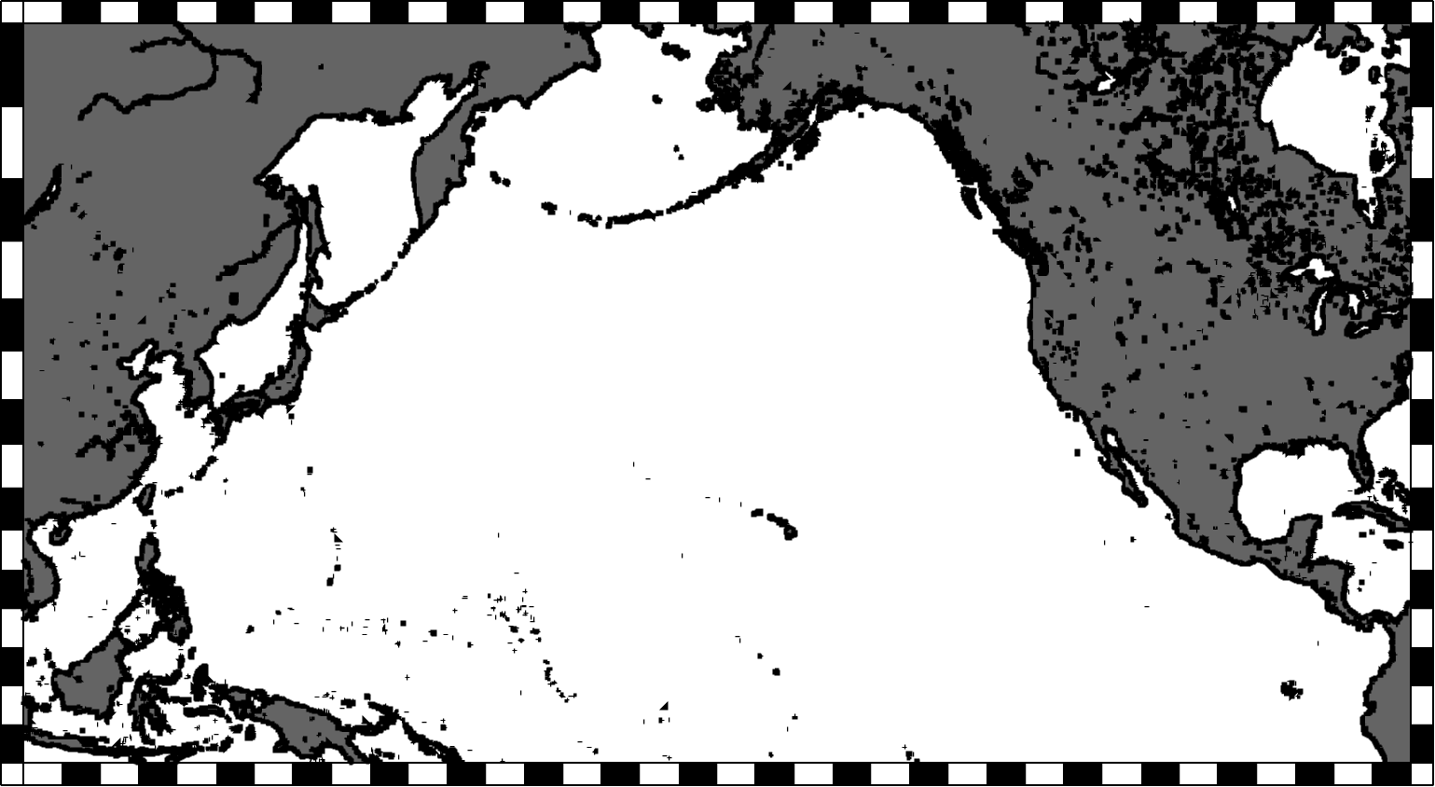
3. a) Ongoing simulation project in JAEA
Radionuclides migration model with data assimilation system using 4D-VAR (adjoint method)
Data assimilation system has been developed by Data Research Center for Marine-Earth Sciences (DrC)
of JAMSTEC and Kyoto University (K7 group)
Atmospheric deposition
Dry/wet deposition by WSPEEDI
Modelling objects and area
Sediment modelling near NPP
High resolution grids (2 km)
Seawater modelling in the
Pacific Ocean
Coarse resolution grids (1 degree)
a
b

Slide 18
3. b) Dispersion simulation using a new JCOPE2 (JAMSTEC)
A new version of the radionuclide dispersion model for JCOPE2 is being developed
The same physical component as in the previous version; i.e. the data-assimilative ocean forecasting system
3-dimensional advection-diffusion scheme, without scavenging processes
Atmospheric deposition will be included, with inputs from the JAMSTEC Air Quality Forecasting System

Slide 19
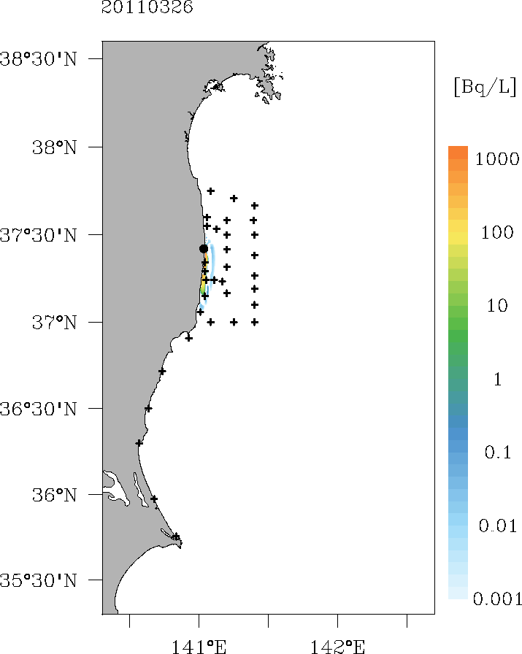
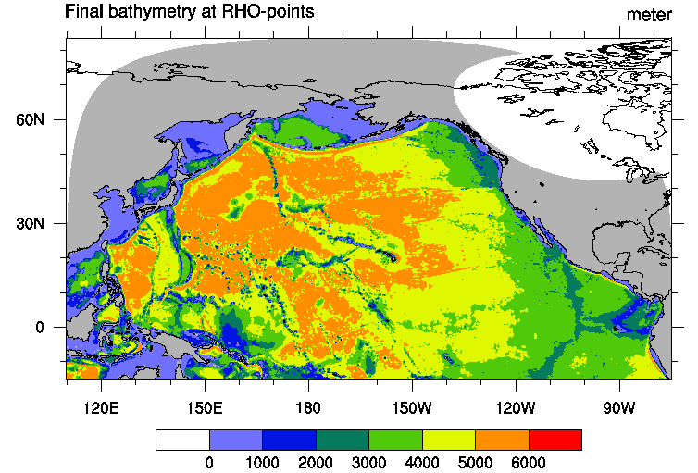
3. c) Ongoing simulation project in CRIEPI
Regional Ocean Modeling System (ROMS) simulation
Horizontal resolution (1km×1km)
Realistic wind forcing
Estimation of direct release rate in comparison between monitoring data and ROMS simulation
Atmospheric deposition to the ocean
Dry/wet deposition by WRF-Chem
Long-term seawater modeling in the
North Pacific
Eddy resolving grids (1/10 degree)

