Slide 1
The MariaBox project has received funding from the European Union’s Seventh Framework Programme for research, technological development and demonstration under grant agreement no 614088
MariaBox
MariaBox: first prototype of a novel instrument to
observe natural and chemical pollutants in seawater
Matteo Bonasso, K46
matteo.bonasso@kontor46.eu
OCEANS ‘17 MTS/IEEE ABERDEEN
19th to 22th JUNE 2017

Slide 2
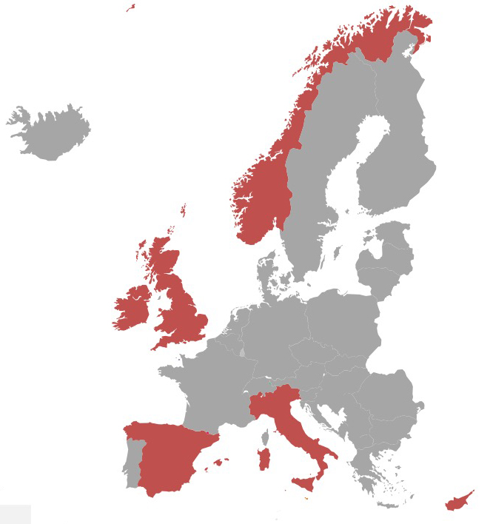
Our project
Duration : 48 months
Project Start Date : 1st of February 2014
13 partners from 6 EU countries
Coordinator : CyRIC Cyprus Research and Innovation Center

Slide 3
Main objectives
To produce an autonomous marine pollution-monitoring device, based on new biosensors, implemented as a set of compact, multifunctional, integrated modules for the analysis of marine pollutants and the assessment of marine water quality. The system will be suitable for free floating devices, buoys, platforms or ships, or as a portable system
To develop new biosensors to monitor selected chemicals and toxins. Biosensors will be developed for 4 man-made chemicals and for 4 categories of microalga toxins relevant to shell fish and fish farming

Slide 4
Main objectives
To develop a software application and a software platform for the marine monitoring and distribution so to be almost real-time available. Data collection is compatible with the
INPSIRE directive
the Copernicus European Earth observation programme,
the GOOS observing system,
the SeaDataNet,
and follows the SOS standard
To validate the system in four real-world scenarios:
Spain, Cyprus, Norway, Ireland.

Slide 5
Conceptual overview
The MariaBox approach includes:
a sensing and analysis device
a modular communication system
a flexible power module
a software platform with open data services
a cell phone application.
The main device includes:
the pre-analytical module
the analysis module, which contains four sub-modules
the man-made pollutants analysis module (Chemical-POD)
the algal toxins analysis module (Biological-POD)
the routine environmental parameters analysis module (Routine-POD)
a custom module (Taylor-POD), which offers additional inputs

Slide 6
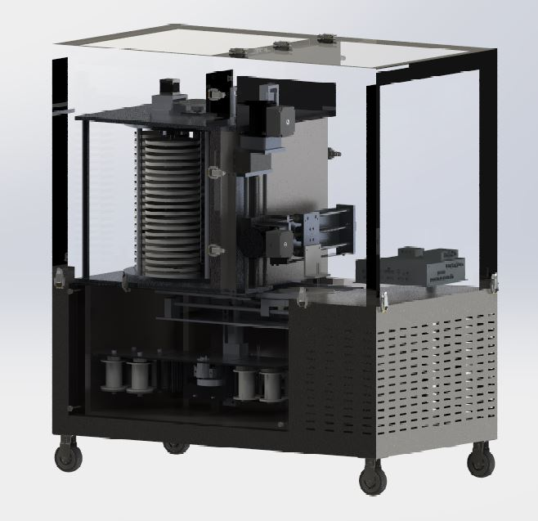
MariaBox instrument developments
Preliminary design of the main MariaBox mechanisms
Pre-analytical and analysis modules
Biosensors storage
Biosensors replacement module
Conditioning
Processing module (CORE electronics)
3D rendering of the first MariaBox prototype
The prototype is about 1m high, 1m long and 0.5m wide
The device is currently being validated in the lab.

Slide 7
MariaBox instrument developments
Some of the most critical and important challenges for MariaBox includes:
Filtering
smart, automatic filter replacement module that automatically replaces all device filters, before each measurement
Sample contamination (wash/cleaning of internal pipes)
washing all device pipes with deionised water before each measurement, in order to avoid cross-contamination
Power consumption
Solar and wind energy are used. Data are transmitted only when necessary

Slide 8
MariaBox instrument developments
Some of the most critical and important components for MariaBox includes:
Biosensors Disc
The modules includes a mechanism for transferring the biosensor discs to the analysis module, whenever an analysis needs to take place.
When a biosensor disc is fully used, then it is positioned in a dedicated position inside the storage chamber and a new disc is automatically loaded.
The analysis module
Is the responsible for reading the biosensors.
The discs containing the biosensors have to be spun following a specific protocol that allows the necessary binding to take place. Afterwards, optical analysis of the disc is performed using an LED and a photodetector, working at predefined wavelengths, using also the appropriate optical filters.
The output of this module are the concentrations of the four man-made chemicals and the four categories of micro-algae toxins targeted by MariaBox

Slide 9
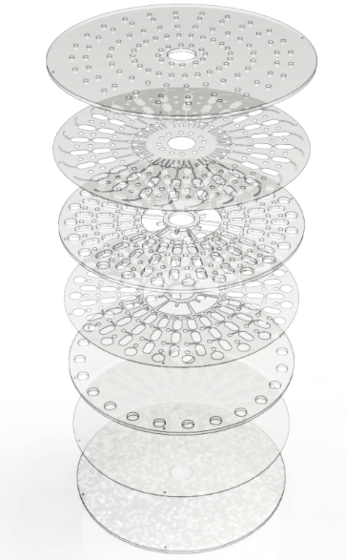
The Disc
The disc is built in a layered format with each layer contributing elements to the platform e.g. valves,micro channels, sample and control reservoirs and air vents.

Slide 10
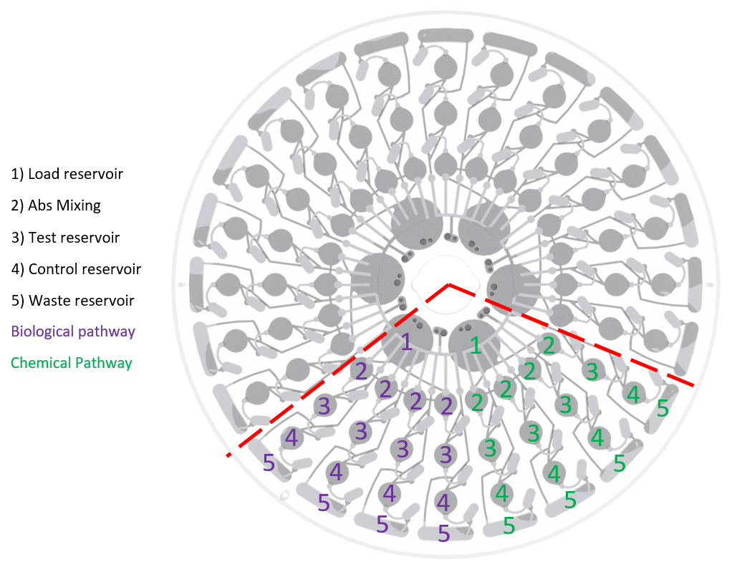
The Disc
The 3-day 8 analyte MariaBox centrifugal microfluidic disc. Red demonstrates a single day portion of the disc which can assess 8 target analytes present in 2 separately injected.
The selective antibody or unique receptor is located in region 2: here the water sample mixes with the receptor before progressing to the test reservoir.
Optical detection takes place in reservoir 3 with a control in reservoir 4.
Sample progresses from each zone by spinning the disc at a designated speed creating the force required to rupture a valve to facilitate progression.
Careful control and management of spin speed and time can control how the fluid progresses through the
disc for measurement of each analyte

Slide 11
MariaBox target Analytes

Slide 12
MariaBox target analytes
In addition to the –CHE and –BIO Data, MariaBox collects also the Routine Data:
Water Temperature [°C]
pH [no units]
Salinity [measured using PSS-78 do not have units]
Dixolved oxygen [mg/L]

Slide 13
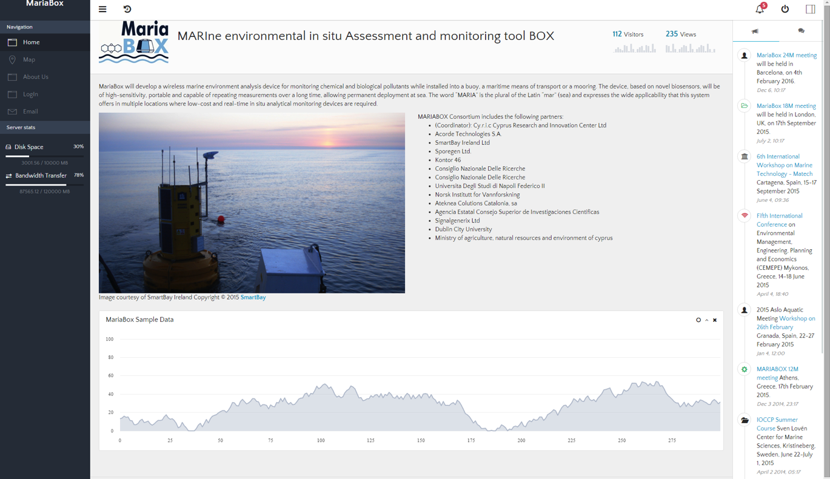
MariaBox software platform developments
Interface between the MariaBox and possible data users
Compliance with EU Inspire directive
Availability to Copernicus
Compatibility to: OGC Sensor Observation Service (SOS), SeaDataNet, GOOS

Slide 14
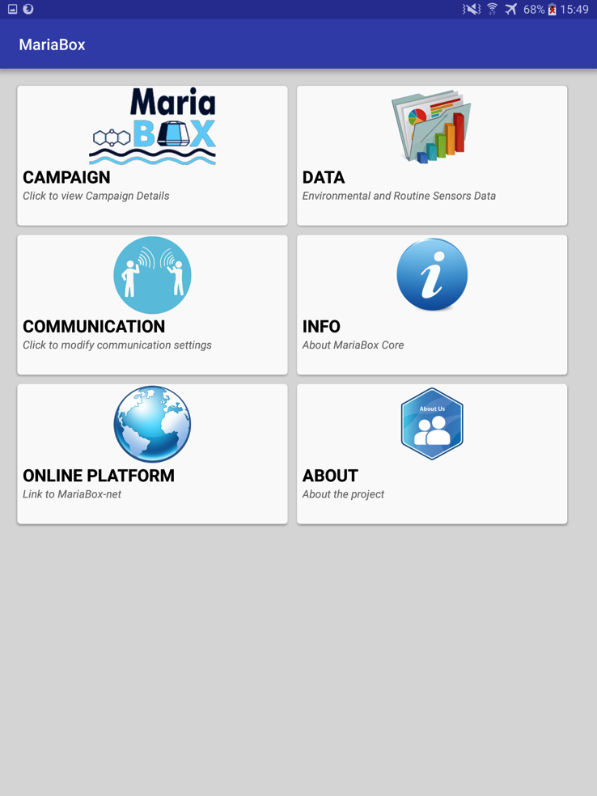
MariaBox mobile App developments
An interface to program and control MariaBox in proximity in the event there are no comms between the buoy and MariaBox
Android App, Wi-Fi
Dedicated list of functionalities

Slide 15
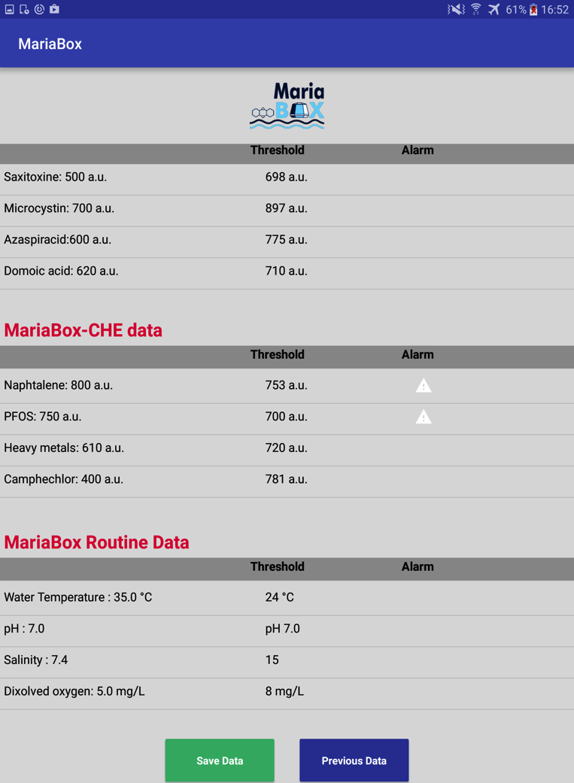
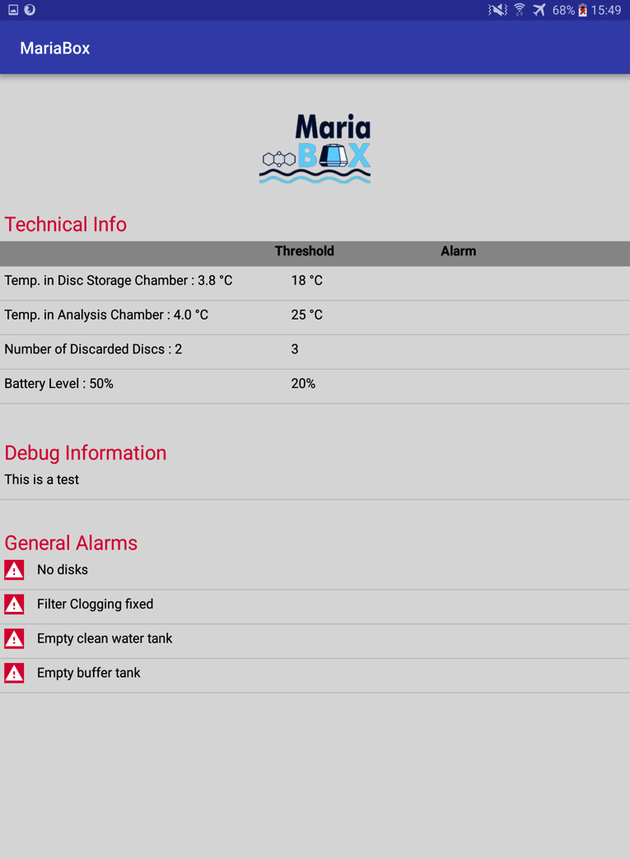
MariaBox mobile App developments

Slide 16
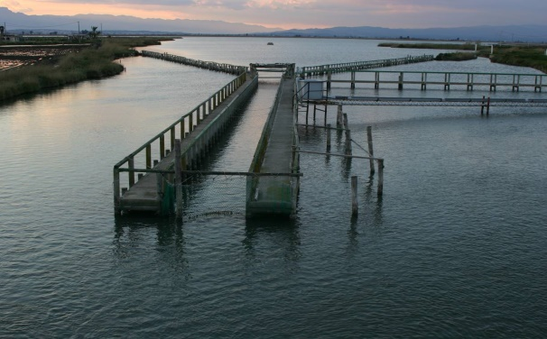
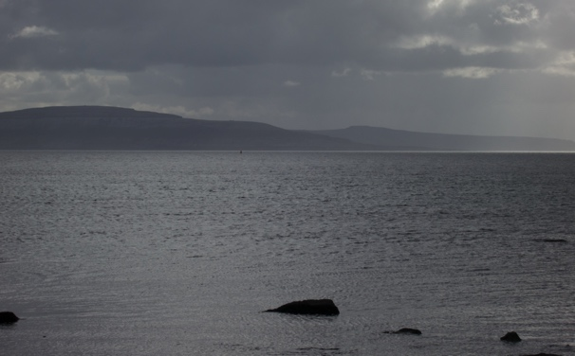
The demos
Alfacs Bay pilot site (CSIC, Spain)
Galway Bay pilot site (SMI, Ireland)
Water depth: | Average and maximum depths of 3.13 m and 6.5 m.
Water temperature: | 5-28 ºC
Ambient temperature: | 3 to 35 ºC
MariaBox to be placed in buoy or boat? | MariaBox will be placed in a SGX buoy
Water depth: | 20 – 25 m
Water temperature: | 6 – 15 deg C
Ambient temperature: | -5 – 30 deg C
MariaBox to be placed in buoy or boat? | Buoy (potentially underwater cabled observatory)

Slide 17
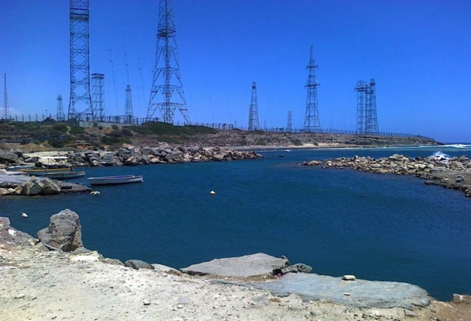
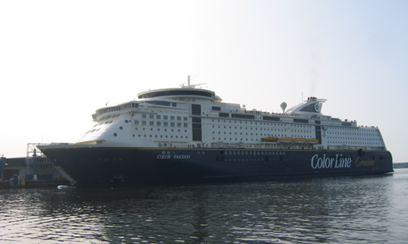
The demos
Vassilikos Bay and Port pilot site (DFMR, Cyprus)
Skagerrak/Kattegat pilot site (NIVA, Norway)
Water depth: | 50-200m
Water temperature: | 21,6-27,3
Ambient temperature: | -1 to 40 deg Celcius
MariaBox to be placed in buoy or boat? | SGX Buoy
Water depth: | Water intake 4 meters
Water temperature: | -1.5 to 25 Deg C.
Ambient temperature: | In machine room: 20-30 DegC
MariaBox to be placed in buoy or boat? | Ferry boat

Slide 18
Thank you

