Slide 1
Workshop on offshore renewable energies 2022
Vincenzo Gente, Charlotte Jagot Senior Project Adviser, CINEA, Sustainable Blue Economy Unit
Online, 04/10/2022

Slide 2
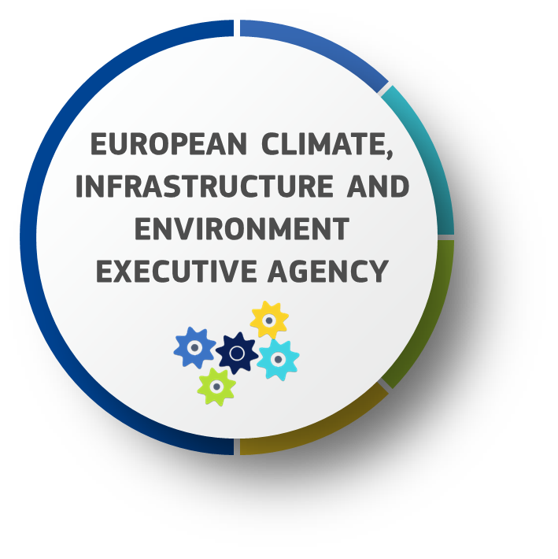
CINEA AND THE EUROPEAN GREEN DEAL
CONNECTING EUROPE FACILITY 2
Transport and Energy
EUROPEAN MARITIME FISHERIES
AND AQUACULTURE FUND
LIFE PROGRAMME
RENEWABLE ENERGY FINANCING MECHANISM
INNOVATION FUND
JUST TRANSITION
MECHANISM
Public Sector Loan
Facility pillar
> 55 billion
HORIZON EUROPE
Climate, Energy and Mobility
Mission Restore Our Ocean
around 500
Notes:
CINEA is so called the EU Green Deal Executive Agency and plays a key role in the transformation of the EU into a modern, resource-efficient and competitive economy.
We can do this by turning climate and environmental challenges into opportunities, and making the transition fair and inclusive for all.
CINEA is implementing for the next now 6 years several EU funded programmes for transport, energy, climate action, environment, maritime fisheries and aquaculture. You can see on this slide all programmes and our budget that we currently manage. (which will be around 55 billion euro).
Thanks to the EU Green Deal and the projects implemented in CINEA, we aim at boosting the efficient use of resources by moving to a clean circular economy, restoring biodiversity, cutting pollution, and achieving climate neutrality by 2050.
Your project is therefore very timely as it is illustrates the opportunities and challenges to be addressed in order to exploit the potential offered by sustainable transport.

Slide 3
CINEA SUPPORT TO ORE
CEF
H2020/HE
EMFF/EMFAF
LIFE
Innovation Fund
JTM
RENEWFM
Cross border cooperation, marine surveys, studies for transmission infrastructure, grids & cross border-RES generation, ports improvements
Technology, upscaling, cost reduction, demonstration of emerging technologies, soft skills
5 EU programmes
Approx. 100 projects*
Operational costs reduction, digitalisation & robotics, maritime spatial planning, multi-use
Efficiency & environmental impact of ORE solutions
Demonstration of innovative low-carbon technologies (ETS funds)
*covers funded as of 2014 completed and on-going projects, including legacy
Notes:
At present, 5 EU programmes managed by CINEA support offshore sector development. In total, CINEA manages > than 100 EU-funded projects (including legacy and counting horizontal: 145). Great part of these are funded by the H2020 and EMFF programmes (predecessors of current HE and EMFAF programmes) in the sector of wind, whereas a number of grants were provided from LIFE, CEF and IF programmes.
CEF: since 2014 supported a number of detailed marine surveys, conceptual & feasibility studies for the offshore & hybrid infrastructure for the PCIs. As of 2021, a new area of funding was open in view of facilitating c-b cooperation between Member States in the field of planning, development and cost-effective exploitation of RES. The first call for proposal brought first ORE project covering conceptual design for hybrid grid connection of a wind farm site
H2020: (by far largest support allocated) invested into RES technology generation upscaling in view of CAPEX reduction (mostly offshore bottom fixed wind), demonstration of emerging technologies (such as floating RES) up to commercial uptake and various breakthrough O&M technologies. Also recyclables. In addition, a number of supported projects aim to address co-existence in marine space (offshore and near-shore ORE generation + fisheries, aquaculture or tourism development).
EMFF: projects mostly relate to high-tech materials against the corrosion of offshore infrastructure elements, sensing and oceanographic equipment, digitalisation and robotics. In addition, EMFF covered environmental impact assessment and development of inclusive maritime spatial plans.
LIFE: few projects in demonstration of the efficiency & environmental impact of wave and tide energy installations. In addition, several initiatives are supported through operational grants
IF: (only two projects pre-selected for funding are invited to sign GAs) and relate to green hydrogen and offshore windfarm innovation. One project will produce, distribute and use green hydrogen through an electrolyser supplied by offshore wind electricity at sea in the Netherlands and another Offshore Windfarm Innovation + electrolyser project in Germany
Last but not least, potential for RENEWFM and JTM programmes. RENEWFM: facilitates Member States collaboration in achieving individual RES targets through EU wide open tenders; JTM: is a key NEW tool to ensure the transition towards a climate-neutral economy happens in a fair way, leaving no one behind
Being in charge of all these EU funding programmers’ implementation, we support synergies across programs, sectors and projects and we transform complementarities into an added-value!

Slide 4
PROMOTING SYNERGIES
CINEA can support synergies across programs, sectors and projects and we transform complementarities into an added-value!
Thematic reports/notes on crosscutting areas
Mapping of projects/project pipelines
Thematic workshops
Cross-programme database of projects
Advanced knowledge sharing
Notes:
On the screen you can see some examples of possible activities that CINEA can undertake to support its parent DGs in enhancing synergies. For instance such activities may be:
Thematic reports: These reports encompass a particular thematic priority or technology, product, process and/or service as agreed upfront with the parent DGs. They are based on data from different programmes and projects about relevant developments, implementation challenges and results, including any relevant recommendations for future policy decisions
Mapping of projects - A list of technologies from research to deployment, including mature technologies, and other solutions (non technological innovation) that can be included in the next phase of deployment or market uptake, as to detect actions with synergy potential at an early stage
Cross-programme database on CINEA projects -Development of a dashboard to which parent DGs (and public) have direct access (e.g. Qliksense) which includes all CINEA programmes and which allows for search of structured information (e.g. geographical representation) around thematic areas. Such database would also reduce the requests for statistical information towards the Agency’s project managers. The information provided can potentially incorporate the cross-cutting and programme-specific KPIs
Thematic workshops with participation of all relevant CINEA’s programmes
Enhanced cooperation among the programmes managed by CINEA, including advanced knowledge sharing -Organisation of lunchtime sessions/targeted meetings on horizontal thematic areas and also with parent DGs participation to allow for colleagues to share information, discuss and come up with common conclusions and/or recommendations.
However, as already mentioned concrete actions should be agreed in advance for each year taking into account the 3 considerations mentioned earlier:
The policy needs of the parent DGs
The most efficient use of the Agency’s resources
The most effective outcome

Slide 5
CURRENT PORTFOLIO OF PROJECTS
Notes:
Wind: bottom-fixed, floating: 40
Tide: 12
Wave: 15
Key Enablers and servicing the industry: 15
Regulatory, multi-use: 15

Slide 6
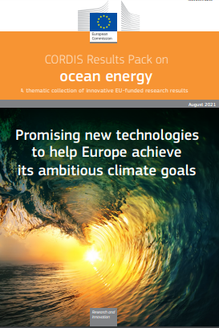
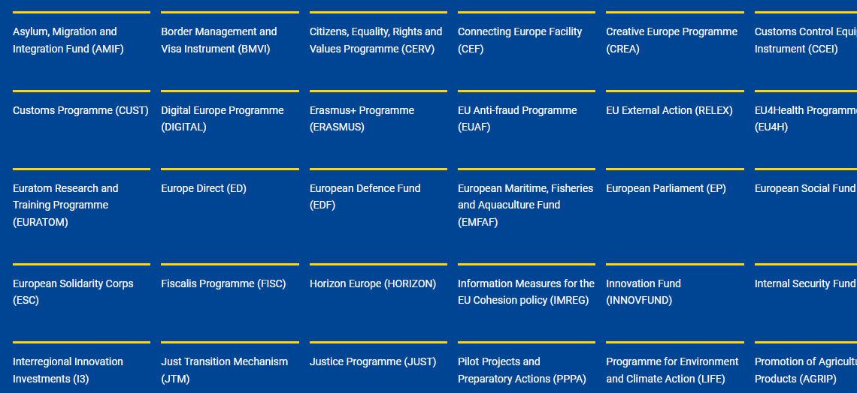
ONGOING FUNDING AND FUTURE OPPORTUNITIES
EU funding for offshore renewables https://energy.ec.europa.eu/topics/renewable-energy/financing/eu-funding-offshore-renewables_en
Funding and tender opportunity portal https://ec.europa.eu/info/funding-tenders/opportunities/portal/screen/home
Ocean energy CORDIS Pack

Slide 7
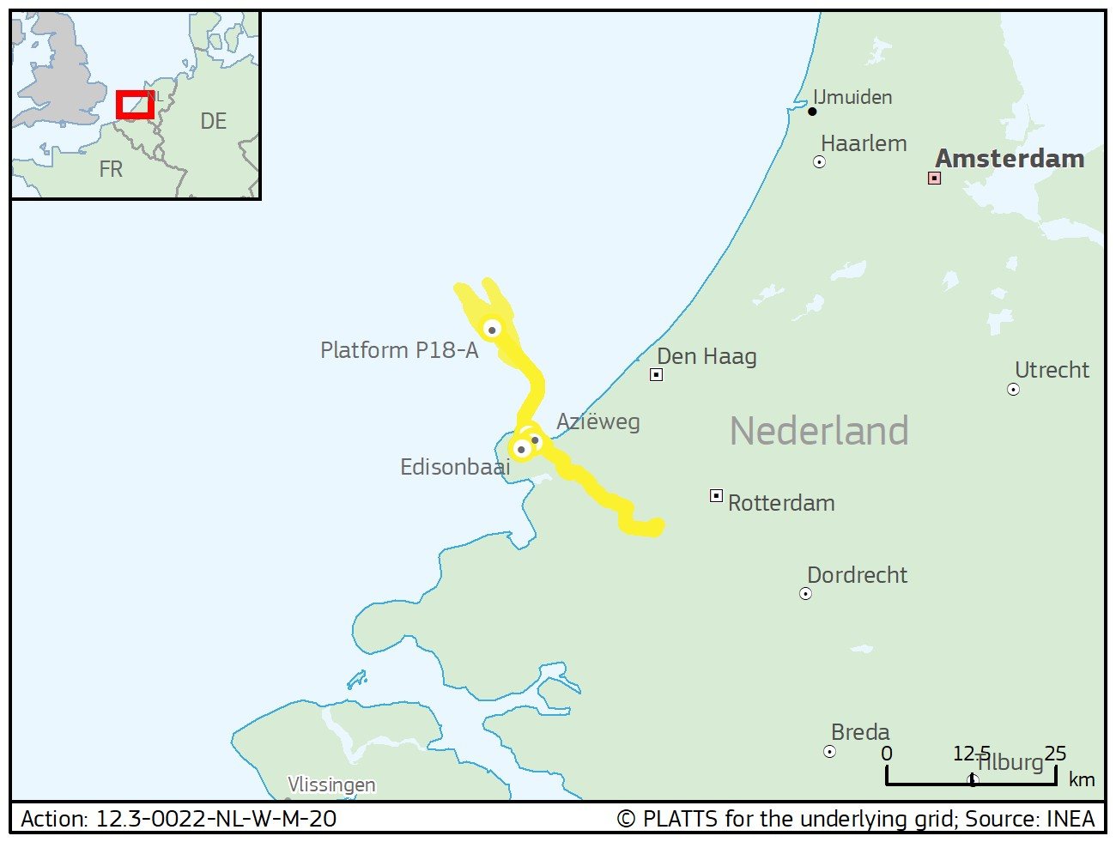
CEF – North Sea Wind Power Hub
Scope:
It is a first building block in the hub concept connecting up to 12 GW future offshore wind parks to the energy systems of DK, NE and DE. It covers pre-feasibility, pre-FEED, CBA, alternatives study, grid, market analysis, environmental Studies.
Coordinator: TenneT TSO B.V. (NL)
EU contribution: € 14M
Start-End date 6/2020-9/2023
Website: https://northseawindpowerhub.eu/
Notes:
Coordinator: TenneT TSO B.V.
(Netherlands), TenneT TSO GmbH
(Germany), Energinet (Denmark)

Slide 8
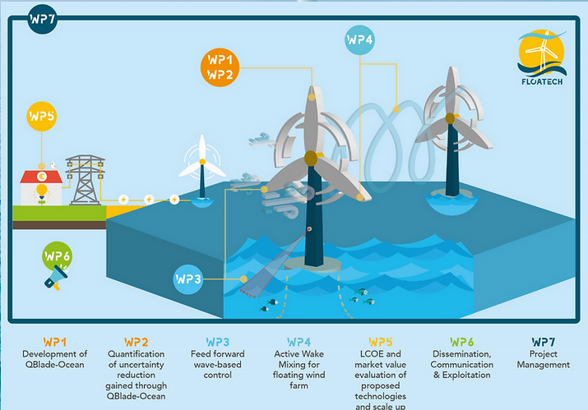
Horizon 2020/Europe
Scope
Develop a set of innovative production and monitoring tools to reduce the uncertainties in the design process of floating wind turbines. FLOATECH aims to provide more advanced, trustworthy and cost-effective floating wind turbines, leading to an increase of the actual energy yield of floating wind farms.
Coordinator: TU Berlin (DE)
EU contribution : € 4 096 355
Start Date-End Date: 01/2021-12/ 2023
Website: https://www.floatech-project.com/

Slide 9
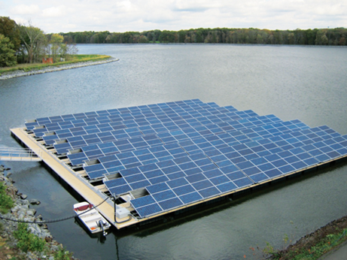
EMFF - FreShER
Scope
Demonstrating an innovative mooring solution in a full-scale floating PV park, that is 50% more cost efficient compared to standard solutions, making the floating solar parks more sustainable with eased manufacturing and installation, as well as lower the transport and maintenance needs.
Coordinator: SEAFLEX AB (ES)
EU contribution : € 709 409
Start Date-End Date: 11/2019-09/2022
Website: https://fresher-project.eu/

Slide 10
LIFE – Life DemoWave
Scope:
Demonstrate the viability of two wave energy converter (WEC) devices.
Highlight the environmental benefits of the system, by quantifying the reduction of carbon footprint and other pollutants along the entire cycle, in comparison with other technologies, and identifying and minimising its impact on biodiversity.
Coordinator: QUANTUM INNOVATIVE SL (ES)
EU contribution: € 1 034 119
Start Date - End Date : 10/2015-06/2019
Website: http://www.life-demowave.eu/en/
Notes:
The two prototypes, each one scaled at 25 kW, were manufactured, installed and tested to demonstrate their socio-economic viability, as well as transferability potential, based on their robust design and systems efficiency (e.g. survival capacity under extreme weather conditions).

Slide 11
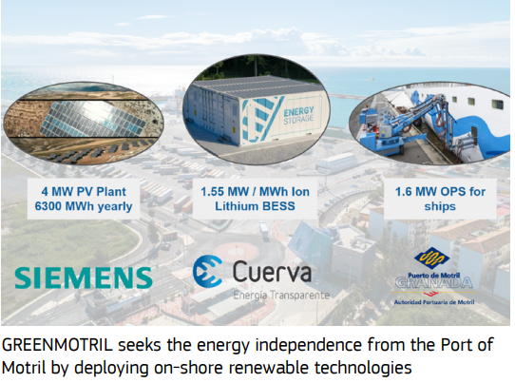
Innovation Fund - GREENMOTRIL
Scope:
The GREENMOTRIL project will transform the seaport of Motril (Spain) into the first European port able to operate off-grid while maintaining its basics services, based on a self-managed energy community which uses renewable energy and storage technologies and can intelligently manage power demand using advanced technologies.
Coordinator: Montajes Electricos Cuerva (SL)
EU contribution: € 4 347 980
Start date – End date: 01/2022-06/2027
Website: https://climate.ec.europa.eu/system/files/2022-07/if_pf_2021_greenmotril_en.pdf
Notes:
All in all, 6 300 MWh of renewable energy will be used every year, therefore reducing significantly (GHG) emissions associated with the port activities thanks to the Onshore Power Supply (OPS)
deployed in the framework of the project

Slide 12
Follow us
LIFE Programme
EU Sustainable Energy Week
cinea.ec.europa
@CINEA_EU
@LIFEprogramme
@#EUSEW2021
CINEA - European Climate, Infrastructure and Environment Executive Agency
LIFE Programme
euenergyweek
CINEATube
LIFE Programme
Dirk Beckers
@CleanEnergy_EU
@DirkBeckersEU

Slide 13
Thank you

Slide 14
FUTURE outlook CEF- Energy - 5.8 billion EUR for 2021-2027
supporting new priorities under revised TEN-E: offshore grids, hydrogen, RES
funding to commercially not viable ORE projects
Exploiting synergies between PCIs and CB RES (e.g. off-shore projects), other CEF sectors (digital, transport)
supporting the potential of complementarities with other funding programmes (RRF, IF)
building on best practices on sustainability, environment and coordinated planning (LIFE, EMFAF)
2022 CALLS for PROPOSALS:
Projects of Common Interest (PCIs): as of 2024, 1st PCI under selection
Two Cross-Border RES calls: early-stage studies (open) and works
Notes:
As you note, ORE sector development already enjoys a considerable EU support; a number of new calls for proposals will be published by CINEA still this year, contributing to the uptake of the innovative solutions for the offshore renewable energy generation, increasing market uptake, enabling the development of energy infrastructure that connects ORES to land energy grids and involves citizens.
CEF PCIs (cover transmission part): Following the revision of the TEN-E Regulation this summer, 4 offshore priority corridors around Europe's sea basins were defined with offshore development targets within each sea basin by 2050 and the intermediate steps in 2030 and 2040. Those ORE projects that obtain status of Projects of Common Interest that can demonstrate the potential for cross-border impact and high EU value, yet are commercially not viable, will be able to receive support from CEF-E. The selection for the PCI status under new TEN-E will be launched this autumn and first calls for proposals relevant for the offshore RES are expected by 2024. Hybrid projects (connecting ORES with transmission grids of several MSs) are the main candidates for such calls, given their risky and atypical nature requiring extensive collaboration between multiple parties. Typically, calls are expected to be launched on an annual basis.
CB RES (can cover generation part): Furthermore, EUR 900 million was earmarked particularly for the early-stage co-investments for renewable cross-border projects until 2027. For preliminary studies, a new call has been launched on 20/9 and remains open till early next year with an aim to select best project concepts and setting up the cooperation agreement. In order to be eligible for CEF Energy c-b works, projects need to first receive status of Cross-Border Project in the field of RES. A recent selection identified one such important ORE project: between LV and EE, promoted by the ministries [Ministry of Economic Affairs and Communications of Estonia and the Ministry of Economics of Latvia]. Annual electricity output of about 3,5 TWh. The project is being developed by ELWIND company, who will present their concept at a later session today.
For the c-b RES status projects, the call for proposals under CEF will be launched in Q4 2022, while a new edition of calls for c-b RES preparatory studies, not requiring special status, is planned for 9/2022 (date tbc) with the closure date in 11/2022. Third countries can also promote projects of mutual interest (PMI) that ensure the interoperability of networks in the Union’s neighborhood and will also be eligible for CEF funding.
CEF is not limited to grants – it brings added value:
Creates synergies between different sectors (CEF Transport & CEF Digital)
CEF-2 allows combing of different EU funding sources (Innovation fund, Recovery and Resilience Facility - RRF) and different financial forms (EIB loans, Invest EU guarantees)
---------------------------------------------
BACKGROUND: Calls launched under other programmes this year
CEF transport part, studies and works for maritime ports, among other aiming at development of ports´ capacities and facilities in relation with offshore wind farms (eligible activities: transportation arranged for the offshore wind farms) are eligible elements for funding. To date, 5 maritime ports projects have been preselected, all in GAP. A new call llaunched 13/9/2022 with the end date in January 2023.
LIFE: LIFE: The Clean Energy Transition sub-programme (CET) of LIFE, previously funded under H2020. The clean energy transition sub-programme supports the objectives of EU policies and regulation in the transition towards a decarbonised energy system. It includes capacity building and dissemination of knowledge, new skills, and innovative techniques in RES. LIFE CET can support the local offshore renewable investments through development of local renewable energy communities, strategies and plans in municipalities, and with its project development assistance for local sustainable energy investments. An indicative amount of EUR 527 million is allocated to CET for the period of 2021-2024. Deadline for Submission: November 16/2022. Another call is upcoming under LIFE Climate sub-programme with a priority climate mitigation and ORE sector investments are eligible.
HE: Its investments are intended to help deliver on the different dimensions of the European Green Deal, the European Union’s new growth strategy. CINEA runs two of the sub-programmes (HEU cluster 5 on Climate, Energy and Mobility). The sub-programmes on climate science, energy supply, energy use and transport&mobility research. A work programme for two years is established with several topics in the field of a) Energy supply, b) Energy systems and grids, c) Energy storage, and d) Climate science and solutions. 6/9/2022 -10/1/2023
IF was designed to scale up innovative clean tech and to finance the demonstration of first-of-a-kind highly innovative projects. Depends on the carbon price for the commercial demonstration of innovative low-carbon technologies, aims to bring to the market industrial solutions to decarbonise the European Union and support its transition to climate neutrality. The call is focused on large scale technology demonstration as well as 3 RePower EU topics, i.a., at innovative electrification and hydrogen applications in industry, mid-sized pilot projects for validating and testing highly innovative solutions. 11/2022- Q1 2023
EMFAF: (under consideration) EMFAF-2023-PIA-FLAGSHIP call to be published on 13 October.

