Slide 1
Common Information Sharing Environment
Enhancing maritime domain awareness and responsiveness in Europe
CISE STAKEHOLDER SURVEY

Slide 2
Outline
Objectives of the consultant engagement
Workshops with national maritime authorities
Survey
  Criteria
  Evaluation
Conclusions

Slide 3
Objectives of the consultant engagement
Identify and prioritize suitable CISE information services
Re-assess user needs for information exchange
Benchmark CISE interoperability solutions (i.e. CISE data model)
Consolidate the added-value of CISE
Identify cornerstones for implementing CISE

Slide 4
Workshops with national authorities
Phases
Monitoring
Intervention
Reporting
Scenario
Description
1
Remote Intervention for an oil spill/ pollution situation
A vessel is suspected of polluting in the EEZ (exclusive economic zone). You identify that it is a Chinese tanker.
2
Search and Rescue operation
A SOS signal is received in the TW (territorial waters) close to the neighbor's waters. You identify that it is a cruise ship with over 400 passengers on board.
3
Countering illegal trafficking operation
You get a notification of a vessel suspected of transporting immigrants/drugs in the EEZ. You identify that it is a leisure ship under a foreign flag.
4
Fisheries control operation
You notice suspicious (IUU) behavior of a vessel in a fishing area in the EEZ. You identify that it is a fishing boat from a neighboring country.

Slide 5
Workshops with national authorities
Crew list service
Cargo service
Incident / event notification service
Distributed search
Collaboration services
Risk information service
Vessel voyage service
Vessel location service
Incident history service
Registry of Authorities (Query)
Intervention asset service
Vessel details service

Slide 6
Survey criteria
Implementation priority
Provider – consumer role
Criticality for operational purposes
Value added to operations
Barriers to implementation
Confidentiality of information exchange
Rate of exchange (usage)
Existence of IT solutions
Ongoing developments
Participation in implementation projects
Collaboration partnerships

Slide 7
General conclusions (evaluation)
Replies from 32 authorities from 12 countries, representing all seven maritime user communities and EU bodies (Europol, European Defense Agency)
Three prioritized CISE Services: Incident Notification, Vessel Tracking (Voyage, Location and Details), Risk Information Exchange
Confirmation and prioritization of the CISE services identified from Workshops - 12 CISE services are a commonly accepted foundational baseline for implementation

Slide 8
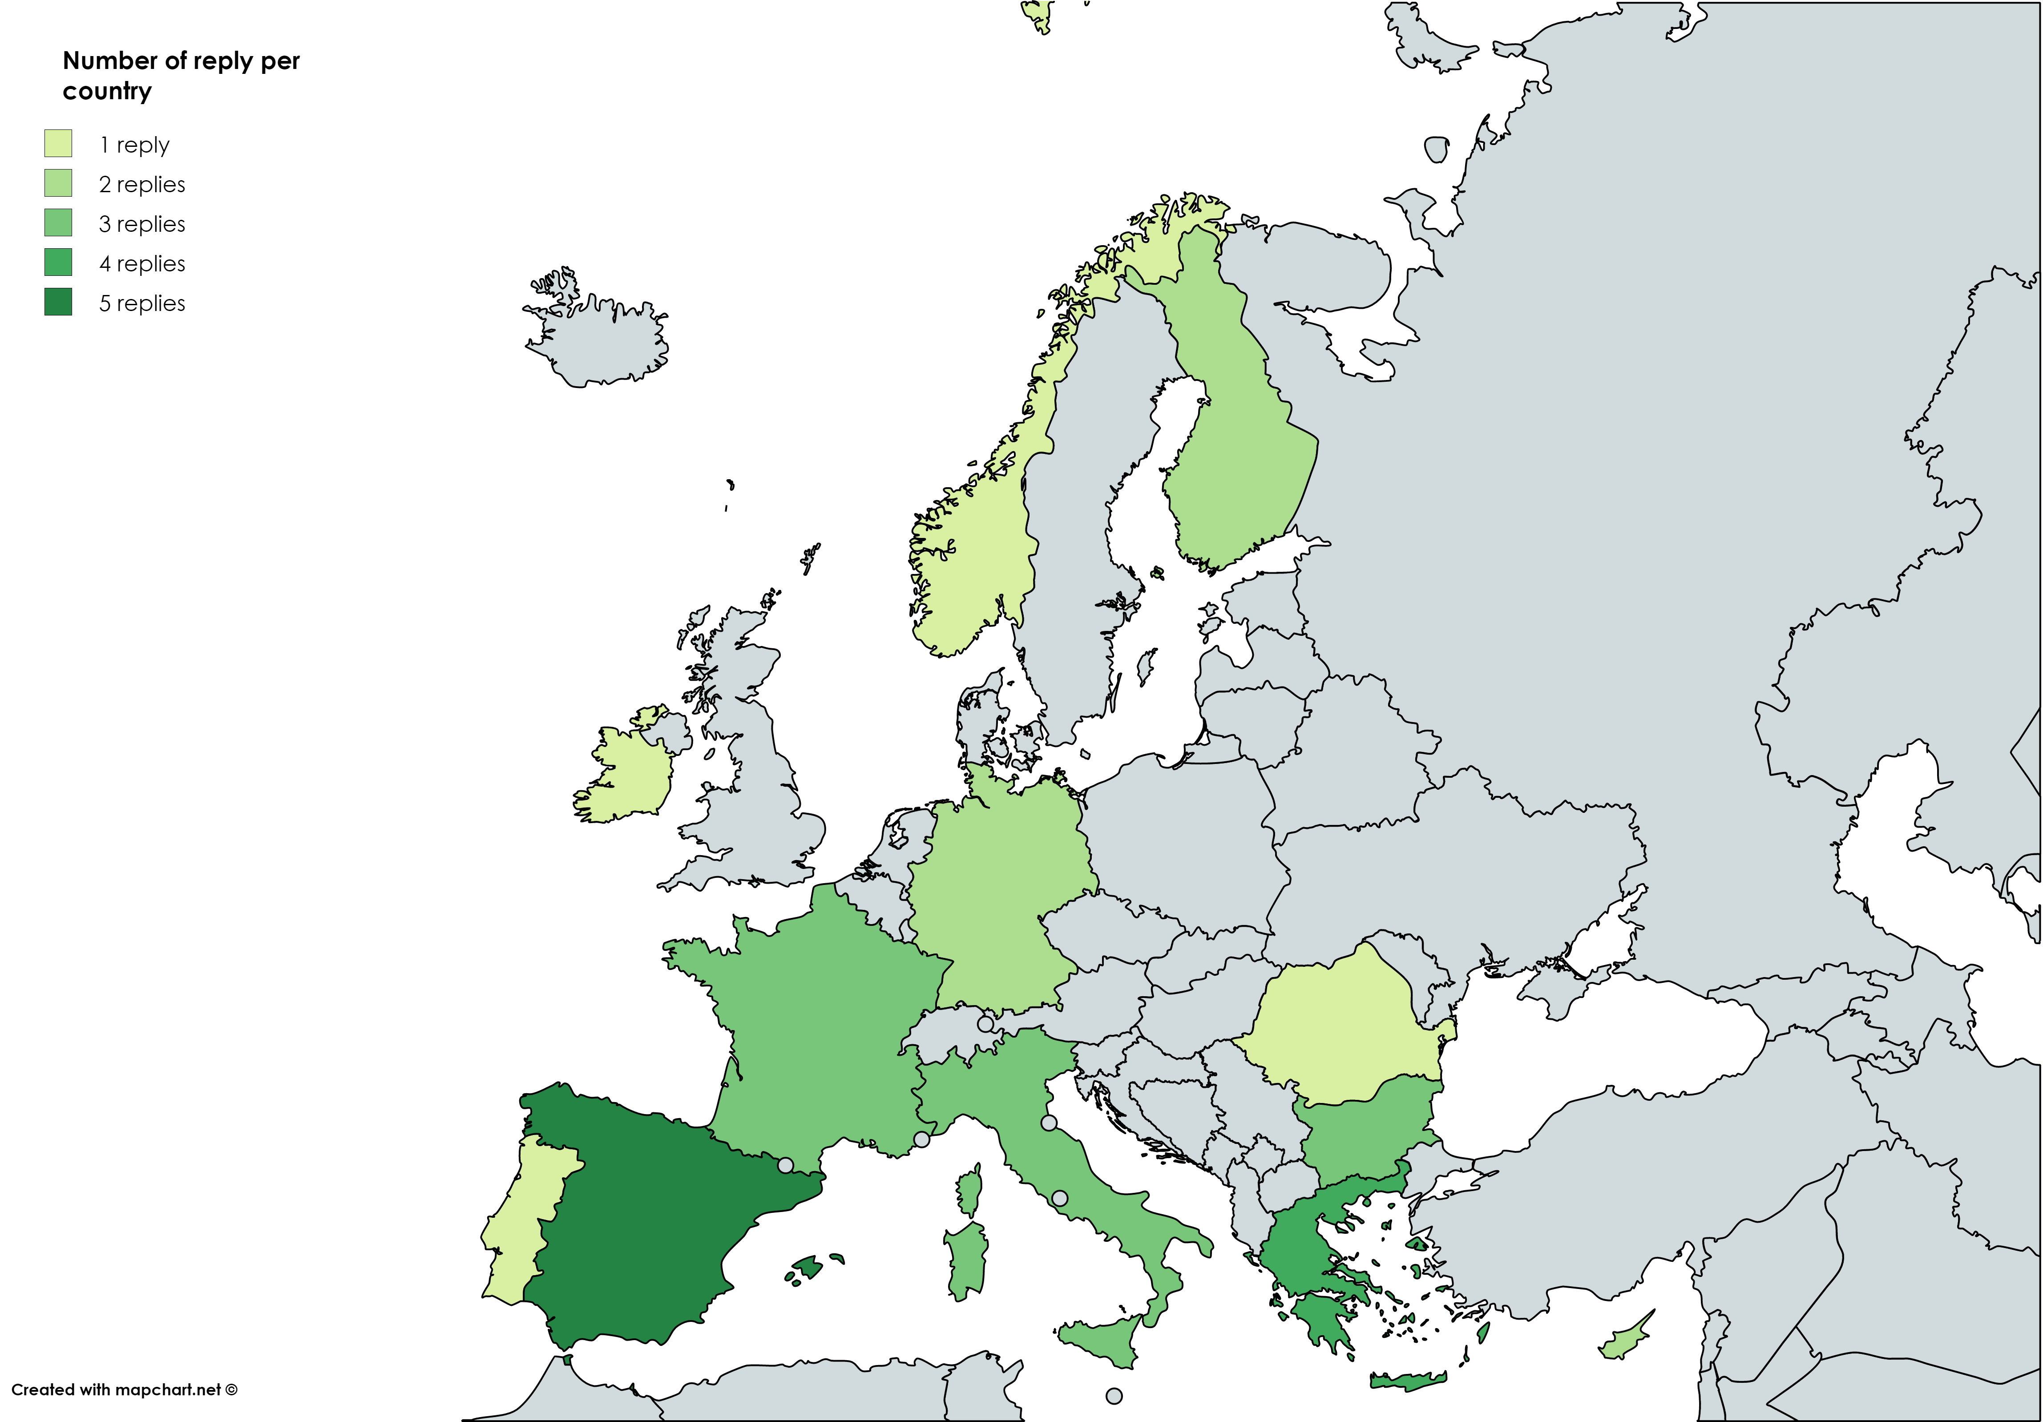
Coverage of the survey

Slide 9
Priority for implementation
  Incident Notification
  Vessel Tracking (Voyage, Location and Details)
  Risk Information

Slide 10
Data Provisioning and Consumption
Authorities who consume information are also very likely to provide information (62.18%),
Clear demand to consume more information are related to the Crew List and Cargo Information Service.
Less than 3% of Authorities could be solely providers

Slide 11
Criticality for operational purposes
All the 12 identified services are considered valuable by the authorities.
The Vessel services (Location, Voyage, Details) and the Crew list service are considered essential or highly valuable by 90% of the authorities.
A registry of Authorities, Incident History and Collaboration, less mission critical, but they could provide a significant improvement of operations efficiency.

Slide 12
Value added to operational purposes
For all the different information services, the main added value is equally split between reducing the time to obtain the needed information and obtaining needed information from partners across the EU

Slide 13
Implementation Barriers
1 to 6 authorities claimed to have no identified barriers to exchange the information: very positive for implementing services
The sensitivity of the information is the most identified barrier (22%).
Other important barriers: technical complexity, the fact that multiple platform need to be supported, the cost and the need to streamline the operational process
The change of legislation has been identified as a barrier in only 5% of the cases.

Slide 14
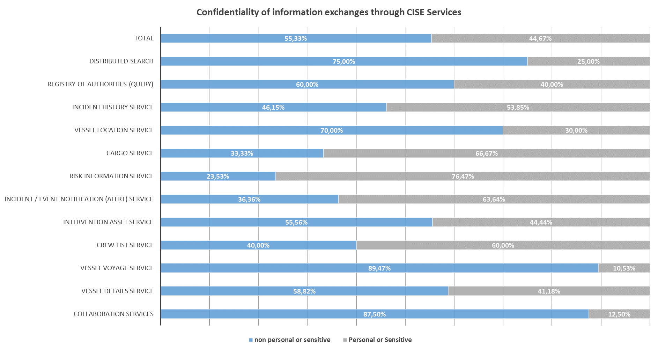
Confidentiality
The services considered as sensitive by the largest number of authorities are the risk, the cargo , the incident and the crew list services.
The services considered as the less sensitive are the collaboration service, the vessel voyage and location services.

Slide 15
Usage
Two distinct frequencies of use for CISE Services: ‘Constantly’ (35%) in the context of monitoring activities or ‘On Demand’ (41%) in the context of interventions.
Clear differences in terms of expected usage patterns for different services:
  Continuous Services: Vessel Location, Risk, Incident Notification, Crew List and Vessel Voyage Services
  On Demand Services: Registry of Authorities, Distributed Search, Incident History, Cargo, Intervention Asset, Vessel Details and Collaboration Services

Slide 16
Current IT Solutions
For the large majority of the case (80%) the authority has already a system ready to be interfaced with the service of interest.
30% of these legacy applications are currently exchanging information using web services with other systems.
Collaboration, Registry of Authorities and Cargo are three services for which a majority Authorities have not yet IT Solutions in place.

Slide 17
Ongoing developments
For the services ranked as essential, the wide majority of the authorities are already working on it or plan to work on it (through CISE projects).
For all the services (except the collaboration service and the registry of authorities), half of the authorities plan to develop it the next 2 years.

Slide 18
Participation in implementation projects
For each service identified, 80% of the authorities showed clear interest to participate in a CISE development project in the next 3 years.

Slide 19
Future Collaboration Partnerships
70% of authorities are interested in applying to a call to develop CISE
Only 3% of the authorities has decided not to participate to a future call
1 out of 3 Authorities intend to collaborate with cross border authorities or European Agencies
1 out 6 Authorities prefer a collaboration with other Authorities in the same country or in the same or adjacent sea basin.

Slide 20
Conclusions
Strong support from MS authorities to CISE development
The 12 services identified in workshops have been confirmed as priority services for the future development of CISE
Obvious interest in services implementation - MS authorities are interested to participate in future projects to implement these services
Necessity and willingness to involve the EU agencies in the CISE services and overall implementation

Slide 21
Thank you for your attention

