Slide 1
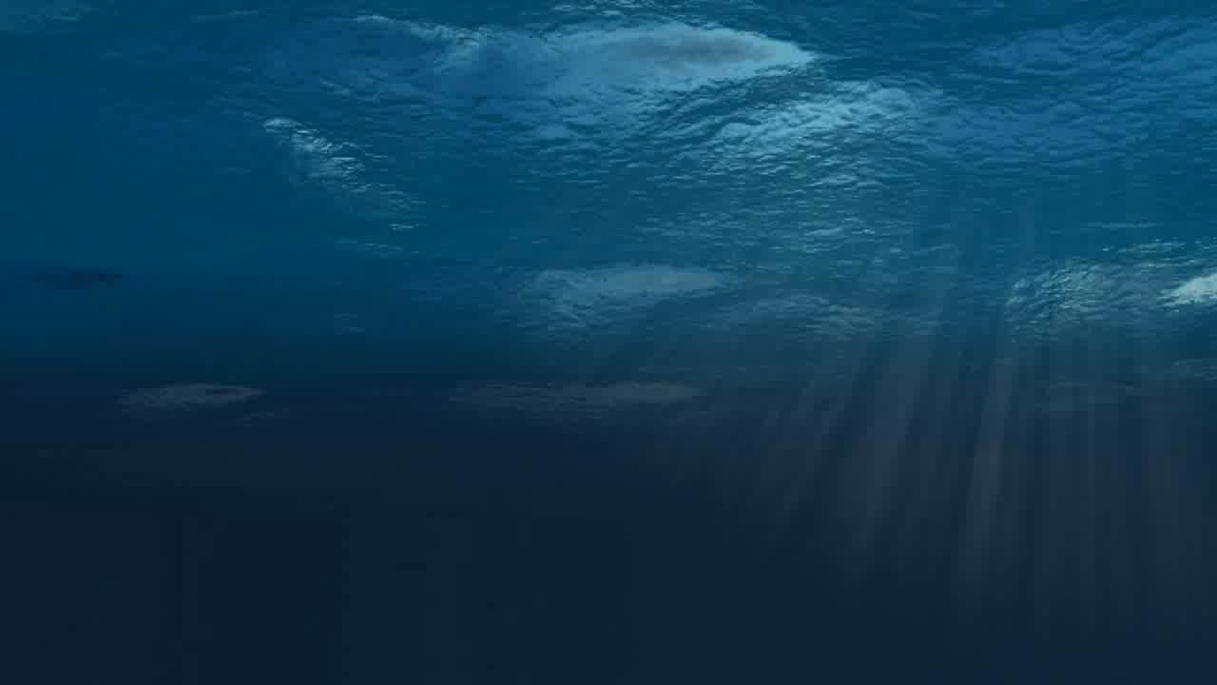
German marine science and the Black Sea
Jan-Stefan Fritz Head, Brussels Office
Notes:
Replace business with technologies
We want all communities to work together – business, education, research and, of course, government.

Slide 2
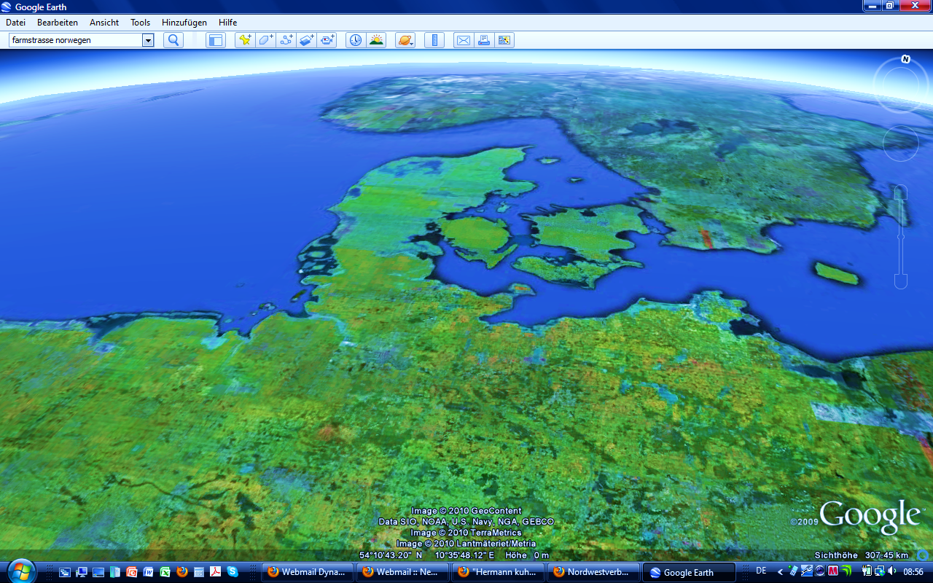
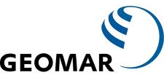
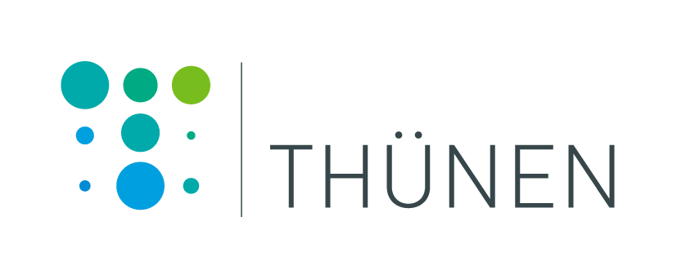
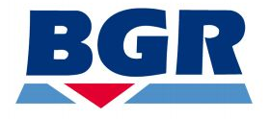
German Marine Research Consortium
The national association of German marine research institutions
Berlin
University institutes
Max Planck institutes
Museums
Brussels
Leibniz institutes
Helmholtz centres
Government institutes
A not-for-profit association of 19 marine, coastal and polar science institutions
Permanent Exhibits: Ozeaneum Stralsund and International Maritime Museum Hamburg

Slide 3
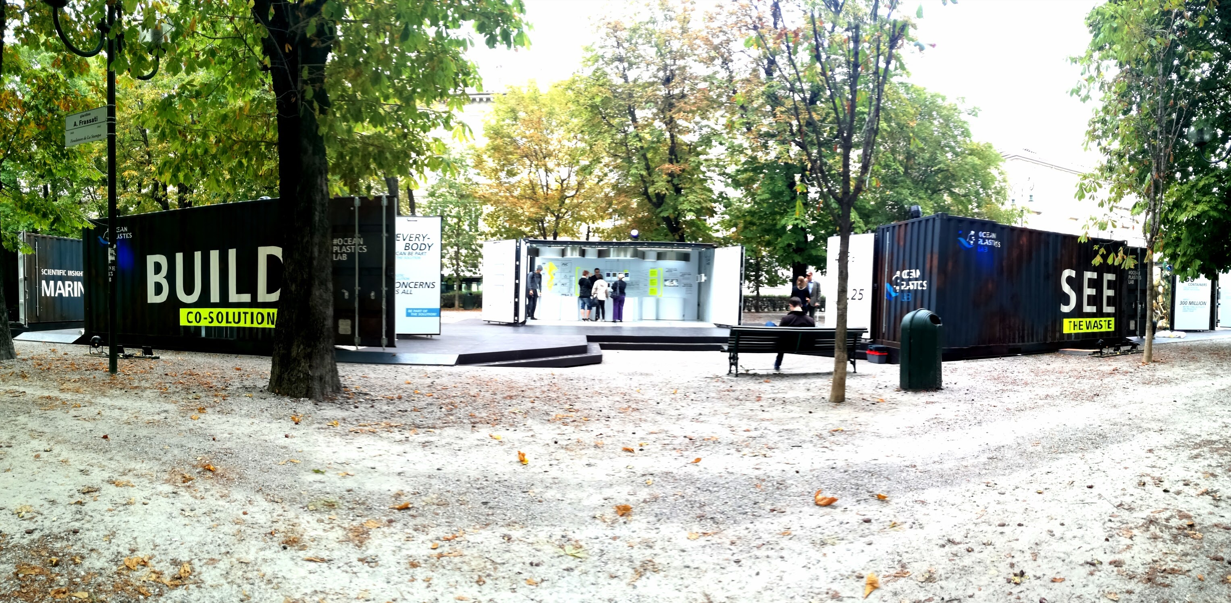
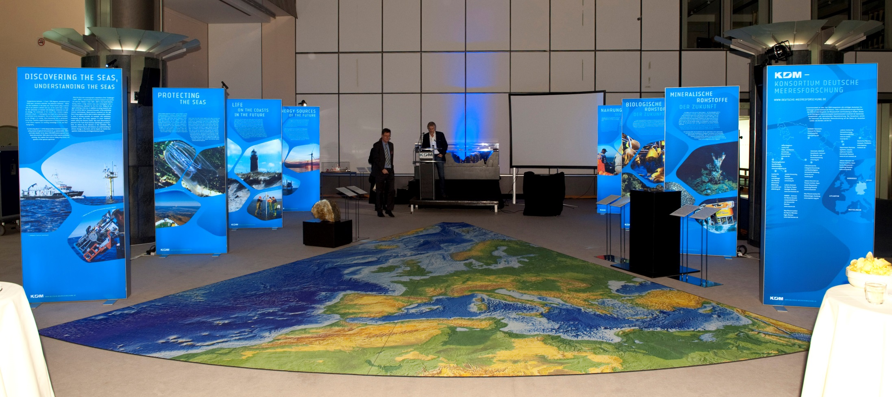
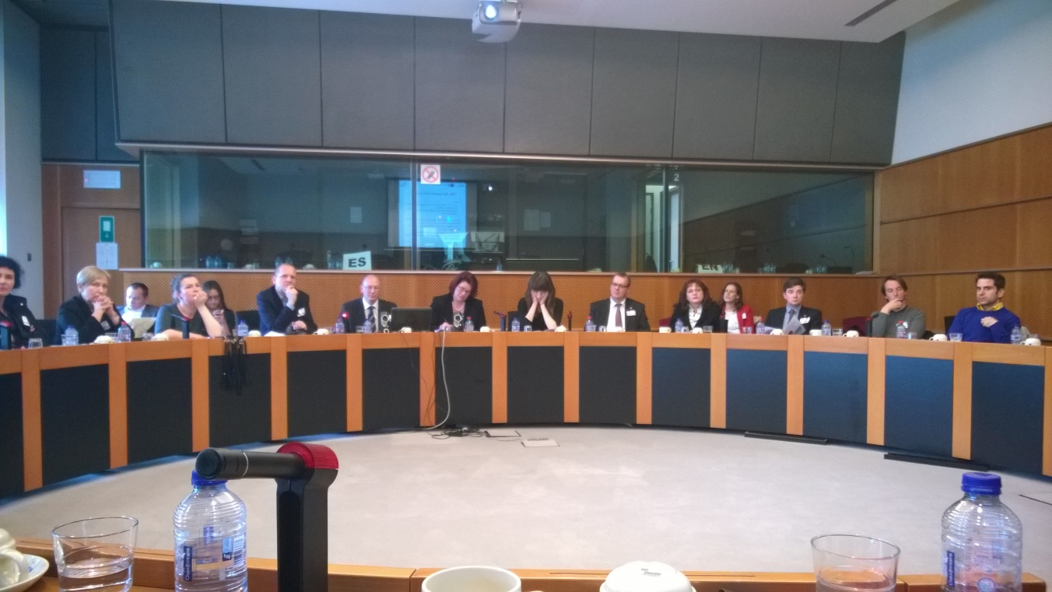
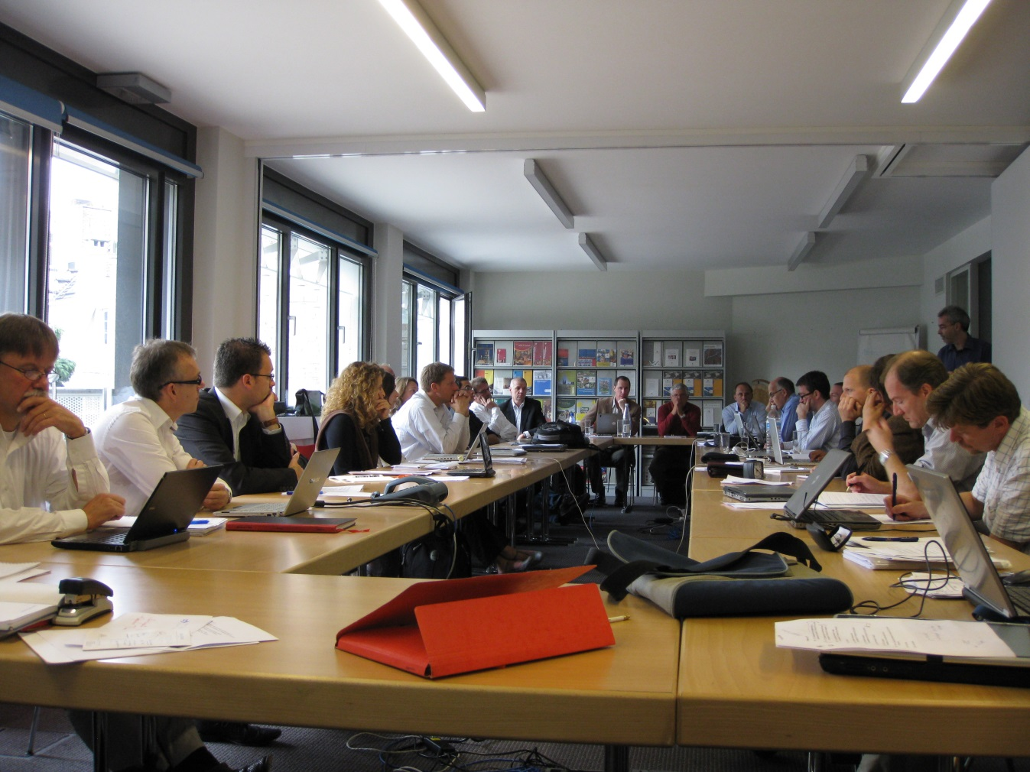
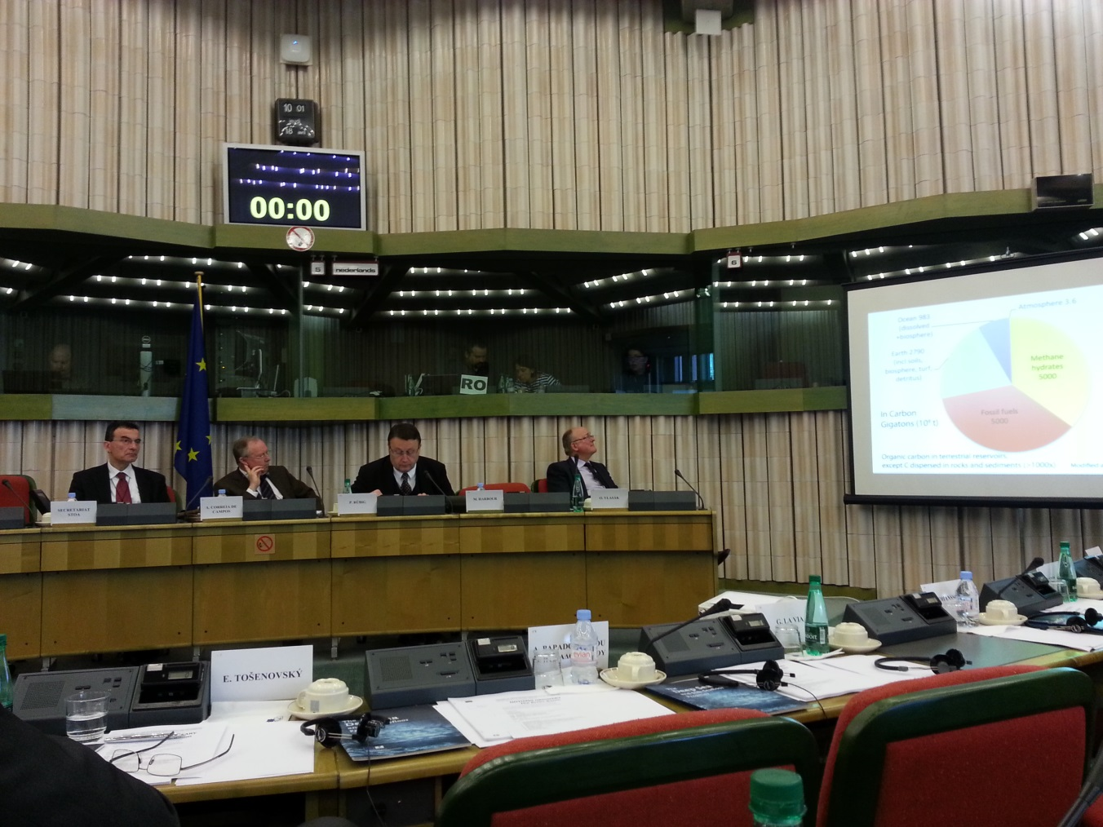
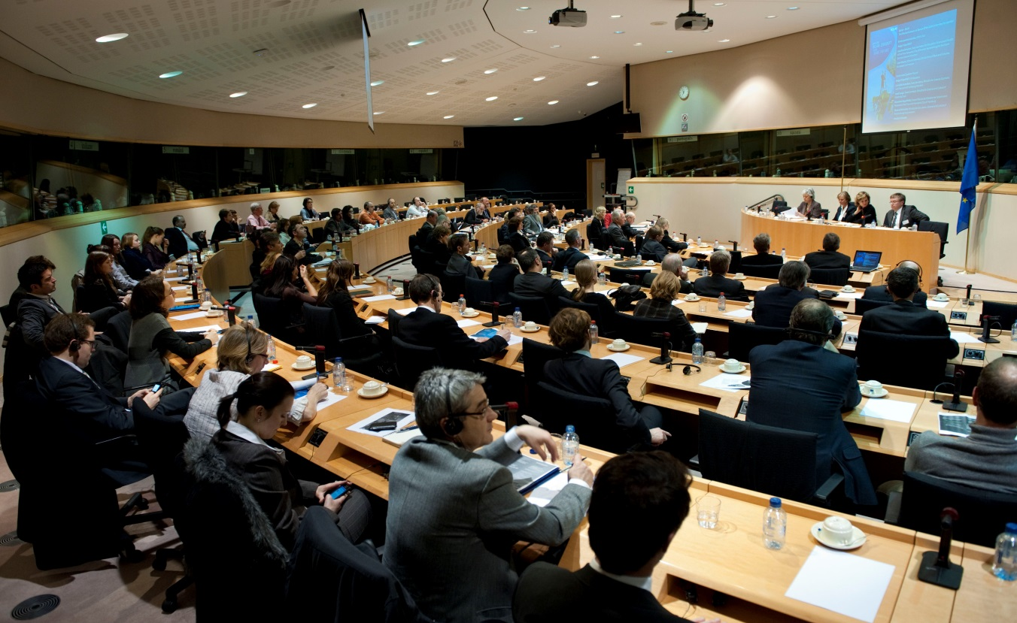
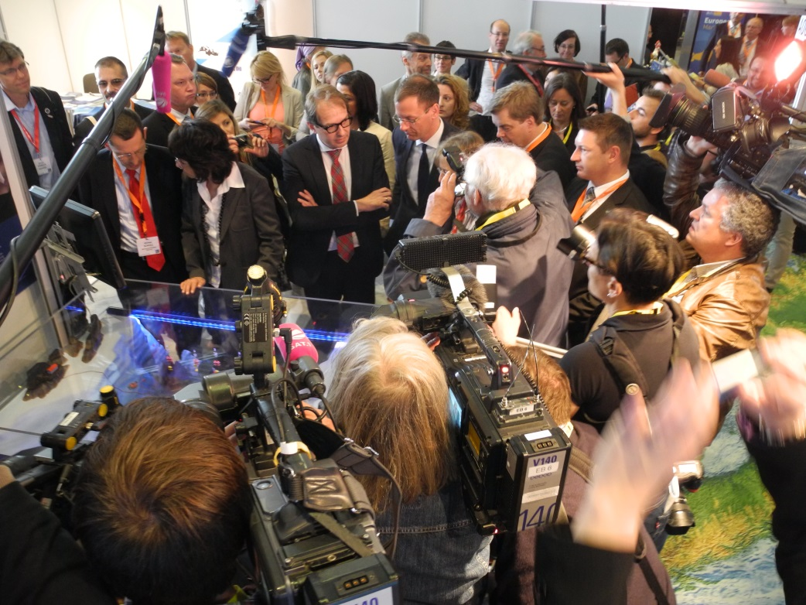
What do we do?
Member of European and international networks, including in European Marine Board, JPI Oceans and Atlantic Ocean Research Alliance
Promote cooperation with research partners, EU-Institutions, NGOs, industry and international organisations
Strategic support to German, European and int’l marine science community
Notes:
For our office, we have decided to focus on:
Meetings
Scientific briefings
Exhibits
Very few papers and brochures – we decided that given the diversity of the marine scientific community in Germany we won’t give broad wish lists of priorities to anyone, but focus on letting the scientists communicate their own individual or group priorities.
Why we have decided to go down this direction reflects my views on science-policy relations.

Slide 4
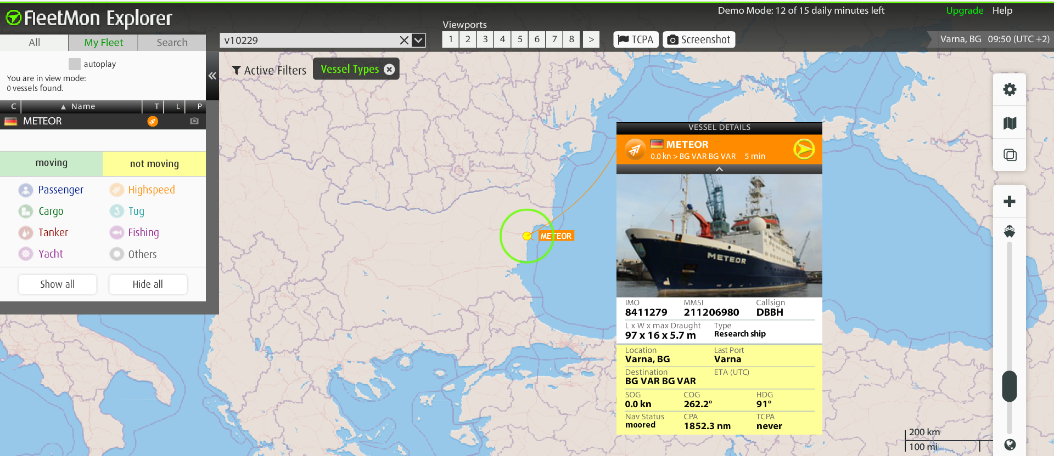
FS Meteor
Location 10 December 2017: Port of Varna, Bulgaria

Slide 5
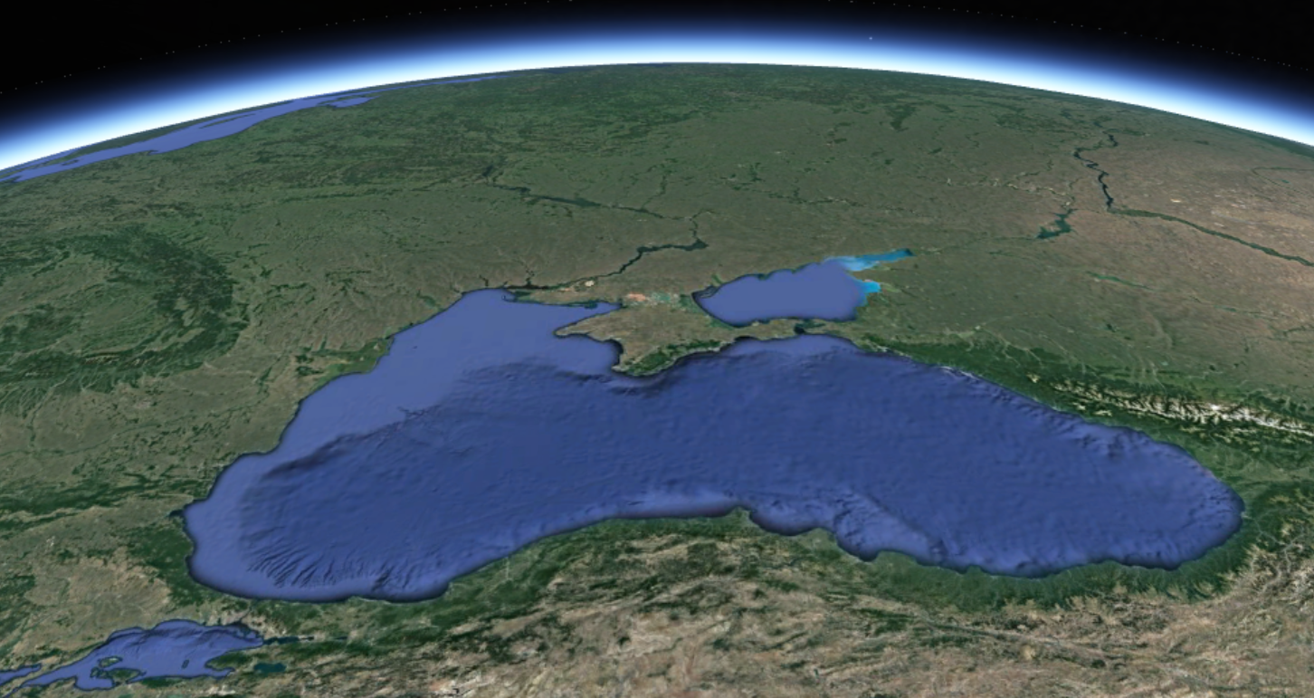
German science interests in the Black Sea
Coastal and ocean observations
Biogeochemistry
Infrastructure development
Geology

Slide 6
Danubius Research Infrastructure
Germany involved in PP-Project and hosts a supersite in the Elbe Estuary
German Partners:
Terrestrial Environmental Observatories (TERENO)
Federal Institute of Hydrology (BfG)
Institute of Coastal Research, Geestacht Centre for Materials and Coastal Research (HZG)
Contact: Jana Friedrich (jana.friedrich@hzg.de)

Slide 7
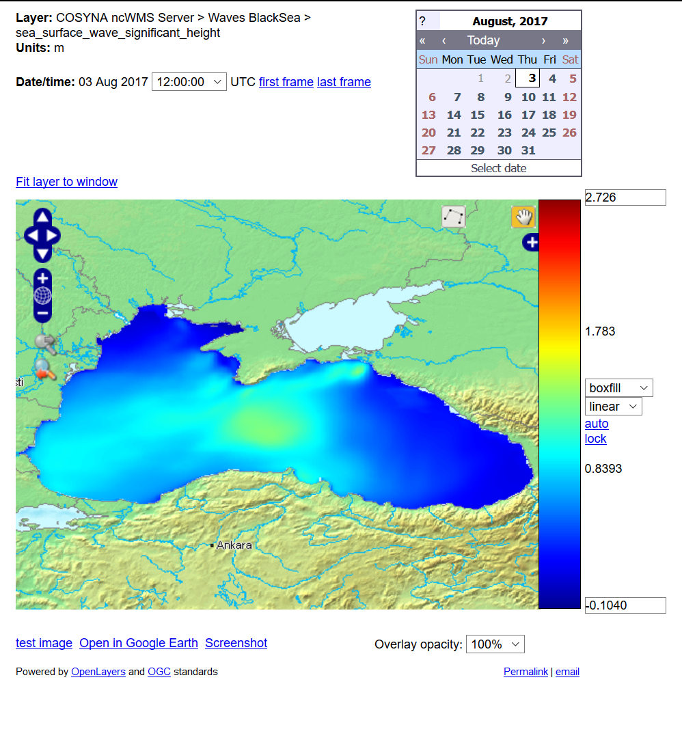
BLACK SEA Marine Forecasting System
BS MFC provides marine data about the Black Sea such as: daily analysis, 10 days forecasts and reanalysis, describing waves, currents, temperature, salinity, sea level and biogeochemistry.
German contribution: Waves Physics Production Unit
Contact: Dr. Joanna Staneva (joanna.staneva@hzg.de)

Slide 8
Euro-ARGO – observing and modelling the Black Sea
http://www.euro-argo.eu/News-Meetings/News/Latest-News/Argo-activities-in-the-Black-Sea
German contact: Prof. Emil V. Stanev, HZG

Slide 9
Joint European Research Infrastructure Network for Coastal Observatory (JERICO-NEXT)
The vision is to improve and innovate the cooperation in coastal observatories in Europe by implementing the coastal part of a European Ocean Observing System
Contact:
Prof. Wilhelm Petersen wilhelm.petersen@hzg.de

Slide 10
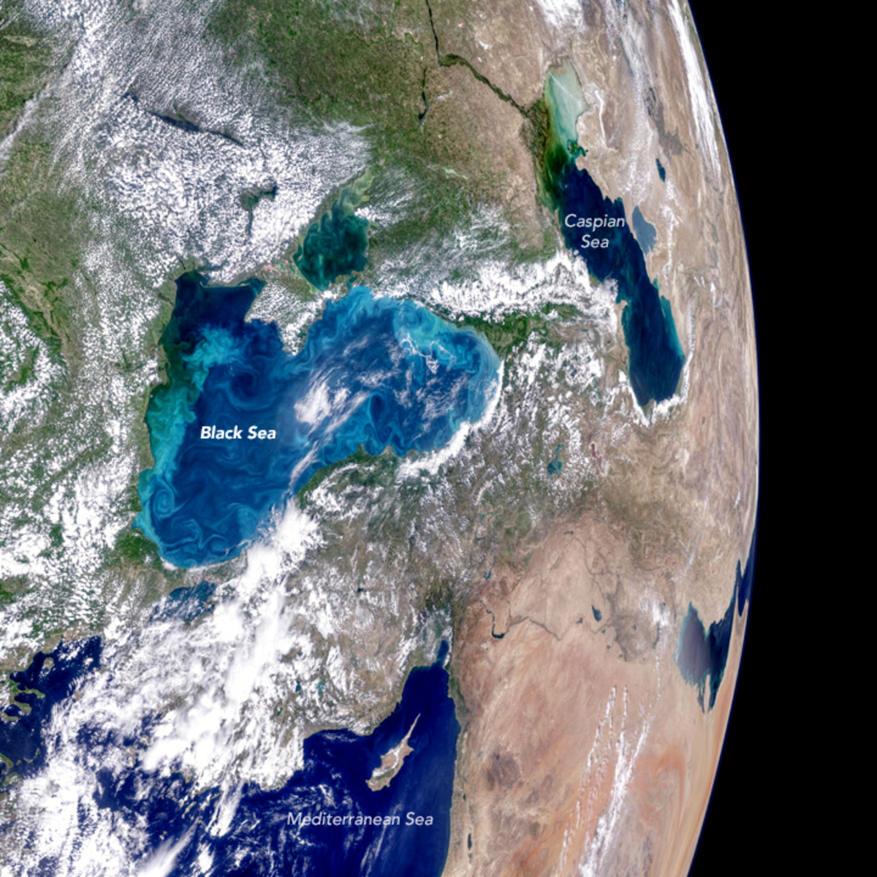
Harmful Algae Blooms – Biogeochemical ARGO
Contacts: Bernd Krock (AWI), Oliver Zielinski (UniOldenburg).
New technologies, esp. biogeochemical ARGO floats, Contact: Oliver Zielinski

Slide 11
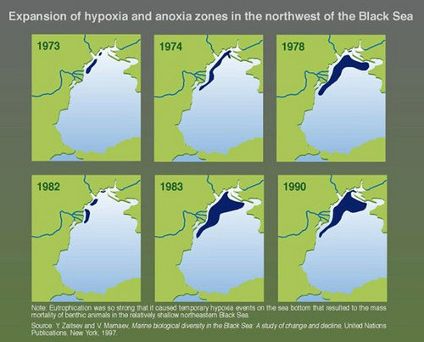
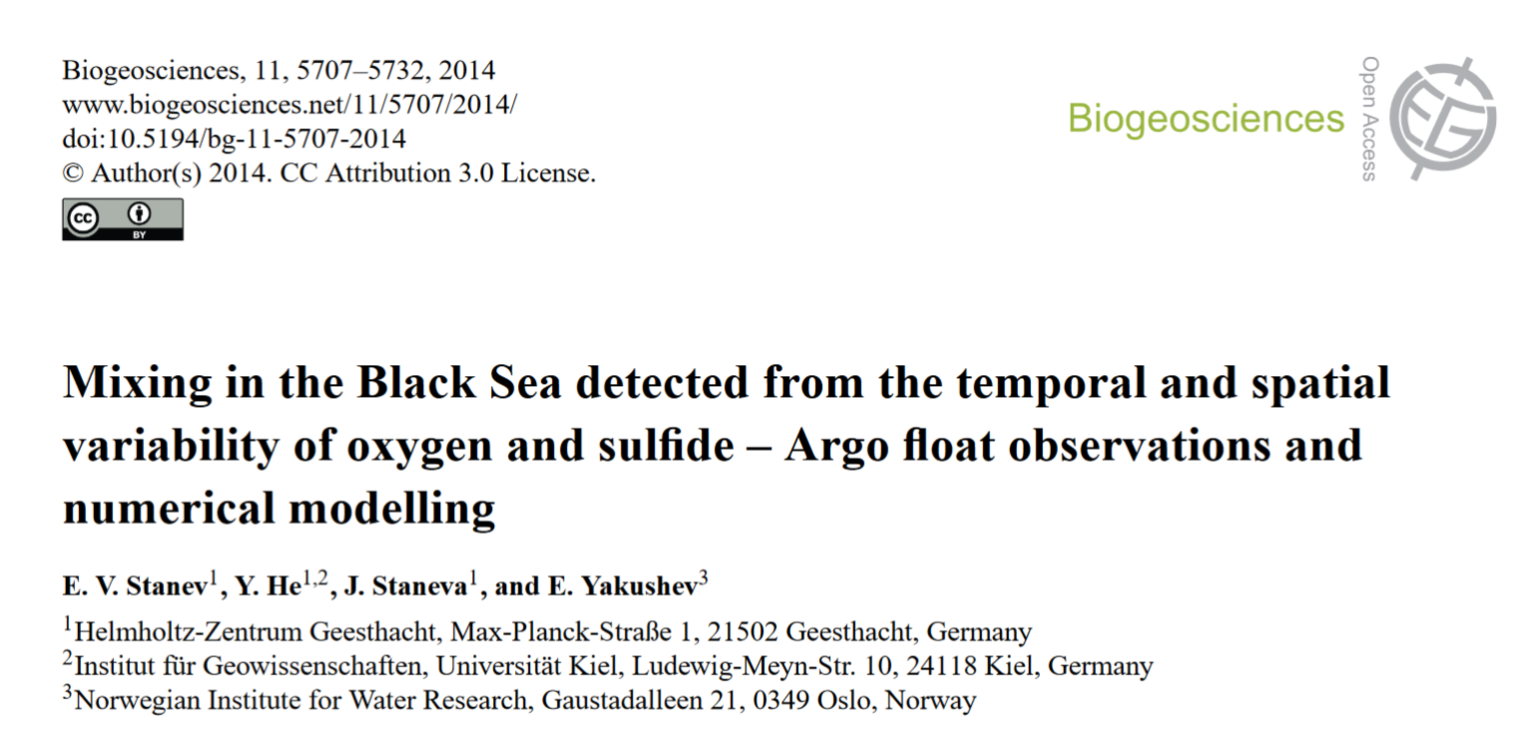
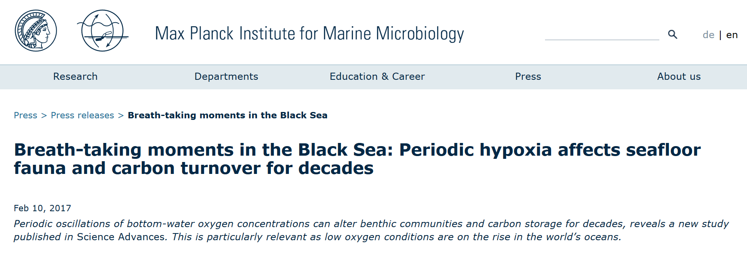
Oxygen in the Black Sea
Contacts: E. Stanev (HZG), J. Staneva (HZG), Gerdhard Jessen (MPI Bremen), Antje Boetius (AWI)

Slide 12
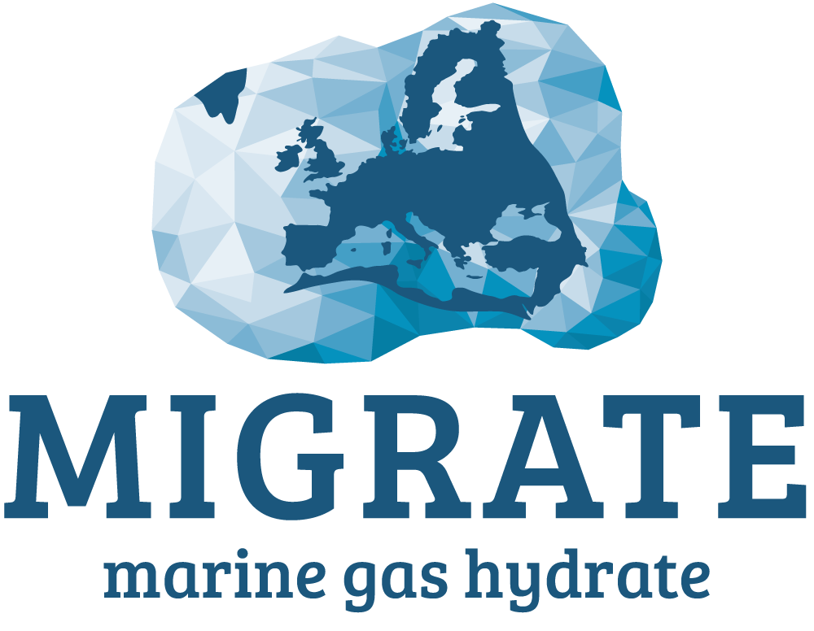
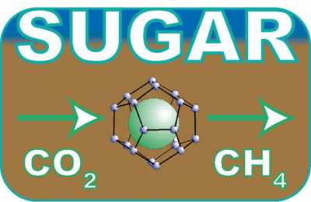
Gas Hydrates and seafloor Geology
https://www.migrate-cost.eu/
SUGAR Submarine Gas Hydrate Reservoirs project (Germany)
Phase I: 2008 –2011
Phase II: 2011 –2014
Phase III: 2014 – March 2018
Contacts: Klaus Wallmann (GEOMAR) Matthias Haeckel (GEOMAR)
Gerhard Bohrmann (UniBremen/MARUM)

Slide 13
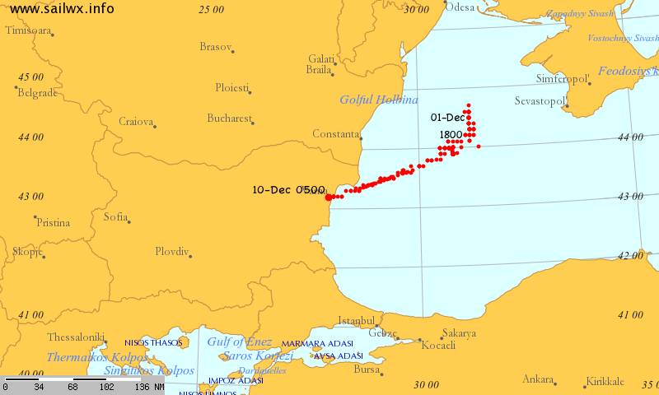
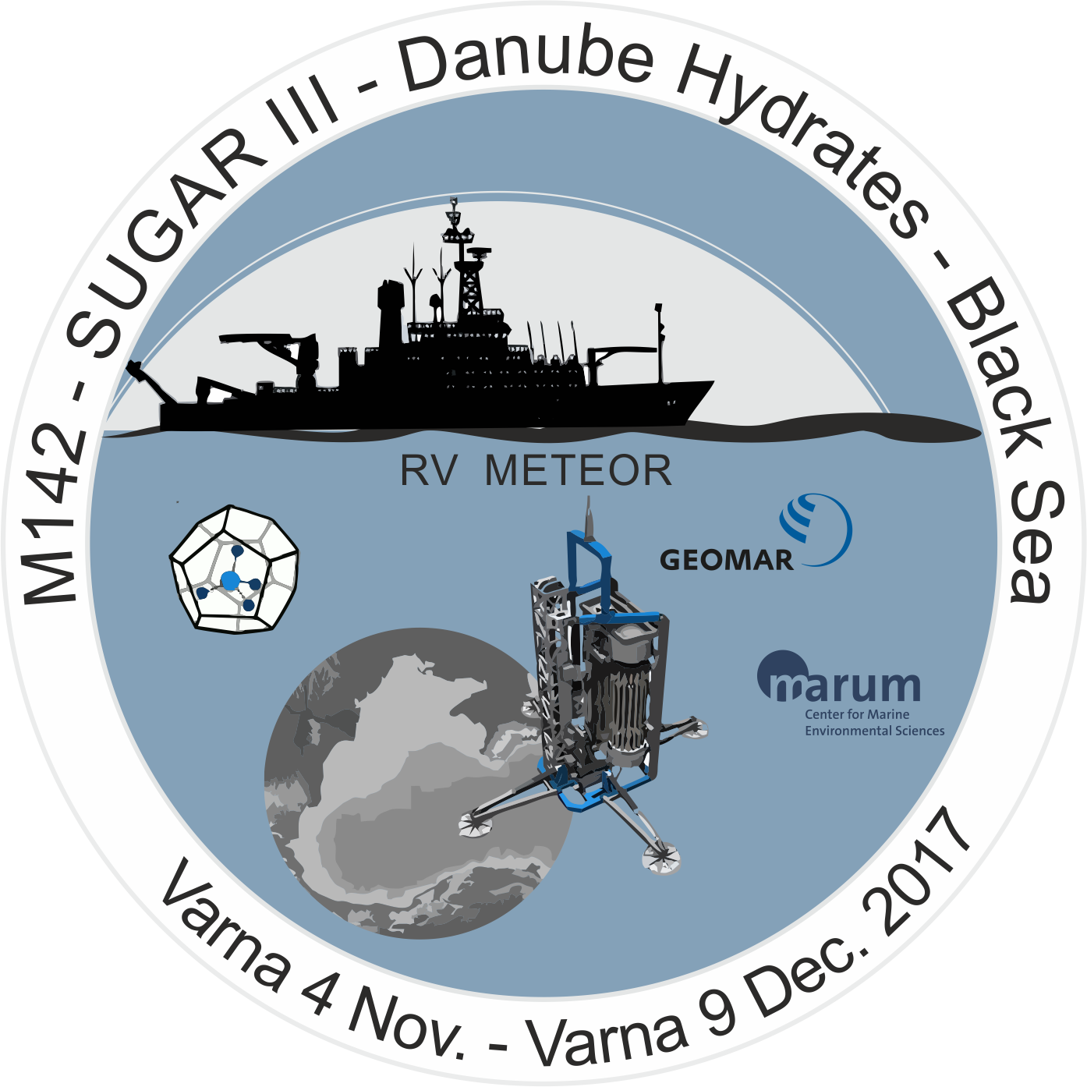
Website of the current cruise:
https://www.marum.de/Forschung/Page6076.html)

Slide 14
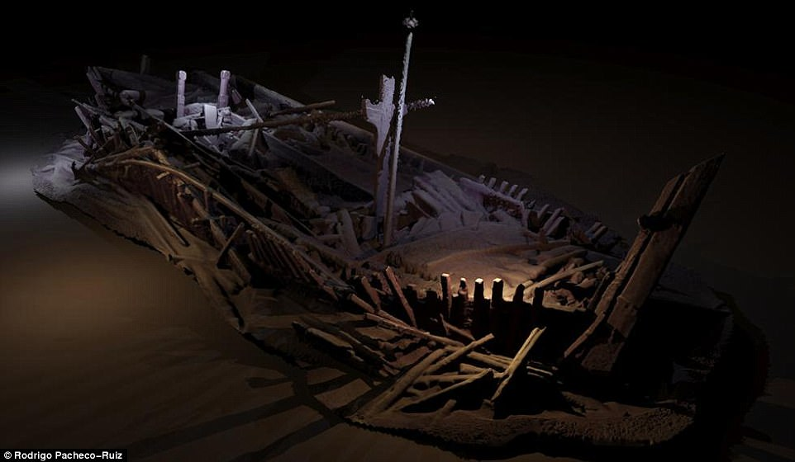
Additional areas of scientific interest
Ship-based cooperation: Summer Schools, Workshops, etc. (e.g. GeoEcoMar Mare Nigrum)
German Maritime Museum (Bremerhaven) – maritime Archaeology. Contact: Prof. S. Kleingaertner

Slide 15
MyOcean Follow On project (MyOcean-FO); Contact: Prof. Emil Stanev (emil.stanev@hzg.de); Contribution to Ocean Monitoring and Forecasting of pre-operational Copernicus Marine Service
ERANET-Programm "European Research Area for Climate Services (ERA4CS): Climate Services for the Water-Energy-Land Nexus" (CLISWELN); koordiniert durch HZG, Ansprechpartner: Dr. Roger Cremades (roger.cremades@hzg.de); HZG contributes to developing a regional framework for climate data to support policy makers; to September 2020. Research and Innovation Action "Nature Insurance Value: Assessment and Demonstration" (NAIAD); Contact: Maria Manez (maria.manez@hzg.de); HZG coordinates Workpackage on integration of results and transfer of reduce risk and promote adaptation strategies. ERANET ERA-PLANET project "Smart urban solutions for air quality, disasters and city growth" (SMURBS); Contact: Dr. Volker Matthias (volker.matthias@hzg.de); HZG coordinates Workpackage “User requirements and gap analysis”; Laufzeitende: August 2020.

Slide 16
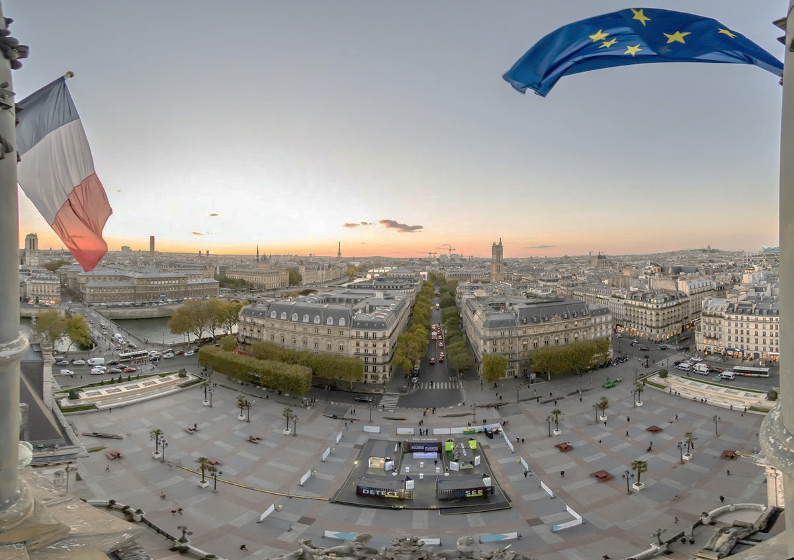
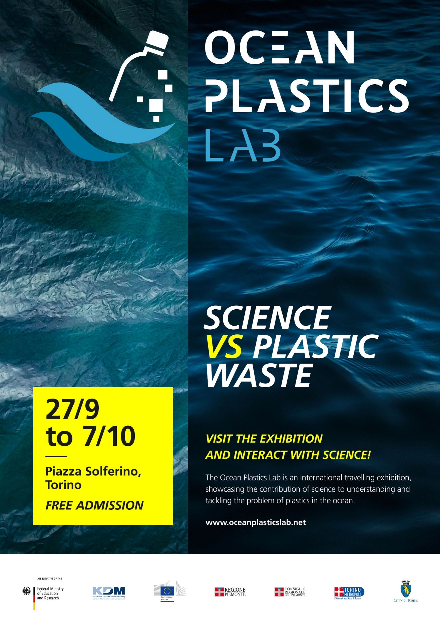
Ocean Plastics Lab
If you are doing scientific work to understand or tackle plastics in the ocean, please contact:
Dr. Julia Schnetzer schnetzer@deutsche-meeresforschung.de
Next Stops: Brussels, Washington, Ottawa, etc.

Slide 17
Alfred Wegener Institute, Helmholtz Centre for Polar and Marine Research, Bremerhaven Centre for Earth Systems Research & Sustainability, Univ. of Hamburg Department of Maritime Systems, University of Rostock Federal Institute for Geosciences and Natural Resources Federal Maritime and Hydrographic Agency of Germany German Oceanographic Museum Stralsund German Maritime Museum Bremerhaven GEOMAR Helmholtz Centre for Ocean Research Kiel Helmholtz Centre Geesthacht, Institute for Coastal Research Institute for the Chemistry and Biology of the Sea, Univ. of Oldenburg Jacobs University, Bremen J.H. von Thünen Institute Aquatic Resources, Hamburg, Rostock Kiel Marine Science – Centre for Interdiscinplinary Marine Science, Christian Albrechts University Kiel Leibniz Institute for Baltic Sea Research, Warnemünde Leibniz Center for Marine Tropical Ecology, Bremen MARUM Centre for Marine Environmental Science, Bremen Max Planck Institute for Marine Microbiology, Bremen Max Planck Institut for Meteorology, Hamburg Senckenberg Society for Nature Research, Wilhelmshaven
Dr. Jan-Stefan Fritz
fritz@deutsche-meeresforschung.de
John Hanus, M.A.
hanus@deutsche-meeresforschung.de
Boulevard St. Michel 80
1040 Brussels
Belgium
Tel: +32 2 733 8948

