Slide 1












SCHeMA integrated in Situ Chemical MApping Probes:
open and modular in situ sensing solution
SCHeMA: FP7-OCEAN 2013.2-Grant Agreement 614002

Slide 2







Intro
SCHeMA : FP7-OCEAN 2013.2-Grant Agreement 614002
Starting date: 1st October 2013 (48 months)
Total budget: € 6.74 Million
EC contribution: € 5.20 Million
Partners.
Partners organization name
Country
1
Université
de Genève (UNIGE)
Switzerland
2
IDRONAUT
S.r.l
. (IDRO)
Italy
3
Universitaet
Ulm (UULM)
Germany
4
Technische
Universitaet
Graz (TUGRAZ)
Austria
5
Ecole
Polytechni
que
Fédérale
de Lausanne
(EPFL)
Switzerland
6
Nanomateriales
y
Polímeros
S.L.
(
nanoMyP
)
Spain
7
Université
de Bordeaux (UBX1)
France
Università
degli
Studi
di Genova
-
IT
8
Università
degli
Studi
di
Genova
)
(
UNIGe
Italy
9
ETT
S.r.l
(ETT)
Italy

Slide 3
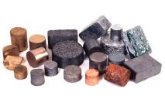
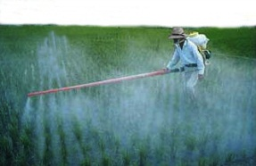
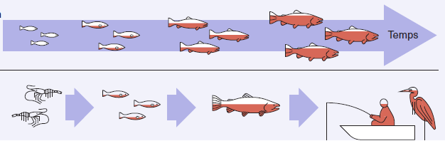
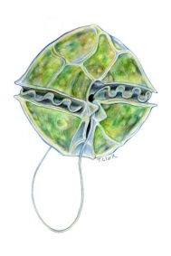

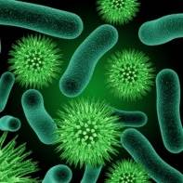

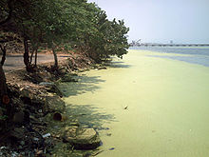


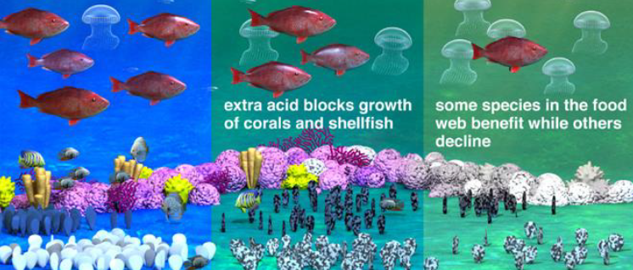
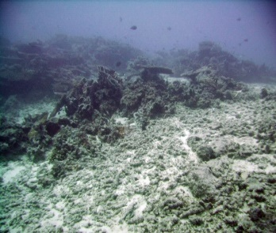

Objectives
An open and modular sensing solution for in situ high resolution mapping of a range of anthropogenic and natural chemical compounds coupled to master bio-physicochemical parameters
$$\left\{\begin{aligned}1 \\ 1 \\ 1\end{aligned}\right.$$
BIO-ACCUMULATION
Time
METALS
PESTICIDES
BIO-AMPLIFICATION
PHYCOTOXINS
PHARMAS
PATHOGENS
(HARMFUL) ALGAL BLOOM
EUTROPHICATION
PHYCOTOXINS
NUTRIENTS
O₂ DEPLETION
CO₂
OIL SPILLS, E-WASTE.....
CLIMATE CHANGE
Notes:
The main objective of the schema project Is to provide an open and modular sensing solution for in situ high resolution mapping of a range of anthropogenic and natural chemical compounds coupled to master bio-physicochemical parameters. The target are chemicals that affects marine ecosystem, living resources and of course human being having interactions.
All of this should be done by implementing new specific sensors, an adaptive probe network, and an ad hoc networking solutions connecting the remote sensors to a land station and a web server for data management and access.

Slide 4

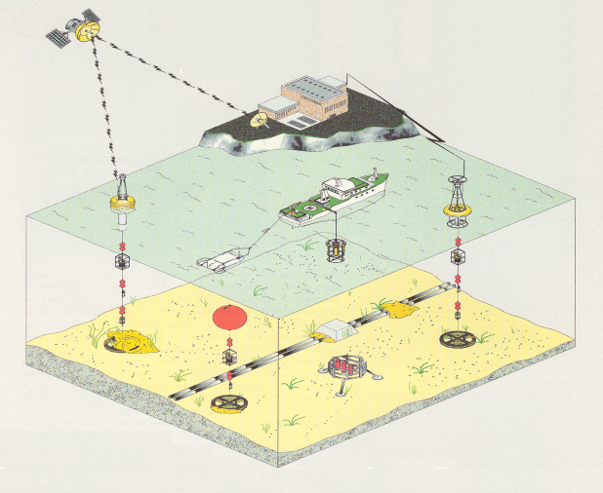
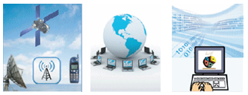
Objectives
SCHeMA open and modular wireless sensing solution
An ad-hoc ICT wireless networking solution
System localization, status & (re)configuration
Data transfer & storage
Web-based front-end data information system
data validation, display, access & download
Plug-and-play adaptive chemical sensor probes
gathering detailed spatial and temporal information (second to hours)

Slide 5
Objectives
Development of an array of novel chemical sensors taking advantage of various innovative analytical solutions.
Incorporation of the novel sensors into miniature, rugged, low power consumption, multichannel probes based on Eco-Design-ISO/IEC standards, EnOcean technology as well as energy harvesting devices.
Development of dedicated wired/wireless communication network and web-based front-end system compatible with EU standard requirements (OGC-SWE, SOS, INSPIRE, EMODnet, GEOOS, SEIS).
Evaluation, validation and demonstration of the SCHeMA individual sensing tools and integrated system via short and long-term field applications in Atlantic and Mediterranean coastal areas.
Exploitation & Dissemination

Slide 6
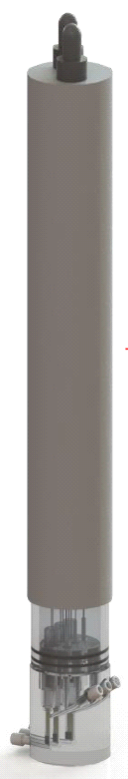
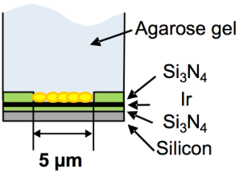
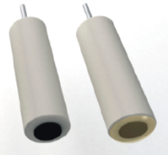
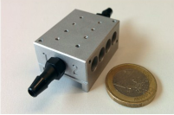
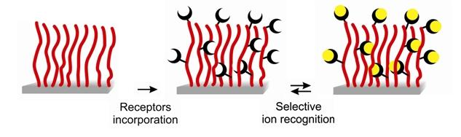
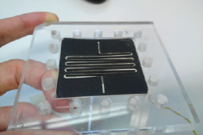
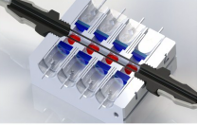
SCHeMA open and modular sensing solution
Sensors and probes | Targets | Partners
(Functionalized) GIME arrays based miniaturized multi-channel voltammetric probe | Bioavailable fraction of: Hg(II), As(III), As(V), Cd(II), Pb(II), Cu(II), Zn(II) | UNIGE, EPFL, Idronaut, nanoMyP
Solid state ion-selective electrodes based integrated electrochemical probe | CO₂, carbonate, alkalinity. Nitrate, nitrite, phosphate. | UNIGE, EPFL , Idronaut
Multi-channel optical sensor probe | 8 algae species producing toxins & Biotoxins (Saxitoxin, Ovatoxin) | TUGRAZ, EPFL , UNIGE
Optochemical mid-infrared sensor probe | VOCs | UULM, nanoMyP

Slide 7
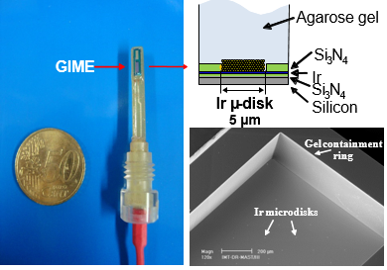
METALSENSORS
PROBE
Direct simultaneous in situ monitoring of :
Cd(II), Pb(II), Cu(II), Zn(II) – Channel 1
As(III) – Channel 2
Hg(II) – Channel 3
Present at sub-nanomolar concentrations (ng/L level)
Potentiostat & preamplifier
RS484 interfaces & memory board
Wireless module
Pressure & Temperature module
3.6V power supply
On-chip antifouling Gel Integrated MicroElectrode arrays (GIME)

Slide 8

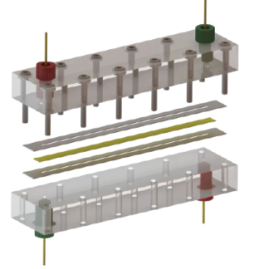


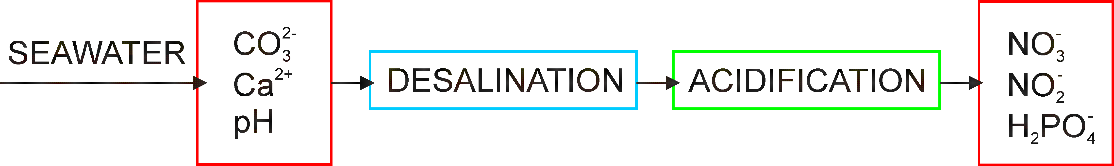
Objectives
ELECTROCHEMICAL
PROBE
ALGA BLOOM - EUTROPHICATION
PHYCOTOXINS - O₂ DEPLETION
Fluidic system components
All-solid-state ISEs
On-line acidification
module
Flow-through cells
Desalinator
FLOW CELL 1
FLOW CELL 2
LOD: µM to sub-µM
Notes:
All solid state ISEs: CG electrode –
functionalized carbon nanotube ion-to-electron transducing layers
ISM - polymeric membrane incorporated selective ionophores
Flow-through cells incorporating three ISE and one mini-ref. electrode
Desalinator: desalination based on an electrochemical process
Acidification module: based on the flow of proton through a cation exchanger membrane from an acidic solution reservoir to the sample

Slide 9
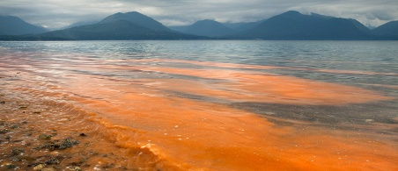
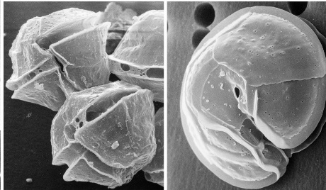
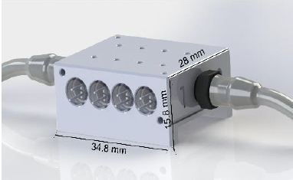
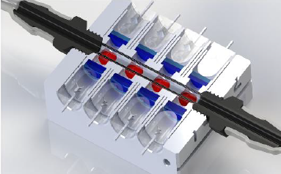
Objectives
OPTICAL SENSORS
PROBE
TOXIC ALGAE
Detection of single cell events
- quantification of average cell density
Using Multivariate Data Analysis (Linear Discriminant An)
- identification/classification of 8 algae classes
- separation of common toxin producing cyanobacteria
8-channel sensing module based on low-cost:
- LEDs
- optical fibers
- photodiodes
- multi-wavelength fluorescence unit

Slide 10

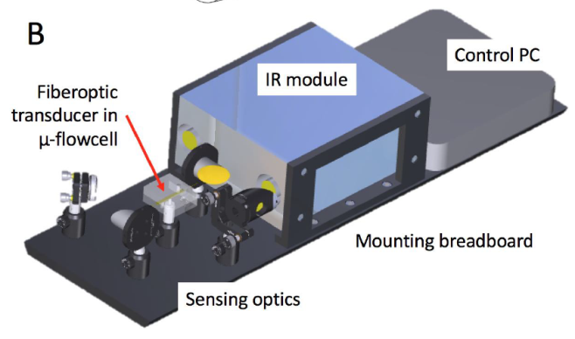
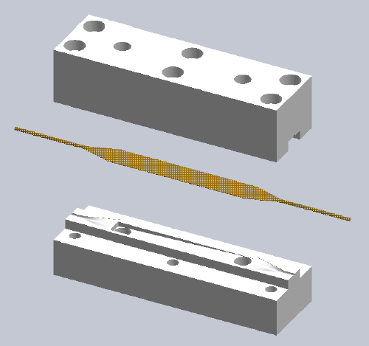
Objectives
OPTOCHEMICAL MID- INFRARED SENSORS PROBE
VOCs
Sensing module
- Flow-through cell
- Planar silver halide (AgX) coated with a
micro-thin enrichment polymer membrane
Detection module
- FT-IR spectrometer
- Stirling-cooled MCT-detector
Lab optimization for detection of:
PAHs
benzene, xylene, and toluene
Notes:
Prototype based on:
- FT-IR spectrometer
- Stirling-cooled MCT-detector (MCT: Mercury-cadmium- telluride)
- planar silver halide (AgX) sensing element
coated with a micro-thin hydrophobic enrichment
polymer membrane

Slide 11
ICT Solution
Communication protocols for
Information about the probes
Data acquired (temperature, salinity, etc…)
Errors or warnings
Configurations
Since there are:
Different probe/sensor type
Different data acquired
Different error type that should be monitored
Different configuration mechanism
COMMON
COMMUNICATION
STANDARD
Data download
Easy access
Probes and Observation Metadata
Different data Format (xml, csv, json, etc..)
Since there are:
Different client needs
Different type of probes and data
COMMON
INTERROGATION
STANDARD
Notes:
The first step we had to face was to define the communication protocols for data exchange between the network controller and the land station. The information that should be exchanged are: information about the probes, the data acquired by the sensors, error or warning e and configuration changes that should occur during the sperimentation. All of these are different from one sensor to another both in form, time resolution and so on so it is important to use a common communication standard that can take into account every single aspect.
Since one of the main goal of the ocean of tomorrow project is to promote interoperability at every level we don’t create a custrom standard for communication but used an existing and emerging standard:
The OGC-SWE enables the discovery, exchange, and processing of sensor observations and tasking of sensor systems by means of 3 standards XML encodings (SensorML, O&M, TML) and 4 standards web service interfaces (SOS, SAS, SPS, WNS)

Slide 12
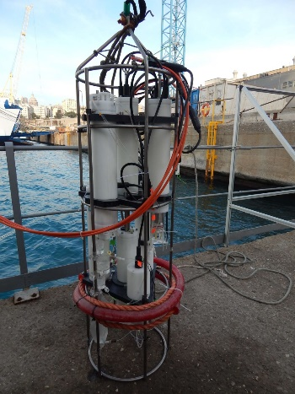

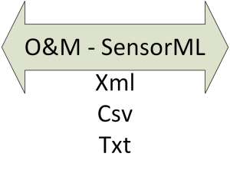
Sensor Web Enablement
The OGC Sensor Web Enablement (OGC-SWE) enables the discovery, exchange, and processing of sensor observations and tasking of sensor systems by means of 3 standards XML encodings (SensorML, O&M, TML) and 4 standards web service interfaces (SOS, SAS, SPS, WNS)
Sensor Observation Service (SOS): data and metadata on sensors and observations
Sensor Planning Service (SPS): data and metadata on sensor configuration
Sensors Alert Service (SAS): data and metadata on alerts and errors from the sensors and probes
Notes:
This is a simple schema that illustrates the communication between the sensors and the SOS interface. We have 4 different modules (ctd, trace metal, nutrients and carbonate, vocs) that communicate with the probe network controller who is in charge of managing the «intelligence» of the probe. It gets the data from the module and then it is in charge of establishing the communication with the SOS interface of the schema web server.

Slide 13
SCHeMA SOS
SOS 1.0 (stable version in 2014, lots of example – ISTSOS, IOOS, etc..)
  Core profile (GetCapabilities, DescribeSensor, GetObservation)
  Transactional profile (RegisterSensor, InsertObservation)
Custom methods for registering error and changing sensor configuration
  RequestSP
  InsertError
Easier and faster to implement in the framework of the project instead of using full SAS (Sensor Alert Service) and SPS (Sensor Planning Service)
Development of a light SOS interface fully integrated with ETT observing system (used also for EMODnet Physics), easier to mantain, manage and deployed.

Slide 14
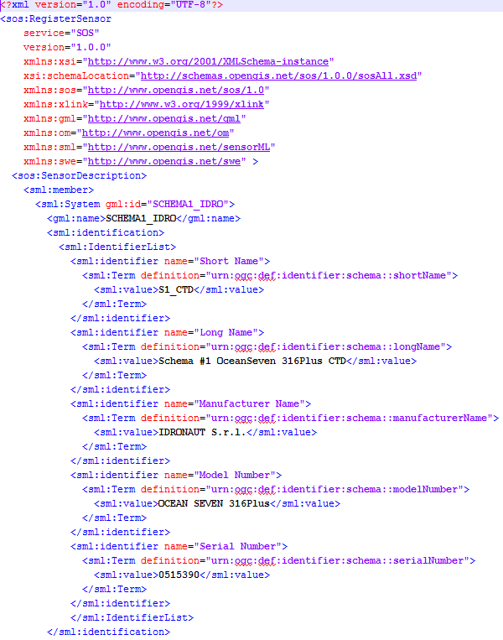
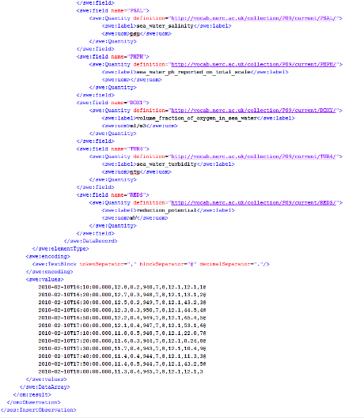
SOS - transactional
RegisterSensor
InsertObservation

Slide 15
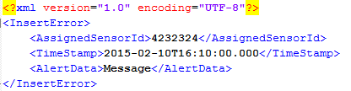

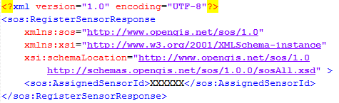

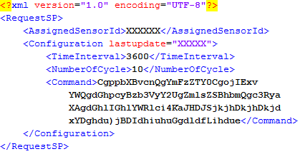
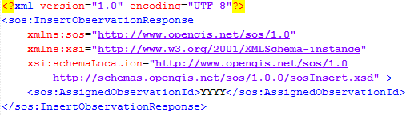
SAS - SPS
InsertError
RequestSP
RegisterSensor response
InsertError response
RequestSP response
InsertObservation response

Slide 16
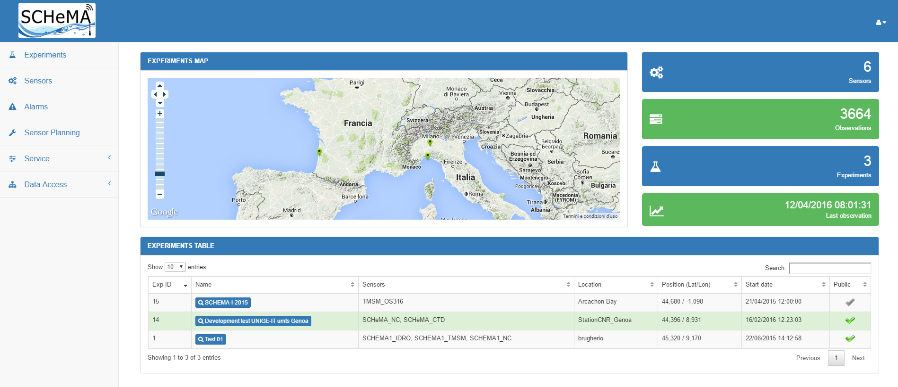
Web Interface
The SCHeMA Web Front-end allows the user to:
manage probes and experiments
handle alarms and sensor configurations
view and retrieve stored observations and metadata
http://dataportal.schema-ocean.eu

Slide 17
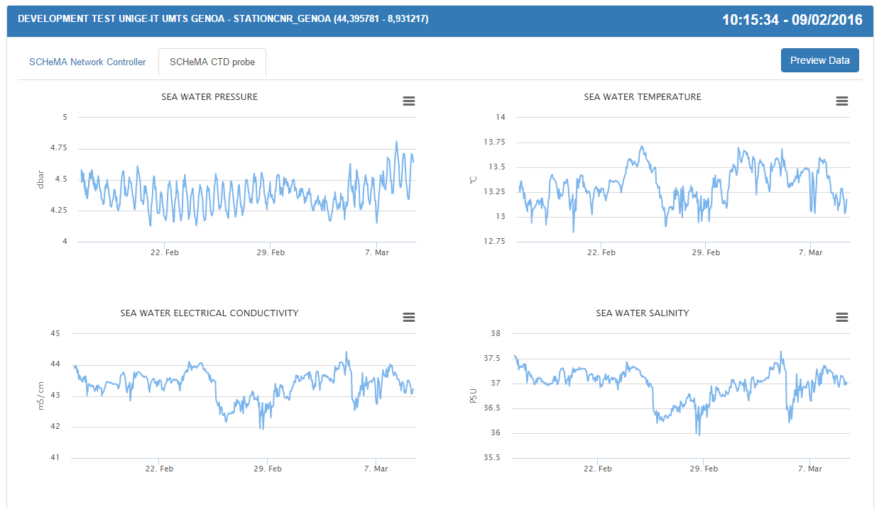
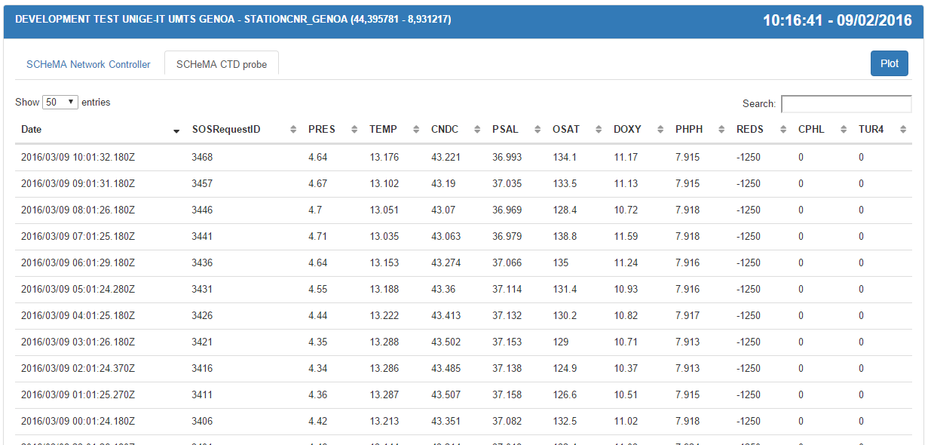
Web Interface
Data Visualization
Sensor Management
Alarm Management
User Management
Dashboard
Data Submission
QC Editor
Data Access – WMS
Data Access – SOS
Data Access - Download

Slide 18
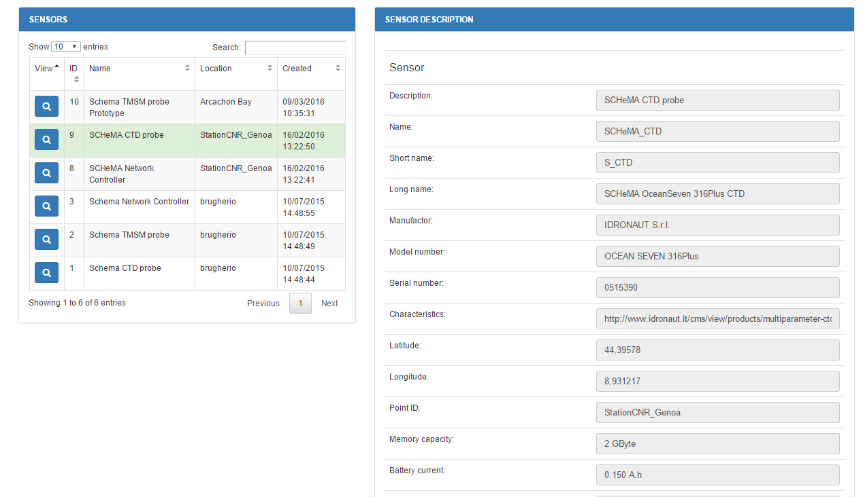
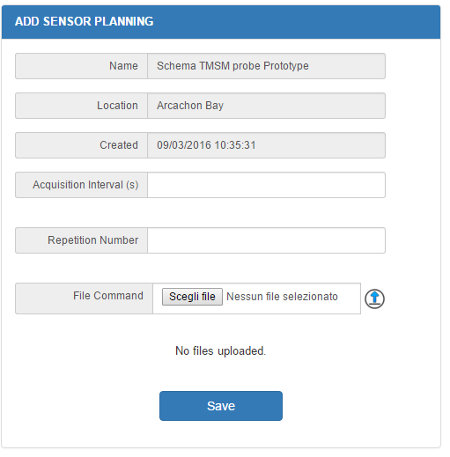
Web Interface
Data Visualization
Sensor Management
Alarm Management
User Management
Dashboard
Data Submission
QC Editor
Data Access – WMS
Data Access – SOS
Data Access - Download

Slide 19
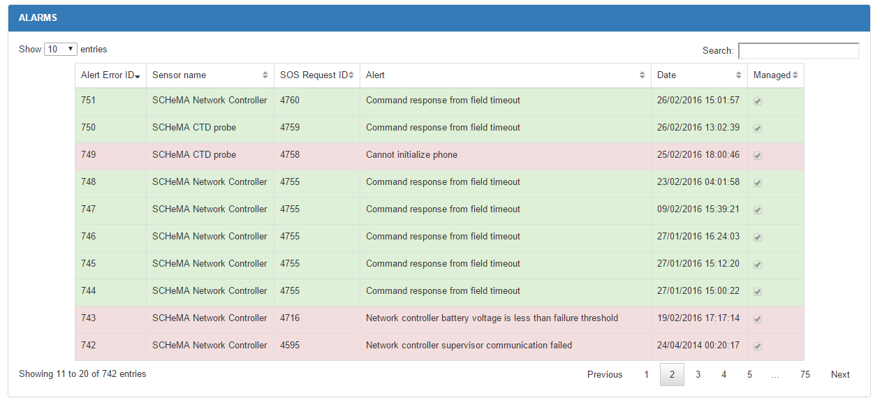
Web Interface
Data Visualization
Sensor Management
Alarm Management
User Management
Dashboard
Data Submission
QC Editor
Data Access – WMS
Data Access – SOS
Data Access - Download
Alarm list with different colors showing different severity and action performed by the system (high: SMS to the probe owner; medium: email to the probe owner; low)

Slide 20
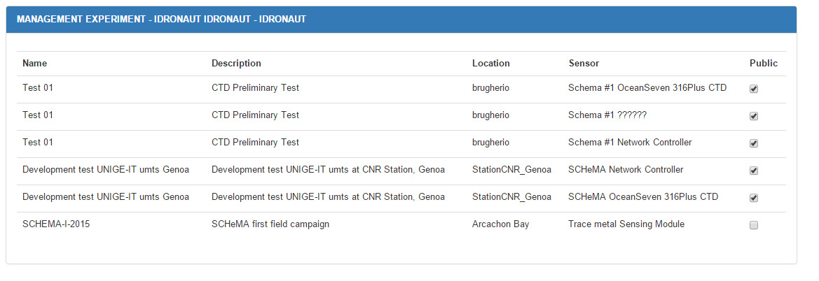
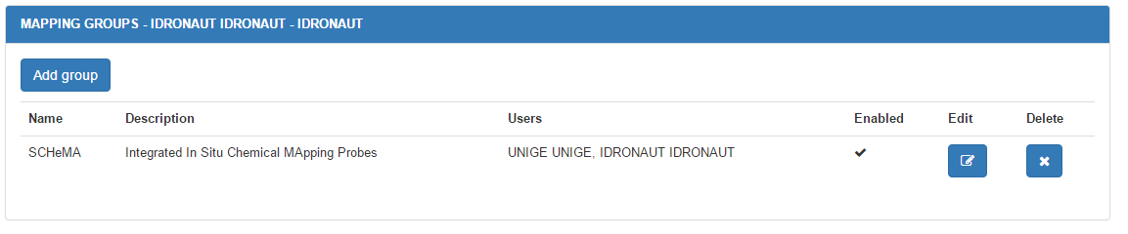
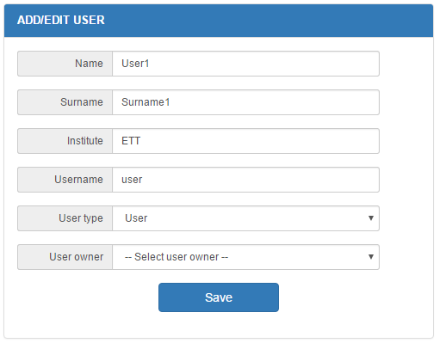
Web Interface
Data Visualization
Sensor Management
Alarm Management
User Management
Dashboard
Data Submission
QC Editor
Data Access – WMS
Data Access – SOS
Data Access - Download

Slide 21
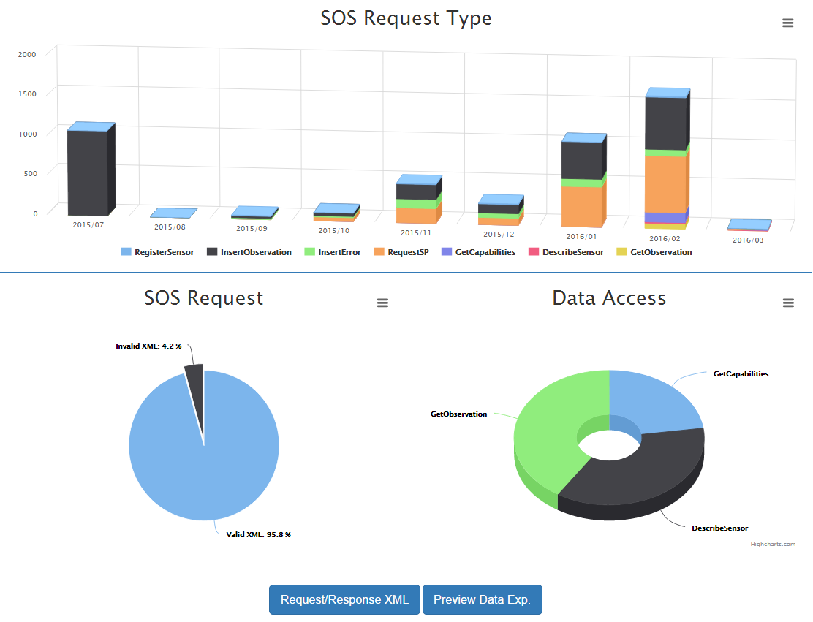
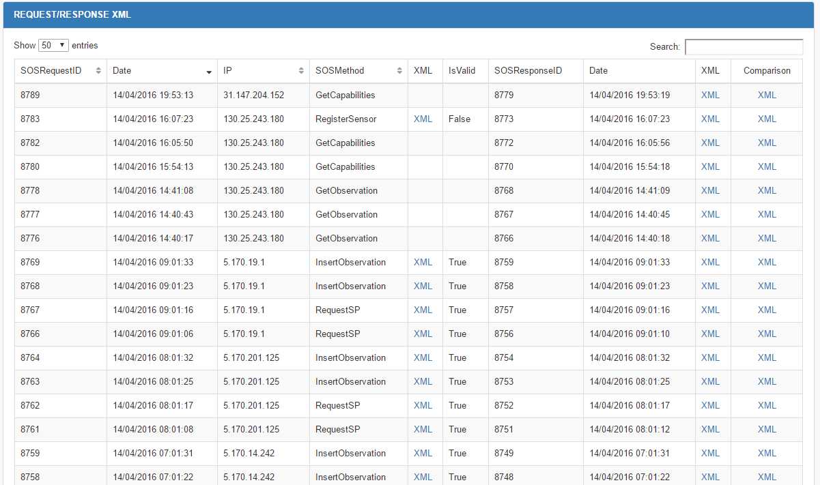
Web Interface
Data Visualization
Sensor Management
Alarm Management
User Management
Dashboard
Data Submission
QC Editor
Data Access – WMS
Data Access – SOS
Data Access - Download

Slide 22
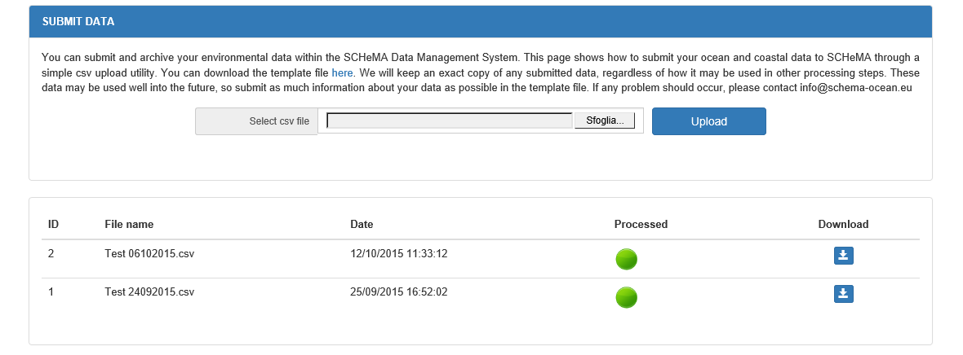
Web Interface
Data Visualization
Sensor Management
Alarm Management
User Management
Dashboard
Data Submission
QC Editor
Data Access – WMS
Data Access – SOS
Data Access - Download
It is possible to upload a csv file (the template is available for download in the same page) with metadata and data and make it available to the SCHeMA system (only for registered users)

Slide 23
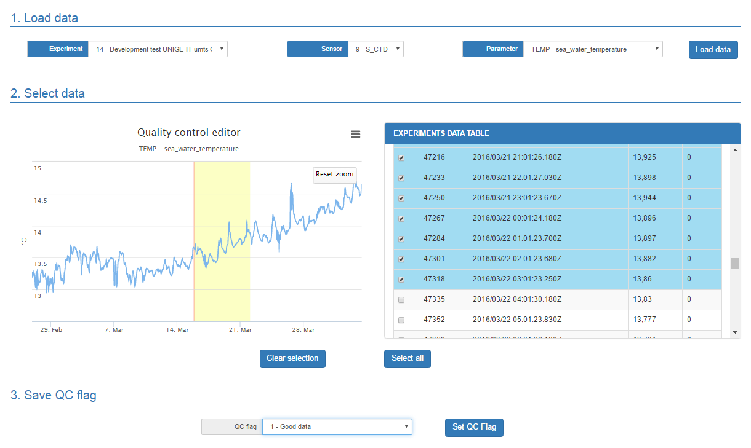
Web Interface
Data Visualization
Sensor Management
Alarm Management
User Management
Dashboard
Data Submission
QC Editor
Data Access – WMS
Data Access – SOS
Data Access - Download
The QC Editor allows to manually edit the QC flag of each observation according to the SeaDataNet Quality Flag Scale

Slide 24
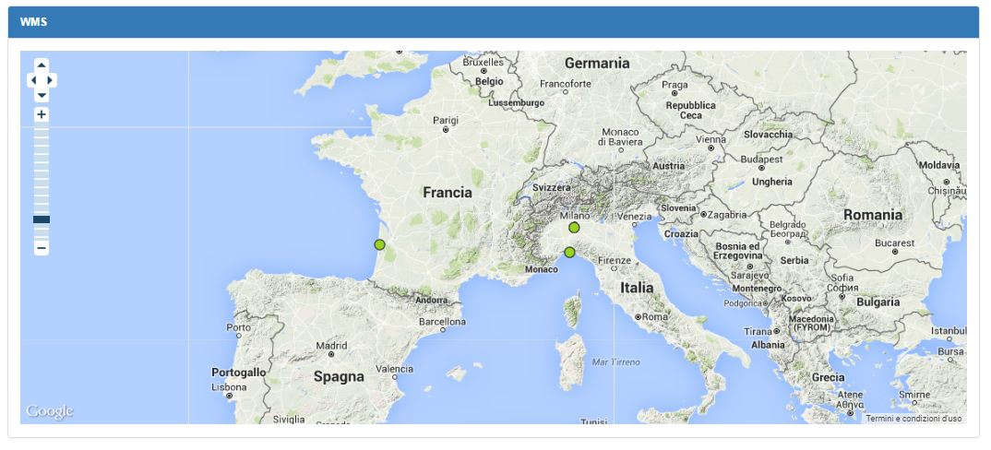
Web Interface
Data Visualization
Sensor Management
Alarm Management
User Management
Dashboard
Data Submission
QC Editor
Data Access – WMS
Data Access – SOS
Data Access - Download
http://151.1.25.219:8181/geoserver/emodnet/wms?service=WMS&version=1.1.0&request=GetMap&layers=emodnet:SCHEMA_Platforms&styles=&bbox=-180.0,-90.0,180.0,90.0&width=660&height=330&srs=EPSG:4326&format=image/png

Slide 25
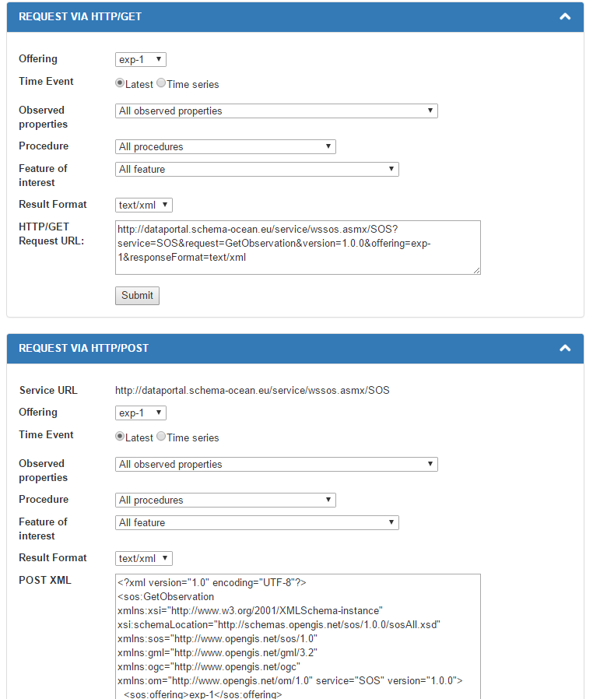
Web Interface
Data Visualization
Sensor Management
Alarm Management
User Management
Dashboard
Data Submission
QC Editor
Data Access – WMS
Data Access – SOS
Data Access - Download

Slide 26
Web Interface
Data Visualization
Sensor Management
Alarm Management
User Management
Dashboard
Data Submission
QC Editor
Data Access – WMS
Data Access – SOS
Data Access - Download
Land Stat
GetCapabilities: What service do you provide?
Client
Response: service metadata (Capabilities)
DescribeSensor: what are the characteristics of sensor YYZ?
Response: sensor metadata (SensorML)
GetObservation: give me data recorded by sensor YYZ
Response: observed data (O&M)
http://dataportal.schema-ocean.eu/service/wssos.asmx/SOS?service=SOS&request=GetCapabilities&version=1.0.0
http://dataportal.schema-ocean.eu/service/wssos.asmx/SOS?service=SOS&request=DescribeSensor&version=1.0.0&outputFormat=text/xml&procedure=urn:ogc:def:procedure:schema::S1_TMSM-2
http://dataportal.schema-ocean.eu/service/wssos.asmx/SOS?service=SOS&request=GetObservation&version=1.0.0&observedProperty=sea_water_temperature&offering=exp-14&responseFormat=text/xml&procedure=urn:ogc:def:procedure:schema::S1_TMSM-2

Slide 27
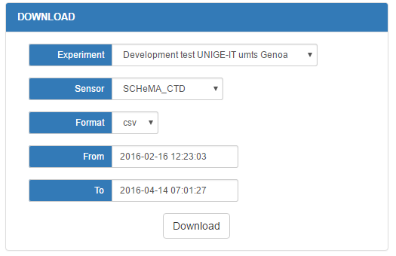

Web Interface
Data Visualization
Sensor Management
Alarm Management
User Management
Dashboard
Data Submission
QC Editor
Data Access – WMS
Data Access – SOS
Data Access - Download

Slide 28








Field tests
Arcachon bay monitoring and demonstration
- R/V Planula IV
Genoa harbor long-term
field evaluation - CNR-platform
coastal monitoring and
demonstration - R /V MASO
SCHeMA summer school and
and demonstration in mesocosm
The Gironde Estuary and
coastal area
and the R/V Thalia

Slide 29


Field tests
Species relevant to Carbon cycle and Nutrient Sensing Module – CNSM
Genoa CNR platform, Italy, February 2017
SALINITY 37.93; DEPTH 4.2 m
Detection level: mM, i.e. concentrations at level of milligram per liter (ppm)
Notes:
CNSM: mM means millimolar corresponding to concentrations at level of milligram per liter (ppm)

Slide 30
Field tests
Three channel bioavailable Trace Metal Sensing Module - TMSM : Arcachon bay, France, May 2017.
DEPTH: 3 m
in situ simultaneous monitoring of the bioavailable fraction of As(III), Cd(II), Pb(II), Zn(II), Cu(II) at various stations (1 hour interval during a 25 hour) - cycle at the station identified by the red star
Results suggest that the main carrier of As(III) in the Arcachon bay is seawater, while Cd(II) and Pb(II) are carried by freshwaters.
Detection level: nM (nanomolar) - As(III) and pM (picomolar) - Pb and Cd,
TMSM can detect trace metals concentration and monitor variation of concentrations at very low level
Notes:
TMSM was applied to in situ simultaneous monitoring of the bioavailable fraction of As(III), Cd(II), Pb(II), Zn(II), Cu(II) – copper - at various stations.
Examples of As(III), Cd(II) and Pb(II) concentrations monitored at 1 hour interval during a 25 hour cycle at the station identified by the red star.
These results suggest that the main carrier of As(III) in the Arcachon bay is seawater, while Cd(II) and Pb(II) are carried by freshwaters.
TMSM: nM = nanomolar (As(III) and pM (Pb – lead, and Cd - cadmium) = picomolar corresponding to concentrations at level of nanogram per liter (ppt), i.e. the TMSM has the capability to detect trace metals concentration and monitor variation of concentrations at very low level.

Slide 31


Field tests
Multichannel Algae Sensing Module – MASM,
Arcachon bay, France, May 2017.
The superordinate results at phylum level are the following:
==== =================== =================
.. Identified phylum probability [%]
==== =================== =================
0.00 Miozoa / Dinoflagellate 27.01 (8.46)
1.00 Bacillariophyta 18.71 (5.86)
2.00 Haptophyta 16.70 (5.23)
3.00 Cryptophyta 13.25 (4.15)
4.00 Ochrophyta 12.96 (4.06)
5.00 Chlorophyta 6.32 (1.98)
6.00 Euglenophyta 5.04 (1.58)
7.00 Cyanobacteria 0.00 (0.00)
==== =================== =================
The confidence interval of this analysis is 93.5% and the separation efficiency 96.0% respectively.
Histogram with relative fluorescence intensity at different excitation wavelengths and final decision based on selection if mainly algae or cyanobacteria a present in the sample
Score plot of the multivariate data analysis (Linear Discriminant Analysis - LDA). The LDA mainly finds algae and dinoflagellates respectively.

Slide 32

Find more on:
www.SCHEMA-OCEAN.eu
Coordinator:
Marie-Louise Tercier-Waeber
Marie-Louise.Tercier@unige.ch

