Slide 1
Blue economy in the Black Sea Panel 3b: Save the sea
Jaroslav Slobodnik
EMBLAS-II Project Team Leader
http://emblasproject.org/
15 September 2017, Batumi, Georgia

Slide 2
Project objectives
Overall objective:
To improve protection of the Black Sea environment
Specific objectives:
To improve availability and quality of Black Sea environmental data in line with the MSFD, WFD-coastal waters and Black Sea Strategic Action Plan (2009) needs
To improve partner countries’ ability to perform marine environmental monitoring along MSFD, WFD principles, taking into account the Black Sea Diagnostic Report II

Slide 3
MSFD –
All EU marine waters to achieve 'good environmental status' by 2020
EMBLAS - 8 out of 11 descriptors

Slide 4
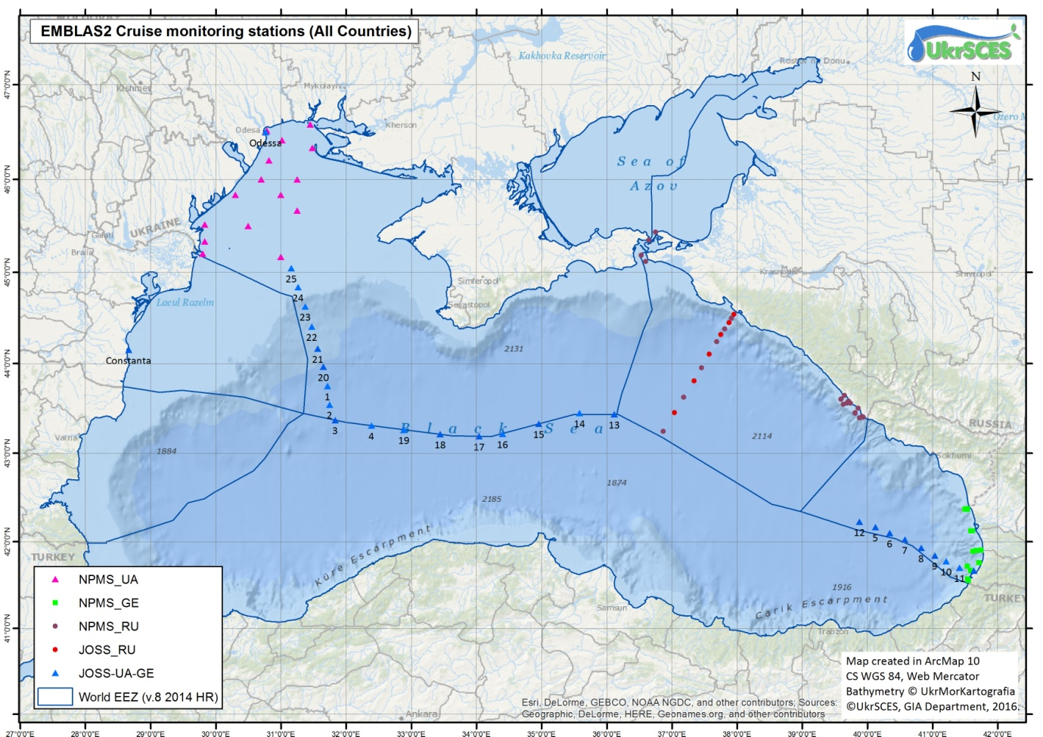
Sampling stations in the Joint Black Sea Survey 2016 including NPMS UA, NPMS GE, JOSS UA-GE and JOSS RF

Slide 5
Status classification schemes
WFD - ecological status (coastal waters) | High | Good | Moderate | Poor | Bad
MSFD - environmental status (territorial waters) | GES |  | Not GES

Slide 6
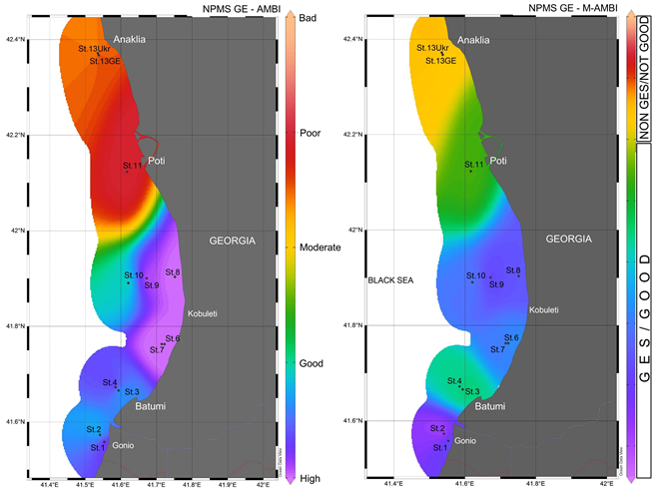
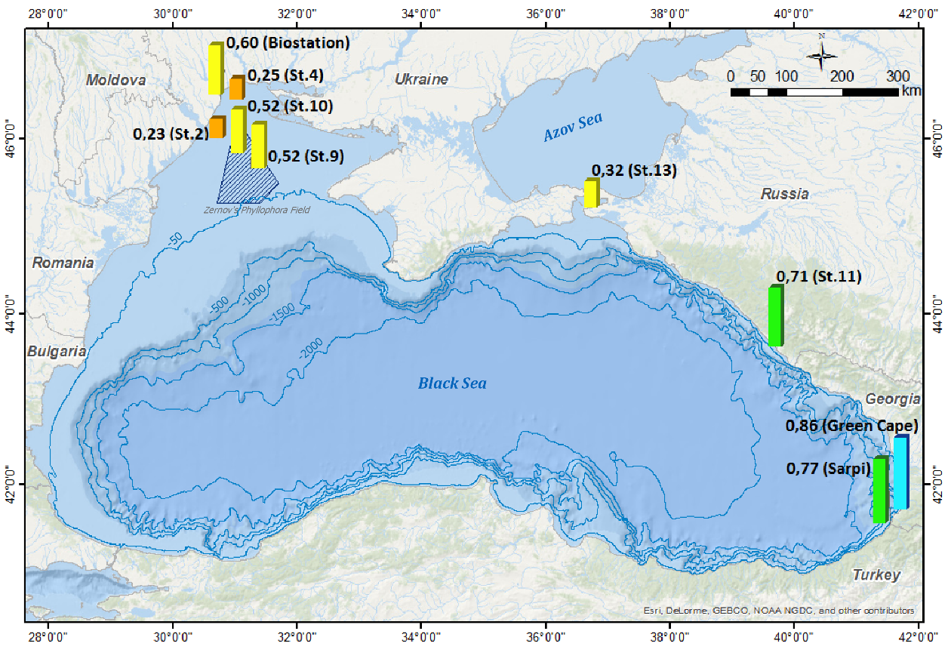
Indicative status assessment
Macrophytobenthos
Macrozoobenthos - Georgia

Slide 7
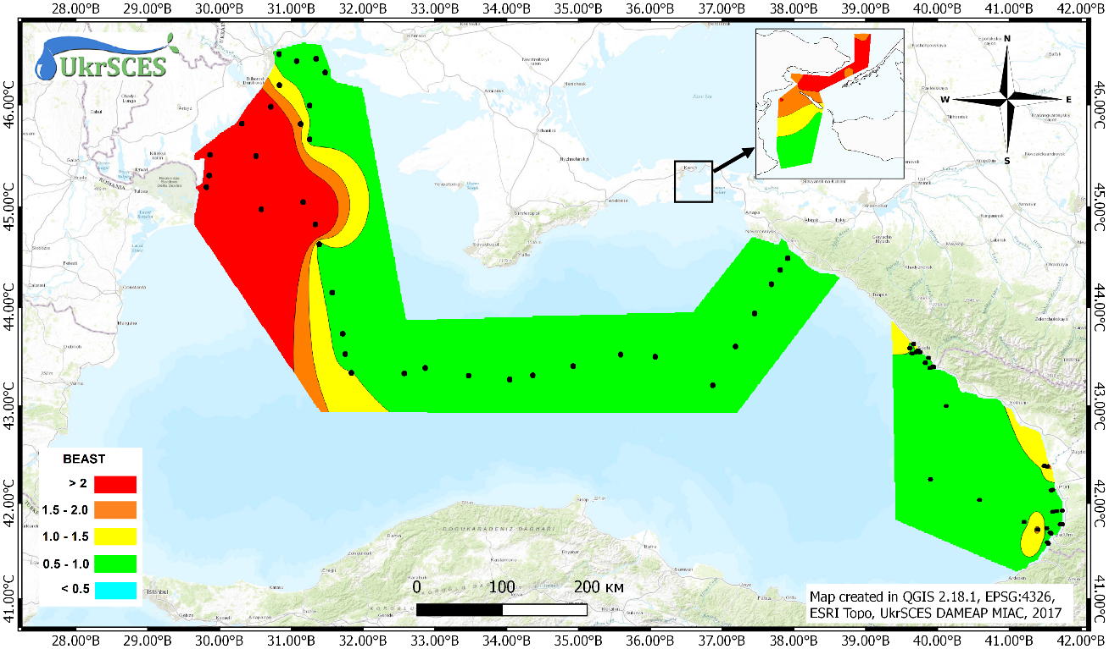
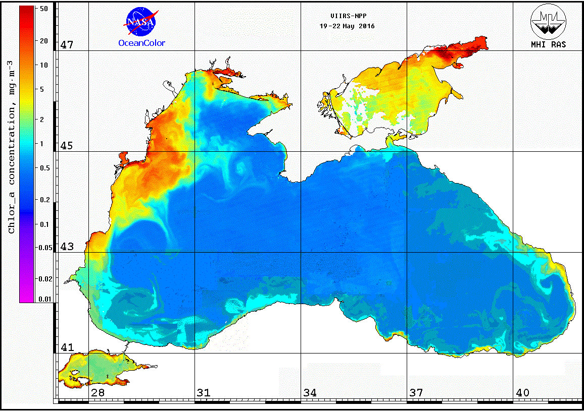
Indicative status assessment
Composite satellite image of the chlorophyll-a concentration
Eutrophication – BEAST index

Slide 8
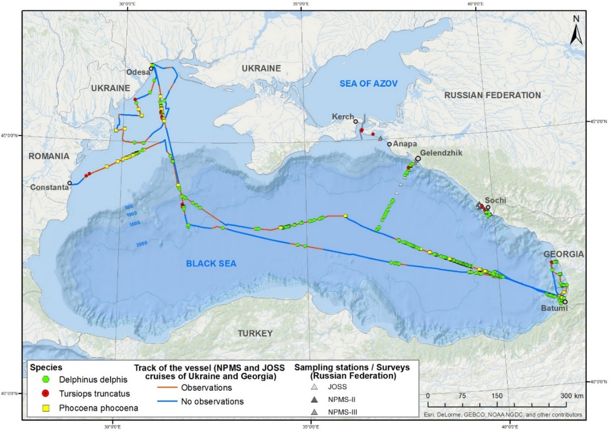
Marine mammals

Slide 9
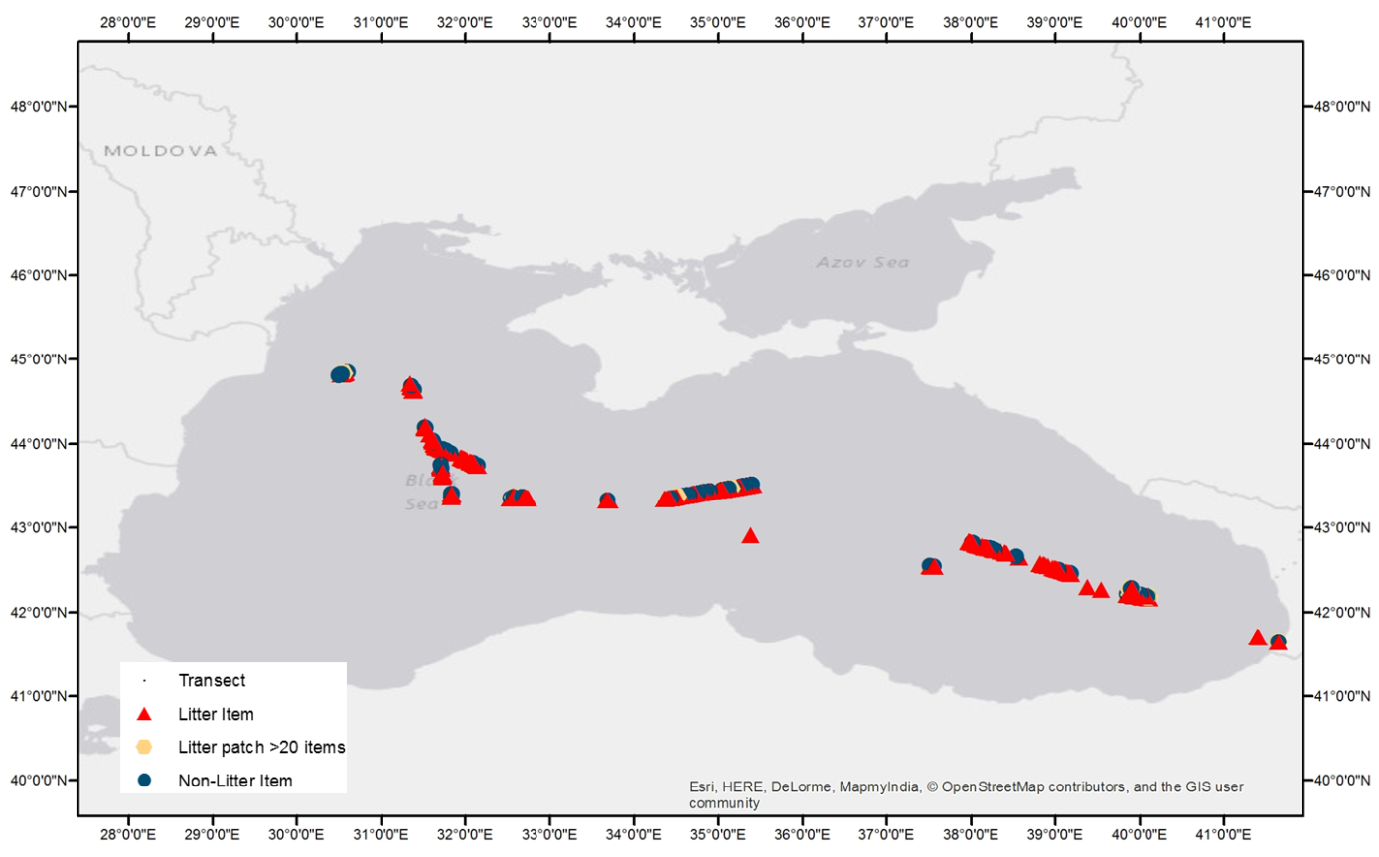
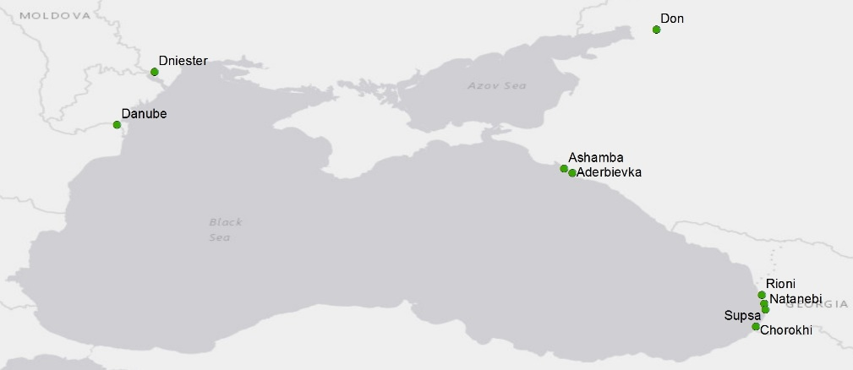
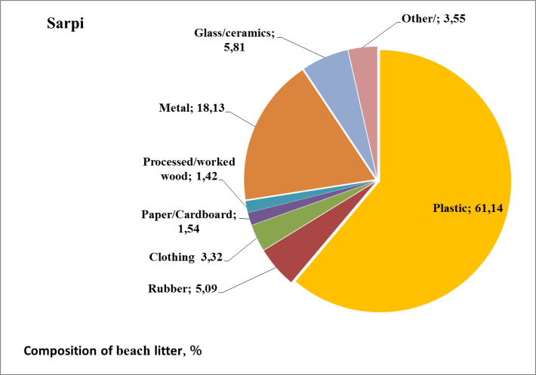
Floating Marine Macro Litter – JOSS GE-UA 2016
Floating Riverine Macro Litter
Composition of beach waste at Sarpi

Slide 10
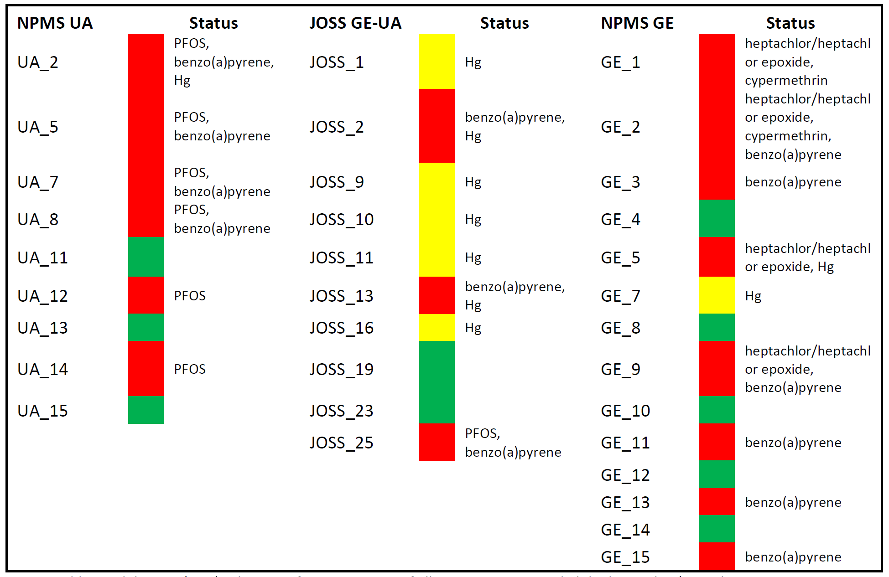
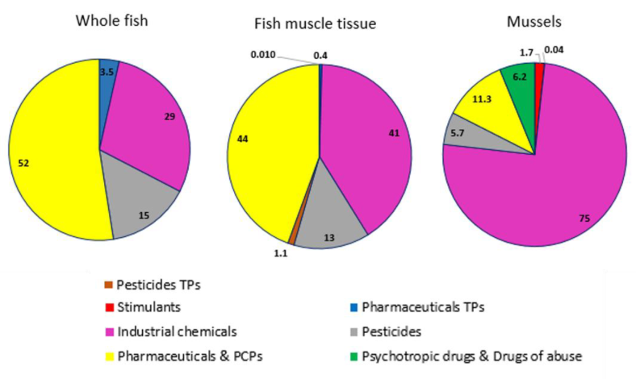
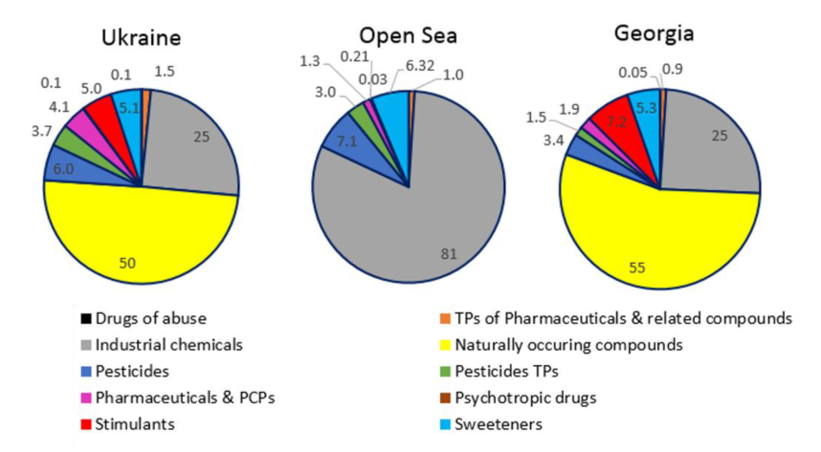
EU WFD priority substances – chemical status
Black Sea Specific Pollutants in water and biota

Slide 11
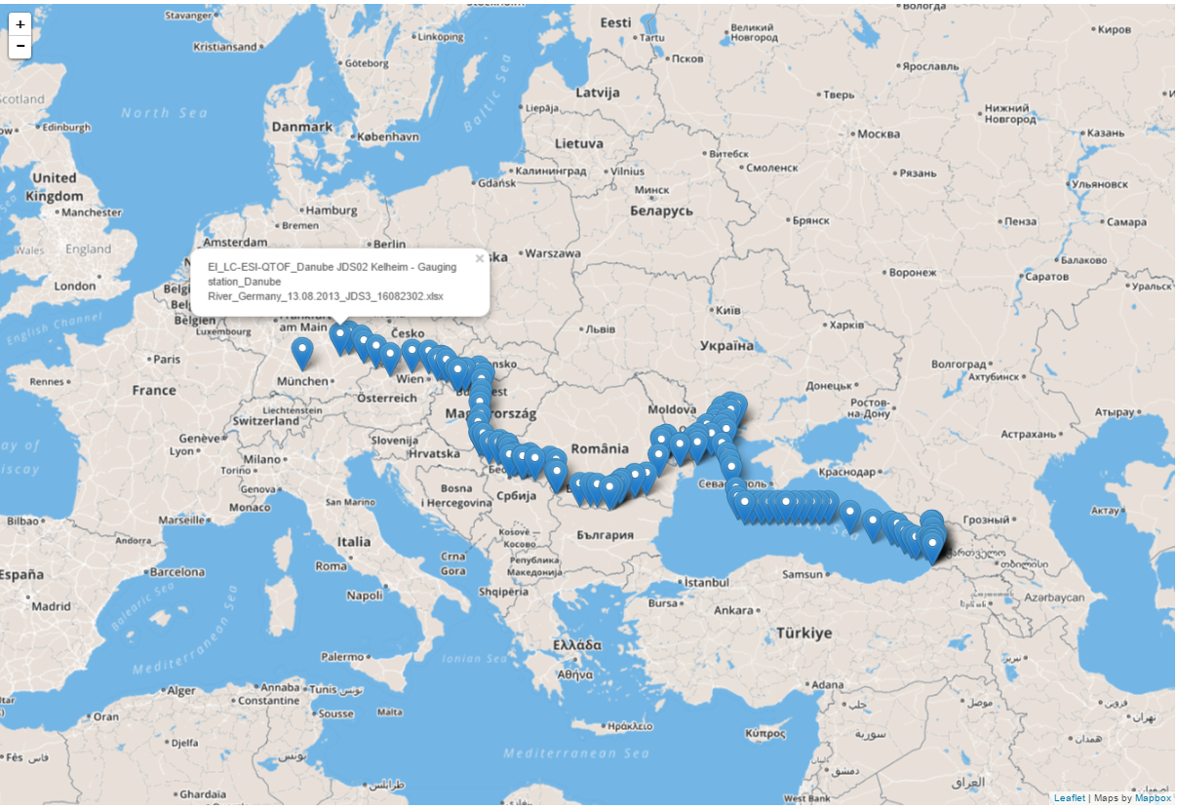
Selection of river water samples from JDS3 (68) and EMBLAS seawater samples (55)

Slide 12
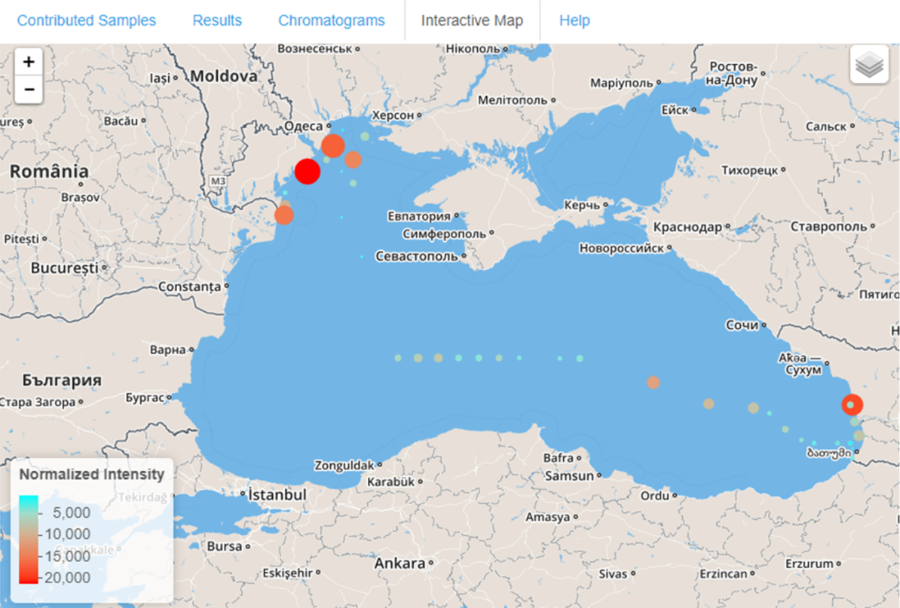
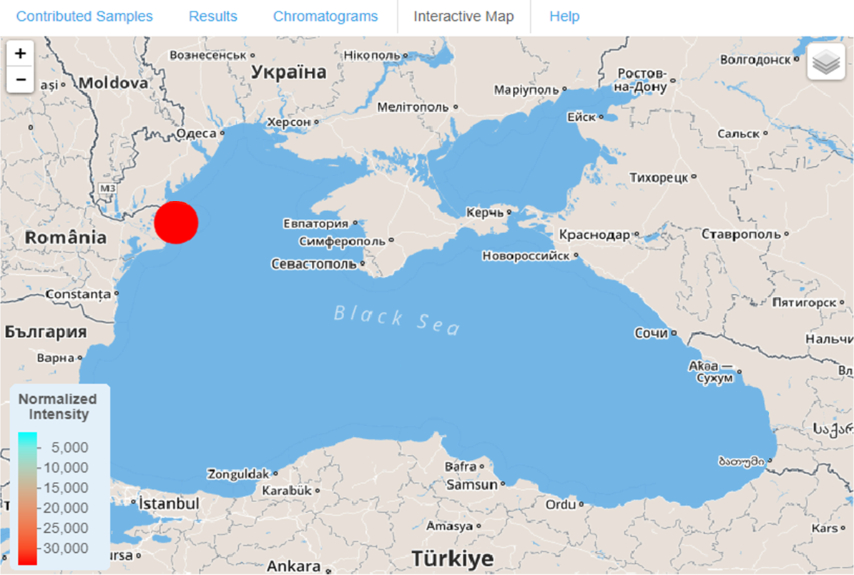
Example of point and widespread detection
DEET detected in many seawater samples from the Black Sea
Monensine detected only at 1 sampling station

Slide 13
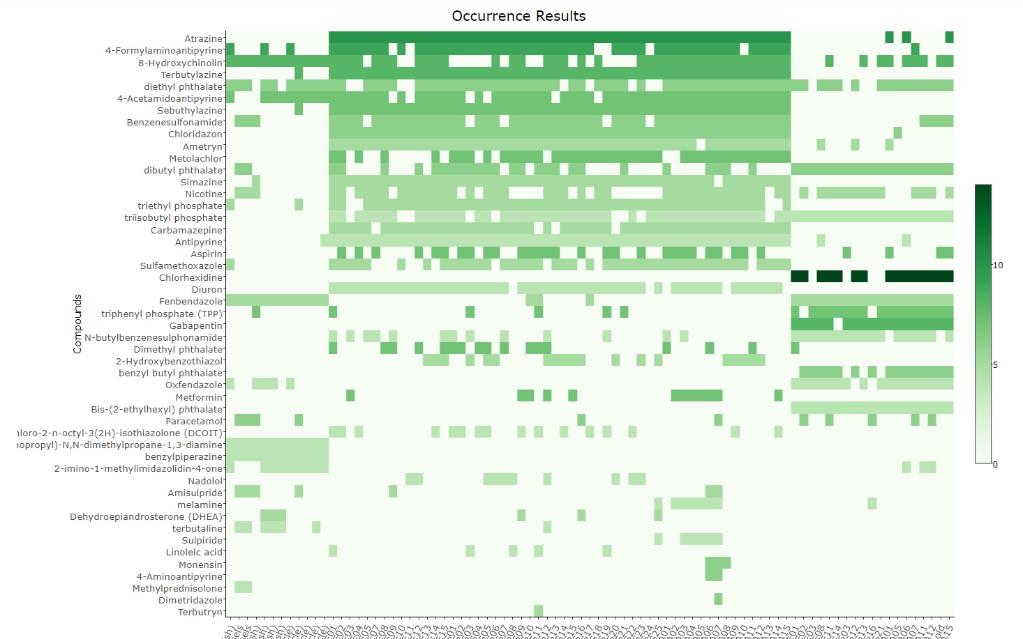
Screening of REACH compounds in samples from the Black Sea
Interactive heatmap available at http://norman-data.eu/NORMAN-REACH

Slide 14
Joint Black Sea Survey and National Pilot Monitoring Studies 2017
Harmonised sampling and reporting methodologies according to the MSFD and WFD
Delineation of coastal water bodies (WFD) as a basis for establishment of the national monitoring schemes
What’s new?
Testing of the environmental (MSFD), ecological and chemical (WFD) status classification schemes
Microplastics
eDNA (phytoplankton, zooplankton, macrozoobenthos, fish, macrophytes)
Super Large Volume sampling of chemical contaminants (EC JRC)
Hypoxia

Slide 15
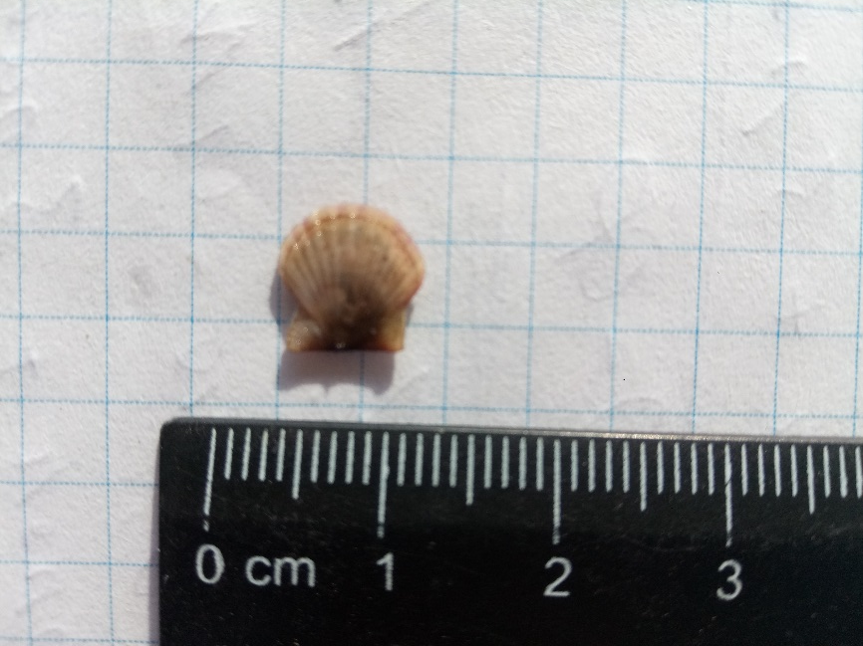
NPMS UA 2017 - Alive Pectinidaes found in the depth 20-30 m in the Zernov’s phyllophora field

