Slide 1

ENVIGUARD: a real-time multi-sensor in a small package with a big future
Sensor & System Innovations for the Oceans of Tomorrow
MTS/IEEE oceans 17, ABERDEEN
22nd June 2017

Slide 2
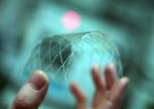
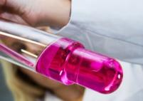



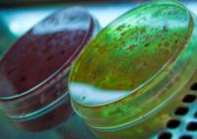



Research for more Quality of Life
Advances in biosensor technology for monitoring harmful algae, algae toxins & PCB
Björn Suckow
ttz Bremerhaven
SEA-on-a-CHIP Final Open Technical
Meeting and Workshop
Olhão, Portugal
16.05.2017
Notes:
Highlights (max 5 sentences)
Measurement of currently hard to measure pollutants/toxins and pathogens in sea water
Development of a novel, fully automated platform technology including new biosensors for detecting toxic microalgae, pathogens, toxins and PCBs
Three completely different approaches were used for the developments of the biosensors
Different species of toxic microalgae, Okadaic Acid and PCB 126 & 169 can be successfully quantified within 60 – 120 min
The degree of automation allows remote operation in the marine environment
In December 2013, the project EnviGuard picked up its work to provide the marine aquaculture industry with a highly specific and precise in situ measurement device for monitoring chemical contaminants and biohazards in seawater. The EnviGuard system combines technologies from the field of nanotechnologies, genomics, molecular science, bio-receptors as well as material science and data processing. It is made up of three different sensor modules one for detecting toxic microalgae, one for pathogens and one for toxins and PCBs. They are connected to the EnviGuard Port, a common interface device and platform, which is responsible for continuous sampling, filtration and sample preparation. It also records and sends the data to a server. Users can access their information online.
The algae detection unit (ADU) and chemical detection unit (CDU) were completed in 2016 and used for the analysis of different water samples. The ADU is based upon the detection of nucleic acids via sandwich-hybridisation. A target specific capture probe is deposited on an electrode. If the target is bound, detection takes place via the hybridization of a second probe. Attached to the second probe are components, which allow for an electro-chemical signal to be measured. The biosensor is fully automated using the AUTOFIM (iSiTEC, Bremerhaven, Germany) filtration unit for sample preparation. Readings from real water samples were compared to the results from classic microscopy. The CDU is an optical immuno-sensor based on photonic nanostructured surfaces called Bicells. The Bicells are integrated in a reusable multiplexed chip within an autonomous fluidic system which allows simultaneous multi-analyte detection. Monoclonal antibodies and a competitive format have been applied for specific detection of toxins and PCBs. Solutions with increasing concentrations of target analytes were used to obtain calibration curves and assess system detectability. Spiked water samples were used to evaluate the system’s capacity.
The ADU has been used to measure the occurrence of two different Dinophysis species in field samples. The biosensor gave positive results for their occurrence. The fully automated system needs two hours per sample. The results of the ADU were confirmed by microscope counting of the samples.
Regarding the CDU, successful protocols for label-free and real-time detection of PCB (126&169) and Okadaic Acid (OA) have been developed and implemented in the integrated unit. Results show a detection limit close to 25 ng/ml for OA and 22 ng/ml for PCBs revealing the sensitivity of the novel sensor. The sensor is able to analyze one sample per hour.
Monitoring of toxic microalgae is usually done by microscopy. This method is time consuming and requires trained personal. Molecular methods have a higher resolution and distinguish better between species. The ADU allows for both quantitative and qualitative measurements. The reaction only takes place when a certain species or group is occurring and the strength of the signal allows for measuring the amount of cells in the sample. This new method is faster - a single measurement takes about 2 hours after filtration - and the device can be used with little training. The main operation of the device can be done remotely, as well as the analysis of the results. Consumables such as different solutions and a new pair of bio-chips is needed once a week.
The results of the CDU constitute the developed bio-sensing technology as a competitive analytical tool, since usually PCBs and OA are determined by more complex and expensive methodologies such as GC/MS or LC/MS, which require sample shipment to analysis laboratory.
Due to these advantages, the two new biosensors have the potential to replace standard procedures and diagnostic tests. The degree of automation allows remote operation in the marine environment. Only basic personal is needed for quantitative analysis. Thus, EnviGuard can serve as an early warning system for aquaculture enterprises as well as regional authorities. The modularity of the platform allows users to purchase a customized product according to their needs and the addition of new biosensor modules in the future.

Slide 3
Advances in biosensor technology for monitoring harmful algae, algae toxins & PCB
Björn B. Suckow¹, P. Ciaurriz², E. Teiletxea², F. Fernández², I. Cornago², A. Baron³, C. Deffaud ³, A. L. Hernandez⁴, R. Casquel⁴, M. Holgado⁴, T. T. Veenstra⁵, H. von Hörsten⁶, F. Dortu⁶, M. Maigler⁷, K. Metfies⁸, J. Hessel⁸, P. Sprong⁸, T. Hanken⁹
1 ttz Bremerhaven, Am Lunedeich 12, 27572 Bremerhaven, Germany
2 Cemitec, ADItech, Polígono Mocholí, Plaza Cein 4, 31110 Noain, Spain
3 Biotem, Parc d’Activités Bièvre Dauphine, Alphonse Gourju 885, Apprieu, France
4 Center for Biological Technology, Technical University of Madrid, 28223 Pozuelo, Spain
5 LioniX BV, PO Box 456, 7500 AL Enschede, The Netherlands
6 Multitel a.s.b.l., 2 Rue Pierre et Marie Curie, BE-7000 Mons, Belgium
7 Bio Optical Detection S.L., Technical University of Madrid, 28223 Pozuelo, Spain
8 Alfred Wegener Institute, Helmholtz Centre for Polar and Marine Research, Am Handelshafen 12, 27570 Bremerhaven, Germany
9 iSiTEC GmbH, Bussestraße 27, 27570 Bremerhaven, Germany

Slide 4
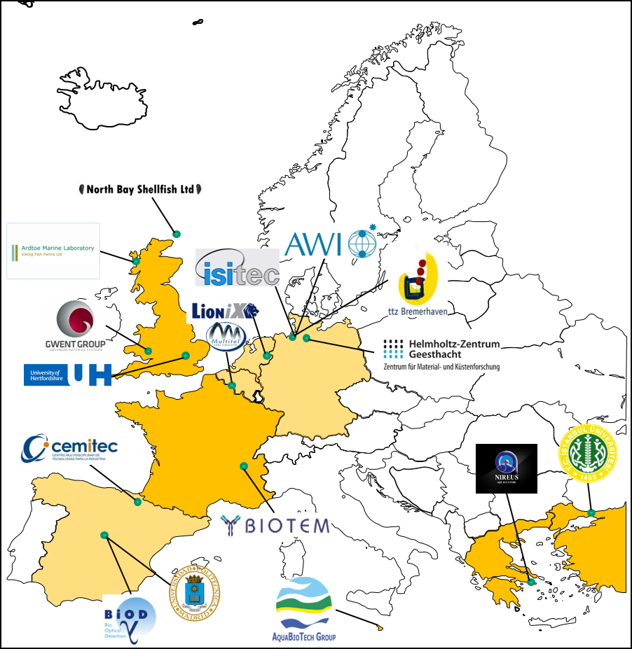
EnviGuard Overview
18 partners
  9 countries
  11 SMEs
  7 RTDs
60 Month
7.2 Mio €

Slide 5

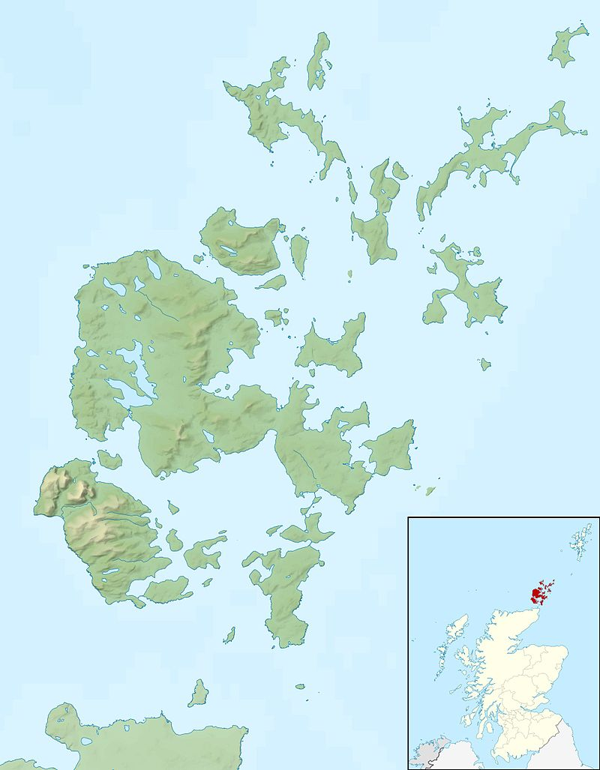
NORTHBAY SHELLFISH LTD
Established 1995
Active in projects investigating shellfish toxins and disease
Leader of 12 EU Research Projects
Member (End-User) of ENVIGUARD

Slide 6
EnviGuard Overview
The objective of the EnviGuard project is to develop a highly specific and precise (i.e. quantitative and qualitative) in situ measurement device for currently hard to measure man-made chemical contaminants and biohazards (toxic microalgae, viruses & bacteria, biotoxins & PCBs) that can be used as an early warning system in aquaculture and as an environmental monitor to assess the good environmental status of the sea in compliance with the relevant marine framework directives.

Slide 7
EnviGuard Overview
The EnviGuard system combines technologies from the field of nanotechnologies, genomics, molecular science, bio-receptors as well as material science and data processing.
Three different sensor concepts are being develop in parallel and will be combined in one common device able to collect, process and send the data to the users.
In the following, the technological concept of all EnviGuard components is described.

Slide 8



EnviGuard Overview
The core of EnviGuard:
  3 biosensors (algae/chemicals/pathogens)
    each using a different detection technique
    completely modular

Slide 9

EnviGuard Overview
Connected to one common interface
    Provide the samples
    Pretreatment
    Power Source
    Collects & sends data
    Platform technology
    ( =EnviGuard Port)
Notes:
Central unit for data processing, data transmission and power supply
Sensor interface module for signal processing and data distribution
Development and set up of the EnviGuard.Net software and website.

Slide 10

EnviGuard Overview
will become an early warning system for the aquaculture industry and an environmental monitoring tool.

Slide 11
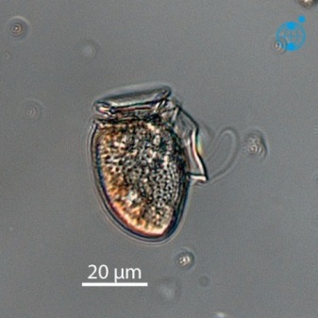
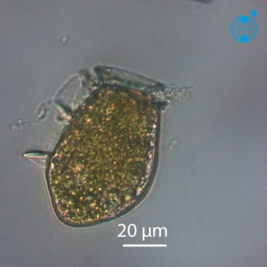
EnviGuard - Background
Dinoflagellates are unicellular protists
Several Dinophysis species can produce shellfish toxins (Okadaic acid, it´s derivates and pectenotoxins)
→ Diarrhetic Shellfish Poisoning (DSP)
Toxin content is highly variable (temporal, seasonal, spatial, between strains)
Evidence exist that toxin content and cell counts are not mandatory coupled.
D. acuminata
D. acuta
Sources: Alfred-Wegener-Institute
Notes:
Dinoflagellates are unicellular protists and one of the most important components in marine plankton with a diverse array of ecological properties,
Dinoflagellates species (e.g. Dinophysis sp. or Alexandrium sp) have become target organisms for monitoring of microalgae species as they may produce several potent shellfish toxins and therefore have negative impacts on marine ecosystem, human health and local economies and aqacultures/Shellfish farming.
Amongst other potential toxic dinoflagellate species
Several dinophysis species can produce shellfish toxins (Ocadaic acid, it´s derivates and pectenotoxins) that cause gastrointenstinal illness (DSP), like e.g. dinophysis acuminate or acuta, that are the main agents of DSP events at European Atlantic coasts and northern Europe.
Therefore affected areas where DSP events occur require periodic field sampling. Species of the genus Dinophysis inhabit some challenges.
Standard quantification methods also might fail to detect and determine Dinophysis species due to their typically low cell densities and their spatial heterogeneity (=patchiness).Toxin content is highly variable (in a temporal, seasonal and spatial way) even between strains and there is some evidence that toxin content and cell counts are not mandatory coupled. The occurrence of toxic dinoflagellates is furthermore affected by climate changes due to complex environmental factor interactions. Therefore innovative technologies for environmental in-situ monitoring of toxic microalgae with a high spatio-temporal resolution are needed to prevent humans and aquatic environments from toxic threats and damage.

Slide 12
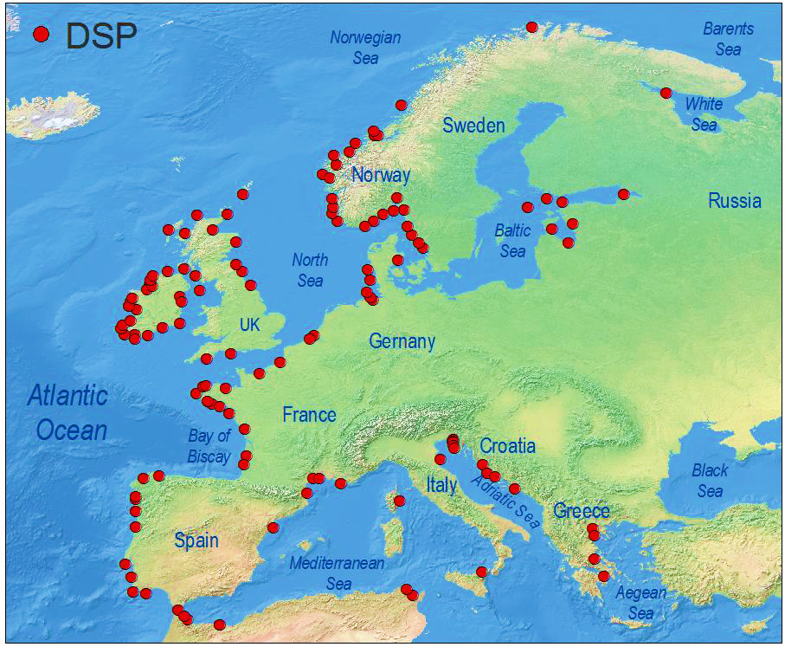
EnviGuard - Background
HAB cause by Dinophysis species are one of the main threat to aquaculture in Europe
Standard quant. methods fail
  Low cell abundances
  Patchiness
Reguera et al. 2014
Early warning tool for DSP outbreaks
Notes:
Dinoflagellates are unicellular protists and one of the most important components in marine plankton with a diverse array of ecological properties,
Dinoflagellates species (e.g. Dinophysis sp. or Alexandrium sp) have become target organisms for monitoring of microalgae species as they may produce several potent shellfish toxins and therefore have negative impacts on marine ecosystem, human health and local economies and aqacultures/Shellfish farming.
Amongst other potential toxic dinoflagellate species
Several dinophysis species can produce shellfish toxins (Ocadaic acid, it´s derivates and pectenotoxins) that cause gastrointenstinal illness (DSP), like e.g. dinophysis acuminate or acuta, that are the main agents of DSP events at European Atlantic coasts and northern Europe.
Therefore affected areas where DSP events occur require periodic field sampling. Species of the genus Dinophysis inhabit some challenges.
Standard quantification methods also might fail to detect and determine Dinophysis species due to their typically low cell densities and their spatial heterogeneity (=patchiness).Toxin content is highly variable (in a temporal, seasonal and spatial way) even between strains and there is some evidence that toxin content and cell counts are not mandatory coupled.
The occurrence of toxic dinoflagellates is furthermore affected by climate changes due to complex environmental factor interactions. Therefore innovative technologies for environmental in-situ monitoring of toxic microalgae with a high spatio-temporal resolution are needed to prevent humans and aquatic environments from toxic threats and damage.

Slide 13

EnviGuard – Algae Detection Unit (ADU)
A quantitative nucleic acid based detection sensor for relevant toxic algae in EU waters
Notes:
Our research aim is was to develop an automated observation system that allows monitoring and surveillance of toxic microalgae species in situ with high spatio-temporal resolution. The system includes an automated filtration module (AutoFiM) and a rRNA biosensor approach that allow rapid, precise and economically efficient high-resolution quantification and identification of microalgae in aquatic environments. Next generation sequencing and genetic fingerprints are used to get additional information on distributional patterns of the most common dinoflagellate species in the observation area.

Slide 14

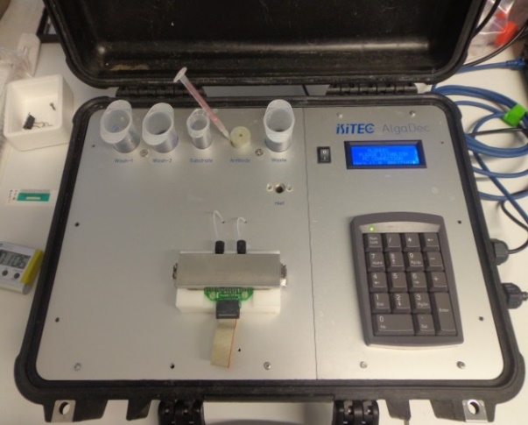
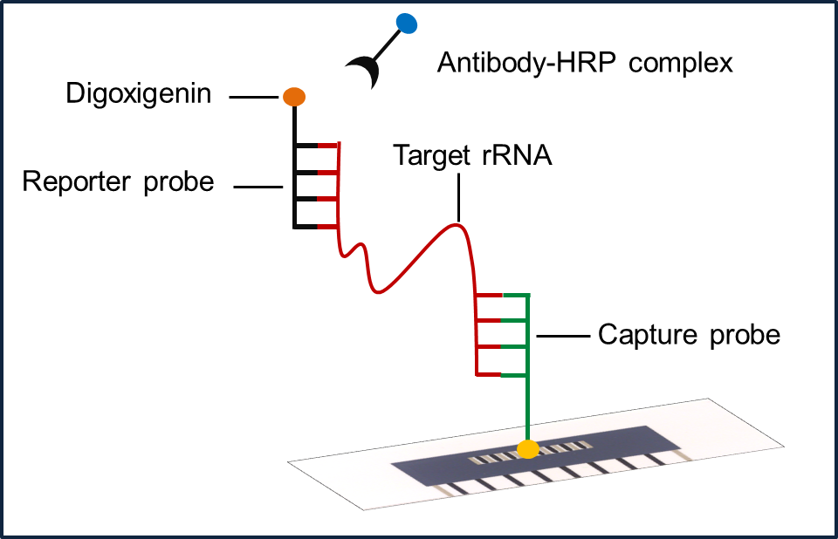
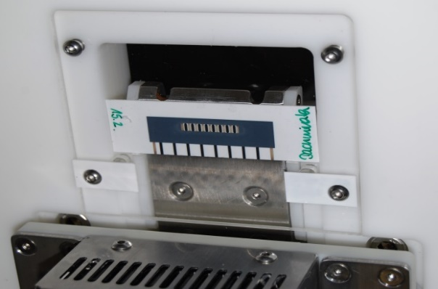
EnviGuard – Algae Detection Unit (ADU)
The molecular detection and quantification uses a Sandwich Hybridisation Assay
Sources: Alfred-Wegener-Institute
Notes:
We introduce a rRNA biosensor device. The detection and quantification of selected microalgae species is based on Sandwich Hybridization that involves two species-specific probes, that bind to a specific area in the ribosomal RNA of the target organism. A sensor-chip is placed in the chamber. One of the probes is, immobilized on the chips surface, the other functions at the detection probe. If the RNA of the target species is present in the sample, it hybridisizes with the probes. The detection probe is labeled with digoxigenin, that binds to an antibody-enzym complex. This redox reaction can measured as an electrochemical signal. The signal could then be used for quantification of the target species based on calibration curves.

Slide 15
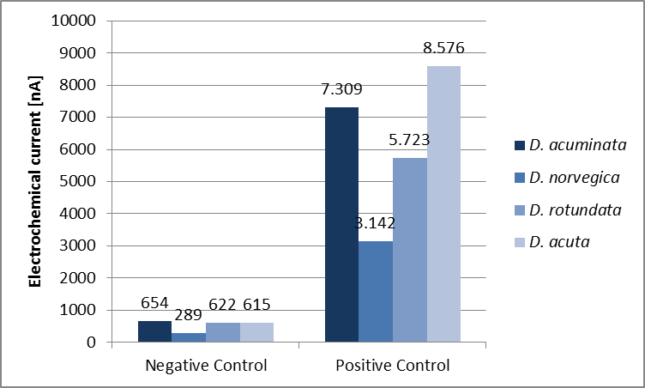
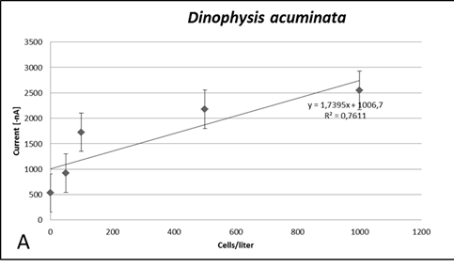
EnviGuard – Algae Detection Unit (ADU)
Calibration based on nucleic acid biosensor of former FP6 project
Signal:Noise ratio
Correlation between signal intensity and cell amounts for Dinophysis sp.
Sources: Alfred-Wegener-Institute
Notes:
Calibration was done using four different probe sets and cell estimates from Dinophysis sp. laboratory cultures (e.g. D.acuminata). Cell counts correlate with signal intensity enabling not only detection but quantification.

Slide 16
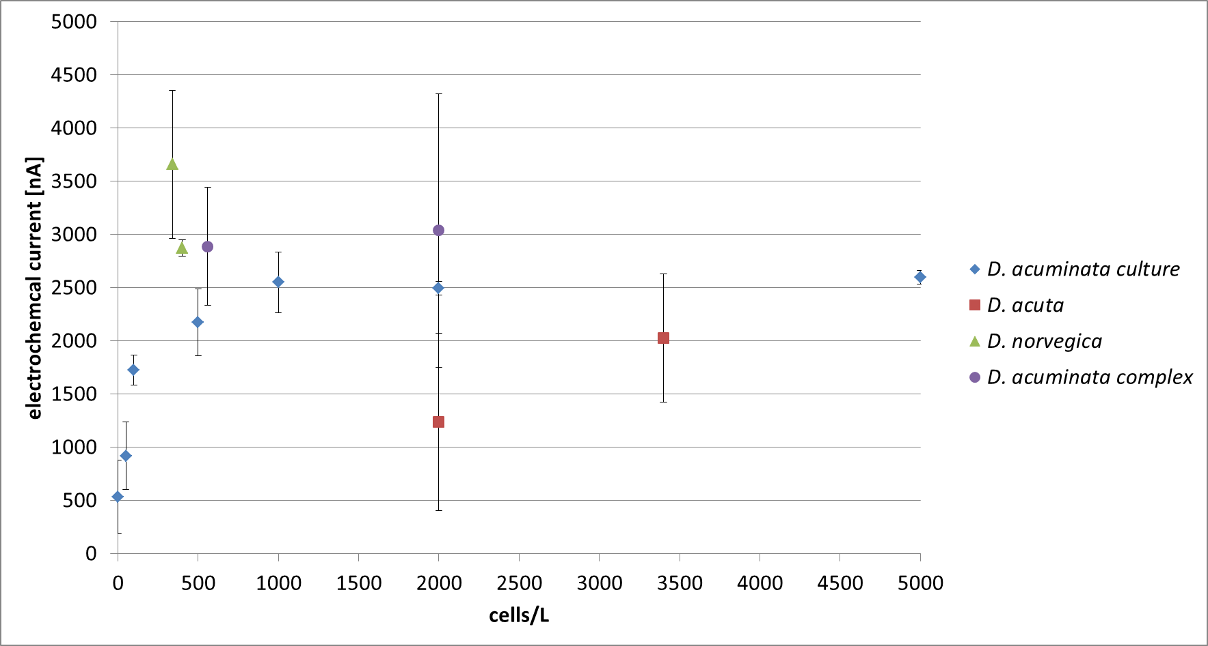
EnviGuard – Algae Detection Unit (ADU)
More recent results from field samples (Sognefjord, Norway)
designed probes work
differentiate between different species
The automated biosensor system is suited for automated quantification of marine microbes
Notes:
We detected Dinophysis sp. in field samples from the Sognefjord, Norway based on the nucleic acid biosensor device.
The specificy of the designed probes is actually proven (especially to differentiate between different species and between potential toxic and non-toxic strains).

Slide 17
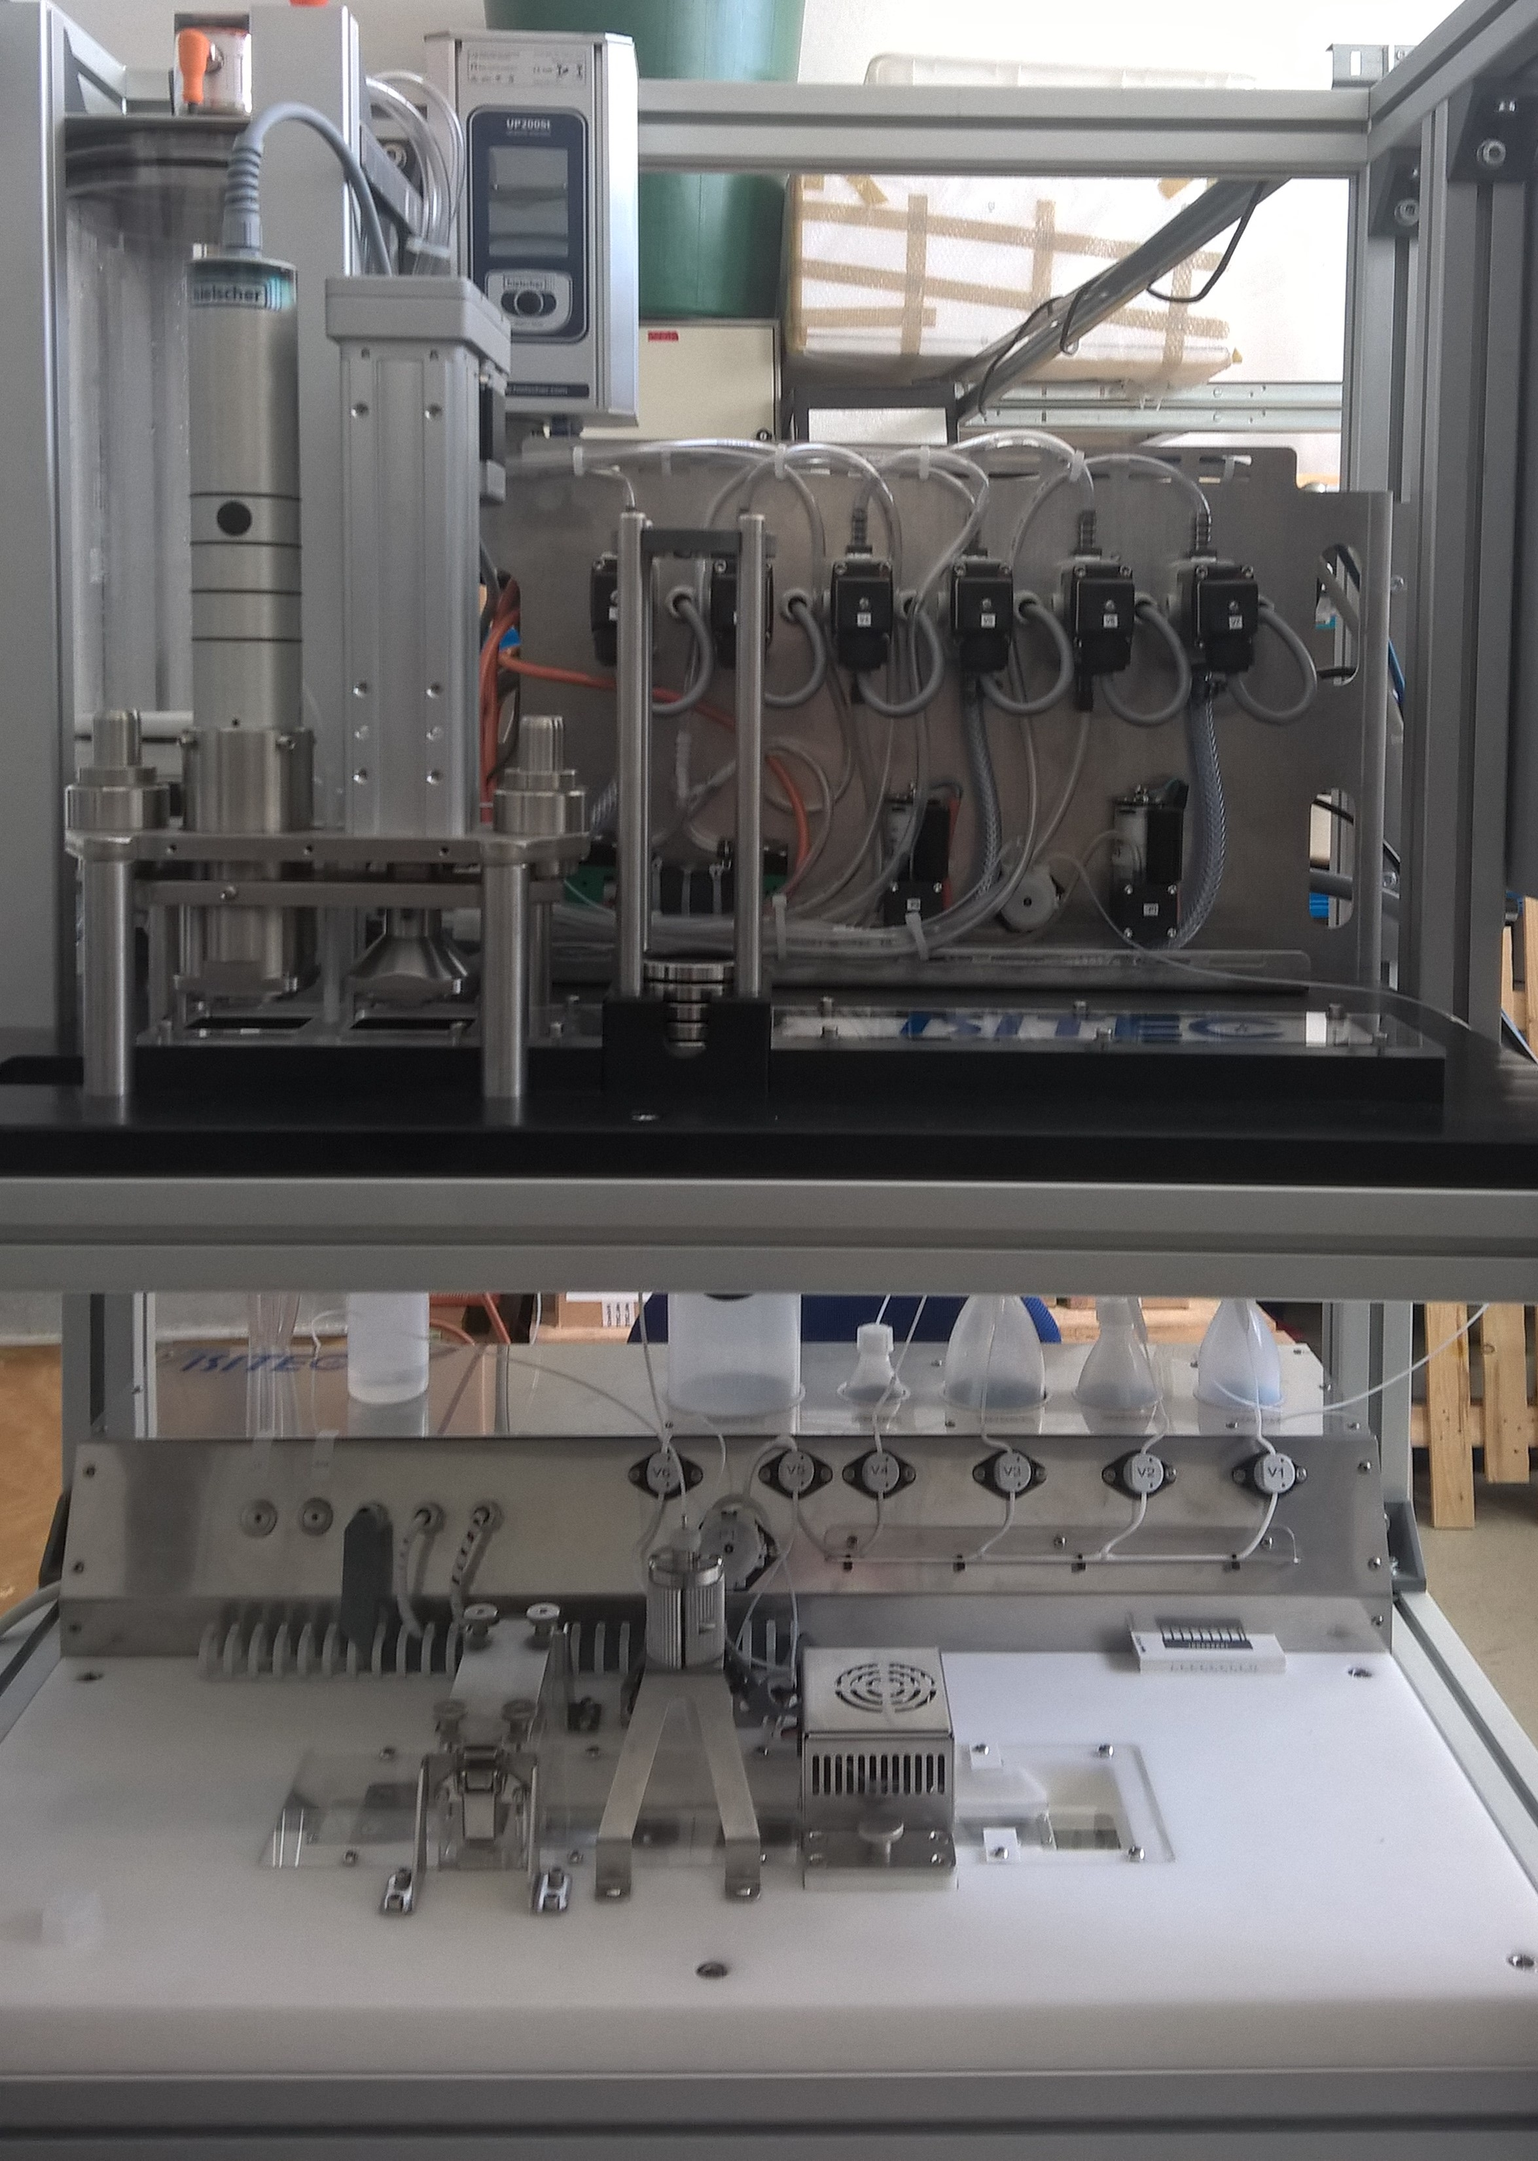
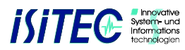

EnviGuard – Algae Detection Unit (ADU)
Automation by
Filtration and Sample preparation
Filtration system
Biosensor system
Detection/
Quantification
Source: Alfred-Wegener-Institute

Slide 18
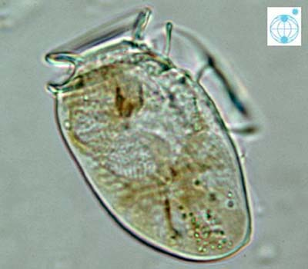
EnviGuard – Algae Detection Unit (ADU)
Calibration of the biosensor ready for:
  Alexandrium minutum
  Alexandrium tamarense/fundyense
  Protoceratium reticulatum
  Dinophysis acuminata/acuta
  Pseudonitzschia sp.
1st prototype of the fully automated ADU is available
  Field trials started 04/2017, will run until 10/2017 (Helgoland)
  Target species
    Protoceratium reticulatum
    Dinophysis sp.
    Pseudonitzschia sp.
Sampling to test the sensitivity of the ADU on field samples
Source: Alfred-Wegener-Institute

Slide 19

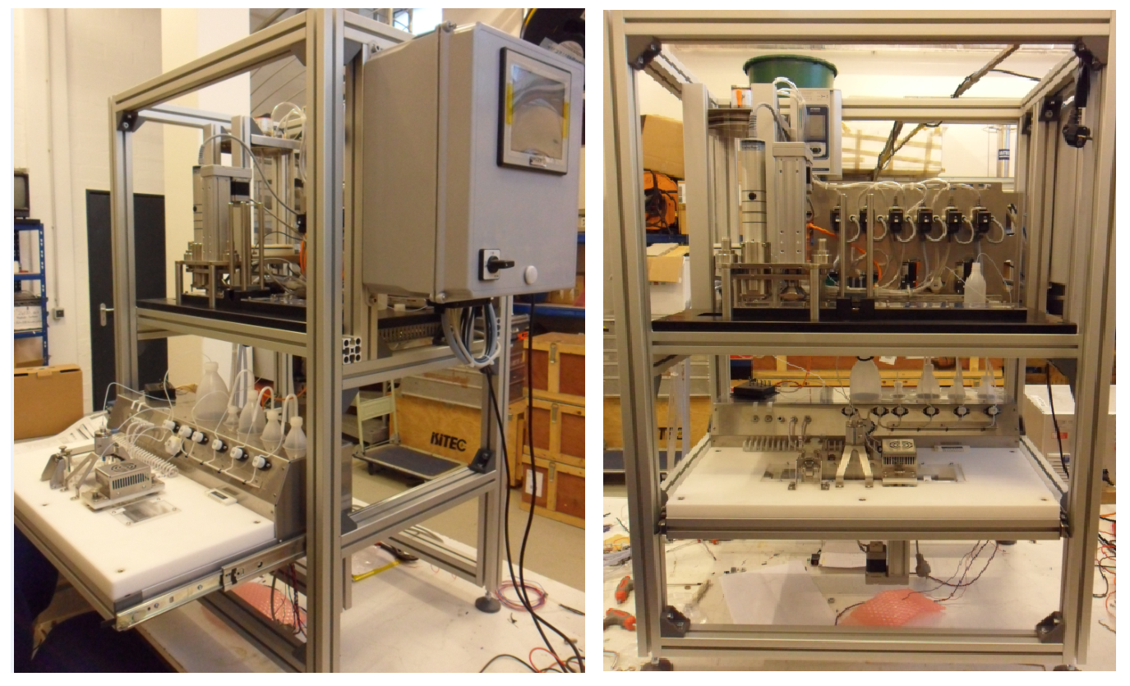
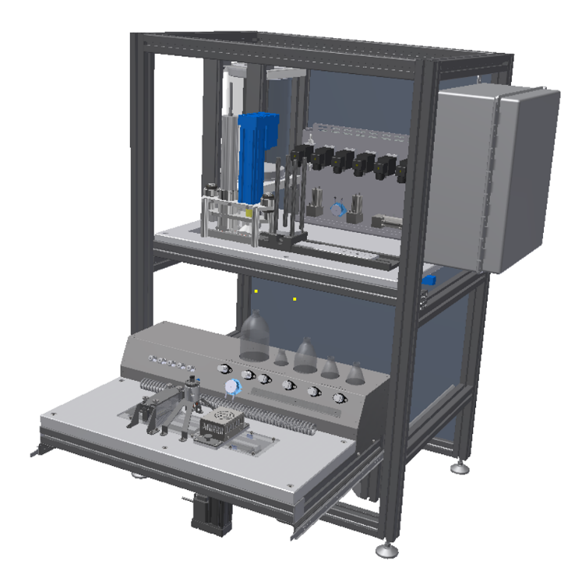
EnviGuard – Algae Detection Unit (ADU)
AutoFIM + Algae Sensor

Slide 20

EnviGuard – Chemical Detection Unit (CDU)
An optical nano-biosensing unit making use of antibodies for the detection of chemicals & toxins
PCBs
Okadaic Acid
Saxitoxin (2018)
Notes:
PCB 126 and PCB 169

Slide 21
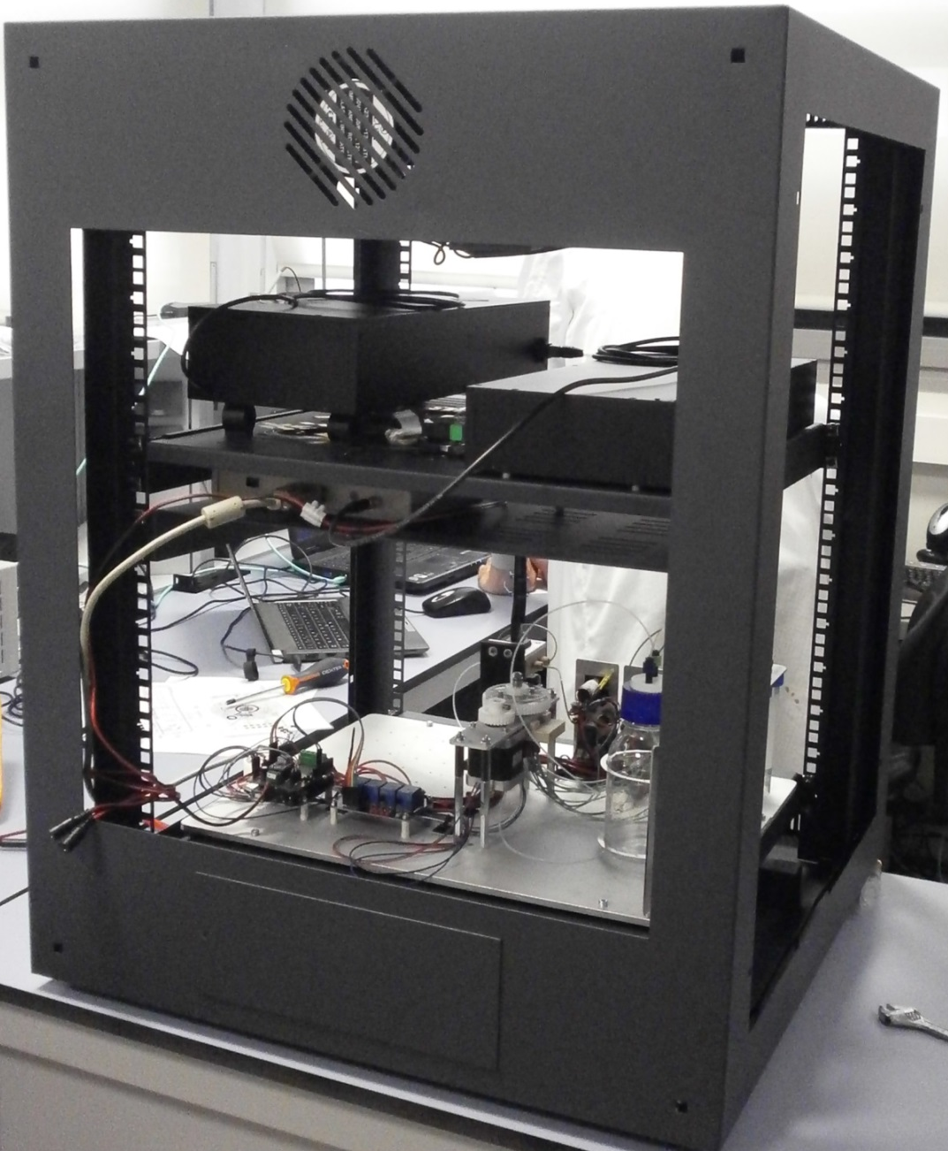
EnviGuard – Chemical Detection Unit (CDU)
1st Prototype
Level 2: OIU (Optical Interrogation Unit)
Level 1: PHOSDI (Photonic Sensor and Device Interface)
Level 0: CFU (Chip and Fluidic Unit) + fluidic drivers

Slide 22
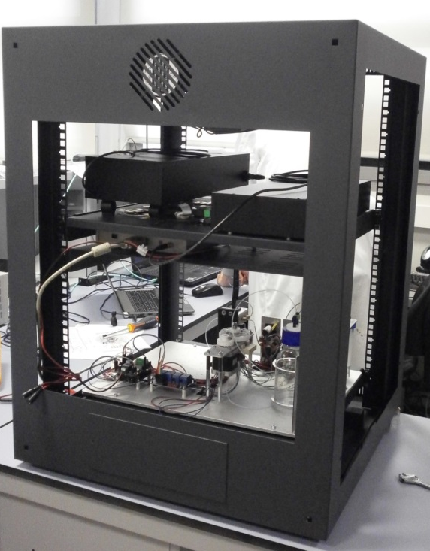
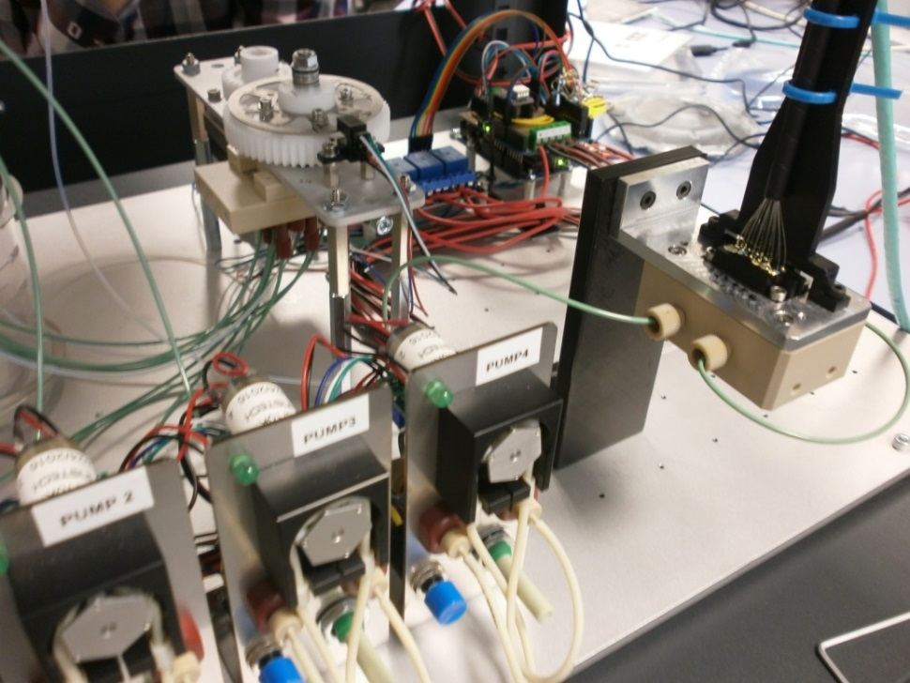
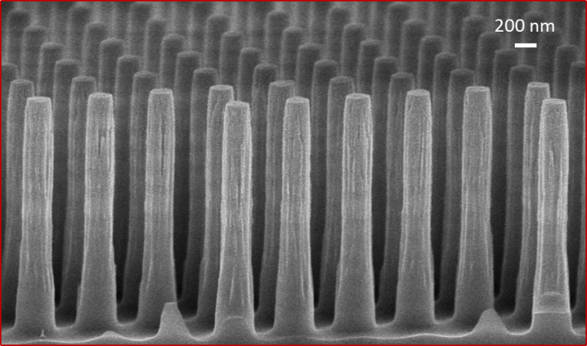
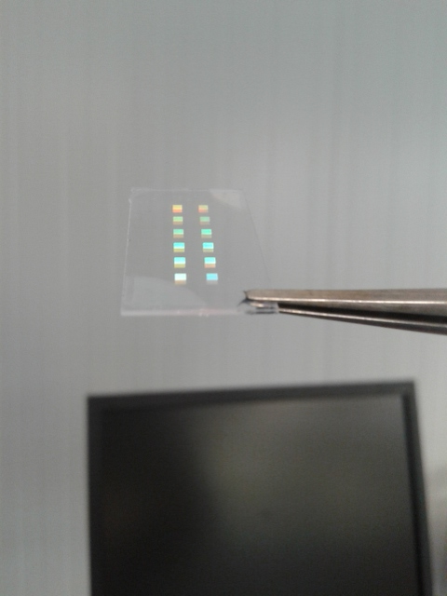
EnviGuard – Chemical Detection Unit (CDU)
Autonomous fluidic system
Rotary valve
Chip-holder
4 peristaltic pumps
Resonant NanoPillars
Bicells chip
Reusable
Notes:
Fluidic system

Slide 23
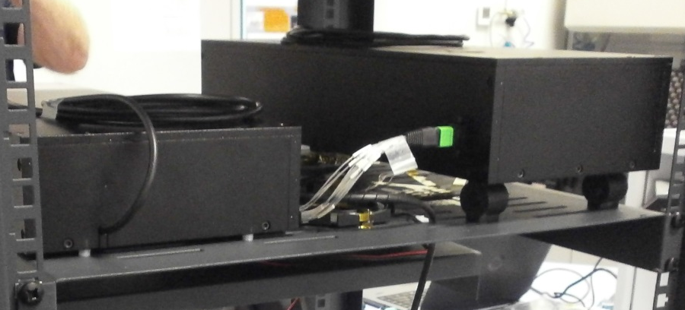
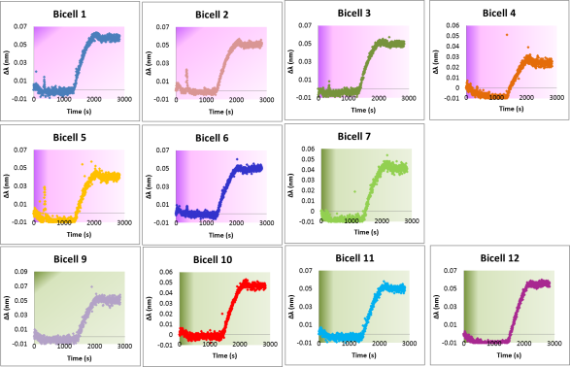
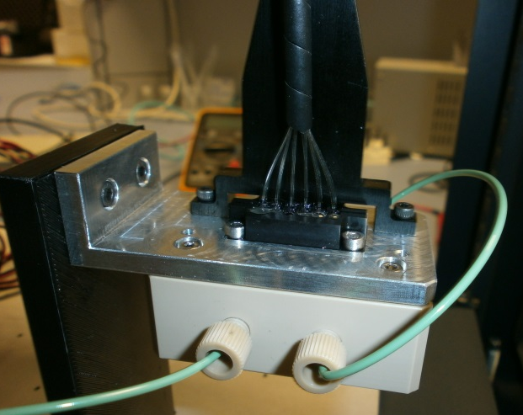
EnviGuard – Chemical Detection Unit (CDU)
Light source
Optical fibers
Spectrometer
Optical fibers
Optical system allows measuring 12 Bicells simultaneously → multianalyte detection in same sample
Notes:
Optical system
optical system able to measure 12 bicells simultaneously, allowing the multianalyte detection in the same sample. The 12 bicells are needed for taking 3 replicates of each analyte plus 3 replicates of blank (unspecific signal).

Slide 24
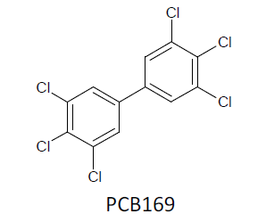
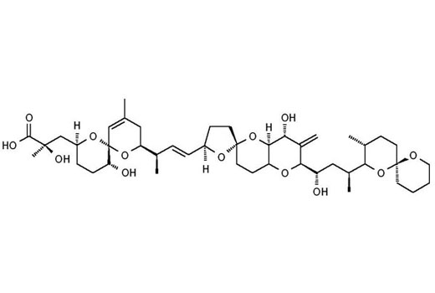
EnviGuard – Chemical Detection Unit (CDU)
Small analytes: competitive format
Resonant nanopillars: optical sensor
Detection causes optical changes proportional to analyte concentration
Δλ₁
Antibodies
Reflectivity
Reflectivity
Competitors
Wavelenght (λ)
Wavelenght (λ)
Analyte
PCB 169
IC50 105 µg/L
Dynamic range ∼ 30-300 µg/L
LOD 22 µg/L
OKADAIC ACID
IC50 90 µg/L
Dynamic range ∼ 40-250 µg/L
LOD 25 µg/L
IC50
IC50
Notes:
Detection
The chemical detection unit is an optical sensor based on resonant nanopillars as transducer and monoclonal antibodies as bioreceptors. Due to the low molecular weight of target analytes, a competitive format is applied, where a conjugate is immobilized on surface of resonant nanopillars. Antibody´s binding to conjugate causes a shift on wavelength of resonant nanopillars reflectivity spectra (this is the base of the measurement, label free and real time). Sample and antibody are mixed before being pumped to the sensor chip with Bicells. When the analyte is present, it binds to antibody in solution and so, inhibits the binding of antibody to surface. This leads to lower signal shift à the more analyte present, the lower signal obtained.

Slide 25
EnviGuard – Chemical Detection Unit (CDU)
1st prototype of the fully automated CDU is available
Successful measurement protocols for PCBs & okadaic acid detection implemented
LoD of 22 µg/L for PCBs and 25 µg/L for OA in water samples.
System allows measuring 1 sample per hour.
currently under development
  Simultaneous multianalyte detection
  evaluation of the matrix effect with blank algae culture
Notes:
Two CDU prototypes have been built, which are mainly composed by an autonomous fluidic system to manage the different fluids needed for measurement protocols (including the mixing of sample+antibody), and an optical system able to measure 12 bicells simultaneously, allowing the multianalyte detection in the same sample. The 12 bicells are needed for taking 3 replicates of each analyte plus 3 replicates of blank (unspecific signal).
Successful measurement protocols for the detection of PCBs and okadaic acid are already implemented to the CDU prototype, showing a LoD of 22 µg/L for PCBs and 25 µg/L for OA in water samples. System allows measuring 1 sample per hour.
Simultaneous multianalyte detection is currently under development, as well as the evaluation of the matrix effect with blank algae culture.
With this on-going work, it is expected to have real sample measurements after next summer.

Slide 26
EnviGuard – Key Results
&
Filtration & pre-treatment unit (AutoFIM) → TRL 9
Sensor for detection of harmful algae → TRL 6-7
Customizable high-resolution spectrometer → TRL 8
Antibodies/conjugates PCBs & Okadaic Acid → TRL 6
Hybrid nanoparticle fabrication method → TRL 7
Fabrication process of resonant nanopillars & their biofunctionalization → TRL 4
Automated microfluidic system for implementation of bio-chemical protocol → TRL 4
Sensor for detection PCBs & Okadaic Acid → TRL 4
Notes:
We added some comments at each line but please, have in mind that most of the parts you mentioned are not our part of work and, in addition, we have only tested them at laboratory scale (also at prototype scale, but not in a industrially relevant environment yet). We did our best...
• Customizable high-resolution spectrometer à TRL 8. It could be since it is a product that Multitel is already planning to sell, but it is a question for Fabian.
• Antibodies/conjugates PCBs & Okadaic Acid à TRL 9. We don´t think these specific bomolecules have TRL 9. Biotem is used to selling antibodies those for PCBs and OA have not been demonstrated in operational environment yet. In addition, Cemitec has produced OA conjugates and it has only been at lab scale. In summary, Biotem should say the TRL of their bioreagents but, from our point of view we wouldn´t say it is higher than 4-5.
• Hybrid nanoparticle fabrication method à TRL 7. Do you mean the nanoparticles used in WP2 by Aaron to help Katja or the nanoparticles taht will be used for amplifying the WP4 sensor signal? If you mean WP2 nanoparticles, they would have a TRL 4, but we ouldn´t include them here because they are not being currently used in WP2 measurement protocols. And if you mean WP4 nanoparticles, we didn´t develope the protocol yet so, we wouldn´t include them either.
• Fabrication process of resonant nanopillars. We have separated the RNP fabrication and their biofunctionalization. RNP have not been validated in relevant environment yet. We would say TRL 4 and, perhaps, after their use with real samples, they can go up to TRL 5 or 6...
• RNP biofunctionalization and OA and PCBs measurement protocols à We would say the same than for the fabrication.
• Automated microfluidic system for implementation of bio-chemical protocol à TRL 5. Again, it is a question for Theo. For sure, it has a TRL 4 because we have validated it, but we don´t know if it has been validated/demonstrated in other environments.
• Sensor for detection PCBs & Okadaic Acid à TRL 4-5. For sure TRL 4, and perhaps 5-6 after their use with real samples...

Slide 27
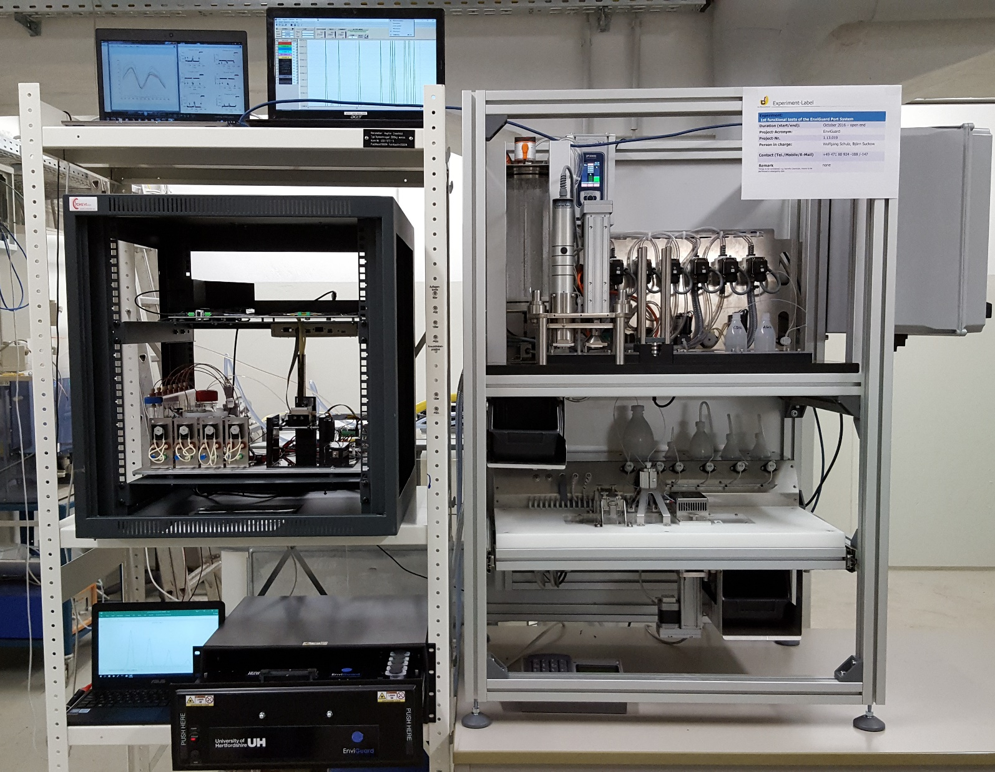
EnviGuard Port

Slide 28
To Summarise…
highly specific, precise and reliable, in situ, measurements of biohazards and chemical contaminants in seawater
multi-class, multi-analyte method for the simultaneous determination of harmful microalgae species, Betanodavirus, E. coli, okadaic acid, and saxitoxin, PCB 128 and PCB 118
their quantitative and qualitative analysis through combination of nanotechnologies with bio-receptors
automatic sampling for a period of at least one week in the marine environment

Slide 29
real-time results → early warning system for aquaculture industry, harbour authorities and monitoring of ballasting/de-ballasting operations at sea and in port areas.
easy access to data from everywhere through internet database allowing environmental status /risk assessment online
durable design for offshore use under multi-stressor conditions

Slide 30
a modular system (of up to three sensors) integrated in a single, portable device
easily maintainable, user friendly device
compatible with existing integrated ship and shore based monitoring units
more cost-efficient than current monitoring practices

Slide 31
ENVIGUARD: a real-time multi-sensor in a small package with a big future
Since the new sensor system comprises a complete new technology which defines its own standards which are missing for many pathogens and toxins in aquaculture nowadays, it should be of great interest for commercialization.
The technology could be of great interest and benefit to the aquaculture industry and beyond to harbor authorities and for monitoring of ballast water transfer- not only at a European but also at a global level.

Slide 32
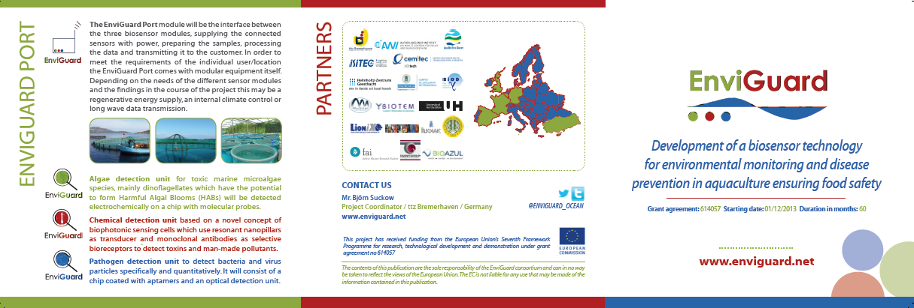
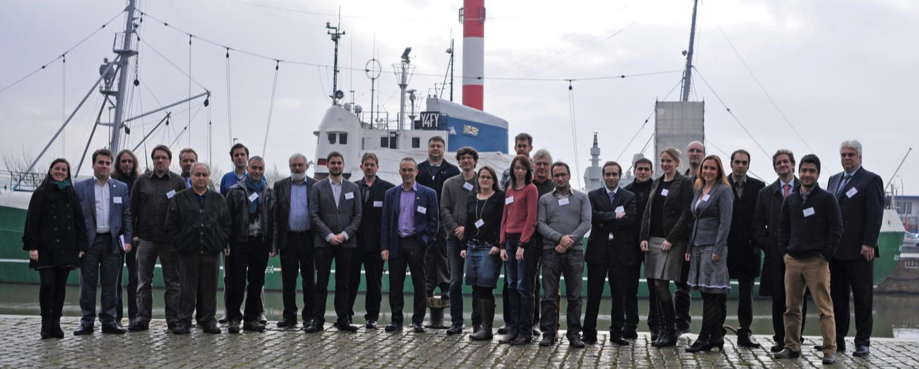
www.EnviGuard.net

Slide 33




RESEARCH FOR MORE QUALITY OF LIFE
Thank you for your attention!
Contact
Björn Suckow
Team Leader
Am Lunedeich 12
27572 Bremerhaven
Germany
fon: +49 (0)471 80 934 200
fax: +49 (0)471 80 934 199
bsuckow@ttz-bremerhaven.de
aquaculture@ttz-bremerhaven.de
www.ttz-bremerhaven.de
This project has received funding from the European Union’s Seventh Framework Programme for research, technological development and demonstration under grant agreement no 614057

