Slide 1
Traffic Density Maps Methodology
Edmunds Belinskis / Project officer Department C: Operations/Unit C.2.1
7 September 2017

Slide 2
Background
HLSG 2 meeting (Brussels 20 June 2017) agreed “on mandating EMSA to start preparing for providing traffic density maps, based on AIS data, to interested parties upon request, as a new service and then report back to the next HLSG”.
EMSA produced in the past TDM on the basis of ad hoc requests.
EMSA contacted several Member State Authorities, EU Institutions and research bodies with prior experience in developing TDM.
Before developing a TDM service, it is necessary to define and agree the methodology of the TDM service, which needs to be shared and fully understood by the users.

Slide 3
Methodology
The HLSG mandated EMSA to start preparing for providing TDM based on AIS data (T-AIS and S-AIS).
There is no international standard definition or method to create TDM.
The most of methodologies are based on grid-based approaches.
Limitations.

Slide 4
EMSA research
The research of EMSA identified the following three grid-based methods:
ship voyage calculation method: how many times the trips (voyages) cross each cell of the grid during the time period;
ship position calculation method: how many positions are reported from ships in each cell of the grid during the time period;
ship route calculation method: rebuilds the ship track from the recorded positions (i.e. how many routes are recorded from the distinct ship in each cell of the grid during the time period).

Slide 5
Selected method
The method proposed by EMSA to generate the TDM is the ship route calculation based method:
can be implemented in all regions (coastal and open sea) utilizing all the available SPD;
allows connecting the dedicated ship’s positions and restoring the ship’s route within areas with a low coverage;
the applied “gaps filling” is based on the ship route assumption:
is sufficient for the purposes of the TDM;
cannot be used for other e.g. monitoring purposes outside the fully covered areas (e.g. fishing vessels activities monitoring).
The creation of the TDM in EU coastal areas will use T-AIS as the main source while outside the coastal areas only S-AIS will be used.

Slide 6
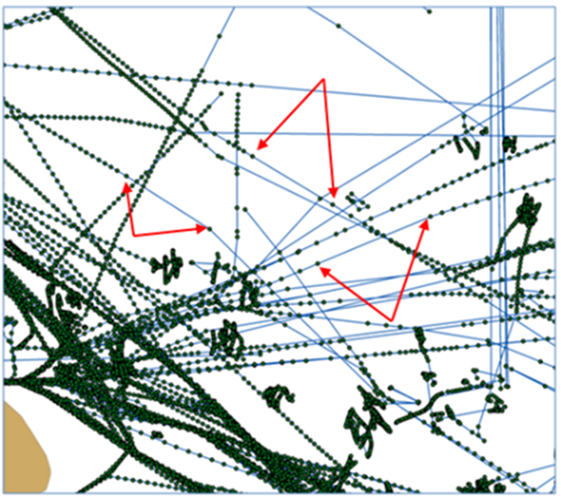
Restoring the ship routes

Slide 7
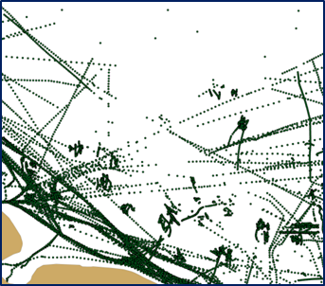
TDM construction: steps
Aggregate the positions
The SPD are collected and aggregated per period of time (configurable), target area, and prepare them to recreate the vessel paths as lines.
The output of this process should be a list of points.
The data with high frequency acquisition as the T- AIS are down sampled.

Slide 8
TDM construction: steps
Filter the positions
The SPD are cleaned for the improbable positions (e.g. position too far from the other data of the target vessel) or position indicating that there was an error (e.g. longitude and latitude equal to 0) are removed.
An additional methodologies might be applied to highlight the number of positions to be treated:
E.g. filtering out the SPD and keeping only one position by dedicated MMSI within the grid cell;
E.g. selecting of one position per hour.
The above methods may decrease the accuracy of the presentation of the ship routes.

Slide 9
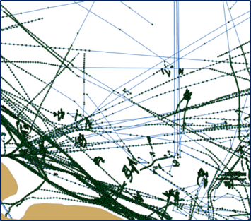
TDM construction: steps
Create lines connecting the dedicated positions
The records with the same MMSI are converted to lines using the acquisition time stamp to order the points.
The output of this process is a file containing the route lines (e.g. as a shape-file), per MMSI, for a period of time.

Slide 10
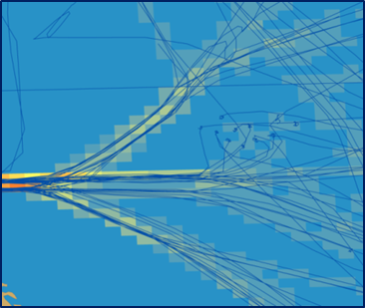
TDM construction: steps
Divide the lines per ship type
The file is divided into different ship types.
The result is a set of files per ship type which includes the lines (for a period of time).
Construct a map
The density map is created counting the number of lines crossing each cell and visualizing the number of crossings by a color code.

Slide 11
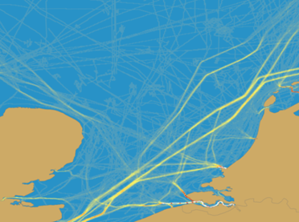
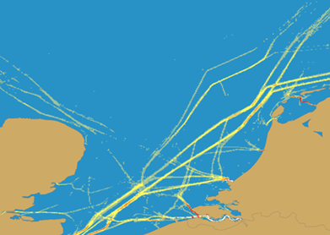
TDM construction: steps
A color classification can be applied to visualize the most clear pathways.
A density level filtering could be applied to present the areas with the highest density traffic.

Slide 12
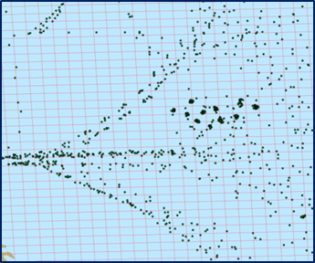
TDM construction: process
Select cells
The area is divided into a number of cells (1*1 km large squares).
Select positions
The aggregated SPD (position reports) of the distinct ship are selected.

Slide 13
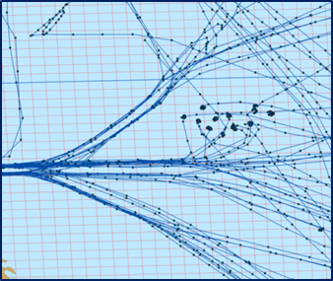
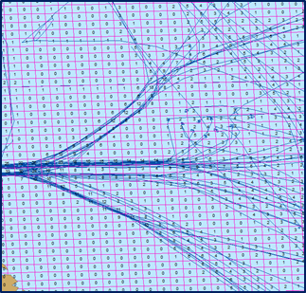
TDM construction: process
Select lines (1)
The selected positions will be connected by lines.
Count and sum (2)
The system will count the number of lines (crossings) inside each of the cells using a spatial join.

Slide 14
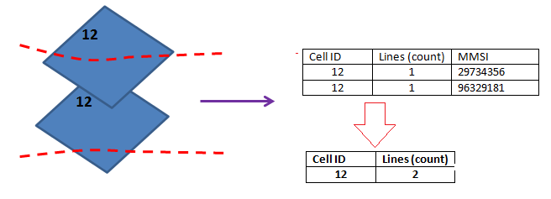
TDM construction: process
All the crossings in each cell will be summed.
Depending of the final map to be produced, the maps can be combined.
Correlation
The result of summing needs to be rasterized as a shapefile or/and transformed in a GIS grid to make it lighter.
The files will be produced per each area, vessel type and the period (predefined).

Slide 15
TDM construction: areas
Baltic Sea area
North Sea/North Atlantic area
Atlantic area
Mediterranean Sea area
Black Sea area

Slide 16
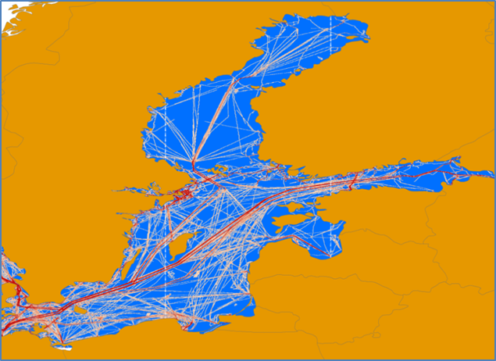
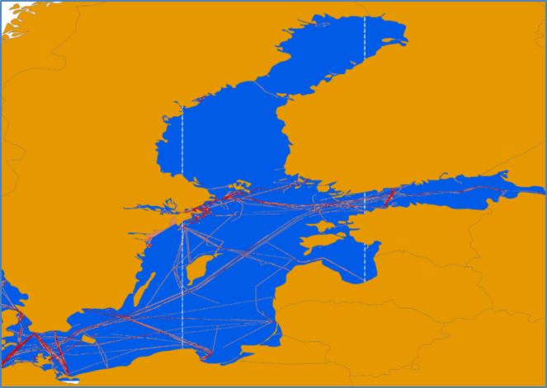
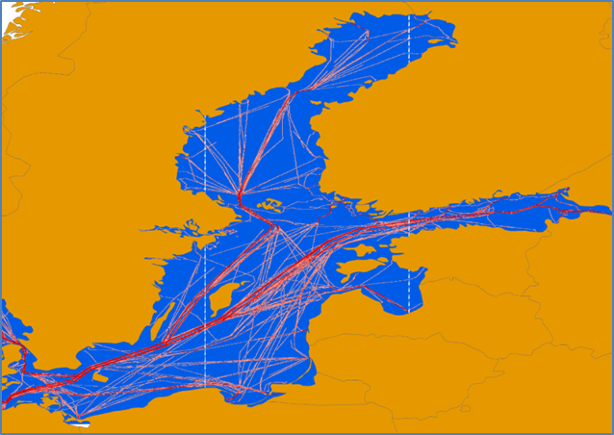
Samples
Baltic Sea area (1 day data, 15th August 2017))
Overall traffic
TDM per ship type “Cargo”
TDM per ship type “Passenger”

Slide 17
Further steps
To use the existing maritime infrastructure and application environment ( e.g. SEG) to develop the TDM web service.
A phased in approach:
The parameters on which the initial service is provided will be fixed:
per predefined period (e.g. per month);
per areas;
per 4 basic ship types (Cargo, Tanker, Passenger and Fishing).
Once more experience will be gained (e.g. from the user requirements and EMSA allocated resources) the TDM service may evolve to provide more sophisticated services:
configurable areas, periods and types of ships;
distribution of maps via a “geoserver”;
production of vectorized maps etc.

Slide 18
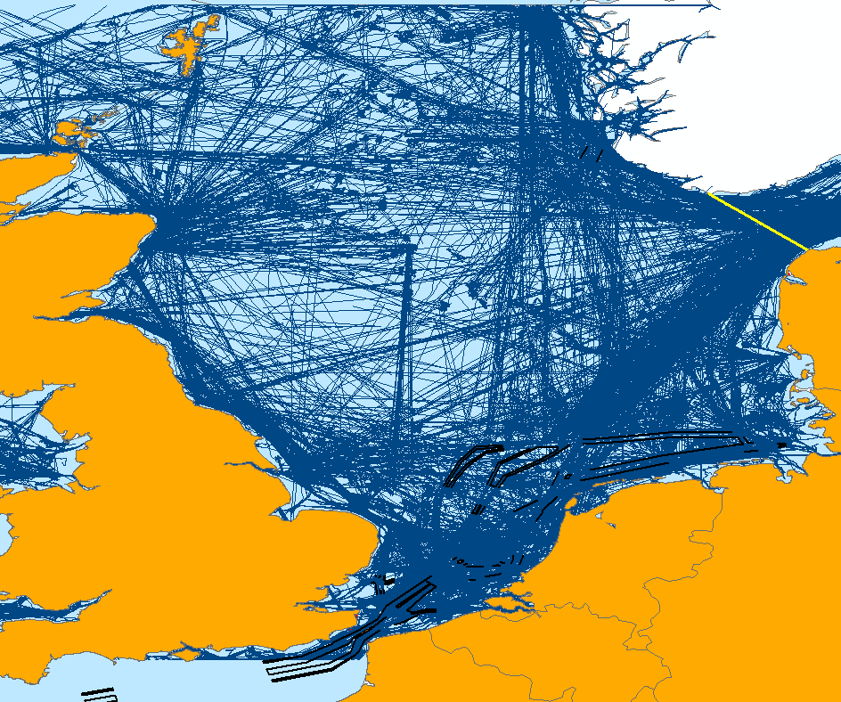
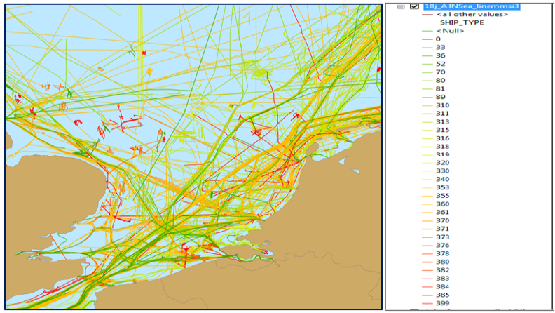
Possible services (examples)

Slide 19
emsa.europa.eu

