Slide 1
BLUE SKILLS EXPERT GROUP MEETING
Fórum Oceano Presentation
Rui Azevedo
Brussels, 16th January 2018

Slide 2
ABOUT US
Portuguese Maritime Cluster
Recognized by the Portuguese Government as a Competitiveness Cluster (2009 and 2017)
To develop a set of cooperation initiatives involving companies and respective associations, public institutions and other relevant support entities namely Universities, R&D centres, training and educational institutions aiming to promote innovation, enhance entrepreneurship and support internationalization in one or various sectors of activity and to promote ocean literacy

Slide 3
ABOUT US
STRATEGIC AXIS
Entrepreneurship and business development;
Innovation and modernisation;
Internationalisation;
Improvement of qualifications and skills;
Promotion of oceans literacy and maritime culture;
Strategic information and monitoring.

Slide 4
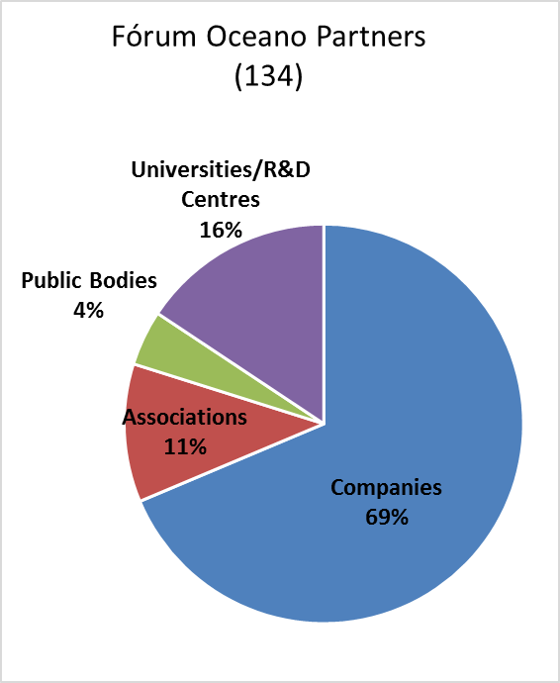
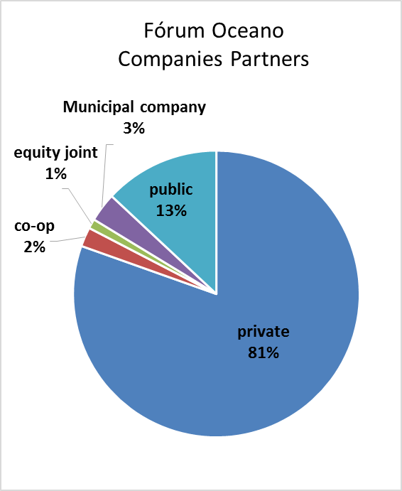
ABOUT US

Slide 5
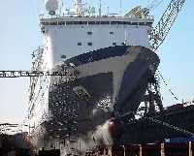
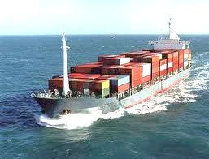
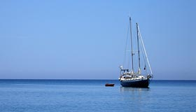
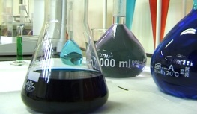
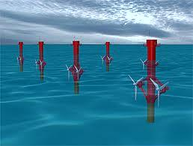
ABOUT US
Shipbuilding, ship repair and maintenance
Maritime transport and Port infrastructures
Nautical tourism and Recreational sailing
Fishing and Aquaculture
Fish processing and Canning industry
Marine technology; New products and materials
Marine renewable energy; Oil and gas
Notes:
Os Associados da OCEANO XXI cobrem as seguintes fileiras da Economia do Mar: (Ver slides)

Slide 6
INTERNATIONAL NETWORKS
ENMC – European Network of Maritime Clusters
A confederation of Maritime Clusters, whose objectives are, among others, the sharing of best practices and to promote and reinforce the European maritime sector and the maritime economy as a whole
ECCP – European Cluster Collaboration Platform
An Online platform, developed by DG Enterprise & Industry, which integrates clusters and other European organizations, allowing the fostering of networking and international cooperation
BTCA – BlueTech Cluster Alliance
A informal network of 9 BlueTech clusters in 7 countries - Canada, France, Ireland, Portugal, Spain, UK and U.S. - to foster innovation and economic development in the Blue Economy

Slide 7
ROLE IN THE PROJECT
Fórum Oceano main role in the MATES project will be the following:
- Mobilization of Portuguese stakeholders to participate in the project (contribution to the state of the art; validation of the skill needs; validation of the priorities lines of action and long term action plan);
- Organization of workshops and seminars to debate and validate, with Portuguese stakeholders, the main results of the project (preliminary strategy; lines of action, pilot experiences, long term action plan,)
- Dissemination of the results of the project near relevant public targets

Slide 8
PARTICIPATION AND INDUSTRY MOBILIZATION
Lessons from our experience:
PARTICIPATION AND INDUSTRY MOBILIZATION IS CRUTIAL FOR THE SUCCESS OF THE PROJECTS (all over the cycle of the project)
Stakeholders need to appropriate themselves the objectives and guide lines of the project to play an active role in its development

Slide 9
WHY IS STAKEHOLDERS PARTCIPATION AND INDUSTRY MOBILIZATION IMPORTANT
Lessons from our experience:
- To identify the real needs of end users;
- To share experiences and perspectives between stakeholders and to learn with each other;
- To ensure the relevance of the objectives and of the Action Plan;
- To play an important role on the monitoring of the project;
- To implement the results of the project.

Slide 10
HOW TO IMPROVE PARTICIPATION OF STAKEHOLDERS
Lessons from our experience:
- Dissemination of information about the project;
- Open and participatory methods
- Workshops with the participation of stakeholders to do the diagnosis of the situation, to set the base line and to formulate the strategy of the project
- Interviews with relevant players;
- Surveys
- Seminars to present and debate the interim results of the project
- Participation in the monitoring process

Slide 11
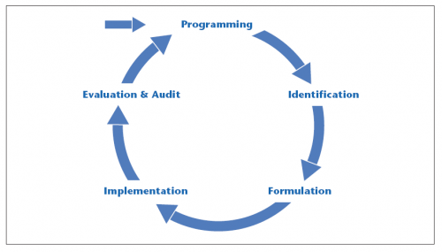
WHEN IS THE PARTICIPATION OF STAKEHOLDERS RELEVANT
Lessons from our experience:
All over the phases of the project cycle, from the diagnosis, strategy formulation until the implementation and evaluation of the project

Slide 12
PARTICIPATION OF STAKEHOLDERS AND INDUSTRY MOBILIZATION IN MATES
All over the cycle of the project
WP1 – Mobilization of stakeholders
- Identification of stakeholders – Directory (Who is who?)
- Mobilization workshops by country – To present the project, to identify good practices; to share experiences; to have the commitment of stakeholders;

Slide 13
PARTICIPATION OF STAKEHOLDERS AND INDUSTRY MOBILIZATION IN MATES
All over the cycle of the project
WP2 – Strategy baseline: skill needs (digital skills; green skills)
- Interviews with relevant players;
- Surveys
- Local and thematic workshops
WP 3 – Priorities and lines of action
- Electronical vote
- Web seminars

Slide 14
PARTICIPATION OF STAKEHOLDERS AND INDUSTRY MOBILIZATION IN MATES
All over the cycle of the project
WP4 – Pilot Experiences (enlarge the participation to other target public – professionals; trade unions; teachers; business associations, …)
- Follow up of pilot experiences
- Validation of conclusions
WP 5 – Long Term Action Plan
- Validation
- Commitment to implement actions

Slide 15
PARTICIPATION OF STAKEHOLDERS AND INDUSTRY MOBILIZATION IN MATES
All over the cycle of the project
WP 6, 7 and 8 ( Dissemination; Management; Evaluation)
Dissemination of information all over the project is fundamental to allow the participation of stakeholders;
Participation in the monitoring process is a criteria of the quality of the project .

Slide 16
THANK YOU
geral@forumoceano.pt
www.forumoceano.pt

