Slide 1

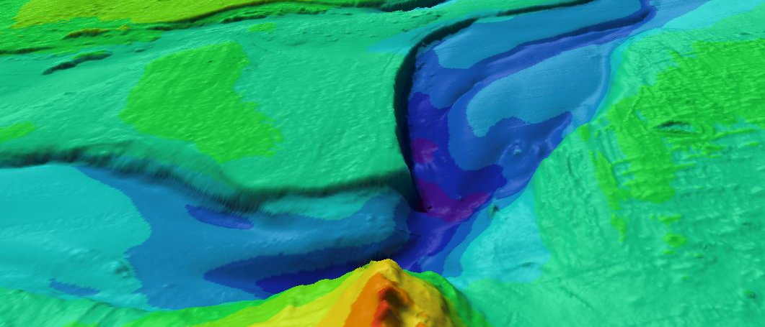

SJÖFARTSVERKET
Baltic Sea Hydrographic Commission, Bathymetric Database and
the MONALISA project
- with co-financing from EU TEN-T
Presentation vid dialogmöte ” Kommunikationer för tillväxt”
Centerpartiet Östergötland, 25 oktober 2011
Magnus Sundström
Magnus Wallhagen
Swedish Maritime Administration
Brussels, 10 October 2012

Slide 2
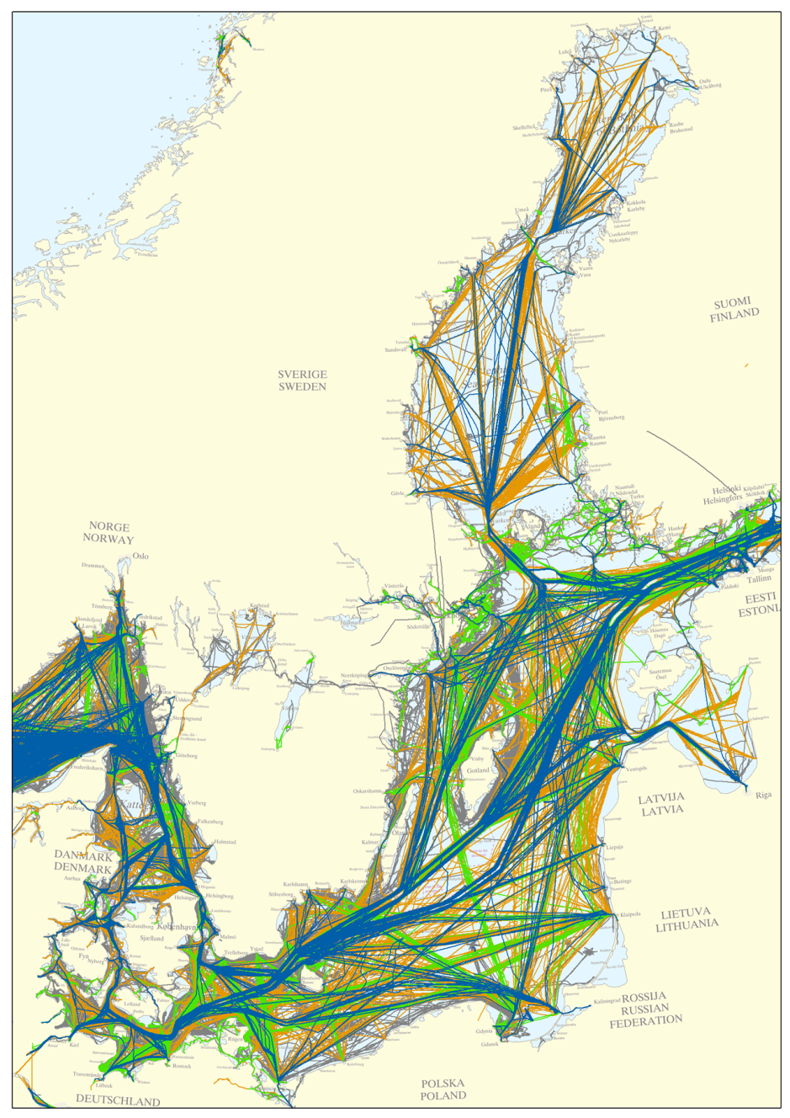
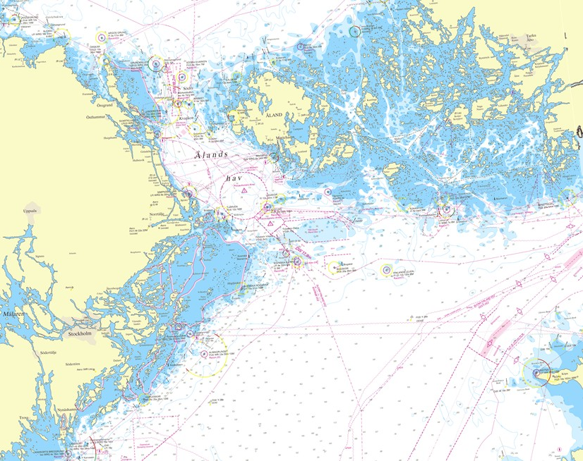
The Baltic Sea - characteristics
100 000 passages per year by commercial shipping plus extensive internal traffic.
9 Coastal States – Denmark, Germany, Poland, Lithuania, Latvia, Estonia, Russia, Finland and Sweden
Unique
archipelagos

Slide 3
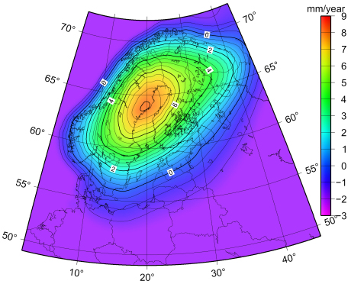
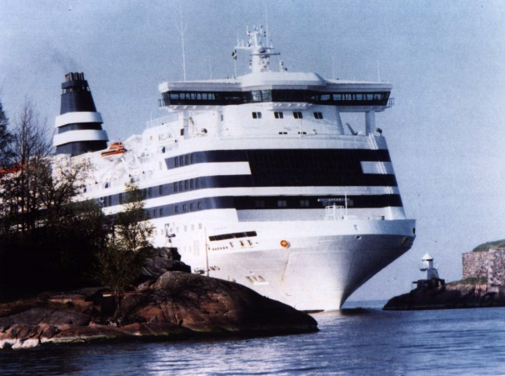
The Baltic Sea - characteristics
Depth range
0 – 460m
Land uplift
No tide
Brackish water
Environmental problems

Slide 4
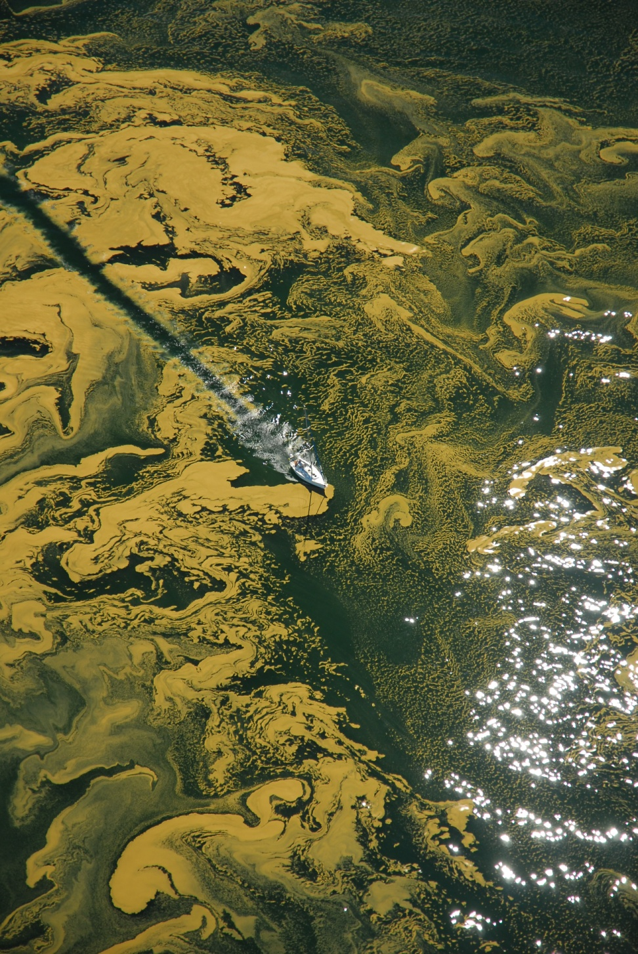

Algal bloom in the Baltic Sea
The Helsinki Commission, or HELCOM, works to protect the marine environment of the Baltic Sea from all sources of pollution through intergovernmental co-operation.

Slide 5
The Baltic Sea Hydrographic Commission
BSHC
9 IHO Member States – Denmark, Estonia, Germany, Finland, Latvia , Lithuania (associated member), Poland, Russia and Sweden
Represented by respective Hydrographic Office

Slide 6
The BSHC
Main Activities and Achievements
Co-ordination of Hydrographic Surveys – BSHC/HELCOM Re-survey scheme
Harmonisation of Vertical Reference Levels
Scheme for International Nautical Charts
Harmonisation of Electronic Charts in
the Baltic Sea
Marine Spatial Data Infrastructure - MSDI

Slide 7
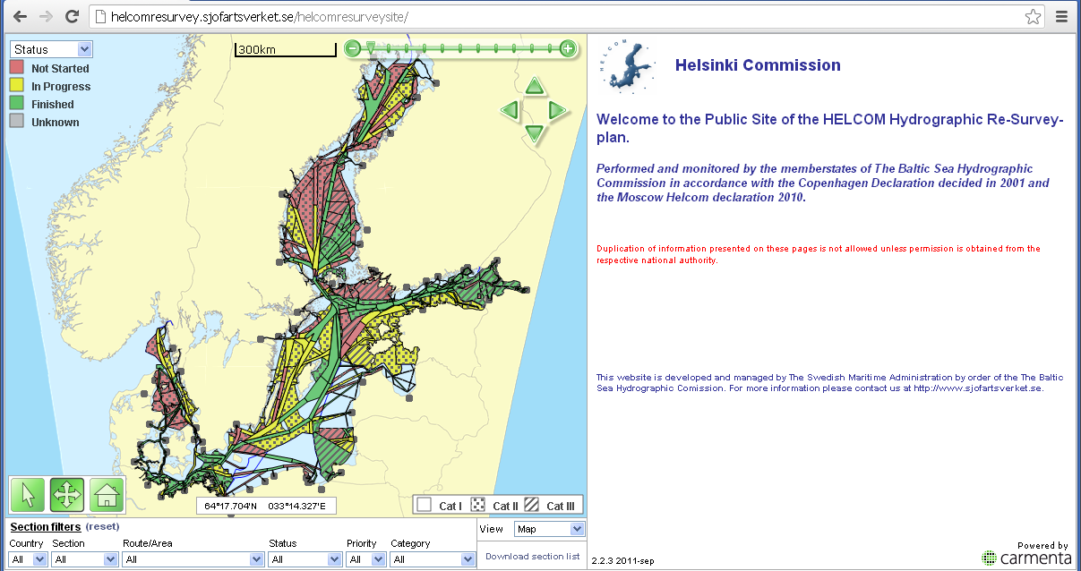
BHSC/HELCOM Harmonized Baltic Sea
Re-survey Scheme
Bathymetric surveys are more or less performed within the Baltic Sea, but most of the area is covered with old poor quality surveys. Large areas are only covered with old lead line surveys.
http://helcomresurvey.sjofartsverket.se/helcomresurveysite/

Slide 8
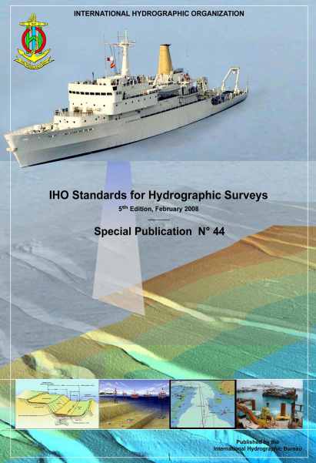
BHSC/HELCOM Harmonized Baltic Sea
Re-survey Scheme
The re-survey plan, co-ordinated by BSHC, focus on covering the Baltic Sea with modern full coverage bathymetric surveys according to the IHO standard S-44.
First phase is to focus on major shipping routes
(in the plan defined as category I and II)
Re-surveying of HELCOM routes is included in the priority area 13 of the EU Baltic Sea Strategy

Slide 9
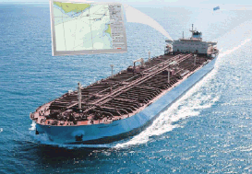

The EU Baltic Sea Strategy
Flagship project 13.3. “Speed up re-surveying of major shipping routes and ports”, as agreed in HELCOM
Lead: HELCOM in cooperation with IHO
http://www.balticsea-region-strategy.eu/

Slide 10

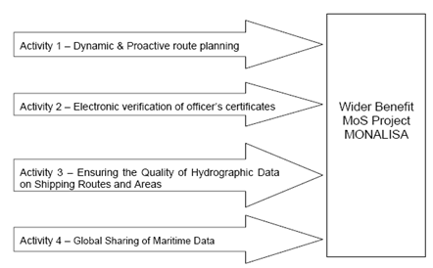
TEN-T and Motorways of the Sea
The Motorways of the Sea (MoS) can be seen as the maritime dimension of the TEN-T
http://www.sjofartsverket.se/en/MonaLisa/EU-project-for-the-Baltic-Sea/

Slide 11
BSHC
Baltic Sea Bathymetry Database WG
Gather high density bathymetric data, as provided by national Hydrographic Offices, for the entire Baltic Sea.
Identify and study differences of existing regulations concerning depth data in the Member states.
Specify bathymetric datasets including application schema to be able to render a homogenous bathymetric model for the entire Baltic Sea.
Develop concepts concerning storage, maintenance, exchange and distribution of the bathymetric data aiming to a “virtual” database and distribution by metadata, view and download services in line with the applying EU initiatives for Geoinformation (e.g. Inspire).

Slide 12
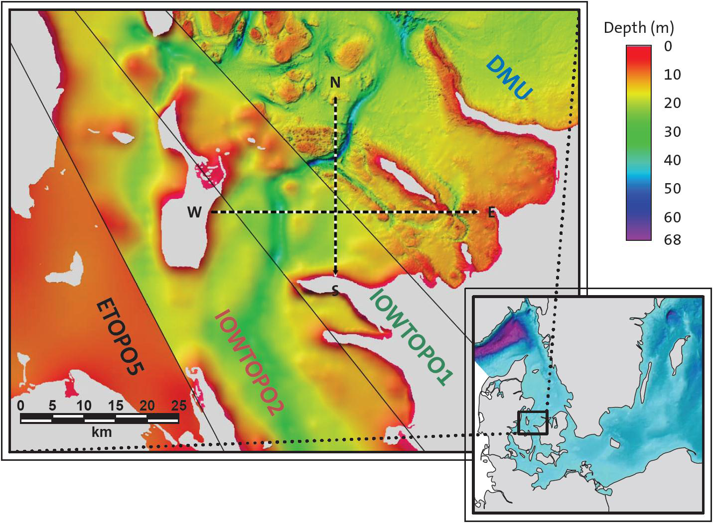
Existing Datasets in the Baltic Sea compared to a high resolution grid

Slide 13
BSHC
Baltic Sea Bathymetry Database WG
BSHC Bathymetrical portal will be localized at SMA in Norrköping, Sweden. A gridding method developed by Stockholm University (used also by GEBCO and IBCAO) will be used.
Data will be provided from each Hydrographic Office and stored by SMA and used for computation of a homogenous Baltic bathymetry model. This will not only support the traditional range of navigational charts but addresses many other stakeholders and needs in the fields of transportation, environmental protection and production at sea (energy, fish farms, exploration).
A homogenous bathymetrical model, initially with 500m resolution for public use. Forms the ideal source to satisfy EU-requests for maritime geoinformation, i.e. for reuse in different portals like Emodnet.

Slide 14
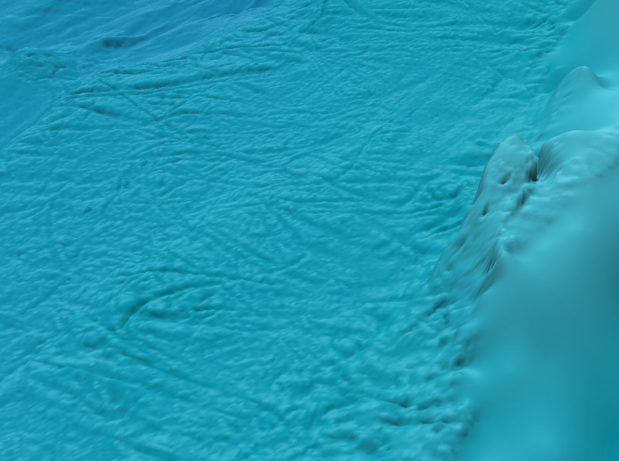
BSHC
Baltic Sea Bathymetry Database
Thank you for your attention

