Slide 1

Bringing Seaweed Products to Feed Markets: A regulatory assessment
Maya Miltell, SUBMARINER

Slide 2
Together we improve the Baltic Sea’s blue environment and economy
The cooperation platform for actors and initiatives across the Baltic Sea Region and beyond who promote innovative approaches to the sustainable use of marine resources

Slide 3


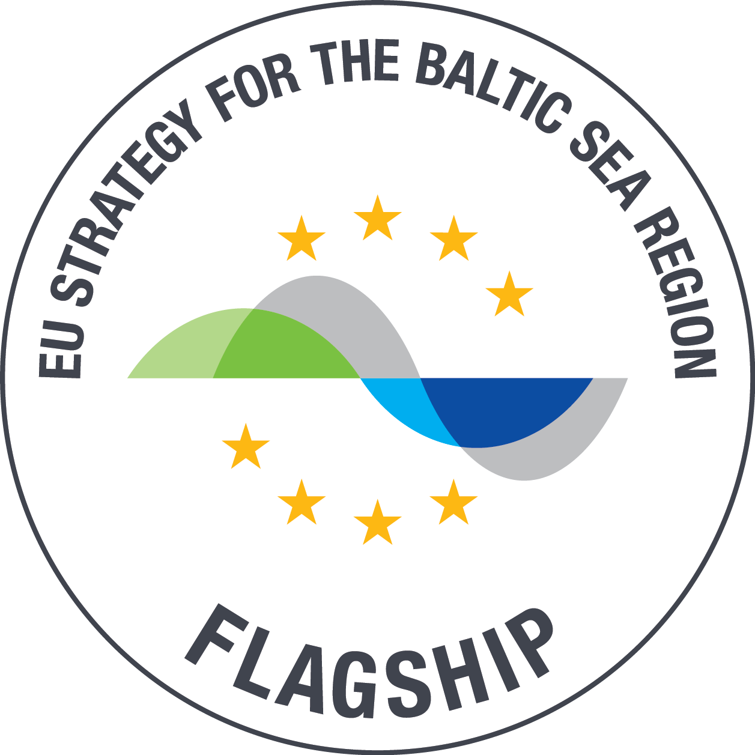





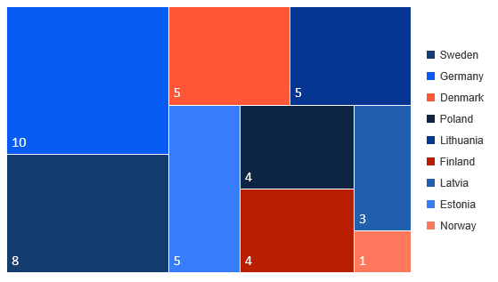
SUBMARINER Network members & collaboration partners
80+
Start-ups/
SMEs
50+
Associate
Members
200+
Institutional Partners
9
Full
Members
60+
Mentors/
Coaches
1500+
Individual
Experts

Slide 4
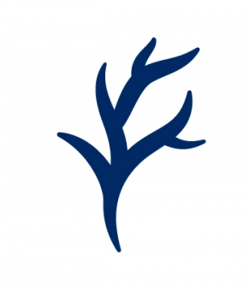
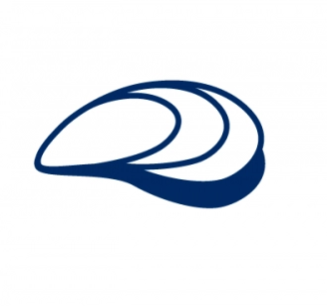
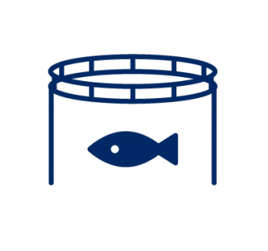




Topics & Vision
Algae Cultivation and Processing
Mussels Cultivation and Processing
Sustainable Fishery & Aquaculture
Use of Waste /
Side Streams
MSP/MPA
Ocean
Multi-use
Marine Litter
Vision 2030
Contribute to decrease of GHG emissions
Ecosystem Restoration
Increase Biodiversity
A smart, resilient
Baltic Sea Region-
local, circular economy
Improve human
well-being
Promote
bio-based innovations

Slide 5
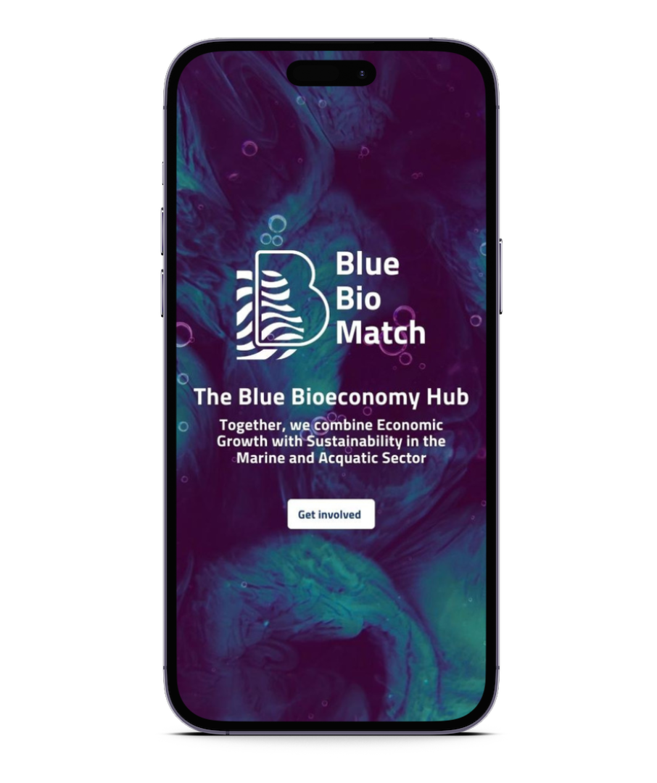

Join BlueBioMatch
Sign up online at bluebiomatch.eu

Slide 6
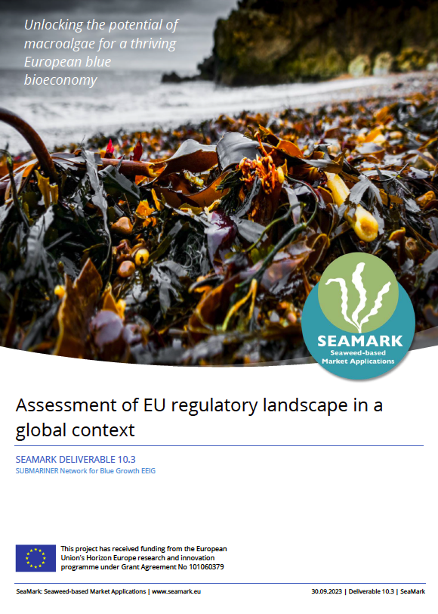
DEMONSTRATE HOW TO SCALE UP INNOVATIVE SEAWEED CULTIVATION AND PROCESSING INTO PRICE-COMPETITIVE PRODUCT APPLICATIONS MAKING THE ENTIRE SUPPLY CHAIN ATTRACTIVE FOR COMMERCIAL INVESTMENTS

Slide 7
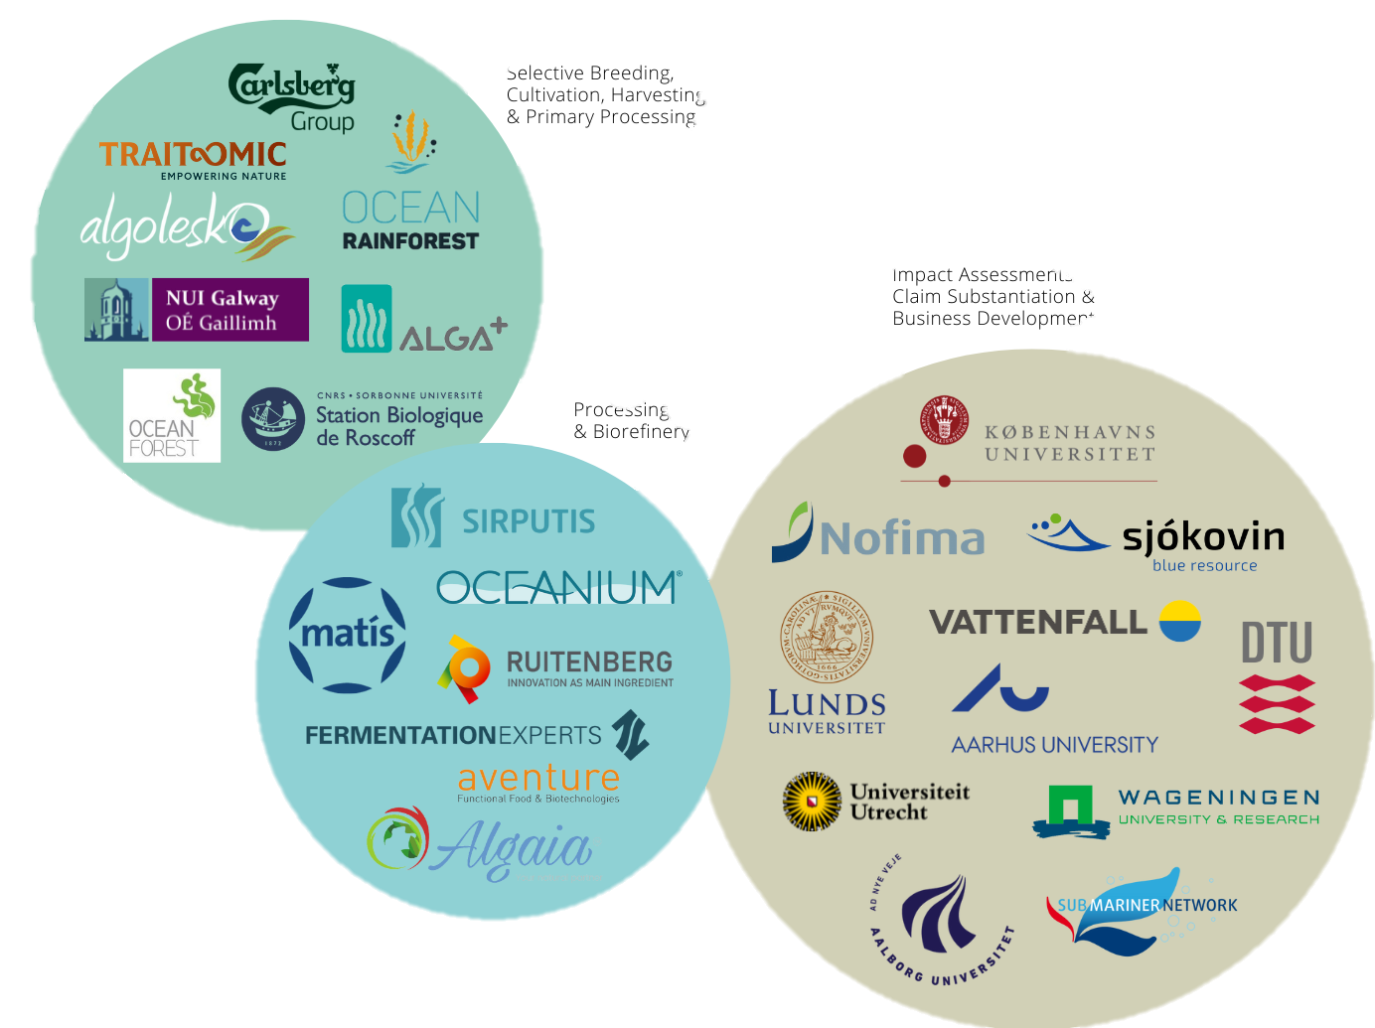
Budget
Duration
Consortium
Solution
10 Million EUR
48 Months
25 Partners
12 Products
12 Countries
9 SMEs
3 Large enterprises
HORIZON Project: 101060379 — SEAMARK
Notes:
Finishing summer 2026

Slide 8
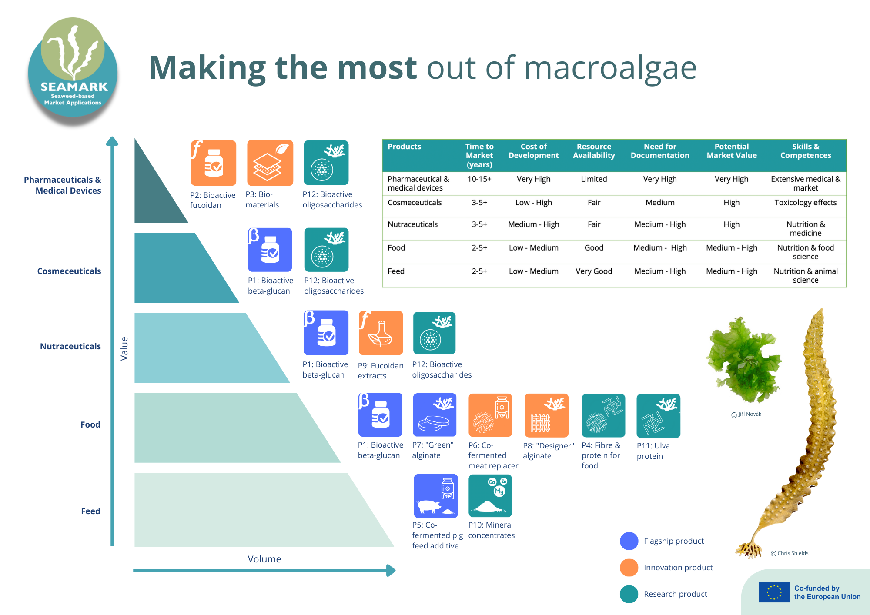
Notes:
Unlike other aquacultures, such as finfish farming, seaweed cultivation often lacks specific and targeted regulations, operating instead under more generalized and loosely formulated laws. This lack of clear and tailored legislation extends to other parts of the seaweed value chain, significantly impeding the growth of the algae sector in Europe.
Manufacturers of ingredients, final products, and primary producers involved in harvesting and cultivation of algae are all impacted by the existing rules, making the industry's growth and development challenging.
The SeaMark project aims to produce 12 marketable products covering market segments in protein feed, human food ingredients, food with health-promoting effects, pharmaceuticals, and biomaterials.
A regulatory assessment was performed on the project’s three flagship products as case studies:
bioactive beta-glucans,
pre- and probiotic pig feed supplements, and
eco-friendly alginates
to shed light on the existing legislative gaps and hurdles hindering the market exploitation and upscaling of seaweed products in the EU.

Slide 9
Notes:
Recent research findings have underscored the favourable impact of seaweed in mitigating enteric methane emissions from cattle, as elucidated by multiple studies. Also, fermentation adds pre- and probiotic qualities to feed, increasing health of feedstock (without antibiotics/zinc)
Today the present cost and production scale of seaweed-derived protein for feed applications do not yet rival alternative protein sources such as soy. Although seaweed exhibits promise, it currently lags behind due to its higher production cost
Further, supplementing parts or the of feed with locally sourced produce mitigated emissions connected to transportation and less sustainable production methods.

Slide 10
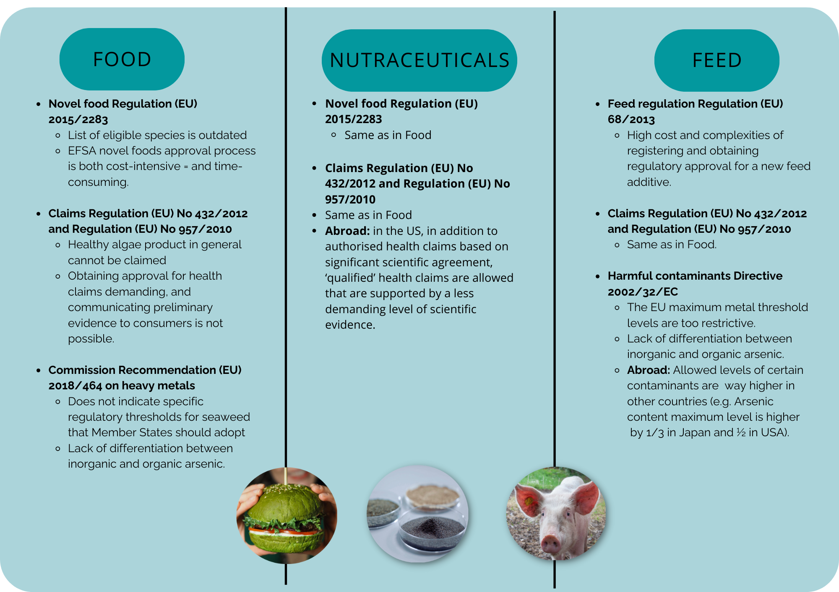
Regulation1831/2003 on additives for use in animal nutrition
Notes:
In the regulatory assessment we have mainly looked at the products, and cultivated seaweed, not wild harvest. This needs to follow common fisheries policy.
For the cultivations, there are of course a whole bunch of other directives like MSP directive, Water Framework Directive, Marine Strategy Framework directive, ailien species regulation, habitats directive etc.
Not mentioned in Annex I to the Treaty on the European Union (TEU) and to the Treaty on the Functioning of the European Union (TFEU), but they are mentioned under “Oterh products” in the market organisation (Regulation (EU) No 1308/2013 )… not covered in CAP
>>> feed:
Generally feed has to follow the food requirements, but also 68/2023 and also 18. Many algae products are approved, but it is more 2022/32/EC that is difficult.
The cost and complexities of registering and obtaining regulatory approval for a new feed additive
Transnational Regulatory Harmonisation: The lack of harmonisation in feed regulations across EU member states can create barriers to market entry. Feed ingredients authorised in one country may not be automatically accepted in others, leading to a fragmented market.

Slide 11
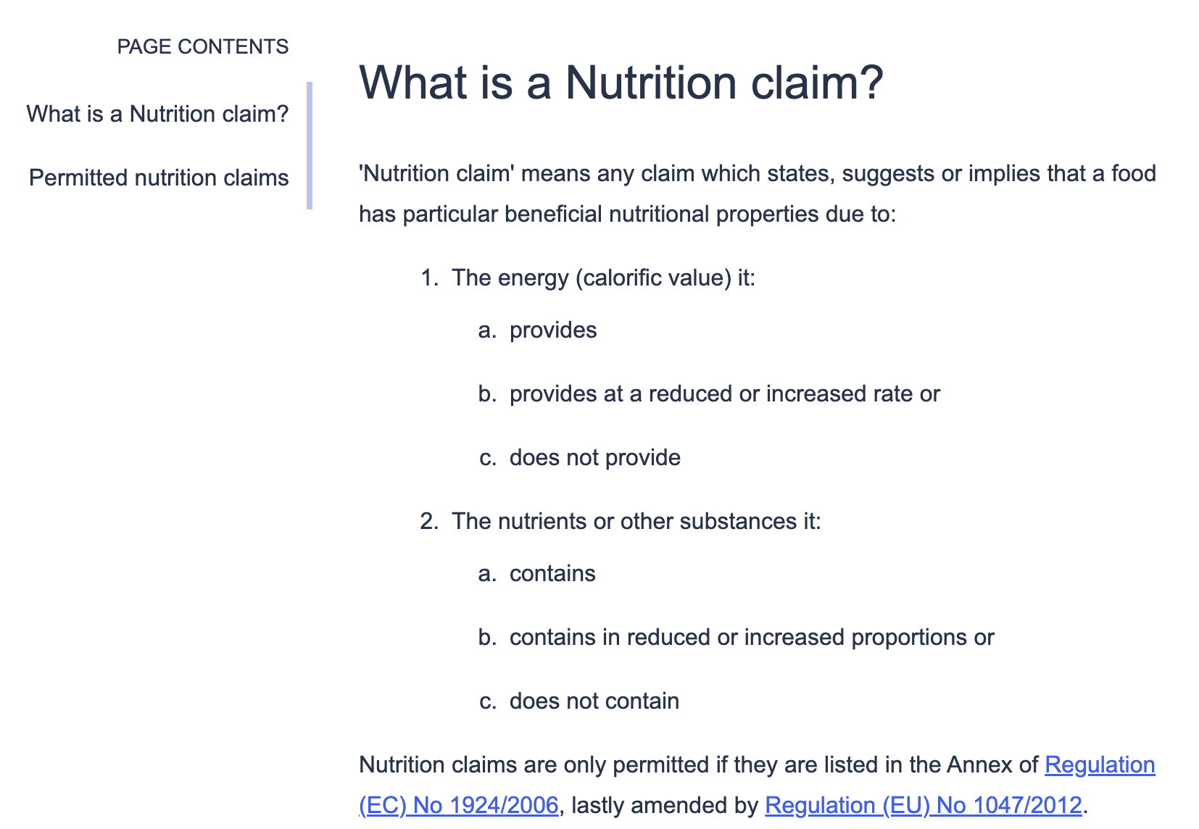
Claims
Only permitted nutrition claims can be used.
Despite health benefits of co-fermentation and algae products in general, products can´t be marketed as such
Market exploitation limitation
Notes:
specific claims related to health benefits, organic certification and sustainability must be supported by scientific evidence and comply with EU regulations on nutrition and health claims.
Claims Regulation:
>>> Healthy algae product in general cannot be claimed (only at ingredients level)
>>> All nutrition and health claims made in commercial communications, including among
other things generic advertising of food and promotional campaigns, must be supported by an authorisation from the EU.
Nutritional claims, such as mineral or dietary fibre contribution may be available to a number of SeaMark
products as will iodine health claims relating to thyroid function.
>> In the US, for example, in addition to authorised health claims based on significant scientific agreement, ‘qualified’ health claims are allowed that are supported by a less demanding level of scientific evidence.
Obtaining approval for health claims within the EU is a demanding process that places a substantial burden on business owners in terms of time and resources.
>>>> To date, two health claims have been applied for macroalgae based on Lithothamiion coralloids and seaweed fibres, which were both not authorised by the EFSA due to insufficient substantiation of claims. Hence, a simpler marketing approach for macroalgae health foods and health-boosting dietary supplements involves focusing solely on nutritional claims.
Green claims regulation to come, help or limitation?!
Market exploitation limitation

Slide 12
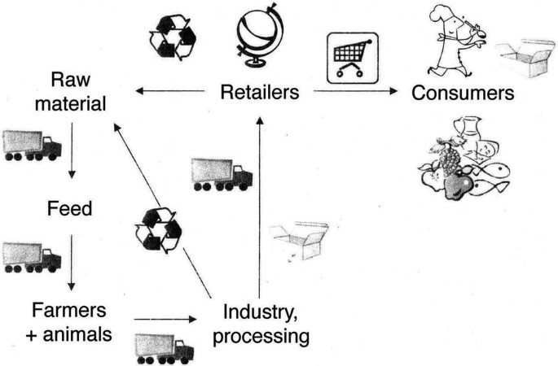
Harmful contaminants
If requested, the feed operator is obligated to demonstrate that
  the inorganic arsenic content is less than 2 mg/kg,
  lead, cadmium, and mercury, the maximum allowable levels in feed materials in general are 10 mg/kg, 1 mg/kg, and 0.1 mg/kg.
Notes:
per Directive 2002/32/EC
EU regulatory requirements for the use of macroalgae in feed have been fully described in the Interreg GRASS project and products.
There is no differentiation between organic and inorganic arsenic in food regulation, THIS IS UNDER REVIEW!

Slide 13
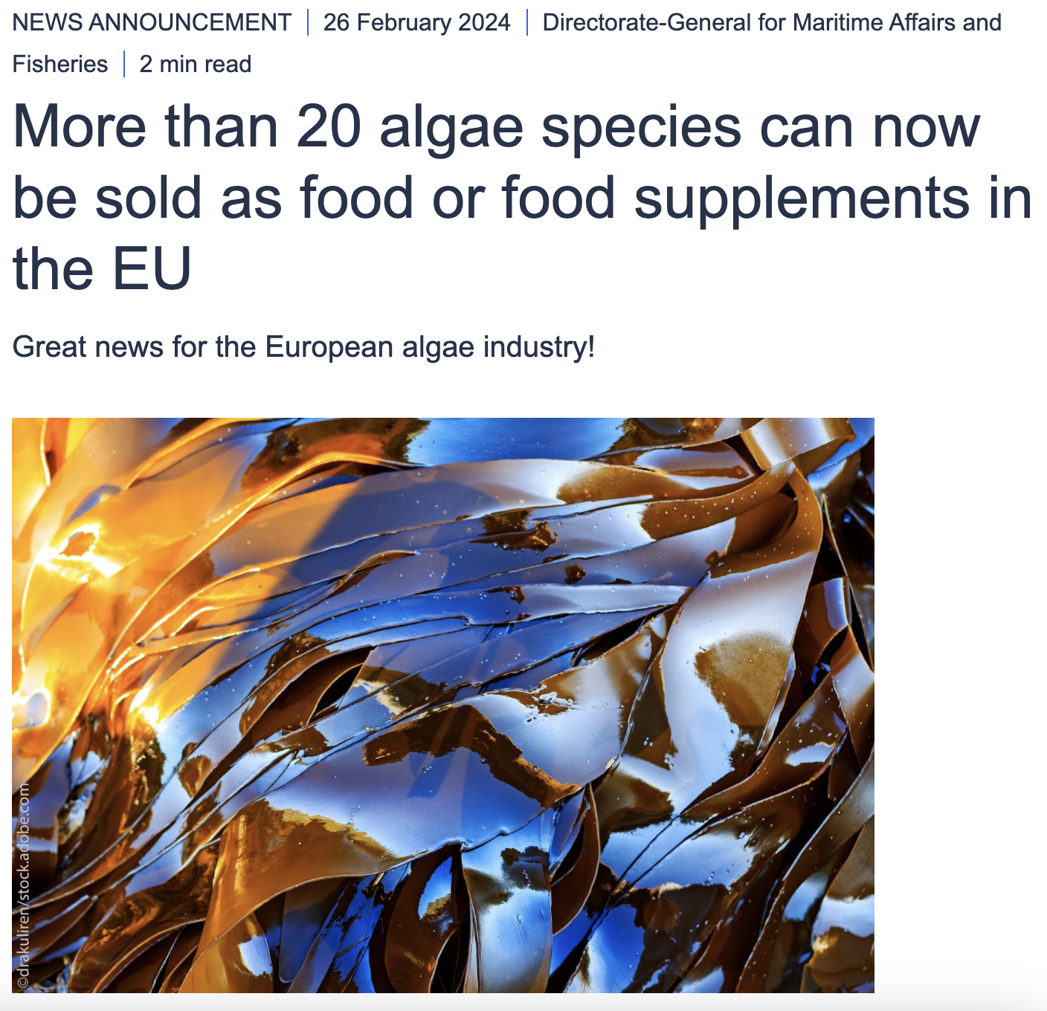
Novel food
Also affects feed market
Rapeseed cake is not approved
Feed solely from seaweed not possible due to harmful contaminants and volumes
Notes:
Novel foods
EFSA novel foods approval process is both cost-intensive (approximately €2-3 million) and time-consuming (usually spanning 2 years). For feed the 68/2013 regulation also has to be considered.
In SeaMark the feed developed is co-fermented with rapeseed cake. This has not obtained novel food approval.

Slide 14
Recommendations
Harmonise Inter-departmental and Transnational Regulations
Enhancing the capacity of EFSA and a dedicated specialized task force
Include the most common seaweed species in the list of approved additives & ingredients (Novel Food)
EU-level standards for seaweed & products, through a straightforward & robust EU certification scheme
Broader EU-wide LCA framework for all seaweeds, or individual seaweed species
Set specific standards for the maximum level of contaminants with clear differentiation between inorganic and organic levels
Notes:
1 Encouraging harmonisation of regulations across EU member states ensures a level playing field for the algae industry.
>>> Policymakers at both national and EU levels
should engage in policy dialogues, exchange knowledge, and develop evidence-based recommendations for
regulatory reforms.
>>>> Collaborative efforts among industry stakeholders, research institutions, and policymakers will
foster the sharing of best practices and joint development of recommendations for regulatory improvements.
2) The current EFSA novel foods approval process is not only time-consuming but also imposes a substantial financial burden, averaging around €2-3 million, with an approximate two-year duration for completion. To streamline this process and expedite the introduction of innovative food products to
the market, it is imperative to
>>> initiate a thorough review of the novel foods approval system.
>>> Enhancing the capacity of EFSA to efficiently conduct the necessary tests and approvals is a crucial step, which could involve allocating dedicated resources such as a specialized task force.
3) there is a growing need to include the most common seaweed species in the list of approved additives, particularly in functional food and feed sectors, including the rapidly expanding vegan and
alternative protein markets.
during the EU4Algae WG4 meeting held in April 2023, where it was evident that risk assessments in the feed industry were facing a considerable gap. These measures include:
4 the development of EU-level standards through a
straightforward yet robust EU certification scheme,
exemplified by the "safe-and-sustainable-by-design" (SSbD)
framework created by the European Commission for
evaluating the safety and sustainability of chemicals and
materials.
5 Furthermore, a broader EU-wide LCA framework for
all seaweeds, or individual seaweed species, is recommended
to comprehensively evaluate their environmental impact.
6)

Slide 15
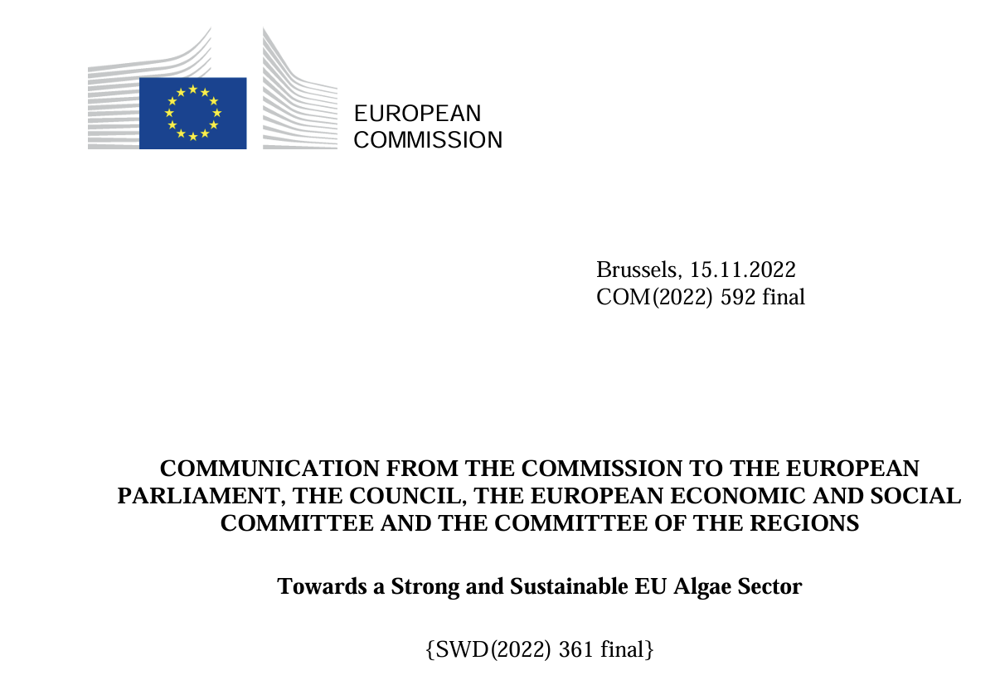
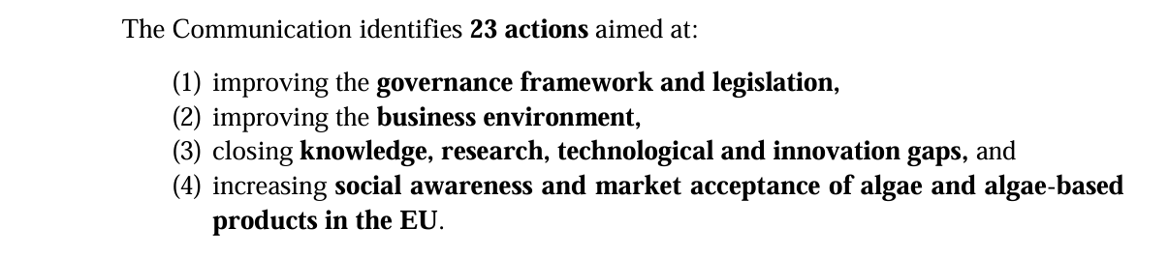
News alert!
Notes:
A lot is happening regarding regulations, support and toolkits to increase market exploitation, knowledge etc.
Novel foods
Iodine limits
Differentiation between organic and inorganic arsenic
Each TRL increase of product developments pushes the development forward

Slide 16


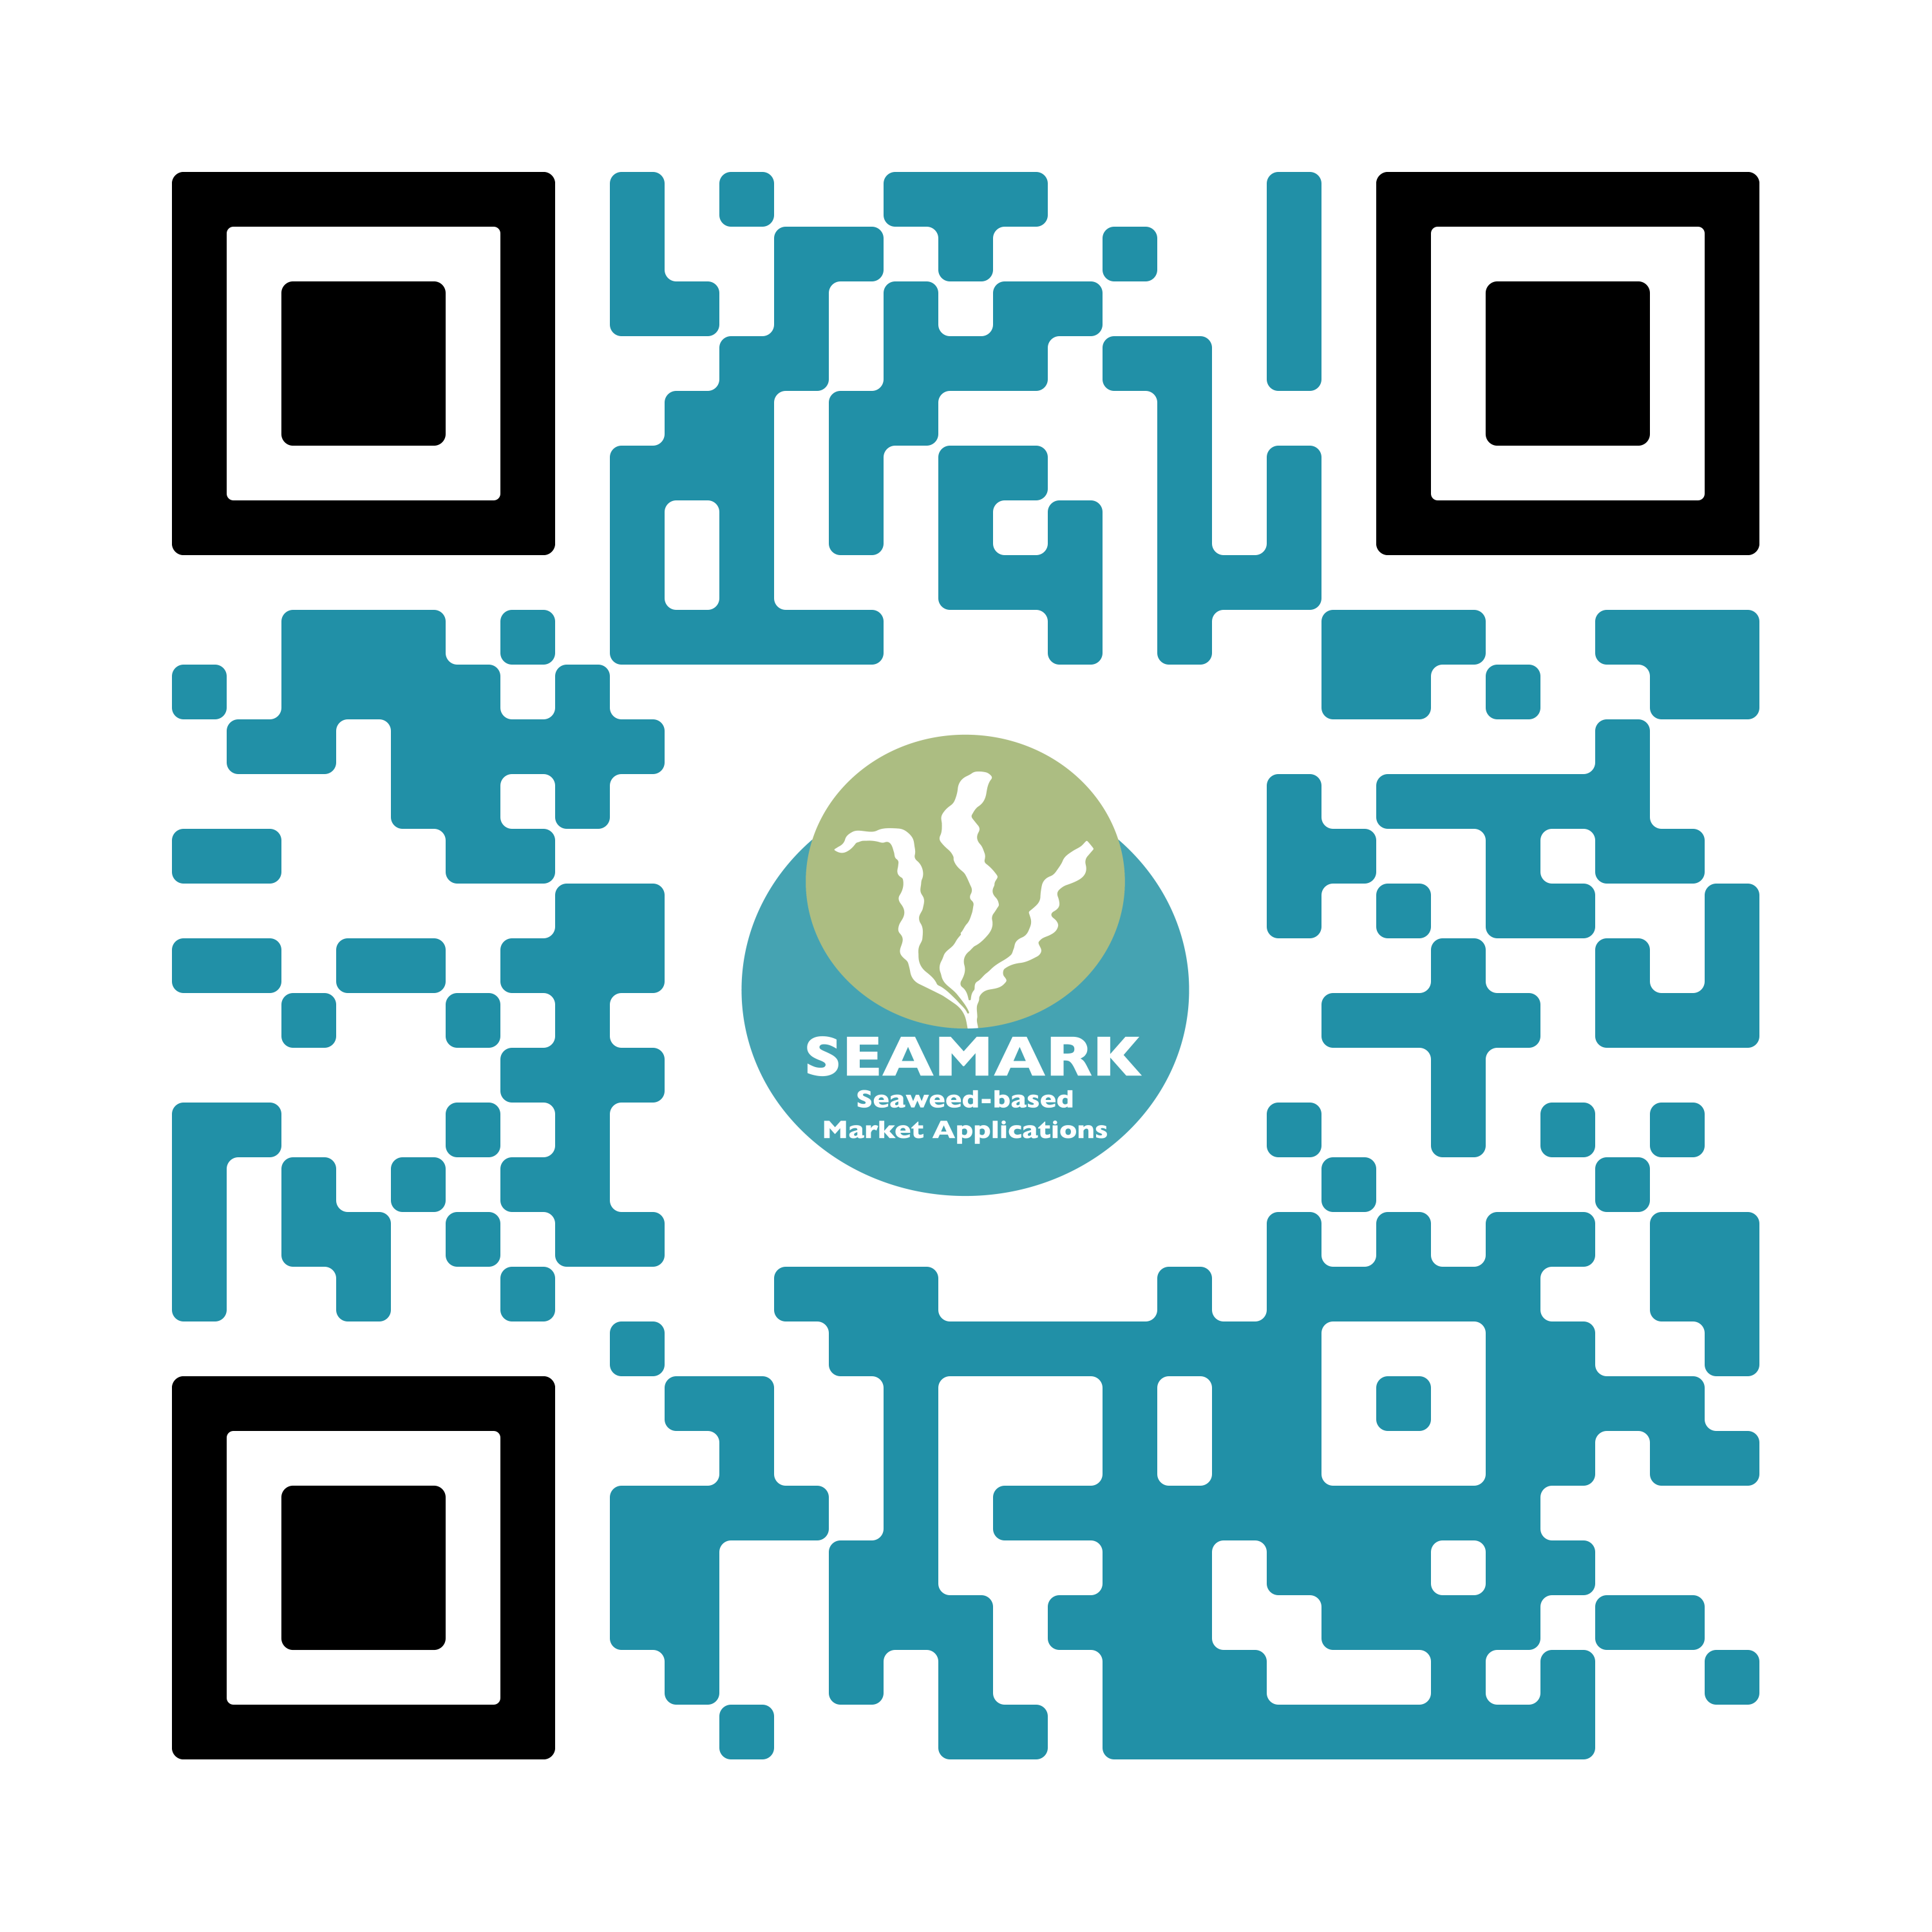

www.seamark.eu
SUBMARINER Network for Blue Growth EEIG
mmi@submariner-network.eu
fb@submariner-network.eu
seamarkeu
DISCLAIMER: Funded by the European Union. Views and opinions expressed are however those of the author(s) only and do not necessarily reflect those of the European Union or EUROPEAN RESEARCH EXECUTIVE AGENCY (REA). Neither the European Union nor the granting authority can be held responsible for them.

