Slide 1
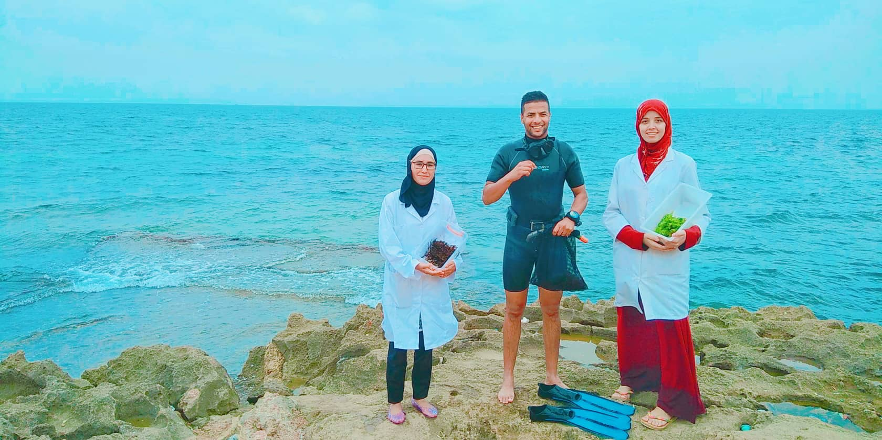
Pitch
Deck
Malte
Pitch
Deck
Make Of Seaweeds
An Exploitation
Of Future
Titre slide
Corps du texte
Corps du texte
BLUE INVEST IN THE MEDITERRANEAN 2019

Slide 2
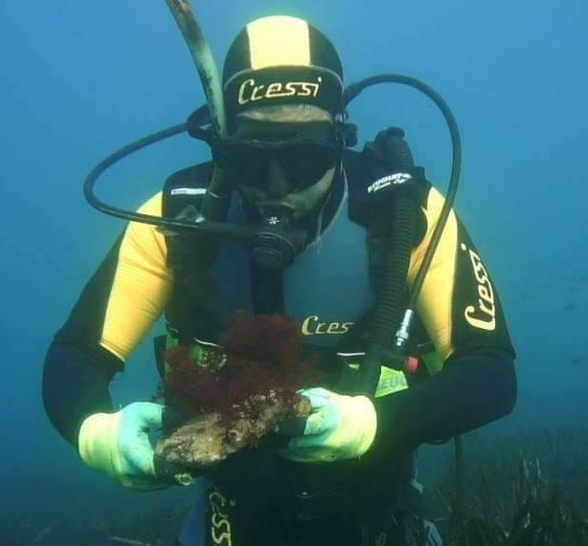
Pitch
Malte
Deck
Khadjidja
Bensmaine
Karima
Bougeroua
Mustapha
Beldjilali
Master
Degree
Sea - Aquacultural
Food
Science
Master
Degree
Food
Science
Engineer
Pitch
CTO
CEO
COO
Deck
Our trust to AlgoAgar is the most powerful thing!
Titre slide
Our
Team
Corps du texte
Corps du texte
BLUE INVEST IN THE MEDITERRANEAN 2019

Slide 3
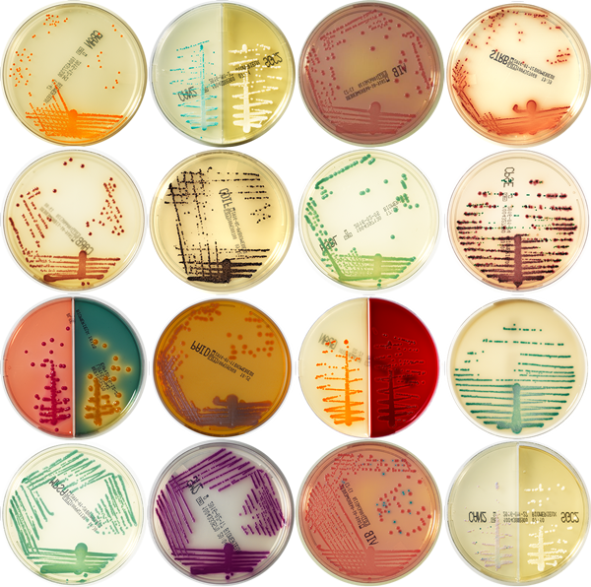
AGAR
IS A PHYCOCOLLOID EXTRACTED FROM A GROUP OF RED SEAWEEDS .
TYPICALLY USED IN A FINAL CONCENTRATION FOR SOLIDIFYING CULTURE MEDIA.
WIDELY EMPLOYED IN THE FOOD INDUSTRY FOR ITS GELLING POWER.
Pitch
Deck
Titre slide
BLUE INVEST IN
THE MEDITERRANEAN 2019
Corps du texte
Matters
Most
Corps du texte
Colonies of bacteria in culture medium plate

Slide 4
Unavailable
UNAVAILABLE ON THE ALGERIAN MARKET
IMPORTED PRODUCT
INTERNATIONAL PRODUCERS
HIGH PRICE
Pitch
Deck
NONEXISTENT
LAWS
Titre slide
BLUE INVEST IN
THE MEDITERRANEAN 2019
Corps du texte
Matters
Most
ENVIRONMENTAL
RISK
Corps du texte

Slide 5
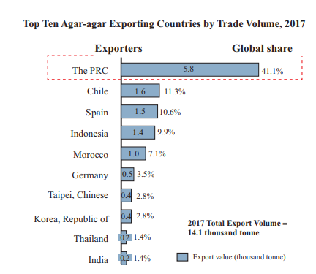
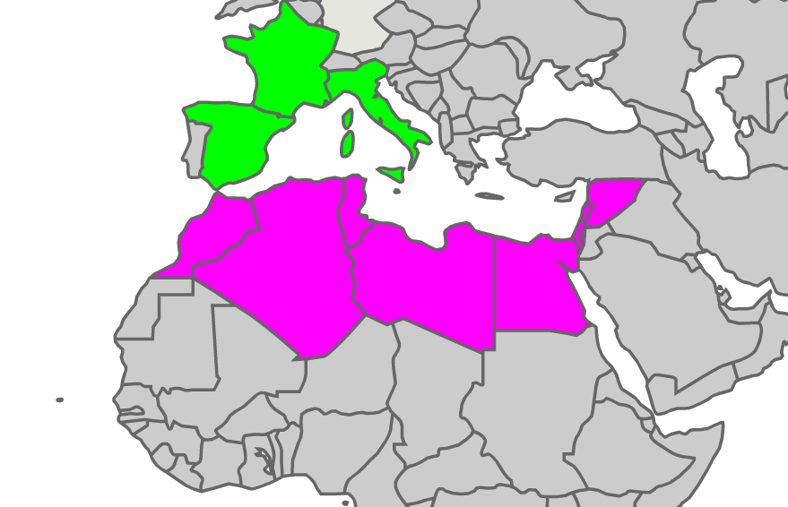
Pitch
Malte
Deck
Pitch
Deck
Source: Tarde Map -Frost & Sullivan
200 million people did not choose animal gelatin
Titre slide
The big
Market
Corps du texte
Corps du texte
BLUE INVEST IN THE MEDITERRANEAN 2019

Slide 6
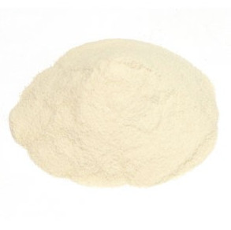
Environment
Friendly
Pitch
Deck
Fair
Trade
Titre slide
BLUE INVEST IN
THE MEDITERRANEAN 2019
Our
solution
Corps du texte
Corps du texte
Reduce the Country’s Import

Slide 7
Pitch
Malte
Deck
Pitch
Deck
Today we need to raise funds to move to our POC to the large-scale and hit the market!
Titre slide
Road
Map
Corps du texte
Corps du texte
BLUE INVEST IN THE MEDITERRANEAN 2019

Slide 8
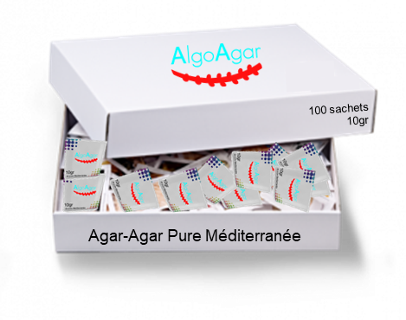
Pitch
Malte
Deck
5gr
de pure Méditerranée
10gr
de pure Méditerranée
Pitch
Deck
Customer Segment
Customer Relationship
Channels
Titre slide
Business
Model
B2B
B2B2C
Corps du texte
Corps du texte
BLUE INVEST IN THE MEDITERRANEAN 2019

Slide 9
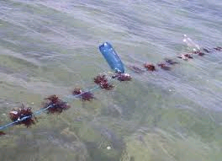
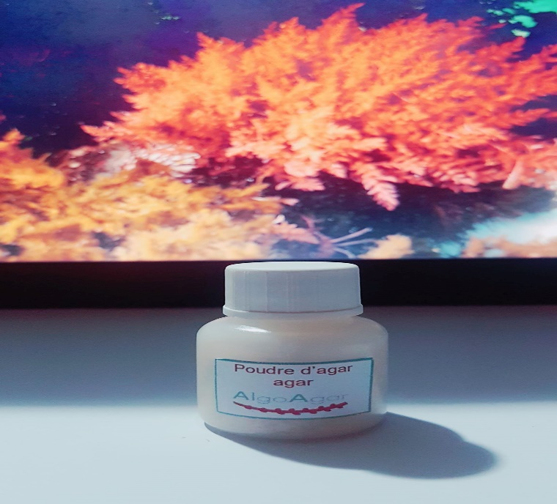
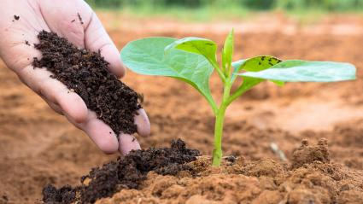
Pitch
Malte
Deck
SEAWEED
FARMING
PRODUCE FOOD AND BACTERIOLOGICAL AGAR
TRANSFORMATION
OF WASTE INTO
CO PRODUCT
MARKETING AND
SALES OPERATIONS
Pitch
Deck
Key Resources
Titre slide
Business
Model
Corps du texte
seaweed
factory
laboratory
divers & boat
sales team
resellers
Brands
Corps du texte
BLUE INVEST IN THE MEDITERRANEAN 2019

Slide 10
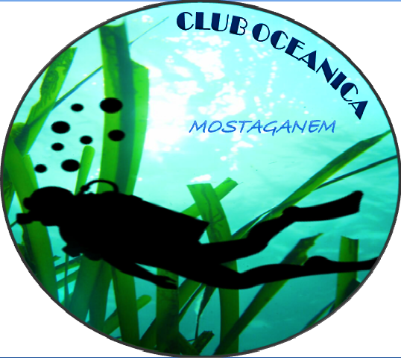
v
Pitch
Malte
Deck
Club
Greenwich
Pitch
Corporation
Research Institution
No-Gov Organization
Deck
THEY GOT CONVINCED BY OUR COMMITMENT AND THE STRONG BUSINESS POTENTIAL OF OUR STARTUP!
Titre slide
Our
Partners
Corps du texte
Corps du texte
BLUE INVEST IN THE MEDITERRANEAN 2019

Slide 11
Make Of Seaweeds
An Exploitation
Of Future
THANK YOU
See You Next Time
HQ ADDRESS
Université de Mostaganem - Site 5 - Haï El Houria, N90, 27000, Algeria
Pitch
Deck
FACEBOOK
www.facebook.com/AlgoAgar
Titre slide
EMAIL
contact@algoagar.com
Corps du texte
BLUE INVEST
IN THE MEDITERRANEAN 2019
TELEPHONE
Corps du texte
(+213) 555 829 691/ (+213) 799 004 690

Slide 12
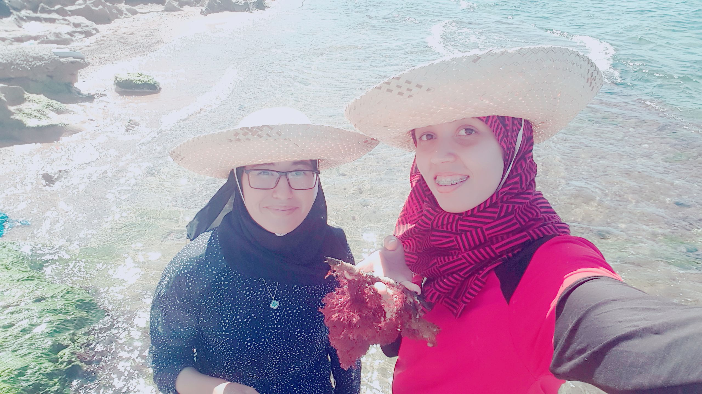
Pitch
Deck
Malte
Pitch
Deck
Q&A
Titre slide
Make Of Seaweeds
An Exploitation
Of Future
Corps du texte
Corps du texte
BLUE INVEST IN THE MEDITERRANEAN 2019

Slide 13
Pitch
Malte
Deck
2019
2020
Margin +25%
2021
Margin +25%
Margin +15%
K€
100
K€
490
K€
2 371
SALES
SALES
SALES
Tns
4,9
Tns
19,6
Tns
62,7
PRODUCTION
PRODUCTION
PRODUCTION
CAPITAL
NEEDS
K€
45
CAPITAL
NEEDS
K€
45
CAPITAL
NEEDS
K€
230
Pitch
Deck
Titre slide
Business Model &
Revenue Stream
Corps du texte
Corps du texte
BLUE INVEST IN THE MEDITERRANEAN 2019
3 DA / gr
3 DA / gr
4,5 DA / gr

Slide 14
Pitch
Deck
Malte
Pitch
Distribution of species seaweeds in 5 major classes coast of Mostaganem (Bouijra, 2012)
Distribution of species of seaweeds in five major classes in Algeria (Seridi, 2003).
Deck
Q&A
Titre slide
Make Of Seaweeds
An Exploitation
Of Future
Corps du texte
Corps du texte
BLUE INVEST IN THE MEDITERRANEAN 2019

