Slide 1
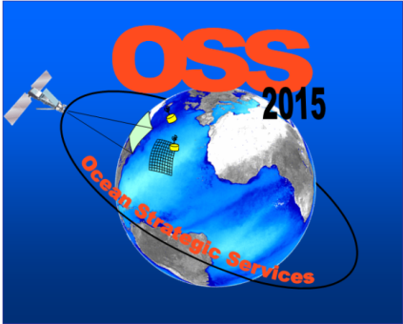
282-723 – OSS2015 Ocean Strategic Services beyond 2015
Antoine Mangin
ACRI-ST

Slide 2
Team and context
Consortium: ACRI-ST (F), UPMC/GIS COOC (F), ARGANS (UK), NURC (It), Frontier Economics (UK), ULCO (F), UCC (Ir), GEOMAR (Ge), DEU (Tu), DOMMRS (Ir)
Budget : € 3.345.747 with EU funding of € 2.000.000
Period : 01/11/2011 to 30/10/2014, 36 months duration
Data Inputs: Ocean Colour and SST
- From ESA GMES data access and MCGS (Marine Collaborative G/S)
- From MCS TACs and MFCs
- In-situ data held internally and externally
* GIS COOC = LOV (UPMC, CNRS), CNES, ACRI-ST

Slide 3
Objectives and overall challenges
Main objectives
Improving the nowcast, the forecast and the estimation of the spatial and temporal variability of biogeochemical variables in the ocean mixed layer
Develop and validate new tools for integration and assimilation of EO and in situ data into biogeochemical models
Develop and validate new products relevant to the biogeochemistry of the ocean
Develop and demonstrate new prototype service lines

Slide 4
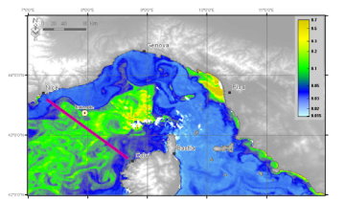
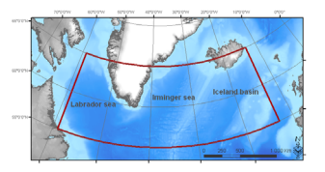
New tools
R&D - Data assimilation
1- We develop algorithms for the fusion of satellite ocean colour data (multispectral radiance of the sea surface) and in situ measurements from platforms (buoys, drifters, gliders, …)
Fusion algorithms are based
- either on geostatistical model
- or on assimilation models according to various schemes
Bio-optical assimilation
Chlorophyll-a concentration assimilation
Fields campaigns (2013)
OSSEs will be carried out in the Ligurian sea and the North Atlantic

Slide 5
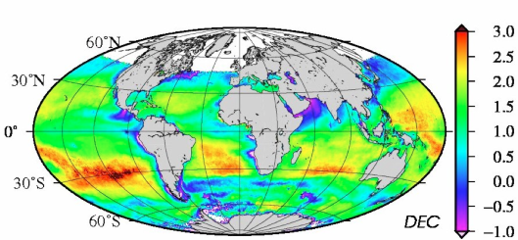
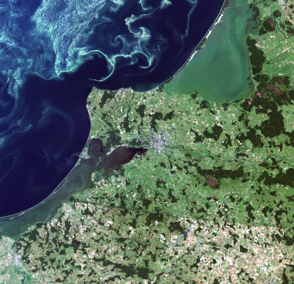
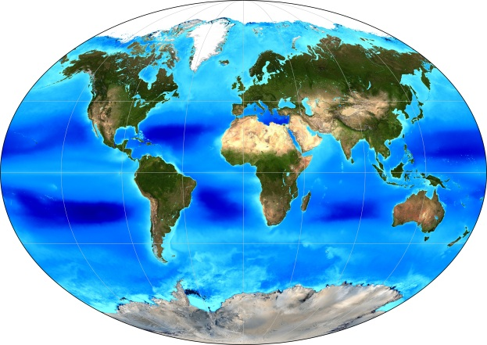
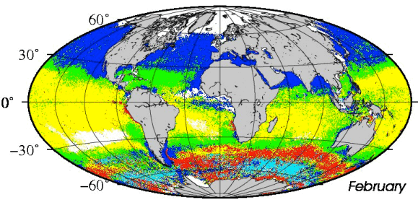
New products
R&D – Development and validation of new product, error characterisation and production of time series
Chlorophyll
NPP (net primary Production)
PSD (Indice of particle size distribution)
POC ( Water Particle Organic Carbon)
PFT (Phytoplankton Functional Types)
Others (on-demand service)
bbp slope
Transparency

Slide 6
New services 1/2
R&D – Prototyping of an on-demand production/distribution service (2014)
To be tested and demonstrated with the new biogeochemistry products.
Data management, identification, dissemination, citation (DOI).
2D, 3D and 4D data & associated statistics
Data analyses: cross comparison, cluster analysis, time series analysis
User flexibility at all levels of the processing chain, input to output.
Investigate other links to the downstream services: combine data products and analysis tools to assess, monitor, predict particular environmental situations (e.g. Environmental hazard monitoring, Support service to campaigns at sea, …)

Slide 7
New services 2/2
R&D – Economical and societal benefits assessments
How ?
Perform R&D activities for the development of marine biogeochemistry products and services not currently available through the current prototyped MCS
Continue dialogue with scientific users and downstream services designers in order to adapt offering to the needs. The development of a new web-based platform will permit “on-demand” feature.
To that end, specific activities have been targeted
Socio-economic benefit analyses and user consultation
Link with MCS (iteration with and feedback to upstream)
Recommendation for the service structure and delivery between MCS and downstream

Slide 8
Achievement and remaining challenges (1/2)
Science
Algorithms for new products : Chlorophyll, NPP, PSD, PFT, POC : implementation, improvement of PHYSAT method, evaluation of 3 bbp inversion models and error characterisation
Assimilation techniques:
Bio-optical assimilation : Setting up and tuning of inverse model to derive IOP from AOP. Experimental work on AOP vertical profiling
Chla-assimilation : Optimisation of bio-profilers deployment / Characterisation of information available from Bio-ARGO

Slide 9
Achievement and remaining challenges (2/2)
Data management
In situ database under construction
Adaptation of MERMAID: Inspire compliant
Arc Marine GIS data model
Climate Science Modelling Language v3.0
Interoperability with other database
EO database under construction

Slide 10
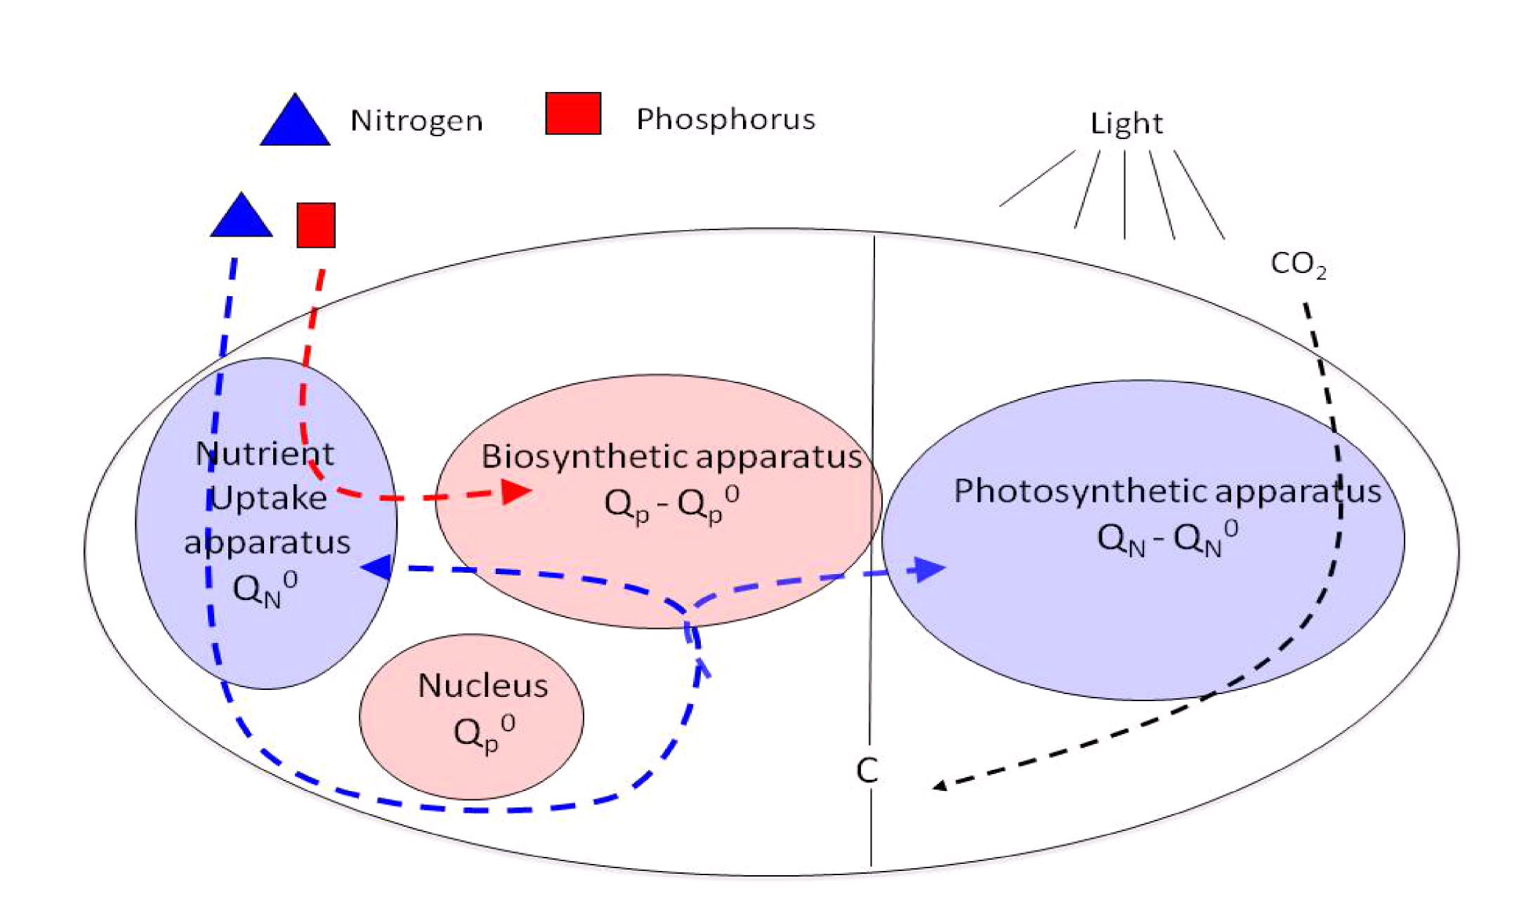
OSS2015 – Examples of Research in-progress (1/4) Integration of in situ, satellite & models Limiting factors of phytoplankton growth
Diagram of the chain model of primary production, illustrating the roles of P (nitrogen assimilation) and N (nutrient acquisition and photosynthesis) in a phytoplankton cell
The primary production model of Pahlow & Oschlies (2009) has been implemented

Slide 11
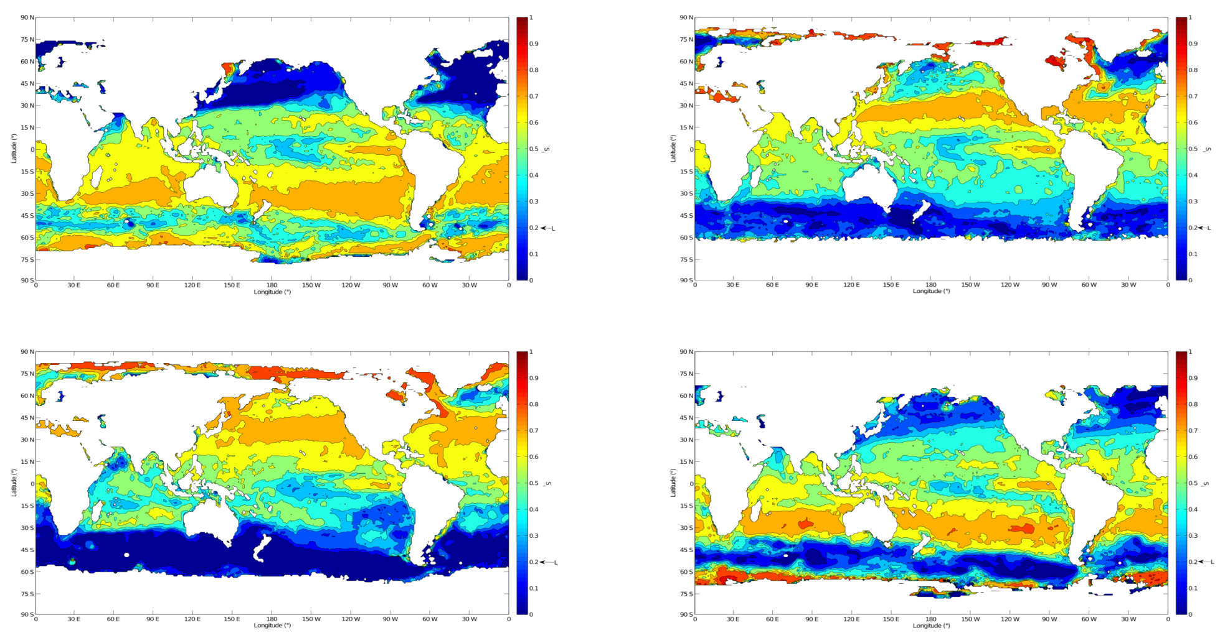
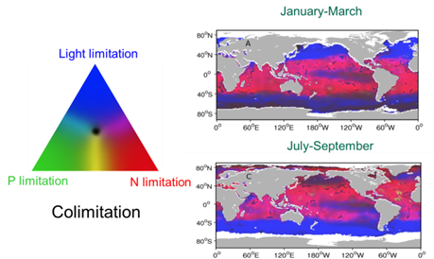
(2/4) Integration of in situ, satellite & models
Light saturation
First simulation results on temporal variability
from the cell scale
to the ocean scale
winter
spring
summer
fall
Light saturation of photosynthesis / season (value between 0 and 1)
-primary production model using mixed layer light availability, mixed layer depth and EO irradiance data-

Slide 12
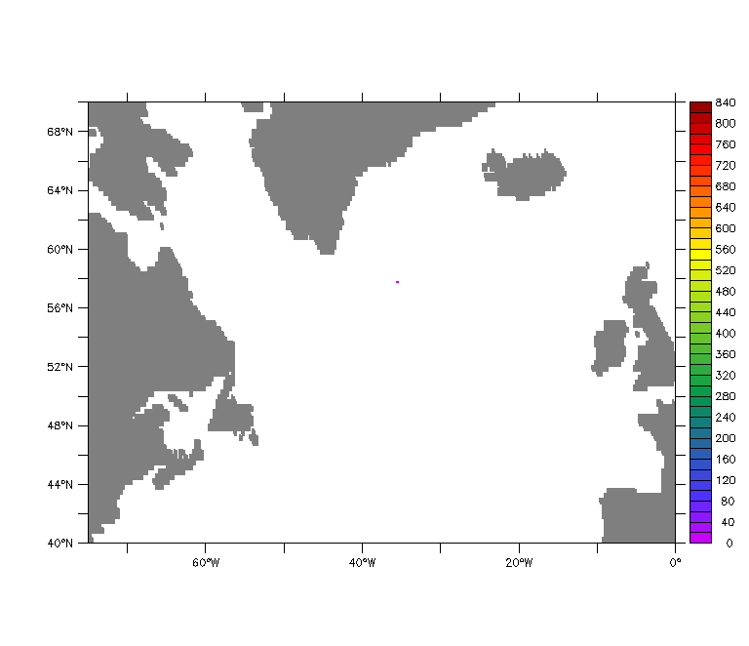
OSS2015 – Achievements and remaining challenges (1/x)
(3/4) Integration of in situ, satellite & models
Floats deployment optimisation
Main activities – 1. R&D
Numerical float cluster dispersion with respect to float age
-simulation of the release of a group of bio-optics drifting floats-

Slide 13
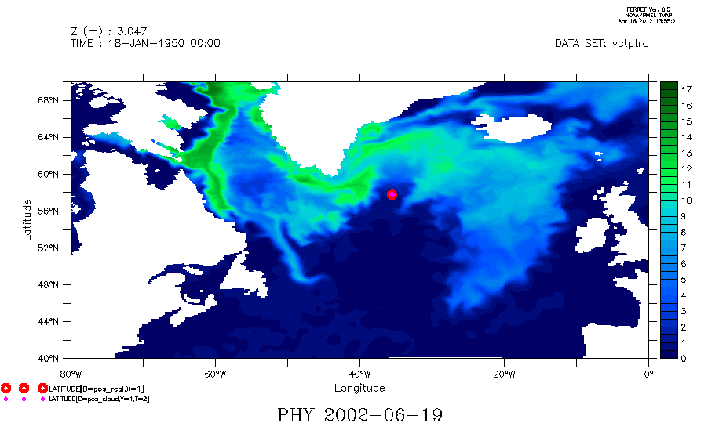
(4/4) Integration of in situ, satellite & models
Successful phytoplankton bloom capture
Main activities – 1. R&D
Comparison with a real deployment
-background is made of maps produced by the Nemo-Lobster model-
(surface phytoplankton concentration)

Slide 14
Filling the green gap
=
provision of reliable EO information on bio-chemical properties of the Ocean owing to dedicated R&D
-the OSS2015 contribution-
optical data assimilation in ecosystem models
vertical distribution of phytoplankton…
optimisation of in situ sensors deployment
(
(
www.oss2015.eu
info@oss2015.eu

Slide 15
OSS2015 is a step forward to bridge initiatives and introduce new R&D
Downstream Services
Aquamar, Cobios, Azimuth, SeaU…
Coastwatch, Rose
New service models
Marcoast 1 & 2
EO products elaboration and distribution
Hermes
Globcolour
Higher level products and services
OSS2015, …
Mermaid DB
R&D outcomes
MyOcean 2
MyOcean 3
MyOcean
How to sustain these efforts and keep the momentum ?
Link with EMODnet ?

Slide 16
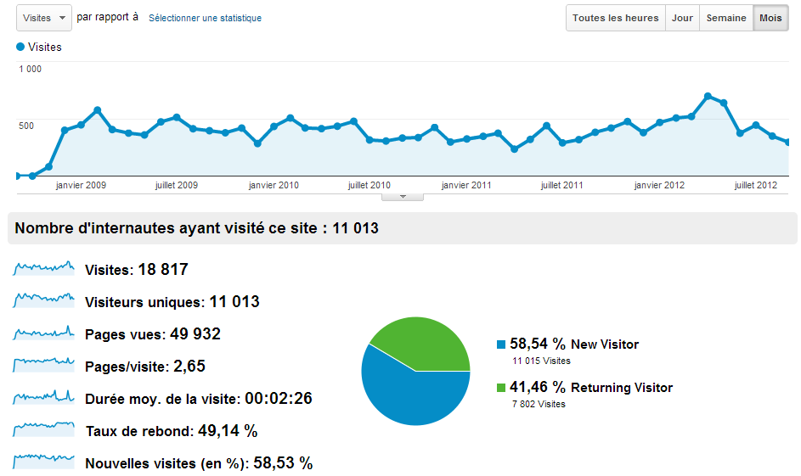
www.globcolour.info

Slide 17
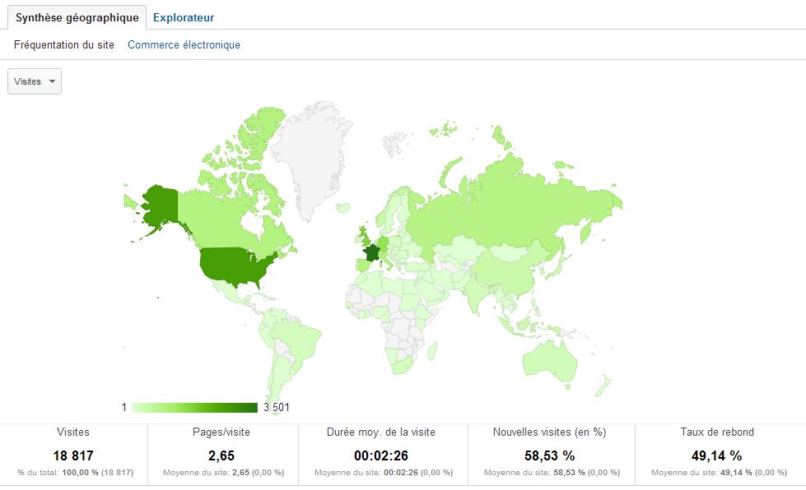
www.globcolour.info

Slide 18
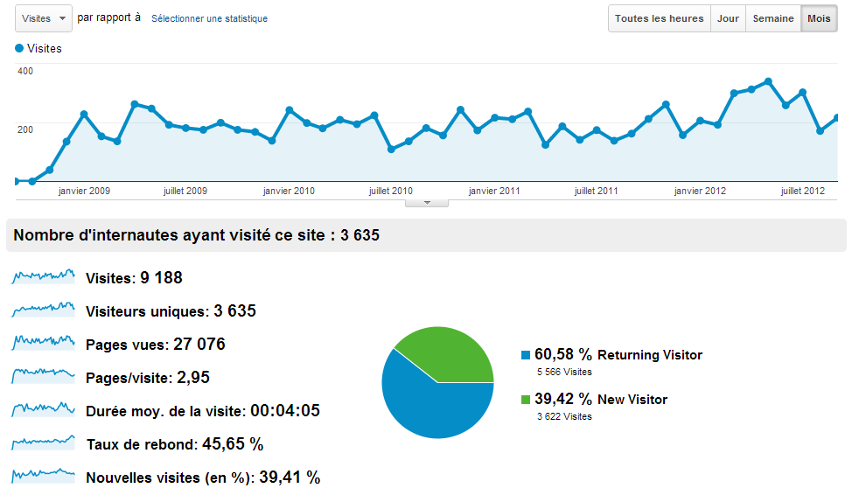
hermes.acri.fr

Slide 19
hermes.acri.fr
Number of users = 395
Total number of products = 876152
Total size of distributed data = 14781.6 Gb
Direct ftp
Number of users : 800
Total number of products = 1 Million
Total size distributed : 6 Terra

Slide 20
Questions wrt MODEG
Interaction of OSS2015 In situ DB with MODEG (EMODnet Biology) ?
Introduction of «merged » EO and In situ into EMODnet ?
Strategy of labelling of data (equivalent to DOI) – studied by MODEG ?
How to get acceptance of EO for environmental reporting ?
Role of / Interaction with private actors ?

Slide 21
OSS2015 –links to other projects
formal information exchange to establish with the GMES services projects of relevance to OSS2015
nature of the links
to AQUAMAR:
service setting up, Chla geostatistics, coastal requirements…
from OSS2015 : matchups EO/in situ DB, in situ sampling strategy, new products
to ASIMUTH, COBIOS :
users, problematic, products, services …
to OPEC:
interface / how OSS2015 could feed in OPEC ecological modelling ?
sharing pilot site experiments (NA and Mediterranean) ?
to SANGOMA:
assimilation expertise sharing, get insights on the most advanced assimilation techniques

Slide 22
OSS2015 – existing links to other projects
Links to MyOcean: WP 3.2 targeting establishment of collaborative links (technical, research, operations) with MCS
Practical implementation since OSS2015 KO:
Support from Pierre Brasseur, science leader in MyOcean
Support from Glenn Nolan, MyOcean user uptake
SLA signed with MyOcean
Outreach – attendance to GMES workshops on Marine Data Information Policy and Marine Monitoring Service (Jan 2012).
Input relation (e.g. science) : WP 2 on data assimilation schemes, data dissemination framework, etc.
Output relation (use of MyOcean service) : EO and in-situ data + outputs of models (ocean colour & SST)
Current issues : no access to the MCS technical documents (e.g. MyOcean URD), difficulties to access in-situ database

