Slide 1
Mediterranean- Gaps and Needs
Nadia Pinardi
University of Bologna
Istituto Nazionale di Geofisica e Vulcanologia
Italy

Slide 2
LARGE SCALE
The GOOS paradigm
SHELF SCALE
● MOORED BUOY ARRAYS
● SOOP EXPANDABLE AND ONDULATING INSTRUMENTS
SATELLITE SENSING:
SEA LEVEL,
SEA SURFACE TEMPERATURE,
SEA SURFACE SALINITY,
COLOR, WINDS
● DRIFTING BUOYS
(SURFACE AND SUBSURFACE)
● GLIDERS
REPEATED MULTIPARAMETRIC SECTIONS
● SATELLITE AND AERIAL SURVEYS
● COASTAL RADARS
● AUTONOMOUS UNDERWATER
VEHICLES
CABLED MULTIPARAMETRIC STATIONS
● RIVER RUNOFF AND LOADING
MONITORING
SEDIMENT/WQ MONITORING
OBSERVING
SYSTEM
Data
Management
MODEL PHYSICS
● PRIMITIVE EQUATION (> 1-5 KM)
● TURBULENCE CLOSURE SUBMODELS
MODEL PHYSICS
Non-Hydrostatic (<1- 5 KM)
● TURBULENCE AND LIGHT
SUBMODELS
DATA ASSIMILATION
OPTIMAL INTERPOLATION
3-DVAR, KALMAN FILTER
DATA ASSIMILATION
● KALMAN FILTERS
● ADJOINT MODELS
BIOCHEMICAL MODELS
● PELAGIC COMPARTMENT
● BENTHIC CLOSURE
MODELING
SYSTEM
BIOCHEMICAL MODELS
● PELAGIC COMPARTMENT
● BENTHIC-PELAGIC COUPLING
● SEDIMENT DYNAMICS
ATMOSPHERIC FORCING
OPERATIONAL ANALYSES AND FORECASTS FROM LARGE SCALE MODELS
ATMOSPHERIC FORCING
OPERATIONAL ANALYSES AND FORECASTS FROM LIMITED AREA MODELS

Slide 3
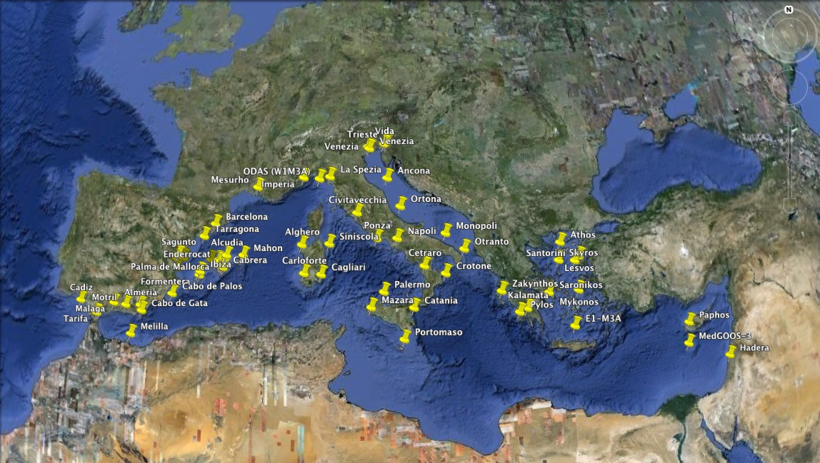
The real time shelf/coastal monitoring now

Slide 4
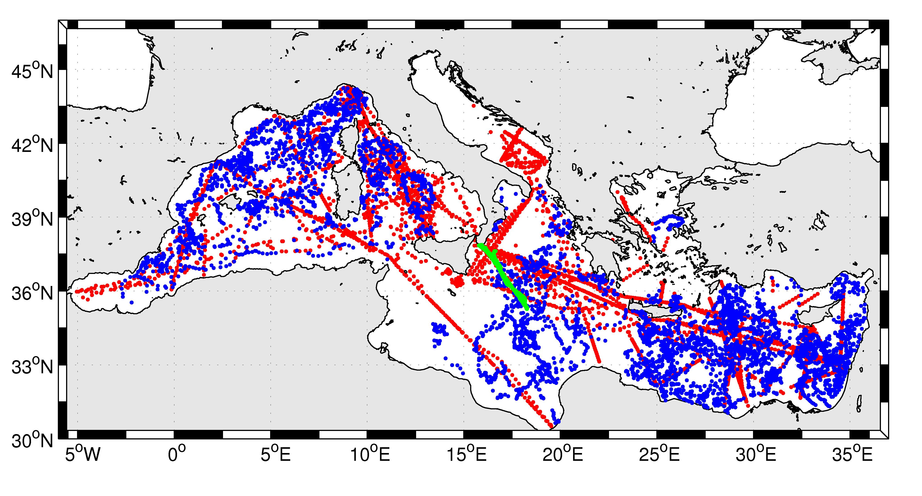
Mediterraean Sea: the real time open ocean monitoring now
gliders
SOOP
ARGO
M3A Buoy

Slide 5
IOOS:
Gaps and needs in the Mediterranean Sea
An ‘IOOS’ data acquisition initiative should be started for the non-Eu borders of the Mediterranean Sea through a dedicated multi-lateral program between Eu and non-Eu States
New data collection initiatives should have a totally free and open access data policy and real time data release
New advanced technology should be privileged for the data collection network in order to fill the gaps in parameter sampling (physical and biochemical data)
The exchange of knowledge and expertise between Eu and non-Eu Mediterranean States should be made permanent, dedicated to the management and the continuous evolution of the observing system

