Slide 1
Data for science the ENVRIplus approach for data life cycle harmonisation of environmental Research Infrastructures
Helen Glaves
On behalf of the ENVRI COMMUNITY

Slide 2
Project summary
15 M € budget
37 beneficiaries
21 Research Infrastructures
19 Work Packages organized in 6 Themes
90 Deliverables
4 Domains (Atmosphere, Biosphere, Marine, Solid Earth)
3 overarching goals:
    favoring cross-fertilization between infrastructures
    implementing innovative concepts and devices across RIs, and
    facilitating research and innovation in the field of environment to an increasing number of users outside the RIs

Slide 3
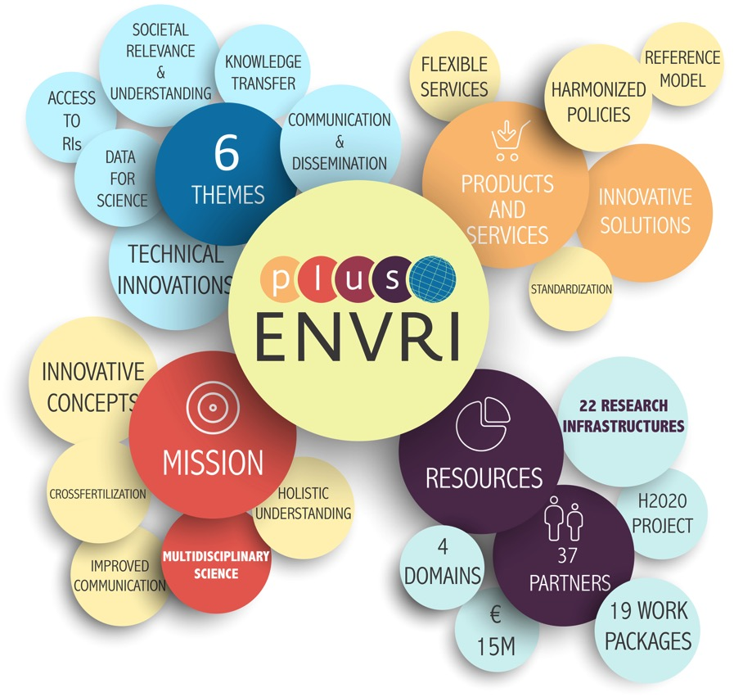
Project summary

Slide 4
Themes & Work Packages

Slide 5
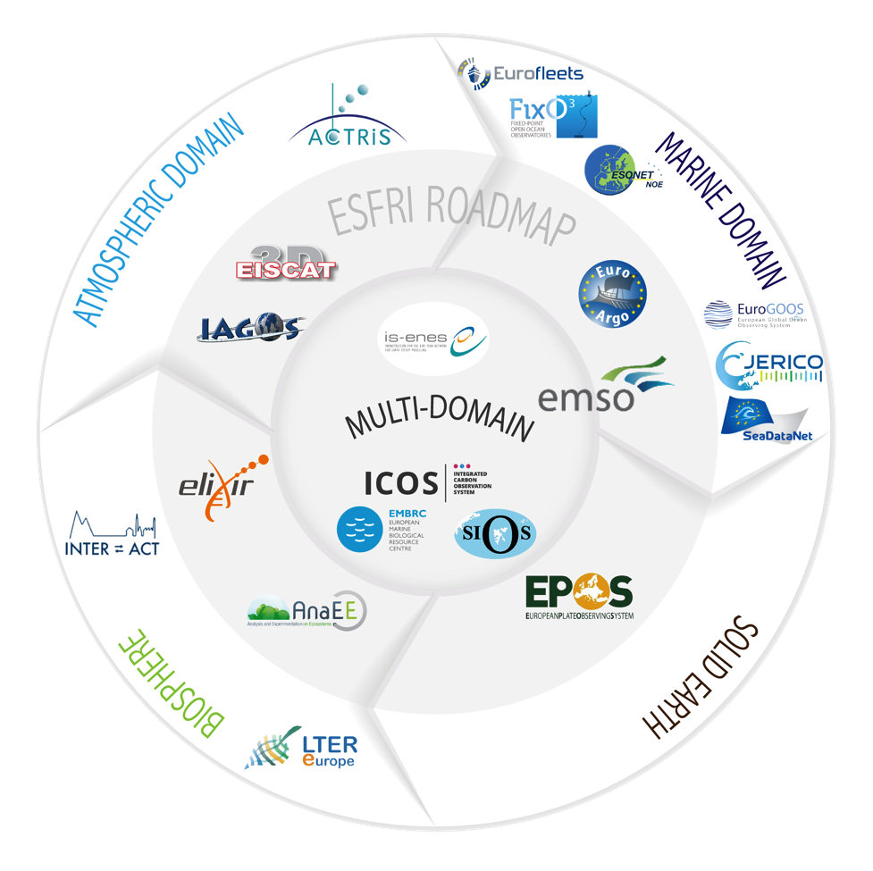
Participating Research Infrastructures

Slide 6
Participating Research Infrastructures
3 ERICs with Ocean focus or Ocean component

Slide 7




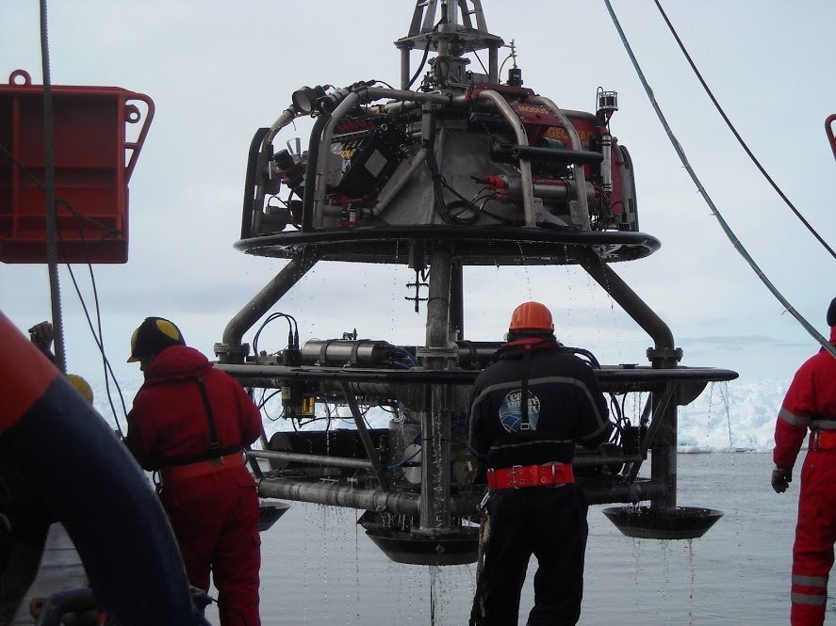
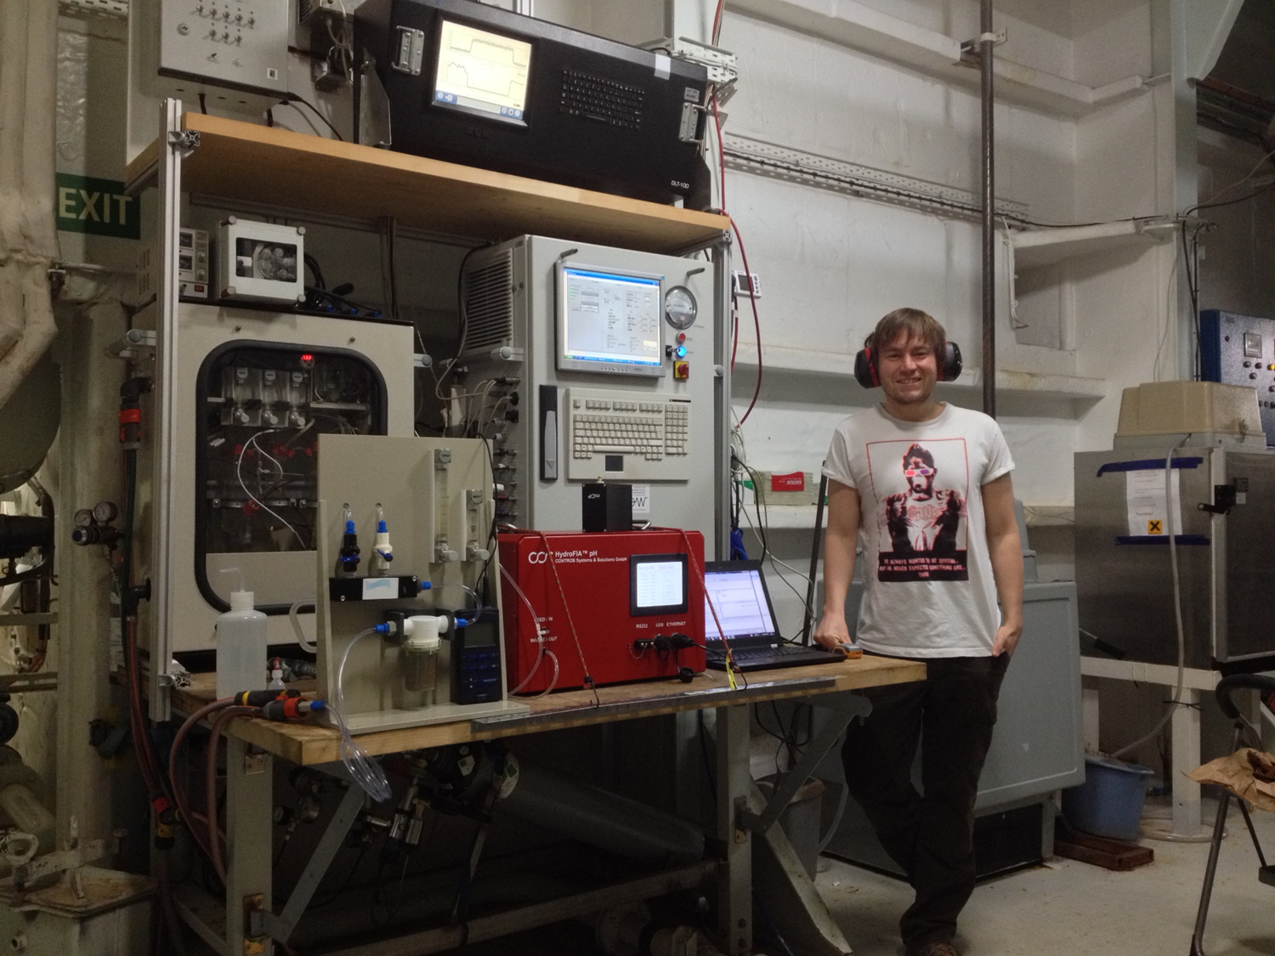
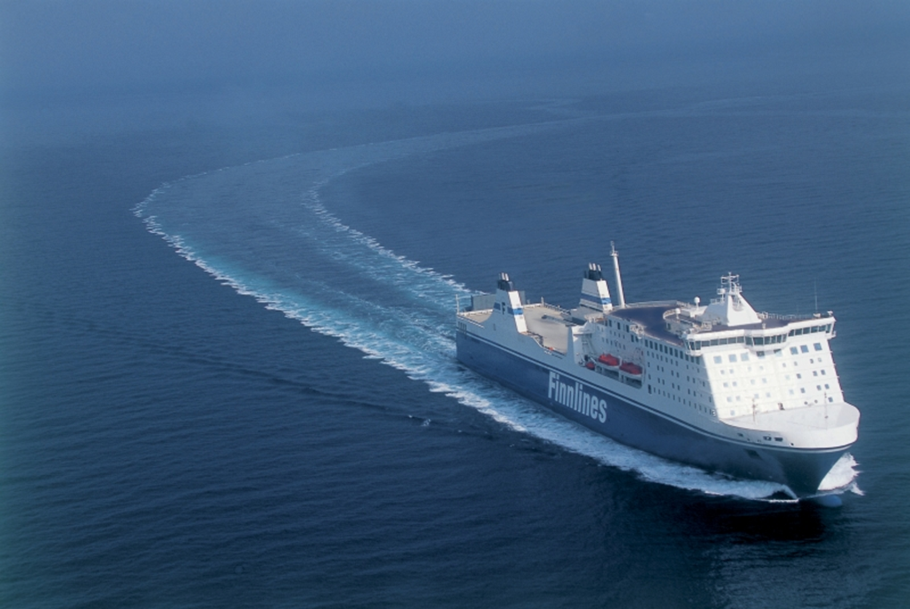
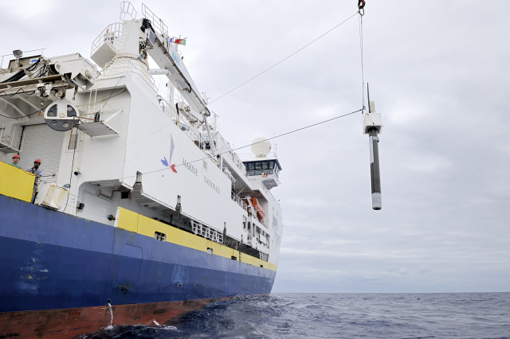
Each Entry to a data cloud are sensors
Data life cycle as example

Slide 8
research Infrastructures are built to share data
  The ENVRI Reference Model is a tool to explain the activities, roles, and processes in environmental RIs
  Used to compare, design and map RIs
  Common terminology to understand activities and roles
  Promotes common solutions on data architecture, data curation, metadata ontologies, data citation
  Ensures interoperability
  Supported by the Projects, but exists as a freely available wiki source
  Much interest inside European Research Area, also internationally

Slide 9
The Market for data of societal Relevance does not follow simplified economic Models

Slide 10
The Market for data of societal Relevance does not follow simplified economic Models
Open Data
Knowledge
Data
Providers
(RIs)
Data and
Knowledge
Consumers
(Society)
Science
Products
Evaluation
Money
Public Funding Organisations
Private

Slide 11
Expectations to EOSC
  Provide tools and services for RIs to better develop their internal data life cycle.
  Support inter-operability.
  Support user interaction (e.g. large data streams)
  Do not increase the costs compared to internal solutions.
  Provide a transparent and stable business model.

Slide 12




Contact
Thank you for your attention!
Werner Kutsch
Coordinator
ENVRIplus Coordination Office : envriplus-coordination@helsinki.fi
Website : www.envriplus.eu
Find us on:
  Twitter - @ENVRIplus
  Facebook page – ENVRIplus
  LinkedIn Group – ENVRIplus
Paolo Laj
Co-Coordinator
Ari Asmi
Project Director
Magdalena Brus
Project Manager

Slide 13
Project summary
Project Number: 654182
Starting date: 1st of May 2015
Duration in months: 48
End of the project: 31st of April 2019
Coordinating institution: University of Helsinki
  Coordination will be changed to ICOS ERIC once it is founded
Call (Topic): INFRADEV-4-2014-2015 - Implementation and operation of cross-cutting services and solutions for clusters of ESFRI and other relevant research infrastructure initiatives

