Slide 1
State of play
EFCA activities related to information sharing

Slide 2
Current activities with regards to information sharing
Pilot projects:
-European Coastguard functions
-EFCA MARSURV Worldwide IUU (IMDatE)
Inter Agency SLA’s for information sharing
-Use of VMS for search and rescue (EMSA)
-Use of VMS for Eurosur (Frontex)
Operational exchange of information
-exchange of air surveillance information between Frontex-EFCA coordination centres on daily basis (JDP BFT)
EFCA Fisheries Information Systems (FIS)

Slide 3
FISHERIES INFORMATION SYSTEM (FIS) Developments 2013 - 2015
FIS SYSTEM COMPONENTS & ARCHITECTURE | Launched
EFCA Electronic Reporting and Recording System (ERS) | Feb 2013
EFCA FISHNET Collaboration and Access Portal | May 2013
EFCA Electronic Inspection Report System (EIR) | Jul 2014
EFCA Enterprise Architecture (EA) | Jun 2015

Slide 4
Fisheries Information System (FIS) Enterprise Architecture
VMS
EIR
JADE
ERS
Positions
JDP Activity
Logbooks (Catches)
Inspections
Joint Deployment Plans
Master Data Register
Vessel Register
User & Access Management
Standard Reporting Tool
FLUX Integrated Environment
Security Control
Business Rules/Validation/Verification
Notes:
The key benefits of the Enterprise Architecture is that whilst each application has a specific function to do (e.g. ERS – Logbook Catches), all the applications ‘talk’ to each other and share access to central services.

Slide 5
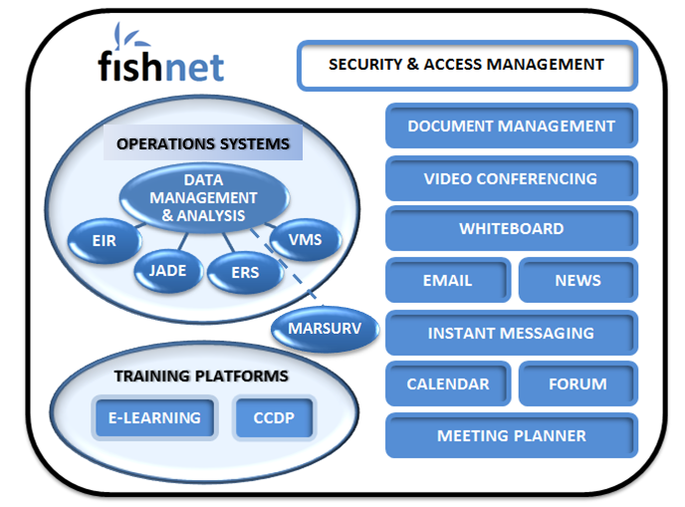
EFCA FIS

Slide 6
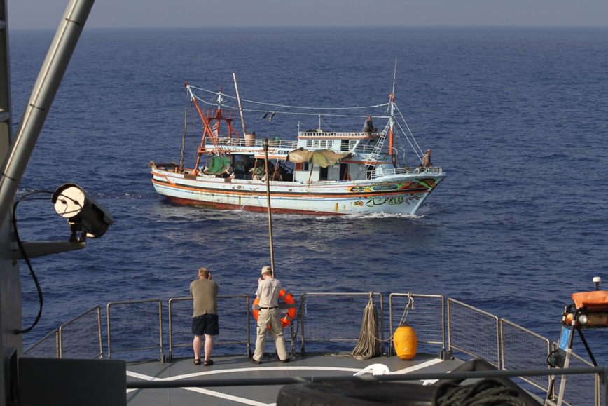
THANK YOU!
efca@efca.europa.eu
http://www.efca.europa.eu
Notes:
6

