Slide 1

First meeting of the EU Member State Expert Group on Ocean Observation
Andreea Strachinescu, Iain Shepherd, Zoi Konstantinou, Rémy Dénos
Brussels, 25 June 2024

Slide 2
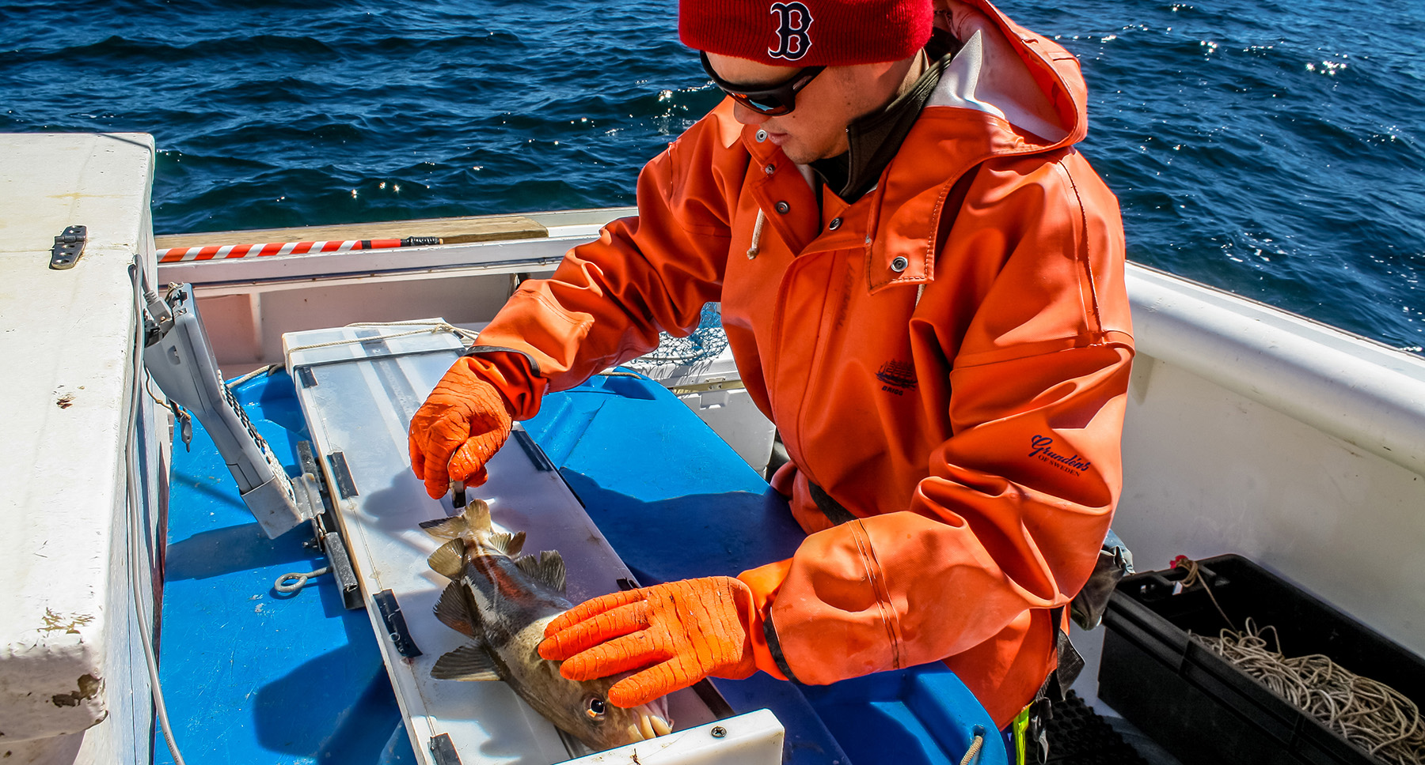
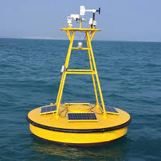
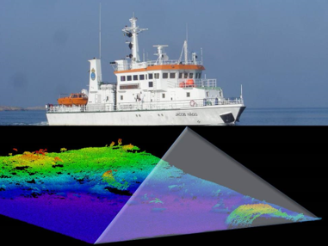
Agenda
10:30 | DG MARE | WELCOME
10:45 | DG MARE | WHERE WE ARE WITH OCEAN OBSERVATION Mandate Outcome of Studies Technology for ocean observation Reporting ocean observation Standards Digital platform (capabilities and timeline) Reducing burden
11:15 | Experts | FEEDBACK AND QUESTIONS
11:30 | Experts | IMPROVING OCEAN OBSERVATION Member State views including on reducing administrative costs accelerating innovation increasing competitiveness of EU companies on global market.
12:30 |  | LUNCH
13:30 | Experts | IMPROVING OCEAN OBSERVATION (CONTINUED)
14:30 | DG MARE and Experts | WRAP UP
15:00 |  | END OF MEETING
Notes:
The main purpose of this meeting is to hear from youi

Slide 3
Definitions
Ocean observations”
  all observations of the state and dynamics of oceans and of marine organisms made within and beyond the jurisdiction of EU Member States, with the exception of observations made from Earth-orbiting satellites
“Ocean waters”
  all salty and brackish waters as well as the underlying seabed and subsoil

Slide 4
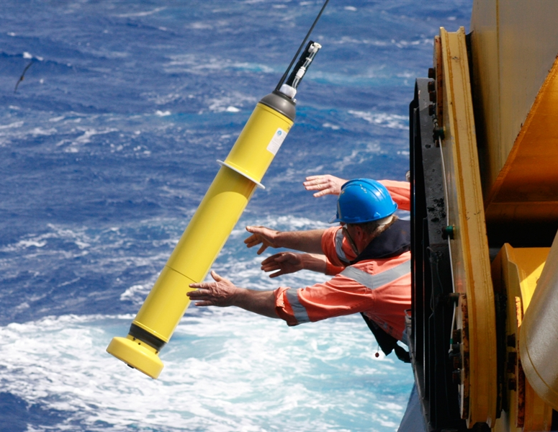

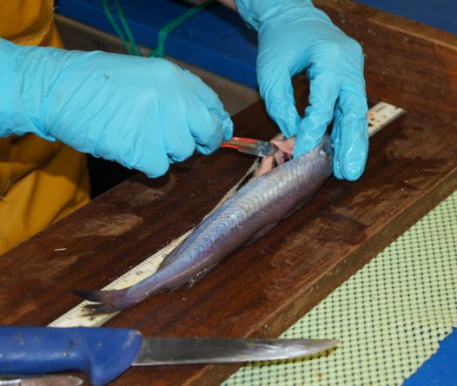
Contents
The mandate
Studies on the market
Study on reporting
Study on standards
Building a Digital Platform
Reducing burden

Slide 5
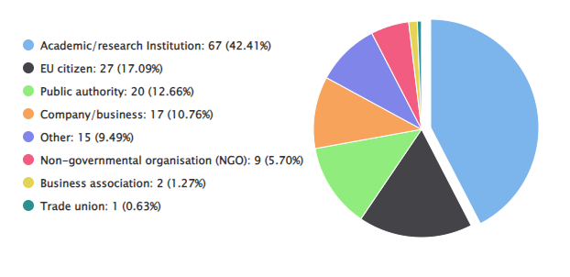
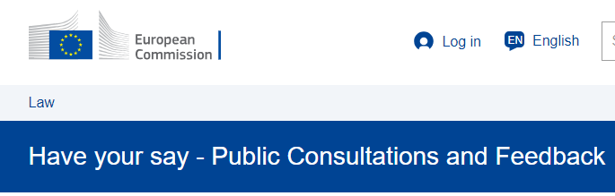
Ocean observation – sharing responsibility
This initiative aims to achieve a common EU approach for measuring once and using the data for many purposes.
It proposes:
  joint planning of observation activities
  a framework for collaboration on a national and EU scale
.

Slide 6
Problems identified
inefficient planning
  made for a specific purpose by a specific user community
opaque planning
  unaware of plans of neighbours
insufficient sharing.
  sharing of these assets could allow more observations for the same money
insufficient innovation
  take-up of new platforms and sensors slow;
unsustainable observation –
  precarious funding
inequitable sharing of effort
  for participation in international programmes
lack of standards
  inhibits citizen science

Slide 7
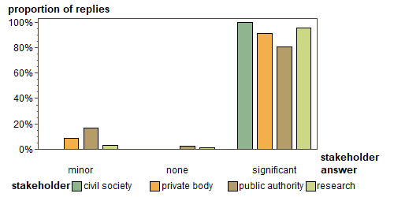
“What is EU role in improving ocean observation?”

Slide 8
Contents
The mandate
Studies on the market
Study on reporting
Study on standards
Building a Digital Platform
Reducing burden

Slide 9
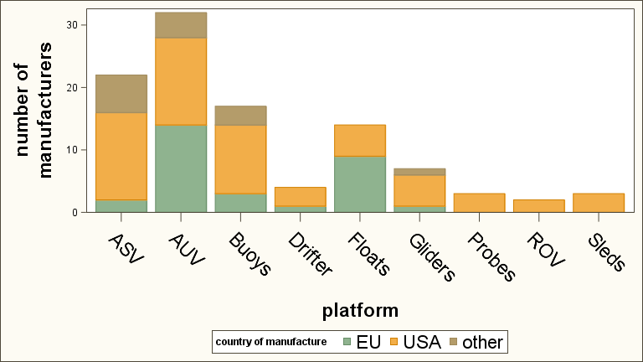
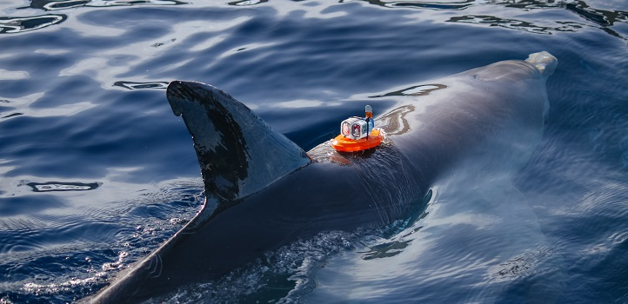
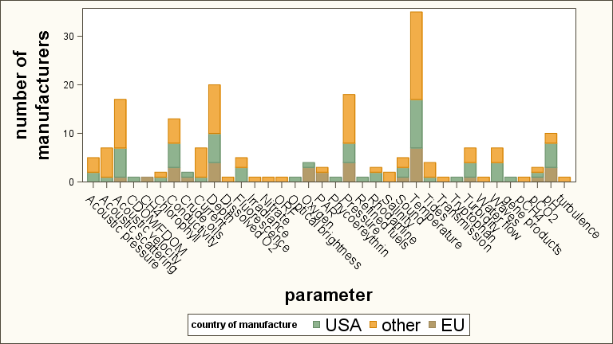
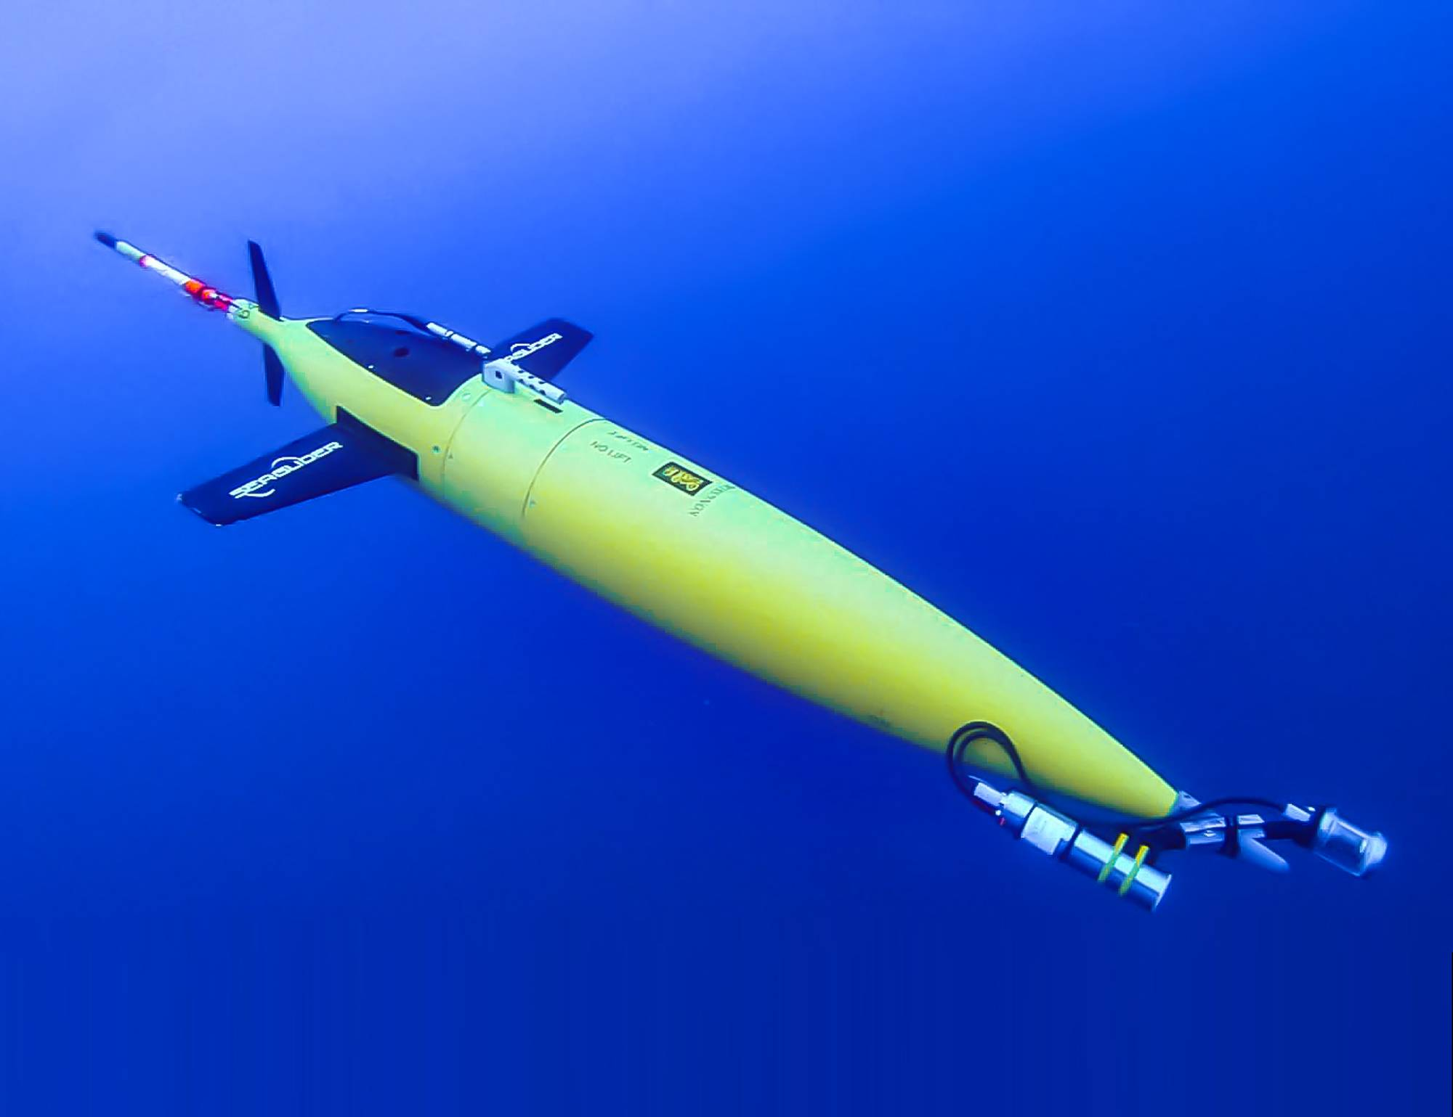
European Market
sensors
platforms

Slide 10
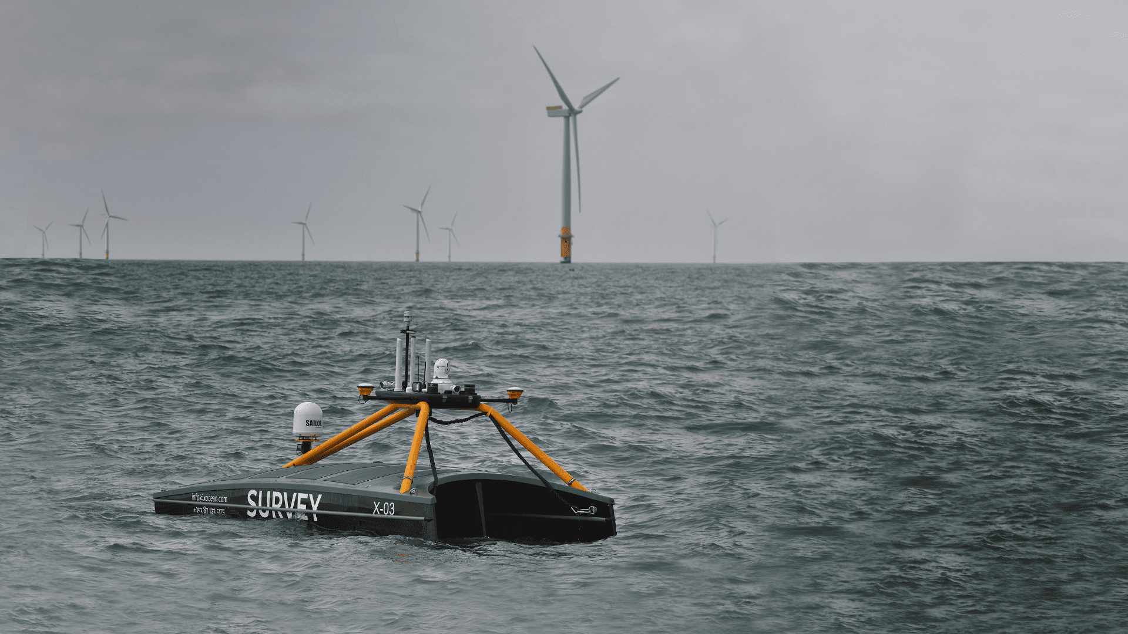
Example of successful company (Europe)
XOCEAN
        founded in Ireland in 2017
        grown to over 200 staff
        offices in Ireland, the UK, the US, Canada, Norway and Australia

Slide 11

Market reform needed
SUPPLY
need capital market that takes more risk
DEMAND
need to aggregate demand among Member States

Slide 12
Contents
The mandate
Studies on the market
Study on reporting
Study on standards
Building a Digital Platform
Reducing burden

Slide 13
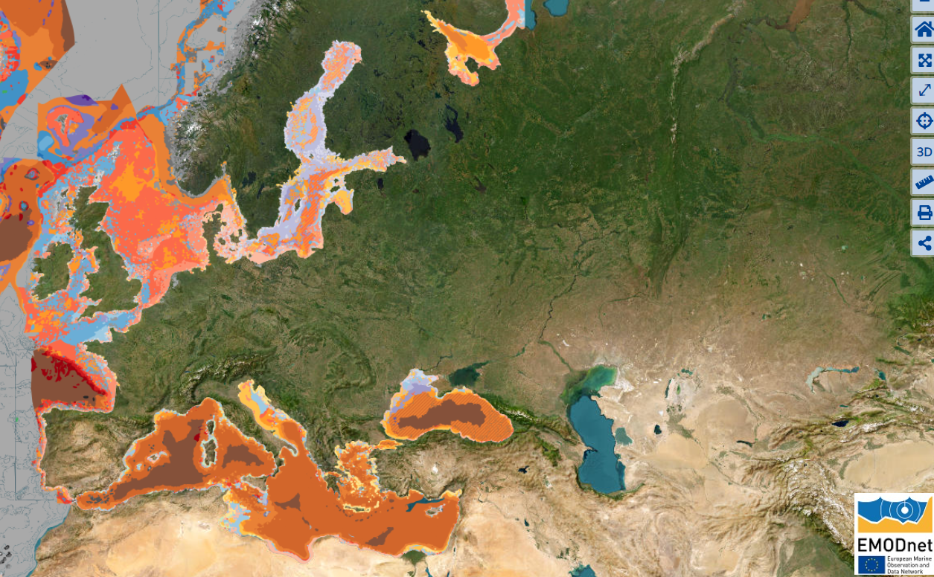
Standards and best practice
Assembling observations from different bodies into a coherent whole requires them to be made in the same way
Over 95% of practitioners feel that lack of standards in observations reduces the reliability of their analysis

Slide 14
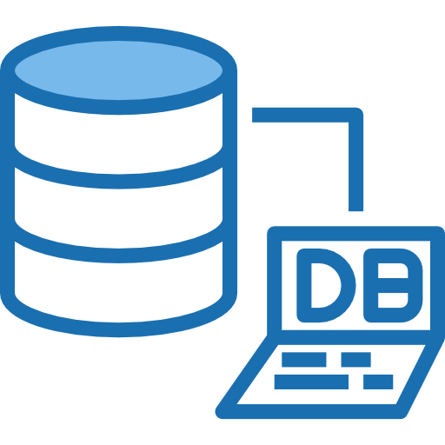
Database on standards and best practice in ocean observation
type
  protocols, equipment, data etc,.
what is being measured
  temperature, chemical concentration etc.
where it is measured
  sea, sediment etc,
who endorsed it
  OSPAR, GOOS etc
PROTOTYPE ON-LINE FIRST QUARTER 2025

Slide 15
Contents
The mandate
Studies on the market
Study on reporting
Study on standards
Building a Digital Platform
Reducing burden

Slide 16
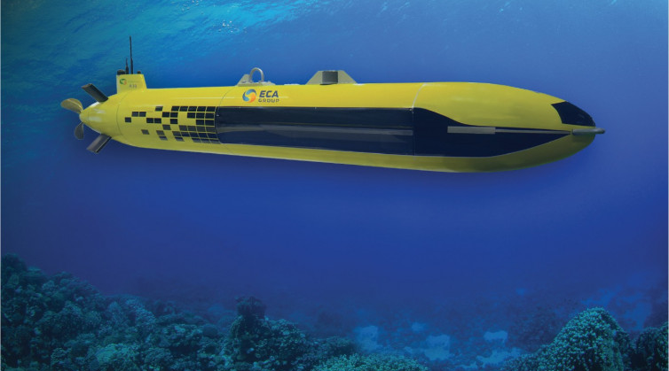
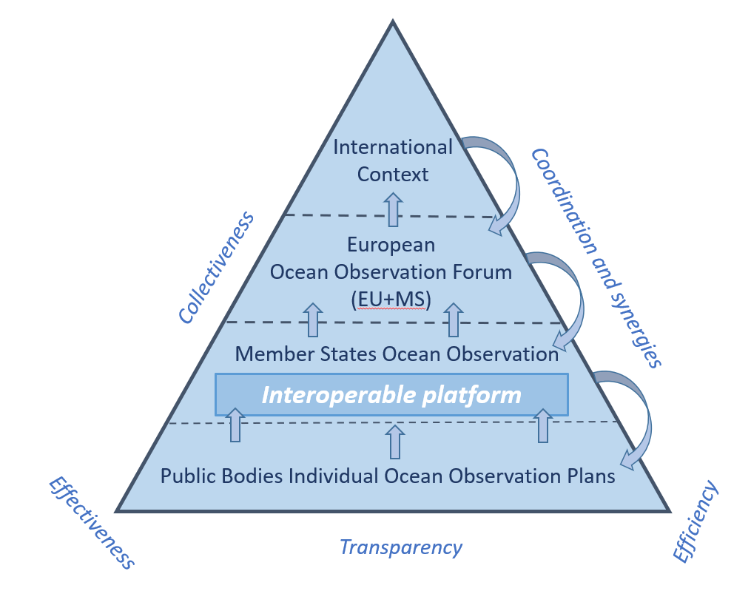
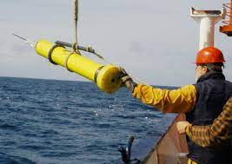
Possible process
16
Notes:
To do this we need to understand how the ocean works, including the marine life it supports. Our understanding is based on observation. We build digital models of the ocean and calibrate them against what has happened in the past. If our models manage to reproduce this past behaviour, we can rely on forecasts of the future.
This ocean observation to feed these models is undergoing a bluetech revolution. In the past, researchers would go out in ships, take samples of the water, analyse them in the laboratory and publish the results. This might be one or two years later. Now we see airborne, surface and underwater drones, either piloted or autonomous, replacing the ships. Advances in batteries, communication, sensors, artificial intelligence and DNA sequencing mean that we can analyse the water and send results to shore in almost real time.
That is the technology. We now need to optimise its use. It is currently organised separately for licensing, fisheries management, research, coastal protection, navigation and environmental protection by at least five ministries, departments or agencies in each EU country. Helping them work together to agree priorities, share responsibilities and assets is our challenge for this Ocean Decade

Slide 17
Study on Ocean Reporting Obligations
Managed by the European Climate, Infrastructure and Environment Executive Agency (CINEA) in collaboration with the European Commission (DG MARE)
Reference number CINEA/2021/OP/0009
Review existing ocean observation reporting obligations and templates
Propose, test and seek stakeholder feedback on a common template and online tool that could be used to better coordinate ocean observation campaign plans in EU Member States and across Europe, for the benefit of the Ocean Observation community.
Stakeholder consultation workshop 20 June 2023: inform, stimulate discussion and collect stakeholder feedback on a draft template and map viewer
https://cinea.ec.europa.eu/publications/study-reporting-obligations-ocean-observation_en
https://maritime-forum.ec.europa.eu/stakeholder-feedback-prototype-ocean-observation-campaign-reporting-template-and-map-viewer-20062023_en

Slide 18
Study on reporting obligations
What kind of information does the initiative aim to capture?
Who is observing the marine domain?
Why are they observing?
When are they observing?
Where are they observing?
What are they observing?
How are they observing?
Where are the observations/data stored? Who is the owner?
Standards adopted

Slide 19
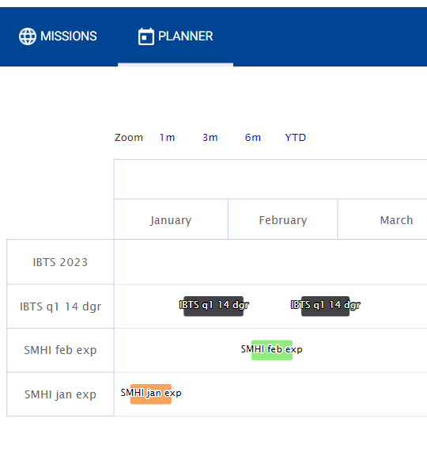
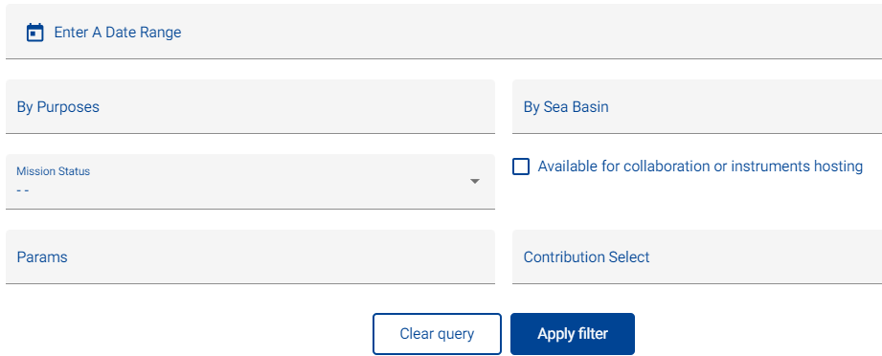
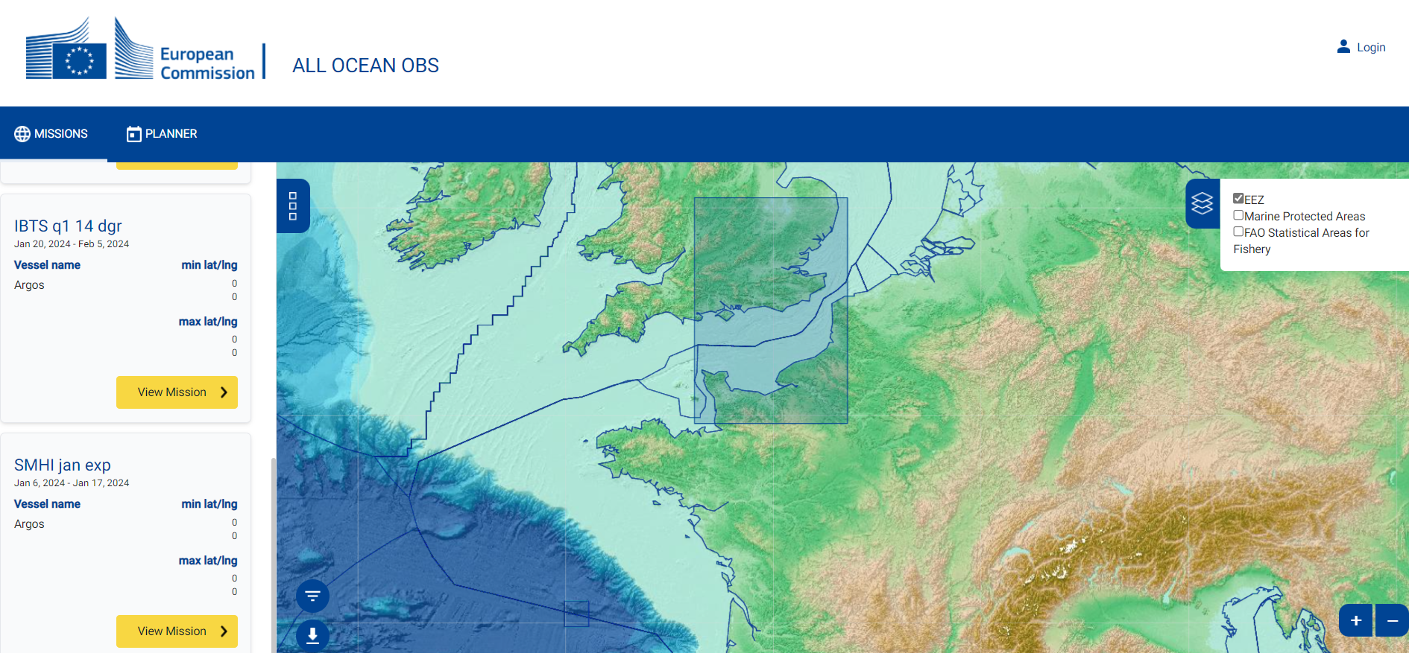
Test platform interface
Filters
Campaign 1
Campaign 2

Slide 20
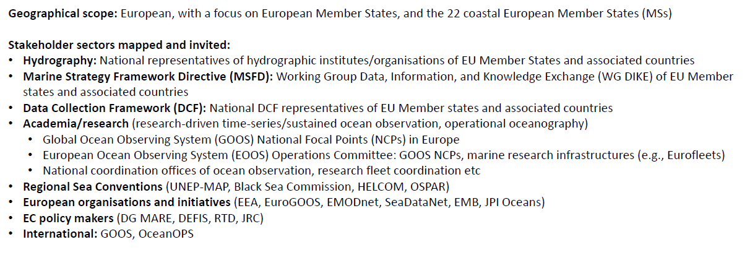
Study on reporting obligations

Slide 21
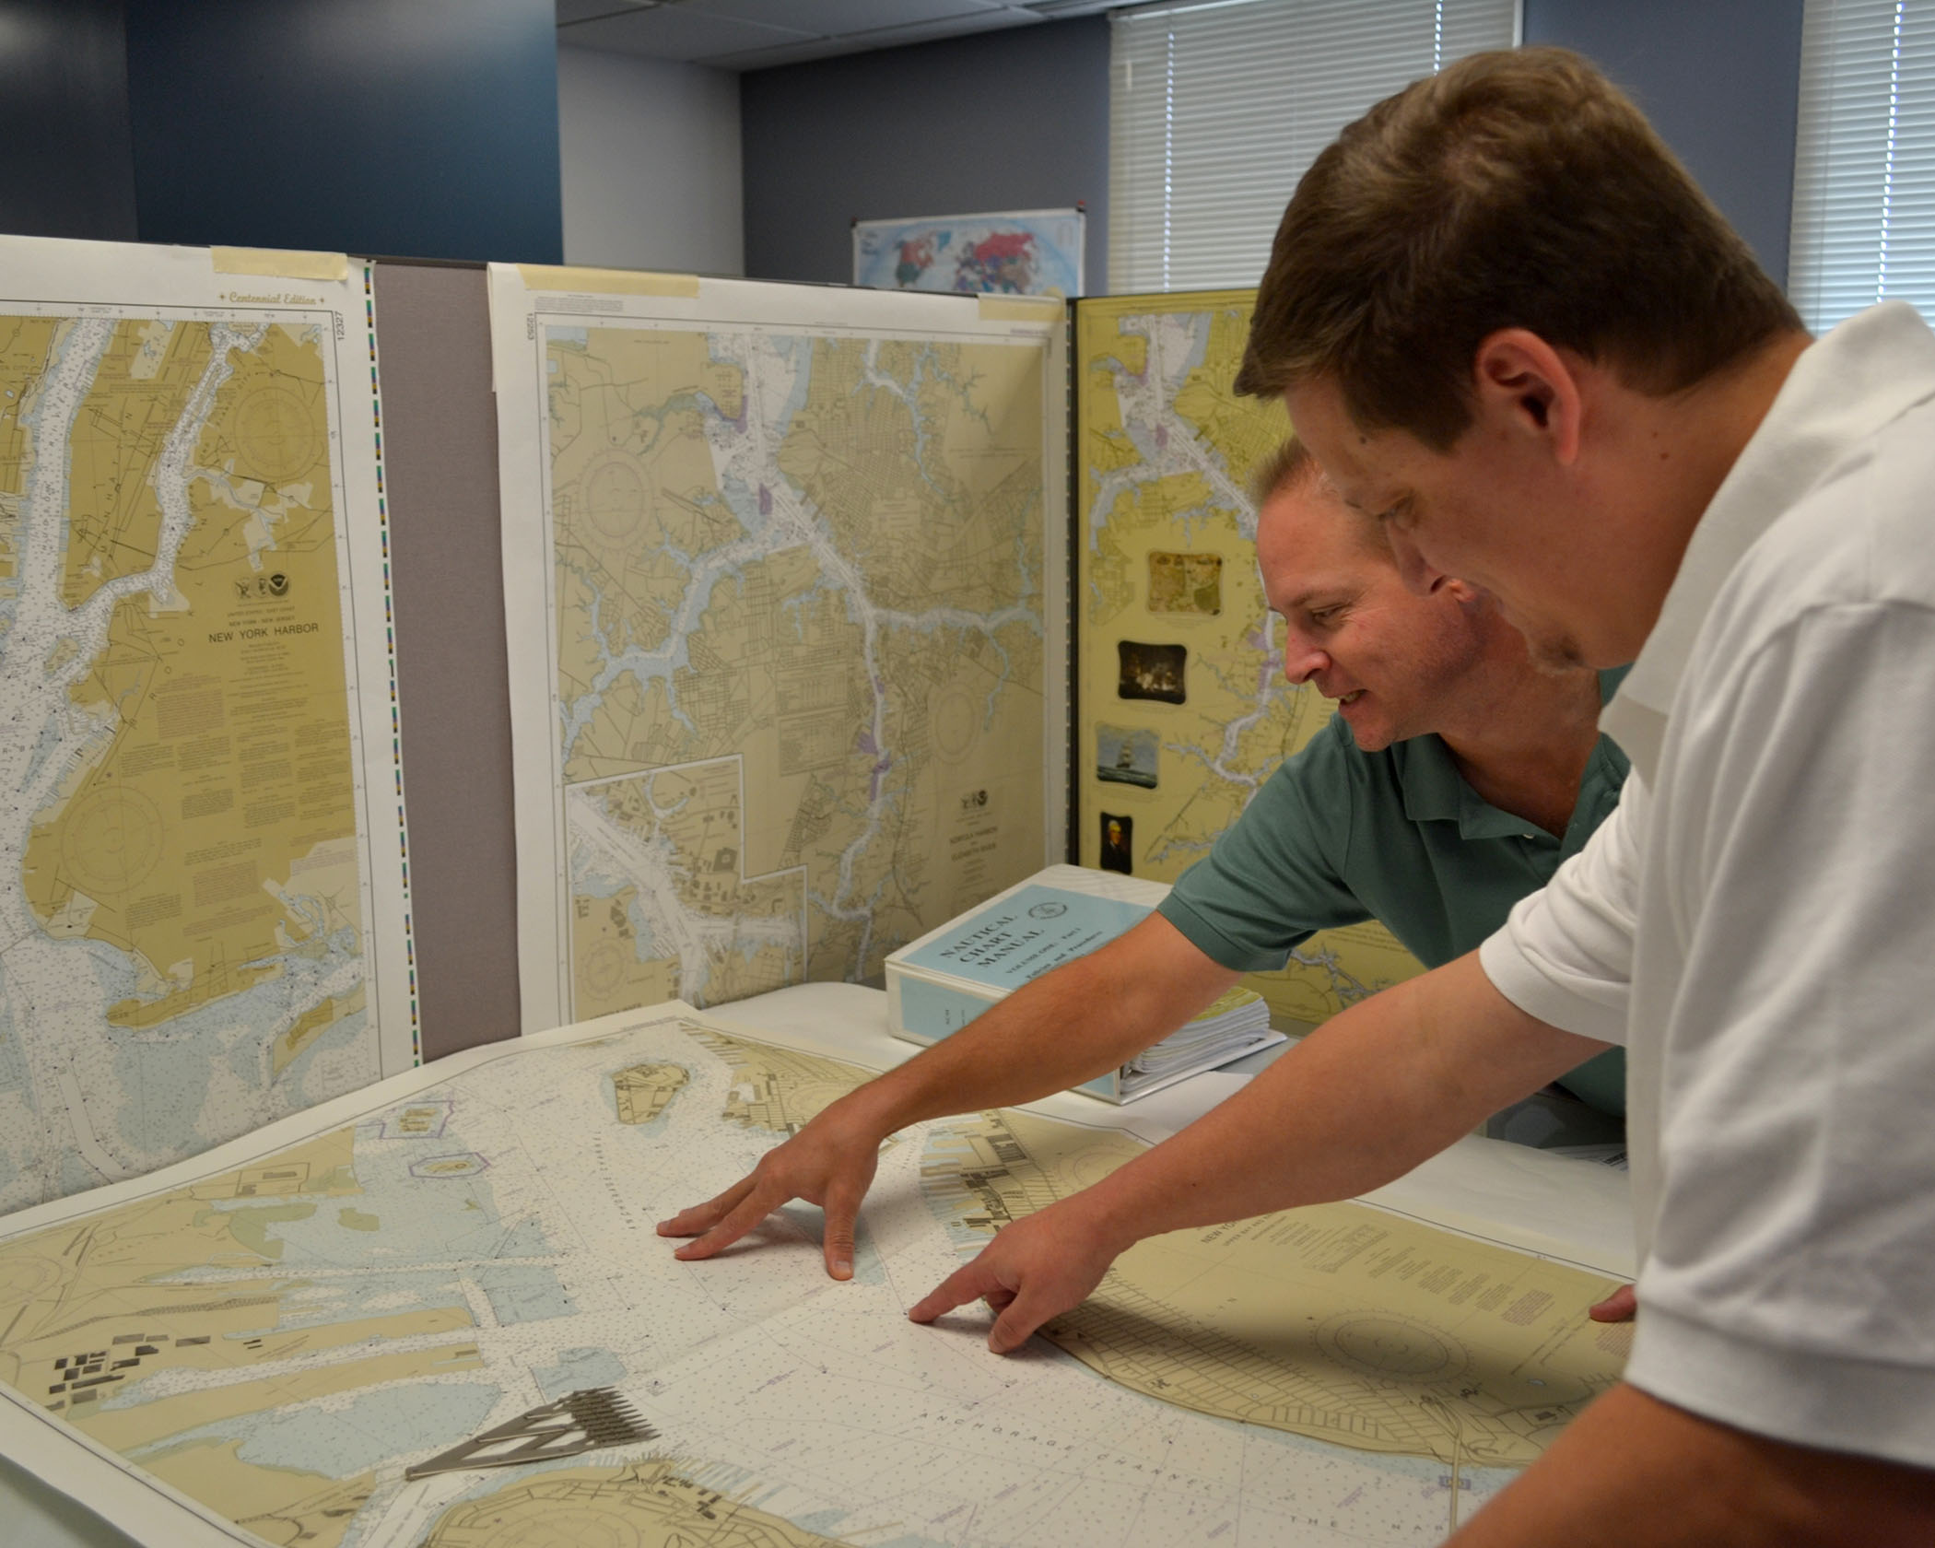
Planning in Member States
 | France | Sweden
hydrographic | 5 | 7
Fisheries | 4 | 2
environmental monitoring | 5 | 13
research cruises | 5 | 6
coastal facilities | 4 | 10
offshore facilities | 6 | 5
Challenging to identify and collate plans
Often devolved to regional administrations

Slide 22
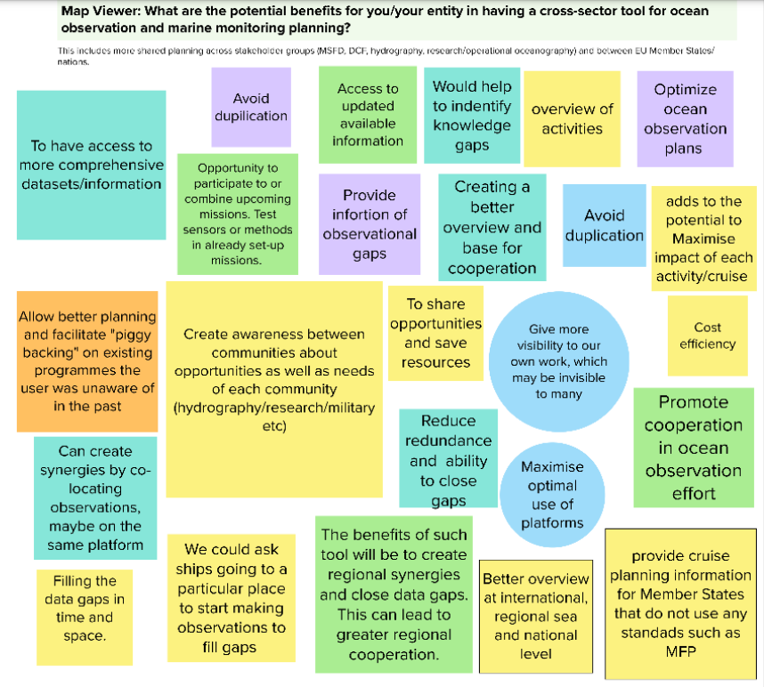
Potential benefits of having a cross-sector tool for ocean observation and marine monitoring planning?
Avoid duplication
Identify knowledge gaps
Optimise plans
Maximise use of OO platforms
Promote cooperation
…

Slide 23
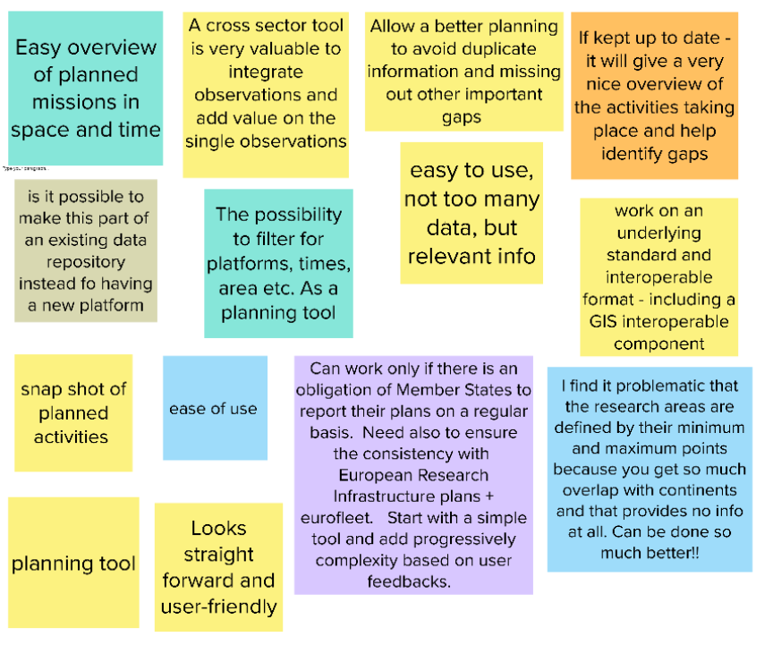
What are the strength or successful component of the pilot Map Viewer ?
Easy overview of planned mission in space and time
Enables a better planning
Allows to filter for platforms, etc.
Uses interoperable components
Easy to use, not too many info

Slide 24
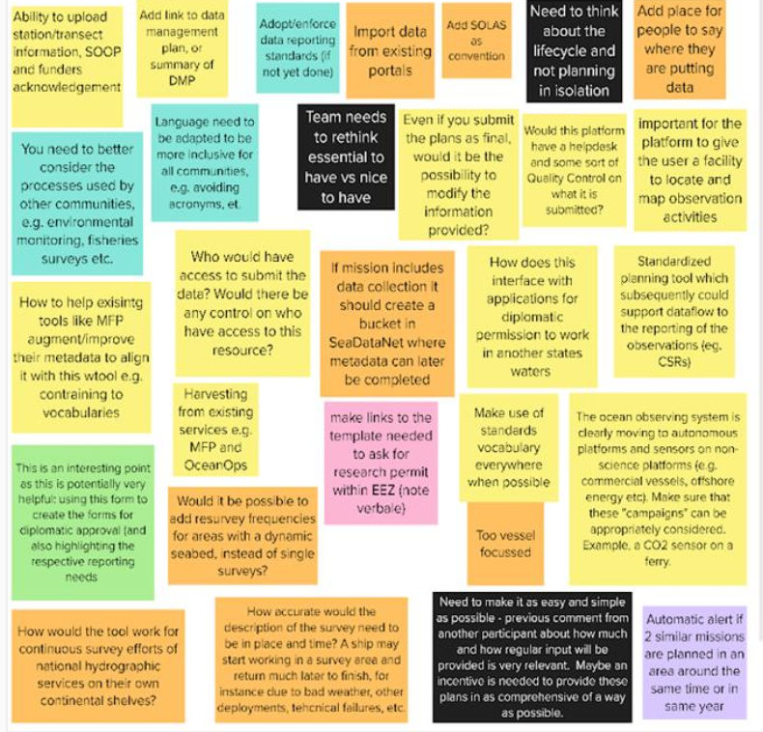
Template: what improvements do you suggest ?
Add information on the (future) location of data
The template is too much focussed on ships
Quality control and helpdesk
Enable modification of the plans (-> consequences ?)
…

Slide 25
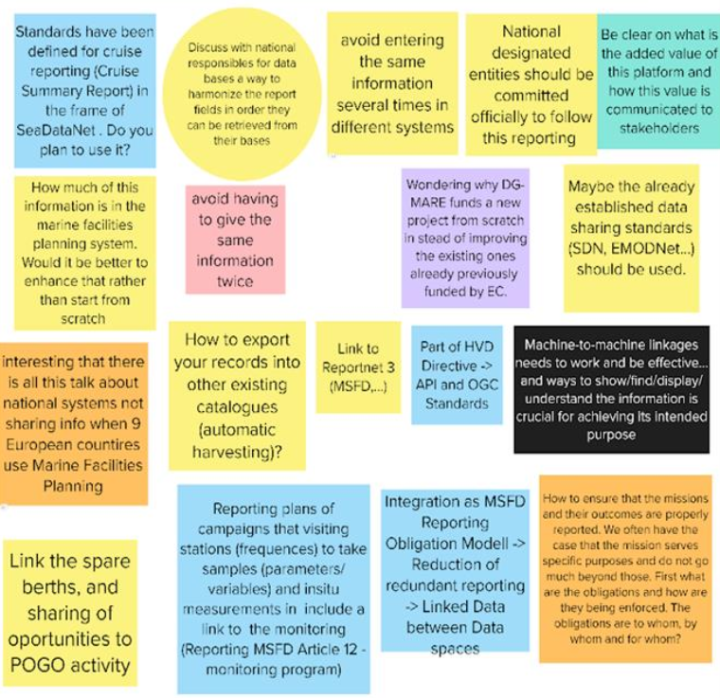
Template: how to connect to existing national / regional / EU
Use standards which are already existing and in use
Discuss with responsible for national databases
Import / export capacity – machine to machine
Look into existing systems (e.g. Marine Planning Facility)
…

Slide 26
Contents
The mandate
Studies on the market
Study on reporting
Study on standards
Building a Digital Platform
Reducing burden

Slide 27
Information on the Digital Platform i
Cost
Programme or sub-programme
Body responsible for the observation campaign + other bodies
Characteristics of the observation platform
  Survey ship, drones, gliders, floats, fixed platforms, on-board observer of fishing vessel, vessel of opportunity…
Purpose
  Research, hydrography, meteorology, fisheries, environment, …
Contribution to obligations
  e.g. MSFD, WFD, Dirds and Habitats Directives Species, BBNJ, …
Expected consumption of fossil fuel
Location and access conditions of data
Sampling
Timing
Notes:
a digital platform will collect information on ocean observation campaign plans and disseminate them, including though on-line digital maps. This overview will help those observing the ocean understand what others are doing. They can then exploit opportunities for collaboration in a self-organised way.
These responsible for these observations already need to report their plans to different authorities, sometimes, for instance, as part of their obligations under EU law. The basic information for all these obligations is the same – who is observing and why, what, where when and how they are observing, The platform will be able to transform this basic information into the form required for these other obligations so that they only need to provide the information once.
At this stage it will be purely voluntary
The work is in collaboration with the European Environment Agency who already deal with reporting on regulatory matters

Slide 28
Digital Platform
Possibly reusing existing platforms components from:
  European Environment Agency
  EMODnet
Call for tender open 13 June 2024
Closing 3 September 2024
Sign contract December 2024
Operational mid 2026
Notes:
a digital platform will collect information on ocean observation campaign plans and disseminate them, including though on-line digital maps. This overview will help those observing the ocean understand what others are doing. They can then exploit opportunities for collaboration in a self-organised way.
These responsible for these observations already need to report their plans to different authorities, sometimes, for instance, as part of their obligations under EU law. The basic information for all these obligations is the same – who is observing and why, what, where when and how they are observing, The platform will be able to transform this basic information into the form required for these other obligations so that they only need to provide the information once.
At this stage it will be purely voluntary
The work is in collaboration with the European Environment Agency who already deal with reporting on regulatory matters

Slide 29
Digital Platform
Regional coordination
  ICES, HELCOM, OSPAR, GFCM, Barcelona, Bucharest, regional hydrographic commissions, regional fisheries management organisations, etc.
Identifying
  Duplications and gaps
  Opportunities for sharing responsibilities and equipment
  Priorities
Notes:
a digital platform will collect information on ocean observation campaign plans and disseminate them, including though on-line digital maps. This overview will help those observing the ocean understand what others are doing. They can then exploit opportunities for collaboration in a self-organised way.
These responsible for these observations already need to report their plans to different authorities, sometimes, for instance, as part of their obligations under EU law. The basic information for all these obligations is the same – who is observing and why, what, where when and how they are observing, The platform will be able to transform this basic information into the form required for these other obligations so that they only need to provide the information once.
At this stage it will be purely voluntary
The work is in collaboration with the European Environment Agency who already deal with reporting on regulatory matters

Slide 30
First feedbacks and questions
Take into account already existing reporting and tools (MSFD, DCF and BBNJ - EUROFLEET RI - AMRIT – Oceanops )
Synergies and coordination between different type of platforms might be challenging (e.g. ships, floats, fixed platforms)
A regional approach dimension already exists (e.g. HELCOM, OSPAR) and one should build on this
Ideally Expert Group / Forum should be populated by authoritative persons
How do you optimise the plans in practice ?
Include feedback from Council WP on IMP and IMP Expert Group end of 2023 / beginning of 2024

Slide 31
Contents
The mandate
Studies on the market
Study on reporting
Study on standards
Building a Digital Platform
Reducing burden

Slide 32
Reducing Burden
Unique entry point / common format
Connecting to existing platforms
Generating ad-hoc reports
Search, view extract
Towards “report once, use for many purposes”
Notes:
Member States are obliged to report their observation plans for the Marine Strategy Directive
monitoring reports due in 2026. We are working with those responsible to ensure that Member States do not need to report twice
A new international legally binding instrument under the United Nations Convention on the Law of the Sea on the conservation and sustainable use of marine biological resources (BBNJ) requires observation plans to be submitted to Clearing House. This can be done through the digital platform

Slide 33
Discussion

Slide 34
Discussion – Improving Ocean Observation
In the agenda:
Member State views
Reducing administrative costs
Accelerating innovation
Increasing competitiveness of EU companies on Global market
Additional points of interest proposed:
Do you have a national plan for OO ?
Do you have national coordination mechanisms on OO ?
Do you have examples of coordination
What are the obstacles you see to synergies and coordination ?
Request from Norway to participate as an Observer

Slide 35
Thank you for your attention

Slide 36
Study on reporting obligations

Slide 37
Study on reporting obligations

Slide 38
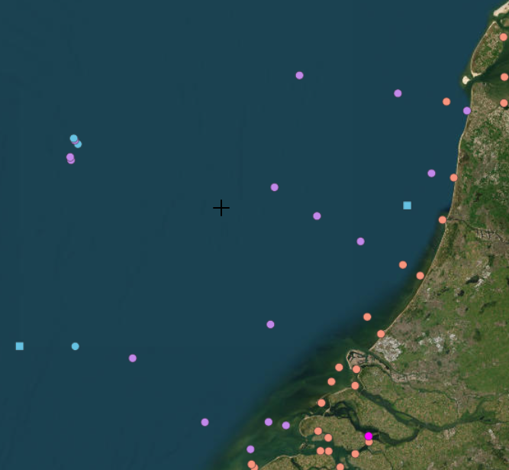
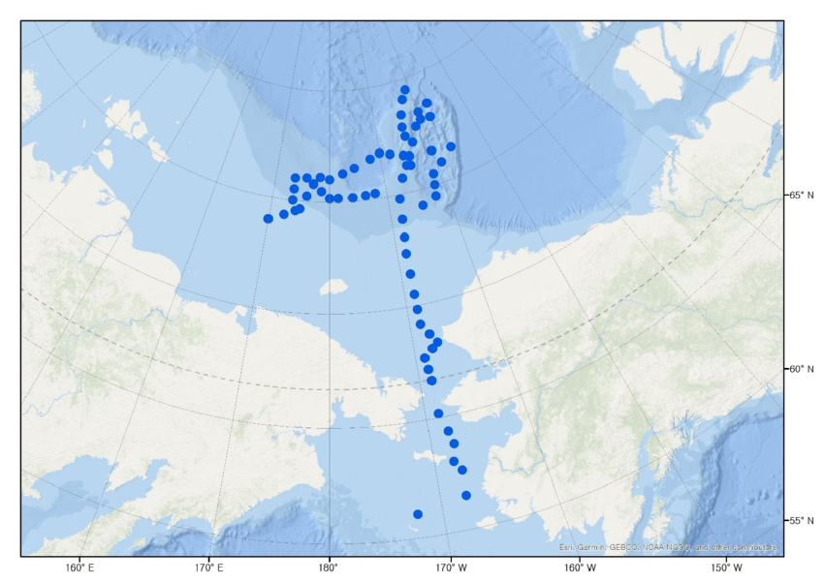
Recommendations for digital platform for ocean observation campaign plans
User-friendly and simple
Automatisation of updates and data harvesting
Include options to export and import information
Standardise metadata
Identify gaps in observations
Unique identifiers to allow cross-referencing
Regular review of template
Up-to-date instruction manual
Indicate where observations data will be stored
https://cinea.ec.europa.eu/publications/study-reporting-obligations-ocean-observation_en
https://maritime-forum.ec.europa.eu/stakeholder-feedback-prototype-ocean-observation-campaign-reporting-template-and-map-viewer-20062023_en

