Slide 1
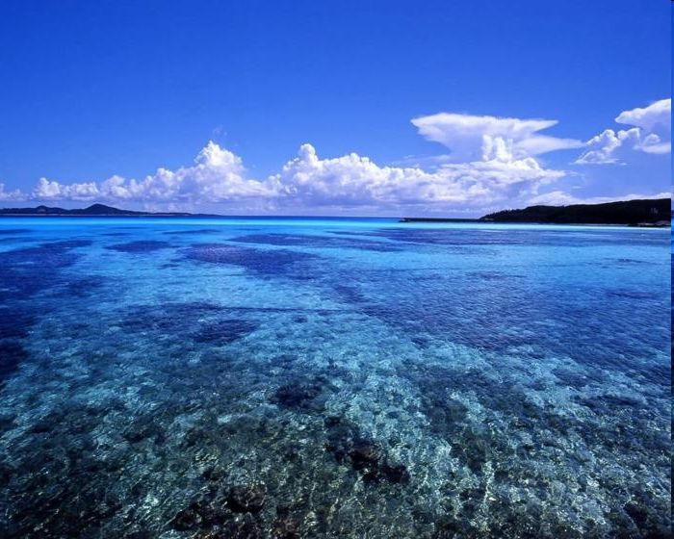
Innovations for the Oceans of Tomorrow
Jay Pearlman
Applications Panel

Slide 2
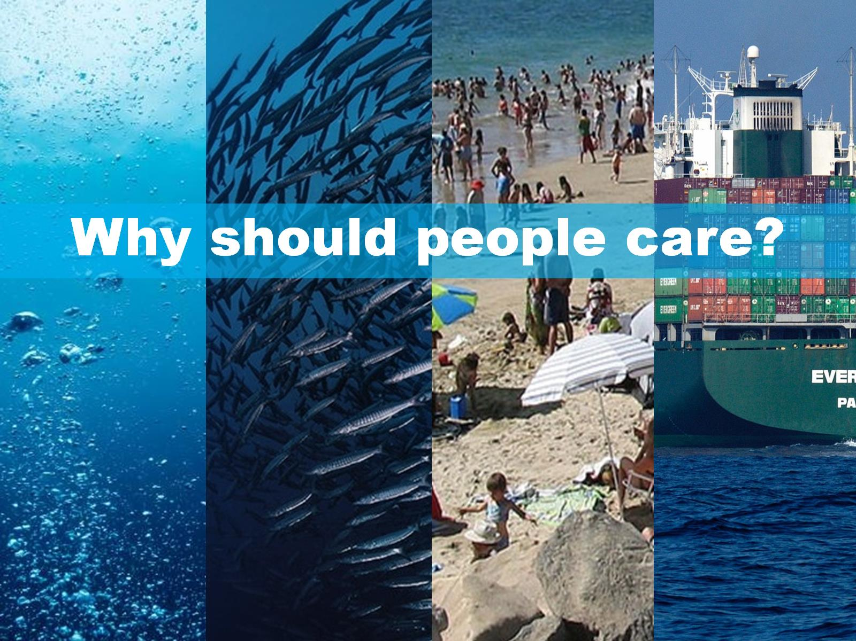
Why should people care?

Slide 3
Why should people care?
Notes:
Providing 97% of the Earth’s water and 95% of its biosphere, the ocean is a crucial source of food, water, energy and raw materials, and acts as a medium for tourism, transport and commerce. Valued at US$24 trillion (WWF report 2015), the global ocean has been termed the world’s seventh largest economy. The OECD has estimated the gross value added (GVA) of the global ocean economy in 2010, measured in terms of ocean-based industries’ contribution to economic output and employment, at USD $1.5 trillion, or approximately 2.5% of the total global GVA. Sustained ocean observing is crucial to provide data products and services driving the Blue Economy in a responsible and sustainably way, to understand the oceanic environment and help mitigate climate change.

Slide 4
VALUE | OCEAN OBSERVATIONS

Slide 5
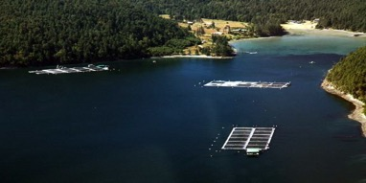
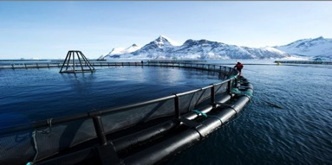
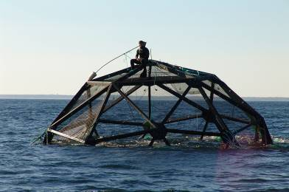
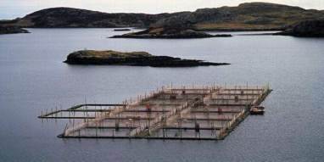
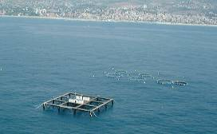
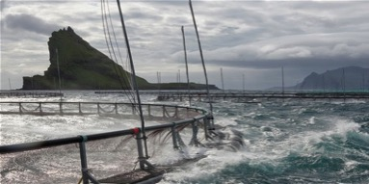
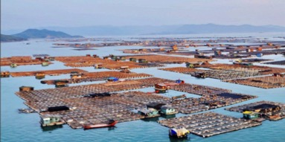
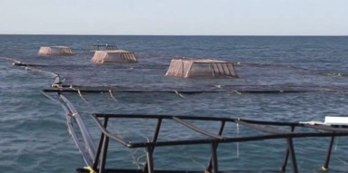
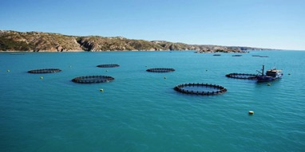
Marine Cage Aquaculture
USA
Norway
USA
Scotland
Spain
Ireland
China
Mexico
Australia
Notes:
There is already a tremendous amount of sea cage aquaculture – the majority is salmon farming. However there is also cobia, seabream, seabass and others
Oysters, mussels, cobia, salmon, seaweed

Slide 6
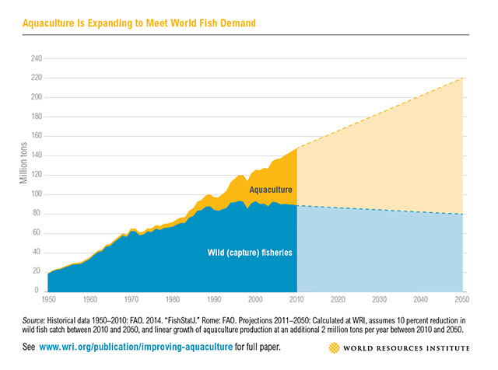
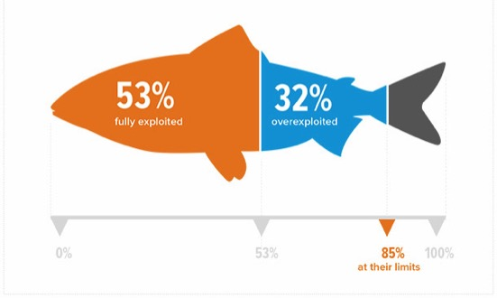
64%
50%
50%
36%
9.7 Billion people
Notes:
Wild captured fisheries has plateaued.
You can see where aquaculture is now and where it will be in the next 30+ years
For aquaculture as an industry, it’s not a question of if or when it will take off, but more about how and where it will expand, and what people can do to help steer it towards more sustainable practices.
So how do we do this with environmental sustainability and production of safe and healthy seafood.

Slide 7
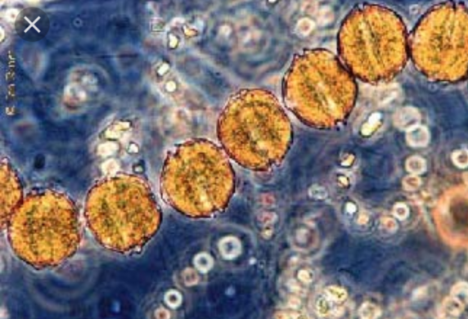
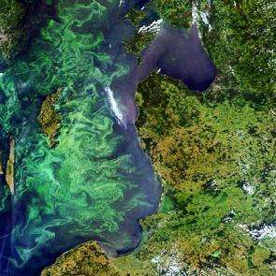
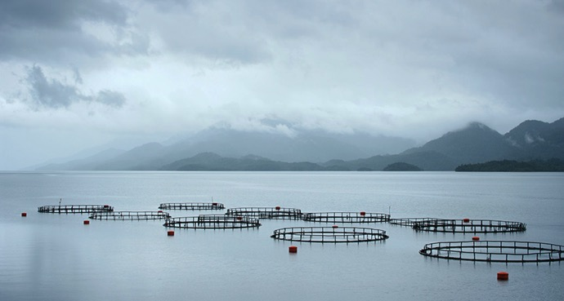
Notes:
Alexandrium catenella (dinoglagelate)
Early 2016 Massive Algal Blooms
The algal blooms coincided with and were enhanced by a strong El Niño event that included higher than normal water temperatures, reduced rainfall and calm wind conditions during the Austral fall season – all conditions that favor HAB development. Nutrients from the sea
The timeliness of HAB detection, bloom tracking and forecasting can be enhanced through the use of several new technologies. Strategically placed buoys can operate autonomously for months without maintenance, identifying and counting algal cells and transmitting results via the Internet for near real-time use. Satellite- based remote-sensing systems for HAB detection, coupled with physical-biological numerical models, can identify blooms, and their bloom transport and landfall.

Slide 8
OoT Workshop Session 3
1. Applications Panel | Organization | Areas of interest
Gareth Davis | Aquatera | Marine Energy
Gordon Drummond | SubseaUK | Technology for subsea environment
David Green | University of Aberdeen | Marine and Coastal Zone Management
David Murphy | AquaTT | Knowledge Transfer for Impact
Iain Shepherd | EC DG Maritime Affairs & Fisheries | Environment/Fisheries
Tom Williams | Institute for Marine Research | The Reference Norwegian Fishing Fleet

