Slide 1
ESCO: Connecting people and jobs
Francesco Losappio
EU Affairs Adviser to DG Employment,
Social Affairs and Inclusion of the European Commission

Slide 2
What is ESCO?

Slide 3
What is ESCO?
Multilingual classification of
European Skills, Competences, Qualifications and Occupations

Slide 4
Why ESCO?
- to improve the communication between the education and training sector and the EU labour market;
- to support geographical and occupational mobility in Europe;
- to make data more transparent and easily available for use by various stakeholders, such as public employment services, statistical organisations and education organisations;
- to facilitate the exchange of data between employers, education providers and job seekers irrespective of language or country;
- to support evidence-based policy making by enhancing the collection, comparison and dissemination of data in skills intelligence and statistical tools, and enabling better analysis of skills supply and demand in real-time based on big data.

Slide 5
Three ESCO pillars
2,414
Qualifications
2,942 Occupations
13,485 Skills

Slide 6
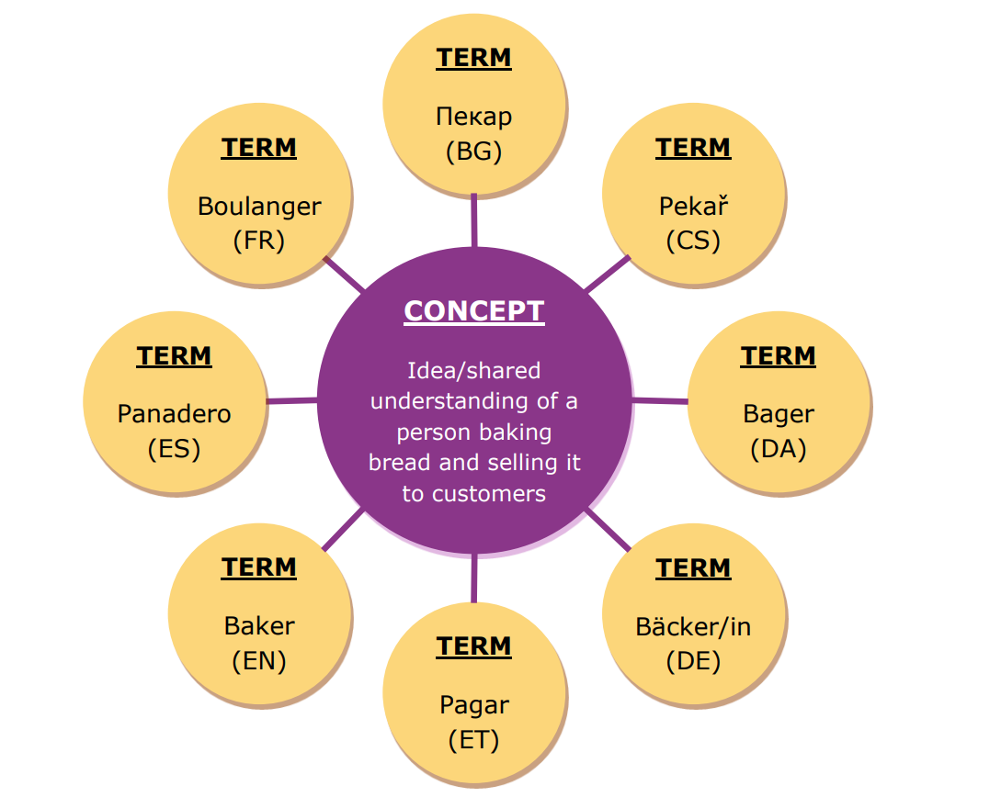

Slide 8
Occupational Profiles in ESCO
https://ec.europa.eu/esco/portal/occupation

Slide 9
Occupational Profiles in ESCO

Slide 10
Skills in ESCO

Slide 11
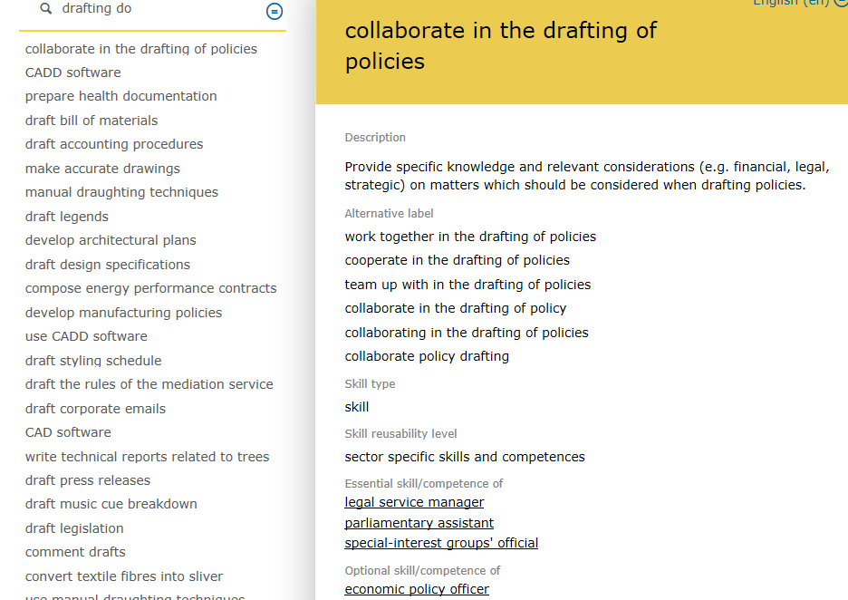
Skills in ESCO

Slide 12
Skill groups
Transversal skills and competences
Digital competences
Languages
Cross-sectoral skills and comp.
Sector-specific skills and comp.
Occupation-specific skills and comp.

Slide 13
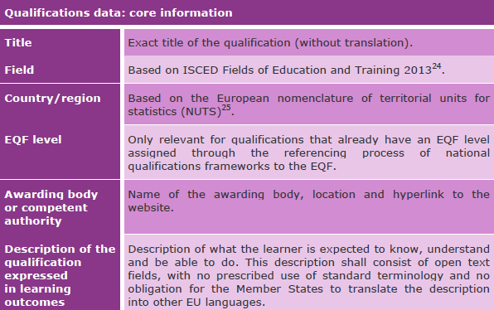
Qualification pillar
National qualifications databases of Member States. These qualifications are included in National Qualifications Frameworks that have been referenced to the EQF

Slide 14
How can ESCO be used?

Slide 15
How ESCO can be used
Information on learning
opportunities
Performance management, appraisals
Job matching
Matching at skills level
Guidance & counselling
Forecasting & planning
Labour Market
Skills/ Competences
Education/
Training
Occupations
Qualications

Slide 16
Continuous improvement of ESCO

Slide 17
Overview of the ESCO improvement process
4. Release
1. Preparation
3. Knowledge engineering
2. Scoping

Slide 18
ESCO COMMUNITY FORA
Accessible only by direct invitation
community forum for ESCO domain experts
community forum for the ESCO Maintenance Committee
community forum dedicated to Member States' representatives
Free open access
community forum for the ESCO implementers

Slide 19
Role of domain experts
Users are encouraged to provide their feedback on:
preferred terms
alternative labels
descriptions of occupations and skills and knowledge concepts
ISCO codes associated to ESCO occupations
essential and optional skills and knowledge foreseen for an occupation
relations between occupations and skills
spelling mistakes
new occupations and skills not included in ESCO

Slide 20
Next steps!
New structure for the Skills Pillar
Translations of the descriptions in all ESCO languages
Reflection on transversal skills
ESCO v.1.1

Slide 21
Thank You!!!

