Slide 1
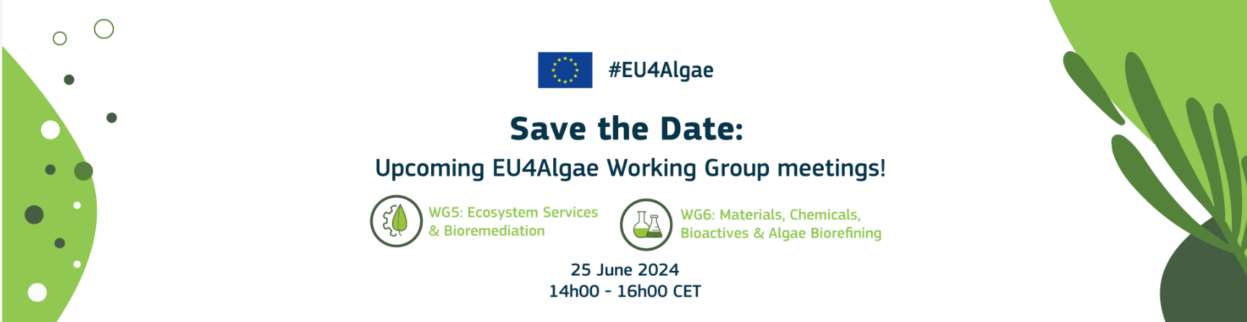

Introduction to microalgae-based biofertilizers produced with circulated nutrients
F. Gabriel Acién.
Dpt. Chemical Engineering, University of Almeria, SPAIN
Notes:
Thanks for inviting me to talk about SABANA Project, focused into the sustainable production of end products for agriculture and aquaculture from microalgae

Slide 2
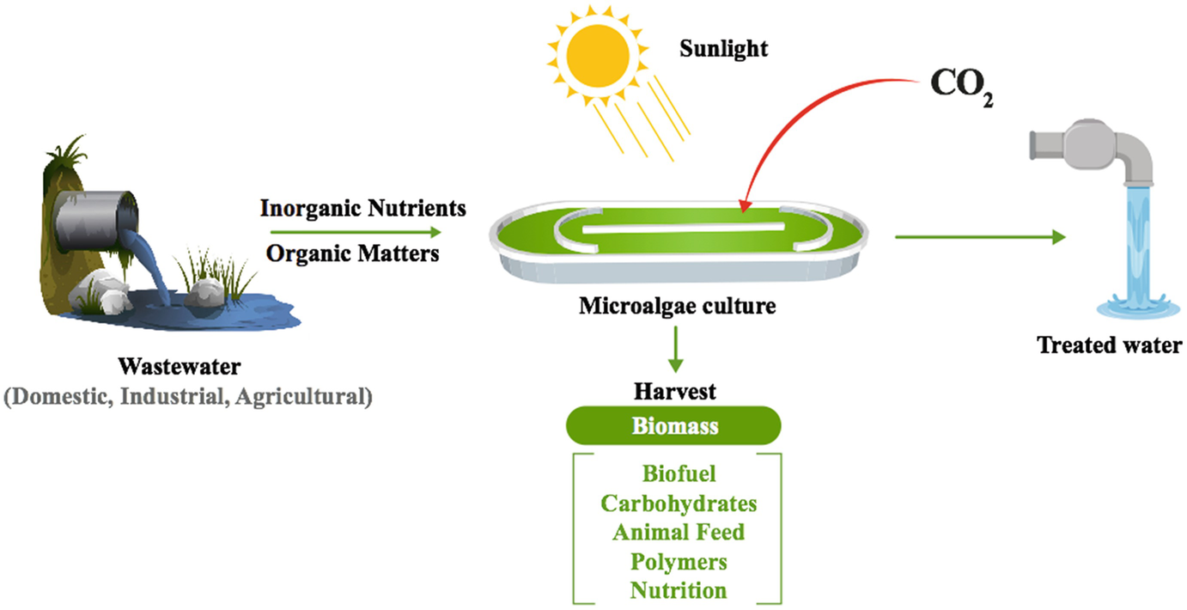
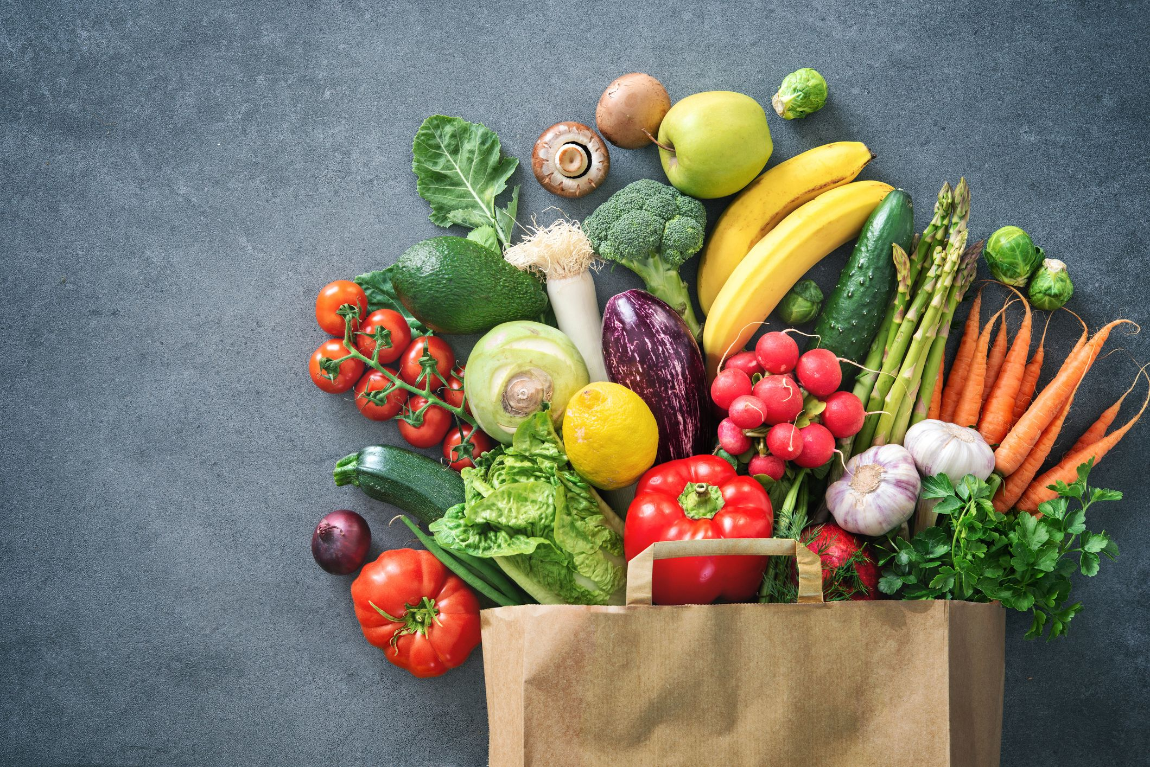
Aim
Biopesticides
Biopesticides
Biostimulants
Biofertilizers
Notes:
Thus, in the presentation we will shortly revise the fundamental of mass transfer, then studying its relevance on the design and operation of two of the main types of photobioreactors, open raceway and tubular photobioreactors.

Slide 3
Agriculture applications
Agriculture related applications
Plant fertilizers
Definition:
A fertilizer is any material of natural or synthetic origin that is applied to soil or to plant tissues to supply plant nutrients. Fertilizers may be distinct from liming materials or other non-nutrient soil amendments. Many sources of fertilizer exist, both natural and industrially produced. For most modern agricultural practices, fertilization focuses on three main macro nutrients: Nitrogen (N), Phosphorus (P), and Potassium (K) with occasional addition of supplements like rock dust for micronutrients. Farmers apply these fertilizers in a variety of ways: through dry or pelletized or liquid application processes, using large agricultural equipment or hand-tool methods.
Plant biostimulants
Definition:
A plant biostimulant is any substance or microorganism applied to plants with the aim to enhance nutrition efficiency, abiotic stress tolerance and/or crop quality traits, regardless of its nutrients content.
Main categories of plant biostimulants:
Humic and fulvic acids
Protein hydrolysates and other N-containing compounds
SEAWEED EXTRACTS and botanicals(=plant extracts)
MICROALGAE incl. CYANOBACTERIA
Chitosan and other biopolymers
Inorganic compounds
Beneficial fungi
Beneficial bacteria
Notes:
Thus, in the presentation we will shortly revise the fundamental of mass transfer, then studying its relevance on the design and operation of two of the main types of photobioreactors, open raceway and tubular photobioreactors.

Slide 4
Agriculture applications
Biofertilizers market
Large volumes are required
Low prices are required
7%N
1.5%P
0.5%K
7%N
1.5%P
0.5%K
Microalgae can be used as biofertilizers in the case of being produced at zero cost during wastewater treatment processes, otherwise it is not cost competitive for this application
Notes:
Thus, in the presentation we will shortly revise the fundamental of mass transfer, then studying its relevance on the design and operation of two of the main types of photobioreactors, open raceway and tubular photobioreactors.

Slide 5
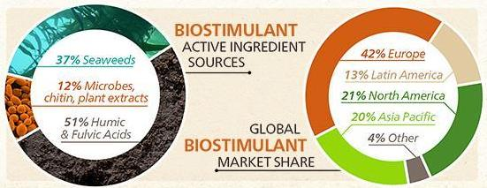
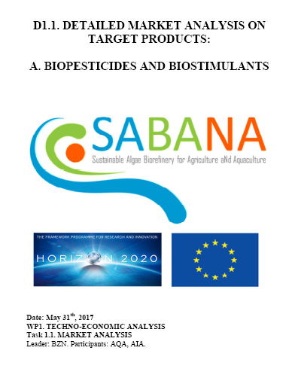
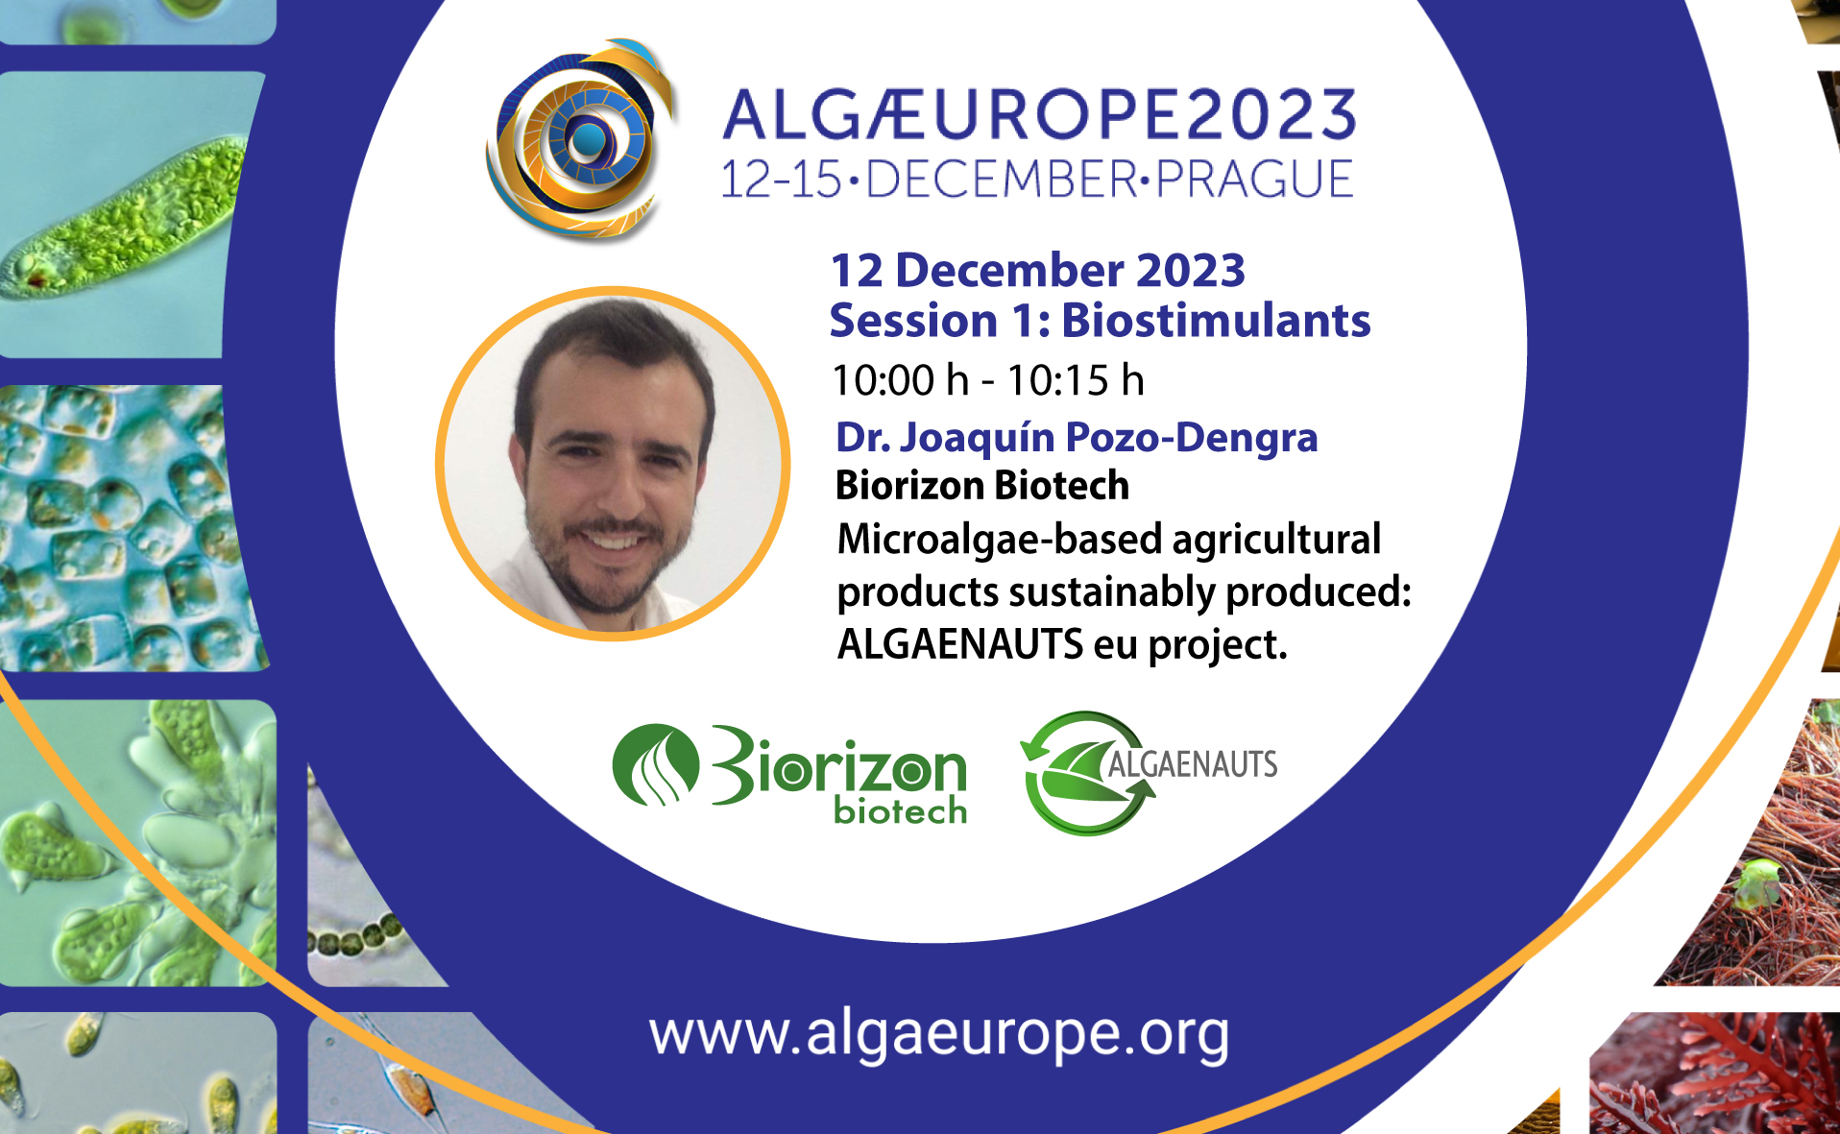
Agriculture applications
Biostimulants market
Biomass production cost<10 €/kg
Minimum capacity>20 tn/year
Market of agriculture products is confirmed for biostimulants related products
Microalgae based products are scarce but highly appreciated, major problem being the low amount of biomass available and high cost
Notes:
Thus, in the presentation we will shortly revise the fundamental of mass transfer, then studying its relevance on the design and operation of two of the main types of photobioreactors, open raceway and tubular photobioreactors.

Slide 6
Agriculture applications
Biostimulants
Major effects:
Improvement of soil
Resistance to stress
Regulation fo growth/fruits
Reduction of requirements
Effects of algal extracts on plants
(Michalak, I., et al. (2017) Molecules 22, 66.)
Notes:
Thus, in the presentation we will shortly revise the fundamental of mass transfer, then studying its relevance on the design and operation of two of the main types of photobioreactors, open raceway and tubular photobioreactors.

Slide 7
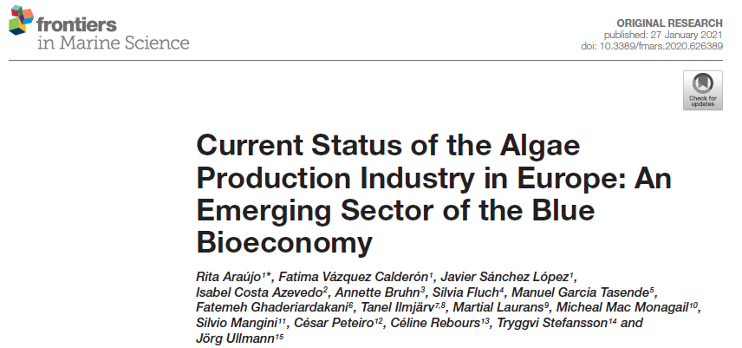
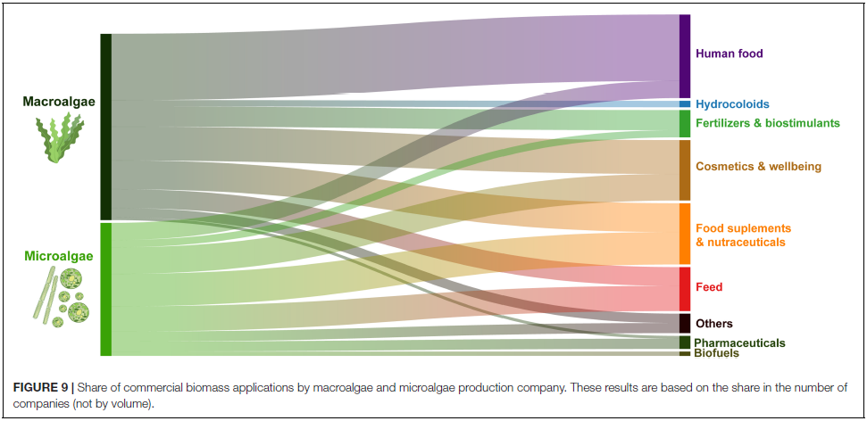
Agriculture applications
Biostimulants from algae
Notes:
Thus, in the presentation we will shortly revise the fundamental of mass transfer, then studying its relevance on the design and operation of two of the main types of photobioreactors, open raceway and tubular photobioreactors.

Slide 8
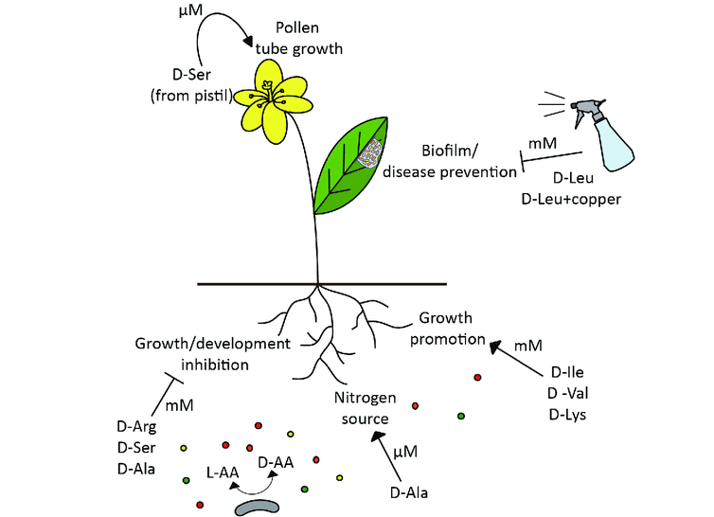
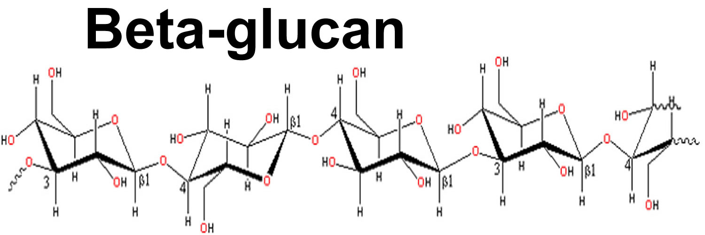
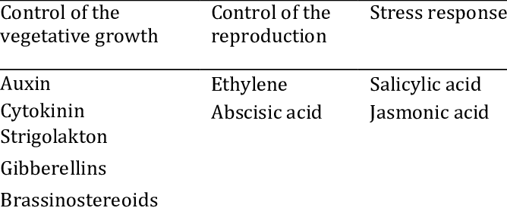
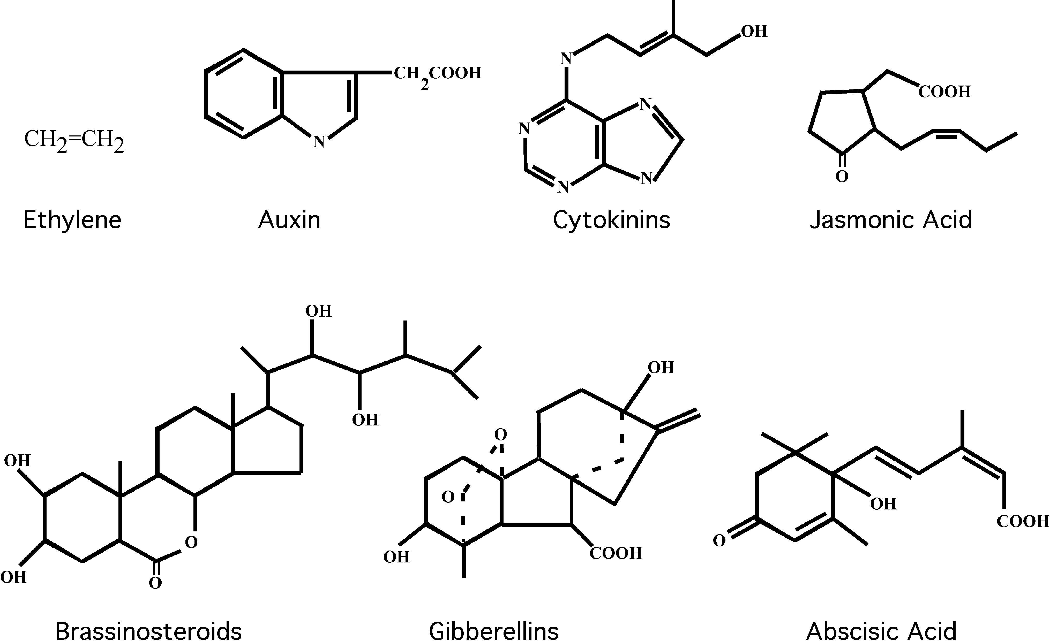
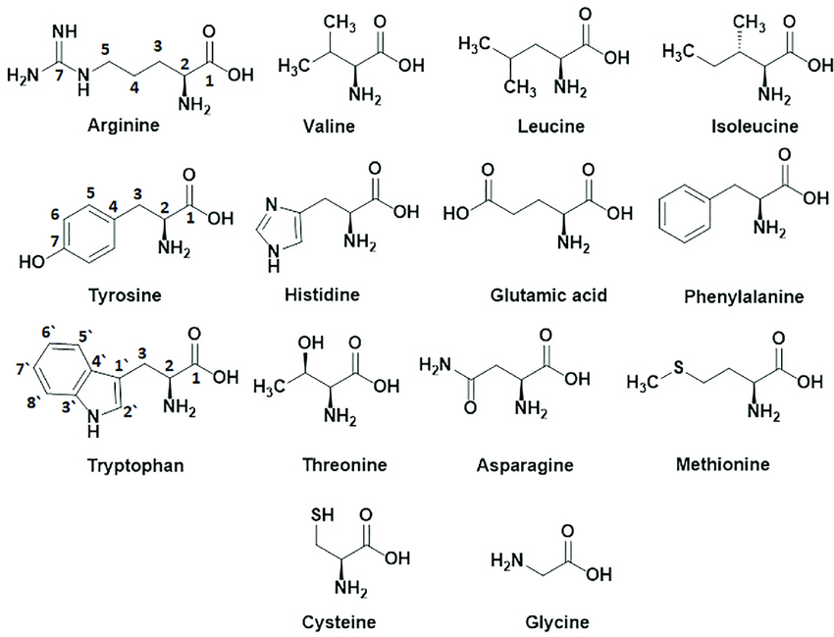
Agriculture applications
Biostimulants compounds
Amino-acids
Most relevant compounds:
Polysaccharides/carbohydrates
Peptides and amino-acids
Phytohormones (auxin, citokinin, gibberelin)
Phytohormones
Notes:
This project is supported by the EU Commission on the Blue growth program, and it is an innovation action coordinated by the University of Almeria in collaboration with industrial partners as Aqualia, Biorizon, GEA Westfalia and Veronessi, in addition to academic partners as university of Milano, Szechenyo university, AlgaTech, KIT and University of Gran Canaria, in addition to CIB.

Slide 9
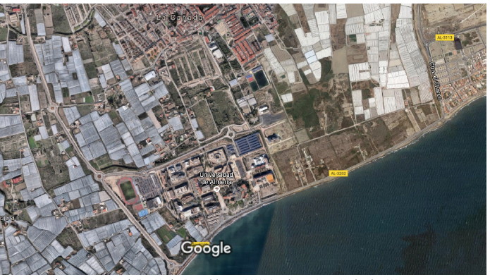
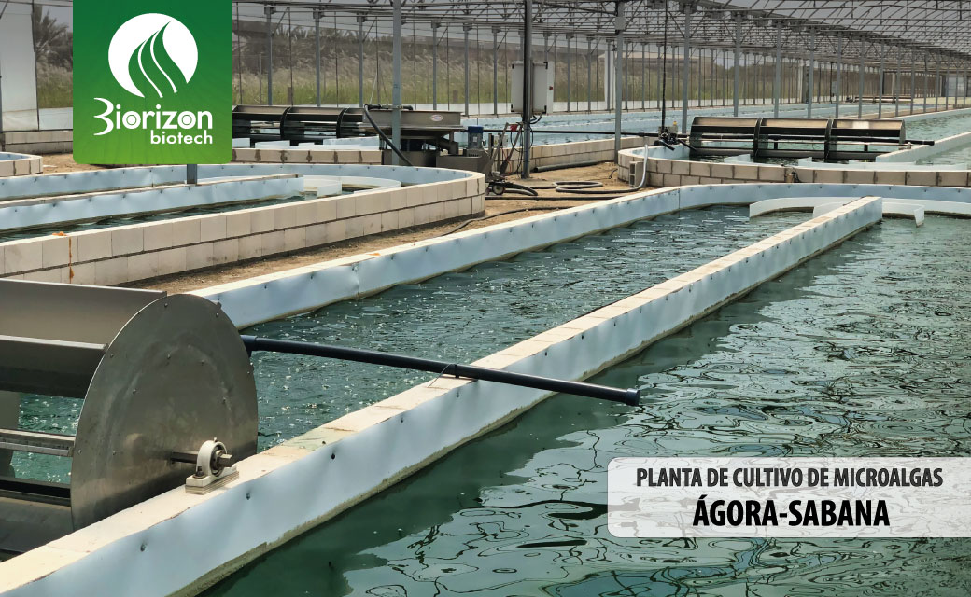
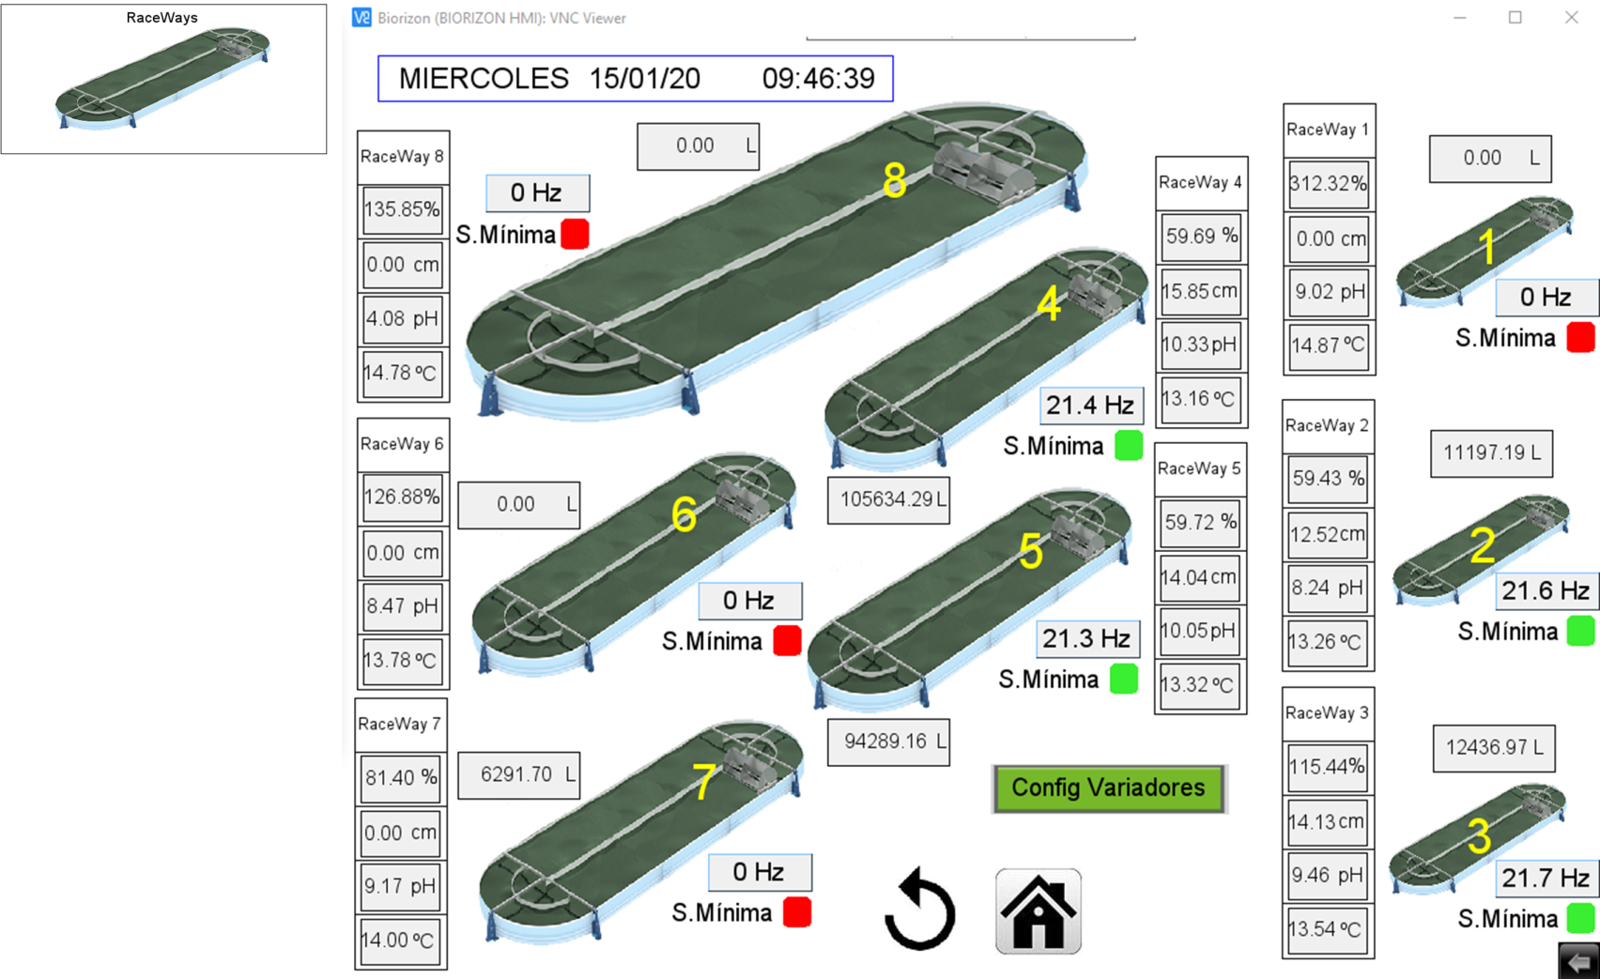
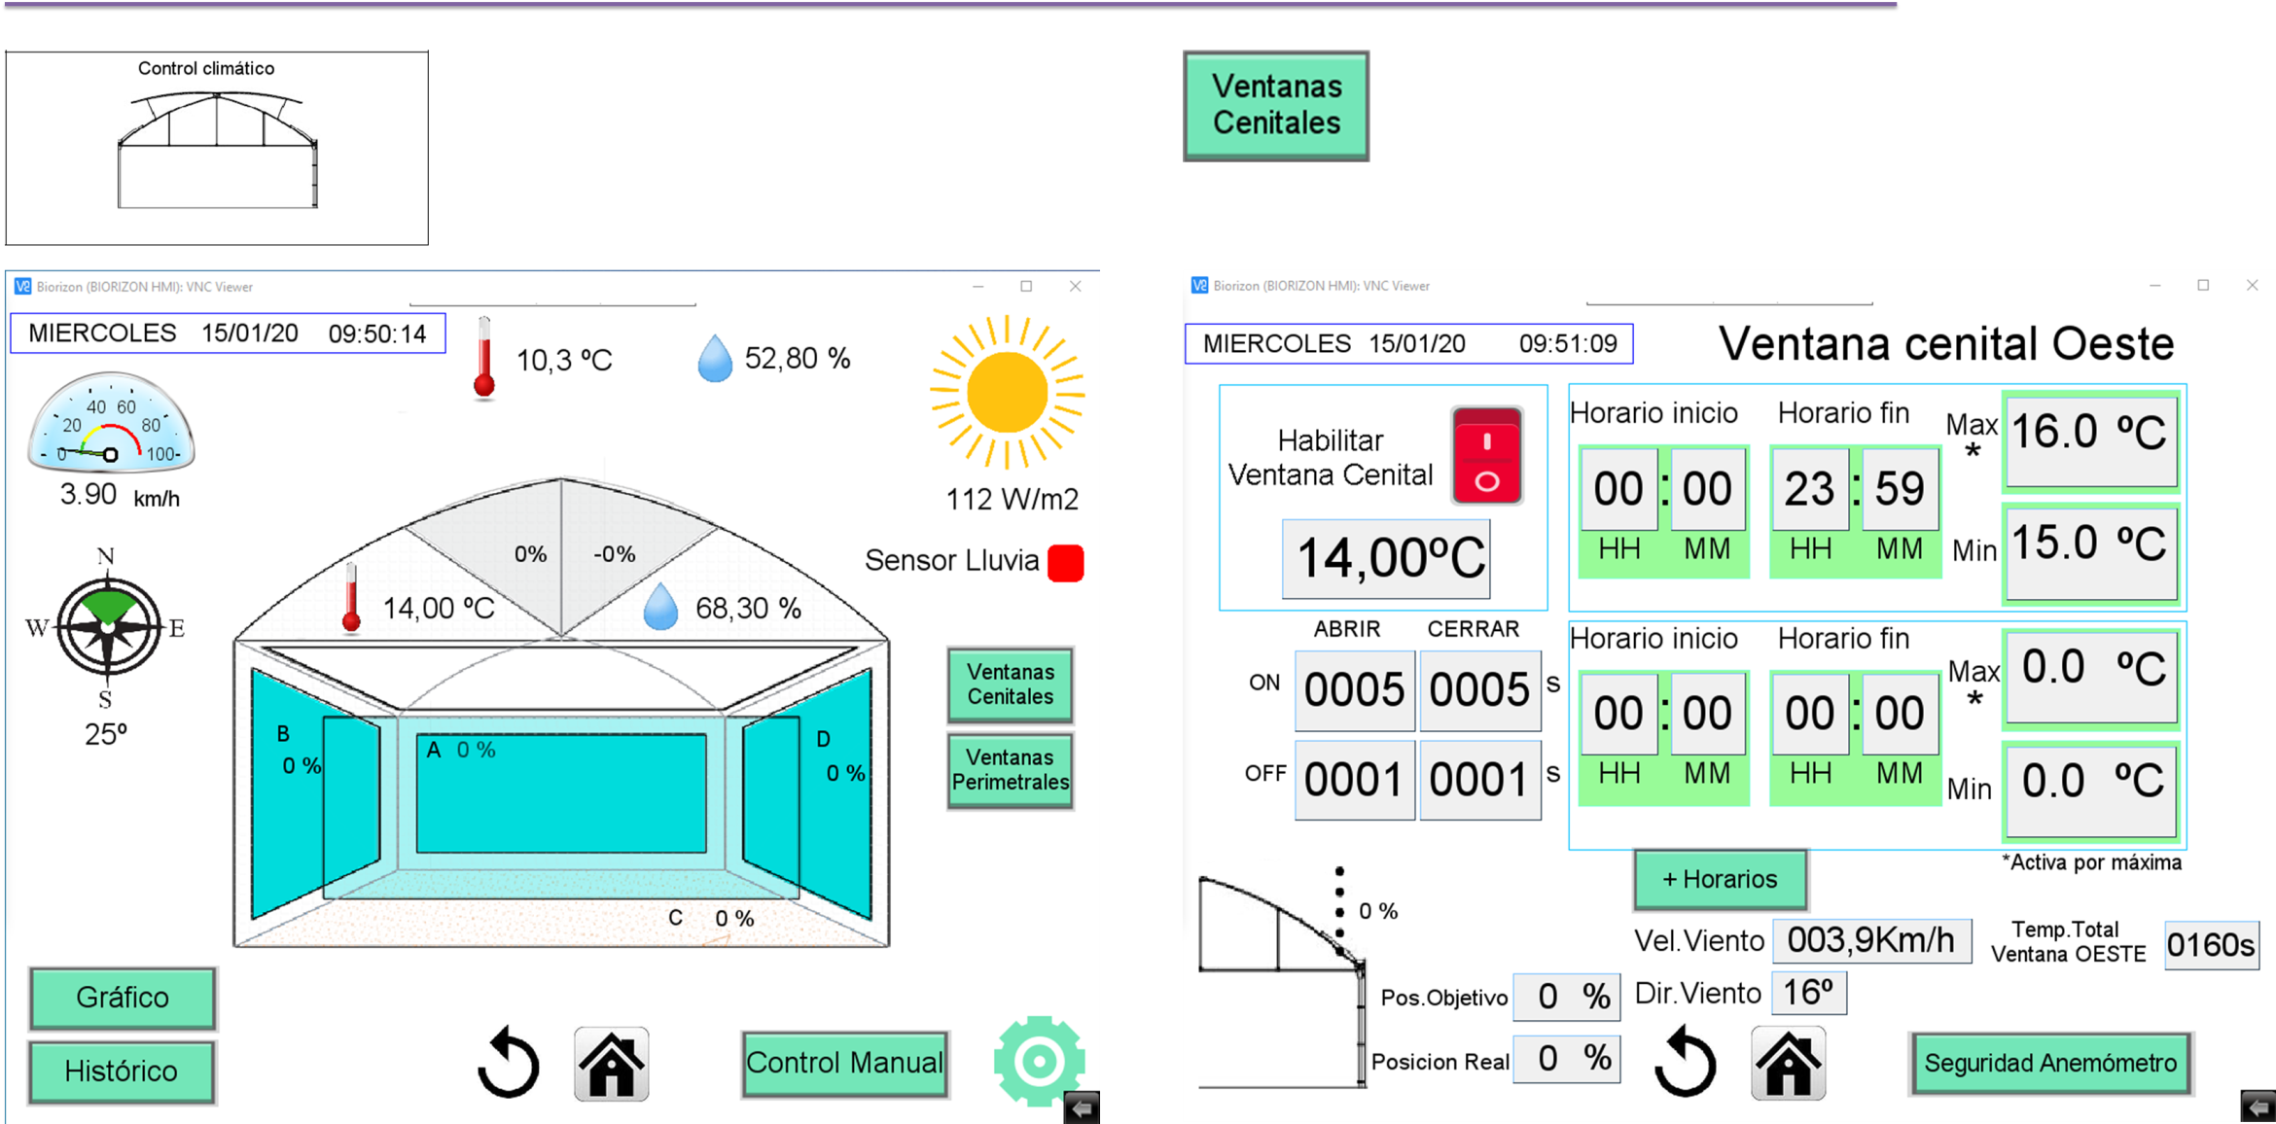
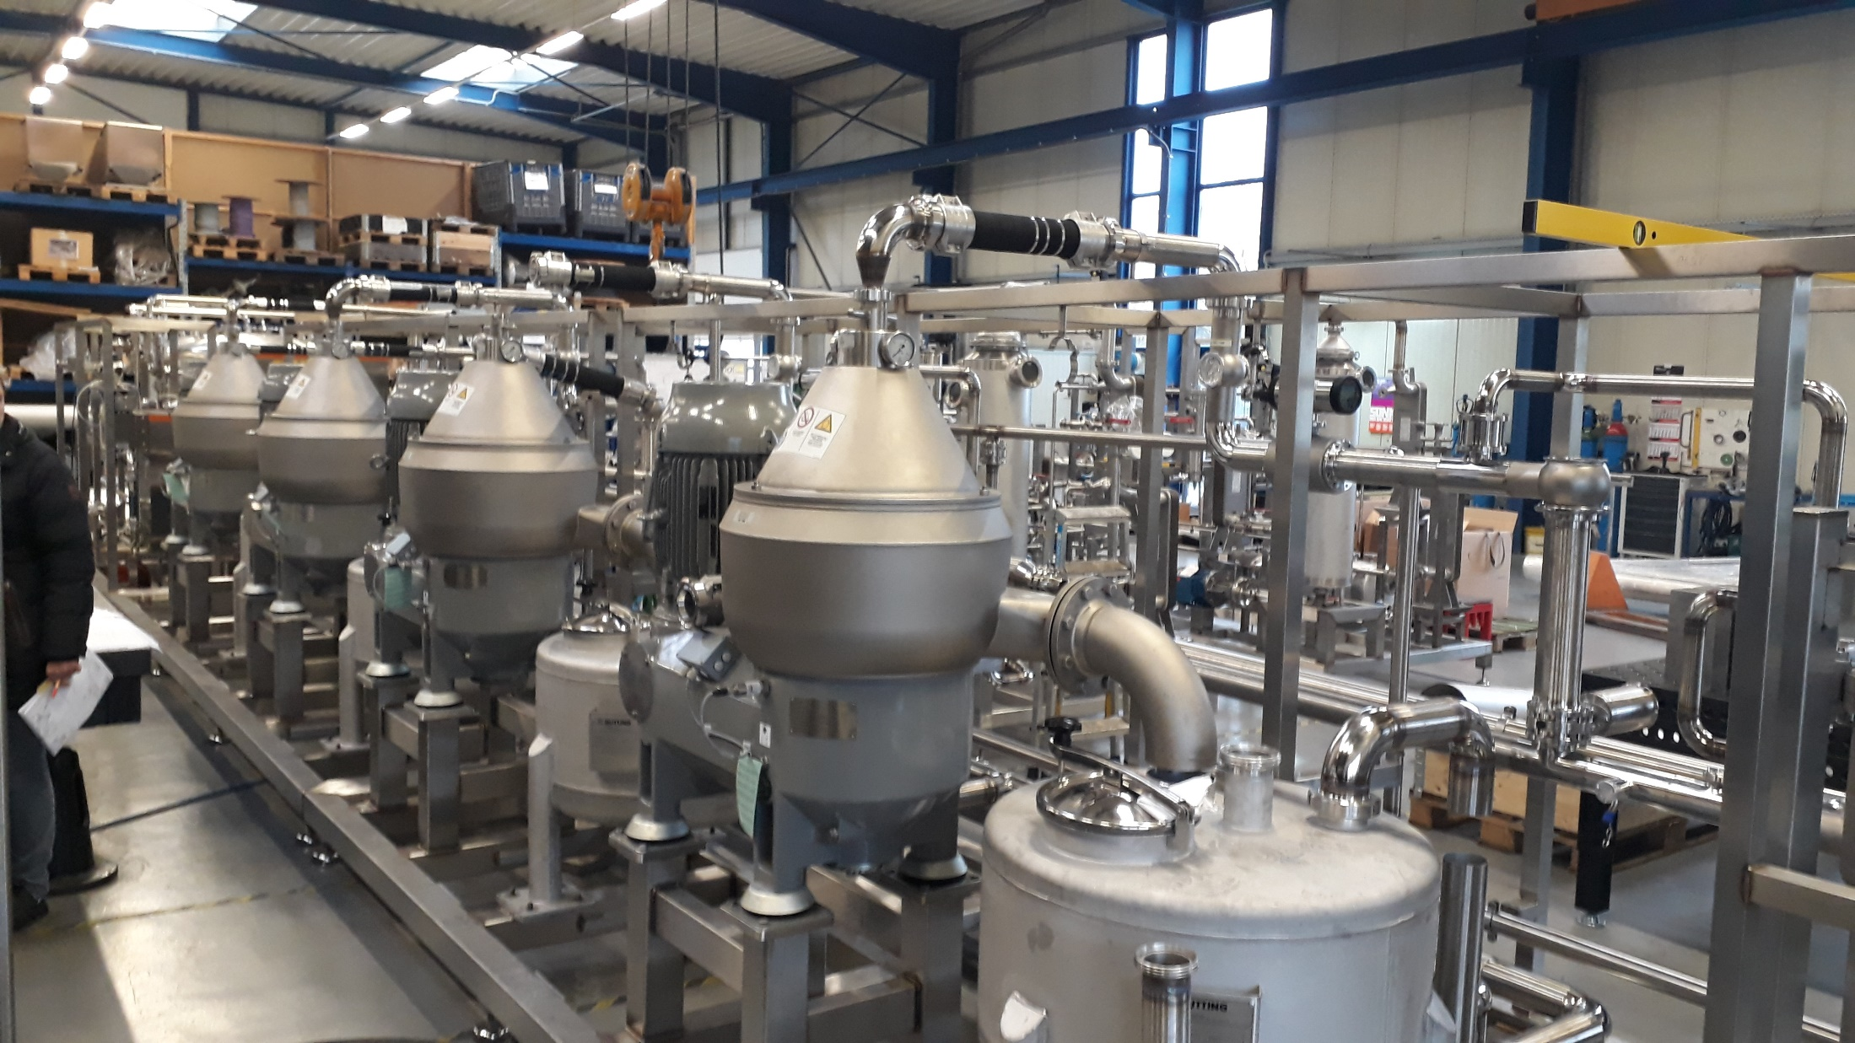
Sustainable production
Development of industrial processes
PRODUCTION FACILITY
1.000 -5.000 m² surface
R&D FACILITY
UNIVERSITY OF ALMERIA
Notes:
This project is supported by the EU Commission on the Blue growth program, and it is an innovation action coordinated by the University of Almeria in collaboration with industrial partners as Aqualia, Biorizon, GEA Westfalia and Veronessi, in addition to academic partners as university of Milano, Szechenyo university, AlgaTech, KIT and University of Gran Canaria, in addition to CIB.

Slide 10
Sustainable production
Wastewater as nutrients source
The composition of sewage and centrate are similar to standard microalgae culture media, but digestate and manure contain too much contaminants
Effluent | COD/BOD, mg/l | N, mg/l | P, mg/l | Total Suspended Solids, mg/l | Turbidity, NTU
Digestate | 9000/7000 | 8000 | 400 | 10000 | 30000
Manure | 16000/12000 | 9000 | 500 | 3000 | 9000
Agro-industrial (Breweries) | 4000/3800 | 30 | 10 | 1000 | 3000
Centrate | 300/200 | 500 | 12 | 1000 | 3000
Sewage | 700/500 | 65 | 11 | 300 | 900
Microalgae culture medium |  | 50 | 10 | 0 | 0
Microalgae can be produced using whatever of these wastewater as only nutrients source, recovering up 90% of nutrients inlet
Notes:
This project is supported by the EU Commission on the Blue growth program, and it is an innovation action coordinated by the University of Almeria in collaboration with industrial partners as Aqualia, Biorizon, GEA Westfalia and Veronessi, in addition to academic partners as university of Milano, Szechenyo university, AlgaTech, KIT and University of Gran Canaria, in addition to CIB.

Slide 11
Sustainable production
Overall capacity is a function of nutrients source
Both biomass production and wastewater treatment capacity is a function of composition of the wastewater, mainly N/P concentrations
Capacity of the process is limited by the performance of photosynthetic reaction
Notes:
This project is supported by the EU Commission on the Blue growth program, and it is an innovation action coordinated by the University of Almeria in collaboration with industrial partners as Aqualia, Biorizon, GEA Westfalia and Veronessi, in addition to academic partners as university of Milano, Szechenyo university, AlgaTech, KIT and University of Gran Canaria, in addition to CIB.

Slide 12

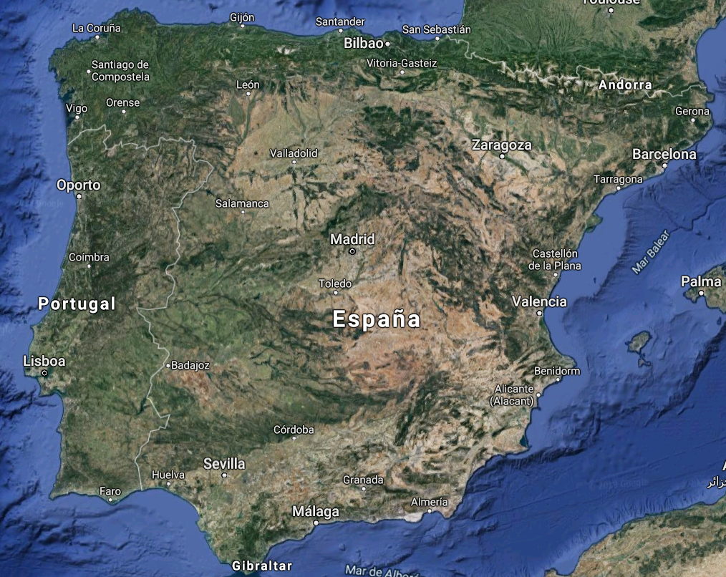
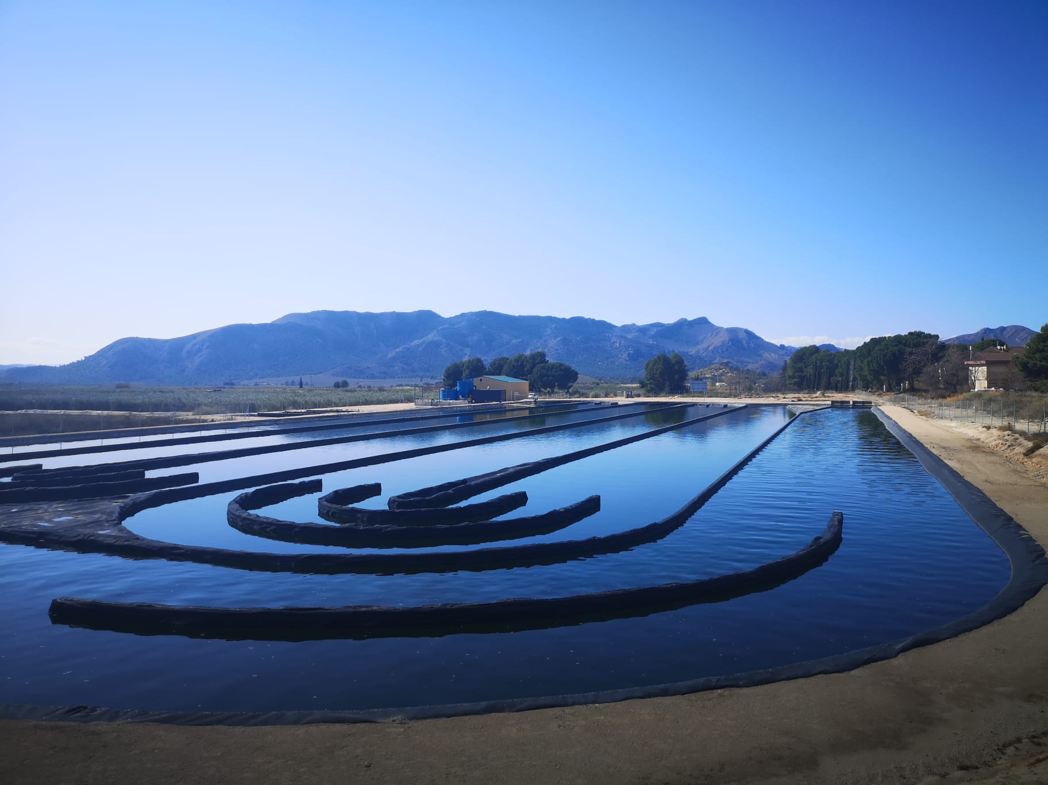
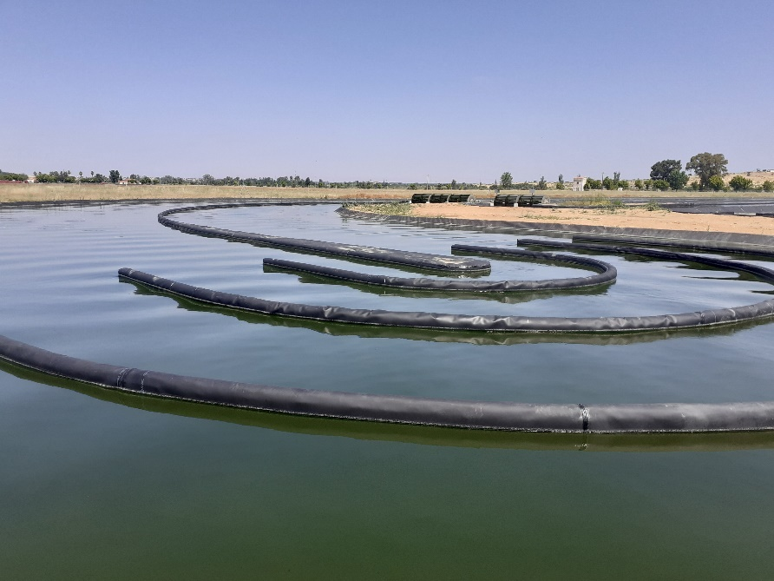
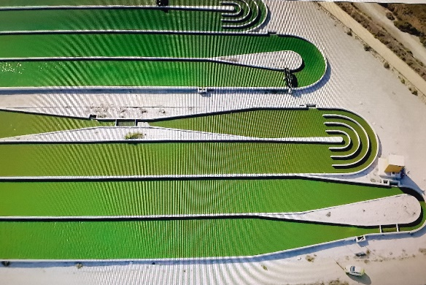
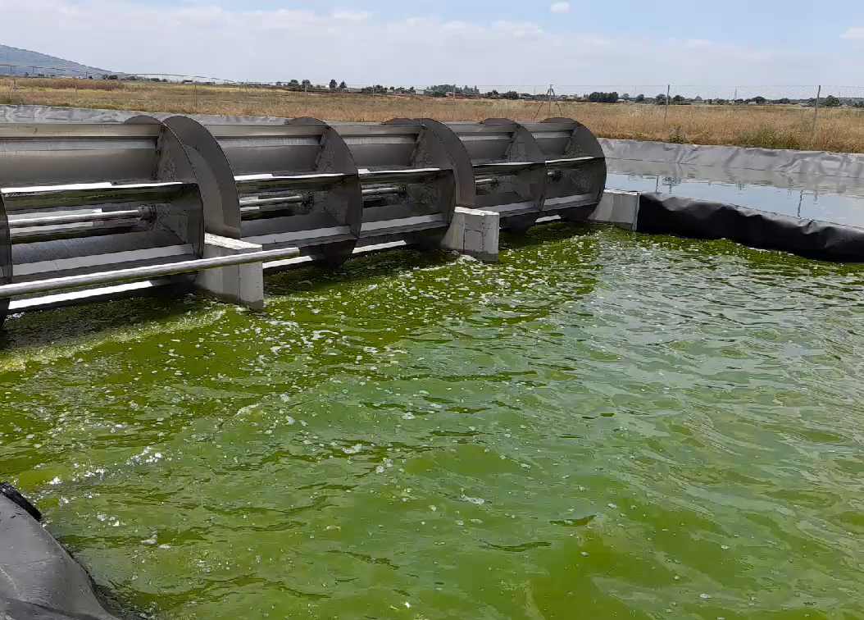
Sustainable production
Industrial demonstrators
10,000m²
20,000m²
Mérida
Hellín
22,200m²
Chiclana
Almería
3,000m²
Notes:
This project is supported by the EU Commission on the Blue growth program, and it is an innovation action coordinated by the University of Almeria in collaboration with industrial partners as Aqualia, Biorizon, GEA Westfalia and Veronessi, in addition to academic partners as university of Milano, Szechenyo university, AlgaTech, KIT and University of Gran Canaria, in addition to CIB.

Slide 13
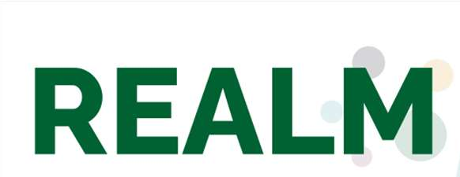
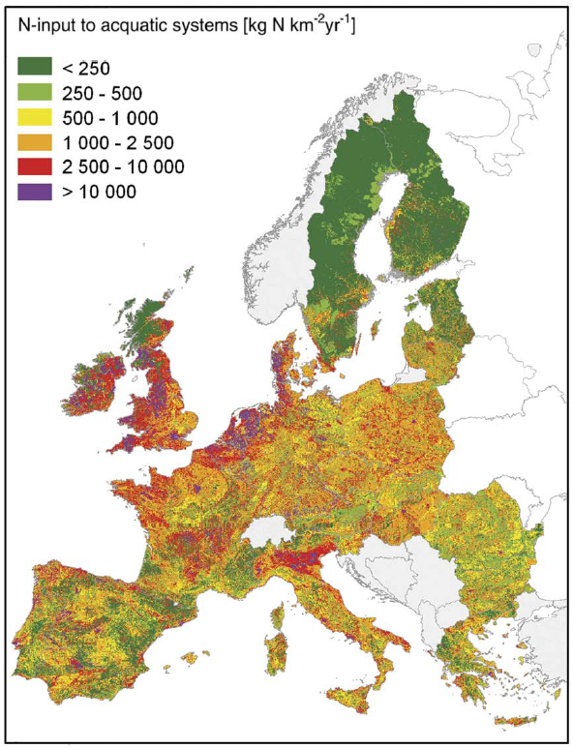
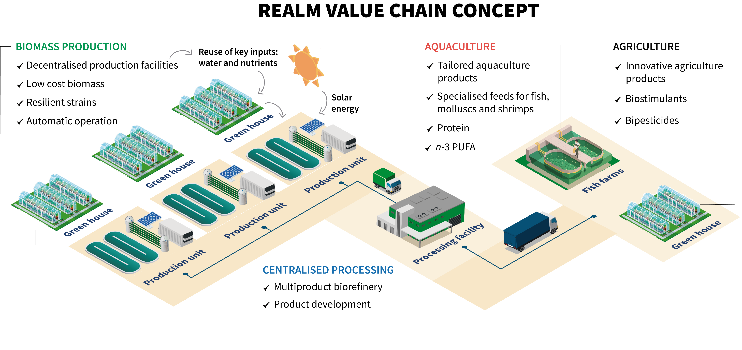
Sustainable production
Industrial demonstrators
HORIZON-CL6-2021-CIRCBIO-01-09 — Unlocking the potential of algae for a thriving European blue bioeconomy. Innovation Action . TRL 7
REUSING EFFLUENTS FROM AGRICULTURE TO UNLOCK THE POTENTIAL OF MICROALGAE (GA 101060991)
Distributed production of microalgae recovering nutrients from drain water and integrated valorization in foods production systems (agriculture and aquaculture)
Notes:
This project is supported by the EU Commission on the Blue growth program, and it is an innovation action coordinated by the University of Almeria in collaboration with industrial partners as Aqualia, Biorizon, GEA Westfalia and Veronessi, in addition to academic partners as university of Milano, Szechenyo university, AlgaTech, KIT and University of Gran Canaria, in addition to CIB.

