Slide 1
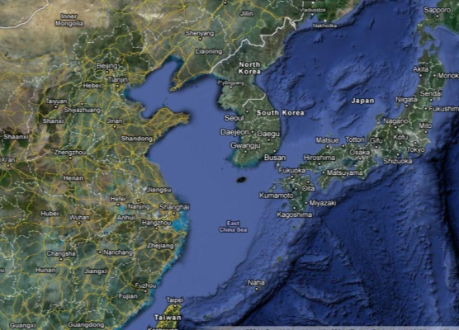
Applications of Marine Observation Data and Numerical Models in North China Sea
EU China Blue Year Event - forecasting, data, monitoring, planning, indicators
LI Rui
North China Sea Marine Forecasting Center, SOA
2017/6/2, Brussels, Belgium
Notes:
海洋观测数据与数值模式在中国北海区的应用

Slide 2
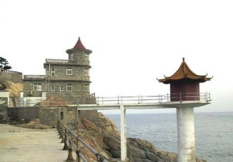
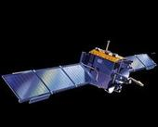
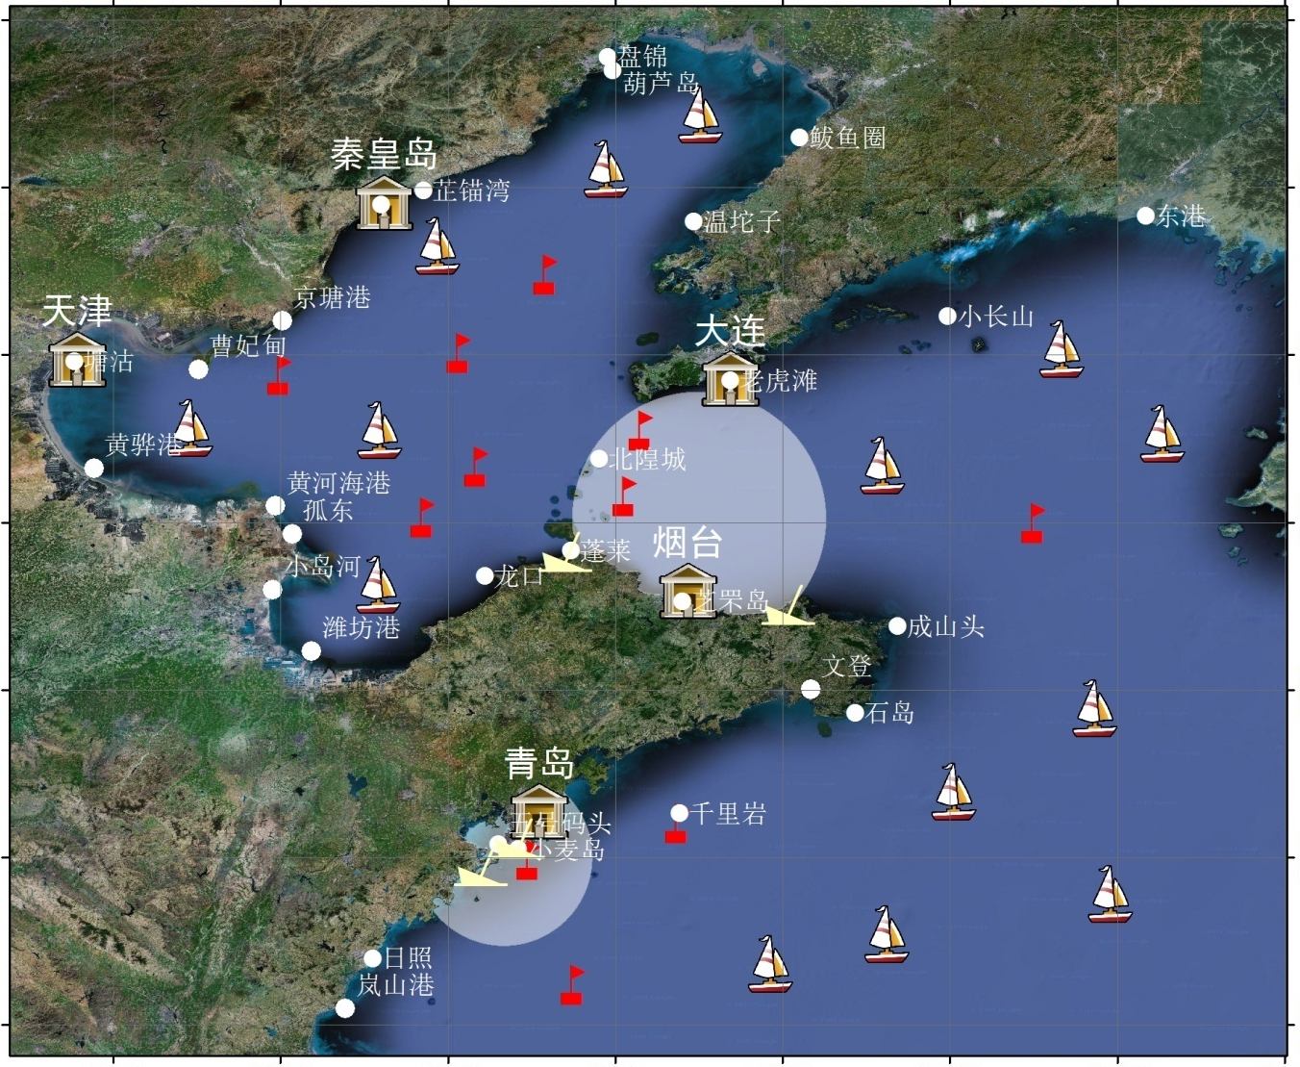
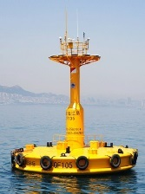
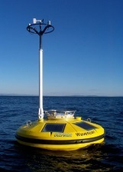
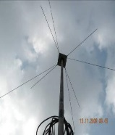
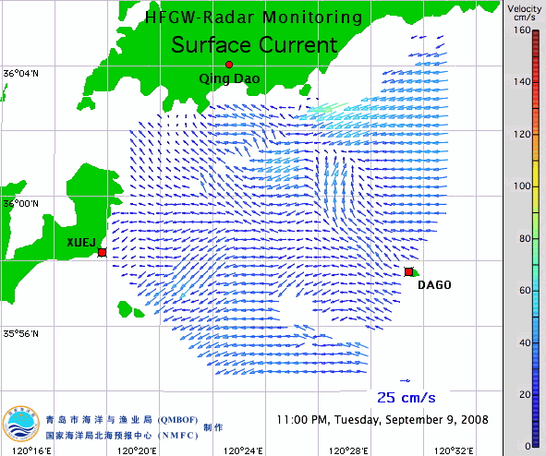
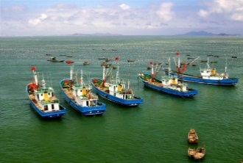
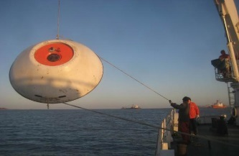
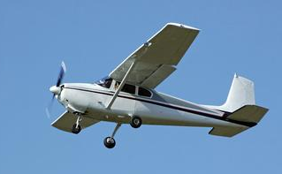
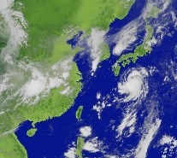
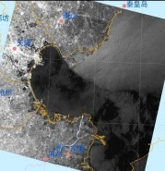
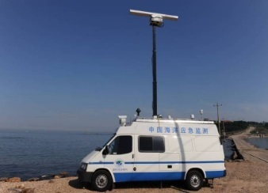
Observation network
Notes:
29 ocean stations
12 buoys
2 HF Radar systems
23 volunteer ship
50 sea bed bases
Satellite data platform & 500+ SAR images
3 monitoring vehicles
Unmanned aircraft

Slide 3
Observation network
North China Sea Marine Forecasting Center
Ocean stations
Buoys
Volunteer ships
HF radar
Sea-bed bases
monitoring vehicles
Satellites
Unmanned aircrafts

Slide 4
Numerical forecast system
Emergency Response
Ocean Environment
Oil spill
Marine Disaster
Meteorology(WRF)
Storm surge (FVCOM)
Green tide
Hydrologic (ROMS, FVCOM)
Ocean wave (WWIII, SWAN)
Sea ice (CIOM, FVCOM)
Search and Rescue
Forecast item | Wind velocity | Wind direction | Tide level | Tidal current velocity | Tidal current direction | Current velocity | Current direction | Significant wave height | Sea surface temperature
24-h error | < 20% | < 20° | < 30 cm | < 30% | < 30° | < 25% | < 30° | < 30% | < 0.8℃
Notes:
As to the forecast, we have established an integrated numerical forecast model system. The foundation of this system is the meteorological model, the hydrological model and the ocean wave model. Based on these models, we have established marine disaster forecast model, such as the storm surge model and sea ice model. Moreover, since the frequency of oil spill, green tide and marine perils are increasing these years, we have developed corresponding forecast models, which will be introduced later. The precision of our forecast models are quite satisfying. The relative error of wind velocity is less than 20%, and the relative error of significant wave height is less than 30%.

Slide 5
Application cases
Green tide prevention in Yellow Sea
Storm surge risk assessment for Shouguang
Emergency response
Sea ice response in Bohai Sea

Slide 6
Case 1 Green Tide in Yellow Sea

Slide 7
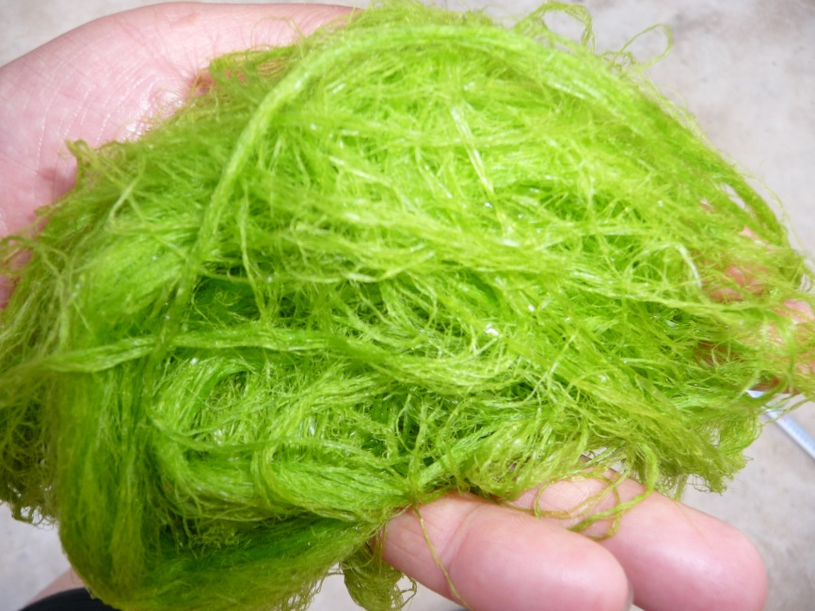
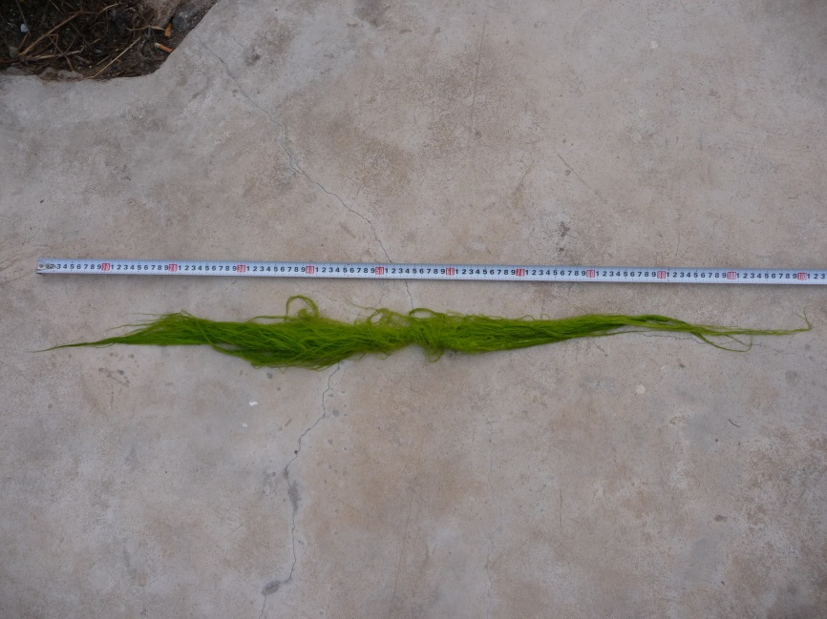
Green tide in Yellow Sea
mostly caused by enteromorpha proliferation.
flow on the sea surface and grow fast during summer.
float from south Yellow Sea to southern Shandong coast
affect the natural view of ocean and breaks the ecological condition.
Notes:
The Green tide disaster in Huanghai Sea is mostly caused by enteromorpha proliferation. The enteromorpha is a kind of green algae which is widely distributed along the coasts of the world's oceans. This kind of green algae flow on the sea surface and grow very fast during summer.
In 2008, it appeared in the Huanghai Sea for the first time. Since then, every summer, the green tide floats from south Huanghai Sea to southern Shandong coast, which affects the natural view of ocean and breaks the ecological condition.
This are two closer pictures of the green algae.

Slide 8
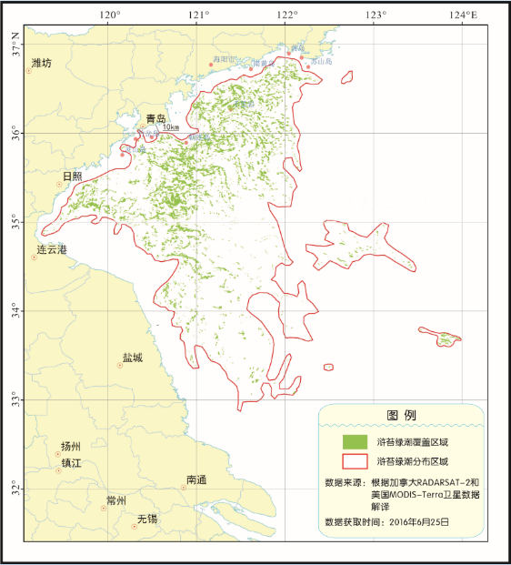
Green tide distribution 2016/6/25
Notes:
2016年，引发大面积绿潮的主要藻种为浒苔。5~8月，绿潮灾害影响黄海沿岸海域，覆盖面积于6月25日达到最大值，约554平方千米；分布面积于6月25日达到最大值，约57 500平方千米，为近7年来最大值。
根据卫星遥感影像反演结果，5月10日，在江苏盐城以东海域发现漂浮绿潮藻；5月中下旬，绿潮持续向偏北方向漂移，分布面积不断扩大；5月25日，绿潮最北端到达35°N，进入北海区管辖海域；6月中旬开始有绿潮陆续影响山东半岛沿海，分布面积保持在较高水平；7月中下旬，绿潮分布面积逐渐减小，进入消亡期；8月2日，绿潮基本消亡。

Slide 9
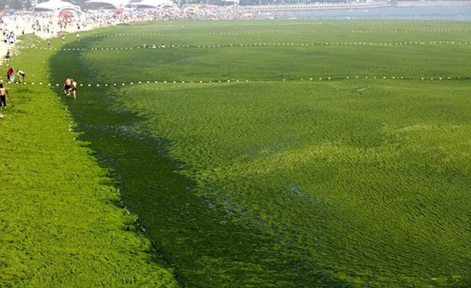
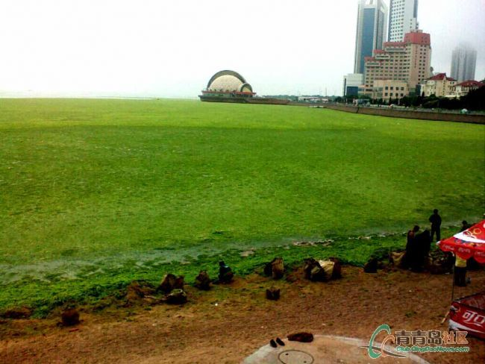
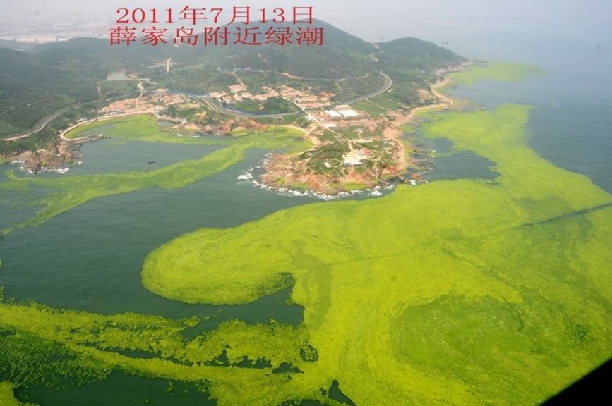
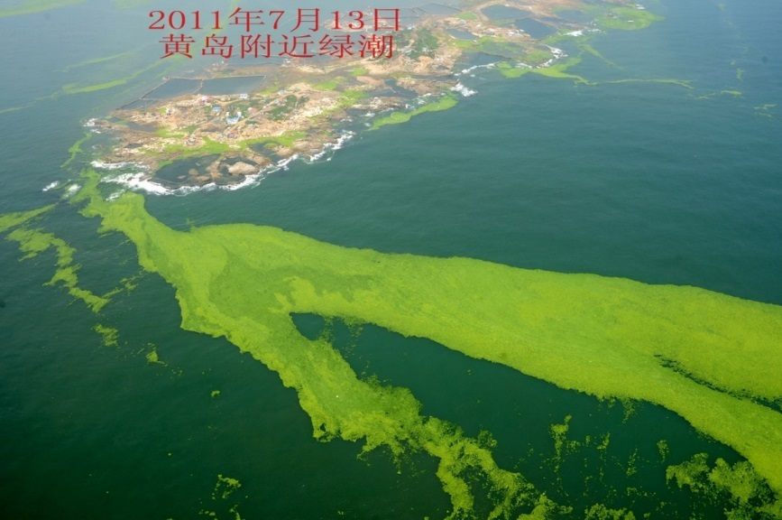
Green tide near Qingdao
Notes:
Enteromorpha prolifera
Every summer, the Qingdao nearshore areas are filled with the green tide. People look into the ocean but see only green rather than blue. Here are some pictures of the green tide. It could cover the whole nearshore region and sometime smells, which affects the nature view a lot.

Slide 10
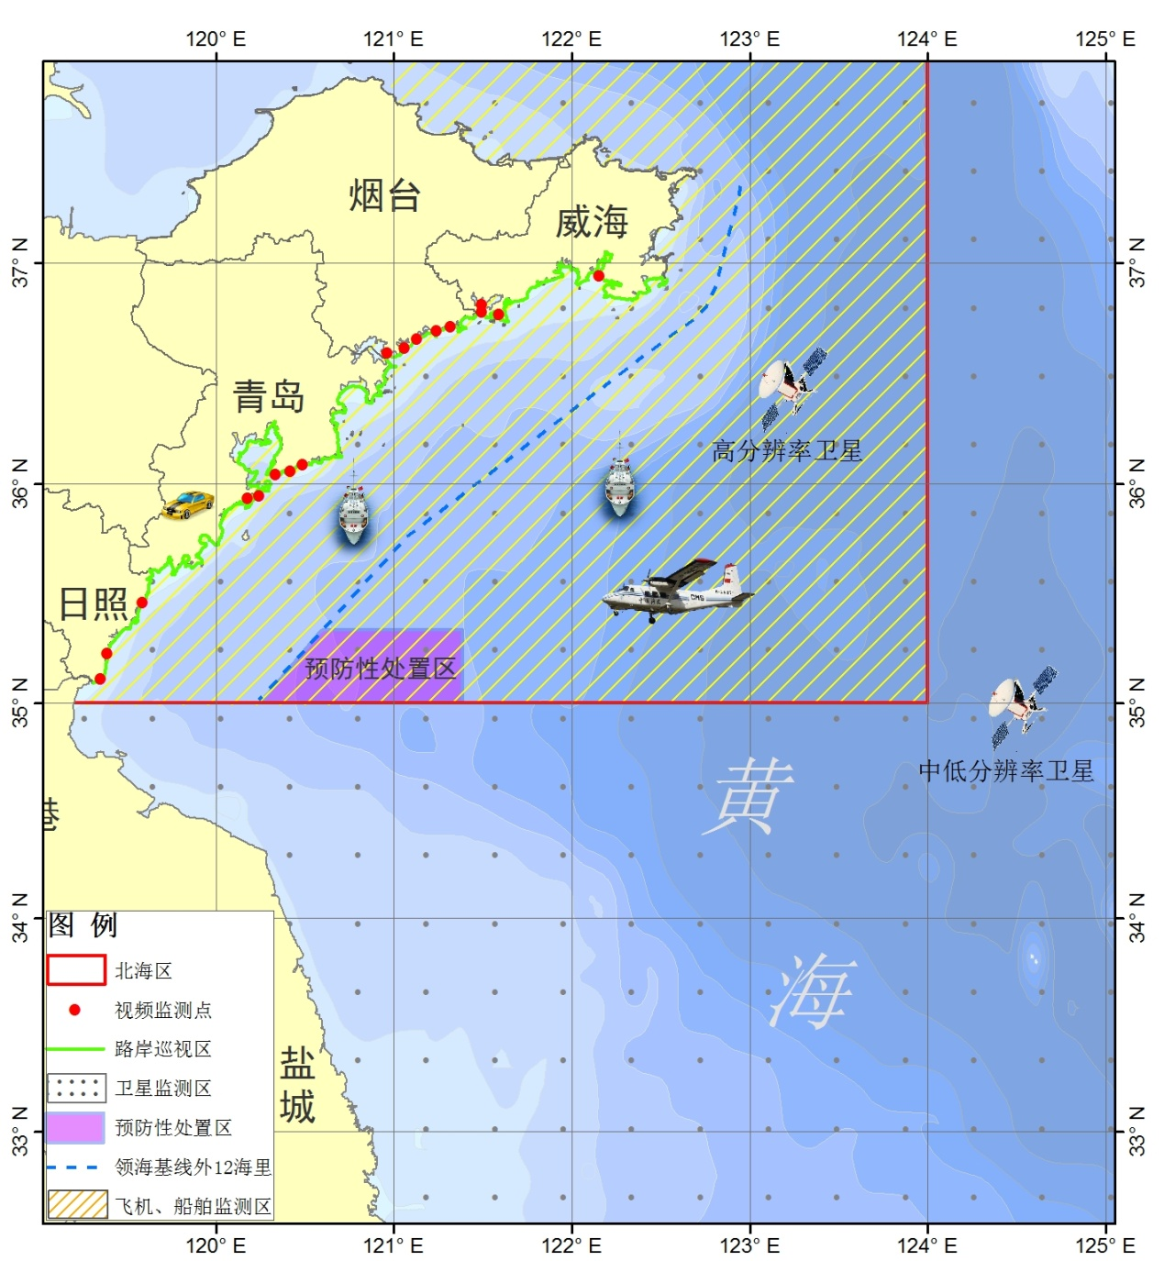
Green tide monitoring
Satellite
optical satellite
SAR
Aircraft
SAR
spectrometer
photograph
ship
coastal surveillance
Real-time video
Notes:
To monitor the range of green tide, we use different ways. For the big area shown in the right, we use optical satellite images. For the small area as shown in the small rectangle, we use SAR to monitor the green tide. Besides, If the green tide disaster has reached certain level, we also use data from aircraft, ship, coastal surveillance and realtime video.

Slide 11
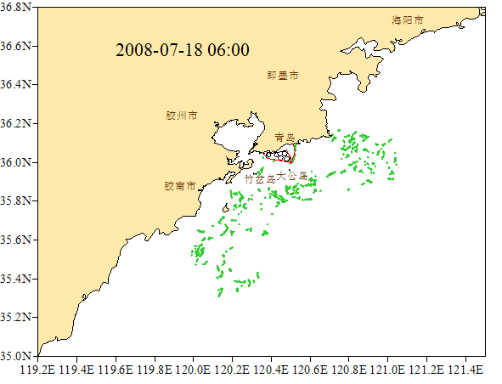

Slide 12
Case 2 Storm Surge Risk Assessment

Slide 13
Shouguang, Shandong, China
Bohai Sea

Slide 14
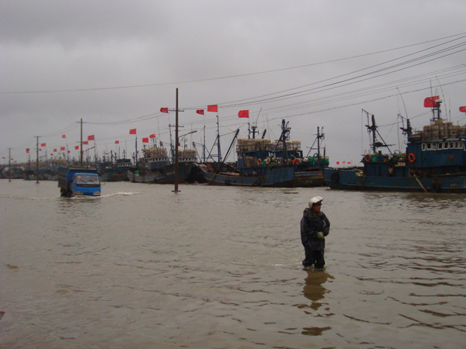
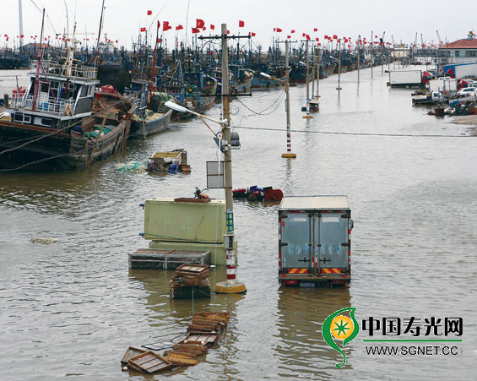
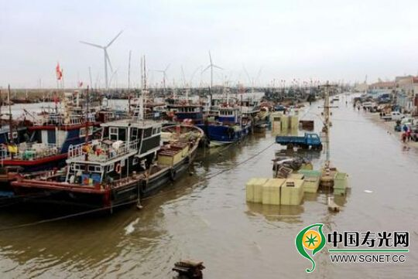
Extratropical storm surge in Shouguang, Shandong, China
2010/9/21
2013/10/12
2015/10/18

Slide 15
Data type and acquisition
Data “in ocean”
Long-term tide, wave, wind
Data “on land”
Land-use
Digital Line Graphic(DLG)
Urban Cadastral
Problems: data acquired from different departments
Data “in ocean”: State Oceanic Administration
Data “on land”: Department of Land and Resources

Slide 16
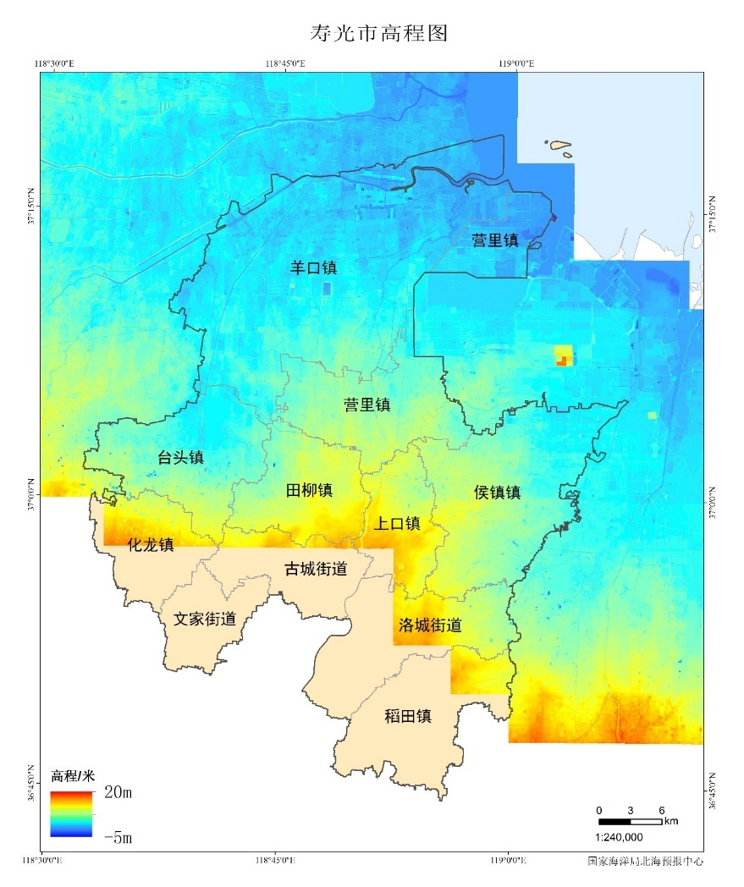
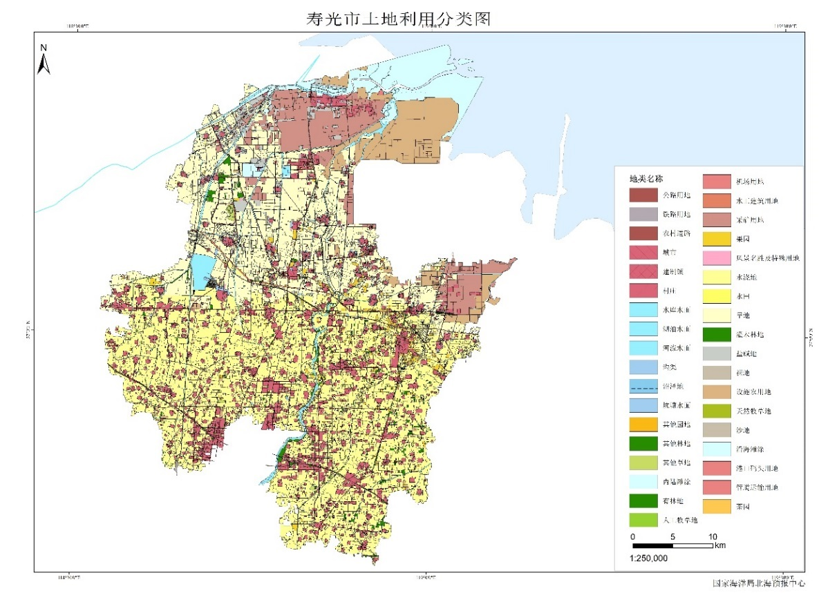
Data
Land altitude(1:50,000)
Land use(1:5,000)

Slide 17
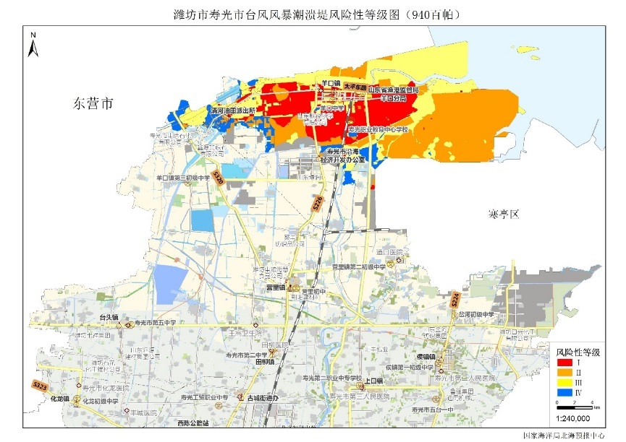
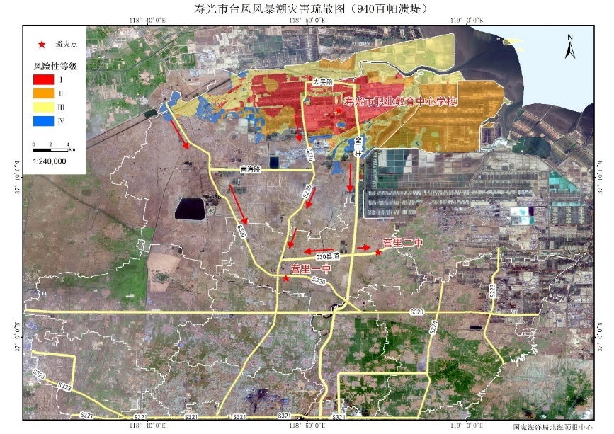
Storm surge risk assessment
Data
Numerical model
Outcome
Risk levels and areas
Evacuation routes
Notes:
Data
Long-term hydrological and meteorological observation
Landuse
Digital Line Graphic(DLG)
Urban Cadastral
Numerical model
WRF, MIKE 21 FM
Outcome
Risk levels and areas
Evacuation routes

Slide 18
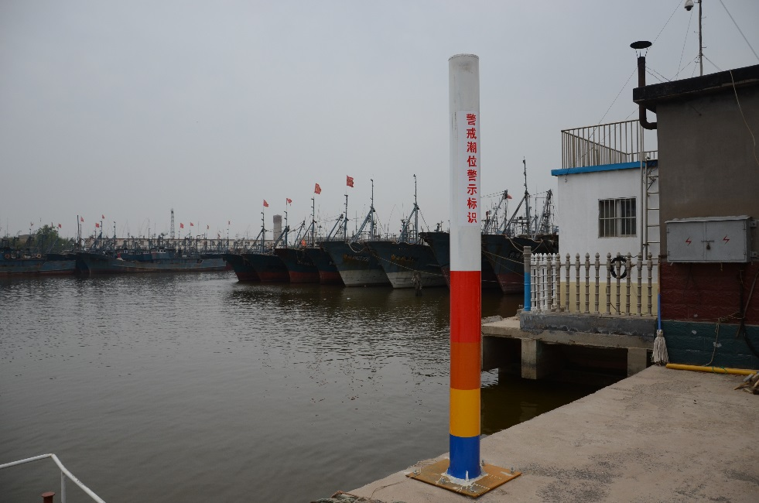
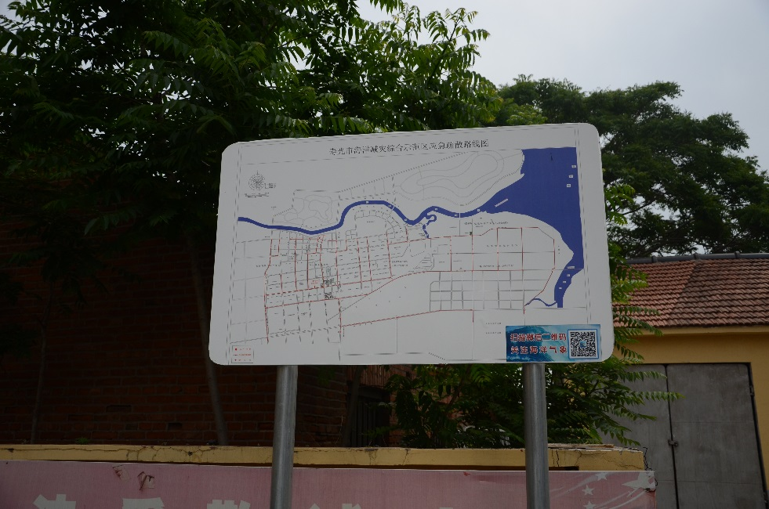
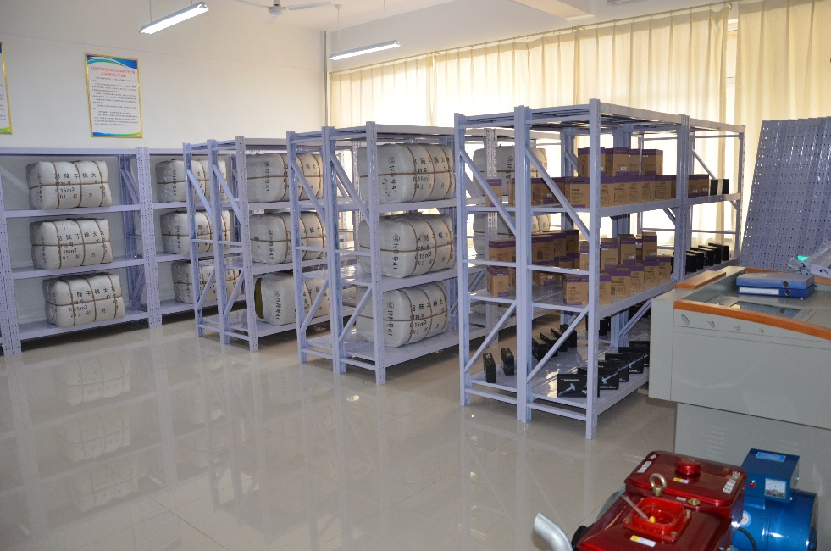
Risk assessment and response
Warning water level gauge
Warning water level gauge
Evacuation routes
Emergency supplies

Slide 19
Case 3 Marine Emergency Response

Slide 20
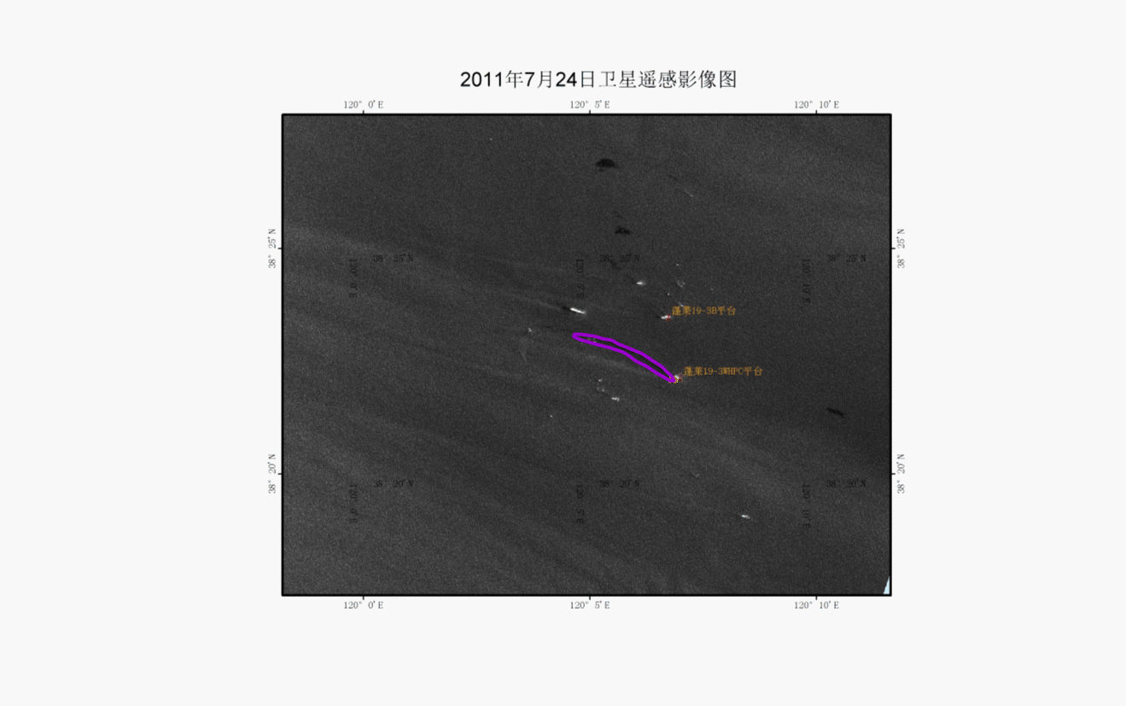
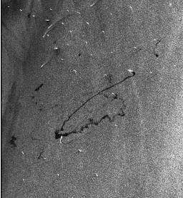
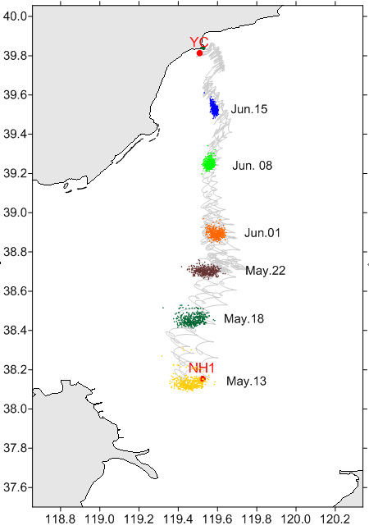
Oil spill monitoring and forecast
SAR images
Forecast model
2-D Trajectory prediction model
2-D trajectory and fate prediction model
3-D trajectory and fate prediction model
Source tracing model
2-D source tracing model
2-D source tracing probability model

Slide 21
Search and rescue

Slide 22
Case 4 Sea Ice Monitoring and Forecast in Bohai Sea

Slide 23
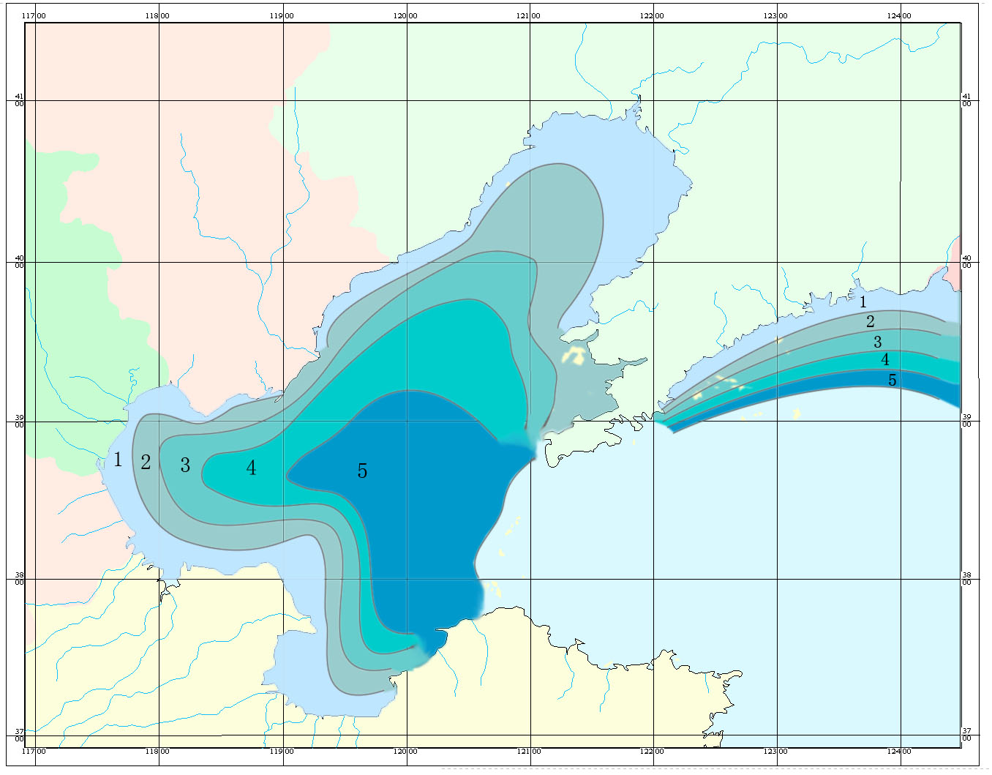
Sea ice in Bohai Sea
5 ranks: (1)light (2)less light (3)normal (4)less serious (5) serious

Slide 24
Sea Ice Monitoring
Approaches
Shoreline survey
Aircraft
Ships, buoys and oil platform
Vehicle-based radar
Satellite
Field survey
Parameters
Area
Intensity
Ice type
Ice shape
Drifting velocity and direction
Ice thickness
outline
Notes:
监测要素
浮冰监测项目：冰量、密集度、冰型、表面特征、冰状、冰块大小、漂流速度和方向、冰厚及冰区边缘线等；
固定冰监测项目：堆积量、堆积高度、固定冰宽度和厚度等；
冰山监测项目：位置、大小、形状及漂流方向和速度等；
海冰的辅助监测项目：海面能见度、气温、水温、海水盐度、风速与风向及简易天气现象等。
监测手段
目前，监测海冰主要有“目测法”、“器测法”和“遥测法”3种方法。
目测法是海冰监测传统的基本观测方法，这种方法是根据海冰观测规范规定，依靠观测员的眼睛和经验进行观测， 如冰量、流冰密集度、流冰冰状、固定冰状等。
器测法是同目测法相结合的方法。这种方法是借助工具和仪器，依靠观测员的手工操作和读数据，如冰厚、冰温、 冰密度、堆集高度等。这些数据是遥测法观测结果进行量值定标处理的依据，所以器测法是海冰监测的重要方法。
遥测法是应用现代科学技术建立的先进方法。这种方法可以完全依赖仪器本身进行观测，如利用卫星能及时、同步、大范围观测海冰。彩色海冰卫星图片则能直观地一目了然地展示海冰的分布情况。但是对冰厚、冰温等要素的观测，目前远不如器测法准确。

Slide 25
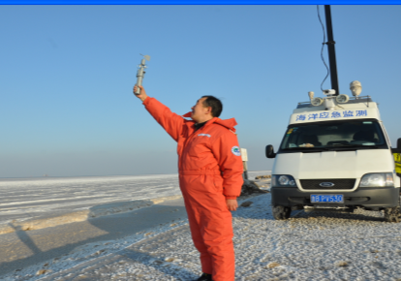
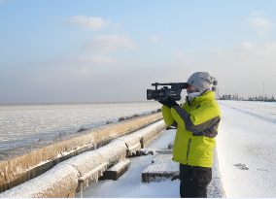
Monitoring Approaches 1: Shoreline survey

Slide 26
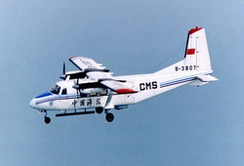
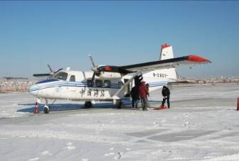
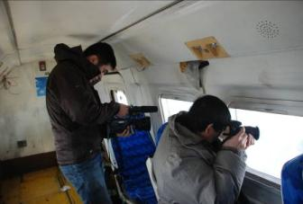
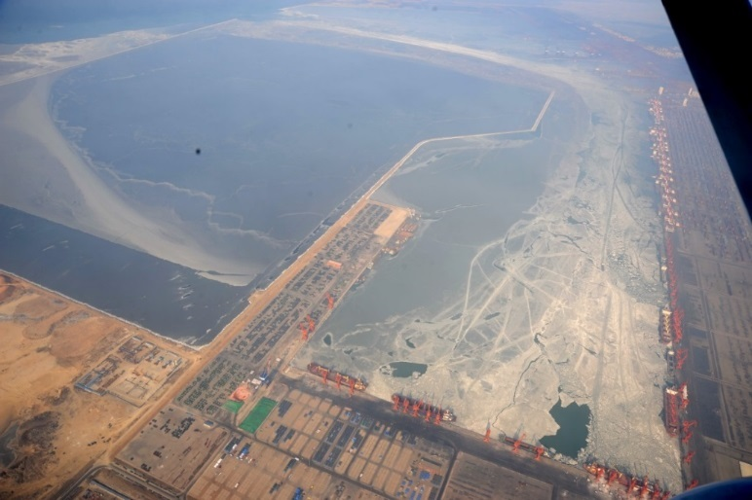
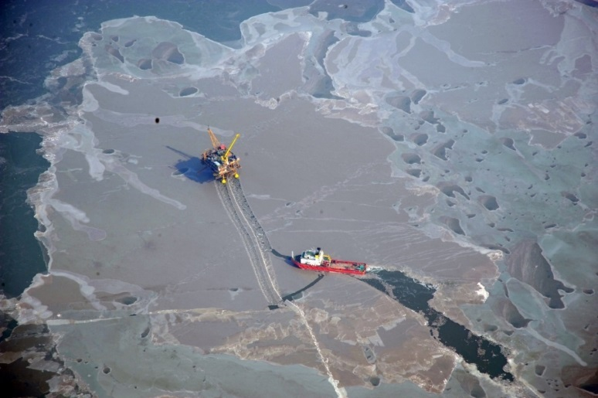
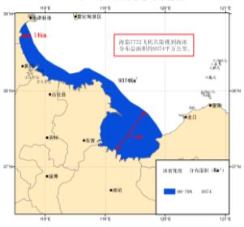
Monitoring Approach 2: Aircraft
鲅鱼圈冰情
锦州9-3油田冰情

Slide 27
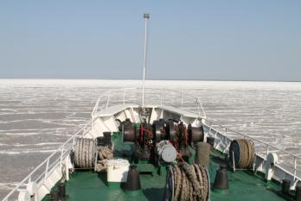
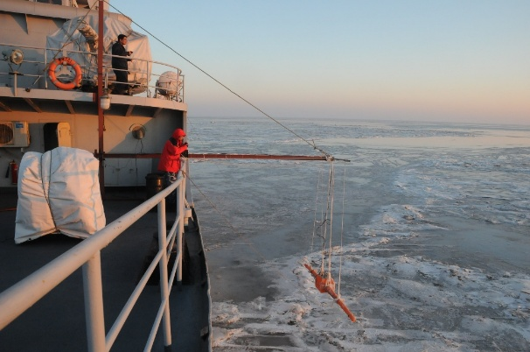
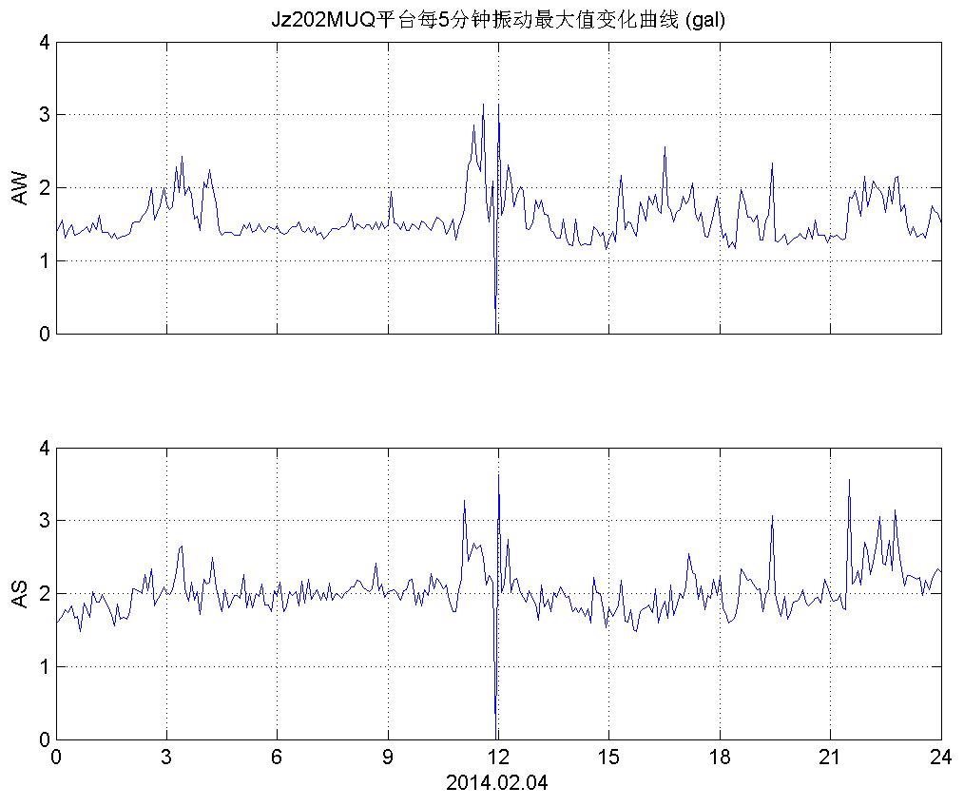
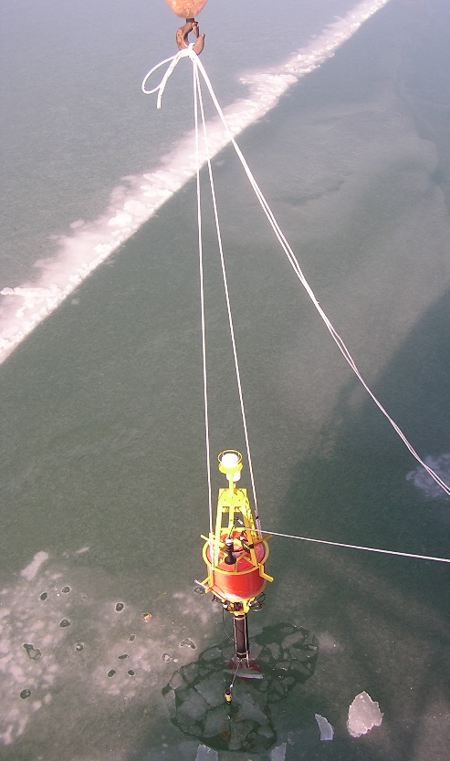
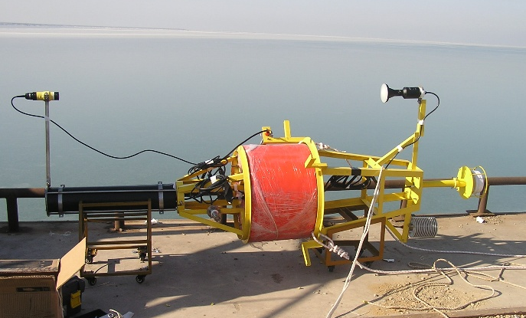
Monitoring Approach 3: Ships, buoys and oil platform
吊放
现场组装
布放入位
Notes:
2014-2-04JZ20-2MUQ每5分钟振动幅值曲线

Slide 28
Monitoring Approach 4: Vehicle-based radar
Notes:
4．车载雷达
海冰车载雷达可以连续测量海冰的雷达回波数据，确定海冰的分布范围及漂移状况，获取了客观准确的遥感图像；

Slide 29
Monitoring Approach 5: Satellite

Slide 30
WEBGIS platform

Slide 31
Monitoring Approach 6: Mechanical field survey

Slide 32
Sea ice forecast
Statistic forecast
3 days
10-15 days
Monthly
Yearly
Numerical forecast
FVCOM
CIOM

Slide 33
Problems
Ice thickness monitoring is inaccurate
Numerical model accuracy still needs to be improved
10-15 days forecast is less accurate than short & long-term forecast

Slide 34
Future cooperation
Similarities of Bohai and Baltic Sea
Enclosed seas
Shallow seas, mean water level less than 60 m
Weak water exchange with outer sea
Sea ice in winter
Looking forward to more cooperation
Workshops, technique exchange, etc.
渤海
Bohai Sea
波罗的海
Baltic Sea

Slide 35
Thank you very much for your listening!
LI Rui
North China Sea Marine Forecasting Center, SOA
E-MAIL: lirui@bhfj.gov.cn
TEL: +86 532 5875 0655

