Slide 1
Gaps and priorities in sea basin observation and data
North Sea
Marie Pendle

Slide 2
Blue Economy
Growth in marine and maritime sector is reliant on innovation
Innovation needs a robust and accessible knowledge base
Private industry and public sector require access to marine data
This project supports sustainable growth through
Looking at the decisions to be taken and the underpinning information to support these decisions
Improving the accessibility and provision of marine data
Not just appraising data gaps, but also the gaps in collecting data
Providing information to improve future marine observation programmes

Slide 3
Aims and Objectives
The objective of the project is to "examine the data collection, observation and data assembly programmes in a sea basin, analyse how they can be optimised and deliver the findings to stakeholders through an internet portal." This will be delivered by the following key tasks:
Undertake a literature survey looking at the findings of existing studies with respect to data adequacy for the North Sea basin
Undertake a series of challenges designed to test the adequacy of data currently available for the North Sea basin across a range of applications
Provide feedback on the adequacy of data employed for each of the challenges alongside the delivery of their outputs.
Develop a project website to facilitate communication with DG MARE and between project team members during the project, centralise the management of data used during the project and provide a catalogue of metadata on outputs from the project
Disseminate results to an expert panel and to the maritime community to optimise the results generated from the literature survey and each of the challenges.

Slide 4
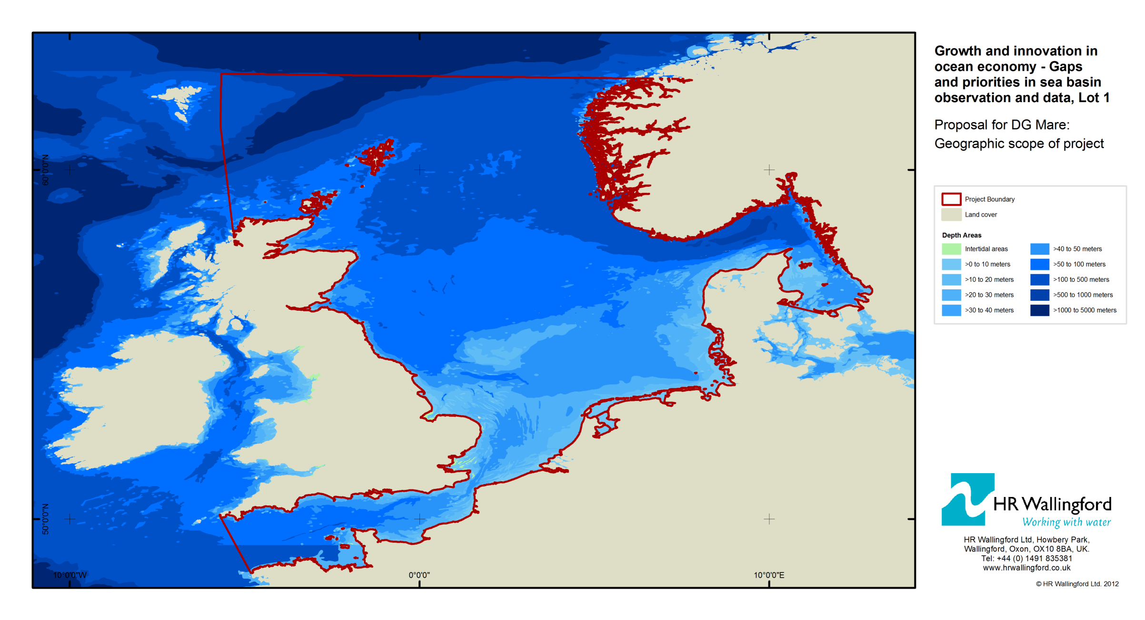
Geographical scope

Slide 5
Marine Knowledge 2020
Obstacles for using marine data
Existing data is not always readily visible
Data are hidden with over-restrictive access and re-use conditions
Standards are fragmented between different data sets
Related data sets can be assembled in different formats and using different nomenclature
Quality of data is not always known
Unrealistic costs to obtain data
Insufficient temporal or spatial resolution
Notes:
Other obstacles likely to occur include:
Data conflicts
- conflicting information - Overlaps in similar datasets published by different organisations leading to conflicts (e.g. two organisations reporting the same shipwreck but reporting different locations, or overlapping ecological studies reporting different results)
- Conflicting versions - Same data made available by different providers but not necessarily updating their data at the same time.

Slide 6
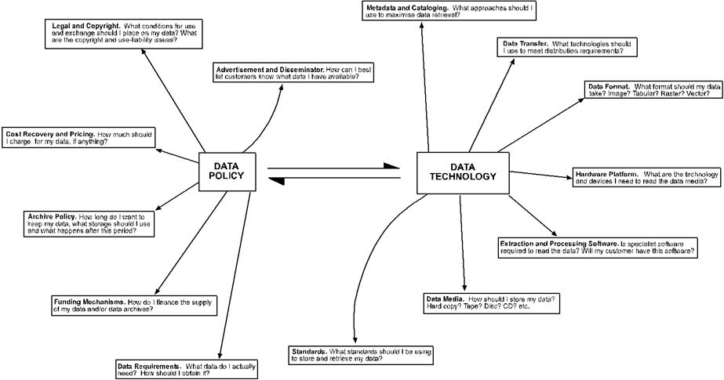
Obstacles to Marine Data Use and Exchange

Slide 7
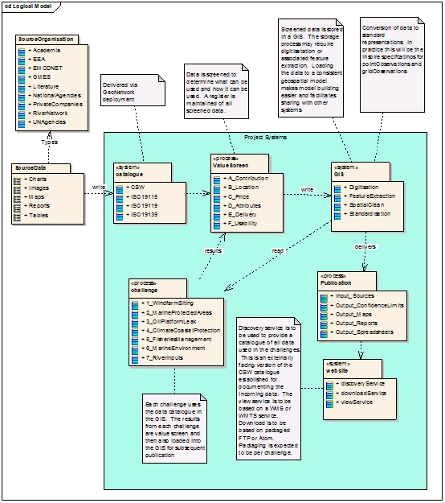
Methodology

Slide 8
Demand criteria
Easier to solve
More Important to Users
Contribution - What impact the data have on solving the problem.
Location - Where the measurements have been taken and at what time.
Price/budget - What the data costs.
Attributes - Fitness for purpose.
Delivery - Can the data be supplied in time?
Usability - How easy is it to use the data (format etc.)

Slide 9
Envisaged Assessment Form
Challenge Name: [name of challenge] |  |  | Input/Output [delete one]
Data Set Name: [meaningful name] |  | Data Set ID: [unique reference]
Demand | Assessment | How to Improve
Contribution | [output from demand assessment] | [output from Business Modelling and Pinciples assessment]
Location | “ | “
Price Attributes | “ | “
Delivery | “ | “
Usability | “ | “
Overall Recommendations: [what should be done in respect of the dataset]

Slide 10
Summary of Work Packages
WP1 | Literature Survey
WP2 | Challenge 1: Wind Farm Siting
WP3 | Challenge 2: Marine Protected Areas
WP4 | Challenge 3: Oil Platform Leak
WP5 | Challenge 4: Climate and Coastal Protection
WP6 | Challenge 5: Fisheries Management
WP7 | Challenge 6: Marine Environment
WP8 | Challenge 7: River Inputs
WP9 | Website Development and Maintenance
WP10 | Organisation of Panels
WP11 | Data Adequacy Reports
WP12 | Project Management

Slide 11
Literature survey
Data Sourcing - is there an overview of data availability?
Data Coverage - if we have an overview then how complete are the data? Is incompleteness due to reluctance of data-owners to release data or because of a lack of measurements?
Data Applicability - are there any statements made as to fitness for purpose – e.g. for fish stock or environmental assessments, for spatial planning, for licensing, for coastal protection.
Notes:
Could mention that a reciprocal relationship exists between literature survey and challenges, with study informing the data gathering for the challenges and action of undertaking the challenges adding to the results of the lit review further down the line. All results will be reported via website and reports to expert panel as project evolves

Slide 12
HR Wallingford Ltd
SeaZone Solutions
IMARES
MacAllister Elliott Partnership
Mainstream
m.pendle@hrwallingford.com

