Slide 1
Transect Overview
http://www.infomar.ie/StoryMaps/Atlantic/index.html

Slide 2
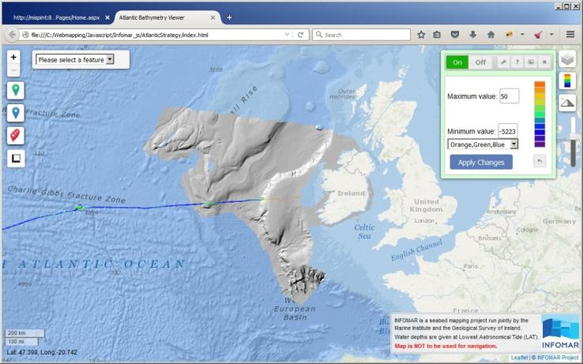
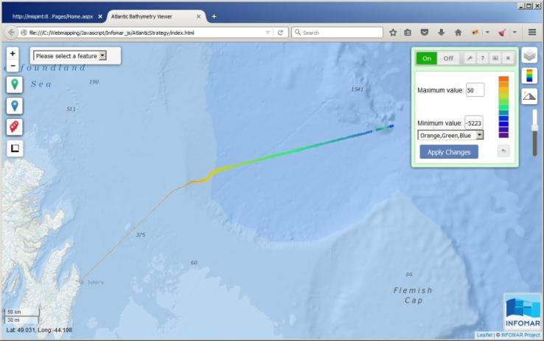
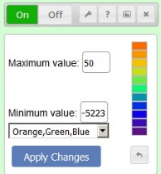
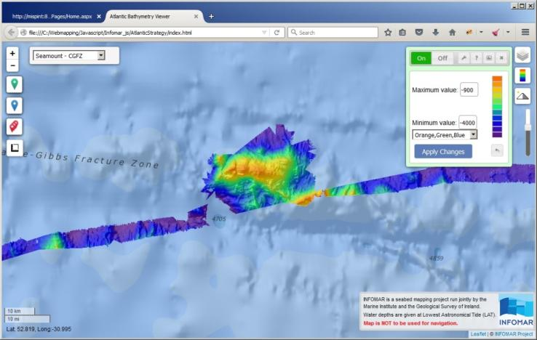
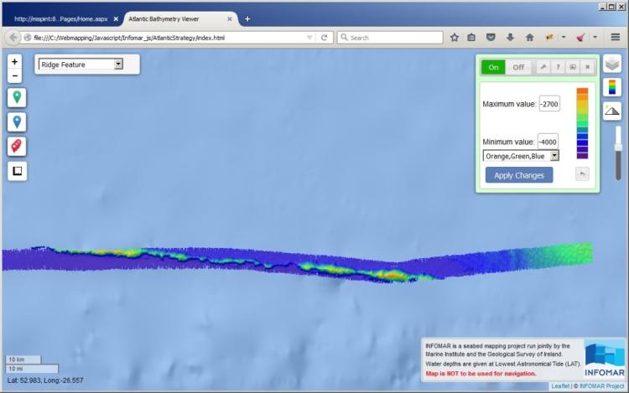
Dynamic Web Map Viewer
http://maps.marine.ie/infomartest
Dynamic Colour Range
Feature selected based on personal comms with Smith& Sandwell

Slide 3
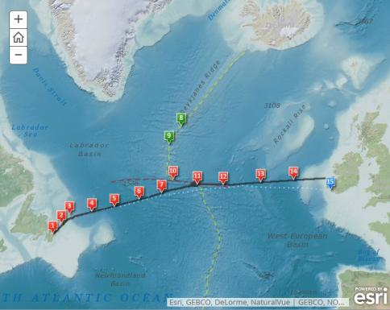
Seamount & Ridge

Slide 4
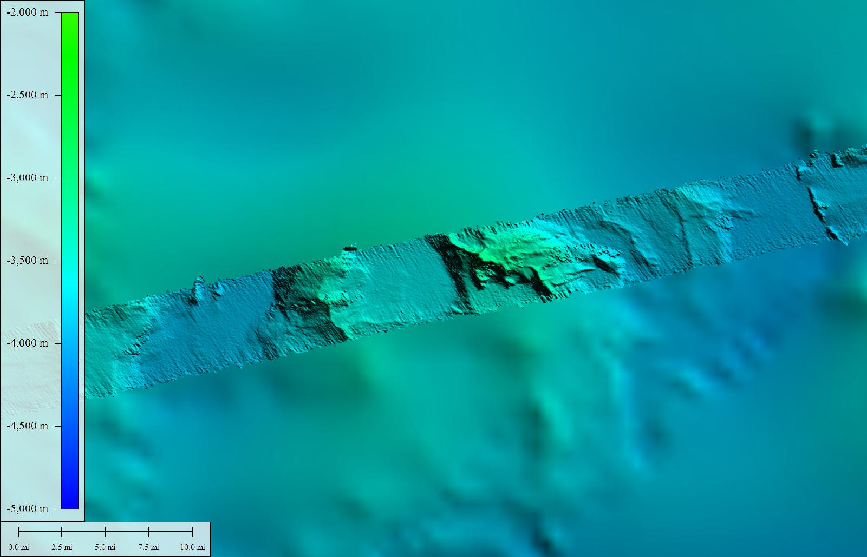
GEBCO (background) / Multibeam (foreground)

Slide 5
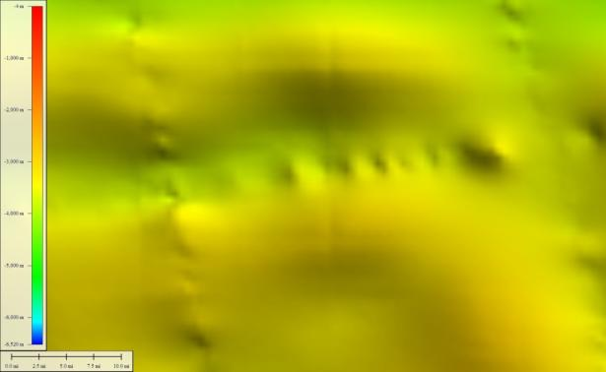
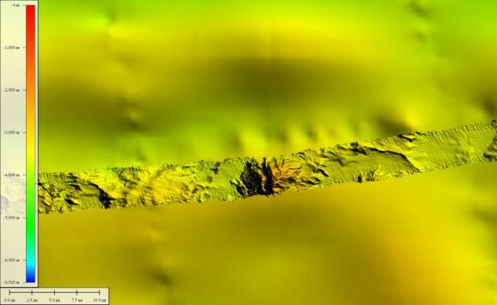
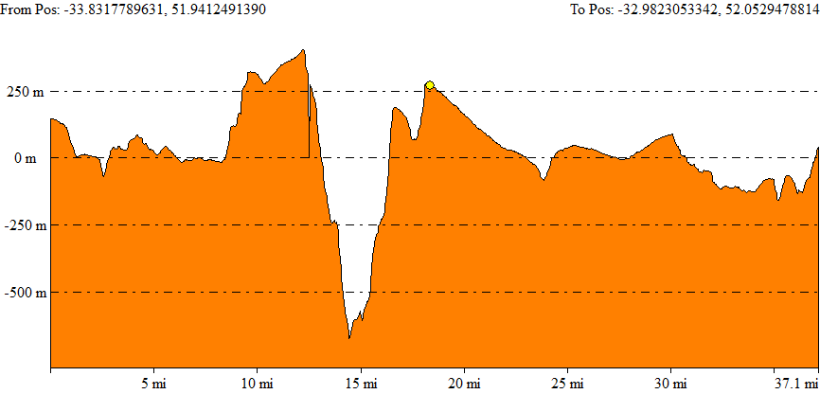
GEBCO & Multibeam Bathymetry
GEBCO bathymetry
Comparison of GEBCO vs Multibeam bathymetry
Comparison of GEBCO vs Multibeam bathymetry surfaces along a single profile West to East. As can be seen, an entire hill, up to 500 m high is missing from the GEBCO dataset

Slide 6
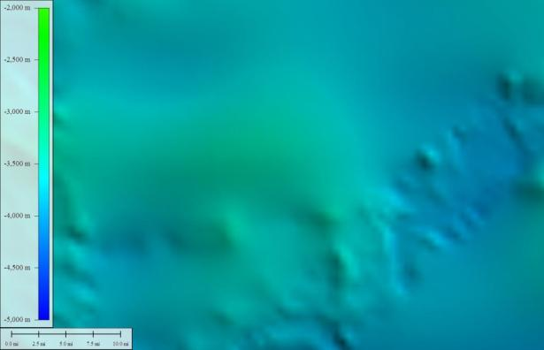
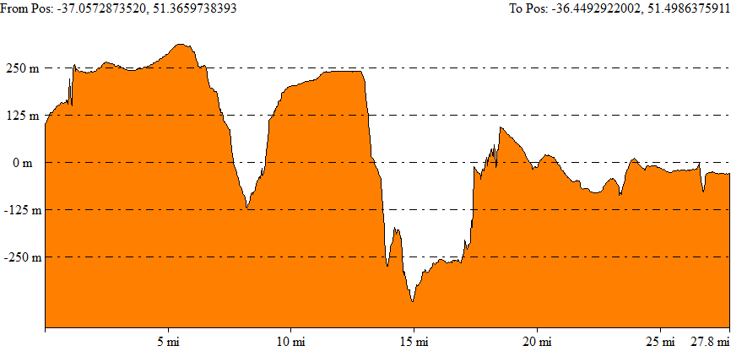
GEBCO & Multibeam Bathymetry
GEBCO bathymetry
Comparison of GEBCO vs Multibeam bathymetry
Comparison of GEBCO vs Multibeam bathymetry surfaces along a single profile West to East. In this case, two hills, up to 270 m high are missing from the GEBCO dataset.

Slide 7
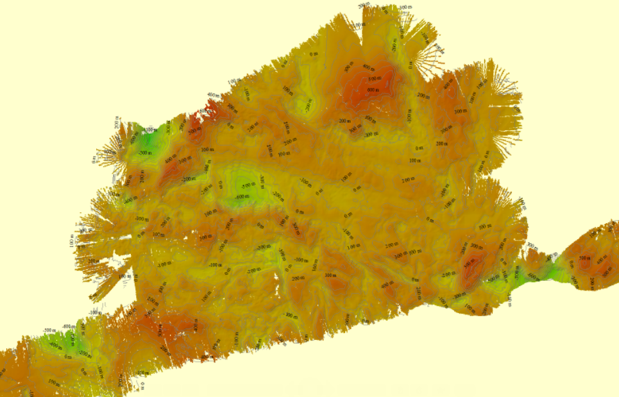
GEBCO – Multibeam Difference
Surface differences between GEBCO (satellite derived bathymetry), and multibeam data:
(25x35 km grid approx)
+500 m
-1100 m
Is that good enough?

Slide 8
Seamount – GEBCO / Multibeam

Slide 9
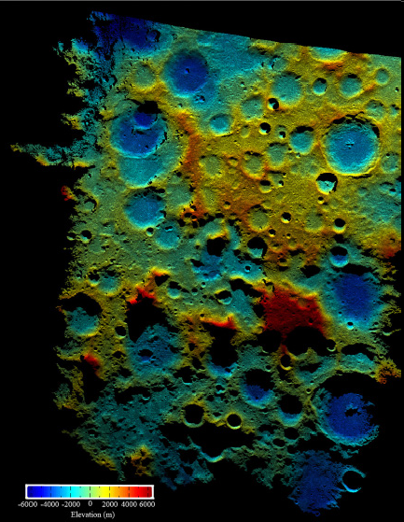
THE MOON
100m pixel resolution
~$600M
http://spie.org/x25472.xml?highlight=x2418&ArticleID=x25472
http://www.nasa.gov/mission_pages/LRO/news/lro-topo.html

Slide 10
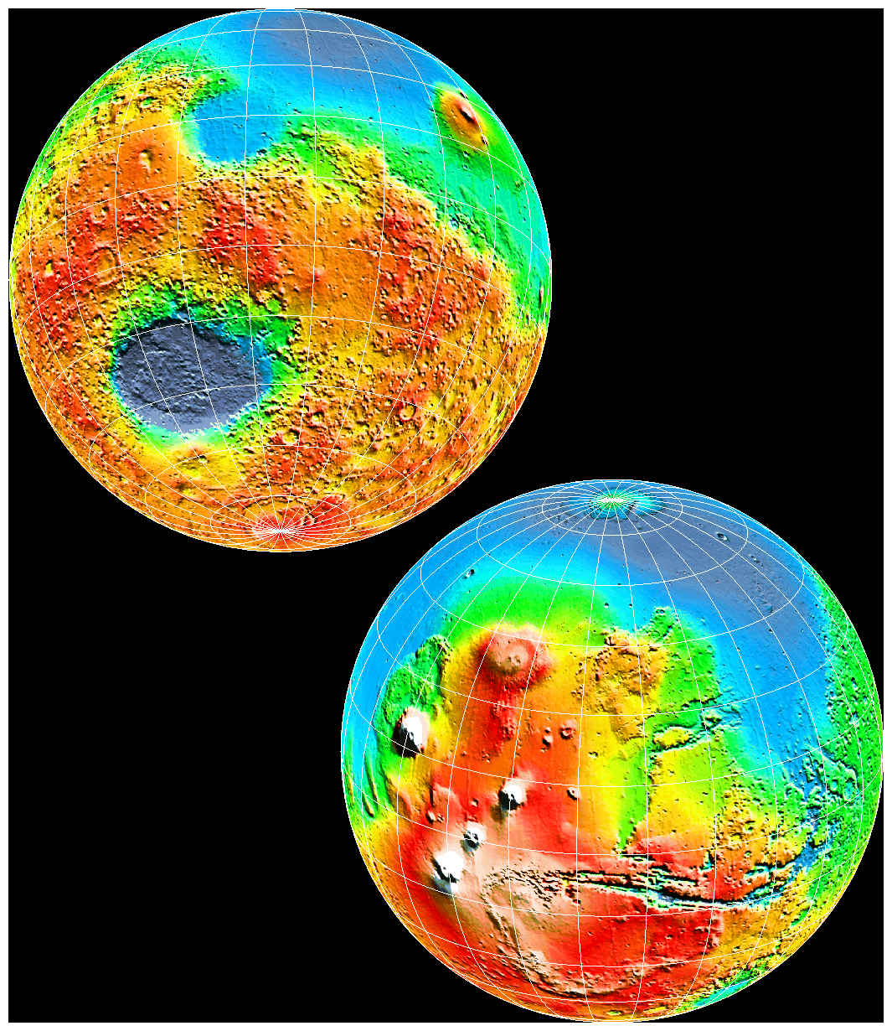
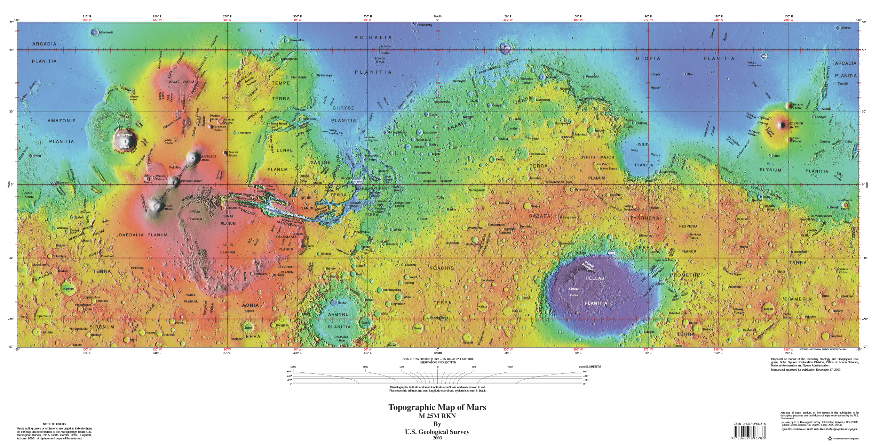
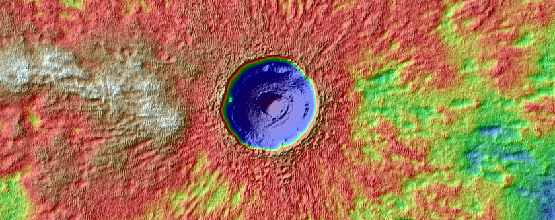
TOPOGRAPHY OF MARS
http://tharsis.gsfc.nasa.gov/global_paper.html
http://pubs.usgs.gov/imap/i2782/
~ 1km pixel resolution
HIRISE Imagery NASA/JPL/UAriz/USGS
http://www.uahirise.org/dtm
2-3 B$
1 m DTMs

