Slide 1
UN Agenda 2030 High-level UN-conference on SDG14 New York, June 2017

Slide 2
UN Agenda 2030
High-level conference SDG14
New York, 5-9 June 2017

Slide 3
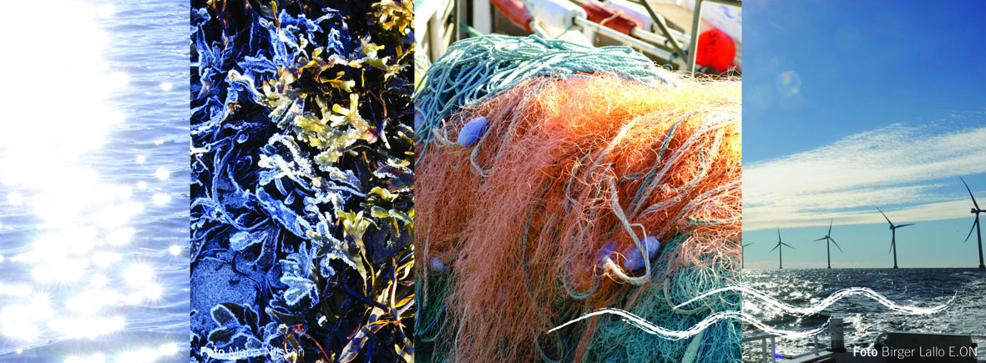
Agenda 2030
Integrated and universal agenda for acheiving sustainable development in 2030
Manifold interlinkages between goals and their targets

Slide 4
The importance of SDG14
The condition of the world’s oceans and seas is extremely serious
No country can solve this within its borders
Climate change, ocean acidification and pollution affecting ocean ecosystems negatively
Stocks are decreasing and many species are being extinct. Unsustainable fisheries worsen the situation.

Slide 5
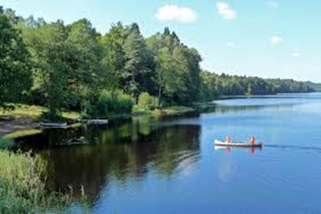
Follow-up of SDG14
Lack of global governance is a big problem, but agenda 2030 and SDG14 opens up for solutions
SDG14 is a truly universal goal, the degradation of ocean environment hits developing countries the hardest
Oceans and seas are essential for economic development and food security for millions of people world wide
SDG14, target 7, provides a clear mandate for exercising the blue economy for small island states and for the least developed countries

Slide 6
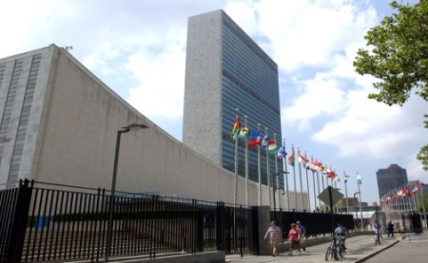
High-level UN-conference on SDG14, June 2017
New York, 5-9 June 2017, Fiji and Sweden hosts
First high-level UN-conference with focus on single goal of Agenda 2030. Driving implementation of SDG14 and its targets
Politically negotiated declaration, 7 partnership dialogues and voluntary contributions (from member states and other actors) main projected outcomes
Achive a good overview on where the world stands in SDG14 implementation
Broad participation from member states, business, civil society and knowledge community expected

