Slide 1
Bruges
03 March 2017
Niall McDonough
European Marine Board | Wandelaarkaai 7 | 8400 Oostende | Belgium - www.marineboard.eu

Slide 2
Outline of presentation
What is the European Marine Board?
New Science Commentary – “Ticking time bomb of climate change”
Decommissioning of offshore artificial structures: taking an ecosystem approach

Slide 3
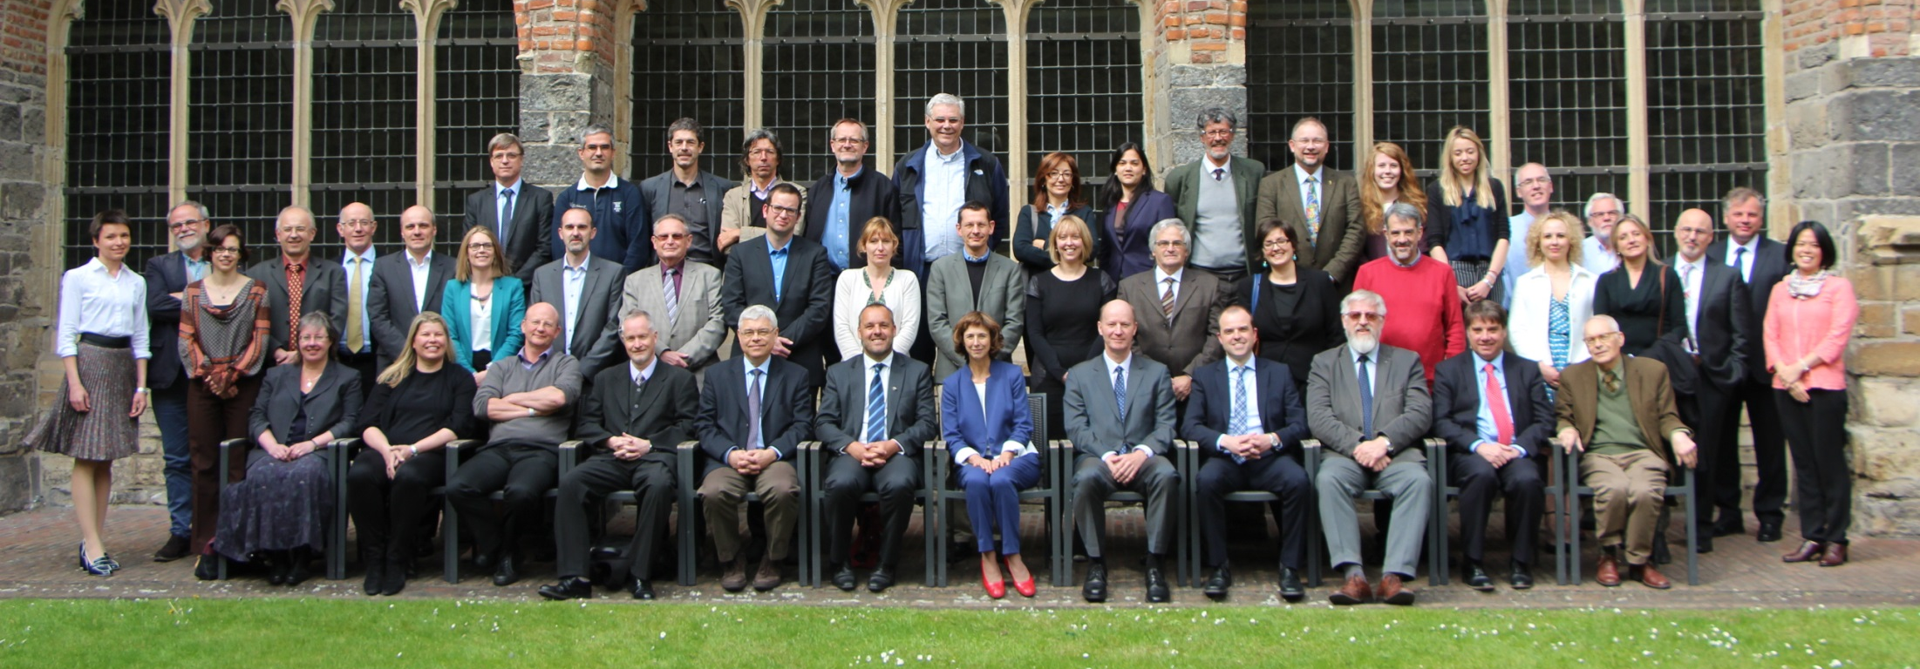
What is the European Marine Board (EMB)?
EMB plenary meeting, Ghent, April 2015
The European Marine Board is a partnership of major national marine research institutes, funding organisations and national networks of universities which aims to facilitate cooperation and coordination in marine science both in Europe and internationally.
www.marineboard.eu

Slide 4
32 members from
18 countries

Slide 5
EMB Mission
“The European Marine Board provides a pan‐European platform for its member organizations to develop common priorities, advance marine research, and bridge the gap between science and policy in order to meet future marine science challenges and opportunities.”

Slide 6
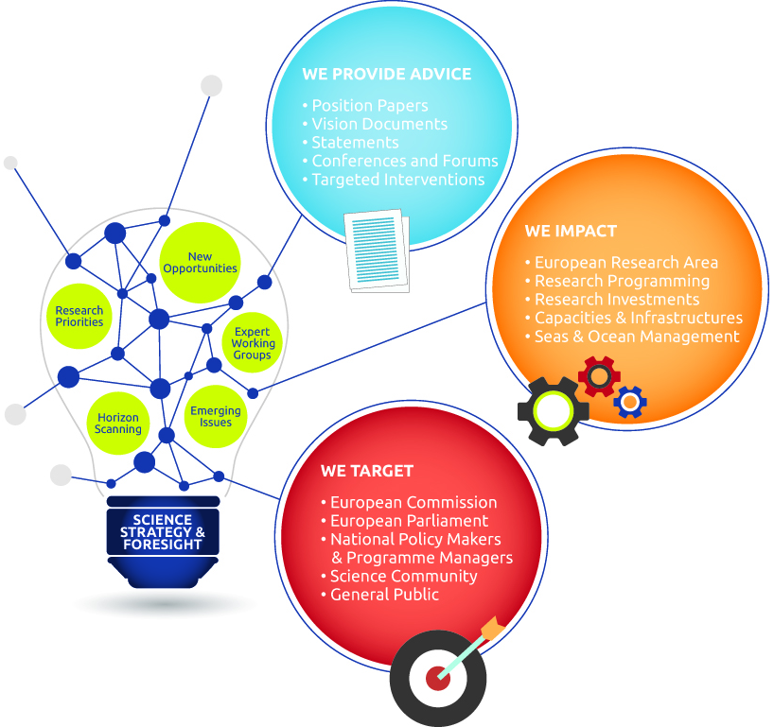
Transferring knowledge to the core of marine research policy

Slide 7
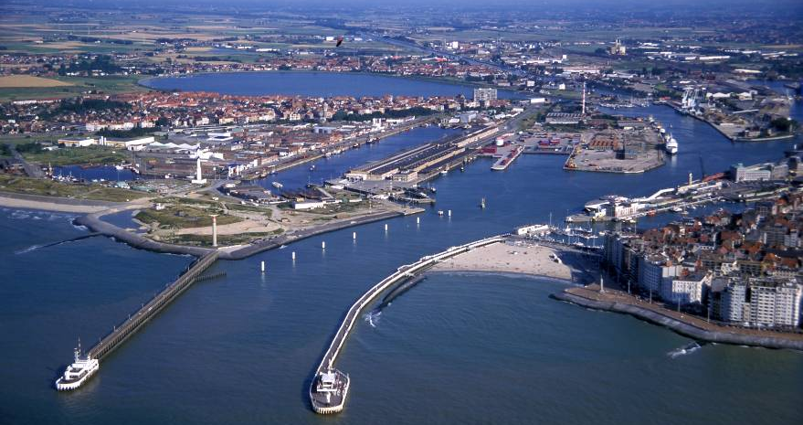
Location
UNESCO IOC -IODE
EMB
Flanders Marine Institute (VLIZ)
EMODNet
Based at the InnovOCEAN site, Harbour of Ostend, Belgium
Hosted by the Flemish Government through VLIZ
European Marine Board | Wandelaarkaai 68 | 8400 Ostend | Belgium
www.marineboard.eu

Slide 8
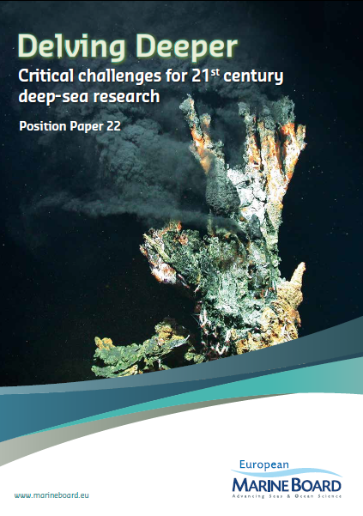
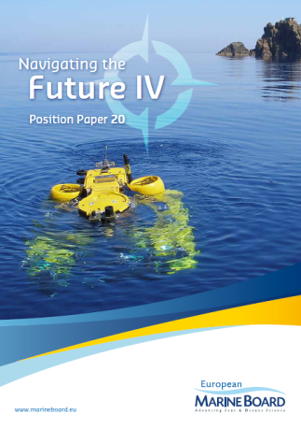
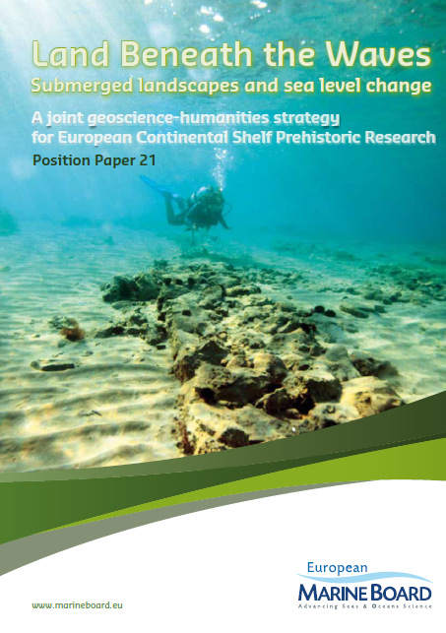
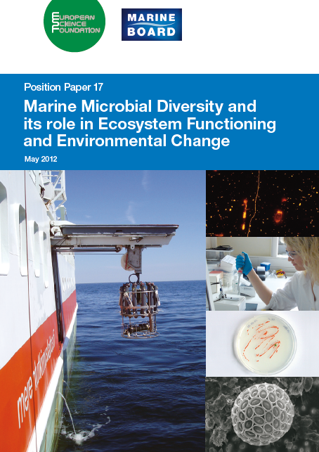
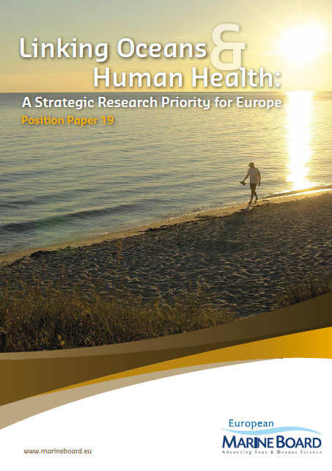
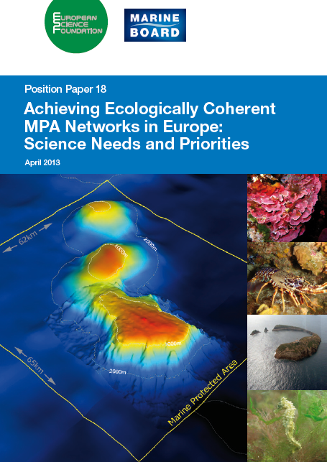
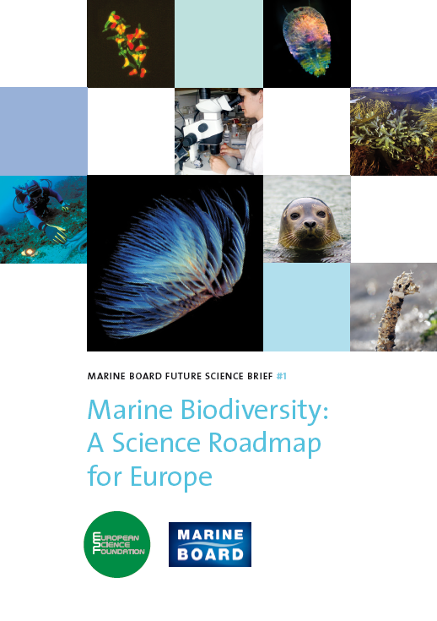
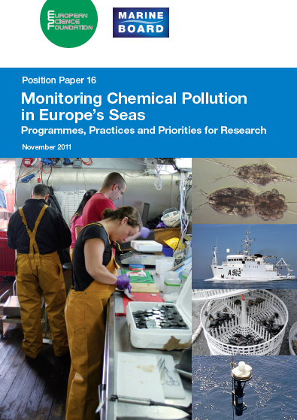
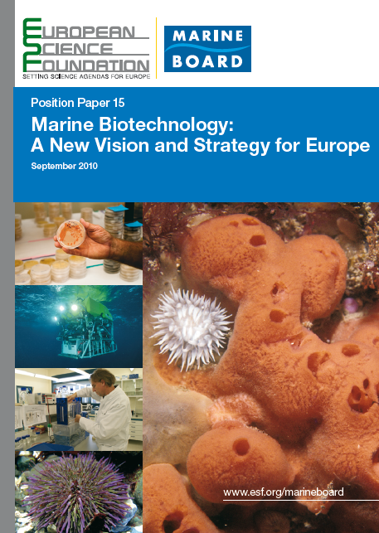
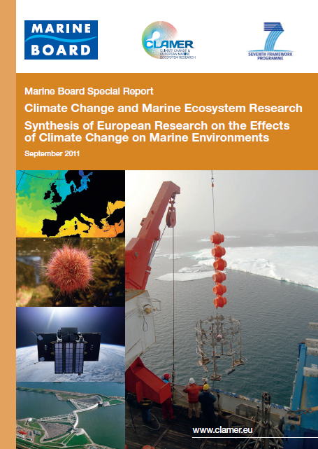
Recent EMB publications
Marine Protected Areas
Microbial ecology
Oceans and Human Health
Navigating the Future IV
Submerged Heritage
Marine pollution
Marine biodiversity
Marine Biotechnology
Climate Change
Deep Sea research

Slide 9
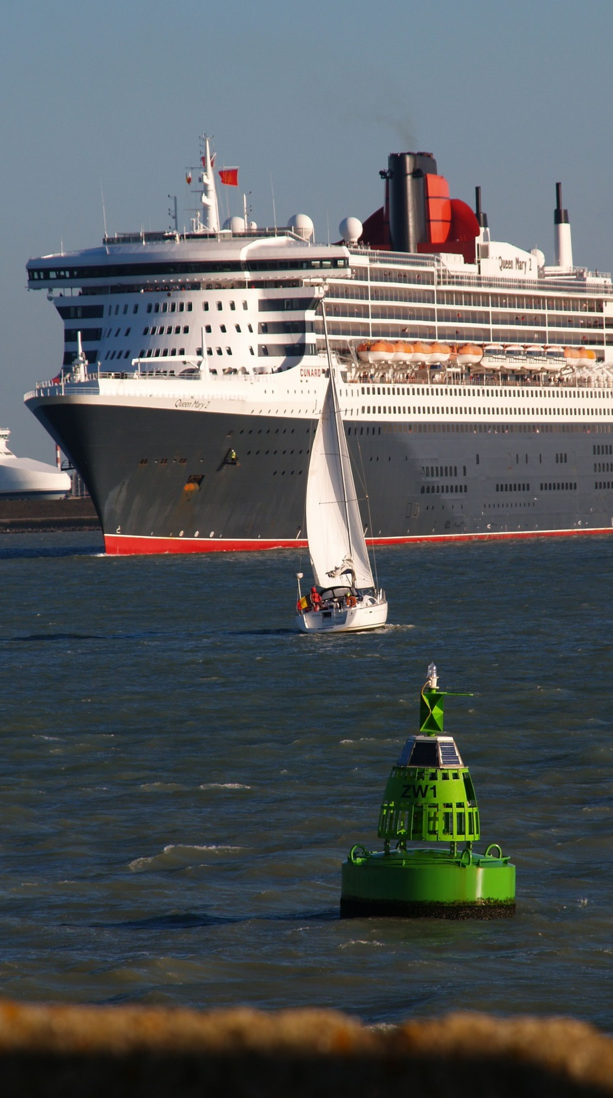
Europe – a truly maritime continent
Surrounded by 4 seas and 2 oceans
89,000km coastline (EU + Norway)
50% of EU territory is underwater
43% EU population lives within 50km of coastline (80% in Norway)
=280m people, 194 cities
Trade: 90% external and 40% internal is seaborne
Maritime activities account for 5.4m jobs and GVA of €500bn per year ¹
¹ EU Blue Growth Strategy: COM(2012)494 final

Slide 10
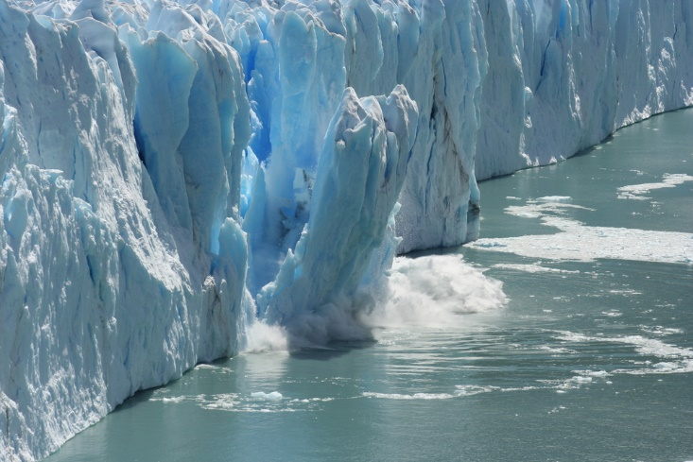
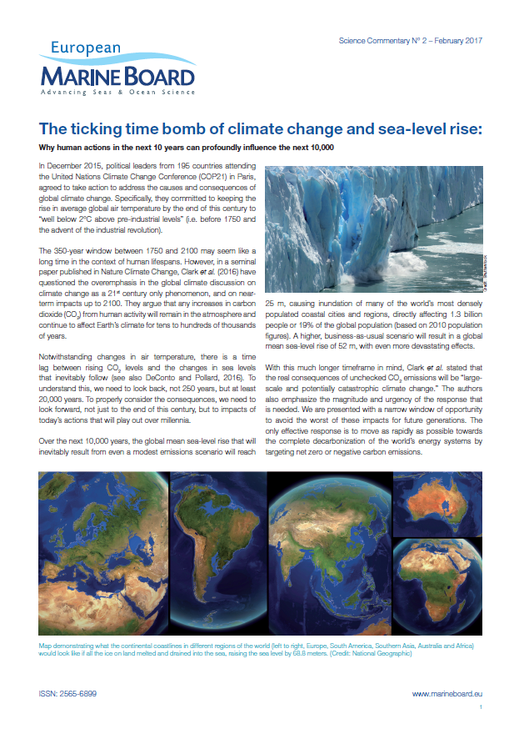
Launched today:
EMB Science Commentary No. 2

Slide 11
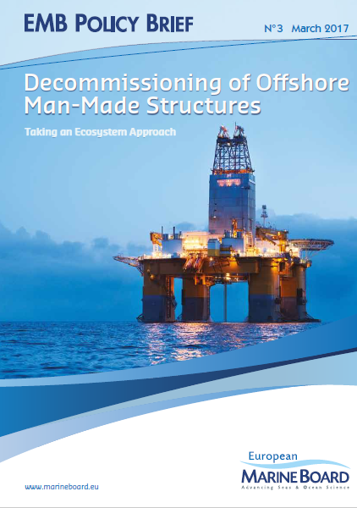
To be published in March 2017:
EMB Policy No. 3

Slide 12
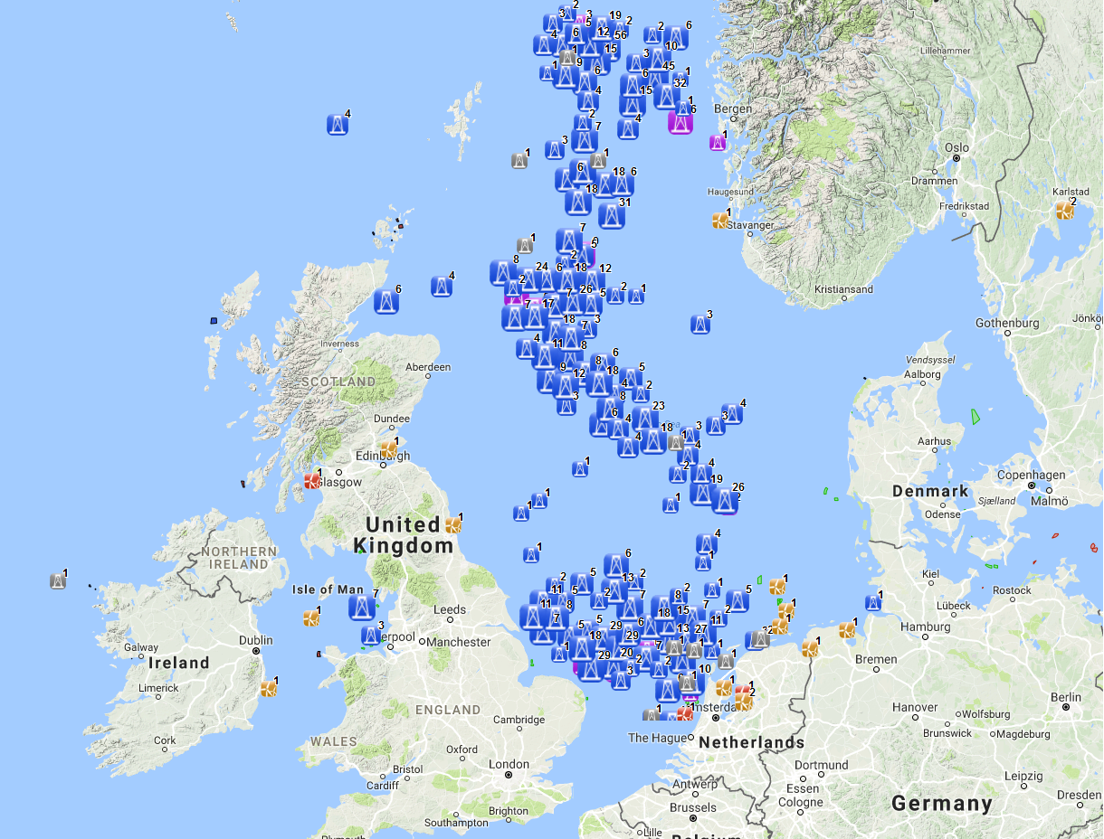
Oil & Gas installations in the North Sea
Taken from EMODnet Human Activities Portal
www.emodnet.eu

Slide 13
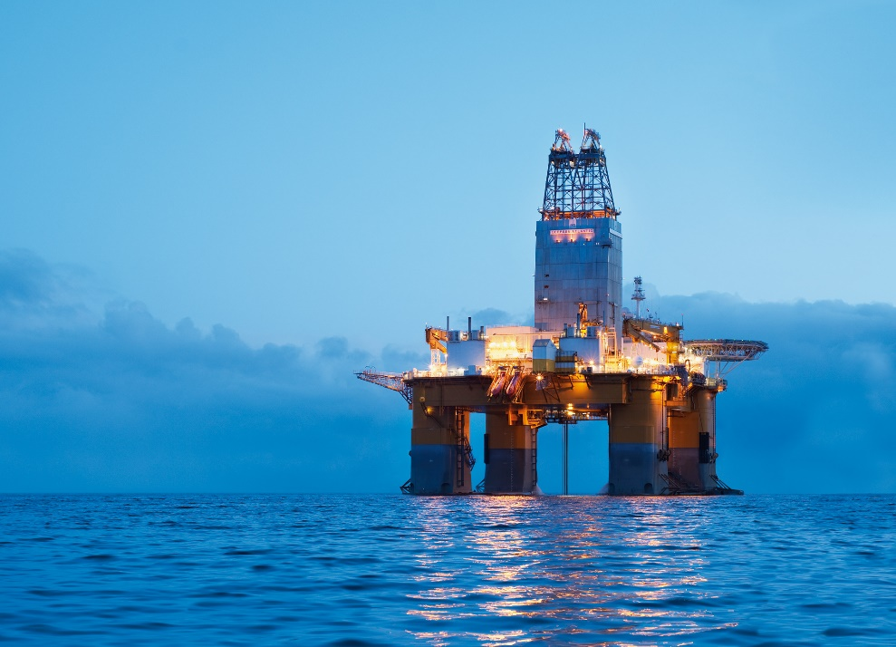
Decommissioning of offshore artificial structures: taking an ecosystem approach
1,357 oil and gas structures in the OSPAR maritime area (Northeast Atlantic)
1,800 grid connected offshore wind turbines in the North Sea
9,000 wind structures predicted in EU waters by 2030
Total estimated cost of full decommissioning of oil and gas structures in the North Sea is €80 - €100 billion

Slide 14
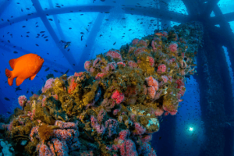
Image courtesy of Jan de Leeuw & Richard Heard, INSITE programme

Slide 15
Overview of the INSITE Programme
INSITE | INfluence of man-made Structures In The Ecosystem:
Funding | 8 Sponsoring organisations, made up of oil and gas operators Foundation Phase £2.4M (£1.8M net) over 3 years (BP, Centrica, CNRI, ExxonMobil, Marathon Oil, Shell, Talisman-Sinopec, Total)
Scientific Direction: Independent Scientific Advisory Board (ISAB) | Dr Graham Shimmield (Chair), Bigelow Laboratory for Ocean Sciences, Maine Professor Jan de Leeuw, Royal Netherlands Institute for Sea Research and University of Utrecht Professor Karen Wiltshire, Alfred Wegener Institute and University of Bremen Professor Steve Thorpe, School of Ocean Sciences, Bangor University (Retired 2015) |  | Professor Torgeir Bakke, Norwegian Institute for Water Research Professor Henk Brinkhuis, Royal Netherlands Institute for Sea Research and University of Utrecht Professor John Shepherd, National Oceanography Centre, University of Southampton
Outcomes | Papers and articles published in the scientific media (requirement) Stakeholder symposia at end of years 1 and 2 of Programme
Timeline | Foundation Phase: | RFP: April to December 2014 Science Programme : Nov 2015 to Nov 2017 Symposia: November 2016 and 2017
Slide courtesy of Jan de Leeuw & Richard Heard, INSITE programme

Slide 16
INSITE Primary objectives
“To provide stakeholders with the independent scientific evidence-base needed to better understand the influence of man-made structures on the ecosystem of the North Sea”
To assess the magnitude of the effects of man-made structures compared to the spatial and temporal variability of the North Sea ecosystem, considered on different time and space scales; and
To what extent, if any, the man-made structures in the North Sea represent a large inter-connected hard substrate system.
Slide courtesy of Jan de Leeuw & Richard Heard, INSITE programme

Slide 17
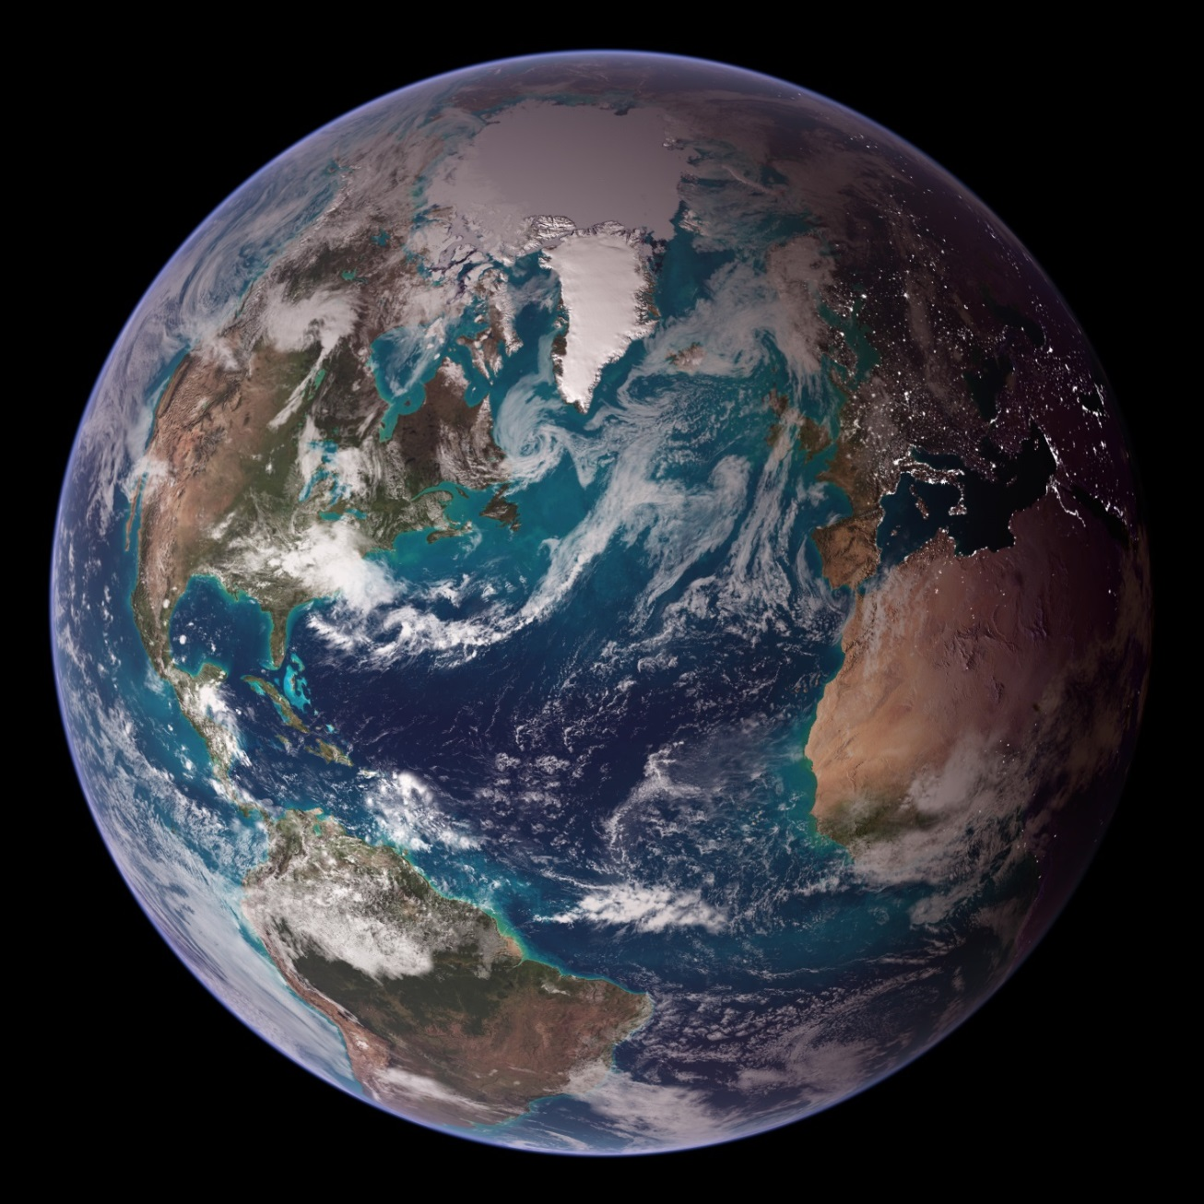
Thank you
www.marineboard.eu

