Slide 1
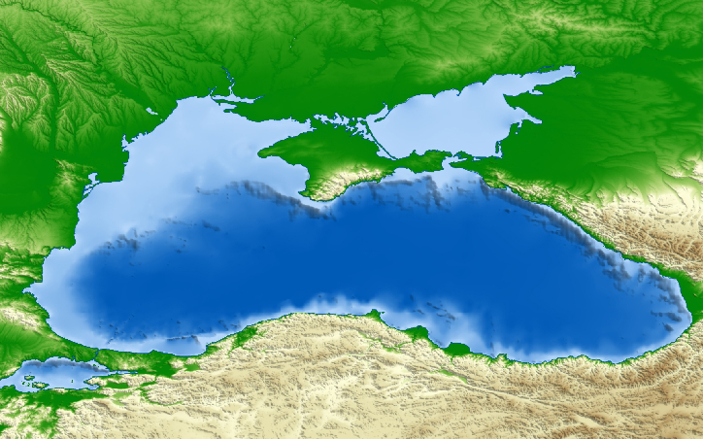
CONFERENCE ON BLUE ECONOMY IN THE BLACK SEA
CONNECTING THE REGION THROUGH MARINE AND MARITIME COOPERATION
Batumi, 15 September 2017
PANEL 2A: SAVE THE SEA
Moderator: Sigi Gruber
Head of Marine Resources Unit
Directorate-General for Research and Innovation
European Commission

Slide 2
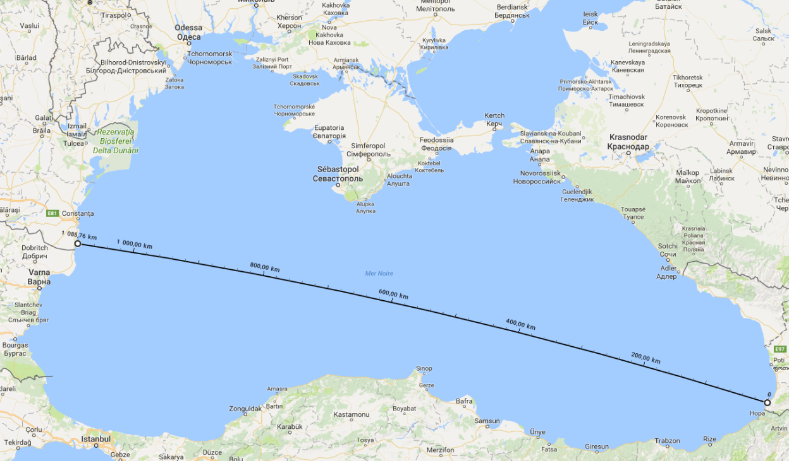
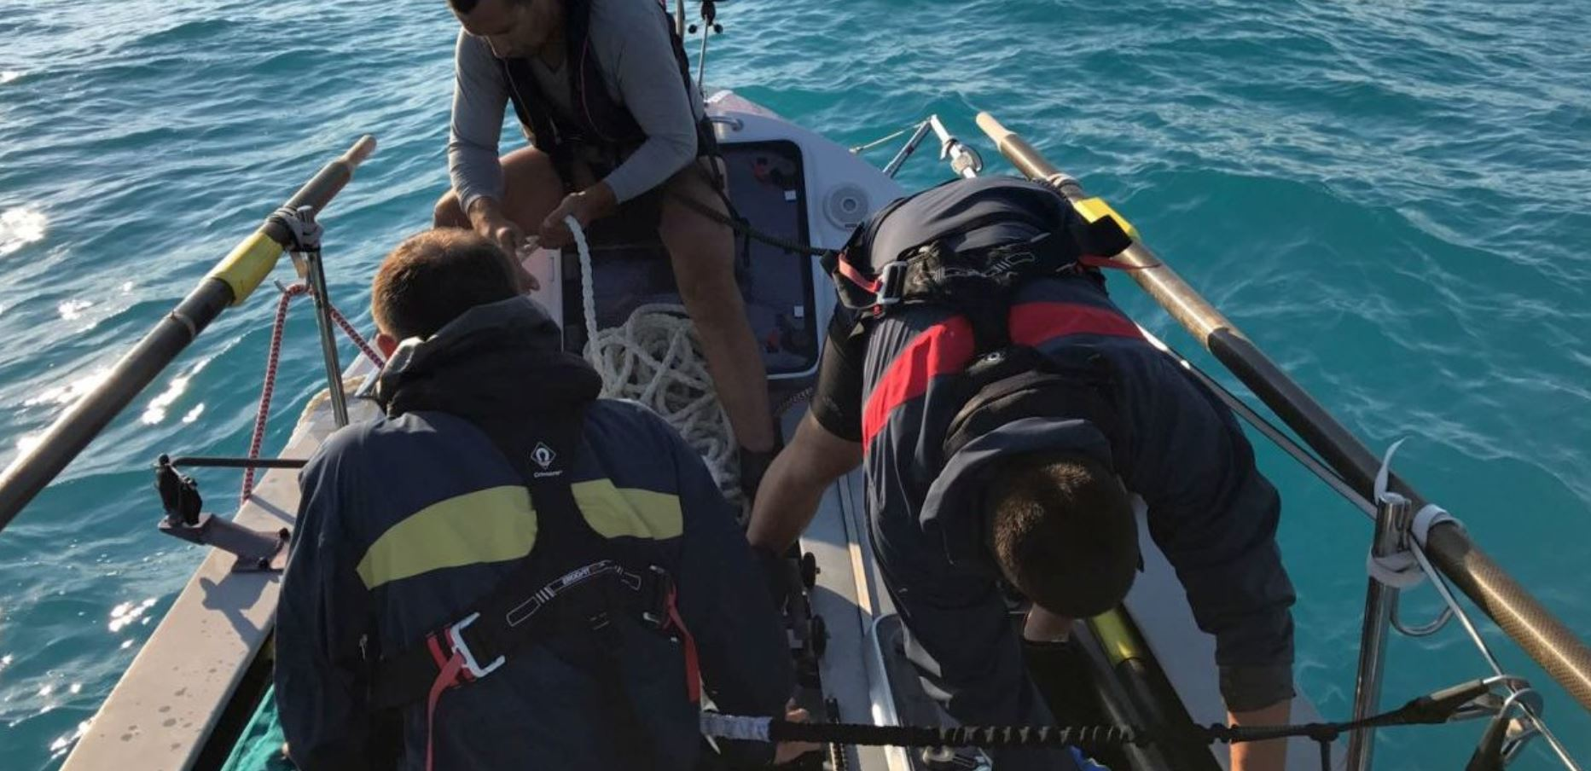
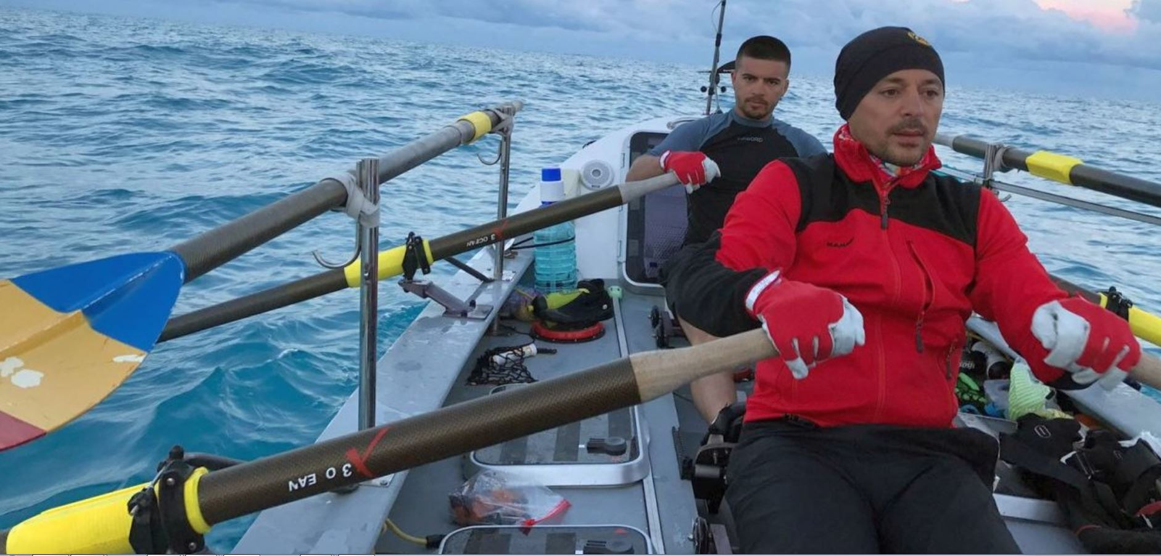
June 2017 - 5 Romanians rowed across the Black Sea from Mangalia (RO) to Batumi (GE) to set a record
Strengths: sea knowledge, good training;
Weaknesses: failing equipment in rough weather conditions;
Opportunities: set a record;
Threats: distance: 1000 km, high temperatures, big thunderstorms.
Result: They crossed the Black Sea in 11 days, 6 hours and 1 minute, entering the Book of Records

