Slide 1
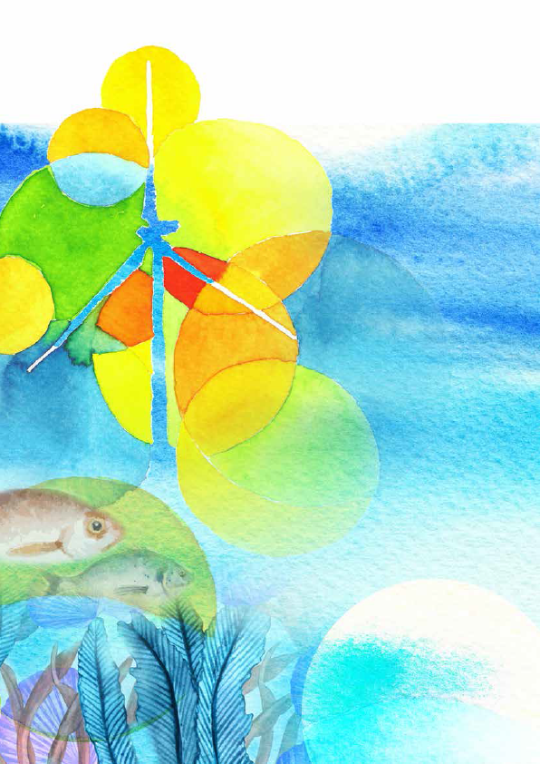
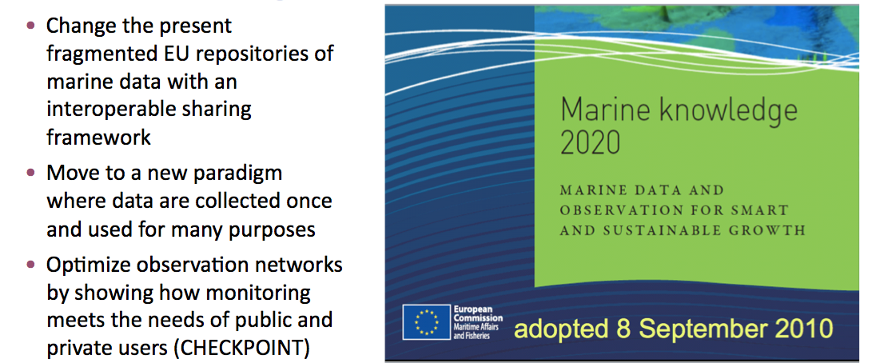
The European Marine Observation and Data Network
EU China Blue Year - discussions on marine science and data
3 March 2017 Bruges, Belgium
Janbart.Calewaert@emodnet.eu

Slide 2
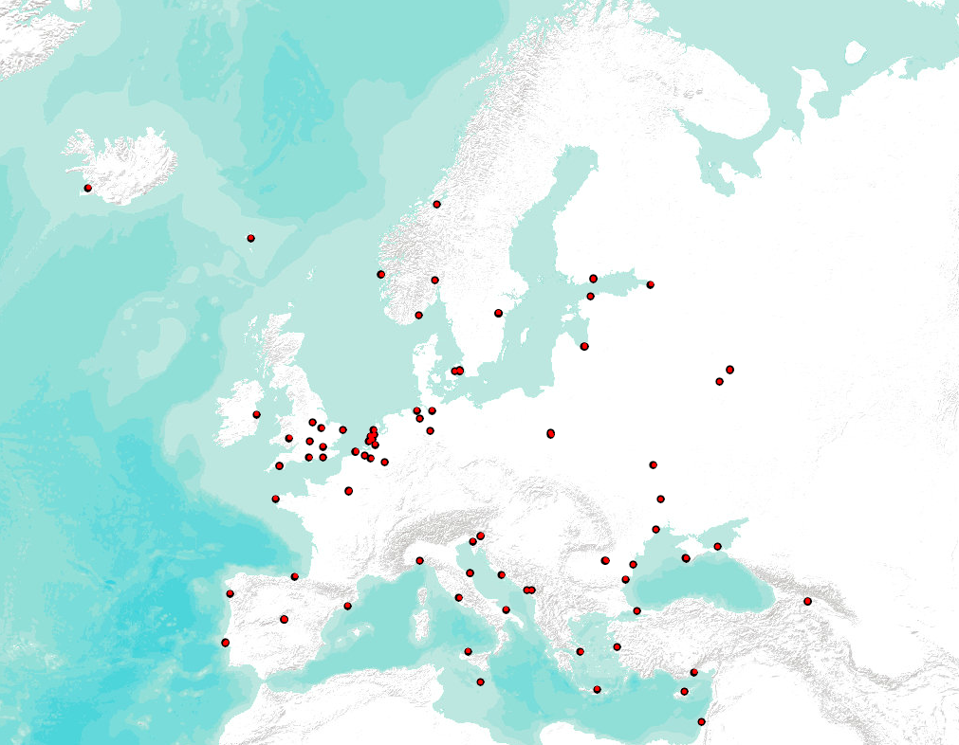
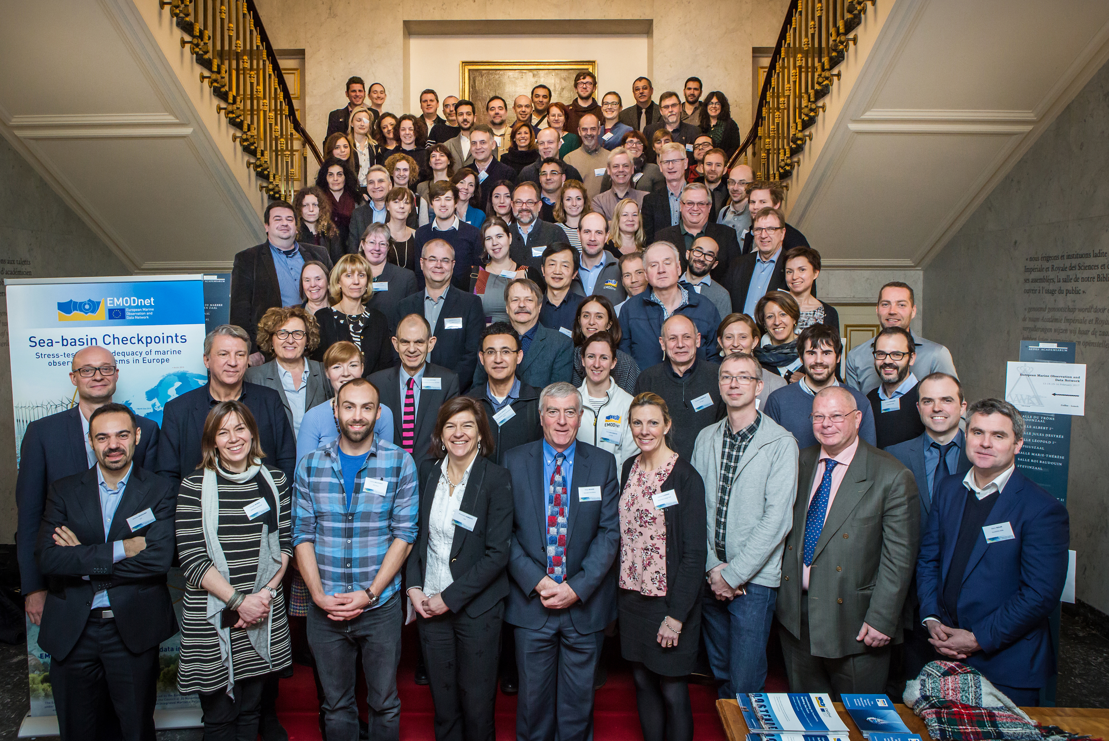
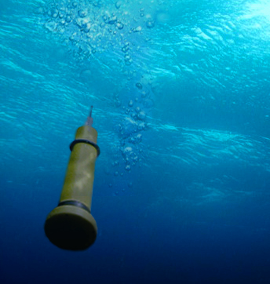
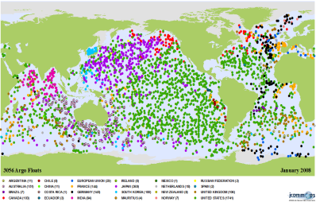
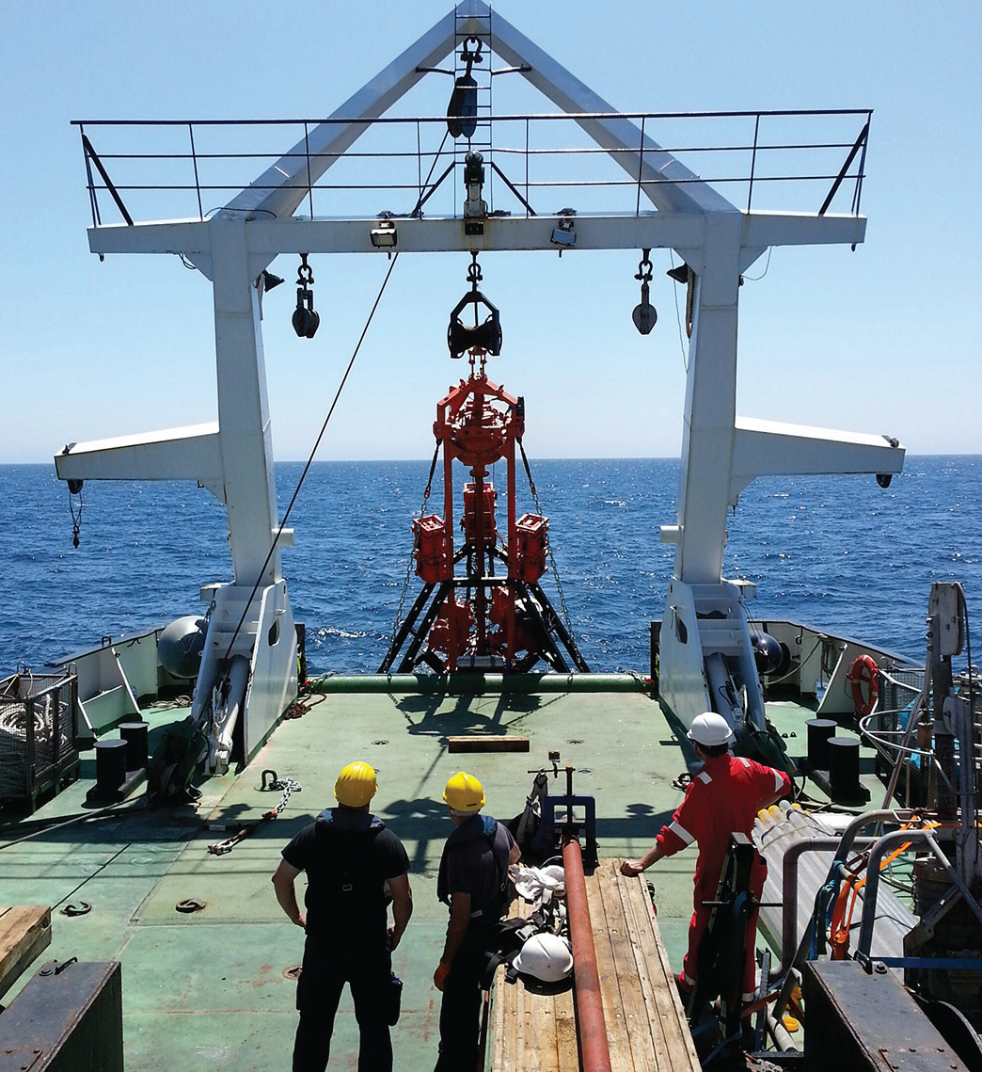
What is EMODnet?
Network of people and organisations
Provide access to marine data, metadata and products
EU Multimillion investment
Collect marine data once, use it many times
Notes:
Network of organisations collecting, assembling and providing access to data stored at various locations around Europe (harmonised, interoperable and free of restrictions on use) + making products such as maps based on these data

Slide 3
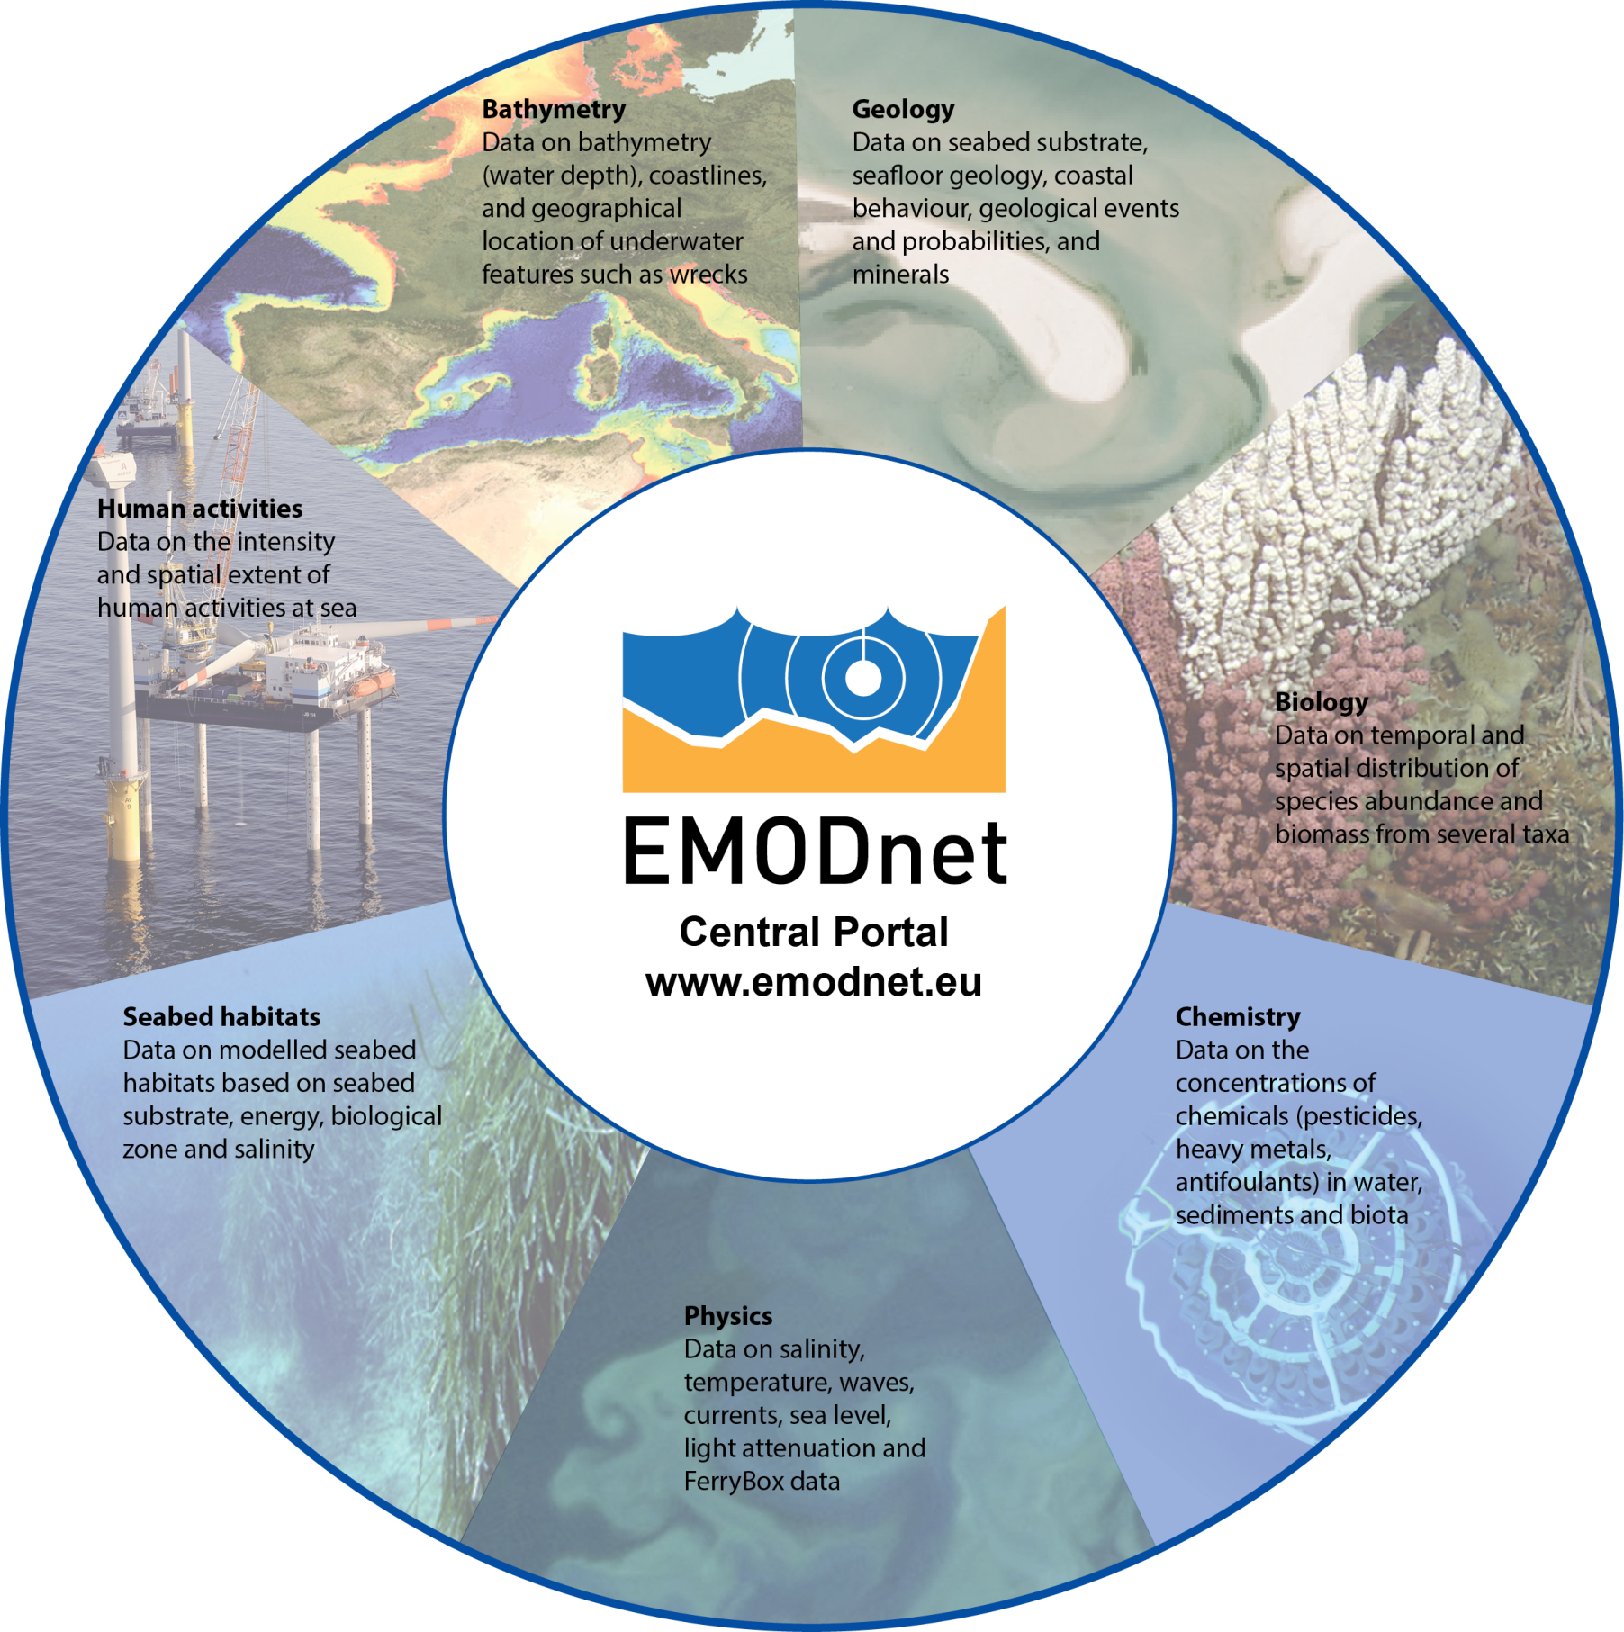

Slide 4
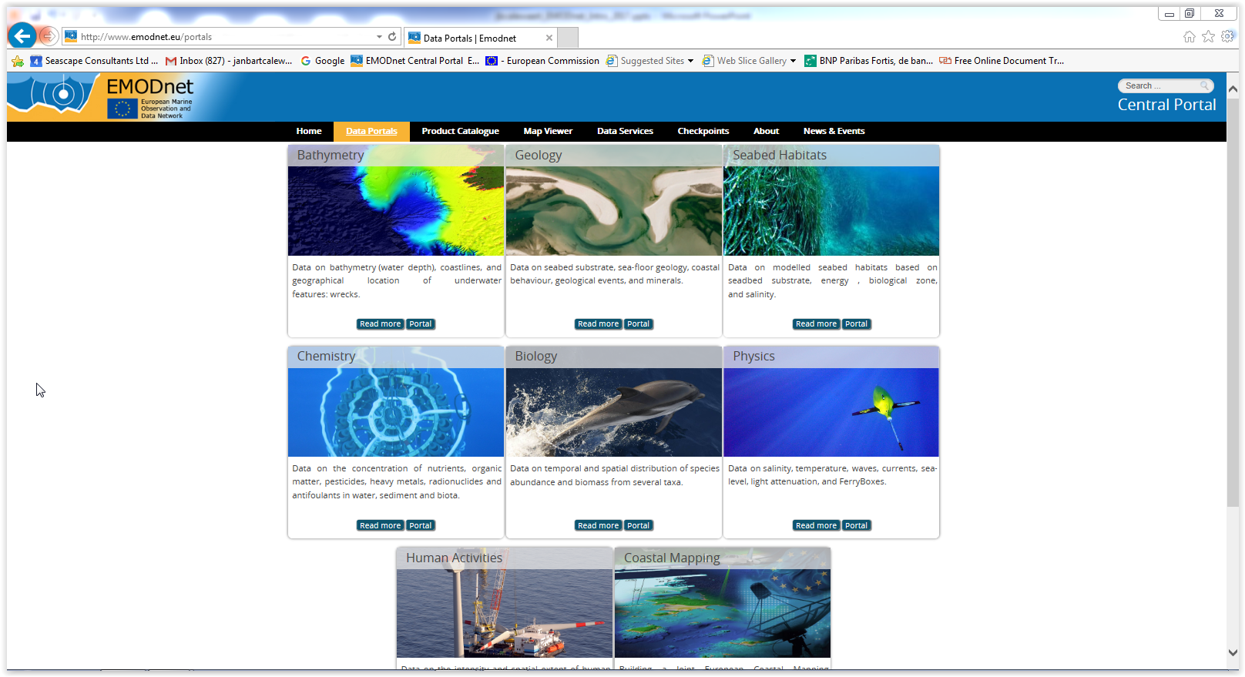

Slide 5
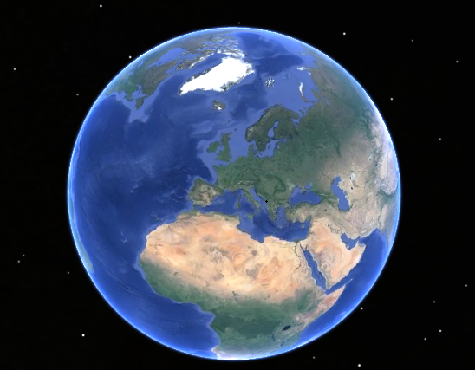
Sea basin Checkpoints
Arctic
Atlantic
Baltic
Black Sea
Mediterranean
North Sea
2015
2013

Slide 6
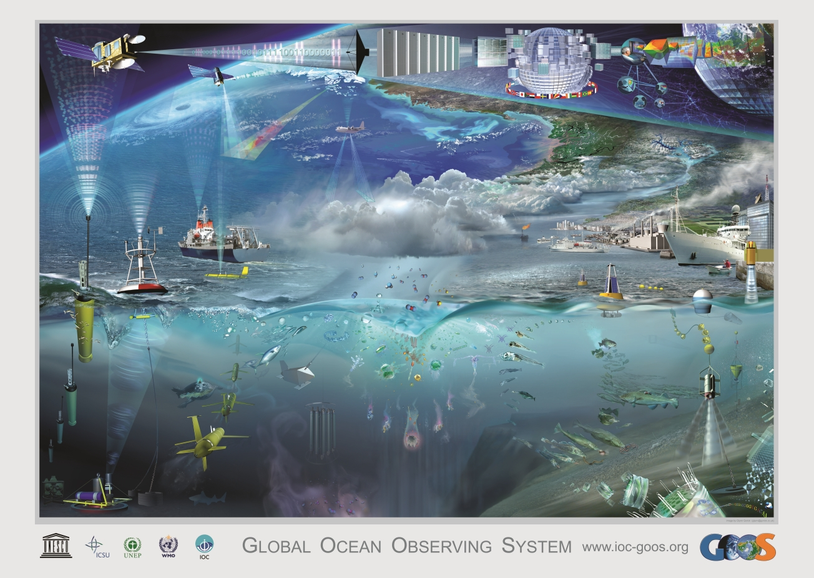
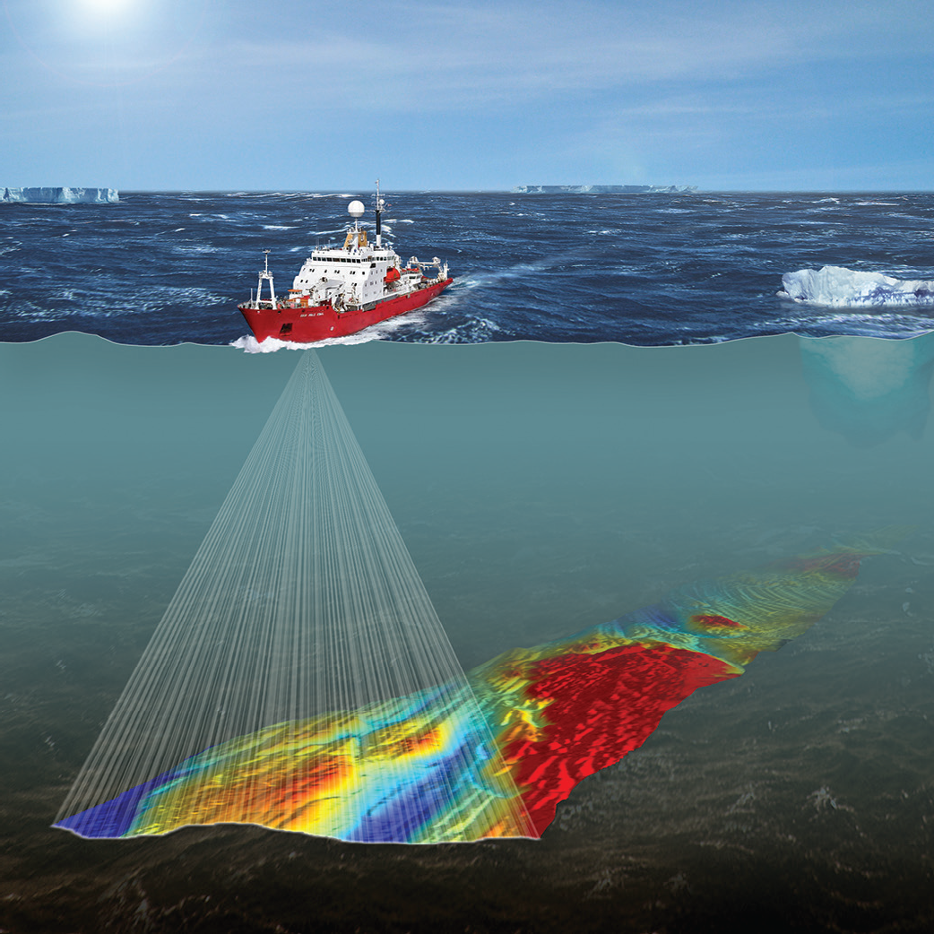
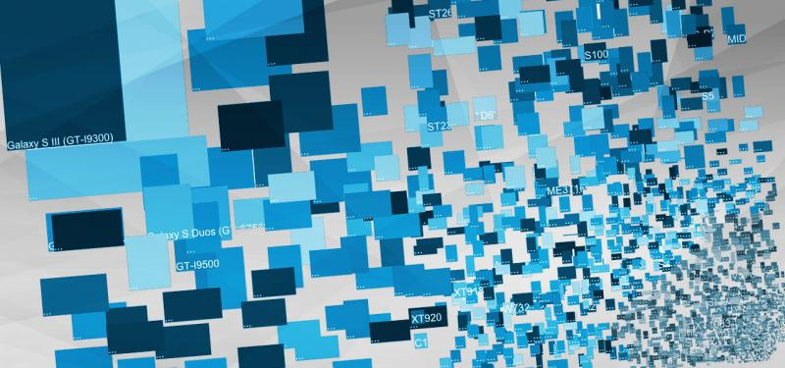
Why EMODnet?
Ocean Observation costs in EU
Space data: € 400 M per year
In-situ data: > €1 billion per year
Data Acquisition (Observations)
Data management & access
EMODnet
Notes:
Observations: lack of coordination and continuity + no integrated assessment as to the needs, gaps, duplications etc. → not an efficient ‘system’ at European level
Data management and access – fragmentation and lack of coordination → difficult and time consuming to obtain existing data for larger areas (e.g. seabasin level)
(…) the data collected through these observations can only generate knowledge and innovation if Europe's engineers and scientists are able to find, access, assemble and apply them efficiently and rapidly. At present this is often not the case.

Slide 7
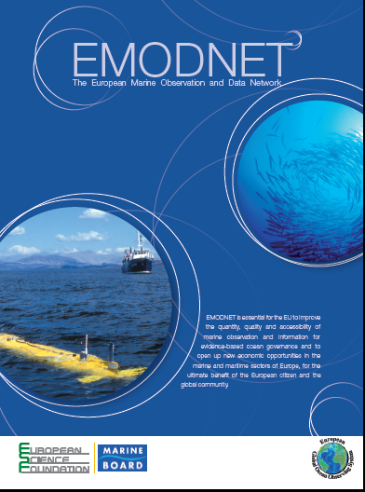
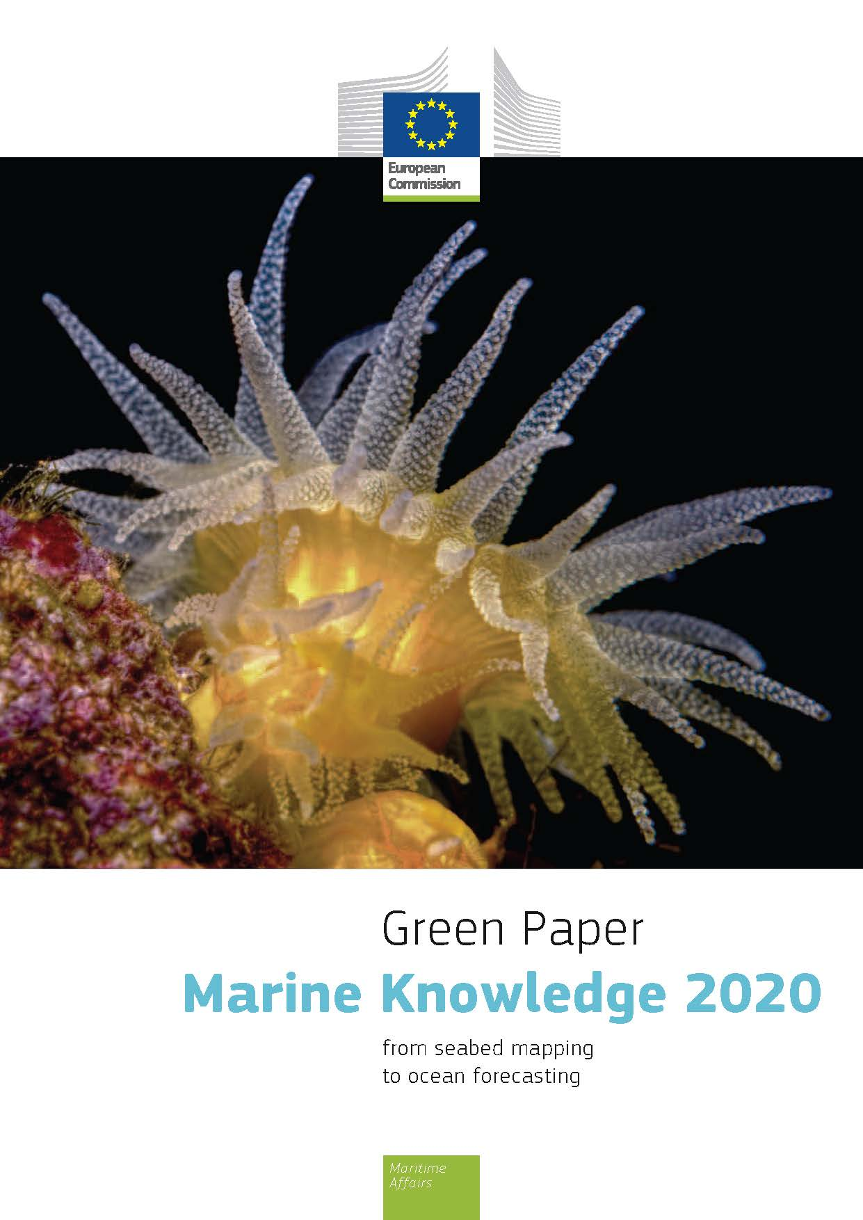
What to do?
A vision for an end-to-end, integrated, inter-operable and user-oriented network of European marine observation and data systems
Notes:
Marine Knowledge 2020 is Europe’s strategy to unlock the economic and societal potential of Europe’s wealth of marine observations.
MK2020 strives to bring together marine data from different sources with the aim of:
Helping industry, public authorities and researchers find the data and make more effective use of them to develop new products and services.
Improving our understanding of how the seas behave.
Objectives are:
Reduce operators costs
Reduce uncertainty about behaviour of the sea
Improve our knowledge

Slide 8
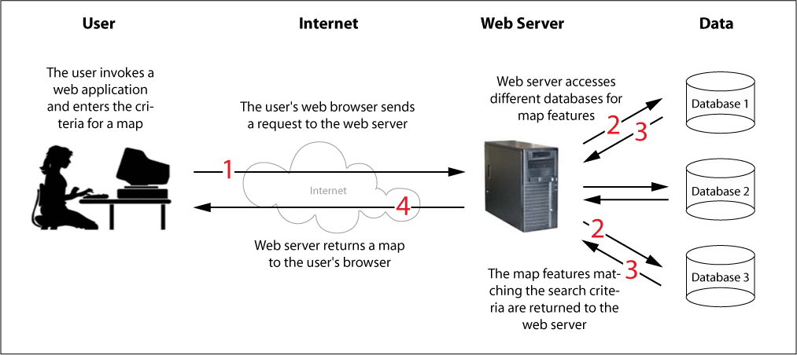
What do we want?
Central Portal www.EMODnet.eu
7 thematic Data Portals
Member State repositories
access data & products
from >1 theme
access to thematic data & data products (maps, indices)
Notes:
We want single access points where professionals from public sector, industry, civil society and science communities have can easilty obtain high quality harmonised datasets and products (e.g. maps) stored in different systems around Europe – we want this to be quick and in provided in formats and ways that allows us to easily use and combine the data and products.
With EMODnet we are developing such a ‘distributed data system’ consisting of a central gateway underpinned by 7 thematic data subportals – Bathymetry, Geology, Seabed Habitats, Chemistry, Biology, Physics and Human Activities.

Slide 9
How do we get there?
2009 | 2010 | 2011 | 2012 | 2013 | 2014 | 2015 | 2016 | 2017 | 2018 | 2019 | 2020
Phase 1 – limited sea basins
 |  |  |  | Phase 2 - low resolution all basins
 |  |  |  |  |  | Phase 3 - multi-resolution
2009: Start EMODnet phase 1: 59 Institutes - Budget €6.45M
2013: Start EMODnet phase 2: 120 Institutes - Budget €16.3M
2016: EMODnet phase 3: towards a seamless multi-resolution digital seabed map of European waters by 2020.[budget ↑↑↑]
→ NOW: 7 thematic portals + 6 regional checkpoints + 2 special projects + Central Portal + Secretariat
Notes:
Vision targets for 2020
Seamless multi-resolution digital seabed map of European waters by 2020
Highest resolution possible in areas that have been surveyed;
Topography, geology, habitats and ecosystems;
Accompanied by timely information on
Physical, chemical and biological state of the overlying water column
Oceanographic forecasts;
Easily accessible, interoperable and free of restrictions on use;

Slide 10
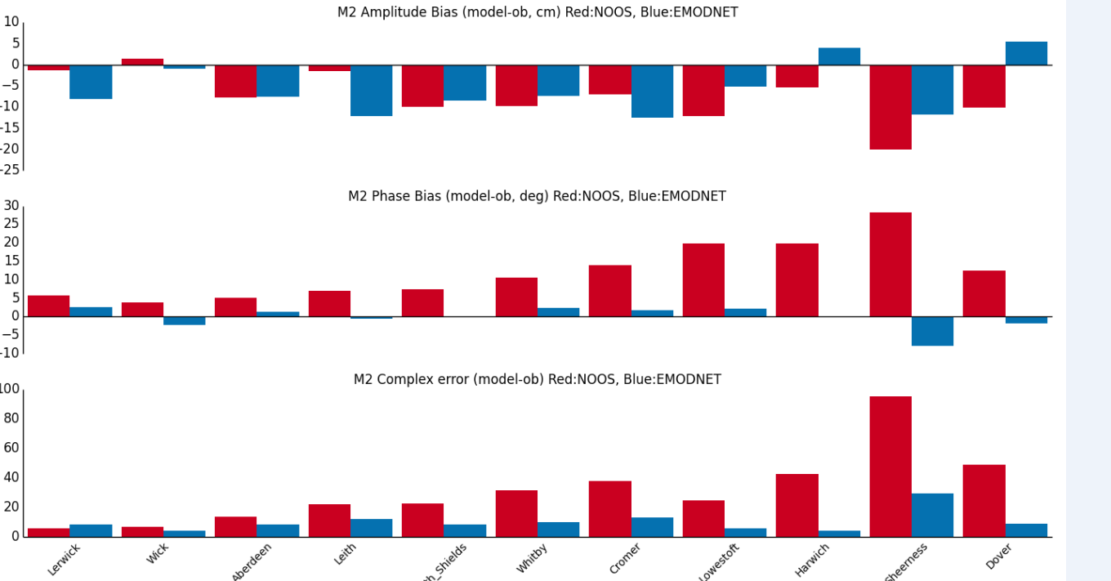
EMODnet bathymetry
UK Met Office & NOC new storm surge forecast model
Requires tidal solution is accurate which in turn requires an accurate bathymetry.
Using a bathymetry based on the EMODnet dataset significantly improved the reliability of the model’s forecasts.
www.emodnet-bathymetry.eu
Notes:
The Met Office and National Oceanography Centre (NOC) are jointly developing a new storm surge forecast model for the UK. The new system uses NEMO as the underlying ocean model. In order to correctly forecast storm surge it is vital that the model’s tidal solution is accurate, which in turn requires an accurate bathymetry. As part of the setup a number of different bathymetry products have been tested, and the results compared against observations from tide gauges around the UK.
Using a bathymetry based on the EMODnet dataset led to an overall improvement in the model tide solution compared with the previously used NOOS bathymetry. Systematic biases in particular have been reduced. The figure shows errors in the M2 constituent (the most dominant in the UK region) for ports on the east coast, where there are significant improvements using EMODnet.
As a result, EMODnet has been selected as the bathymetry to be used by the new system.
Dr Clare O'Neill Ocean Modelling Scientist Met Office Fitzroy Road Exeter Devon EX1 3PB United Kingdom Tel: +44(0)1392 886241 Email: clare.oneill@metoffice.gov.uk Website: http://www.metoffice.gov.uk

Slide 11
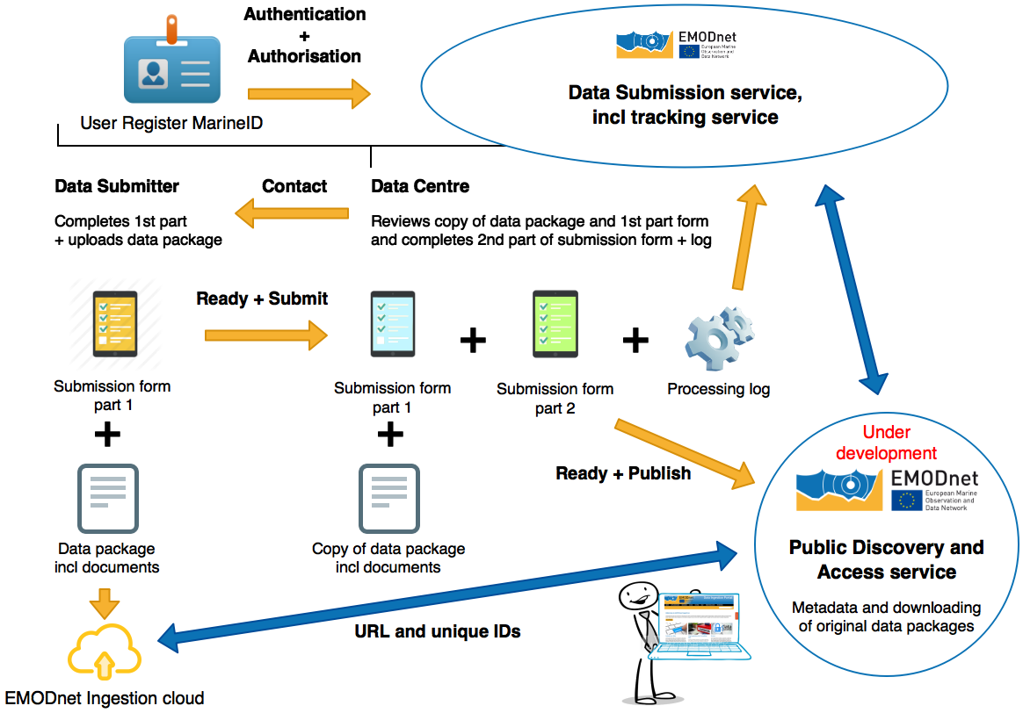
Whats new?
Higher resolution coverage - more parameters:
marine litter (chemistry portal) incl. macro-objects as well as fragments and microparticles in water column, sediments and beaches. Data on marine litter to be assembled and normalised to a common classification.
Underwater noise (physics portal)
More chemical & biological species
Data Ingestion Portal www.emodnet-ingestion.eu
More machine to machine communication
Higher performance of portals
More coherence
Notes:
marine litter (chemistry portal) - collected on beaches, in fishermen's nets, or in specific surveys). This shall include macro-objects (nets, bottles etc.) as well as fragments and microparticles in water column, sediments and beaches. This is new compared to phase 2 of EMODnet. The various efforts to collect marine litter shall be assembled and normalised to a common classification.

Slide 12
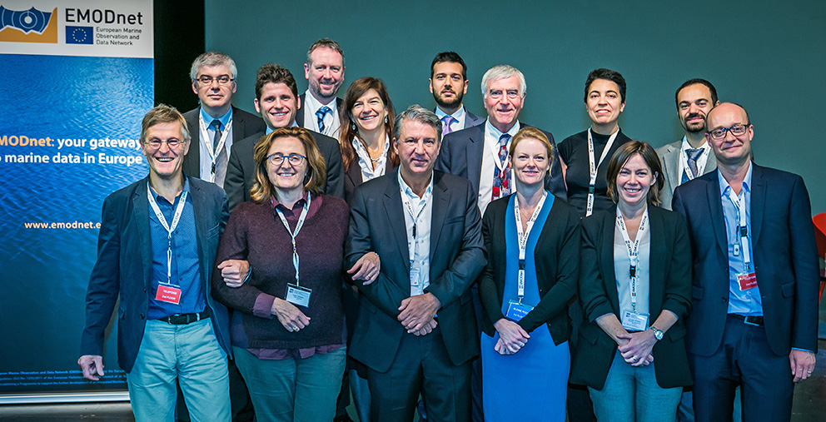
Thank you!
There is only one Earth, with only one history, and we get only one chance to record it. Ideas not followed through can be taken up again later. A record not made is gone for good. Editorial - Nature 450, 761 (6 December 2007)
http://www.emodnet.eu/video

Slide 13
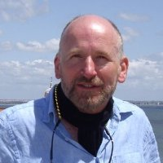
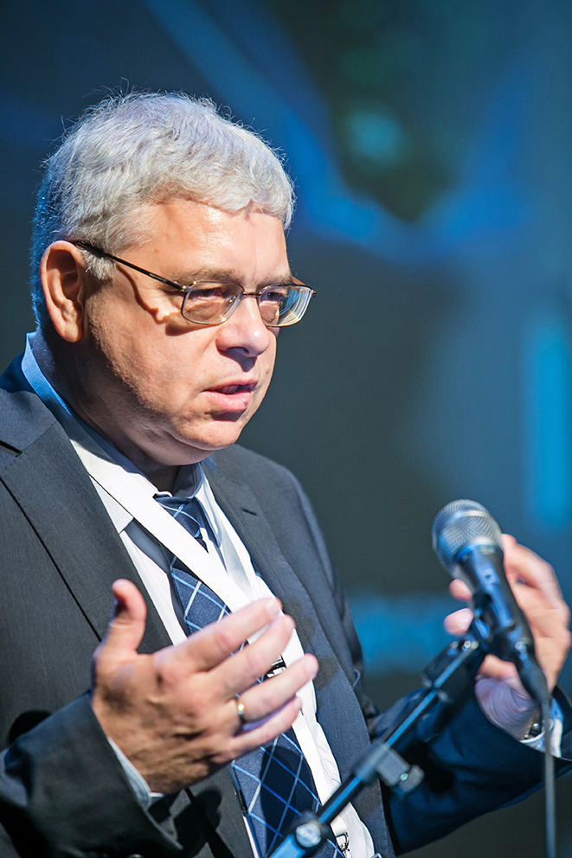
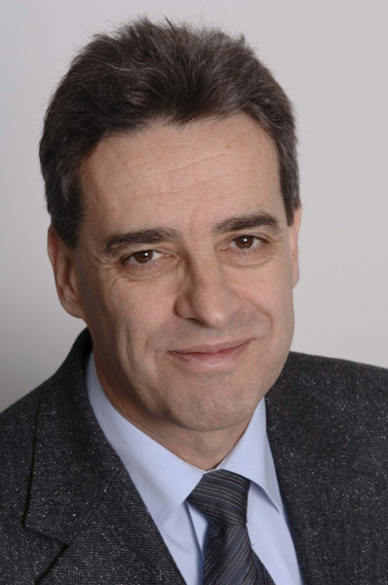
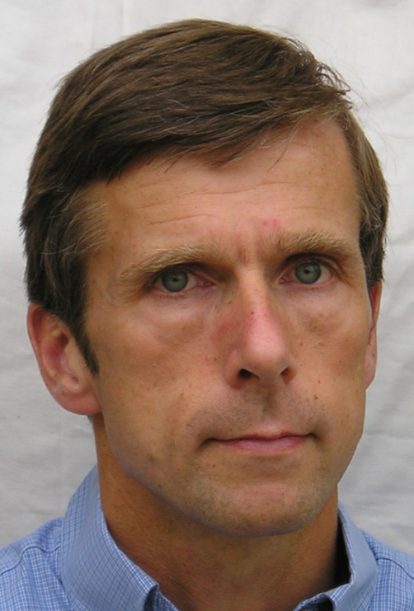
Says who?
“This is, without doubt, the most exciting development in data management in Europe that we’ve had for the last twenty years” Richard LAMPITT, Coordinator of FIXO3 European Programme project
“From a scientific perspective EMODnet is a giant step in data availability” Jan MEES, Chair of the European Marine Board
”EMODnet – a true hallmark in Marine Observations and Data and its networking; it is hugely important not only for Europe but is an example for other regions, a valuable partner for IOC of UNESCO” Vladimir RYABININ, Executive Secretary of the Intergovernmental Oceanographic Commission (IOC-UNESCO)
“EMODnet is fundamental to how blue economy will develop” Matthew KING, European Commission DG MARE
“Exploitation of EMODnet data will not only happen in EU, it will happen all around the world” Jean-François MINSTER, Scientific Director, TOTAL
“Enterpreneurs will take advantage of the data resources made available by EMODnet and deliver very specific information services to specific costumers” Jonathan WILLIAMS, CEO Marine South East Maritime Cluster

