Slide 1
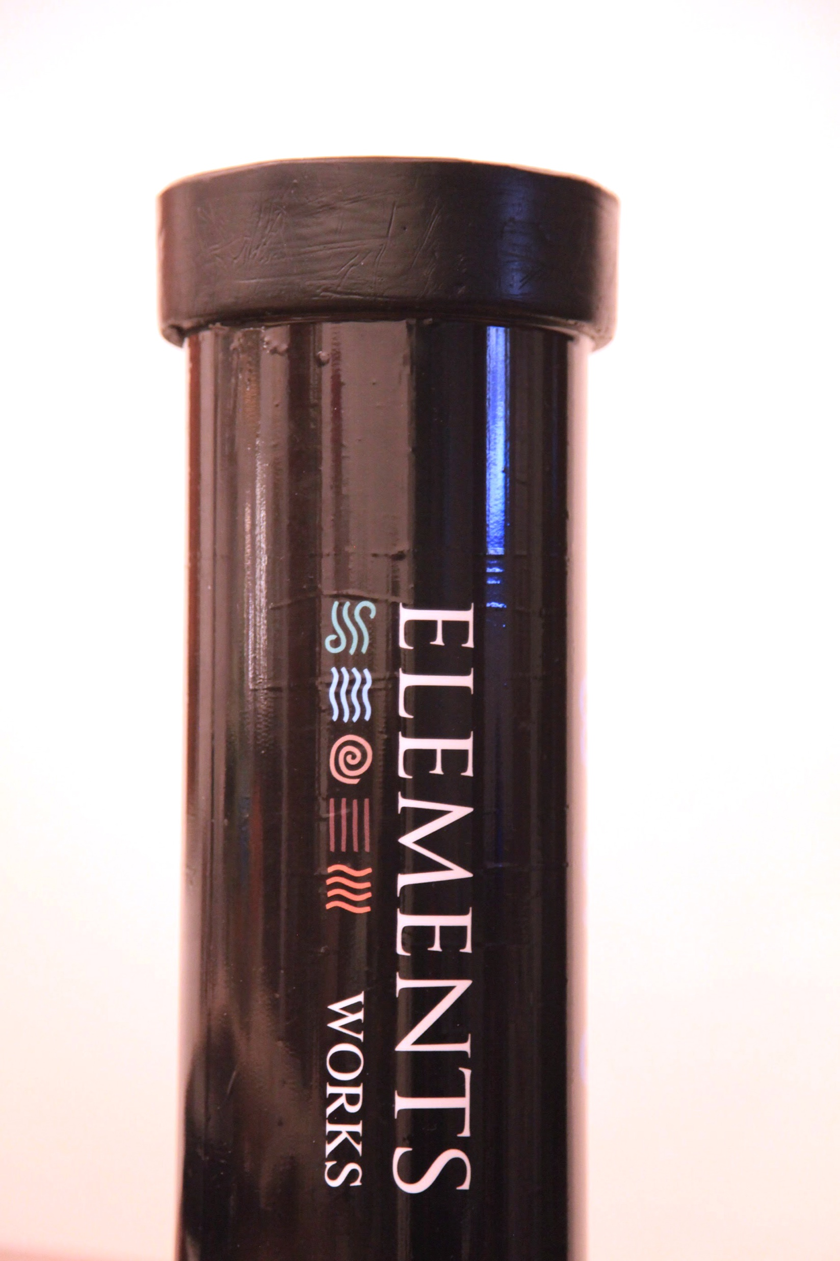
netH₂O personal smart buoy
Blue Invest in the Med
Michele Grassi, PhD
CEO and CTO, Elements Works SRL
The netH₂O buoy addresses the rapidly growing need for distributed, affordable and simple data collection from the water environment.

Slide 2
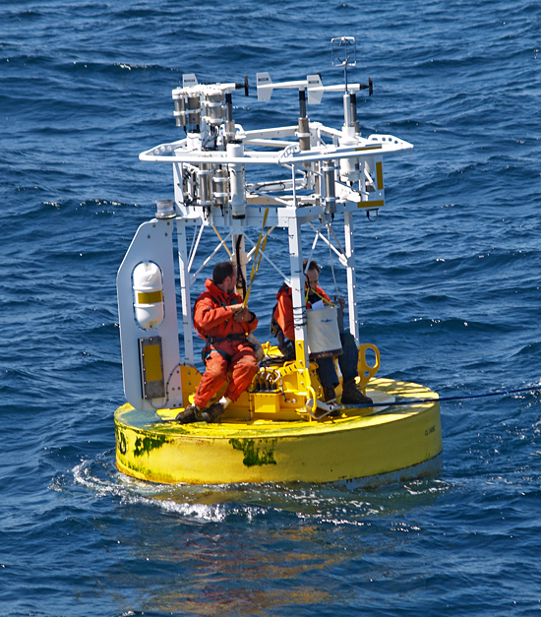
netH₂O personal smart buoy
WHAT IT IS, WHAT IS ITS DIFFERENTIATION
The netH₂O is a sturdy handheld, personal oceanographic buoy.
It provides services similar to those of a traditional oceanographic buoy, at a fraction of size, cost and operational complexity.
The netH₂O can also used in swarms or Reduntant Arrays of Inexpensive Buoys, an application with a huge potential for new and innovative uses.
netH₂O

Slide 3
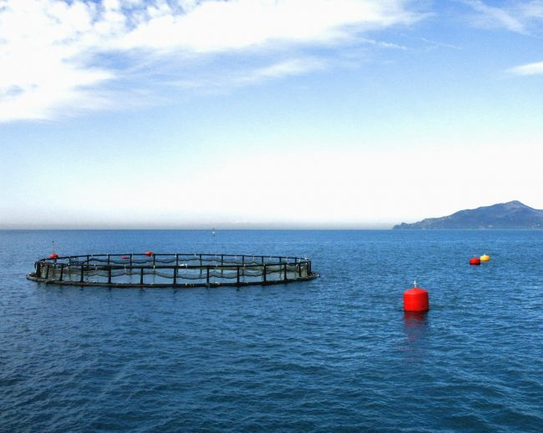
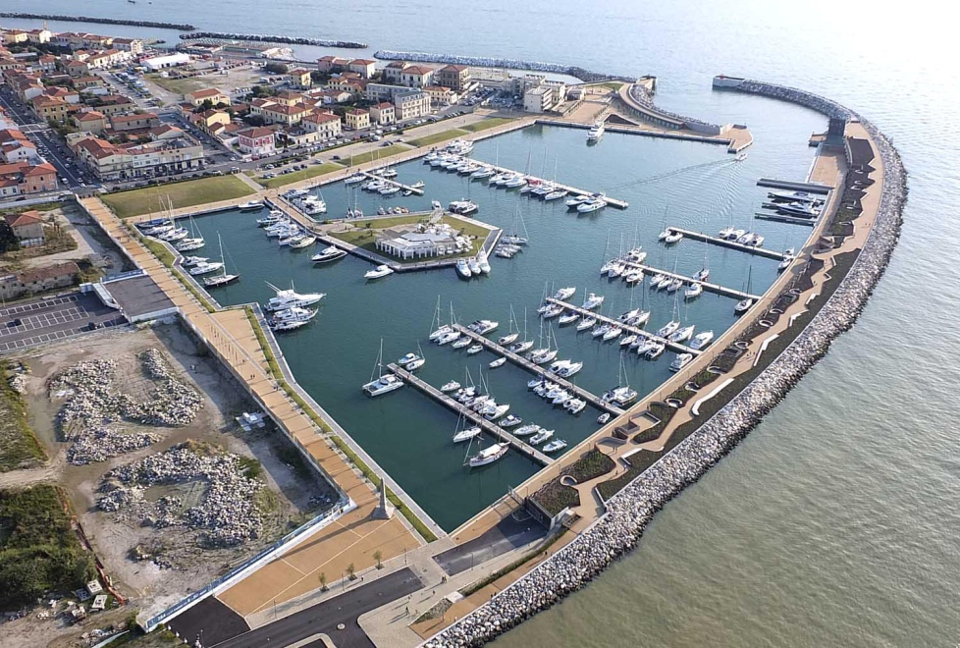
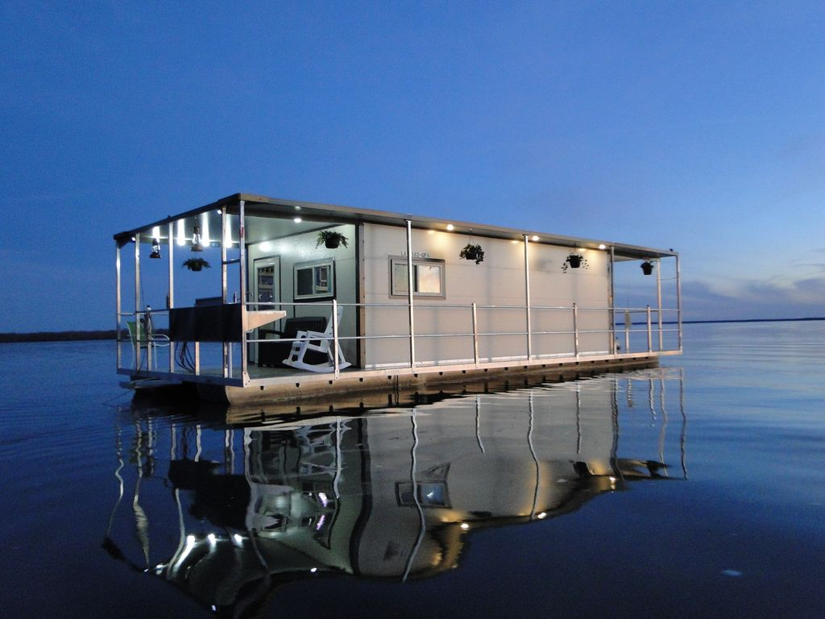
B2B AGRIFOOD: FISHFARMING USAGE SCENARIOS (leads already present)
B2B ENVIRONMENTAL MONITORING:
MARINE PARK – PORT – MARINA
USAGE SCENARIOS (prospects already present)
B2C PERSONAL USAGE: (Kickstarter® campaign planned, to launch this segment, netAtmo ® for boat-homes)

Slide 4
netH₂O personal smart buoy
netH₂O ADDRESSABLE MARKETS AND FIRST MARKET APPROACH
The first markets to be attacked are: small ports and marinas, marine parks and reserves, fishfarming sites and beach resorts.
The main business model is to sell the buoy with accessories and services.
The first sale (underway) is valued at 12k euros:
1.5k the buoy, 10.5k accessories (power packs, mooring, additional sensors) and additional services (installation, O&M)
A rough value for the first segment of the global addressable market is approximately 750M euros (excluding accessories and services, which can 10x this value)

Slide 5
netH₂O personal smart buoy
ELEMENTS WORKS SRL History and Key Personnel
ELEMENTS WORKS SRL based in Pisa, Italy. Collected approximately 500,000 euros in seed money until now. It has 12 clients for its current products and services, bringing the company to positive cashflow already in 2018.
Michele Grassi, Ph.D. (Founder CEO, CTO)
Serial entrepreneur having founded 40South Energy Limited in London in 2008 (collected more than 15M euros in equity and debt, 2.5M of which recently from Enel Green Power and Invitalia Ventures). He is a certified European Scientific Diver.
Eng. Alessandra Licciardello (Software and control Engineer, COO)
12 years of previous work as Control software engineer and as Project Manager for technology projects. She directed the team which developed, under Michele Grassi’s supervision, the power management and control systems for the 40South Energy wave energy converters.

Slide 6
netH₂O personal smart buoy
NEXT STEPS AND INVESTMENT OPPORTUNITY
to launch commercially the main variations of the netH₂O, reaching 1,000 units/year as first production target.
to develop new products sharing the “computing core” of netH₂O (a USV and an amphibious drone are in the pipeline).
To complete these steps over 24 months we are seeking 500,000 euros to be used principally for promotion of pilot plants, marketing, R&D.

