Slide 1

Estimating the direct and indirect economic impacts of Ireland’s Ocean Economy
Stephen Hynes
DG Mare, 29th September 2015

Slide 2
Overview
Building on EU MARNET project we examine the value of Ireland’s ocean economy
  Report launched in July 2015
Disaggregate Irish ocean economy sectors from National Input/Output tables
Recognition of Ireland’s marine potential – Harnessing Our Ocean Wealth (HOOW)
  The successful expansion of Ireland’s ocean economy can contribute significantly to economic recovery.
Use Input/Output model to investigate the full effects of this expansion

Slide 3
Ireland’s Ocean Economy
 | 2007 | 2010 | 2012 | % Change 2010-2012 | 2014 (e) | % Change 2012-2014 (e)
GVA | €1.7 billion | €1.2 billion | €1.3 billion | 9.2% | €1.4 billion | 8.2%
% GDP | 0.8% GDP | 0.7% GDP | 0.7% GDP | 4.3% | 0.8% GDP | 3.1%
Turnover | €4.4 billion | €3.1 billion | €4.2 billion | 33.1% | €4.5 billion | 7.6%
Employ. | 19,938 FTEs | 16,614 FTEs | 17,425 FTEs | 4.9% | 18,480 FTEs | 6.1%
*Figures for 2014 are estimates (e)
Ireland’s ocean economy performs on average better than the general economy

Slide 4
Direct Turnover, GVA and Employment by sector, 2012
2012 | Turnover €000's | Direct GVA €000's | Direct Employment (FTEs)
Shipping & Maritime Transport | 2,006,483 | 436,566 | 3,978
Marine Tourism and Leisure | 644,692 | 257,877 | 5,195
Cruise | 22,249 | - | -
Marine Retail Services | 126,194 | 40,082 | 728
Sea-Fisheries | 241,500 | 178,200 | 2,233
Aquaculture | 130,300 | 60,600 | 956
Seafood Processing | 514,566 | 98,455 | 1,839
Oil and Gas | 131,678 | 56,266 | 506
Marine Manufacturing/Engineering/Construction | 138,581 | 34,901 | 836
High Tech Marine Products & Services | 71,277 | 38,612 | 420
Marine Commerce | 86,559 | 49,167 | 161
Marine Biotechnology and Bio-products | 44,510 | 18,755 | 373
Marine Renewable Energy | 12,949 | 7,075 | 200
Total | 4,171,537 | 1,276,555 | 17,425

Slide 5
Established Industries, 2012

Slide 6
Emergent Industries, 2012

Slide 7
Harnessing Our Ocean Wealth
Based on the recognition that all matters relating to the sea are interlinked and should be dealt with as a whole.
Published in 2012, HOOW presents the Government’s vision, high-level goals and integrated actions across policy, governance and business to enable Ireland’s marine potential to be realised

Slide 8
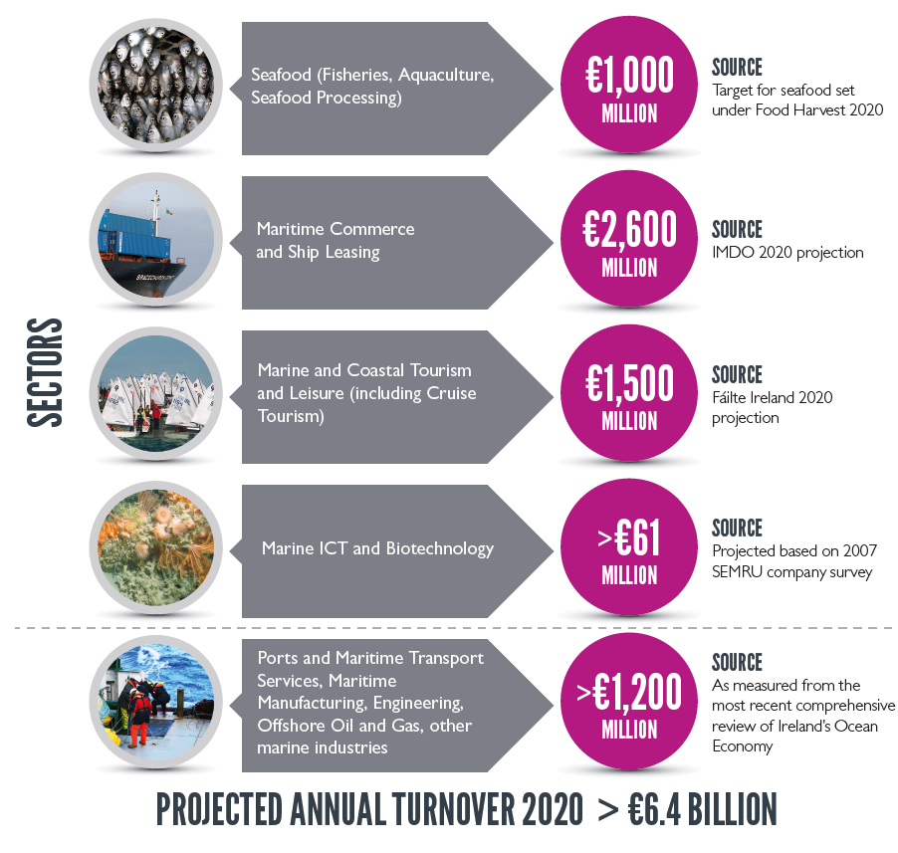
HOOW Targets
Double the value of Ireland’s ocean economy to 2.4% of GDP by 2030
Increase the annual turnover to exceed €6.4bn by 2020

Slide 9
Data & Assumptions
CSO census and surveys provided at the four-digit NACE level: Census of Industrial Production (CIP), 2007-2012; Annual Service Inquiry (ASI), 2007-2012; Building and Construction Inquiry (BCI), 2007- 2012; Intrastat, 2007-2012
Assumptions needed to identify specific targets for the 8-sector Marine disaggregation defined in the Bio-economy I/O model
Seafood | €1bn | Applied pro-rata on the basis of output to the Fishing, Aquaculture and Seafood Processing
Maritime Commerce and Ship Leasing | €2.6bn | Combined for a target of €3.8bn and applied pro-rata across the Oil & Gas, Marine Manufacturing, and Engineering & Construction, Marine Retail and Shipping and Transport sectors
Ports and Maritime Transport Services (…) | >€1.2bn

Slide 10
Results-Ranking Sectors
Sector0 | Multiplier | Rank
Shipping & Maritime Transport | 2.08 | 1
Other serv. | 1.87 | 2
Wood & wood products | 1.85 | 3
Membership organisation serv. | 1.75 | 4
Marine Manu Eng & Const. | 1.74 | 5
Travel & tourism service activities | 1.74 | 6
Repair of consumer goods | 1.73 | 7
Construction | 1.70 | 8
Land transport serv. | 1.69 | 9
Other non-metallic mineral products | 1.68 | 10
Other professional, scientific serv. | 1.68 | 11
Seafood Processing | 1.65 | 12
Scientific research | 1.64 | 13
Water transport serv. | 1.60 | 14
Marine Tourism | 1.60 | 15
The Bio-Economy Input-Output model returns an output multiplier value of 1.76 for the Marine sector - significant relative embeddedness in the domestic economy in comparison to other sectors.
Shipping and Maritime Transport is ranked at the top of the classification, with a multiplier of 2.08.
Other marine sectors rank among the top 15 - Marine Manufacturing, Engineering and Construction (1.74), Seafood Processing (1.65) and Marine Tourism (1.60) all of which are relatively more dependent on the consumption of domestic inputs.

Slide 11
Results – Output
Estimated direct impact of €3.3bn on the 2010 base year with an additional indirect effect of €2.7bn in the wider economy, giving a total impact of over €9bn.
 | Fishing | Aquaculture | Oil &Gas | Seafood Processing | Marine Manu, Eng. & Const. | Marine Retail | Shipping and Transport | Marine Tourism | Total €M
Output Multiplier | 1.40 | 1.41 | 1.57 | 1.65 | 1.74 | 1.51 | 2.08 | 1.60 | -
2010 Output €m | 164 | 123 | 126 | 390 | 111 | 58 | 1,272 | 723 | 2,965
Required €m | 79 | 59 | 179 | 187 | 158 | 82 | 1,814 | 777 | 3,335
HOOW Target €m | 242 | 181 | 305 | 577 | 269 | 140 | 3,086 | 1,500 | 6,300
Indirect Impact €m | 31 | 24 | 101 | 122 | 118 | 42 | 1,841 | 468 | 2,747
Total Impact €m | 273 | 205 | 407 | 698 | 386 | 182 | 4,927 | 1,968 | 9,047

Slide 12
Distribution of Indirect Impacts
 | Fishing | Aquaculture | Oil &Gas | Seafood Processing | Marine Manu, Eng & Const. | Marine Retail | Shipping and Transport | Marine Tourism | Total €M
Primary | 0 | 7 | 18 | 72 | 0 | 0 | 10 | 5 | 113
Manufacturing | 12 | 7 | 23 | 24 | 13 | 5 | 203 | 54 | 343
Services | 18 | 10 | 60 | 26 | 104 | 37 | 1,628 | 409 | 2,291
Total Impact | 31 | 24 | 101 | 122 | 118 | 42 | 1,841 | 468 | 2,747
The Service sector experiences the greatest indirect impact across all marine sectors with the exception of the Seafood Processing sector
Shipping and Transport generates the largest share of indirect output mainly focused on Services

Slide 13
Results - Employment
 | Fishing | Aquaculture | Oil &Gas | Seafood Processing | Marine Manu, Eng & Const. | Marine Retail | Shipping and Transport | Marine Tourism | Total
Emp. Multiplier | 1.49 | 1.38 | 2.37 | 2.39 | 1.84 | 1.60 | 2.79 | 1.49 | -
2010 Employment | 2,084 | 952 | 359 | 1,586 | 726 | 252 | 4,137 | 5,497 | 15,593
2010 Output €m | €164 | €123 | €126 | €390 | €111 | €58 | €1,272 | €723 | €2,965
HOOW Increase €m | €79 | €59 | €179 | €187 | €158 | €82 | €1814 | €777 | €3,335
Direct Jobs | 1,000 | 457 | 512 | 761 | 1,035 | 359 | 5,901 | 5,908 | 15,932
Indirect Jobs | 487 | 173 | 701 | 1,054 | 874 | 217 | 10,567 | 2,881 | 16,953
Total | 1,486 | 629 | 1,213 | 1,815 | 1,910 | 576 | 16,467 | 8,789 | 32,885
The model estimates the creation of 16,953 indirect jobs - over 60% allocated to Shipping and Maritime Transport.
Total employment impact resulting from reaching HOOW targets would be an additional 32,885 jobs

Slide 14
Summary and Conclusions
Generated actual marine accounts for reference year 2012 and produce estimates of activity by sector for 2014.
The Bio-economy Input-Output model used to estimate the total economic impact of reaching HOOW targets - estimated direct impact of €3.3bn, with an additional indirect effect of €2.7bn million in the wider economy. Total of impact of over €9bn.
Creation of 16,953 indirect jobs. The total employment impact of reaching HOOW targets would result in an additional 32,885 jobs.

