Slide 1



Study on the establishment
of a framework for processing
maritime economic data in Europe
Preliminary results
N.B. the data and graphs included in this presentation are provisional and currently under review. Please do not share this presentation with third parties
Brussels
8 November 2016

Slide 2
Fisheries and aquaculture (includes production and processing)
Maritime transport (includes passenger and freight transport, renting and leasing services, transportation support activities, insurance and reinsurance services)
Shipbuilding (includes building of ships, floating structures, leisure boats, engines)
Ship repair
Equipment (includes equipment for navigation, fishing nets, other fabricated metal products)
Wind energy (production and transmission)
Other renewable energy
Extraction of oil and gas
Extraction of aggregates
Ports (includes cargo handling, construction on ports, and dredging)
Public activities (waste, environmental protection, defense, public order and safety, general public administration)
Extraction of salt
Blue biotechnology
Seabed mining
Desalination

Slide 3
Notes:
N.B. Coastal tourism and public sector not included in this graph. The work on landlocked countries is not yet complete. There are still several gaps. So, it’s high likely that the current figures underestimate the size of the blue economy

Slide 4
Notes:
N.B. Coastal tourism and public sector not included in this graph. The work on landlocked countries is not yet complete. There are still several gaps. So, it’s high likely that the current figures underestimate the size of the blue economy

Slide 5
Notes:
N.B. Coastal tourism and public sector not included in this graph. The work on landlocked countries is not yet complete. There are still several gaps. So, it’s high likely that the current figures underestimate the size of the blue economy

Slide 12
CAGR of the blue economy: -4,24%
CAGR of the whole economy (2008-2013): 0,68%
Notes:
Equipment +4,45%
Extraction of aggregates +3,04%
Extraction of oil -14,46%
Extraction of gas -9,24%
Marine aquaculture +17,19%
Marine fishing -8,88%
Fish processing activities are all growing
Freight transport -5,26%
Passenger transport +4,63%
Building of pleasure and sporting boats -5,42%
Building of ships 2,25%

Slide 13
CAGR of the blue economy: -2,22%
CAGR of the whole economy: 0,47%
Notes:
Equipment 9,25% (abnormal data in Manufacture of instruments and appliances for measuring, testing and navigation)
Extraction of oil -19,89%
Extraction of gas -3,76
Marine fishing 0,22%
Marine aquaculture 1,22%
Freight transport -4,28%
Passenger transport 4,67%
Warehousing and storage services 9.4%
Cargo handling -4,75%
Ship repair -2,05%
Building of pleasure and sporting boats -6,22%
Building of ships -7,01%
Engines and turbines -8,71%

Slide 15
Blue economy (without tourism): 320 billion euro
Tourism: 200 billion euro
Notes:
Total turnover 200.174.000.000 euros
Expenditures on durables and valuable goods
Expenditures on restaurants/cafés
Other expenditures
Accommodation
Transport (including water transport)

Slide 17
Blue economy (without tourism):
1 million people
Tourism: 2.3 million people
Notes:
Total persons employed 2.297.728

Slide 18
Notes:
Total persons employed 2.297.728

Slide 26
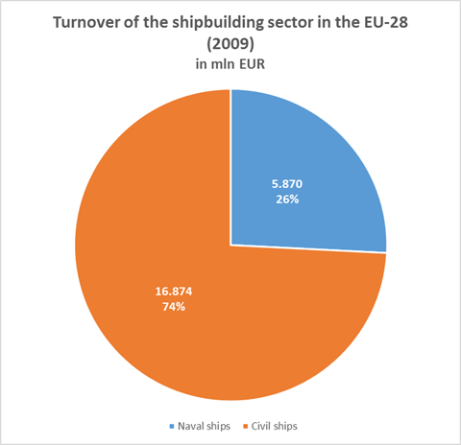
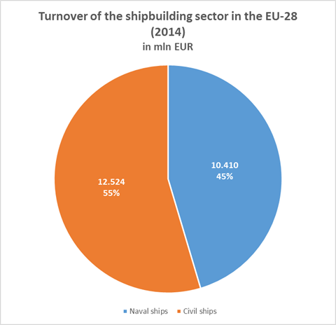

Slide 27
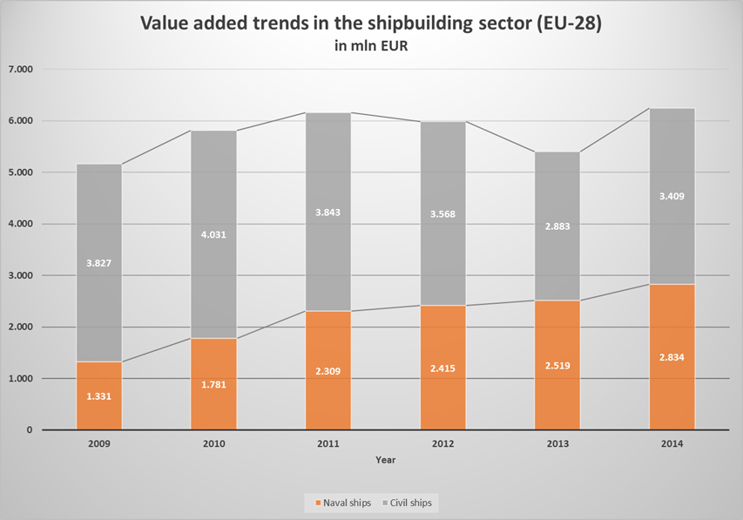

Slide 28
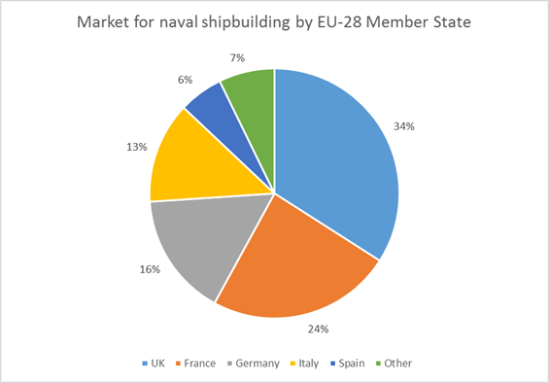

Slide 31
To sum up
In 2014, the blue economy (without tourism) was worth about 320 billion euros turnover, 85 billion euros value added, and 1 million persons employed.
Then we have coastal tourism with 200 billion euros turnover, 70 billion euros value added, and 2.3 million persons employed
Then we have the public sector (defence activities, environmental protection, public order and safety activities, and general public administration) with about 30 billion euros of public expenditure and about 370.000 persons employed.
Finally, we need to consider the indirect impact of the blue economy with 40 billion euros of GVA and further 195.000 persons employed

Slide 32
Thanks for your attention!
Alessandro Pititto
apititto@cogea.it

