Slide 1
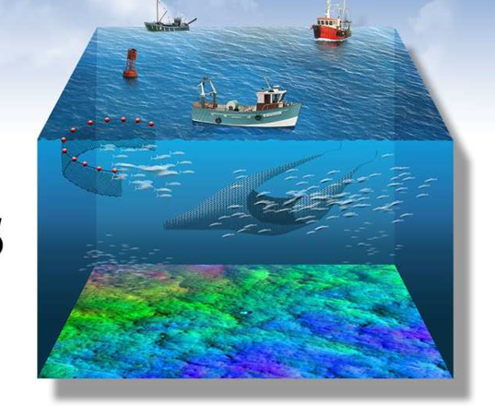
the fisheries sector and the European Marine Observation and Data Network
(EMODnet)

Slide 2
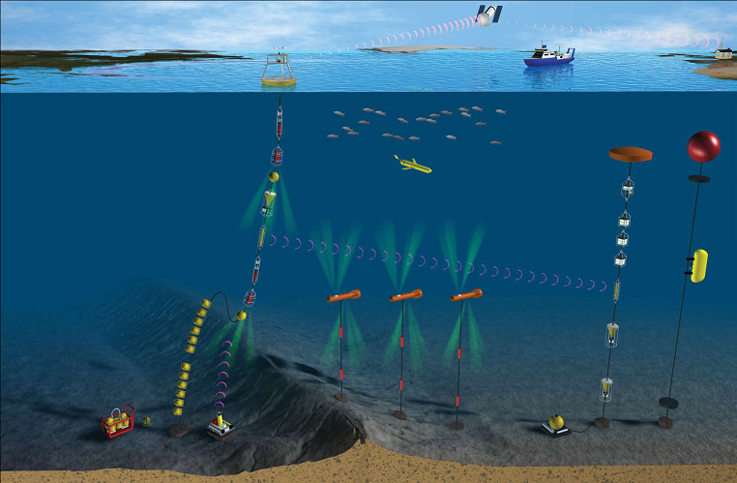
cost of ocean observation in EU
space data | €400 million per year
in-situ data | > €1 billion per year

Slide 3

Maria Damanaki, Commissioner for Maritime Affairs and Fisheries
MARITIME
AFFAIRS
(..) the data collected through these observations can only generate knowledge and innovation if Europe's engineers and scientists are able to find, access, assemble and apply them efficiently and rapidly. At present this is often not the case.
Notes:
Despite all this spending we can’t use the data

Slide 4

what is it?

Slide 5
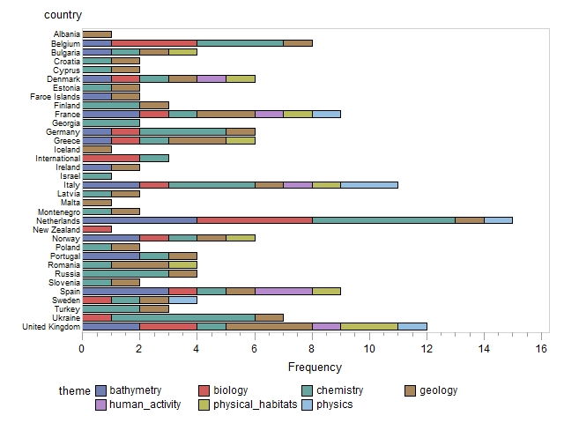

it is a network of 112 organisations

Slide 6
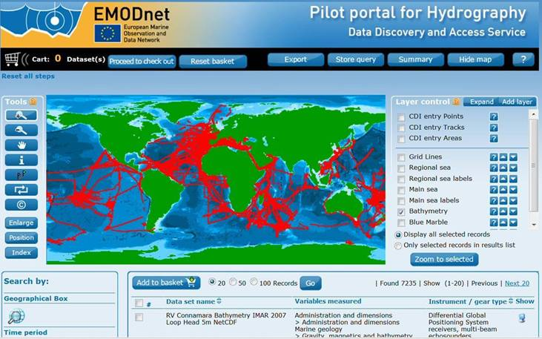
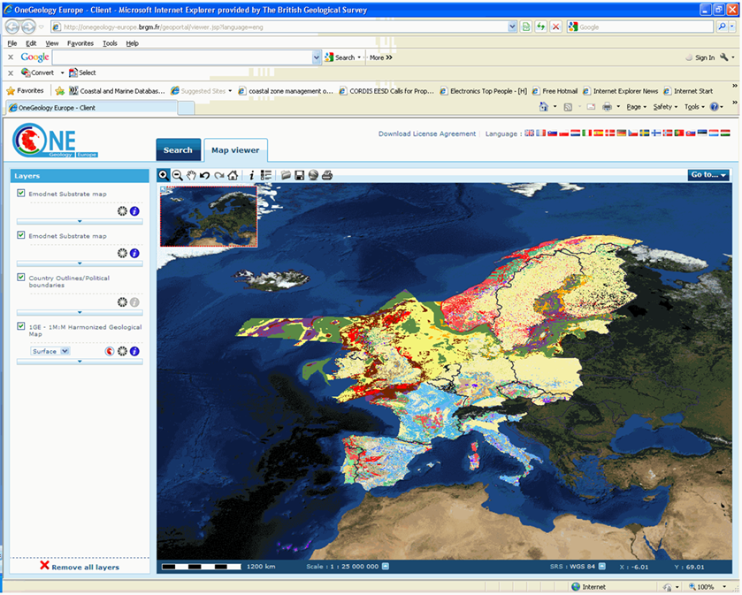
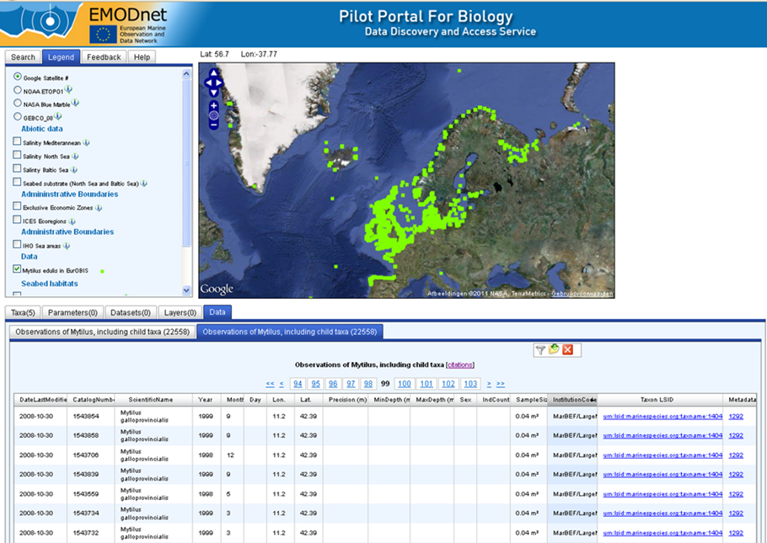
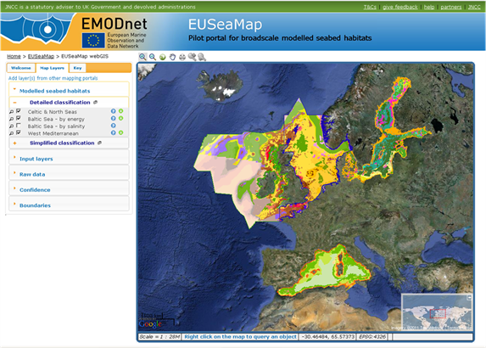
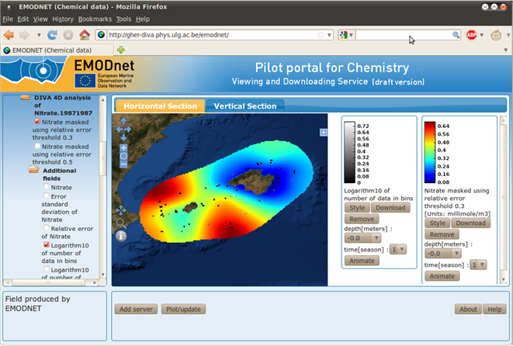
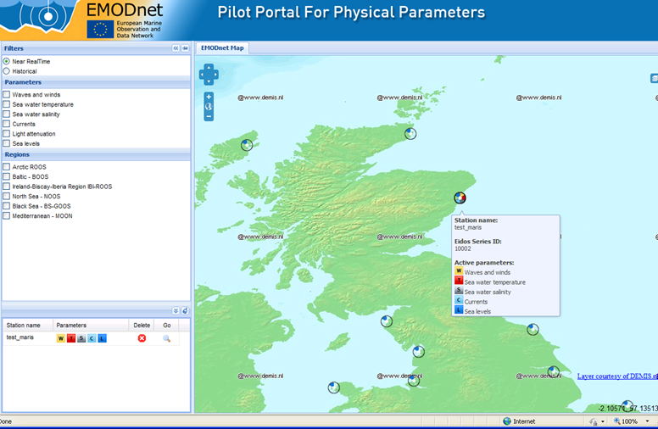
access to data held by Member States
and to map layers across sea-basins

Slide 7
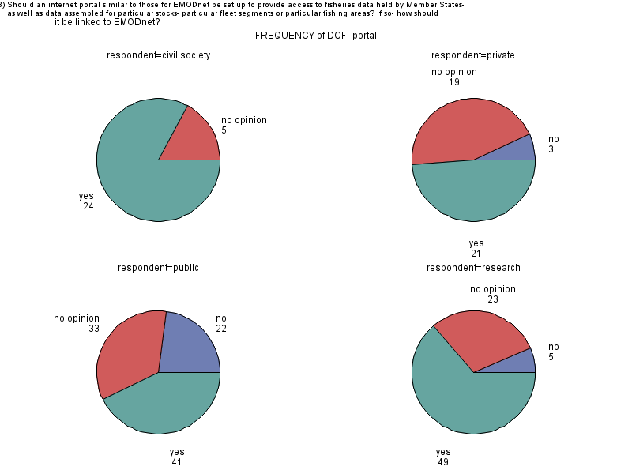
Should an internet portal similar to those for EMODnet be set up to provide access to fisheries data held by Member States,
civil society
private sector
240 replies
public bodies
researchers

Slide 8
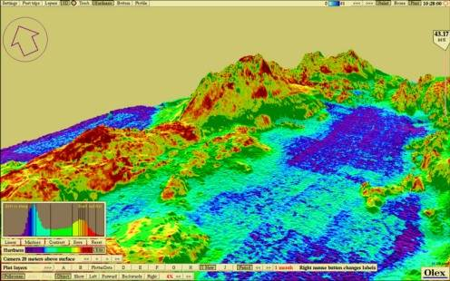

improved on-board display

Slide 9
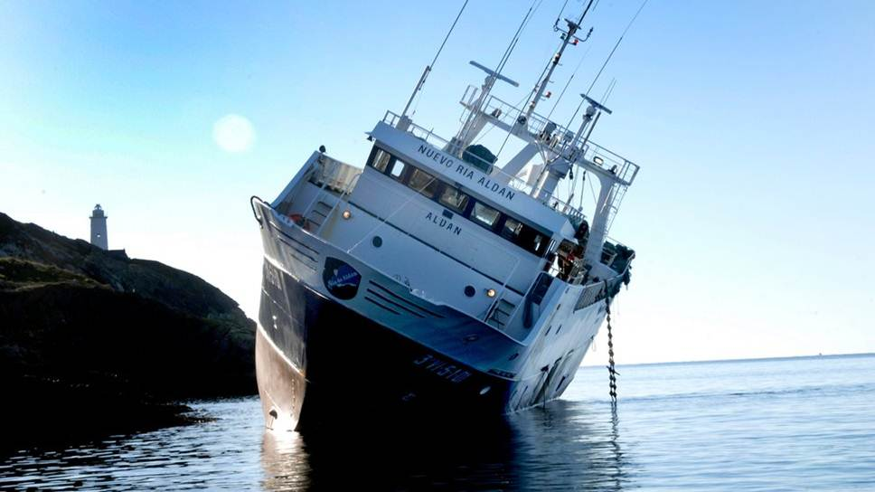
better charts for fishermen

Slide 10
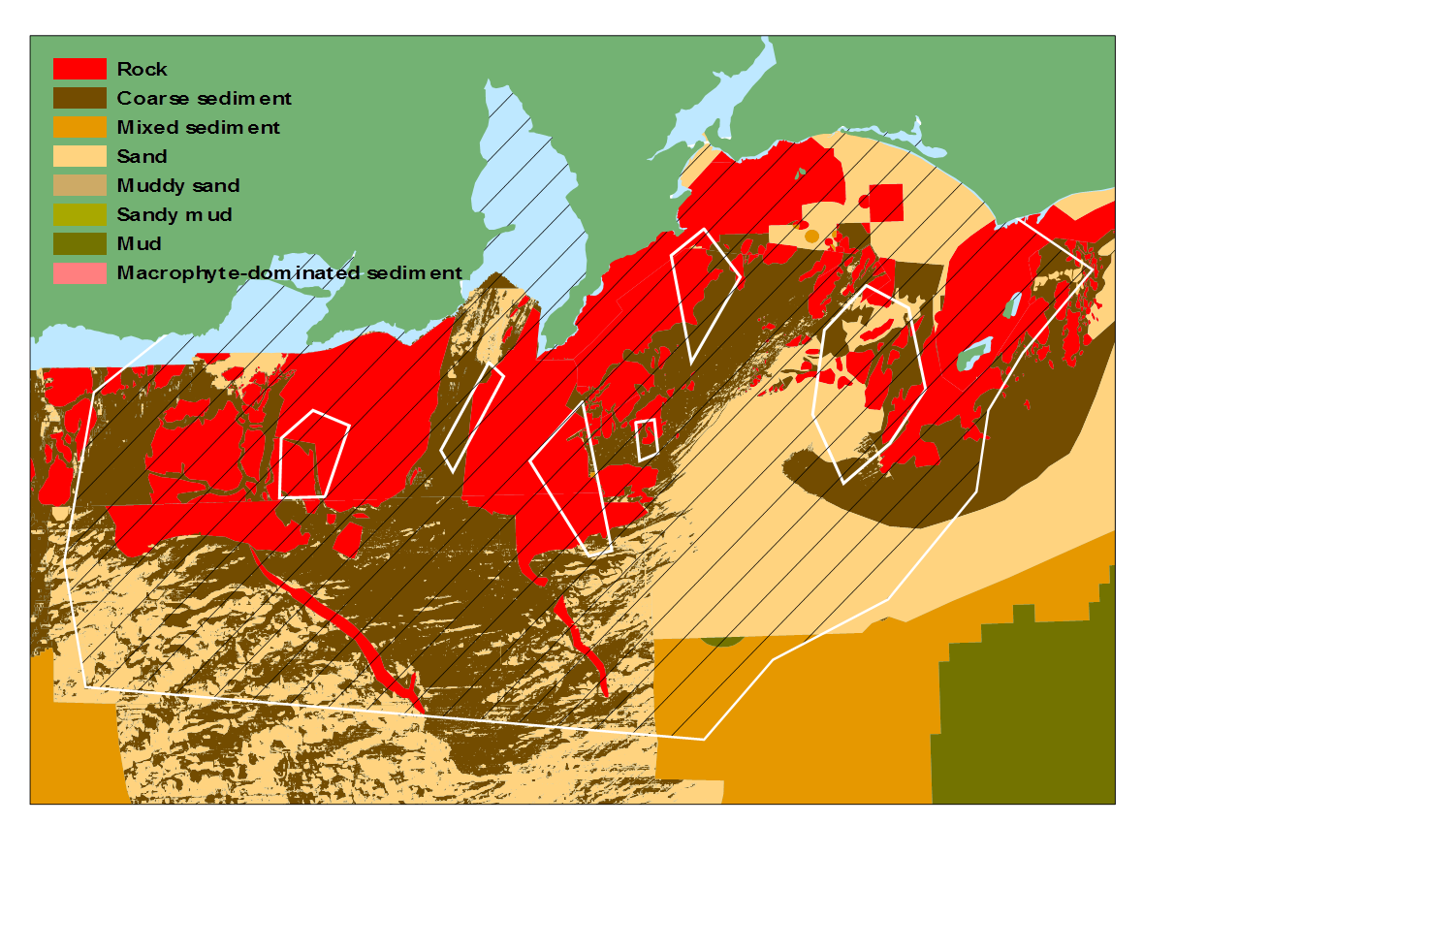
revision of herring spawning areas

Slide 11
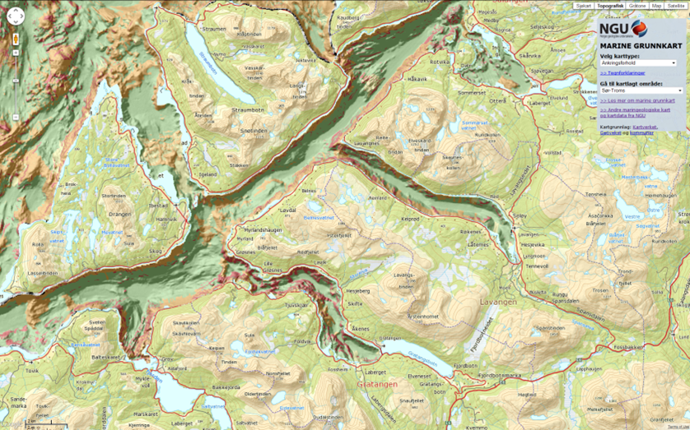
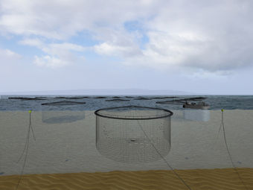

selection of anchoring sites for aquaculture

Slide 12
benefits
Approximately €300 million per year
reduce operational costs and delays:
  help private industry;
  improve the quality of public decision-making at all levels;
  strengthen marine scientific research.
  Allows participation of civil society
increase competition and innovation;
reduce uncertainty in knowledge of the seas and oceans.
study nearing completion

Slide 13
follow-up of Green Paper
Impact Assessment to evaluate options for:
  helping Member States fix priorities for surveying, observation and processing;
  further coordination between the different EU financial instruments and policies concerned with better access to marine data;
    EMODnet, Data Collection in Fisheries, Copernicus
  more involvement of the private sector;

Slide 14
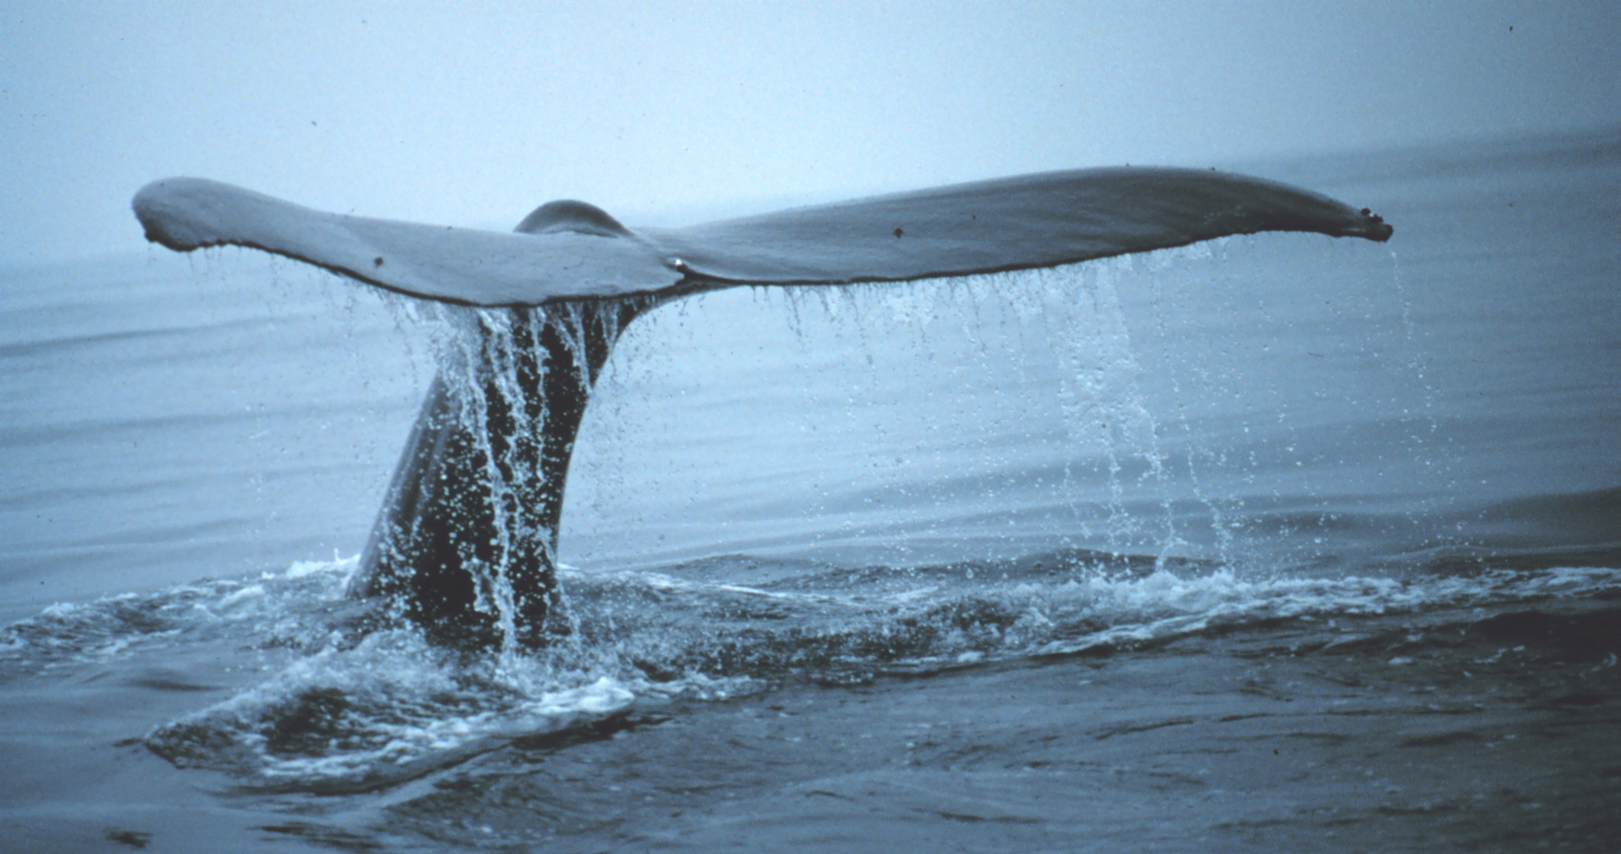
questions?

