Slide 1
EU Adaptation Strategy to Climate Change
Lunch time seminar on climate change adaptation in coastal regions and maritime sectors
16th of March 2012
Thomas Dworak

Slide 2
Support to the EU Adaptation Strategy
Preparation of the EU Adaptation Strategy is supported from December 2011 till February 2013 by the service contract “Support to the development of the EU strategy for adaptation to climate change” – EU AdaptStrat (CLIMA.C.3/SER/2011/0026)
Project team:
  Environment Agency Austria (EAA): Project Lead
  Fresh Thoughts Consulting (FT): Project Co-Lead
  AEA Technology plc (AEA)
  FEEM Servizi Srl (FEEM)
  Alterra

Slide 3
Three Objectives of the strategy
The knowledge objective

Slide 4
Growing knowledge base …
I. Projects financed by DG CLIMA, e.g.
Climate proofing of key EU policies (01-10/2011)
Methodologies for climate proofing investments and measures under cohesion and regional policy and the common agricultural policy (11/2011 – 8/2012)
Use of innovative market based instruments – insurance and financial products & services (01 – 10/2011)
…
II. Projects conducted by EEA, JRC, OECD, etc. or financed by other DGs (e.g. DG ENV, DG SANCO):
EEA report on urban areas
Peseta II (available in April 2012)
CEHAPIS project
…
III. Results from European (and national) research programs (e.g. FP, Interreg)
ClimateCost projct (FP7)
Weather, EWENT,…
ESPON Climate
…
IV. Case Studies
&
&
&
&
&
&
Relevant results will feed into EU Adaptation Strategy
Notes:
EU adaptation strategy will build on current status of adaptation knowledge taking into account international, EU and all other relevant research and experience (in addition, stakeholder events shall ensure the consideration of a broad range of knowledge and experience)

Slide 5
Knowledge objective
The knowledge objective
further the understanding of climate change vulnerability and adaptation
improve and widen the knowledge base
address the issue of dealing with large array of uncertainties
  Consolidating current knowledge (national/EU/international level) and additional small contracts on specific issues
  Linking to CIRCLE-2 initiative on uncertainties
  Hosting an expert workshop on climate scenarios and natural hazards (damage costs) and available data

Slide 6
Knowledge objective
The knowledge objective
identify knowledge gaps
outline paths from knowledge generation to knowledge use
enhance access to related information
  Identifying knowledge gaps that cannot be closed until the adoption of the strategy
  Developing a strategy for the short, medium and long run to close remaining knowledge gaps after 2013

Slide 7
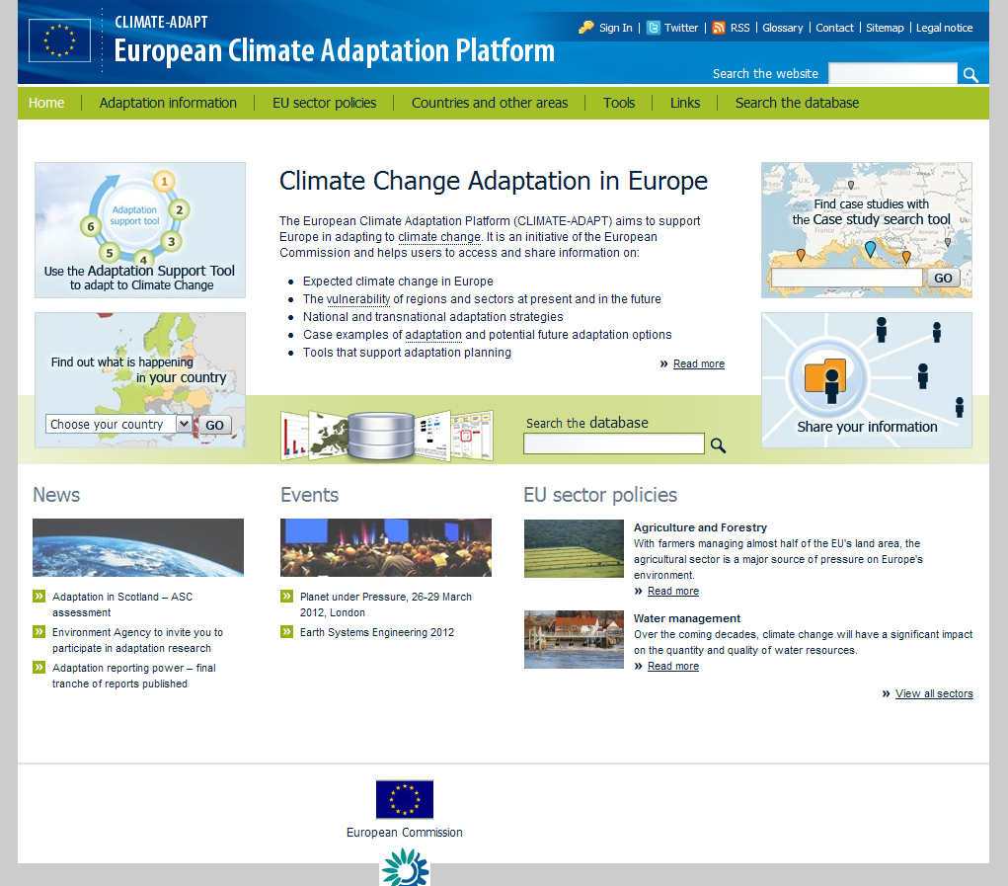
Knowledge objective
… feeds into …

Slide 8
Three Objectives of the strategy
The knowledge objective
The facilitation and cooperation objective

Slide 9
Facilitation and cooperation objective
facilitate exchange between and cooperating with Member States, regions, cities and all other relevant stakeholders
provide guidelines for adaptation
The facilitation and cooperation objective
  Stakeholder involvement on various level
  Developing a strategic approach to stakeholder involvement, governance structures and procedures for facilitating cooperation across all levels (national, regional, cities), Member States and institutions
  Elaborating guidelines

Slide 10
Meetings with Member States
EPA Interest Group Climate Change Adaptation on the 5th and 6th of March 2012 in Dessau/Germany
ASG-Meetings in Brussels (8 and 9th of March 2012; May 2012; and 2nd quarter 2012 if needed; tbd. by DG CLIMA)
EIONET Meeting in Brussels (22 and 23th of May 2012)
CIRCLE 2-Workshop on Adaptation Strategies in June in Vienna (date tbd. with Markus Leitner, EAA; focus on Eastern European countries)
Member State Meeting for Southern Europe (venue and date tbd.)
EPA Interest Group Climate Change Adaptation on 27th and 28th of August 2012
Second Nordic International Conference on Climate Change Adaptation from 29-31th of August in Finland (tbd. with DG CLIMA)
Notes:
1. Context, problem definition
Describe the nature and scale of the problem
Identify who is most affected
Establish the drivers and underlying causes
Identify clearly assumptions made, risks and uncertainty involved
Describe how the problem has developed over time and which existing policies at Community or Member State [if applicable] level are likely concerned
Identify a clear baseline, i.e. describe how the problem is likely to develop in the future without new EU action
Address the necessity for the COM to act, i.e. develop an argument for EU value added
2. Objectives
Set objectives that correspond to the problem
Establish objectives at a number of levels, going from general to specific/operational
[If already possible:] Express the objectives in SMART terms (specific, measurable, achievable, realistic, time-dependent)
3. Options
Consider options to develop around the following three categories:
filling the knowledge gaps and facilitating exchange of best practices between Member States and actors concerned,
further developing adaptation mainstreaming into relevant EU policies and strategies,
capturing the potential of the market for enhancing the EU's resilience to climate change ([where applicable:] including considerations on standards, insurance, finance, climate risk disclosure and market based instruments)
4. Evidence base, work planned
What information and data are already available and will be used?
Which ongoing activities need to be taken into account?
What further information needs to be gathered, how will this be done (e.g. within the project or by external experts under a separate contract)?
Which cross-cutting issues need to be considered?
5. Meetings, Consultations
Who are the relevant target groups (i.e. who will be affected and who will be involved in the implementation?)
Which stakeholders & experts will be consulted, how, and at what stage?
Which meetings are foreseen and when?

Slide 11
Stakeholder dialogues
Meeting with experts on climate scenarios and (the costs of) natural disasters on the 15th of March 2012
Meeting with forest experts organised with the support of EUSTAFOR scheduled for June 2012
Coastal zones and Marine issues: This expert workshop should be held back to back with a CIS meeting in the context of the implementation of the Marine Framework strategy Directive
Meeting with standardization bodies and national experts or officials in charge of the transposition of EU standards or the development and /or implementation/application of national standards, in particular for the energy, construction and transport sectors
Notes:
1. Context, problem definition
Describe the nature and scale of the problem
Identify who is most affected
Establish the drivers and underlying causes
Identify clearly assumptions made, risks and uncertainty involved
Describe how the problem has developed over time and which existing policies at Community or Member State [if applicable] level are likely concerned
Identify a clear baseline, i.e. describe how the problem is likely to develop in the future without new EU action
Address the necessity for the COM to act, i.e. develop an argument for EU value added
2. Objectives
Set objectives that correspond to the problem
Establish objectives at a number of levels, going from general to specific/operational
[If already possible:] Express the objectives in SMART terms (specific, measurable, achievable, realistic, time-dependent)
3. Options
Consider options to develop around the following three categories:
filling the knowledge gaps and facilitating exchange of best practices between Member States and actors concerned,
further developing adaptation mainstreaming into relevant EU policies and strategies,
capturing the potential of the market for enhancing the EU's resilience to climate change ([where applicable:] including considerations on standards, insurance, finance, climate risk disclosure and market based instruments)
4. Evidence base, work planned
What information and data are already available and will be used?
Which ongoing activities need to be taken into account?
What further information needs to be gathered, how will this be done (e.g. within the project or by external experts under a separate contract)?
Which cross-cutting issues need to be considered?
5. Meetings, Consultations
Who are the relevant target groups (i.e. who will be affected and who will be involved in the implementation?)
Which stakeholders & experts will be consulted, how, and at what stage?
Which meetings are foreseen and when?

Slide 12
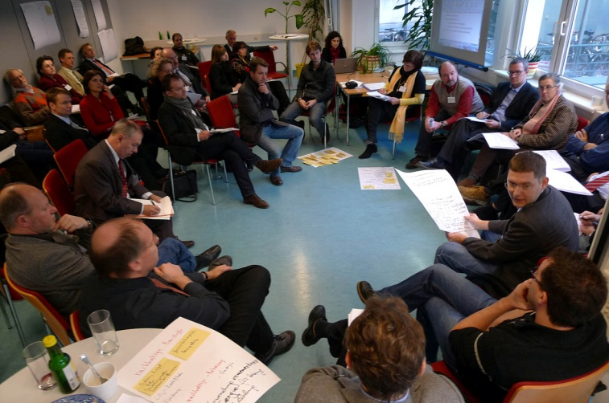
Lunch time seminars
Lunch time seminars are foreseen for EC internal exchange on specific topics of the EU strategy
Notes:
1. Context, problem definition
Describe the nature and scale of the problem
Identify who is most affected
Establish the drivers and underlying causes
Identify clearly assumptions made, risks and uncertainty involved
Describe how the problem has developed over time and which existing policies at Community or Member State [if applicable] level are likely concerned
Identify a clear baseline, i.e. describe how the problem is likely to develop in the future without new EU action
Address the necessity for the COM to act, i.e. develop an argument for EU value added
2. Objectives
Set objectives that correspond to the problem
Establish objectives at a number of levels, going from general to specific/operational
[If already possible:] Express the objectives in SMART terms (specific, measurable, achievable, realistic, time-dependent)
3. Options
Consider options to develop around the following three categories:
filling the knowledge gaps and facilitating exchange of best practices between Member States and actors concerned,
further developing adaptation mainstreaming into relevant EU policies and strategies,
capturing the potential of the market for enhancing the EU's resilience to climate change ([where applicable:] including considerations on standards, insurance, finance, climate risk disclosure and market based instruments)
4. Evidence base, work planned
What information and data are already available and will be used?
Which ongoing activities need to be taken into account?
What further information needs to be gathered, how will this be done (e.g. within the project or by external experts under a separate contract)?
Which cross-cutting issues need to be considered?
5. Meetings, Consultations
Who are the relevant target groups (i.e. who will be affected and who will be involved in the implementation?)
Which stakeholders & experts will be consulted, how, and at what stage?
Which meetings are foreseen and when?

Slide 13
Three Objectives of the strategy
The knowledge objective
The facilitation and cooperation objective
The policy and market objective

Slide 14
Policy and market objective
The policy and market objective
Policy related objectives:
review existing EU instruments in place
propose possible adaptation action
mainstream adaptation into policies at EU level
  Identifying concrete options for mainstreaming adaptation in existing policies (liaison with concerned DGs)
  Preparing a strategic approach to achieving an adequate reflection of climate impacts and adaptation in all relevant policies, including the required interaction and involvement of key stakeholders within and outside the European Commission

Slide 15
Policy and market objective
The policy and market objective
Market related objectives:
capture the potential of the market, market-based instruments and the private sector in strengthening adaptive capacity and climate impact preparedness and responses
  Investigating options for insurance, financing, market-based instruments, climate risk disclosure, per sector (as relevant) and across sectors
  Facilitating private sector engagement

Slide 16
The strategy will likely address…
… the following policy areas/themes:
  Agriculture and rural development
  Forestry
  Soil
  Ecosystem based adaptation and biodiversity
  Water
  Marine and Coastal zones
  Disaster Risk Reduction
  Health
  Social issues (including migration)
  Cohesion
  Transport
  Energy
  Construction/Buildings
  Cities and urban areas
  Private market
  Jobs/employment

Slide 17
Roadmap
Adoption
of the STRATEGY
START
December 2011
March 2013
from 2nd half 2012 onwards
EU Adaptation Strategy
Communication
Impact Assessment
Staff working document
Guidelines
1st half 2012
October 2012
Impact Assessment
to IA Board
Background studies
Stakeholder involvement
Cooperation with Commission services

Slide 18
Potential impacts from CC
Four main impacts
Sea level rise
Increase of coastal flooding
Increase in water temperature
Saline intrusion
→ Impacts of combinations and increased wind speeds are difficult to assess

Slide 19
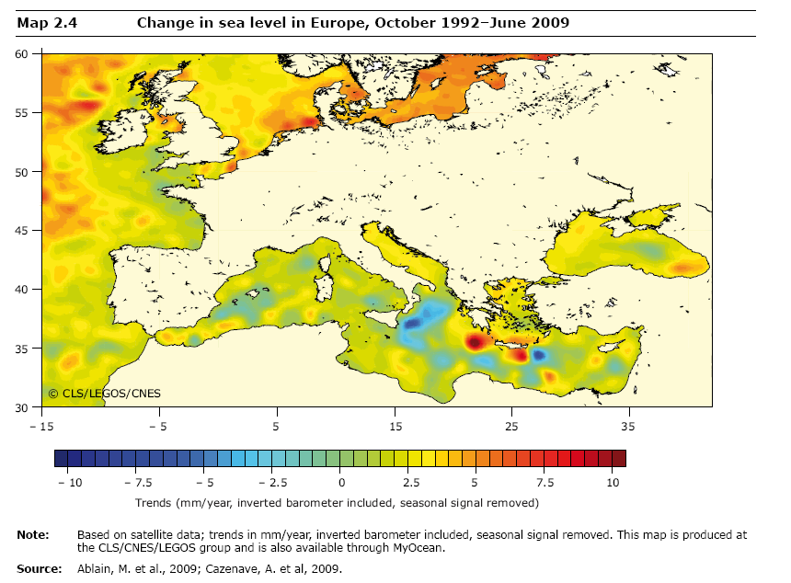
EEA State of the Environment Report 2010
Sea level change - Observations
  1992-2009:
  Sea-level rises in most regions
  Large spatial variability:
    Mediterranean: 1.8 mm/year
    North Atlantic: 3.8 mm/year
    Ionic Sea: sea-level drop

Slide 20
Sea level change - Projection
In general:
  High uncertainties
  The UKCP 09 projections for the sea level rise change at the end of 21st century in the Atlantic Ocean around the UK increases this range to 12 – 76 cm.
  For the cascading Mediterranean and Black seas global averages are moderated by the two narrow straits, Gibraltar and Bosporus respectively. These straits determine the distinct current behaviour of the Mediterranean and Black seas - while at some parts the Mediterranean sea it even slightly decreases, Black sea level rises much faster than the global average.
  Regional projections for the Mediterranean sea for the end of 21st century made within CIRCE project suggest a positive trend of on average 0.24, 0.31 and about 0.23 cm/year rise rate
Sea-level is rising much faster than projections

Slide 21
Observations vs Projections
EEA State of the Environment Report 2010
Observations
Projections
So far reality is
worse than our worst predictions!!!

Slide 22
Coastal Flooding
People at risk of flooding without adaptation in 2100 scenario according to the A2 and B1 IPCC SRES scenarios. Source: Hinkel et al. 2009 and Hinkel et al. 2010, reported in EEA (2010).
People actually flooded (thousands/year) across Europe, for the A2 scenario, 2080s (ECHAM4), without adaptation (Richards and Nicholls, 2009)

Slide 23
Sea-level damage
Scenarios considered in this presentation:
No SLR: only socioeconomic changes, no Sea Level Rise (SLR)
A1B: medium-high emissions
E1: mitigation scenario
Source: FP7 ClimateCost

Slide 24
Sea-level damage:
Damage costs include erosion & flooding
Source: FP7 ClimateCost

Slide 25
Sea-level damage by country
Few countries
heavily affected
Source: FP7 ClimateCost

Slide 26
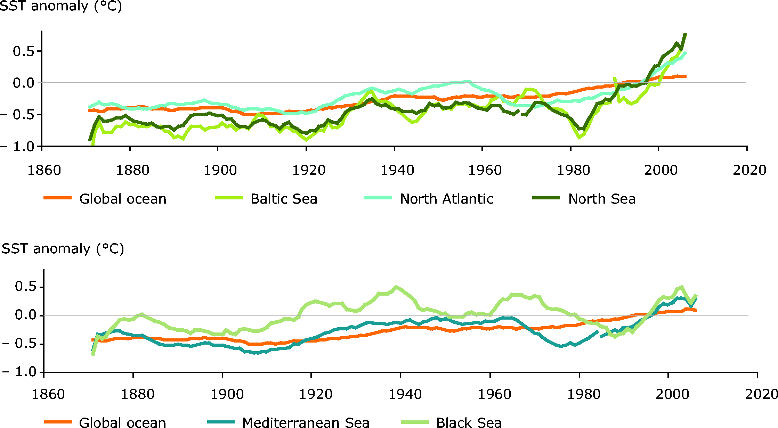
Increase in temparature - Observations
Increases in temperature have been the greatest in the Baltic Sea and the North Sea, with lower rates identified in the Black Sea and Mediterranean Sea (EEA, 2008).
In the North Sea and Baltic Sea values are over .06-.07 °C/year. (EEA, 2008).

Slide 27
Increase in temparature - Projections
Under both the A2 and the B2 scenarios, the mean annual surface temperature can be expected to increase by 2-3°C during the 21st Century, with larger increases up to 3-4 °C expected during the spring and summer months (IPPC, 2007).
Warming is expected to be greater in the upper 100m, but also the lower reaches will be affected in the latter half of century (IPPC, 2007)
→ impacts on fish population are difficult to predict.
→ Change in population, Change in habitats
→ Changes can also be positive

Slide 28
Saline Intrusion
low river flow conditions of rivers and sea level rise can trigger salt water intrusion (impacts are already reported in NL)
Transitional waters are expected to be threatened mostly.
Estuaries of southern European rivers are particularly endangered, and the situation becomes even more severe in summer when river discharge is even lower.
During the low flow season, Europe’s biggest rivers are affected, e.g. Danube, Rhine, Elbe, Tagus and Loire.
The risk in a shift in freshwater-seawater balance is highest in summer and lowest in winter
Highly urbanised coastal areas rely in particular upon aquifers sensitive to saline intrusion for domestic water supply.

Slide 29
Marine Basin | Main concern | Additional concerns
Baltic Sea | Overall vulnerability low, most impact projected for marine species | Low SLR expectations, projected land-uplift along major parts of the coastline and many uninhabited areas minimise the vulnerability to coastal flooding; Projected increase in sea surface temperature in the semi-enclosed Baltic marine basin threatens marine species as migration is difficult; Ice-cover reduction resulting in a different exposure of the coast to winter storms (erosion and sediment transport)
North Sea | Coastal flooding: Significant SLR expectations, storm surges, many low-lying areas (more than 85% in BE and NL) | Significant erosion problems (20% of the coastline).
Atlantic Ocean | Coastal flooding due to SLR | Changes in both the direction and the power of waves; Southern countries could become more exposed to freshwater shortage in the future due to prolonged and more intense periods of droughts.
Mediterranean Sea | Freshwater shortage | Medium SLR and few parts of the coastline situated below 5 m elevation result in a modest risk of coastal flooding, with the exception of hot-spot Venice Longest stretch of coastline affected by erosion (30%) Large areas affected by saltwater intrusion; dry periods projected to increase in length and frequency putting additional pressure on freshwater availability
Black Sea | Erosion (13%) of coastline | Vulnerable to the impact of SLR on intertidal habitats and ecosystems due to low intertidal range and limited scope for on-shore migration Dry periods area projected to increase in length and frequency putting pressure on freshwater availability

Slide 30
Sea-level: costs of adaptation
Source: FP7 ClimateCost

Slide 31
Sea-level rise: benefits of adaptation
Source: FP7 ClimateCost
The benefits of adaptation far outweight the costs, already in 2020

Slide 32
Existing Knowledge gaps
Climate change impacts are certain, but the projections still need to be better understood.
The projections on sea level rise based on the behaviour of polar ice-sheets are still in their infancy.
Limited knowledge about the link between sea temperature increase and fishery and aquaculture.
No information (data) on the impact of climate change on employment in coastal regions and maritime sectors (including fishery industry).
No assessment of the damage and adaptation costs due to e.g. sea level rise and coastal erosion on port infrastructure and activities.
Interactions in the food web are hard to predict (e.g. it is unknown how plankton blooms will coincide with growth of larvae and small fish).
No assessment of the damage and adaptation costs due to increased occurrence of extreme-weather events (e.g. storminess) in coastal areas.

Slide 33
Contact:
Thomas Dworak
Director
Fresh-Thoughts Consulting GmbH –
Where science meets policy!
thomas.dworak@fresh-thoughts.eu
Sabine McCallum
Head of Unit
Environmental Impact Assessment and Climate Change
Environment Agency Austria
sabine.mccallum@umweltbundesamt.at

