Slide 1
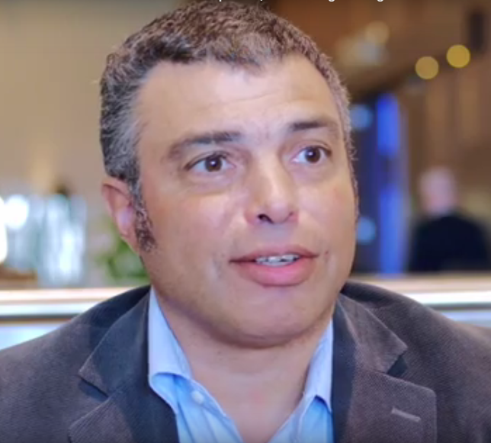
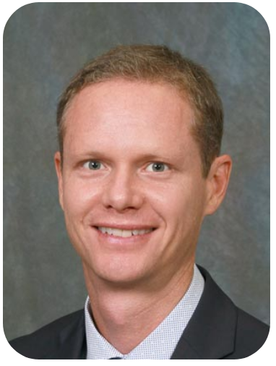
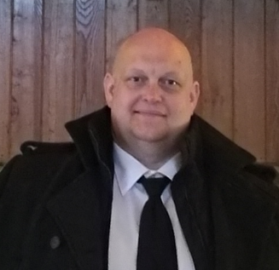
www.waterfountain.no
Tor M. Stolpestad
Rolf B. Bendiksen
Kyle Hopkins

Slide 2
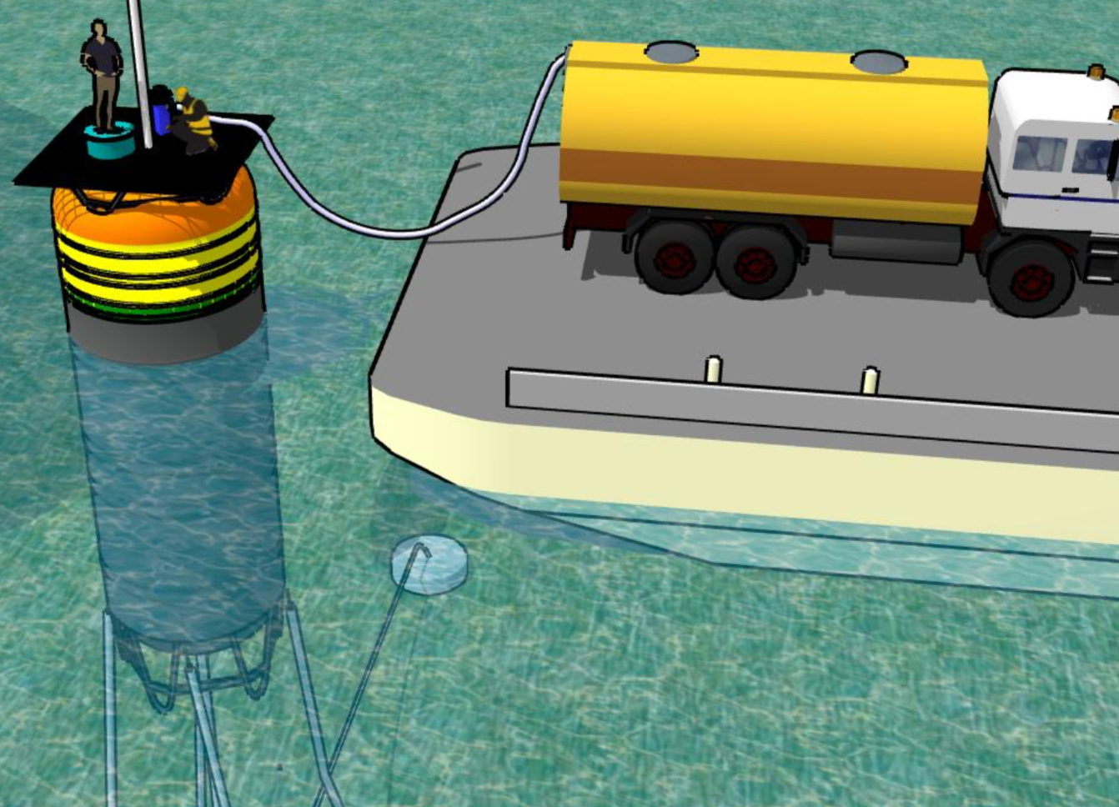
Waterfountain10
Offshore Desalination System
Field Tested, Proven, and patented
Production up to 100 m³/day
Scalable to 30,000 m³/day
Simple to relocate
Up to 95% reduction in brine salinity
Up to 50% reduction in operating cost

Slide 3
Investment Opportunity
Up to €40mill. contract
LOI Signed 2018
Pūlama Lānaʻi,
Hawaiʻi USA
€2,000,000
Hawaiʻi Permits
€3,000,000
Scaling up the company
Randy Truby
former president IDA
International Desalination Organisation
€750,000
Build, Test, Sell Waterfountain10
Conservation
International
NGO
Environmental, Aid and finance

Slide 4
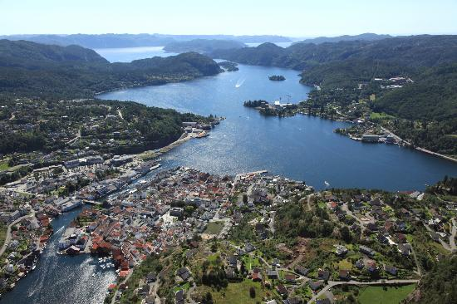
Details
Tor Stolpestad CEO
tor@waterfountain.no
+47 404-52-924
Org nr: 916 804 784 Norway
Org nr: 858 594 298 Netherlands
Ausvigheia 10 | 4640 Søgne, Norway
Agora 4 | 8934CJ Leeuwarden, Netherlands
Waterfountain
Test-site in Flekkefjord
Norway

